Slide 1

Towards the conceptual design of the cryogenic system of the Future Circular Collider (FCC)
M Chorowski, H Correia Rodrigues, D Delikaris, P Duda, C Haberstroh,
F Holdener, S Klöppel, C Kotnig, F Millet, J Polinski, H Quack & L Tavian
Madison, 11 July 2017

Slide 2
Content
Introduction: Scope of the FCC study
FCC-hh tunnel cryogenics and user heat loads
FCC-hh cryogenics layout and architecture
FCC-hh cool-down and nominal operation
FCC-hh electrical consumption and helium inventory
Conclusion

Slide 3
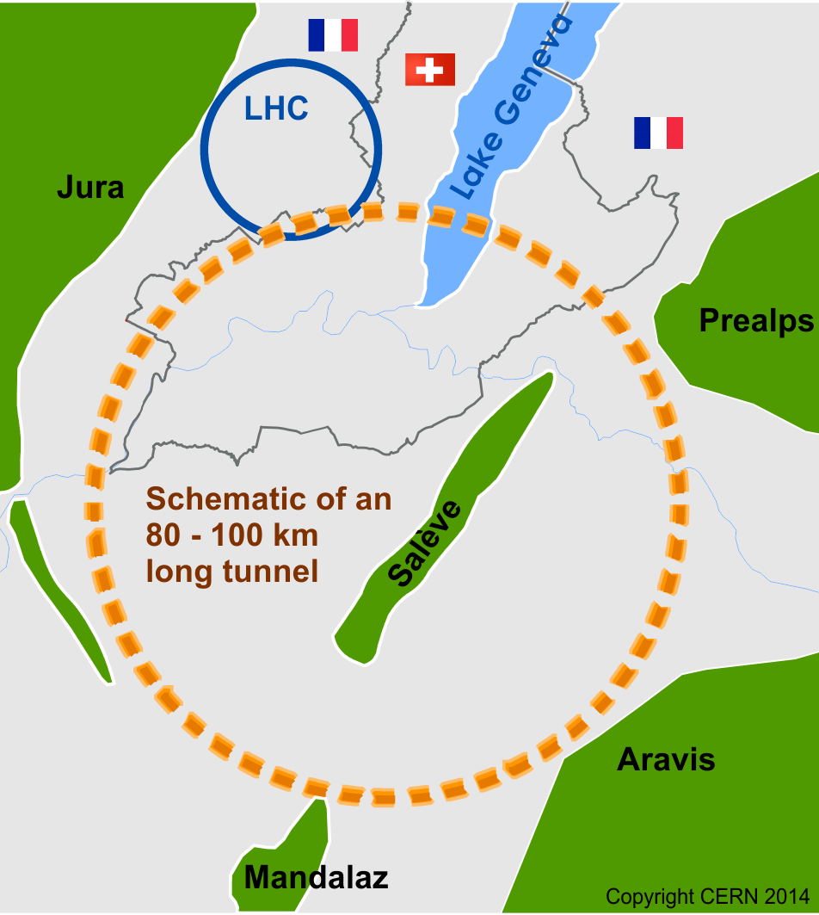
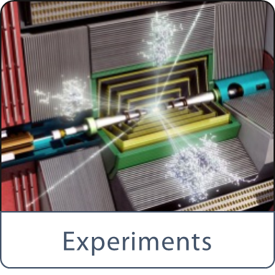

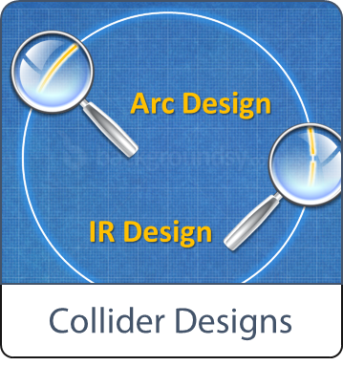
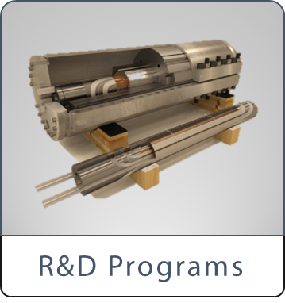


Scope of FCC Study
International FCC collaboration (CERN as host lab) to study:
pp-collider (FCC-hh) → main emphasis, defining infrastructure requirements
~100 km tunnel infrastructure in Geneva area, site specific
e⁺e⁻ collider (FCC-ee), as potential first step
p-e (FCC-he) option, integration one IP, e from ERL
HE-LHC with FCC-hh technology
CDR for end 2018
~16 T ⇒ 100 TeV pp in 100 km

Slide 4
FCC-hh: tunnel cryogenics
Main distribution based on INVAR® technology
Contribution of WUST

Slide 5
Specific heat loads at different temperature levels
Temperature level |  | 40-60 K | 1.9 K | 4 K VLP
Static heat in-leaks [W/m] | CM supporting system | 2 | 0.13
 | Radiative insulation |  | 0.13
 | Thermal shield | 3.1
 | Feedthrough & vacuum barrier | 0.2 | 0.1
 | Beam screen |  | 0.12
 | Distribution | 4 | 0.1 | 0.24
 | Total static | 9.3 | 0.58 | 0.24
Dynamic heat loads [W/m] | Synchrotron radiation | 57 | 0.08
 | Image current | 3.4
 | Resistive heating in splices |  | 0.3
 | Beam-gas scattering |  | 0.45
 | Total dynamic | 60 | 0.83
Total [W/m] |  | 70 | 1.4 | 0.24
Dynamic range [-] |  | 8 | 2.5 | 1

Slide 6
FCC-hh cryogenic layout and architecture
40-60 K [kW] | 1.9 K [kW] | 4 K VLP [kW] | 40-300 K [g/s]
580 | 12* | 2 | 85
Without operational margin !
*: Outside State-of-the-Art

Slide 7
FCC-hh cryoplant architecture
Ne-He 300-40 K cryoplant
Beam screen (40-60 K)
Current leads (40-300 K)
He 1.9 K
cryoplant
SC magnet cold mass
Thermal shield (40-60 K)
Precooling of 1.9 K cryoplant
Contributions of TU Dresden and CEA/SBT

Slide 8
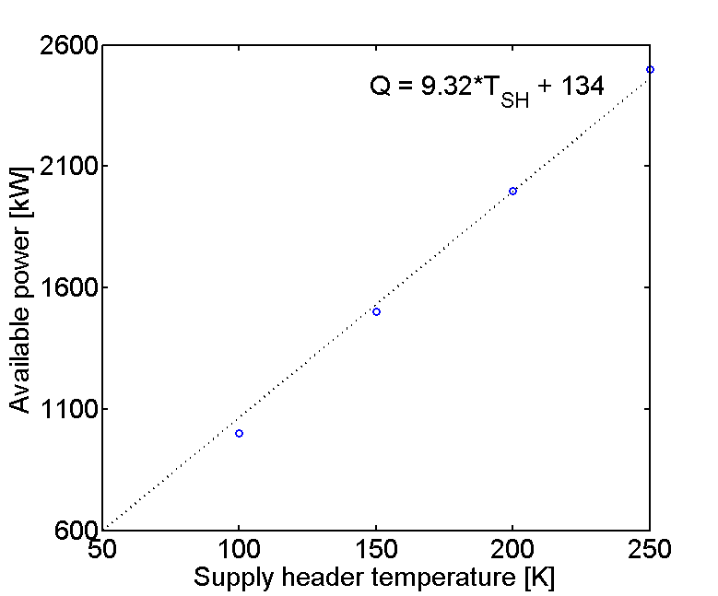
Cooldown of FCC-hh
He cycle
Ne-He cycle
Cool-down capacity produced by the Ne-He cycle:
No need of LN2 cool-down unit with its huge LN2 storage and logistics
TUD
Cold mass: 2.8 t/m i.e.
23 kt per sector
230 kt for FCC
15 days of cool-down time from 300 to 40 K (10 days (on paper) with LN2).
Cost (only energy)
Full FCC CD → 2.3 MCHF
(To be compared with the cost of a CD using LN2 → 45000 t, i.e. ~4 MCHF)
50 bar supply pressure
→ indirect cool-down of cold-masses (design pressure of 20 bar)

Slide 9
FCC-hh Nominal operation
He cycle
Ne-He cycle
Use of large centrifugal compressor for the
Ne-He cycle (~10 MW unit input power)
BS cooling with cold circulator (+130 kW @ 40-60 K)→ Exegetic efficiency of BS cooling loop: 82 %
BS cooling with warm circulator needed for cooldown (+140 kW @ 40-60 K and +500 kW @ 300 K) →
Less efficient (exergetic efficiency of 71 %) but good for redundancy.
1.8 K refrigeration based on a mixed compression cycle (cold centrifugal compressors in series with warm volumetric compressors)

Slide 10
FCC-hh Half-cell cooling loop
Cold mass cooling: C. Kotnig
See C1PoG-01

Slide 11
FCC-hh Beam-screen cooling loop parameters
Main parameter | Unit | LHC | FCC
Unit cooling length | m | 53.4 | 107.1
Sector cooling length | m | 2900 | 8400
Average BS nominal capacity | W/m | 1.6 | 60
Max. supply pressure | bar | 3 | 50
Supply helium temperature | K | 5 | 40
Max. allowed BS temperature | K | 20 | 60
BS helium outlet temperature (nominal) | K | 20 | 57
Minimum BS temperature (nominal) | K | 5 | 43
BS pressure drop (nominal) | bar | 0.5 | 3
ΔP control valve (nominal) | bar | 0.8 | 1
ΔP supply and return header (nominal) | bar | 0.4 | 2
Total cooling loop pressure drop | bar | 1.7 | 6
Supply/return header diameter | mm | 100/150 | 250/250
Exergetic efficiency (distribution only) | % | 76 | 86
Total exergetic eff. (with cold circulator) | % | N/A | 82
Total exergetic eff. (with warm circulator) | % | ? | 71
Transient modes
- Working at constant nominal mass-flow to handle the severe transient during energy ramp-up
- Working at constant He inventory to avoid big mass discharge and refill (~6 t) (i.e. pressure increase during energy ramp)
Large inertia of the distribution system
→ time constant of~ 4 h
→ OK with the capacity adaptation of the cryoplants
→ In high luminosity operation (4 h of stable beams), the cryoplants will be never in steady-state
H. Rodrigues
See C1PoG-02

Slide 12
FCC-hh electrical consumption
RH: resistive heating
BGS: beam-gas scattering
BS: beam screen
CM: cold mass heat-inleaks
CL: current lead
BS cir.: Beam screen circulator (warm)
TS: thermal shield
IC: image current
SR: synchrotron radiation
Carnot efficiency:
- Ne-He plants: 40 %
- Helium plants: 28.8 %
Isentropic efficiency
- cold compressors: 75 % per stage
- Warm circulator: 83 %

Slide 13
FCC-hh He inventory
Cold mass He inventory : 33 l/m (scaled from LHC)
Distribution inventory dominated by the beam-screen supply and return headers
Inventory breakdown
FCC
LHC
FCC He inventory: ~800 t ! (~6 LHC He inventory)

Slide 14
Conclusion
The conceptual design of the cryogenic systems for a Future Circular Collider is in progress in the framework of an international collaboration (CEA, CERN, TUD, WUST)
The final Conceptual Design Report (CDR) will be issued by 2018 and then examined by the next European Strategy for high energy particle physics.
In the case of a positive feedback, the next step will be the studies and developments of the new concepts with the construction of demonstrators and/or prototypes.

