Slide 1
In-medium mass modification of hadrons at KEK and J-PARC
K. Ozawa
(KEK, University of Tokyo, KRF)

Slide 2
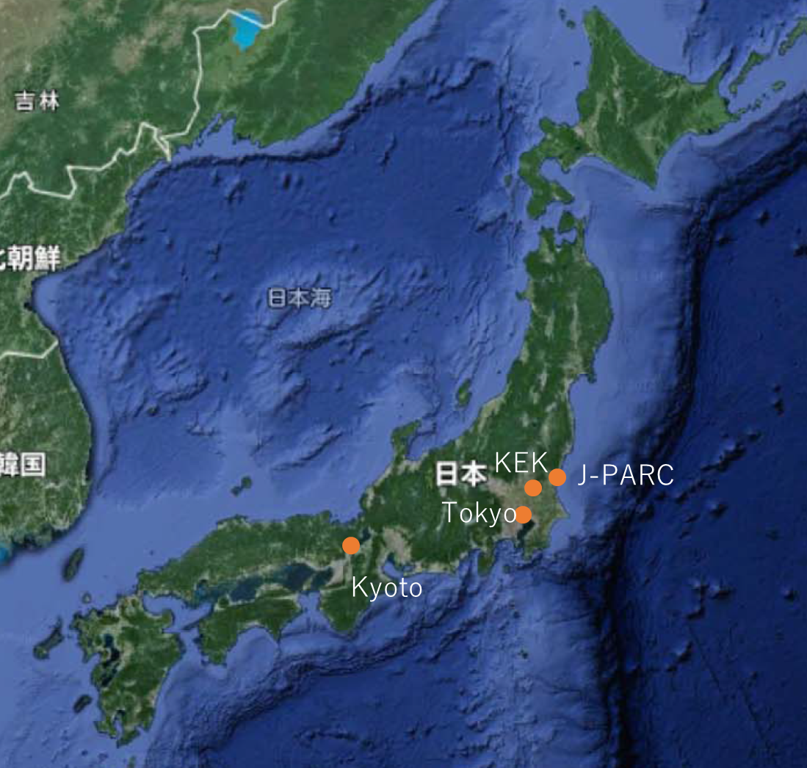
Introduce myself
2000 km
Kyoto University
  Experiment at KEK
University of Tokyo
  RHIC-PHENIX at BNL
KEK
  Experiment at J-PARC
Main research topic is experimental study of the matter formed by the “strong interaction”.

Slide 3
What is “Strong Interaction”
Interaction between quarks and gluons
Proton
Gluons mediates between
Quarks
It makes strong interaction

Slide 4
Special characteristics of “strong interaction”
Three kinds of “charges”
  It’s called “color charge”
  (red blue green)
cf. Electro-magnetic → Charge (+ -)

Slide 5
How interact?
Red Quark
Blue Quark
Anti-red - Blue
Mixed Color Gluon
Blue Quark
Red Quark
Quarks change their “color”,
when they emit or absorb gluons.
It causes that gluons also have a “color”.
  cf. photons don’t have charge.

Slide 6




Then, What Happen?
Change of Vacuum Properties
Electro-Magnetic
Strong
-
+
-
+
-
+
-
+
+
-
+
-
+
-
+
-
+
When you see the charge from a long distance, the polarization effect is cancelled.
Effects of vacuum polarization ($\overline{q}q$) can remain for a long distance due to gluons.
It causes change of
Vacuum (Surrounded medium) properties

Slide 7
In “macroscopic” picture,
Pairs of quark – anti-quark
anti-quark - quark condensates
Quark
Proton and Other Hadron
Anti-quark – quark condensates spontaneously break a symmetry
Hadron Mass generation
Properties of “vacuum” (medium) determines properties of hadrons

Slide 8
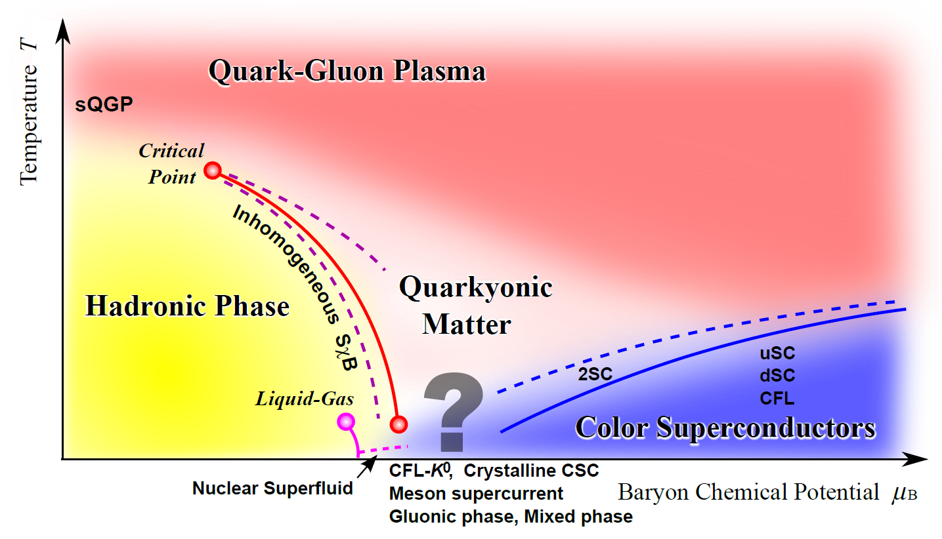
QCD “vacuum” (medium)
QCD: Quantum Chromo Dynamics
Relativistic heavy ion collisions
K. Fukushima and T. Hatsuda, Rep. Prog. Phys. 74 (2011) 014001
Temperature T
Nucleus
Free Space
Baryon Chemical Potential μ_{B}

Slide 9
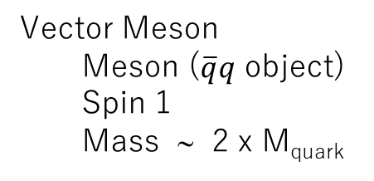
“Condensates” and vector meson
Vector Meson
  Meson ($\overline{q}q$ object)
  Spin 1
  Mass ∼ 2 x M_{quark}
Quark – anti-quark condensates
    M.A. Shifman, A.I. Vainshtein and V.I. Zakharov, Nucl. Phys. B147, 385 (1979); B147, 448 (1979).
    Hatsuda and Lee, Phys. Rev. C46 (1992) R34
Amount of Anti-quark – quark condensates strongly related with mass spectra of vector mesons
*Another important object is a pseudo-scalar meson
Mass spectra of vector mesons in a medium are measured intensively

Slide 10
Many measurements are done
Modifications of spectra are observed, however, condensates are not yet evaluated.
High energy heavy ion collisions
  SPS-NA60 (PRL 96 (2006) 162302)
    Modification of ρ meson due to hadronic effects
  RHIC-STAR (PRL113(2014) 022301)
  RHIC-PHENIX (PRC81(2010) 034911, PRC93(2016)014904 )
    Enhancement in low mass region
Nuclear targets
  HADES (G. Agakishiev et al. Eur. Phys. J. A 48 64 (2012).)
    Enhancement in low mass region
  CBELSA/TAPS (Phys.Rev. C82 (2010) 035209)
    Modification of ω is not observed
  J-LAB CLAS G7 (PRL 99 (2007) 262302)
    Mass broadening of ρ due to hadronic effects
    Large Width of φ (Phys. Rev. Lett. 105 (2010) 112301)
  LEPS (Phys. Lett. B608 (2005) 215)
    Large Width of φ
  KEK-PS E325 (PRL 96 (2006) 092301, PRL 98(2007) 042581)
    Peak shift and width broadening of ρ/ω, φ

Slide 11
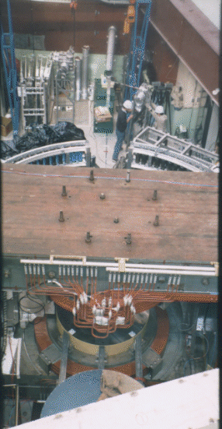
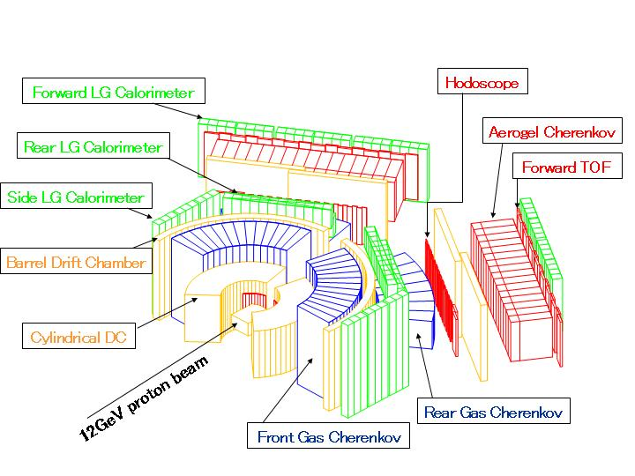
KEK-PS E325 experiment
12 GeV proton induced.
p+A → φ + X
Electrons from φ decays are detected.
Spectrometer

Slide 12
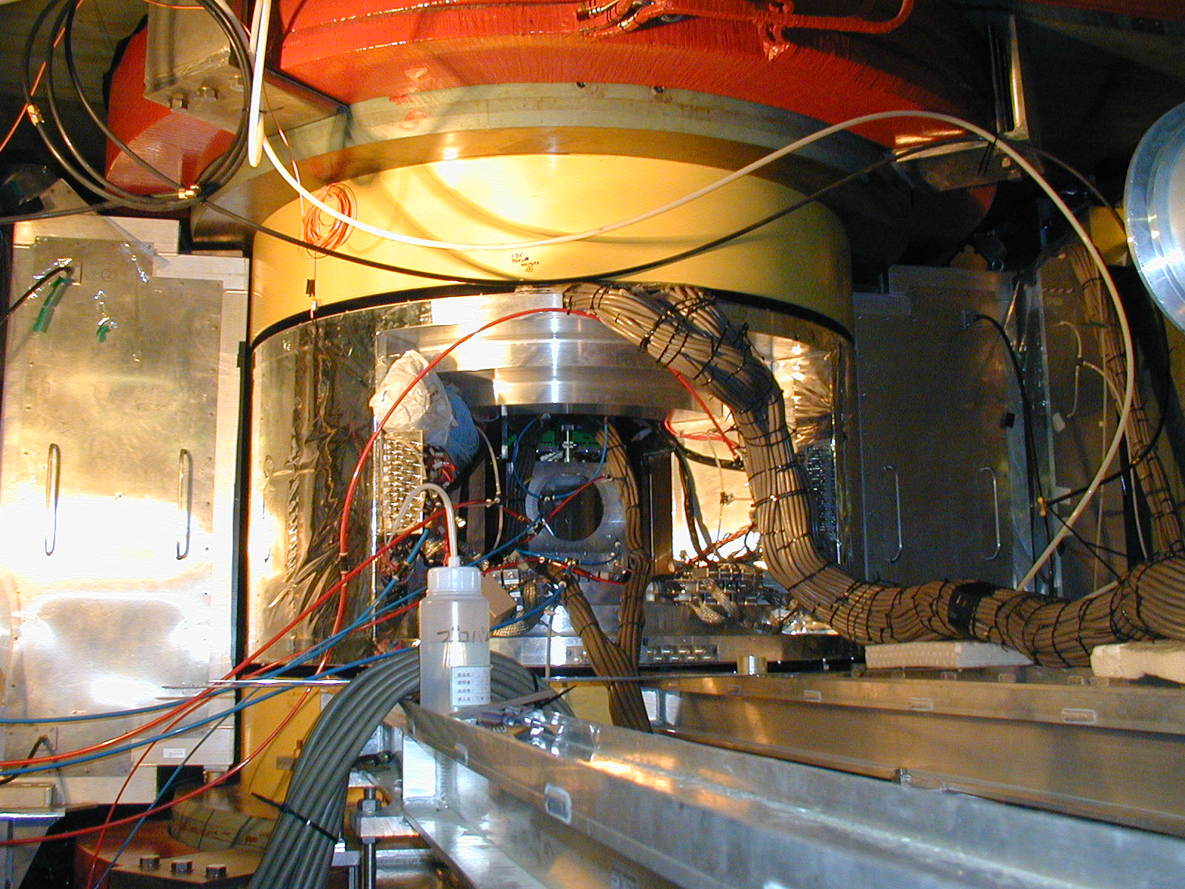
E325 Spectrometer

Slide 13
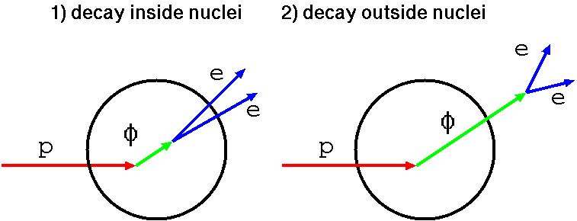
Measurements at KEK-PS
Invariant mass spectra of electron-positron pairs in φ meson mass region.
βγ<1.25 (Slow)
R. Muto et al., PRL 98(2007) 042581
Decays outside nucleus
Decays inside nucleus
Cu
meson has NO mass modification
Blue line shows expected line shape including all experimental effects
wo mass modification
meson has mass modification
Modification is shown as an Excess
e⁺e⁻ invariant mass

Slide 14
Target/Momentum dep.
βγ<1.25 (Slow)
1.25<βγ<1.75
Two nuclear targets:
  Carbon & Copper
  Inside-decay increases in large nucleus
Momentum bin
  Slowly moving φ mesons have larger chance to decay inside nucleus
Only one momentum bin shows a mass modification under the current statistics.
To see clear mass modification and establish QCD-originated effects, significantly larger statistics are required.
Excess
Same as previous slide
e⁺e⁻ invariant mass

Slide 15
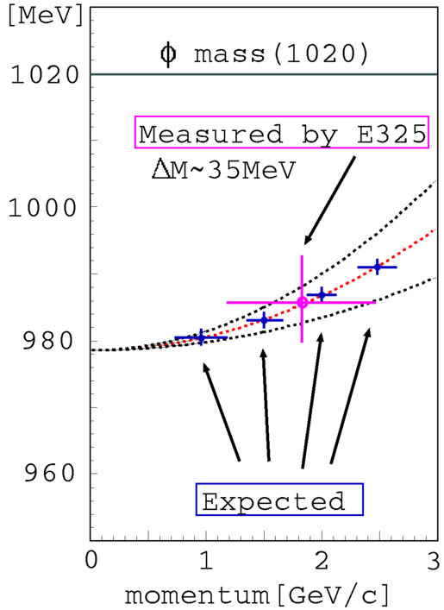
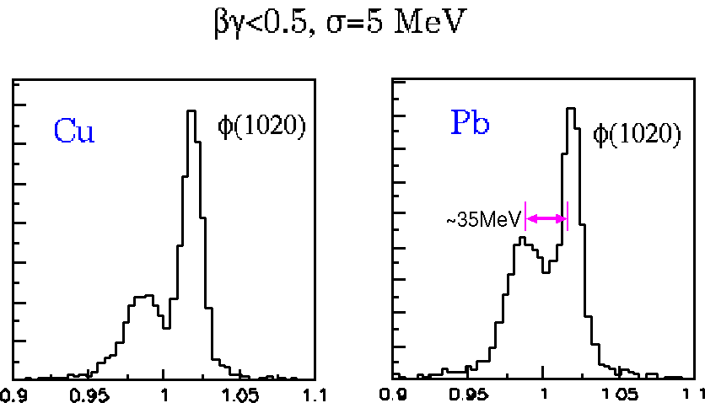

Next Goal @ J-PARC
A clear shifted peak needs to be identified to establish QCD-originated effects
Momentum Dependence
Pb
E325 results
Proton
Extrapolate
Large statistics is required

Slide 16
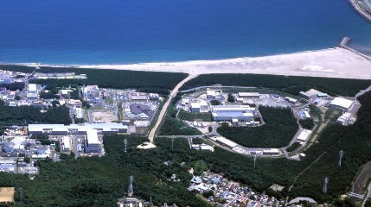
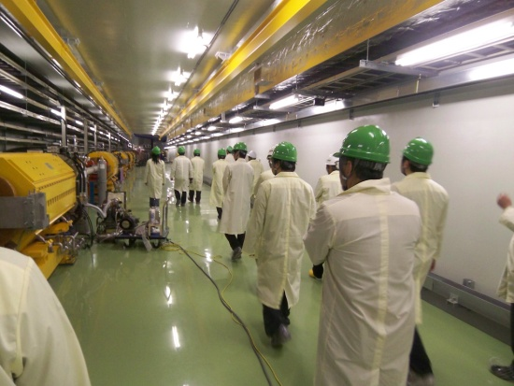
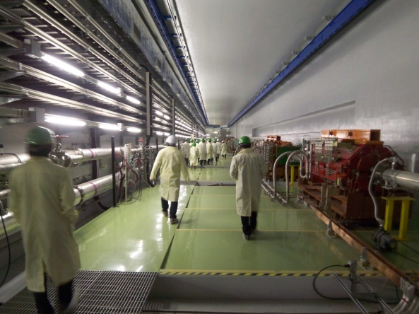
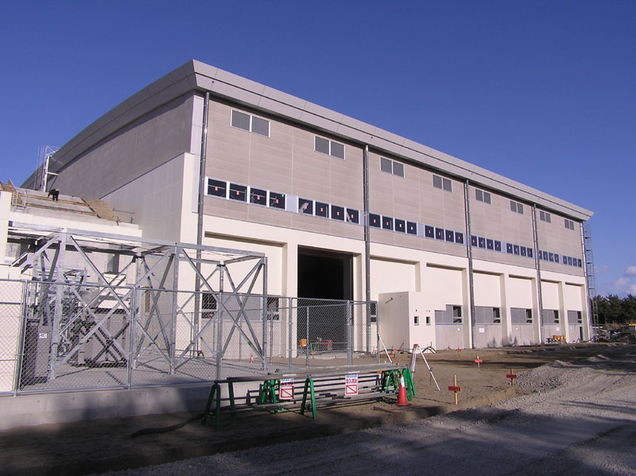
J-PARC
(Japan Proton Accelerator Research Complex)
Tokai, Japan
Material and Life Science Facility
MR
30 GeV Synchrotron
RCS
3 GeV Synchrotron
Hadron Experimental Facility
400 MeV Linac
Hadron Hall
60m x 56m
Neutrino Experimental Facility

Slide 17
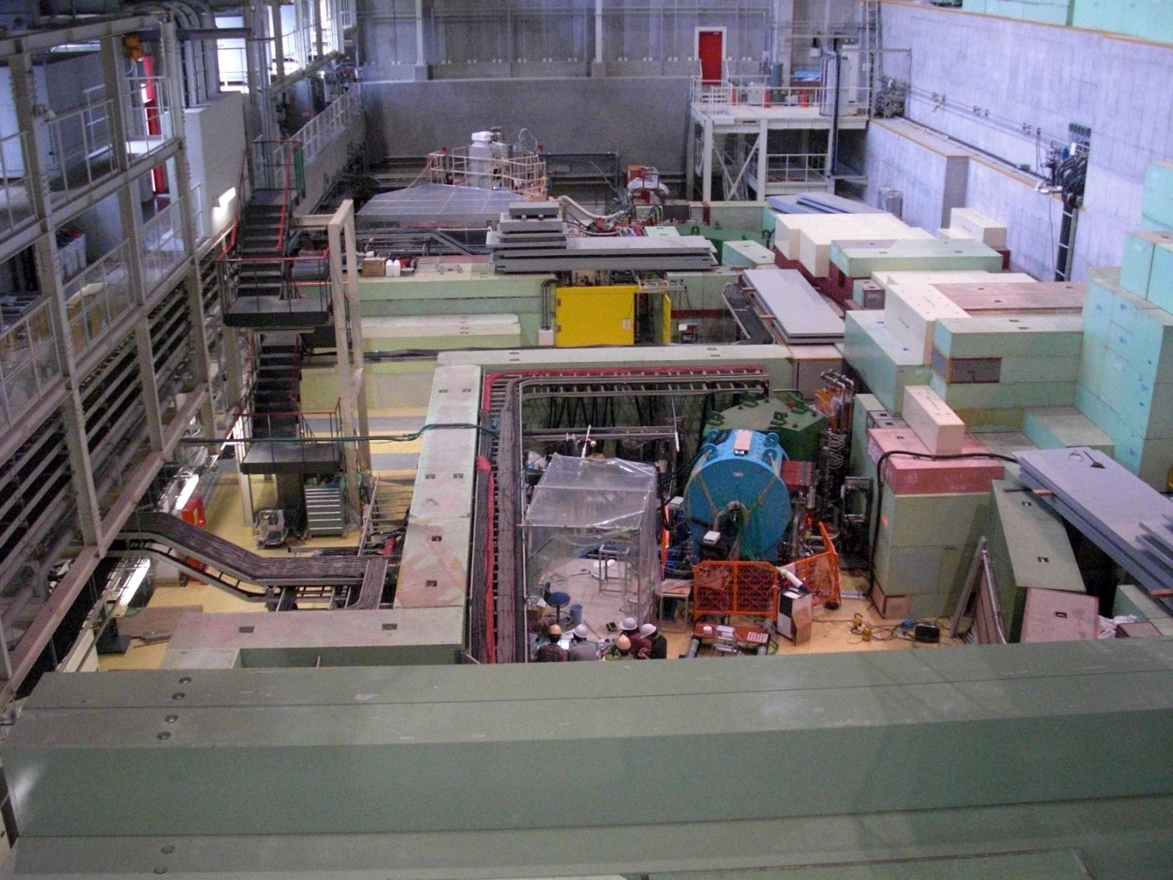
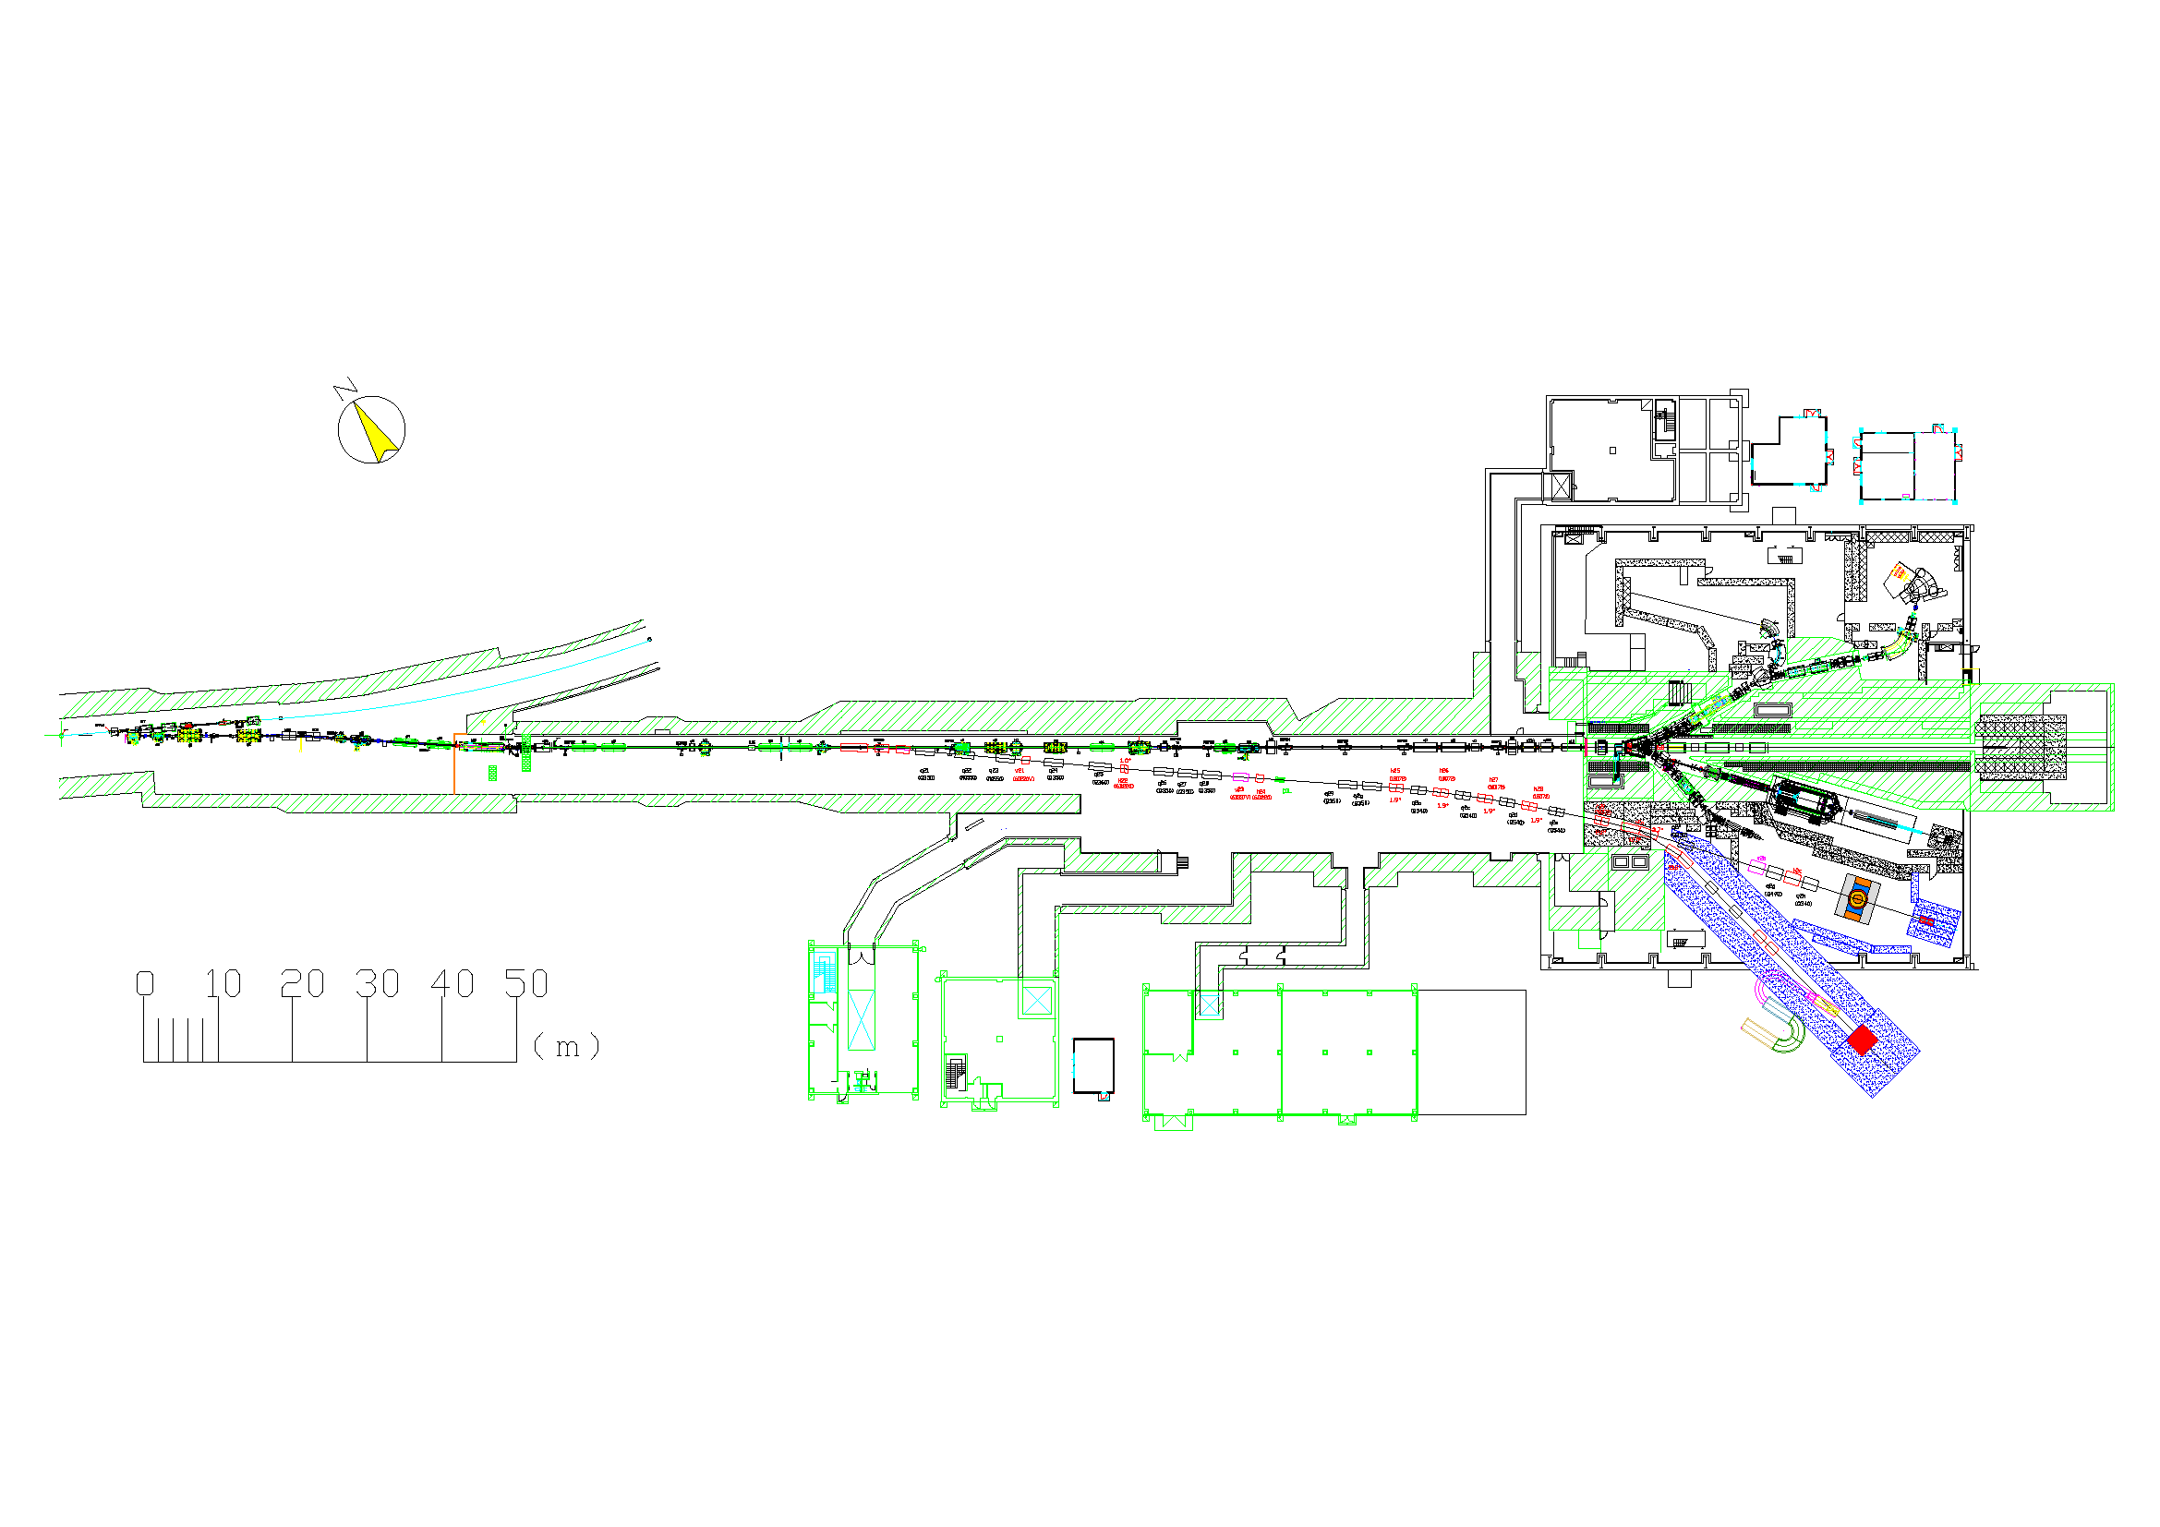
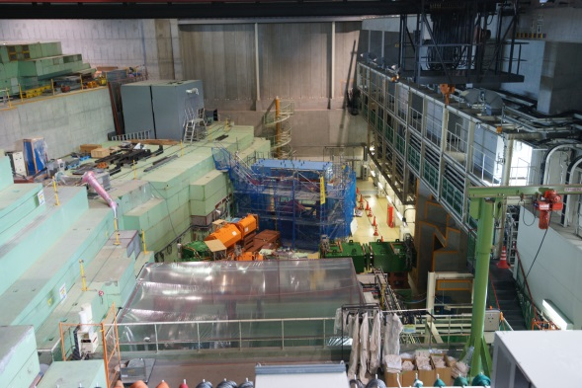
30 GeV Accelerator &
Hadron Experimental Facility
Hadron Experimental Facility
30GeV proton Accelerator
Transfer Line from Acc. to Hadron
North Side
New Beamline (under construction)
Current Production target for secondary beams
Branch Point from Acc. to Hadron
South Side

Slide 18
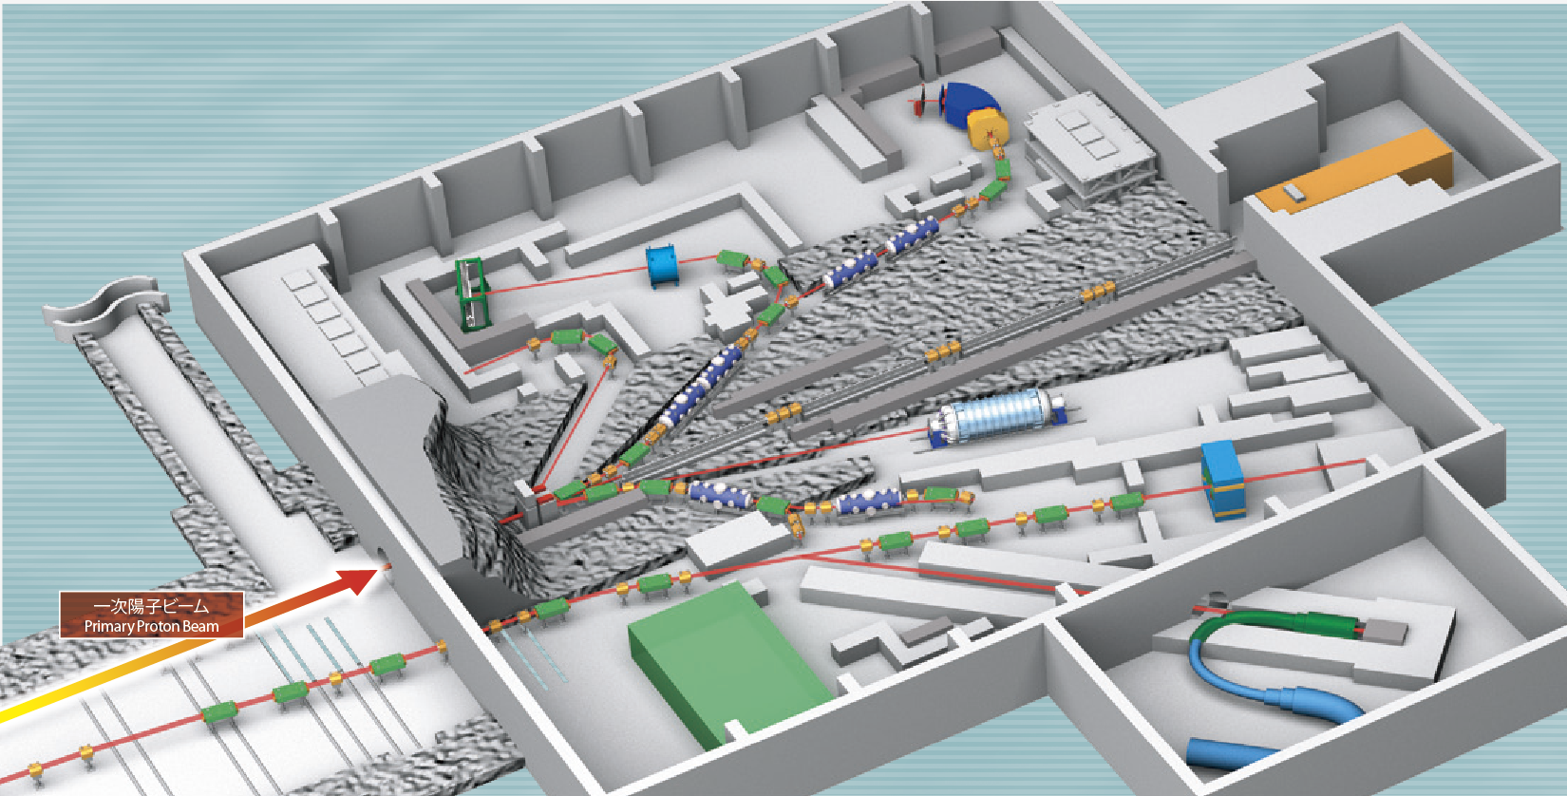
Hadron
Experimental Facility
K1.8
K1.8BR
KL
Production Target
High-p
K1.1
COMET
Name | Species | Energy | Intensity
K1.8 | π±, K± | < 2.0 GeV/c | ~10⁵ Hz for K⁺
K1.8BR | π±, K± | < 1.0 GeV/c | ~ 10⁴ Hz for K⁺
K1.1 | π±, K± | < 1.1 GeV/c | ~ 10⁴ Hz for K⁺
High-p | proton | 30GeV | ~ 10¹⁰ Hz
 | Unseparated | < 20GeV/c | ~ 10⁸ Hz
Under Construction

Slide 19
New Beam Line
Construction of New Beam Line is proposed as a high priority plan of the lab.
Characteristics of the beam line is following.
  Primary Proton Beam (30GeV), 10¹⁰ per spill
  High Momentum un-separated secondary beam (< 20GeV/c), 10⁸ per spill
The new beam line will be operated in JFY2018.
New Beam Line

Slide 20
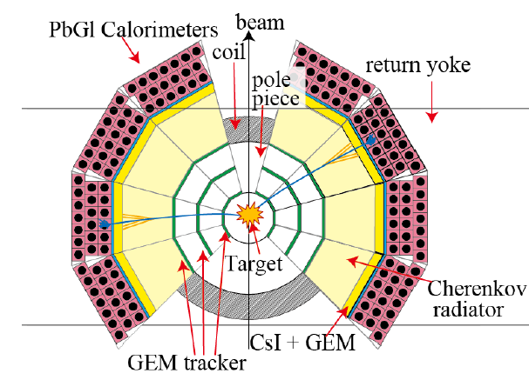
New experiment
Measurements of e⁺e⁻ pair invariant mass spectra in nucleus
  vector meson mass modification due to nuclear matter effects
  High statistics/Good resolution
Coping with a high intensity beam
  10¹⁰ protons per spill, spill length 6s, spill on 2s
  Counting rate: 5 kHz/mm² (maximum)
  10 times larger beam intensity than KEK
Covering a large area
  2 times larger coverage in vertical
  Large coverage in electron ID counters
  Horizontal: +-15 ~ +-135, Vertical: +- 45
Precise mass (momentum) resolution
  ∫Bdl ~ 1Tm
  Minimum material to avoid MS
  Position resolution of 100 μm
Detector configuration
  Trackers are placed near target
  Electron ID counters are placed in outer side.
    Total rejection factor of 1000 for two stages identification counters (HBD and LG)
Design

Slide 21
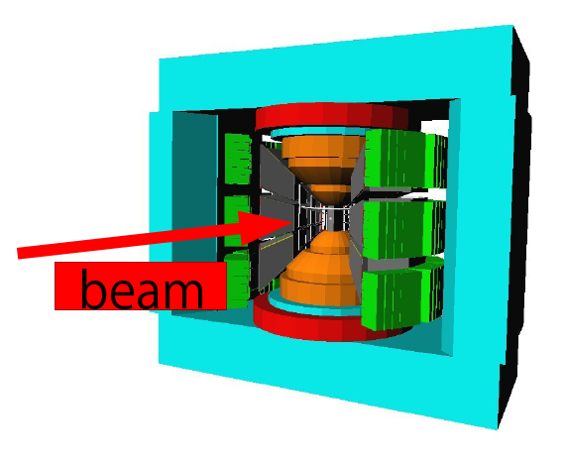
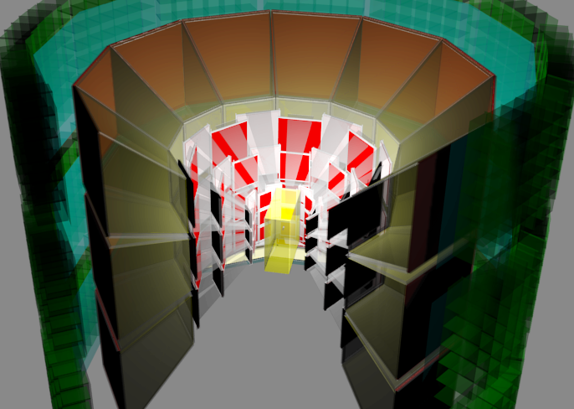
Detector R&D
Gas Electron Multiplier (GEM) technology is fully adopted.
Cope with 10¹⁰ per spill beam intensity
Extended acceptance (90° in vertical)
GEM Tracker
Micro Pattern Gas Detector, such as GEM Tracker, works under a high counting rate environment
Hadron Blind Detector (electron ID)
Window-less Cherenkov type electron identification counter is suitable to cover a large acceptance

Slide 22
Spectrometer magnet

Slide 23
Expected Spectrum and Yield
A realistic estimation is done with a simulation based on R&D results
Yield estimation
 | Condition | Target | N_{φ}
RUN 1 | 160 shifts 8 modules | Cu | 18100 (1900)
RUN 2 | 320 shifts 26 modules | Cu | 76000 (13700)
 | E325 | Cu | 2400 (460)
βγ < 1.25
Expected Spectrum with a combinatorial background
(On-going realistic simulation for N_{φ} ~ 1000 )
Numbers in parenthesis are for βγ <1.25

Slide 24
Future projects of J-PARC
Primary Proton Beam
pA reaction
Vector meson spectra via Di-electron measurements
Secondary Beam
πA reaction
Exclusive measurements
Resonance Study
Charmed Baryon
Heavy Ion Beam
AA reaction
Vector meson in high density matter

Slide 25
η’ meson in nucleus
~ Collaboration btw Hungary and Japan
A new experiment is being proposed by Prof. Csörgö and me to study properties of η’ meson in nucleus
Pseudo scalar mesons are Nambu-Goldstone bosons in the spontaneous breaking of the chiral symmetry. Especially, η’ meson is related to UA(1) anomaly and important.
  At RHIC-PHENIX, a large mass reduction is observed and it should be studied also in nucleus
    T. Csörgö et al., Phys. Rev. Lett. 105:182301,2010
Missing mass by Forward emitted particle
π beam
η’
γ
Nucleus
γ
Invariant Mass of 2γ

Slide 26
Summary
Measurements of hadron properties in QCD medium are important to study properties of the medium.
Several experiments are performed to measure modifications of mass spectra of vector mesons in nucleus.
An experiment performed at KEK shows a modification of φ meson. New experiment is under preparation at J-PARC to confirm the KEK result and investigate properties of nucleus.

Slide 27
backup

Slide 28
Four Interaction in Nature
Strong Interaction Strength：1
Electro-Magnetic Interaction Strength：10⁻²
Gravity Strength：10⁻⁴⁰
Weak Interaction Strength：10⁻⁵

Slide 29
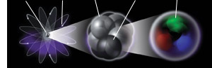
How do the world was made?
Nucleus
Electron
Proton
Neutron
Quark
Carbon Atom
(10⁻¹⁰ m)
Nucleus
(10⁻¹⁴ m)
Proton
(10⁻¹⁵ m)
Interaction between quarks
  ~ “Strong Interaction”

Slide 30
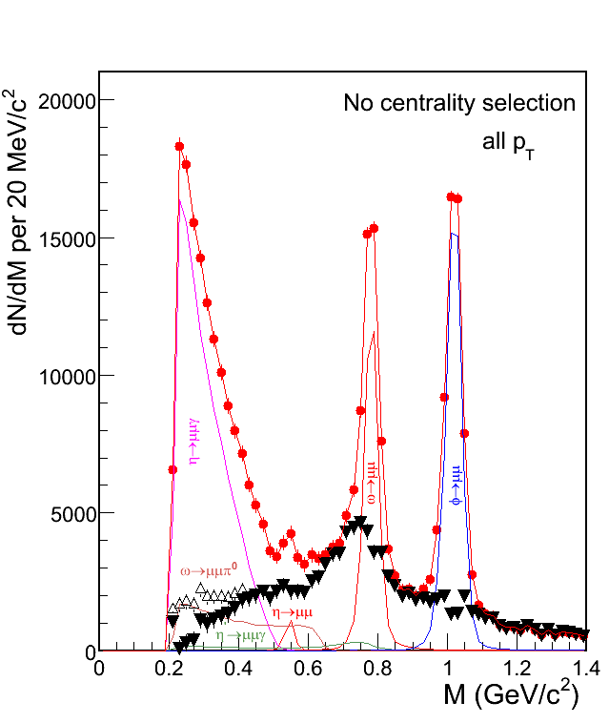
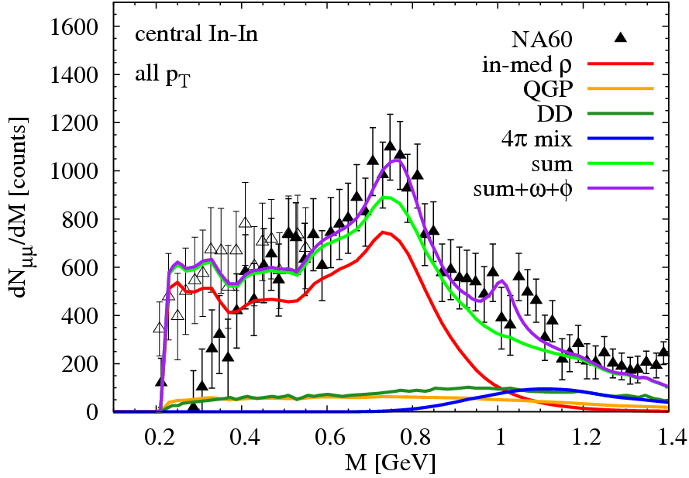
NA60 Results @ SPS
  Muon pair invariant mass in Pb-Pb at √s_{NN}=19.6 GeV
PRL 96, 162302 (2006)
[van Hees+R. Rapp ‘06]
Mass spectra is reproduced by a calculation based on hadron interaction.
Evaluation of condensates should be done.
30

Slide 31
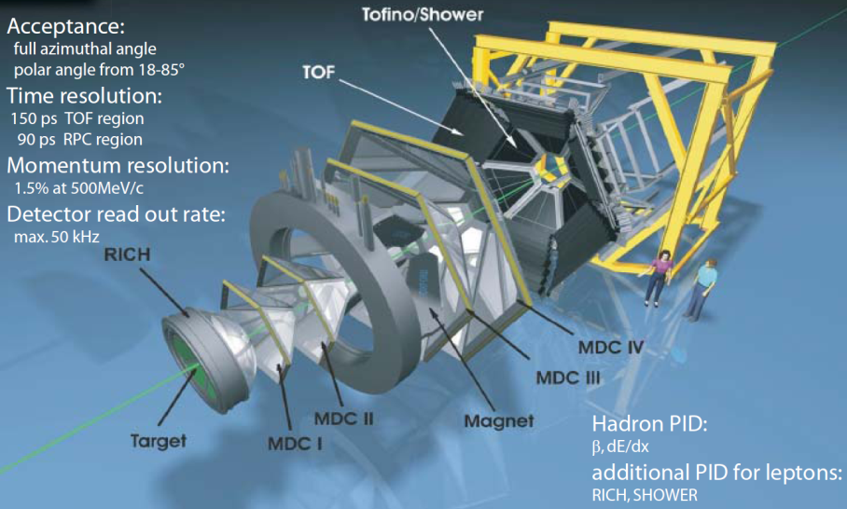
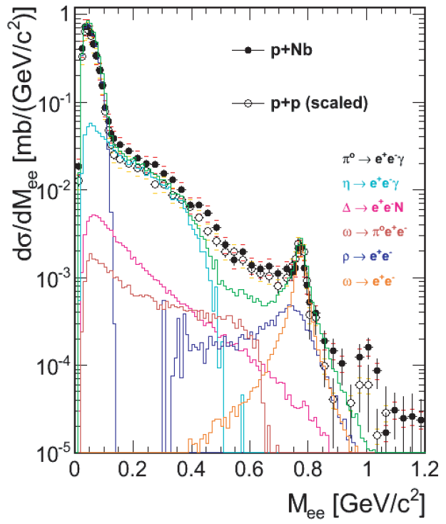
HADES@GSI
G. Agakishiev et al. Eur.Phys.J. A 48 64 (2012).
Proton beam energy at 3.5 GeV
Enhancement both for p+p and p+Nb?!
They claim effects of N* resonances.

Slide 32
INS-ES TAGX experiment
Eγ~0.8-1.12.GeV, sub/near-threshold ρ⁰ production
PRL80(1998)241,PRC60:025203,1999.: mass reduced in invariant mass spectra of 3He(γ, ρ⁰)X ,ρ⁰ --> π+π−
Phys.Lett.B528:65-72,2002: introduced cosθ analysis to quantify the strength of rho like excitation
Phys.Rev.C68:065202,2003. In-medium ρ0 spectral function study via the H-2, He-3, C-12 (γ,π+ π-) reaction.
Try many models, and channels
Δ, N*, 3π,…
Eγ | STT model Present work | Previous work
800-960 MeV | 700-710 MeV | 672±31 MeV
960-1120 MeV | 730 MeV | 743±17 MeV

Slide 33
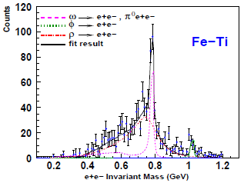
CLAS g7a @ J-Lab
Induce photons to Liquid dueterium, Carbon, Titanium and Iron targets, generate vector mesons, and detect e+e- decays with large acceptance spectrometer.
R. Nasseripour et al., PRL 99 (2007) 262302
ω/ρ/φ
γ
No peak shift of ρ
Only broadening is observed
m_{ρ} = m₀ (1 - α ρ/ρ₀)
for α = 0.02 ± 0.02

Slide 34
Mass spectra measurements
KEK E325, ρ/ω → e⁺e⁻
Induce 12 GeV protons to Carbon and Cupper target, generate vector mesons, and detect e+e- decays with large acceptance spectrometer.
M. Naruki et al., PRL 96 (2006) 092301
ω/ρ/φ
Cu
ω→e⁺e⁻
The excess over the known hadronic sources on the low mass side of ω peak has been observed.
ρ→e⁺e⁻
m_{ρ} = m₀ (1 - α ρ/ρ₀) for α = 0.09

Slide 35
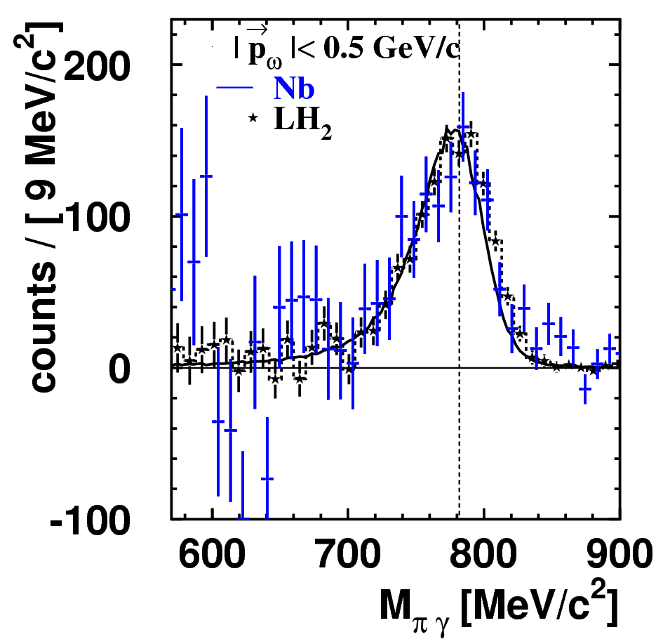



Results from CBELSA/TAPS
TAPS, ω → π⁰γ with γ+A
p
arXiv: 1005.5694
γ
γ
ω
π⁰
γA → ω + X
γ
π⁰γ
γ
γγ
advantage:
• π⁰γ large branching ratio (8 %)
• no ρ-contribution (ρ → π⁰γ : 7 ⋅ 10⁻⁴)
disadvantage:
• π⁰-rescattering

Slide 36
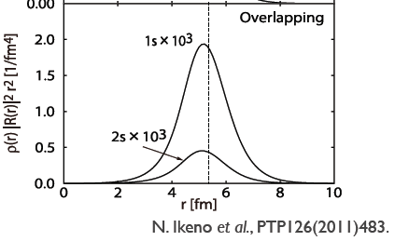
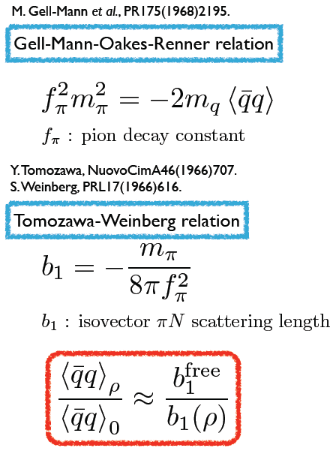
Deeply bound π
Large overlap of wave function
Sensitive to π-nucleus strong interaction potential
Measure binding energy can be converted to this b1 information

Slide 37
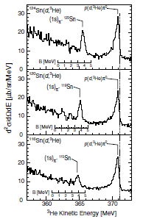
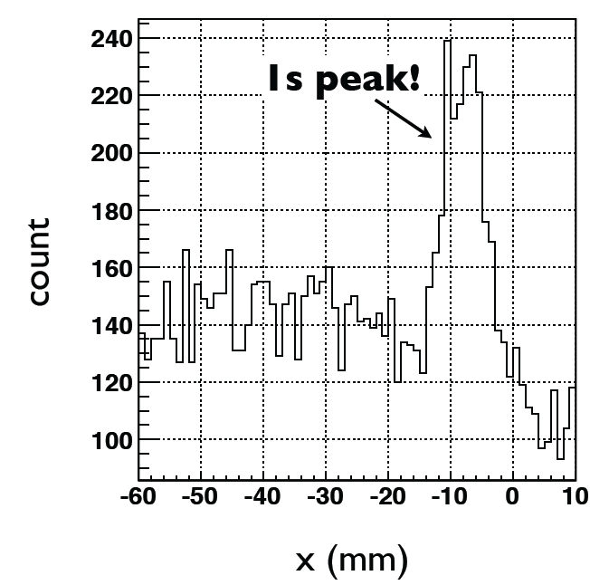
Exp. Results
K. Suzuki et al., Phys. Rev. Let., 92(2004) 072302
bound state is observed in
Sn(d, ³He) pion transfer reaction at GSI.
Reduction of the chiral order parameter, f*_{π}(ρ)²/f_{π}²=0.64 at the normal
nuclear density (ρ = ρ₀ ) is indicated.
Experiment is continued at RIKEN and positive results are already obtained.

Slide 38
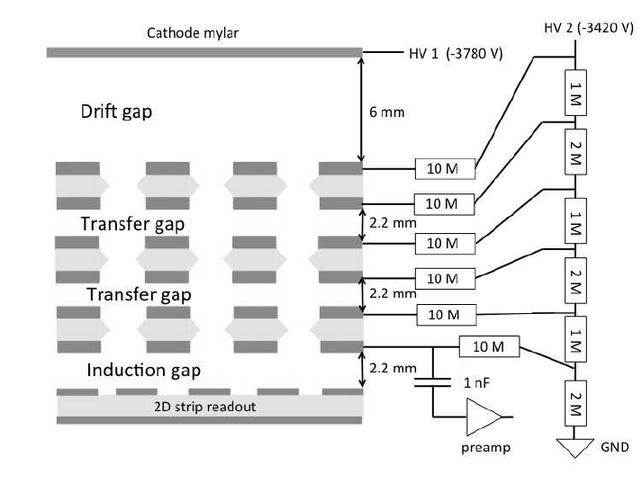
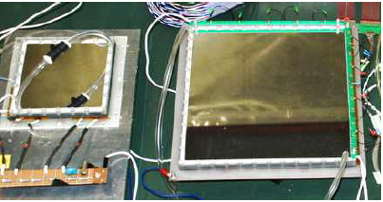
GTR (GEM Tracker)
Mesh electrode
Drift Gap
3 mm
Ionization electrons in the drift gap are collected and amplified by GEMs.
Charge collected on to 2D strip readout.
  X: 350um pitch
    Sensitive to bending direction.
    100 um resolution required.
  Y: 1400um pitch
GEM
GEM
GEM
readout
X2
X1
X3
Y1
Y2

Slide 39
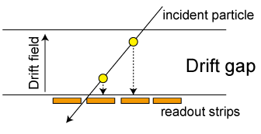
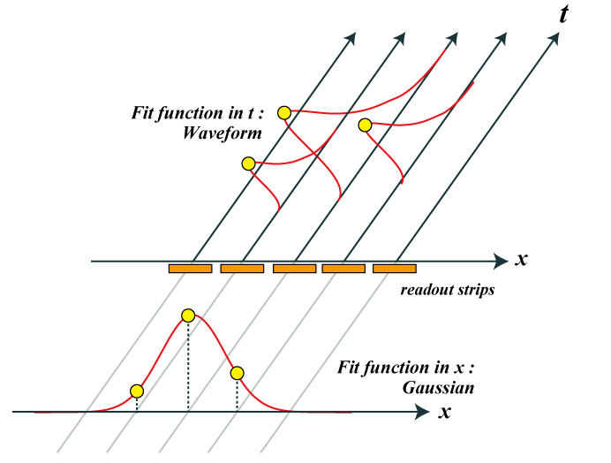
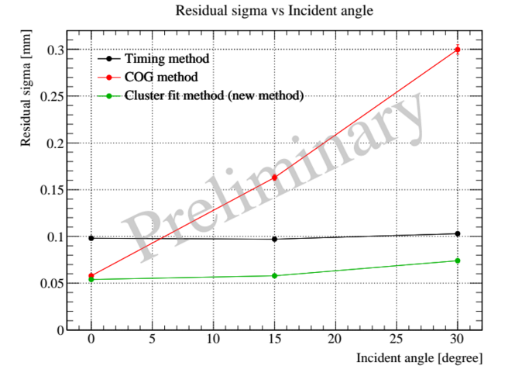
GTR Performance
2D fit (Charge + Timing)
  Each ionized electron cluster generated by a charged particle drifts in a drift gap
  Arrival timing reflects generated position in the drift direction
  Wave forms of signals are sampled and each hit has charge and timing information
  Mini-tracks is reconstructed in the drift gap like a mini-TPC
300
COG only
Timing only
2D fit
200
Residual sigma [um]
100
0
0
15
30
Incident angle [degree]

Slide 40
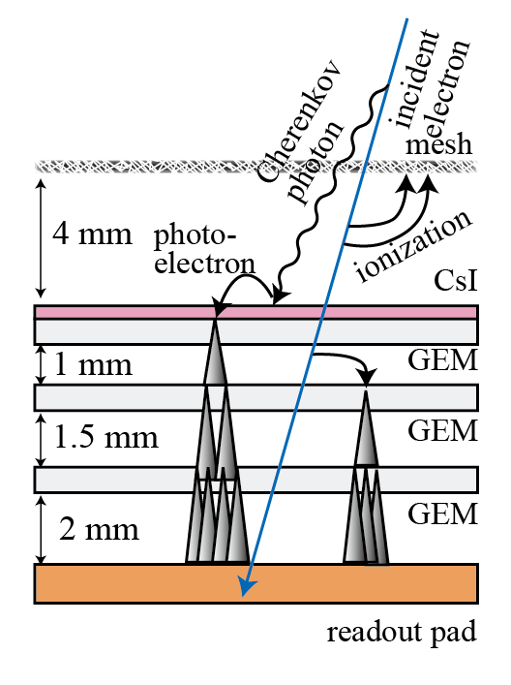
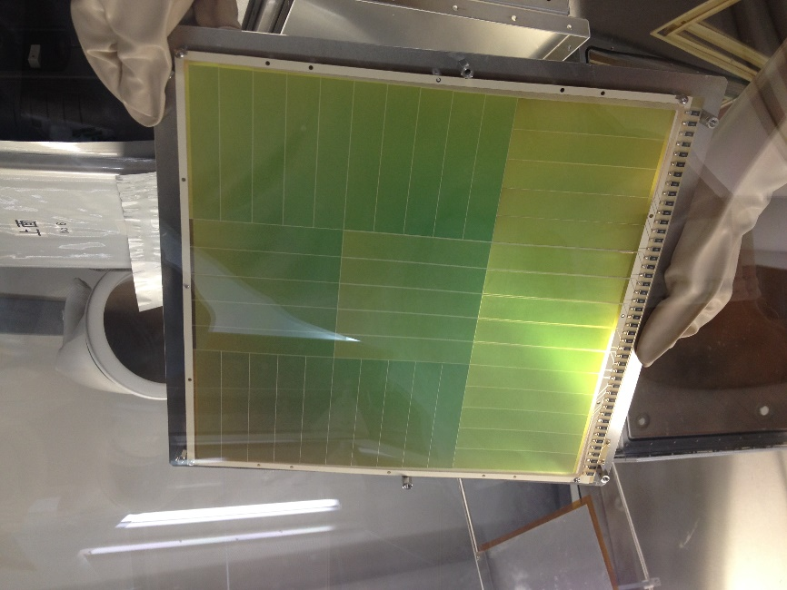
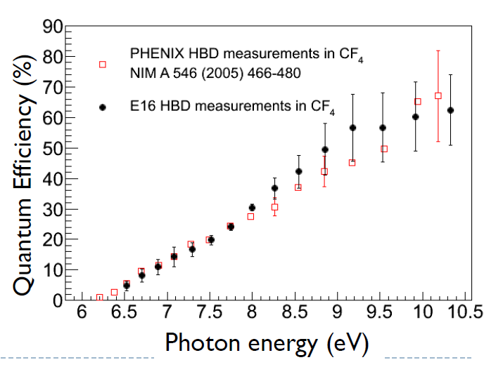
HBD
(Hadron Blind Detector)
Based on PHENIX HBD.
CF4 serves as radiator and amplification gas
  Radiator 50 cm. / p.e. ~ 11
Gas Electron Multiplier (GEM) for amplification
CsI is evaporated on top GEM
  Photocathode (> ~6eV)
300x300mm² GEM with CsI

Slide 41
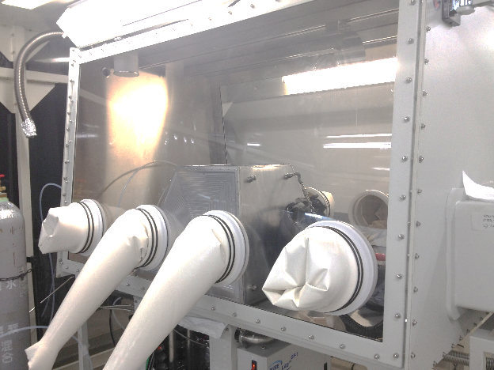
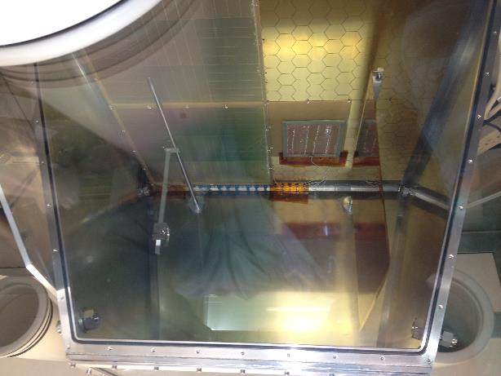
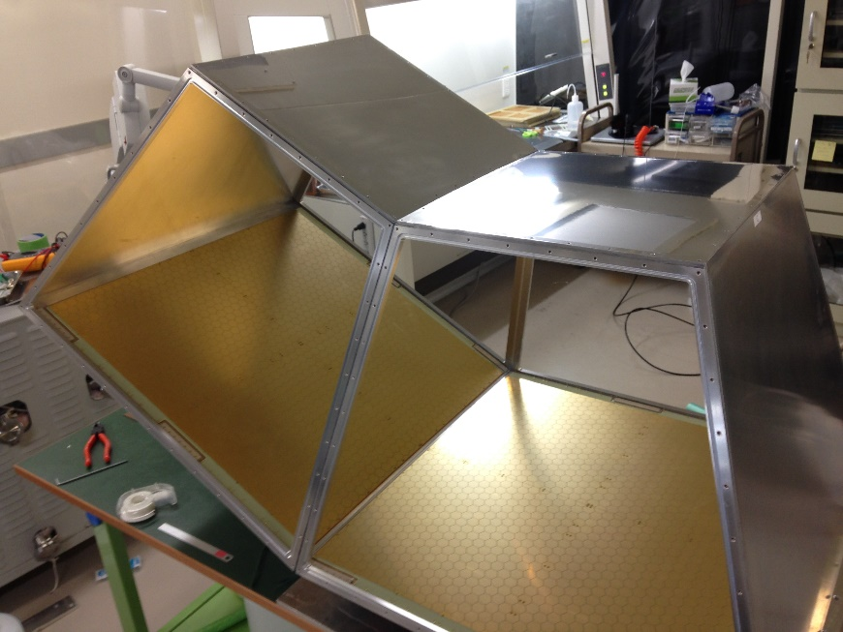
HBD
GLOVEBOX
prototype
CsI photocathode have to be treated in dry environment.
HBD chamber (production type)

Slide 42
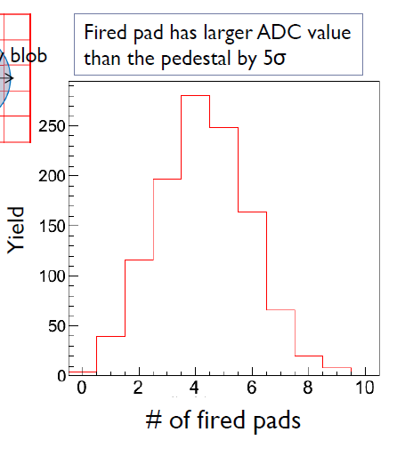
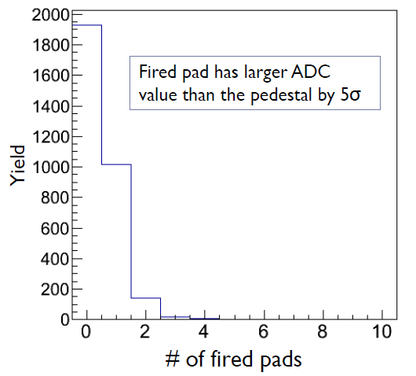
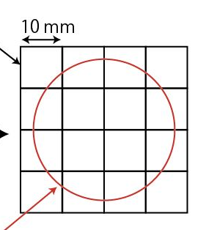
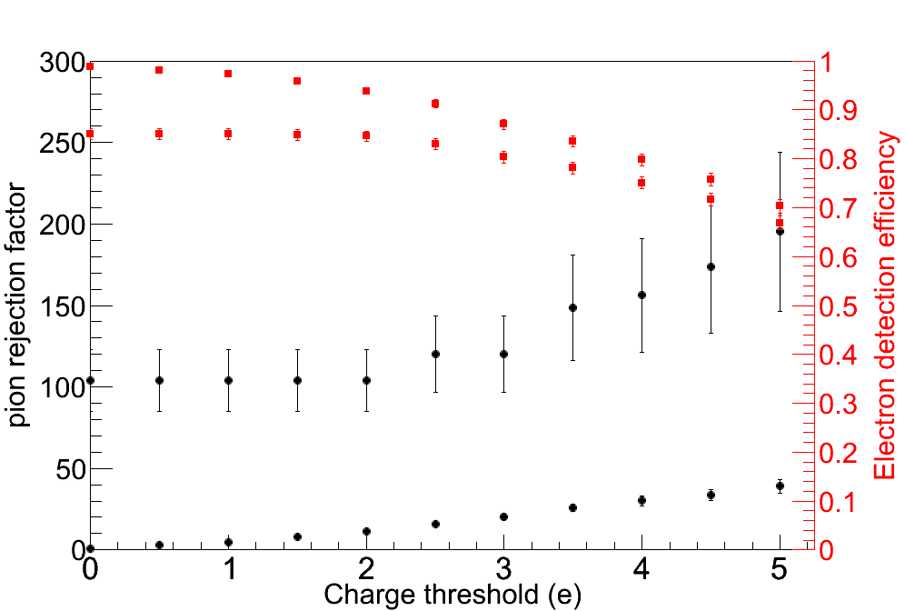
Cluster Size
pions
electrons
Pad
Cluster size - 1
Cluster size - 1
Cherenkov Blob
Pion rejection factor of 100 with 80% electron efficiency achieved at beam test.
  Using charge threshold and cluster size.
  NIM A 819 (2016) 20-24
Cluster size analysis

Slide 43
