Slide 1
Status of the search for U_{A}(1) symmetry restoration at RHIC and LHC energies
T. Csörgő ^{1,2}
¹ Wigner RCP, Budapest, Hungary
² EKU KRC, Gyöngyös, Hungary
Introduction
CERES: dilepton spectrum at SPS
Indirect observation method and null result at CERN SPS
Indirect observation in Bose-Einstein correlations at RHIC
Expectations for LHC
Implications for dilepton spectra and for direct photon spectra
New experiments being proposed
Summary
arXiv:nucl-th/9802074
arXiv:0912.0258
arXiv:0912.5526
arXiv:1211.1166

Slide 2
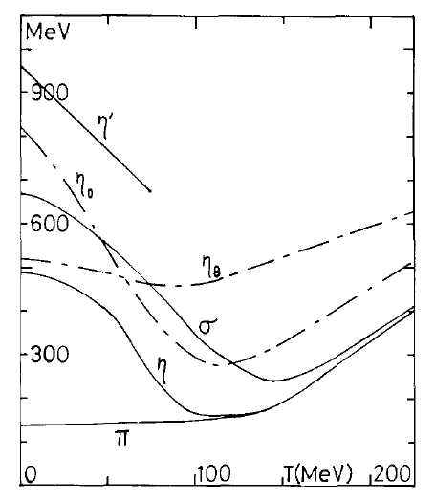
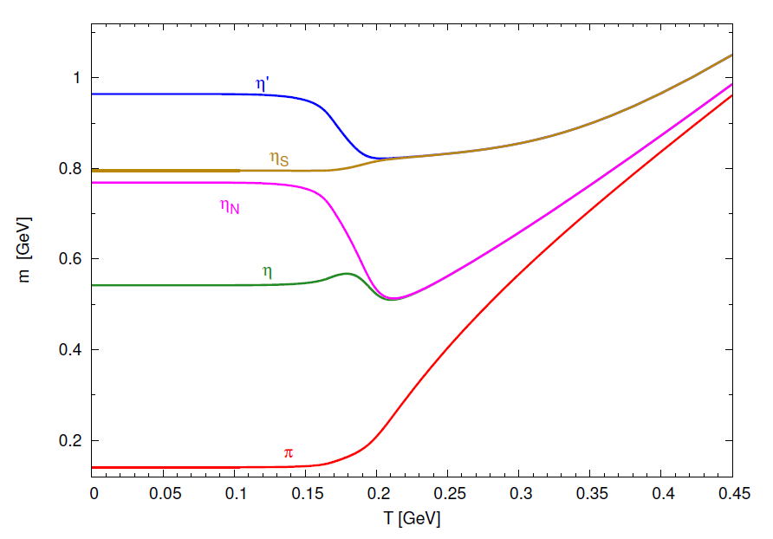
Motivation: Kunihiro’s prediction
P. Kovács, Zs. Szép, Gy. Wolf,
2015 Zimányi Winter School
arXiv:1601.05291
T. Kunihiro, PLB 219 (1989) 363

Slide 3
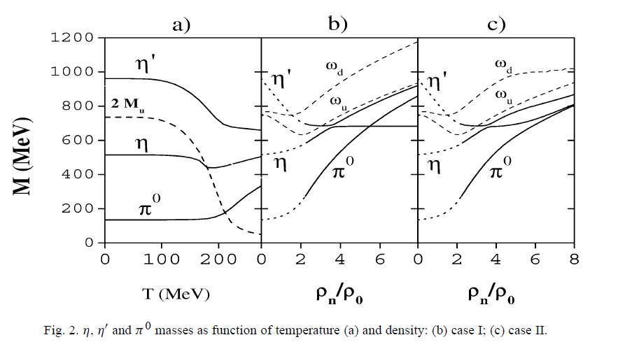
Density and temperature effects
P. Costa, M. C. Ruivo, Yu. L. Kalinovsky, PLB 560 (2003) 171

Slide 4
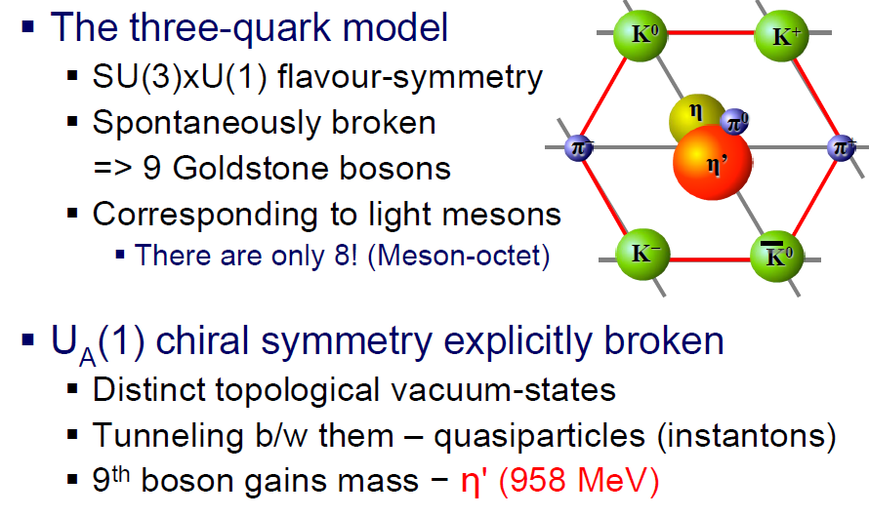
Why η'? Chiral and U_{A}(1) symmetry

Slide 5
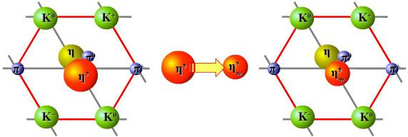
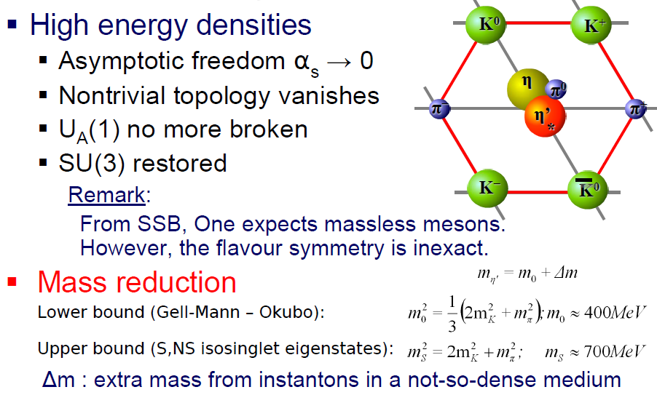
Restoration of U_{A}(1) symmetry

Slide 6
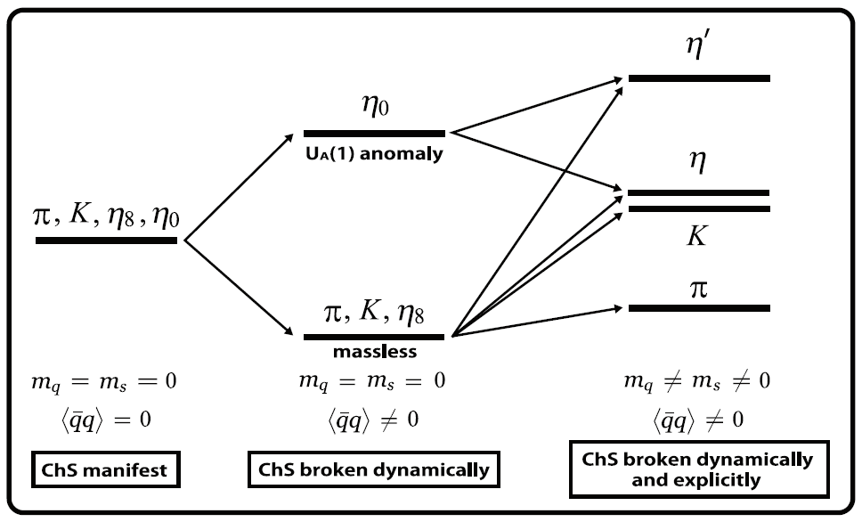
Motivation: mass hierarchy
Nagahiro, Jido et al, arXiv:1211.2506

Slide 7
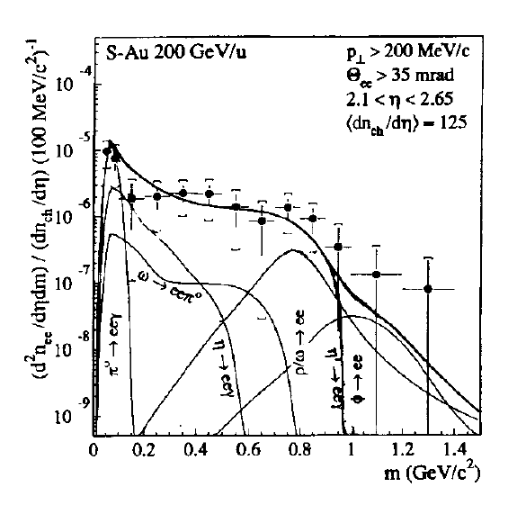
Motivation: CERES data at CERN SPS
Kapusta, Kharzeev, McLerran: hep-ph/9507343

Slide 8
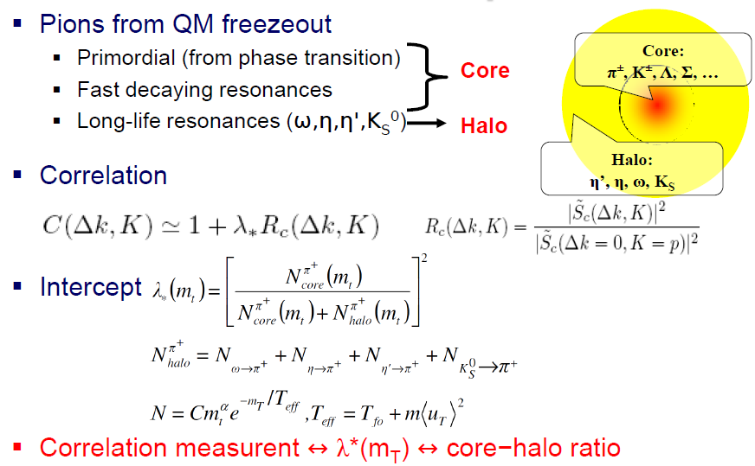
Core/halo picture for Bose-Einstein
T. Cs, B. Lörstad, PRC 54 (1996) 1390

Slide 9
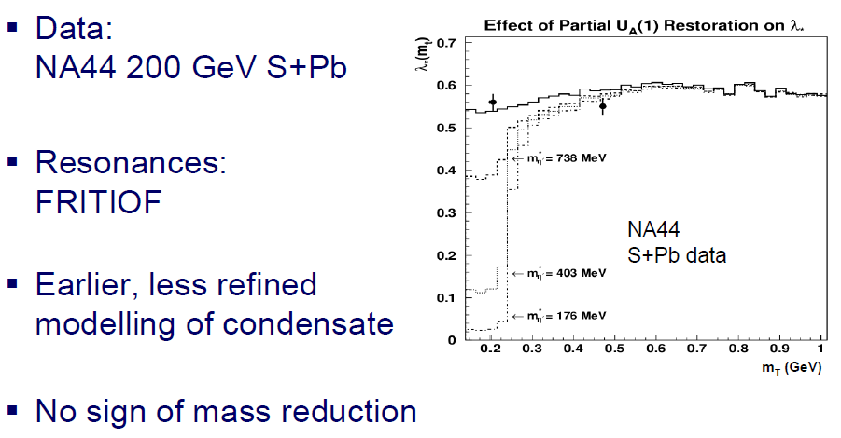
Result at SPS: no in-medium η'* → η'
T. Cs, D. Kharzeev, S. E: Vance, hep-ph/9910436
S. E. Vance, T. Cs, D. Kharzeev, Phys. Rev. Lett. 81 (1998) 2205

Slide 10
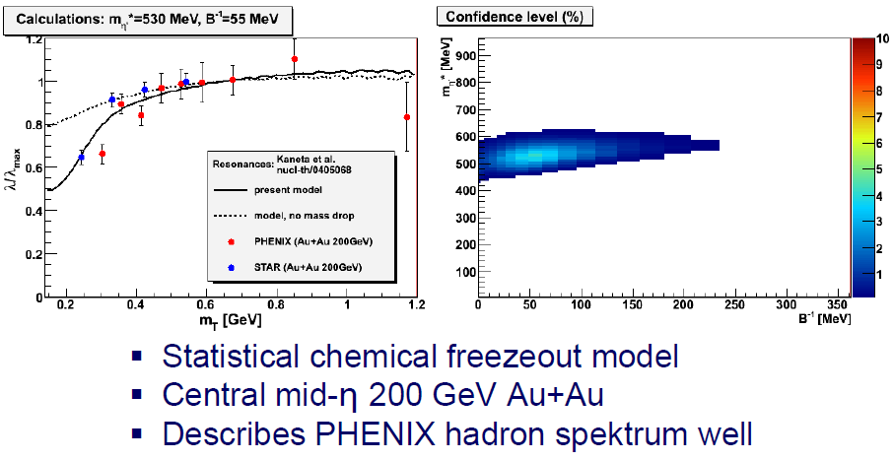
Example results, based on Kaneta & Xu
Resonance model:
Kaneta and Xu, nucl-th/0405068

Slide 11
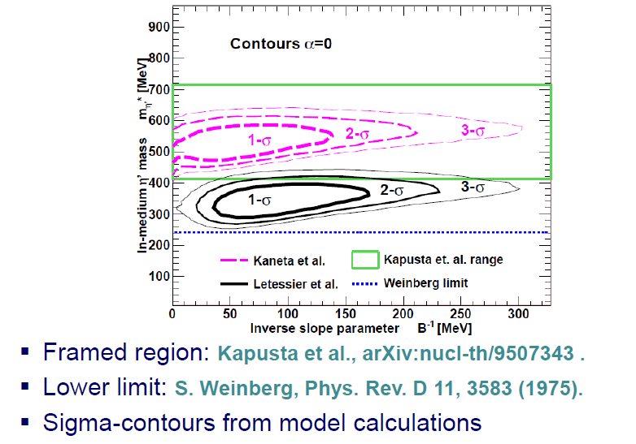
Femtoscopic Analysis: Results at RHIC
T. Cs, R. Vértesi, J. Sziklai, Phys. Rev. Lett. 105 (2010) 182301
Details: R. Vértesi, T. Cs, J. Sziklai, Phys. Rev. C38 (2011) 054903

Slide 12
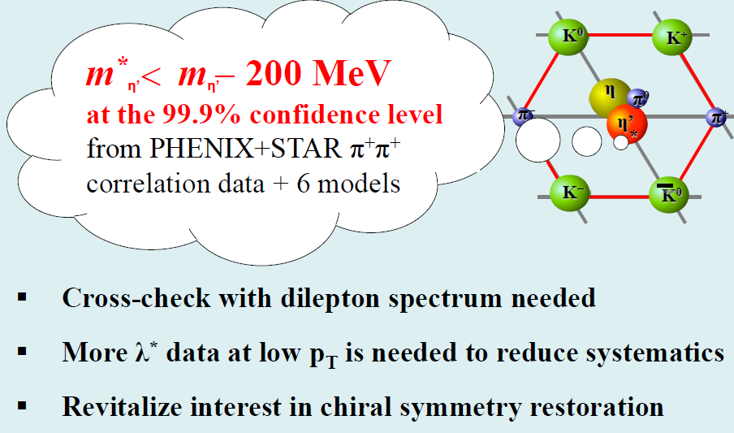
Conclusions of femtoscopic study
T. Cs, R. Vértesi, J. Sziklai, Phys. Rev. Lett. 105 (2010) 182301
Details: R. Vértesi, T. Cs, J. Sziklai, Phys. Rev. C38 (2011) 054903

Slide 13
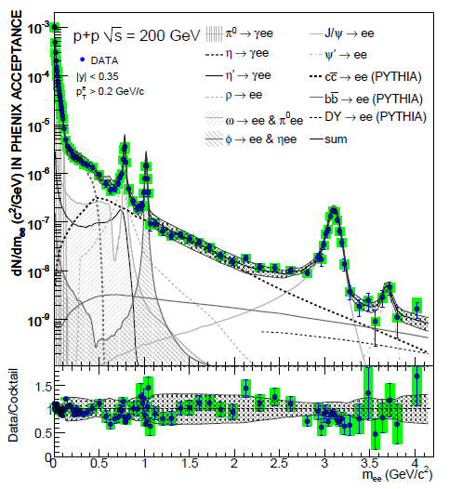
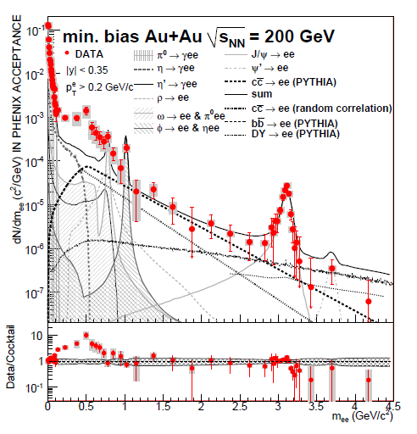
200 GeV Au+Au: low mass dileptons
In low mass region, 0.12 < m_{ee} < 1.2 GeV region:
excess of dileptons, that are expected from hadronic phase
S. Afanasiev et al, PHENIX, arXiv:0912.0244v1 [nucl-ex]

Slide 14
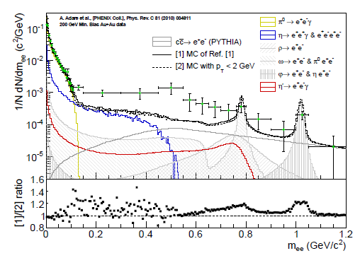
Return to dilepton spectra at RHIC
PHENIX cocktail reproduced and also calculated with p_{t} < 2 GeV
lower panel indicates that the dilepton enhancement is soft
→ make sure that hydro /flow effects are included in background

Slide 15
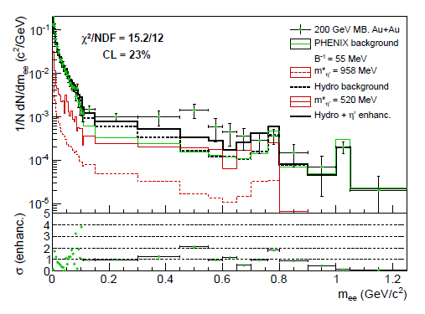
Hydro background + all chain decays
Hydro background is different from PHENIX default
In-medium η' mass drop:
acceptable fit but systematics

Slide 16
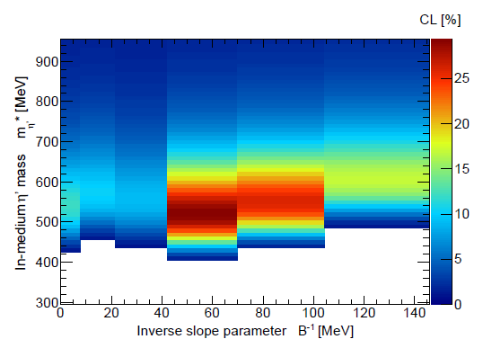
Parameter scan from dilepton data
η' mass values below 400 excluded at 99.9 % CL
consistent with femtoscopy, but B⁻¹ scan is preliminary

Slide 17
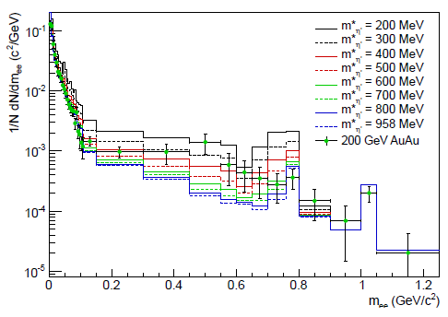
η' mass scan vs dilepton data
m*(η') ~ 400-600 MeV
B⁻¹ fixed to 55 MeV (best)
Needs update for new PHENIX data
M. Vargyas, CsT, R. Vértesi,
CEJP 11 (2013) 553-559 arXiv:1211.1166

Slide 18
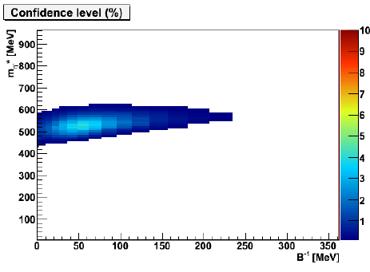
What have we learned so far?
Final femtoscopy/BE and first dilepton spectrum analysis
→ consistent picture of in-medium η' mass modification
at 99.9 % CL: 400 < m(η'*) < 758 MeV
→ dilepton and femtoscopy analysis is complementary
→ details available in centrality and pt dependence of dileptons
Needs cross-checks, density effect at J-PARC

Slide 19
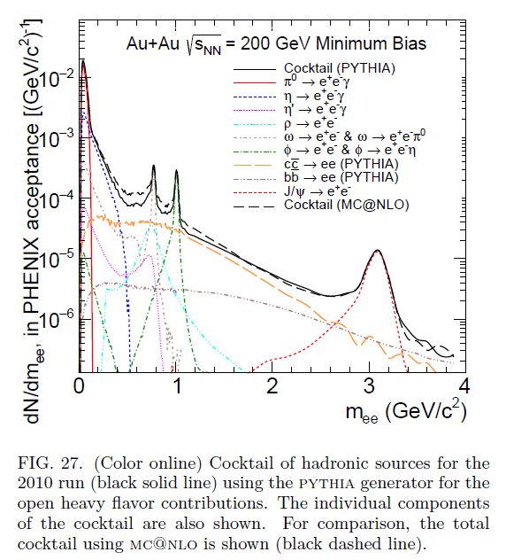
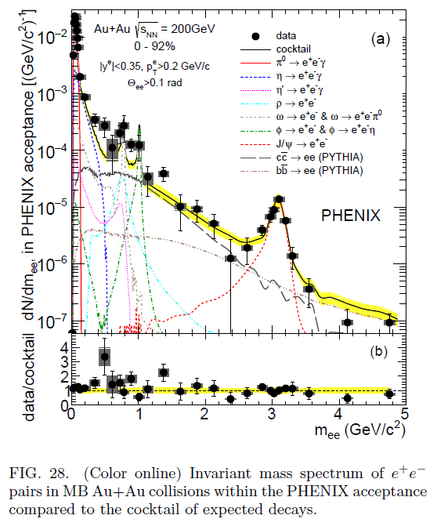
200 GeV Au+Au: new PHENIX results
In low mass 0.12 < m_{ee} < 1.2 GeV region: excess of dileptons, but ρ modification! heavy flavour e⁺e⁻: PYTHIA < MC@NLO !
PHENIX, PRC93 (2016) 1, 014904 arXiv:1509.04667 → ongoing η’ analysis

Slide 20
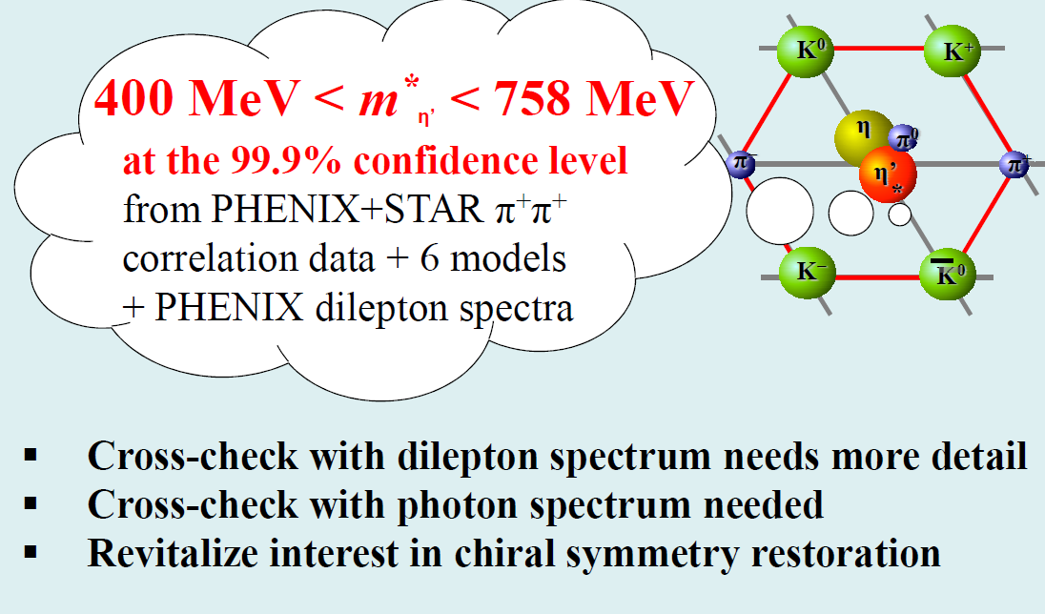
Conclusions, T>0

Slide 21
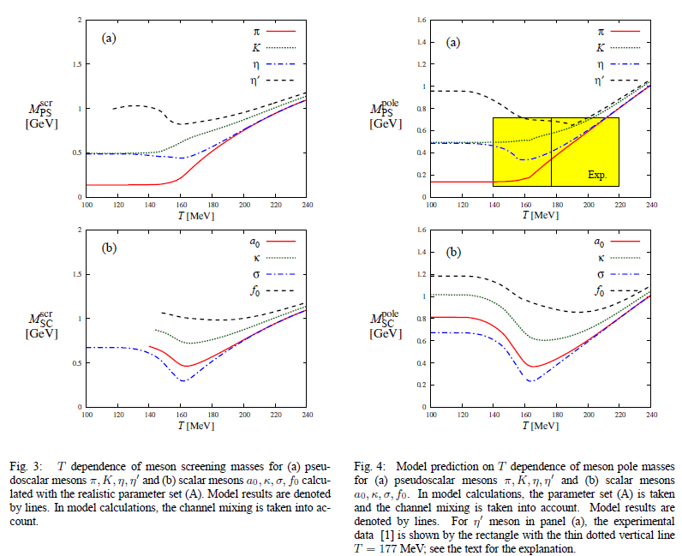
Recent theoretical results
arXiv:1609.04575

Slide 22
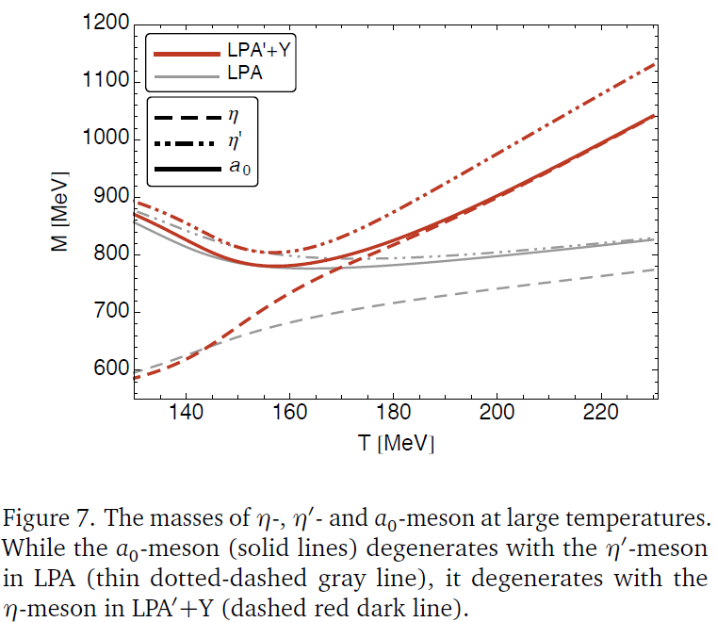
Recent theoretical results 2.
arXiv:1610.08478

Slide 23
η' at T>0 vs η' at ρ>0, time scales
5 fm/c:
fireball of
hadrons
η' at T>0
1000 fm/c
η’ decays
t
10 fm/c:
fireball
decays
η' at ρ>0
5 fm/c:
η’ passes
through A
1000 fm/c
η’ decays
t
10 fm/c:
η’* decays
Nuclear
medium
stable !

Slide 24
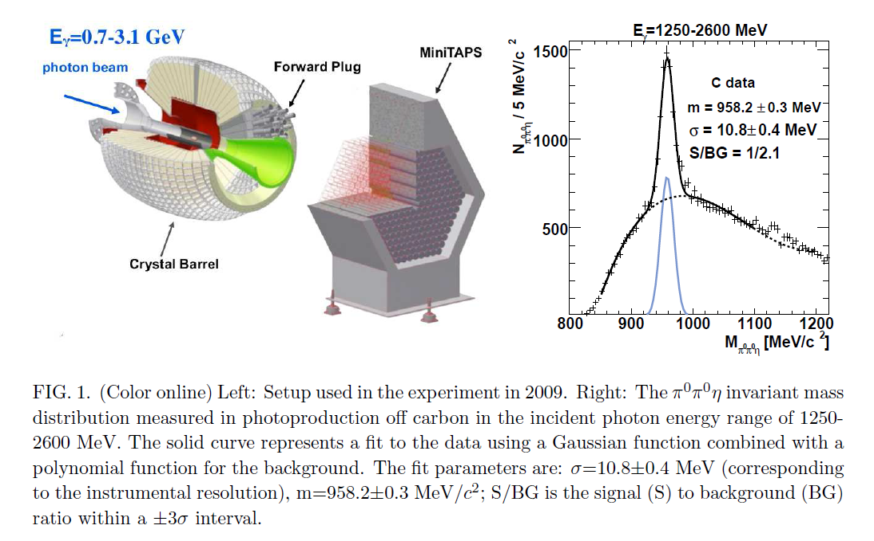
TAPS results at T=0, finite density

Slide 25
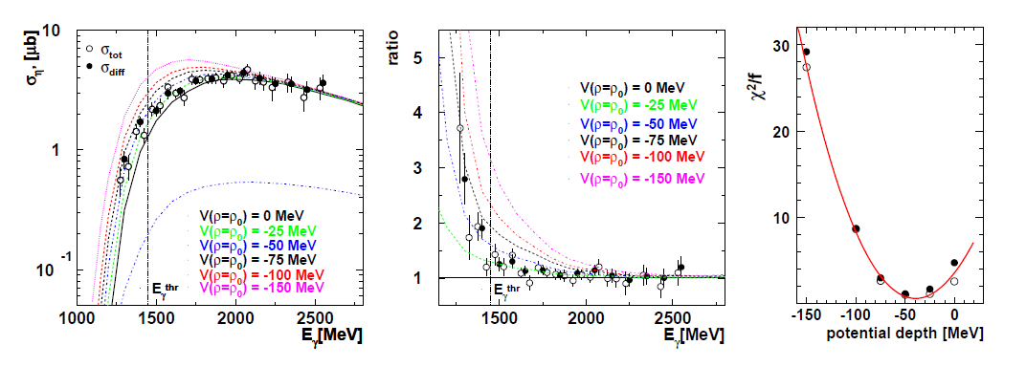
TAPS results
real part: V(ρ₀) = -37 ± 10 (stat) ± 10(syst) MeV
imaginary part: W(ρ₀) = -10 ± 2.5 MeV
Γ(ρ₀) = 20 ± 5 MeV
Mass at PDG value, width broadening by factor of 100!
but: η’ is not stopped in A

Slide 26
Indirectly: η’ in hot hadronic matter:
Femtoscopy and dilepton analysis at RHIC
If m*(η’) < m(η’) = 958 MeV
two-pion Bose-Einstein correlations indicate a hole in λ(m_{t})
in the low transverse mass, 0 < m_{t} - m< 0.25 GeV region:
Method: S. Vance, CsT, D. Kharzeev, PRL 81 (1998) 2205-2208, nucl-th/9802074
Data: PHENIX: PRL93 (2004) 152302 nucl-ex/0401003 + new arxiv:1602.04578
STAR: PRC80 (2009) 024905 arXiv:0903.1296 [nucl-ex]
Dilepton spectra:
In low mass region, 0.12 < m_{ee} < 1.2 GeV region:
excess of dileptons, that are expected from hadronic phase
Data:
PHENIX: PRC 81 (2010) 034911, arXiv:0912.0244
STAR: PRL 113 (2014) 022301
STAR: PRL 113 (2014) 049903
PHENIX: PRC93 (2016) 1, 014904, arXiv:1506.07834
Indirect observation of η’ modification
HBT: CsT, R. Vértesi, J. Sziklai, PRL 105 (2010) 182301, arXiv:0912.5526
HBT: R. Vértesi, CsT, J. Sziklai, PRC 38 (2011) 054903, arXiv:0912.0258
Dilepton: M. Vargyas, CsT, R. Vértesi, CEJP 11 (2013) 553 arXiv:1211.1166
Dilepton: CsT, G. Kasza, M. Vargyas… in preparation

Slide 27
Summary
Indication of a hadronic phase
where η and η' are like identical twins
U_{A}(1) restoration
Bose-Einstein and dilepton analysis consistent and complementary
400 < m(η'*) < 759 MeV at 99.9 % CL
but ongoing dilepton analysis of
recent PHENIX and STAR data
needs confirmation:
γ channels, T dependence at RHIC
new measurements:
Density dependence at J-PARC

Slide 28

Thank you for your attention!
Questions?

Slide 29
Backup slides – Discussion

