Slide 1
Status of the cryogenic system for B180
20 October 2016
A. Perin (TE-CRG), H. Derking (TE-CRG), K. Iakovidis (TE-CRG), L. Stewart (TE-CRG) and inputs of he B180 cryo project team

Slide 2
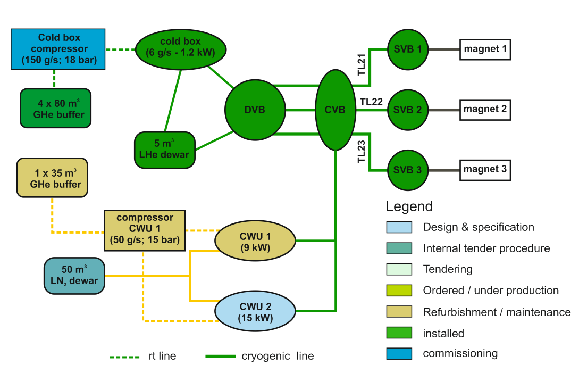
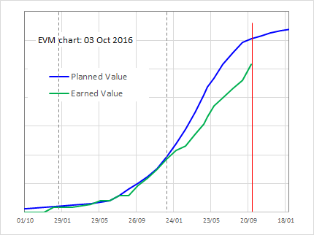
B180 cryogenics project status
B279 (compressor building)
B279: Oil spillage protection & painting 90% done. Work on ventilation system (50%) and fire detection system (90%).
Mayekawa compressor: power & control system operational. Commissioning started on 4th October. Standby waiting end of building works (oil spillage protection). Restart on 7th November for 2-3 weeks.
Piping: LP, HP & buffer piping finished and pressure tested.
B180 (cold box + cryogenic distribution)
Cold box: work on valves, turbines. Cabling and control system starting.
DVB + piping: done. Cabling to be done.
Next steps & schedule
Next major step: cabling and control system for the cold box & cryo distribution: Oct-Nov
Commissioning of cold box Nov-Dec. Target: liquid helium by 8 December (high risk of shift !)
LN2 system (pre-coolers): specification ready for Spec Comm in Nov 2016: critical.
Layout and status overview
Nb. Baseline Oct 2015 not taking into account shift in LN2 system

Slide 3
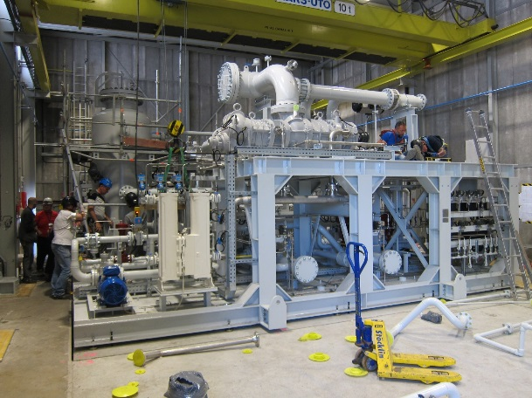
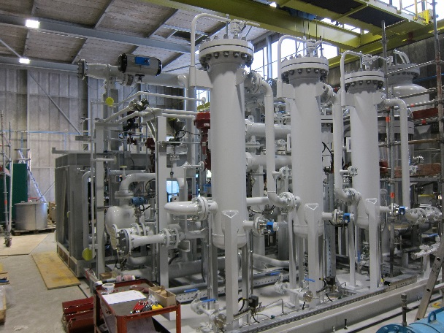
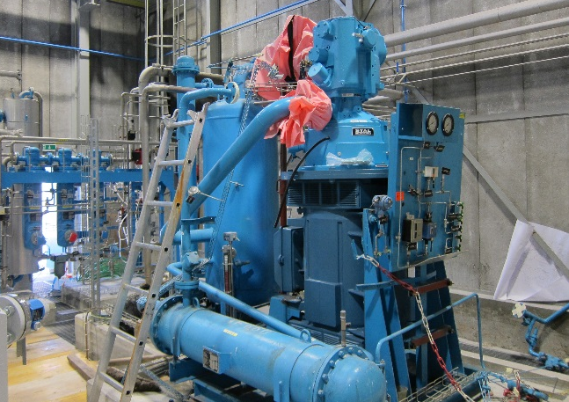
Building B279 & compressors
Currently managing 8 subprojects (Civil engineering, oil containment, piping, controls, ventilation, safety, etc.) involving more than 100 tasks.
Critical: oil containment measures: installation of final details ongoing.
Piping: Buffer line & valves (>100 m) done. Pressure and leak tested.
Mayekawa compressor (for cold box) 50% of commissioning done. Finish first half of Nov.
Stal compressor (for pre-coolers)
    Phase 1 maintenance done (ML-Sercal)
    Commissioning in 2017
19 May 2016

Slide 4
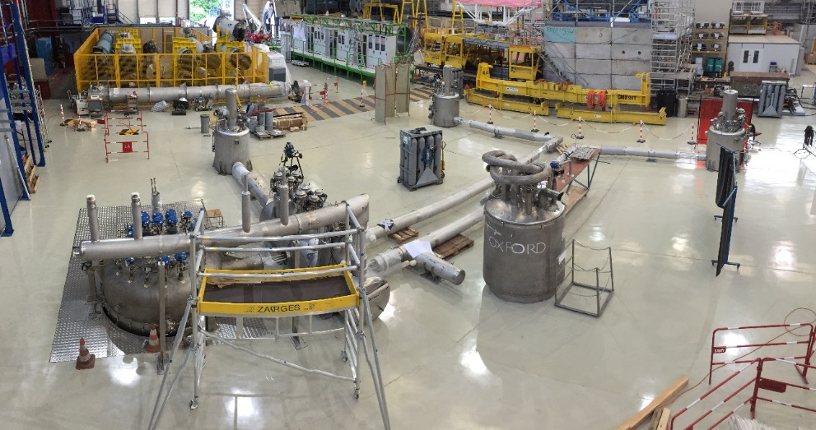
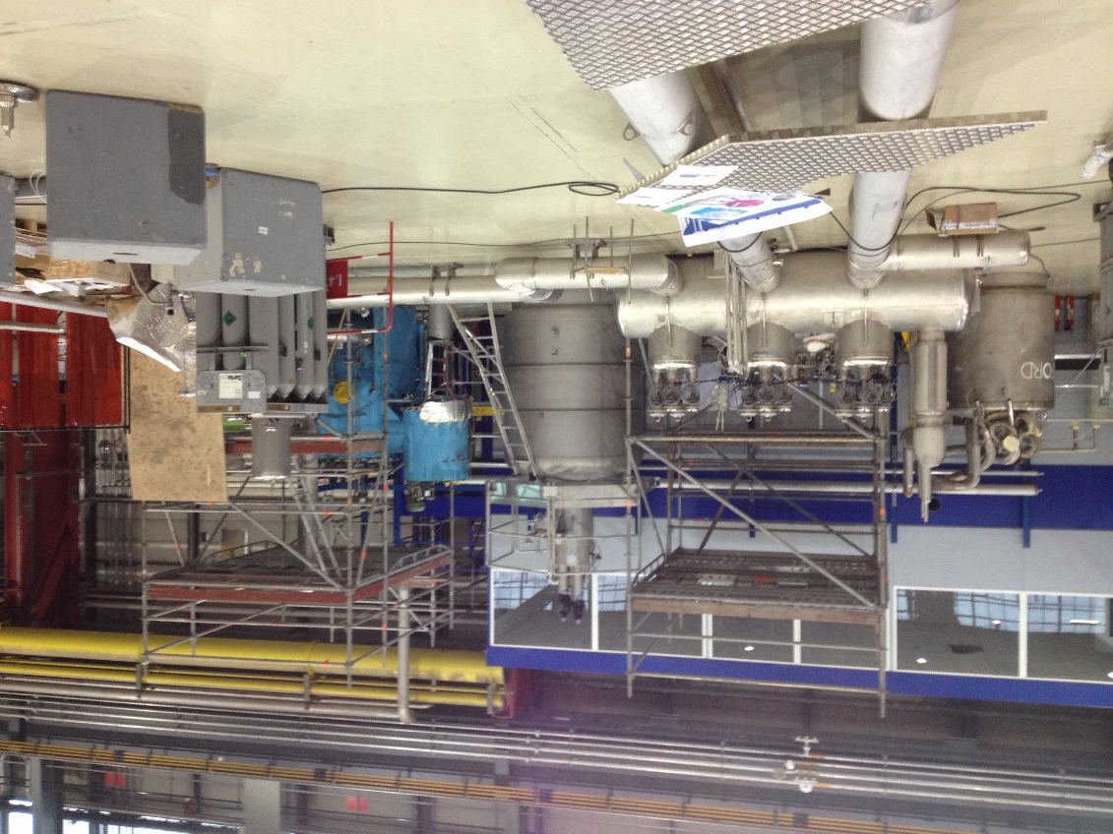
B180 cryogenic distribution system - status
All deliveries by companies according to planning. All contracts finalized.
Cryogenic distribution system: delivered and installed by Kriosystem. Pressure & leak tested, as built documentation received and contract finished.
Cold box: refurbished by Linde, documentation received and contract finished. To do: installation of turbines, turbine coolers, safety valves, compressed air and vacuum circuits.
LHe dewar + VB + transfer lines delivered and installed by Cryoworld. Final documentation received, contract finished. Pressure & leak test to be done by CERN.
DVB: work in progress. Purge panel 90% finished, compressed air, end switches, solenoid valves, instrumentation installed. To do: finalized panel and pressure & leak test.
Warm piping: HP & LP to cold box finished. To do: compressed air distribution, GHe supply distribution, final part of current lead return & pump lines.

Slide 5
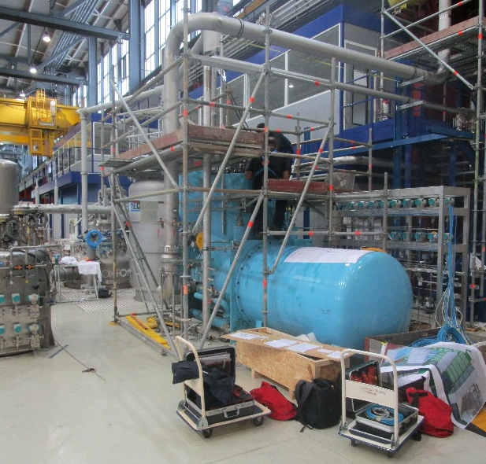
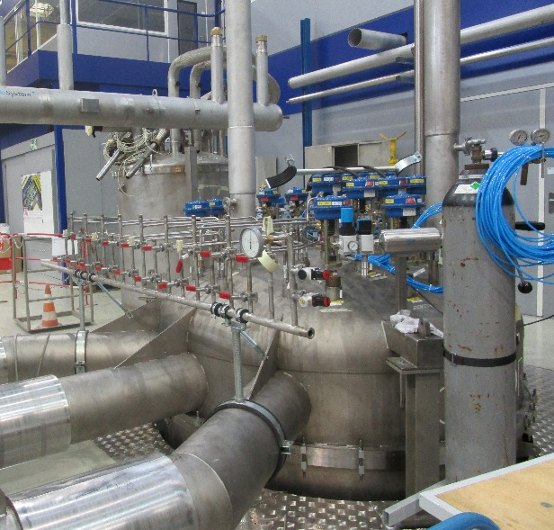
B180 cryogenic project - outlook
Project is being performed in two phases:
1. LHe system:
Cold box compressor (Mayekawa): first run on 7/11/2016
Cold box: start commissioning on 21/11/2016
control racks 95% finished, cabling to be started
Cryodistribution: operational 1st quarter of 2017
LHe system fully operational and handover: May 2017
2. LN2 system:
CWU1 & LN₂ piping: installation finished May 2017
50 m³ LN₂ tank: installation Sep-2017
CWU2: to be ordered:
contract placement: Feb-2017
Installation: Nov-2017
Operational: Dec-2018
Work on cold box by Sercal & ME
Work on DVB by ME in progress

