Slide 1

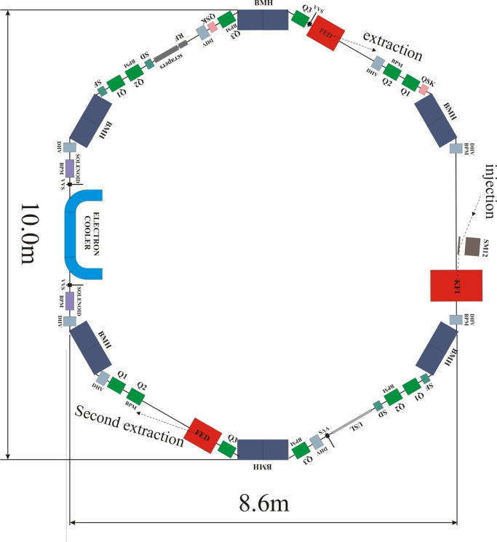
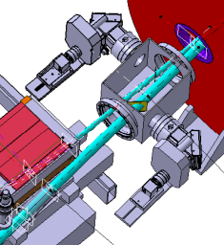
BTVs @ ELENA Status 2016_10_27
BTVs for ELENA
Relocation of
DE.BTV7045 -> LNI.BTV.0015
AD Extraction line
LNR.BTV.0117
Circulating beam
Location of new BTVs
Between Septum and Kicker
LNR.BTV.0118
Injected beam
S.Burger, A.Guerrero

Slide 2
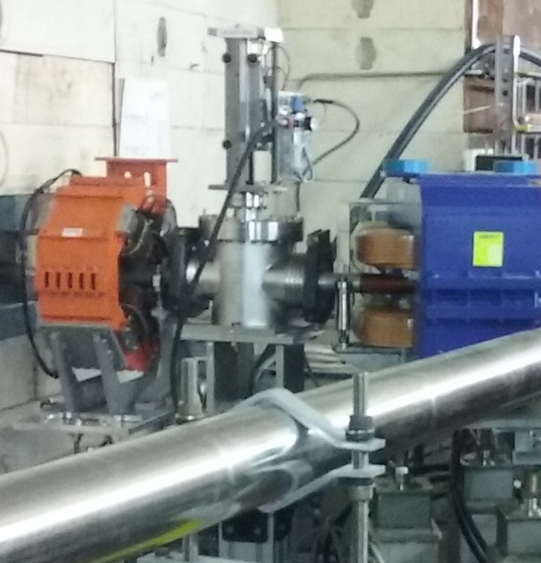
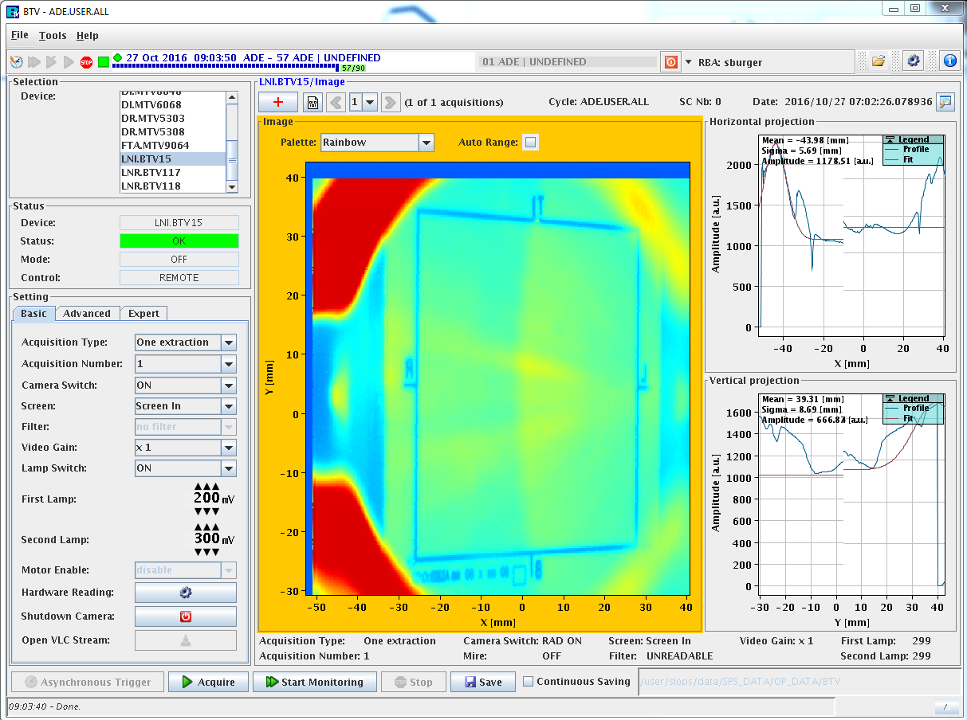
BTVs @ ELENA Status 2016_05_27
LNI.BTV.0015
Installed Q1 2016
Operational – Waiting for beam...

Slide 3
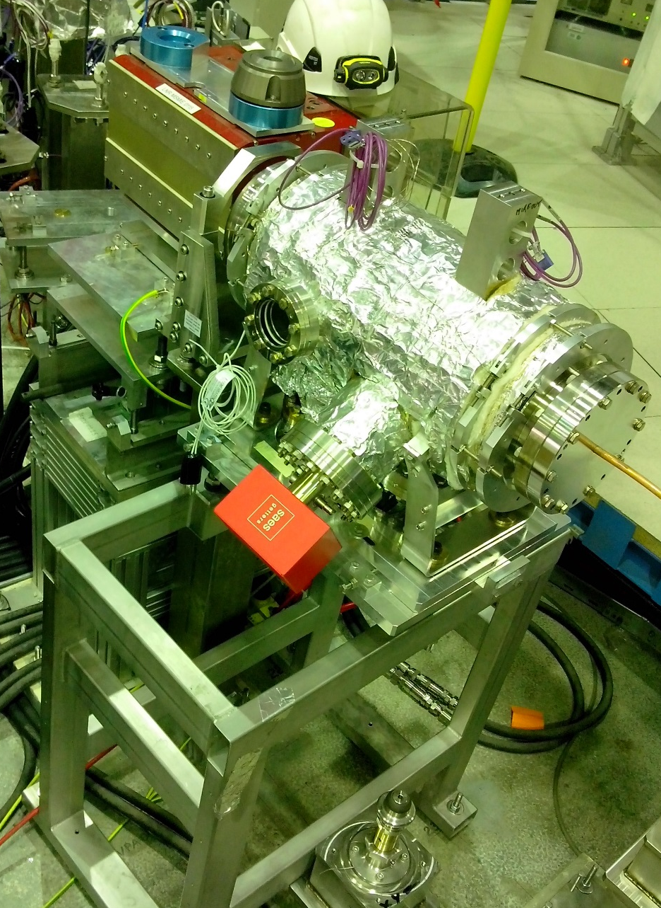
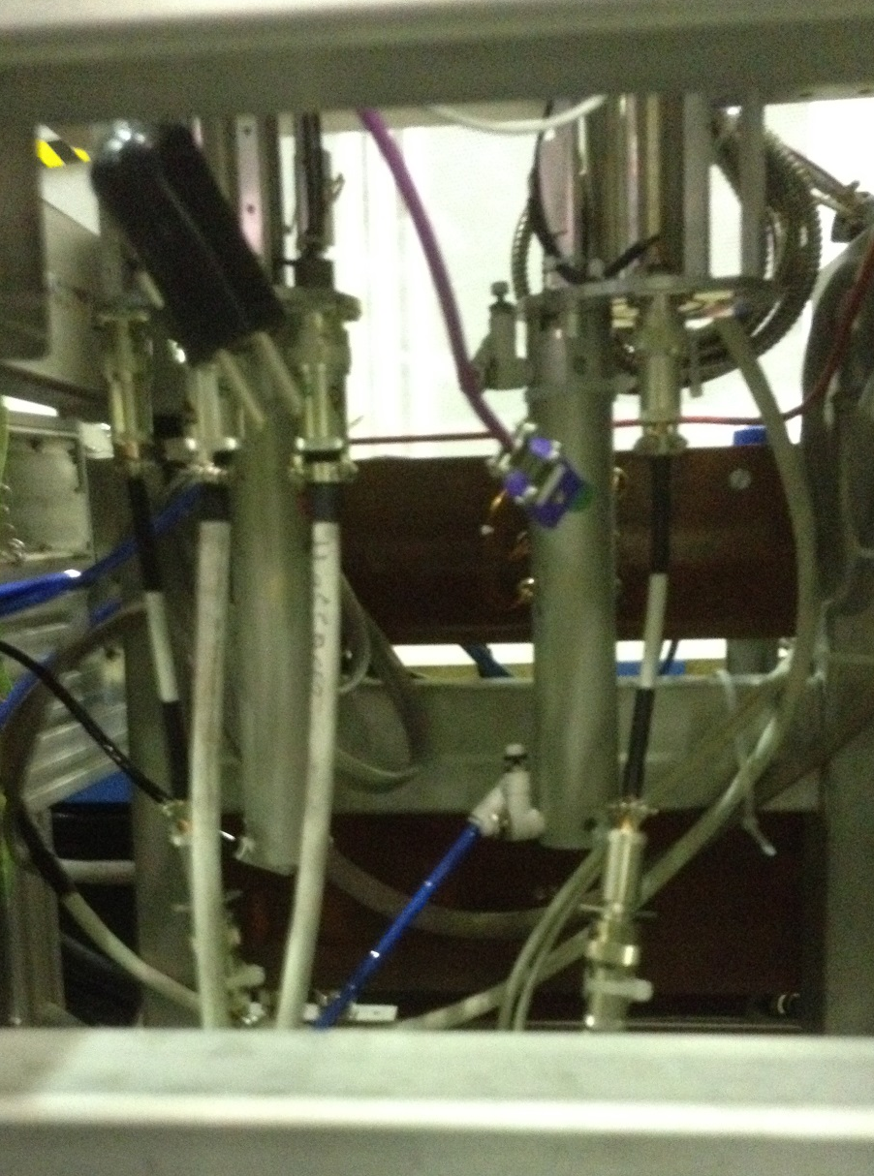
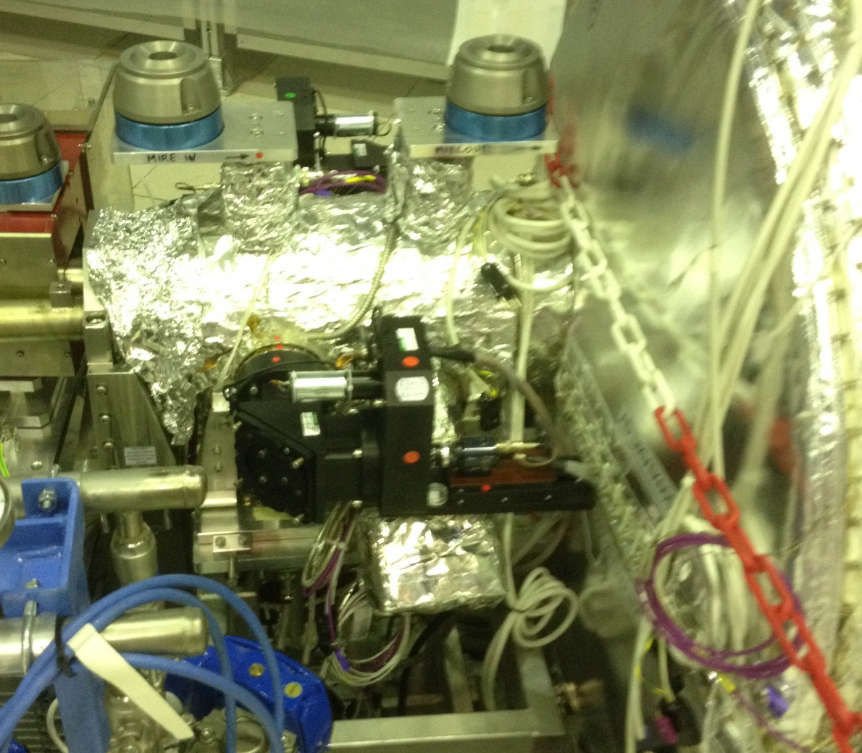
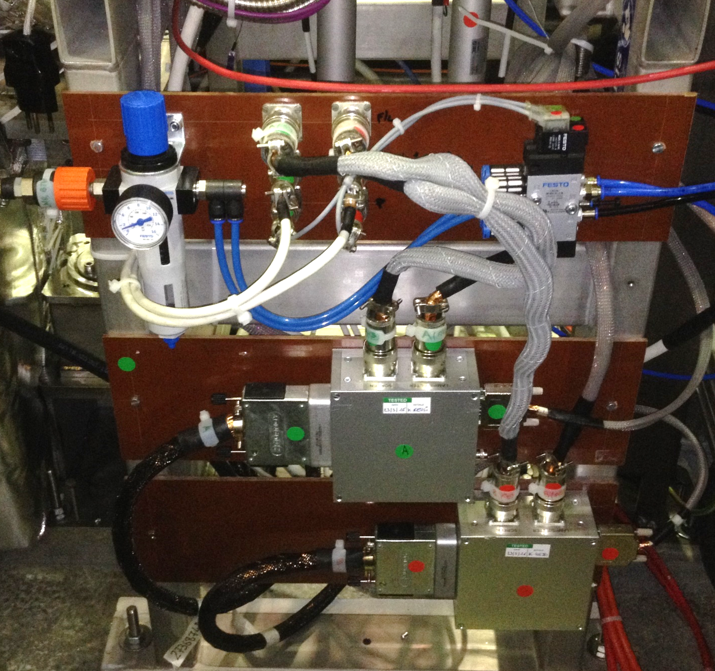
BTVs @ ELENA Status 2016_05_27
LNR.BTVPA.0117
LNR.BTVPA.0118
Final vacuum tests were OK. Installation in LNR20 was done in July 16.
Vacuum and bake out finished mid October.
Installation of:
  the pneumatic interfaces
  the push-pull external parts
  the ‘Cloches’ (cameras + filter wheels + lights)
EIS tests -> OK on BTV side (LNR.BTV0117 in the access chain)
Documentation for Safety file has been transmitted to C.Alanzeau
Operational- Waiting for the beam…
BTVs in LNR20 section of ELENA ready for operation

Slide 4
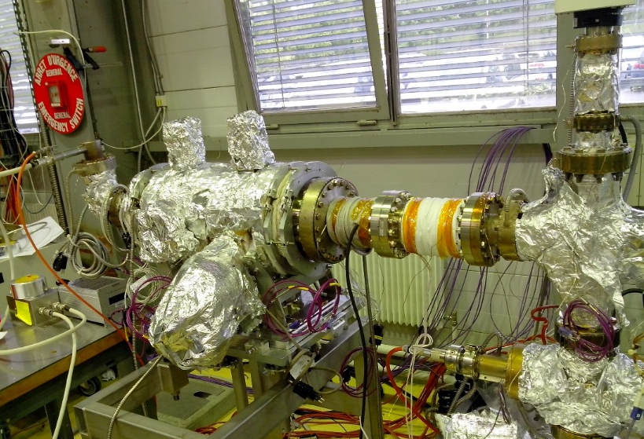
BTV ELENA – Pressure measurement during BTV movement in Building 113
Magnetic Push-Pull from UHV with CERN modifications:
- replacement of FRELON© and PEEK© pieces by BeCu
- large grooves for better vacuum pumping
NEG Coated vacuum chamber
Initial vacuum pressure for this test in building 113 setup was ~3E-10 (1E11 reached after cooling a vacuum pump that was discovered still warm on the setup).
3 gauges for monitoring. 2 are represented here.
Gauges
SVT Neg
Pe2
Movement of BTV0117
Screen OUT
Screen IN
Movement of BTV0118
Conclusion
Pressure rising with a level between 5E-9 and 2E-8 during movement.
Vacuum gets back to initial values after few seconds.
Screen IN
Screen OUT
2016_07_04 S.Burger/Y.Delaup

Slide 5
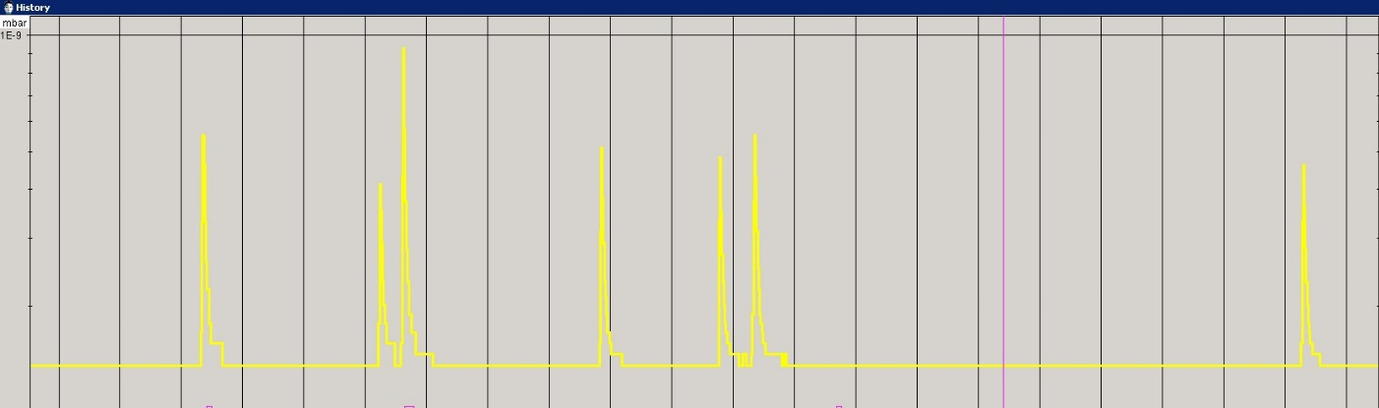
BTVs @ ELENA Status 2016_05_27
Vacuum performance in LNR20
1E-9
1E-10
~5 to 10x less than in lab

