Slide 1
Review of the industry session at the Advanced Low Emittance Rings Technology (ALERT) workshop
R. Geometrante – Kyma S.r.l.
With contributions from E. Karantzoulis, Y. Papaphilippou and R. Bartolini
Special thanks to all participants for stimulating and interesting remarks during discussions.

Slide 2
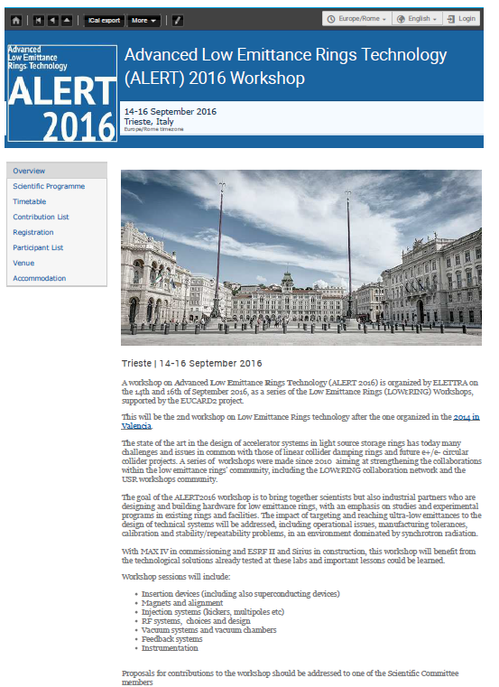
The goal of the workshop was to bring together Research Institutes – Industries
There were 67 registered participants from Asia, Europe and America including
15 from the industry
In total with locals about 75 people
https://indico.cern.ch/event/518497/
Courtesy of E. Karantzoulis

Slide 3
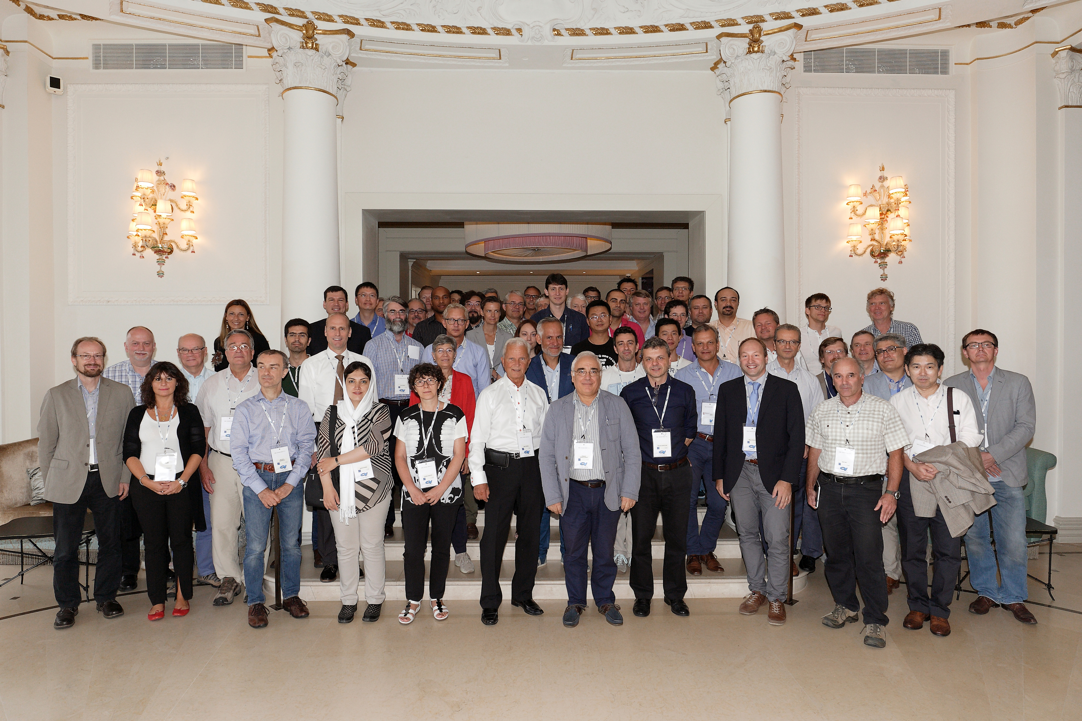
Courtesy of E. Karantzoulis
3

Slide 4
Motives
Universities and Research Institutes do not have appropriate resources and sufficient competences and even culture to exploit an opportunity from the commercial point of view
  Better accelerators
    Better science and technology
For enterprises it is almost impossible to cover all the different disciplines and relevant knowledge that are often necessary to conceive and set up a new technology and/or a new product
  Access to new technology
    Possible Competitive advantage
4

Slide 5
Aims
The main object of the workshop was to explore and identify the areas of collaboration between Research Institutes and Industry focusing on:
R&D: needs, opportunities and capabilities
How can we fill the gaps?
How to improve the interaction / communication?
Initiate and encourage communication, discussion and interactions
5

Slide 6
Potential
Low Emittance Rings ~2018-2028
(beyond MAX IV – ESRF-EBS – SIRIUS)
APS-U, ALS-U, ELETTRA 2.0, SLS II, PETRA IV, HEPS, DLS II, SOLEIL, ANKA, …
(Iran, Mexico, Thailand, African LS, …)
CepC, FCCee
100-200 Meuros (acc only) each → ~1 B€
200-500 Meuros (inc. beamlines) each → ~2 B€
6

Slide 7

Technical challenges and R&D needed
General Session Chair. Y. Papaphilipou (CERN)
  Highlights from MAX IV commissioning and operation, Pedro Tavares (MAX IV)
  ESRF II, Dieter Einfeld (ESRF)
  Sirius and Sirius magnets, James Citadini (LNLS )
  BESSY-VSR-Project, Martin Ruprecht (BESSY)
Insertion devices Chair: D. Einfeld (ESRF)
  Super-conducting Undulators at ANL, Joel Fuerst (ANL)
  Planar superconducting undulator with neutral pole: test results of the prototype, Nikolay Mezentsev (BINP)
  Fixed gap undulators and performance, Bruno Diviacco (Elettra)
Magnets (static and pulsed) Chair: P. Tavares (MAX IV)
  MAX IV 3 GeV ring magnet, Martin Johansson (MAX IV)
  Magnets for DDBA and lessons learned for Diamond-II, Abolfazl Shahveh (Diamond)
  Magnets for Elettra 2.0, Davide Castronovo (Elettra)
7

Slide 8
Technical challenges and R&D needed
Magnets & alignment Chair: P. Kuske (HZB)
  Dipoles with longitudinally variable field for CLIC damping rings, Manuel Dominguez (CIEMAT)
  NbTi wiggler tests at ANKA, Axel Bernhard (ANKA)
  Vibrating wire method and hall probe measurements for combined function magnets (DQ) alignment, Alexander Temnykh (Cornell)
Beam transfer systems Chair: R. Bartolini (JAI - DIAMOND)
  Production of round beams, Peter Kuske (HZB - BESSY)
  Development of Multipole Injection Kicker for SOLEIL and MAX IV, Pierre Lebasque (Soleil)
  Stripline kicker development at ALS, Cristoph Steier (LBL)
  Transient studies of the stripline kicker for beam extraction from the CLIC damping rings, Carolina Belver Aguilar (CERN)
  Inductive adders ultra-stable kicker pulse generation, Janne Holma (CERN)
RF systems and power Chair: R. Nagaoka (SOLEIL)
  MAX IV RF Systems, Lars Malmgren (MAX IV)
  Conceptual Design of a 2 GHz RF System for the CLIC DRs, Alexej Grudiev (CERN)
  State-of-the-art RF solid state amplifiers, Massamba Diop (SOLEIL)
  Experience and future trends of Harmonic RF systems, John Byrd (LBNL)
8

Slide 9
Technical challenges and R&D needed
Feedback systems and Engineering Chair: S. Guiducci (INFN-LNF)
  Fast orbit Feedback for ESRF-EBS, Benoit Roche (ESRF)
  Application of wide-band feedback systems for low emittance rings, John Fox (SLAC)
  Engineering for DDBA and lessons learned for Diamond-II, Nigel Hammond (Diamond)
  Risk assessment for the ESRF II, Dieter Einfeld (ESRF)
Diagnostics, Instrumentation and coating Chair: Å. Andersson (MAX IV)
  Ultra-low vertical emittance measurements in the Australian Light Source, Mark Boland (Australian Synchrotron)
  Conceptual design of X-ray interferometer for extremely apparent small beam size in FCC-ee and beam halo measurement with coronagraph for HL LHC, Toshiyuki Mitsuhash (KEK)
  Ultra-short bunch length diagnostics, Axel Bernhard (KIT-ANKA)
  Laser engineered surfaces, Amin Abdolvand (Dundee University)
  Experience with coating of low gap chambers, Roberto Kersevan (CERN)
Vacuum, coating and other Key technologies and engineering Chair: A. Bernhard (KIT-ANKA)
  MAX IV 3 GeV ring vacuum system, Marek Grabski (MAX IV)
  Vacuum systems for DDBA and lessons learned for Diamond-II, Matthew Cox (Diamond)
  Transverse and horizontal beam size diagnostics with visible SR, Åke Andersson (MAX IV)
  Particle Accelerator Components’ Metrology and Alignment to the Nanometre scale (PACMAN), Michele Modena (CERN)
9

Slide 10
Interaction
Institutes-Industries
Collaboration with Industry
The main objective of the industry session was to expose to the industrial partners a number of key technologies driven by the design of ultra-low emittance rings.
Particular emphasis were given on the prototyping aspects of several low emittance rings technologies, including Insertion Devices, Magnets and alignment, kicker systems, RF technology, vacuum systems and instrumentation.
Laboratory procurement rules and Knowledge Technology Transfer (KTT) aspects were also discussed together with various aspects of industry/laboratory/university partnerships.
10

Slide 11
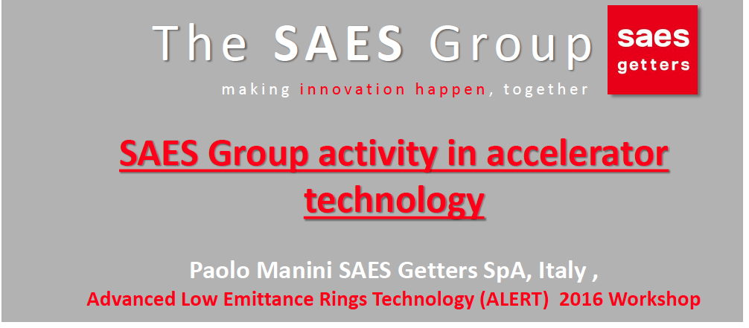
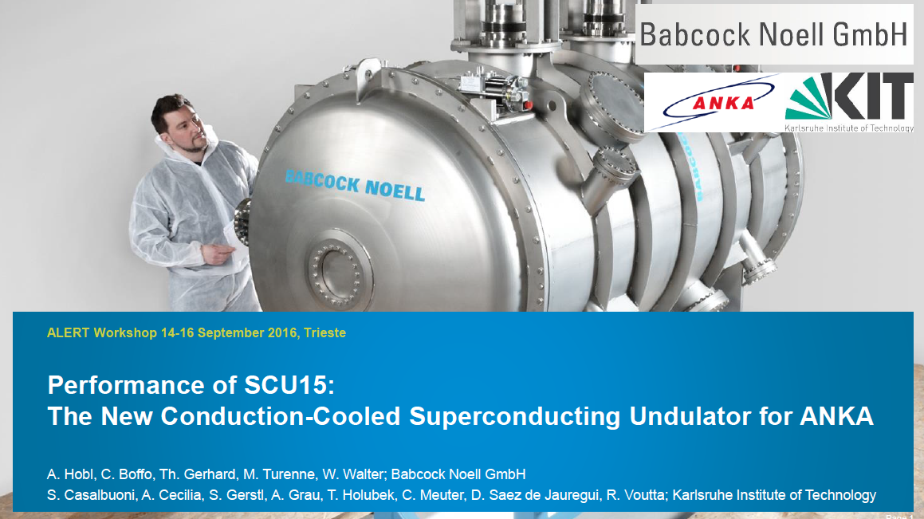
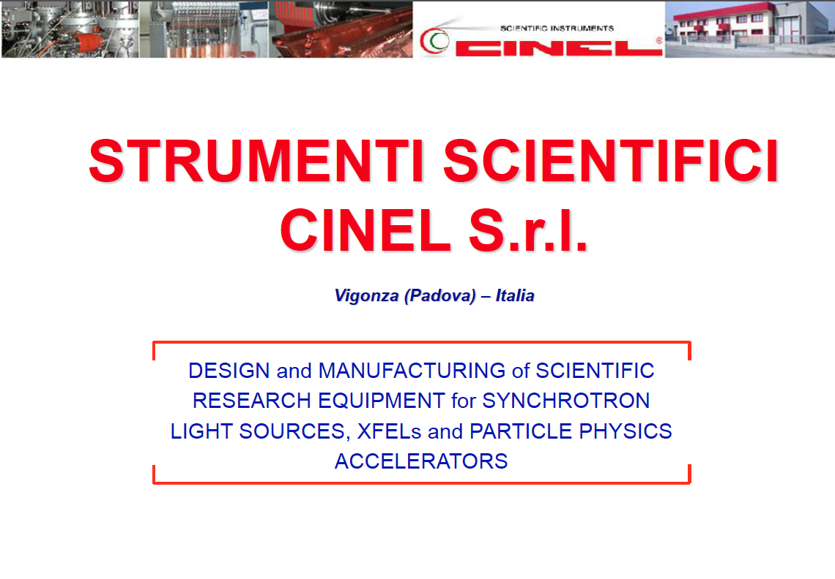
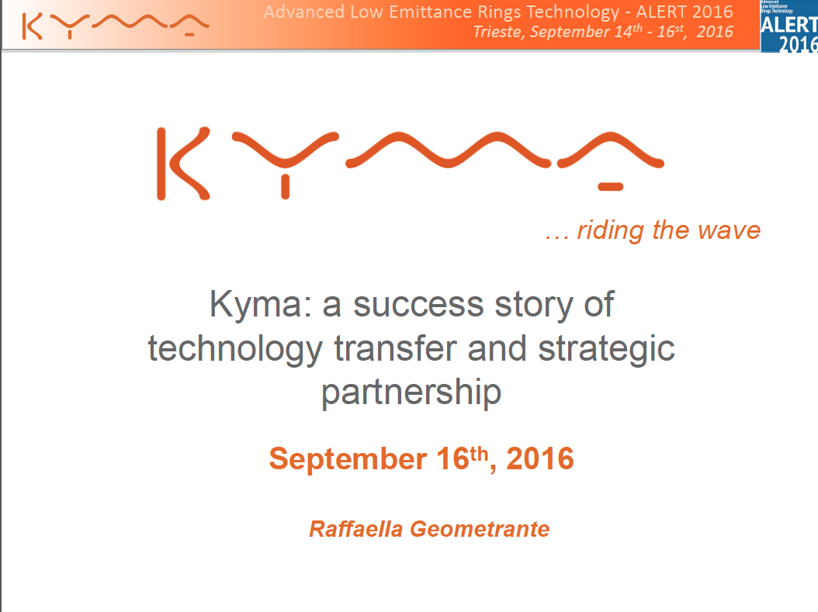
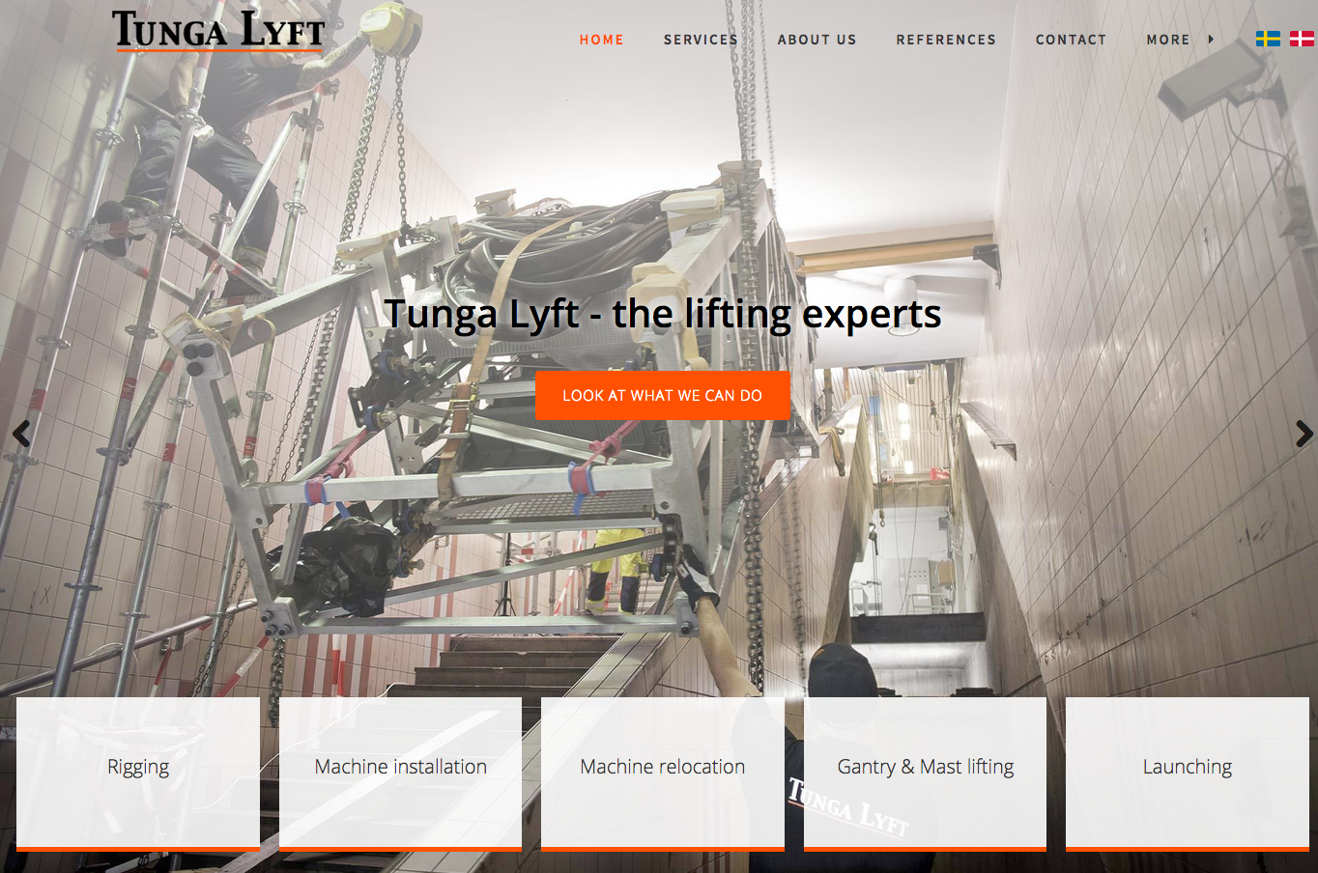
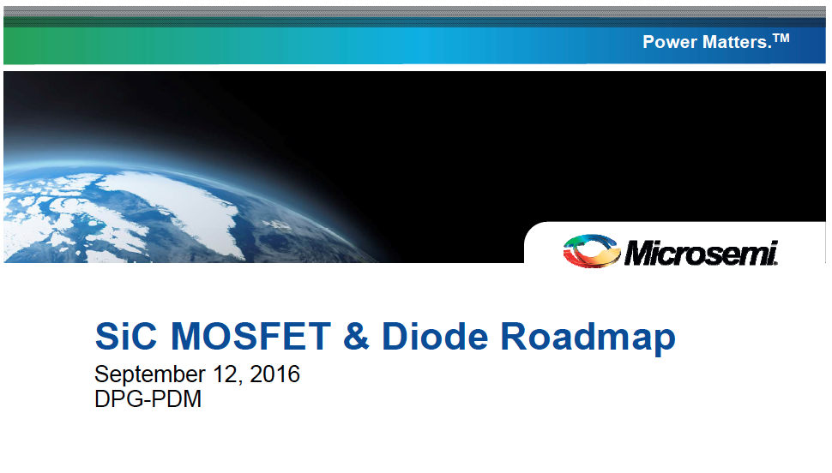
Technical challenges and R&D needed
Collaboration with industry Chair: R. Geometrante (Kyma)
  SAES group activity in accelerator technology, Paolo Manini (SAES Getters SpA)
  Strumenti scientifici CINEL: a reliable supplier for products as well as a skillful partner for R&D projects, Riccardo Signorato (CINEL)
  SiC MOSFET & Diode Roadmap, Wolfgang Knitterscheidt (eurocomp)
  Superconducting undulators, Cristian Boffo (Babcock Noell GmbH)
  KYMA: a success story of technology transfer and strategic partnerships, Raffaella Geometrante (KYMA)
  Tunga Lyft - Installations at MAXIV, Olle Torsteni (Tunga Lyft)
11

Slide 12
Interaction Research Institutes-Industries
Knowledge and Technology Transfer (KTT)
The technology and expertise generated in Research Institutes may have application beyond the immediate goals or intent and could have market value if further developed by the industrial community.
Technological progress is the principal driving force in long-term economic development and growth
Need (also political) to KTT to industry
Financial benefit for the institute
Industry view?
Working with the laboratories could be difficult and time-consuming
Access to new technology
12
Notes:
It is widely accepted that technological progress is responsible for up to one-half the growth of the U.S. economy and is the principal driving force in long-term economic growth and increases in our standard of living.
Congressional Research Service
Technology Transfer: Use of Federally Funded Research and Development
Wendy H. Schacht
Specialist in Science and Technology Policy
December 3, 2012

Slide 13
Mechanisms and tools for KTT
Interaction Research Institutes-Industries
EDUCATED-ORIENTED
Didactic activities
Scientific publications
Mobility of researchers
Outplacement of students
Academic networks
Participation to conferences, meetings, fairs
Postdoc masters (also for workers)
MARKET-ORIENTED
Research contracts
Co-operative research programs
R&D consortia
Shared laboratories
Sell of intellectual property
Spin-off creation
Services for tests and analysis
Technological consultancy
Accreditation and certification activities
TOOLS
Scientific parks
Innovation districts
Business incubators
Industrial Liaison Offices (ILO)
Patents

Slide 14
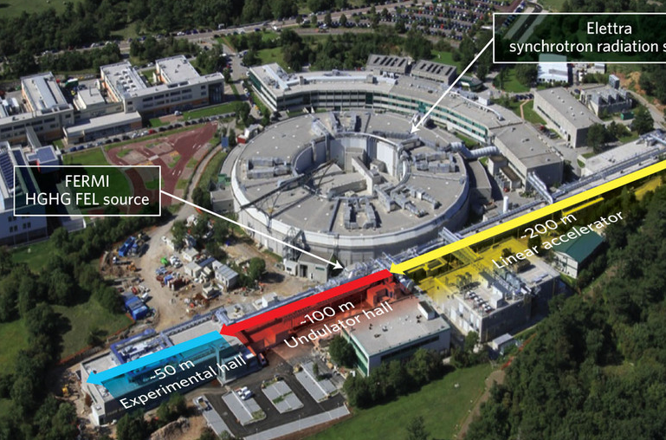

Interaction Research Institutes-Industries

Slide 15
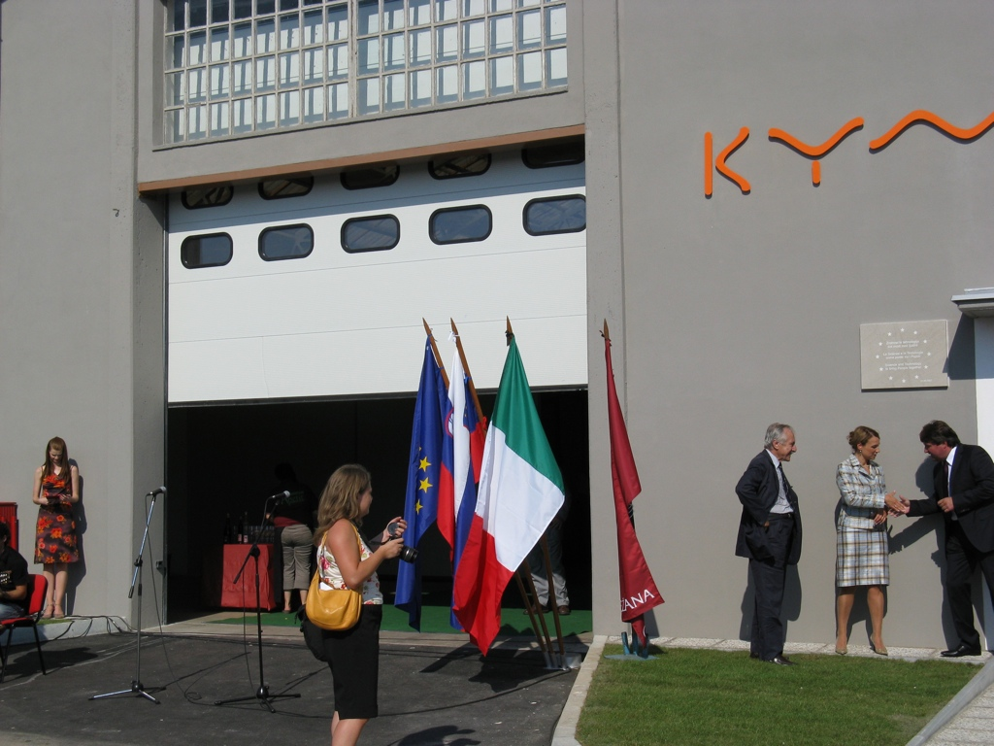
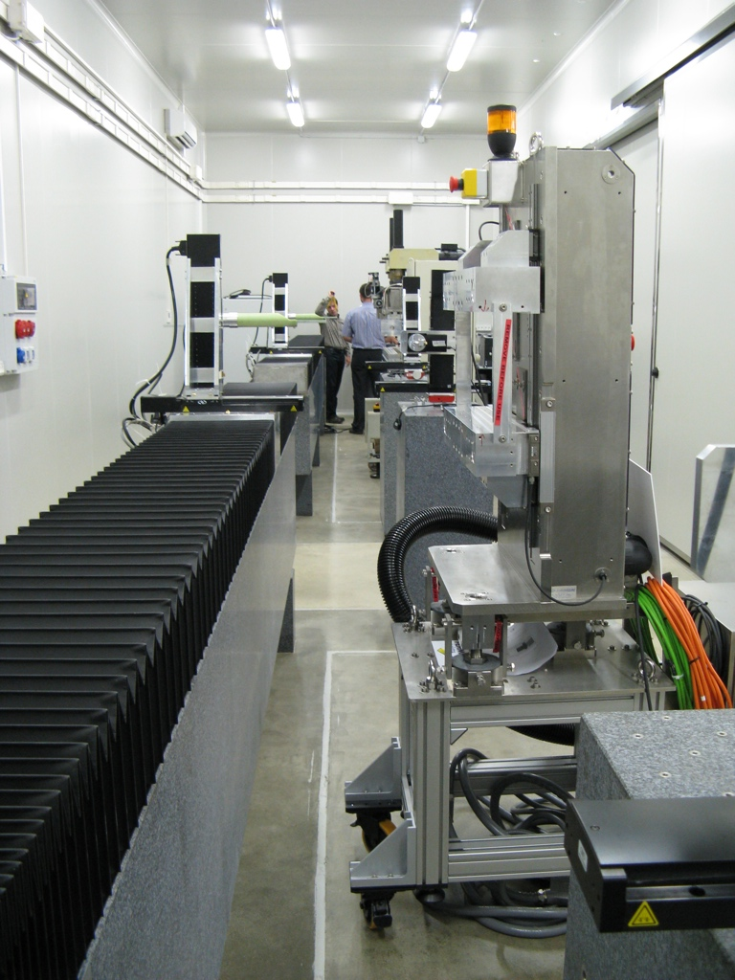
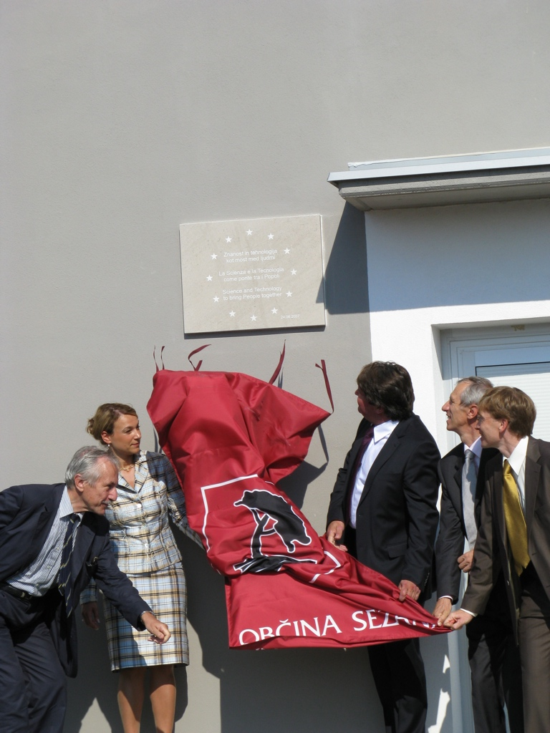
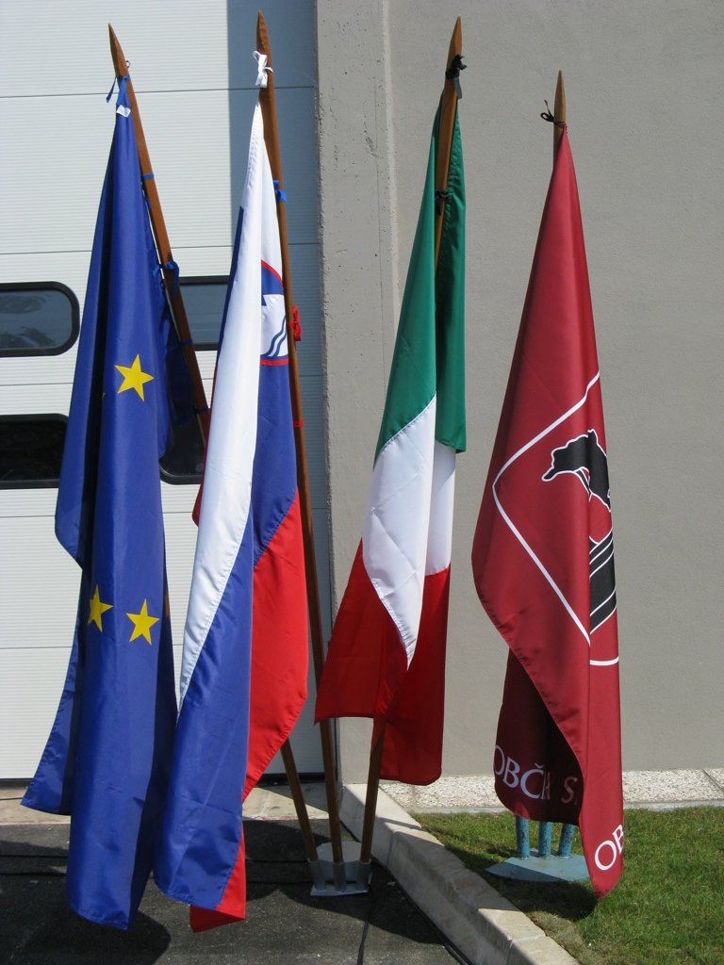
Interaction Research Institutes-Industries

Slide 16
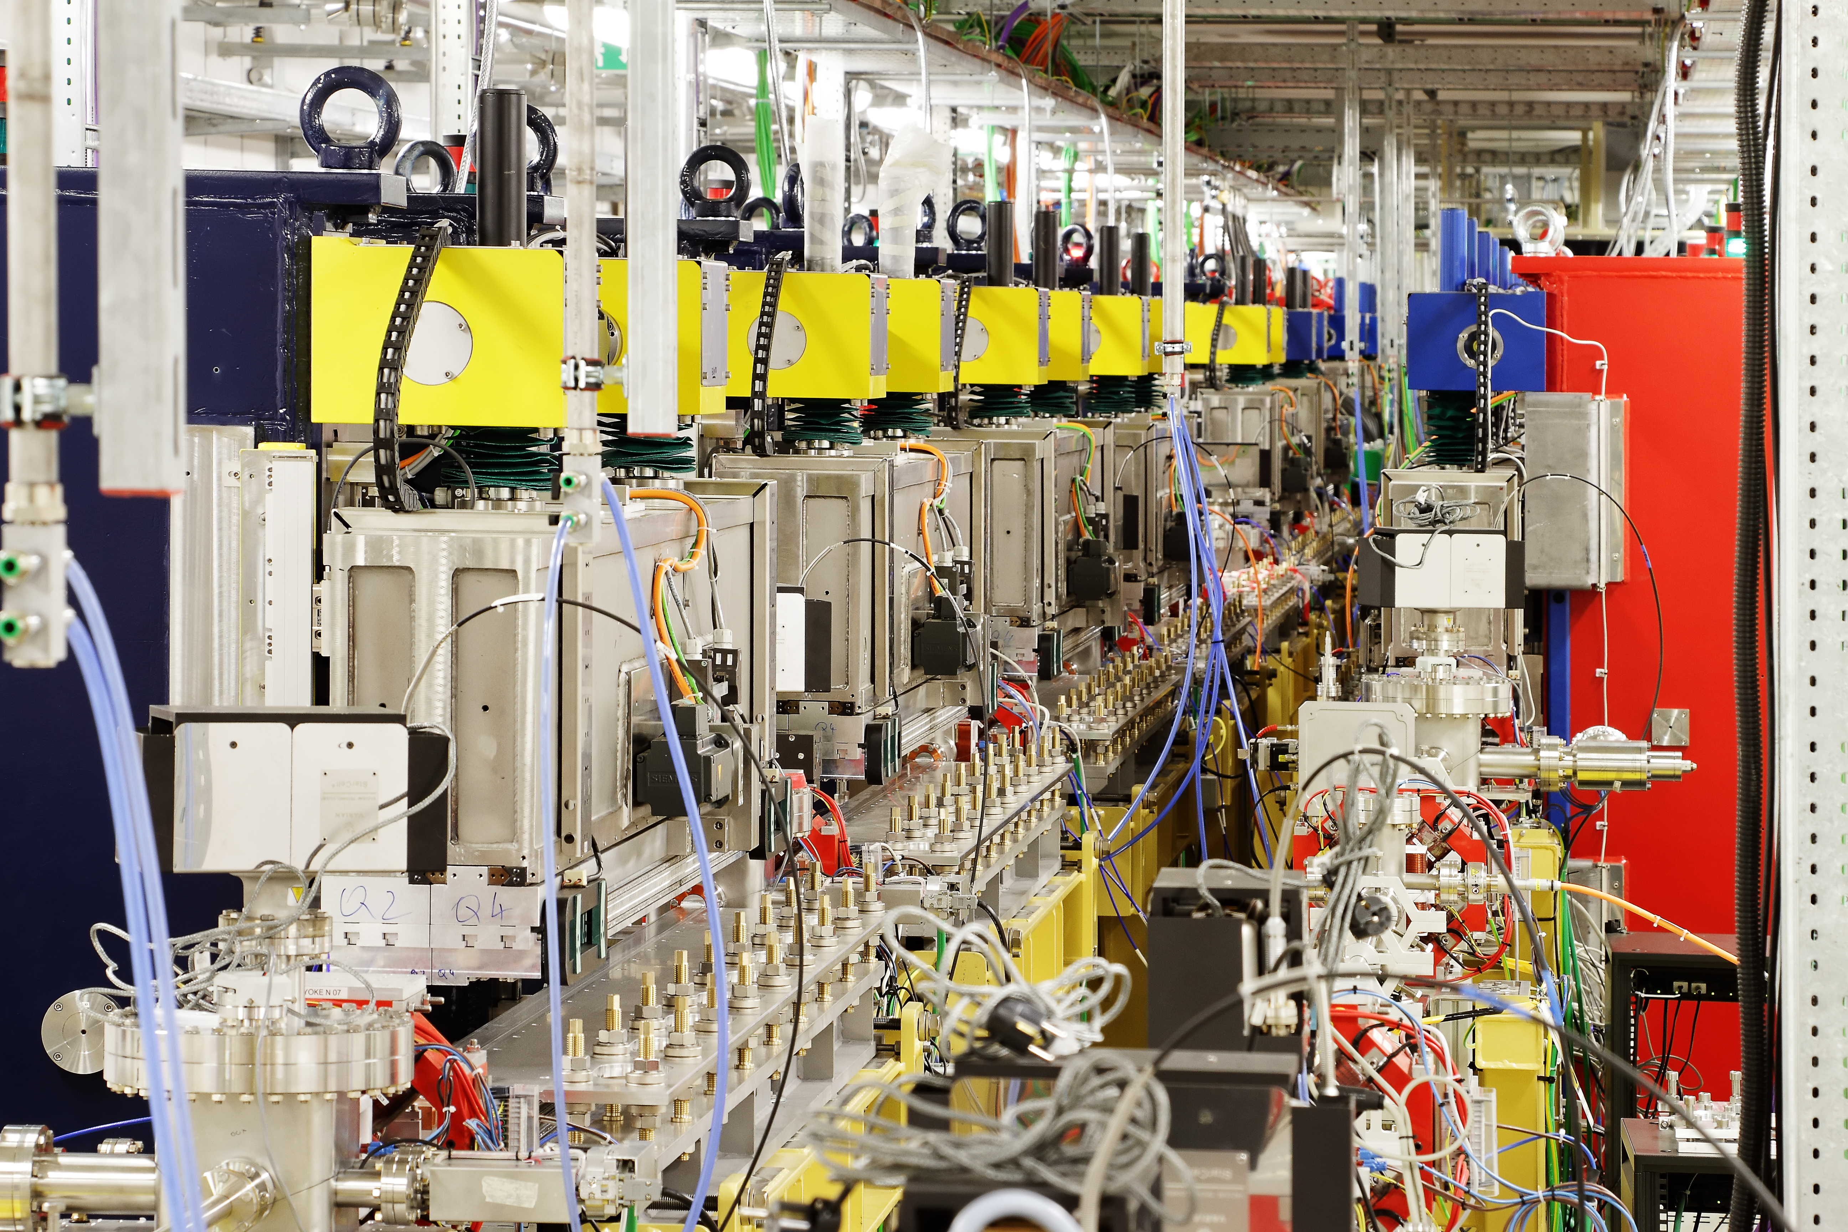

Interaction Research Institutes-Industries

Slide 17
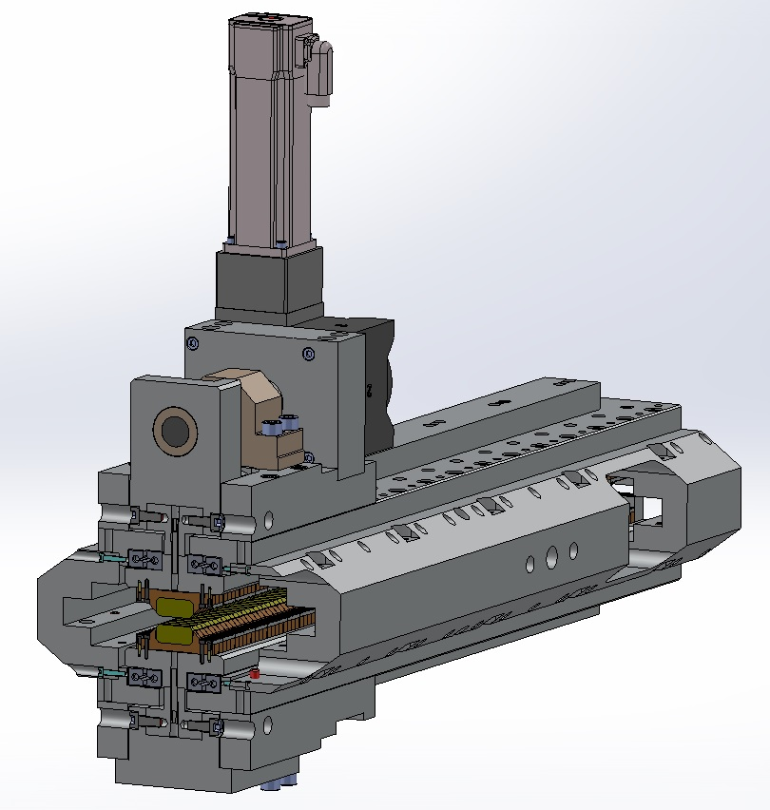

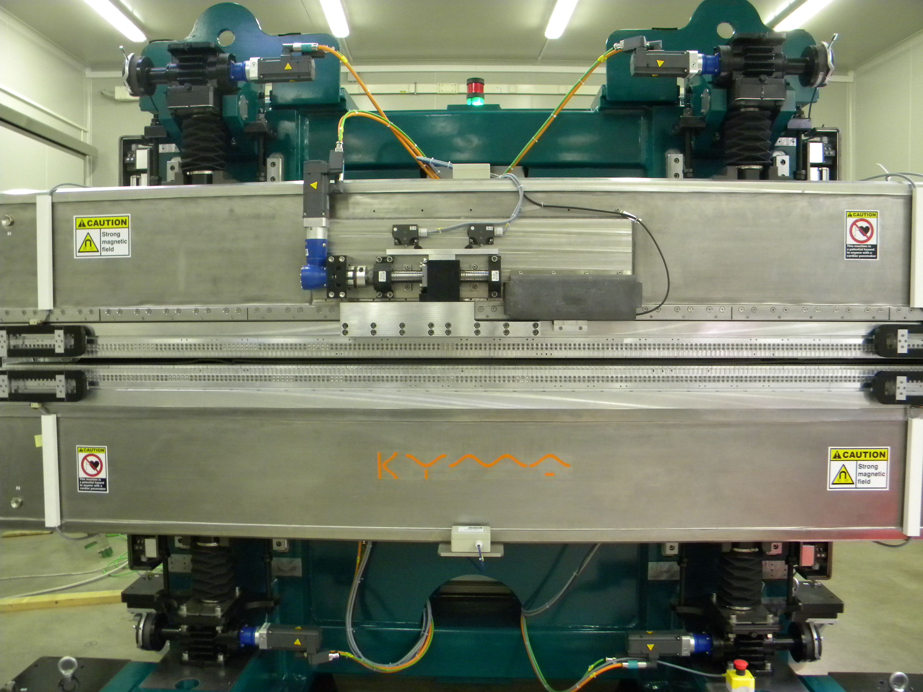
Interaction Research Institutes-Industries
17

Slide 18
Interaction Research Institutes-Industries
Different interaction depending on institutes
  Customer-manufacturer
  R&D collaboration
  Engaging with local industries
  …
18

Slide 19
Interaction Research Institutes-Industries
ISSUES
Complaints from institutes
Delays…
Suggestions from industries:
Procurement rules need revision
  should not win always the cheapest
  most appropriate procedure according to the kind of product
Feedbacks to companies when they are not awarded the contract - lessons learnt useful information for the supplier
IMPROVEMENTS
Communications
Common design reviews
Monthly report (is there anything better?) – web conf?
Quality control / visit to the customer – open companies
Expeditors / Delay management / Project management for making sure there is no line stopping situation
19

Slide 20
Final considerations
First EXPLORATIVE meeting to foster discussion and reflect on how to improve the collaboration between research facilities and industries
Consider:
Technical challenges and required R&D
Industry interests and capabilities
Where technology transfer can happen
How to foster this exchange?
special committees/individuals
(e.g. industry liaison officers)-> in some labs already exist ( Electra, ESRF,..)
Actions:
Workshops/networks - bringing together systems users and industries
Seconded PhD with EU support (Marie Curie netw.)
Use the PACMAN example for univ + lab + company collaboration
PACMAN = a study on Particle Accelerator Components’ Metrology and Alignment to the Nanometre scale, is an Innovative Doctoral Program network founded by the European Commission FP7 Marie Curie Actions, hosted by CERN, providing training to 10 Early Stage Researchers (ESR) all enrolled to PhD studentship programs.
20

Slide 21
  THANK YOU
  for
  your attention
Raffaella Geometrante
raffaella.geometrante@kyma-undulators.eu

