Slide 1
ANAC2
Novel Acceleration Techniques
Glasgow, 28-30 March 2017

Slide 2
Missions of ANAC2
The Anac2 team :
8 contractors, CNRS, DESY, UDUS, HZDR, INFN, LUND, STRATH, UCL+ One invited CERN.
Task 13.1. Coordination and Communication (V. Malka)
• Coordination and scheduling of the WP tasks and WP budget follow-up
• Monitoring the work, informing the project management and participants within the JRA
Task 13.2. Achievement of high brightness electron beam with laser plasma accelerators (O. Lundh)
• Feasibility study of external injection done at INFN and HFZD
• Optical injection done at LOA and LLC
• Two stage laser plasma accelerator done at STRATH
Task 13.3. Ultra-fast accelerator science (H. Schlarb)
• Digital intra-bunch-train feedback for femtosecond arrival-time control of electron bunches
• Determine opportunistic effects causing slow and fast femtosecond bunch arrival time variations at FLASH
• Further improvements of the low level RF regulation system for pulse superconducting accelerators towards
2e-5 field instability
Task 13.4. Modulation of long plasmas (M. Wing)
• Concept for plasma cells for beam acceleration with a length of equal or above 10m
• Understand instabilities and modulations in long plasma, driver and accelerated beam
• Prototyping and development of diagnostics for long plasma cells to be used in CERN experiment testing
proton-driven plasma wakefield acceleration

Slide 3
Missions of ANAC2
The Anac2 team :
8 contractors, CNRS, DESY, UDUS, HZDR, INFN, LUND, STRATH, UCL+ One invited CERN.
Task 13.1. Coordination and Communication (V. Malka)
• Coordination and scheduling of the WP tasks and WP budget follow-up
• Monitoring the work, informing the project management and participants within the JRA
Task 13.2. Achievement of high brightness electron beam with laser plasma accelerators (O. Lundh)
• Feasibility study of external injection done at INFN and HFZD
• Optical injection done at LOA and LLC
• Two stage laser plasma accelerator done at STRATH
Task 13.3. Ultra-fast accelerator science (H. Schlarb)
• Digital intra-bunch-train feedback for femtosecond arrival-time control of electron bunches
• Determine opportunistic effects causing slow and fast femtosecond bunch arrival time variations at FLASH
• Further improvements of the low level RF regulation system for pulse superconducting accelerators towards
2.10⁻⁵ field instability
Task 13.4. Modulation of long plasmas (M. Wing)
• Concept for plasma cells for beam acceleration with a length of equal or above 10m
• Understand instabilities and modulations in long plasma, driver and accelerated beam
• Prototyping and development of diagnostics for long plasma cells to be used in CERN experiment testing
proton-driven plasma wakefield acceleration

Slide 4
Task 13.1. Coordination and Communication: Summary
Publication of 48 scientific papers
21 publications in refereed journals in 2016-2017
1 International workshop LPAW in Guadeloupe in 2015
2 PhD prizes (John Dawson)
4 communications in H2020 portal
1 communication in Accelerator News
6 ANAC2 meetings

Slide 5
Missions of ANAC2
The Anac2 team :
8 contractors, CNRS, DESY, UDUS, HZDR, INFN, LUND, STRATH, UCL+ One invited CERN.
Task 13.1. Coordination and Communication (V. Malka)
• Coordination and scheduling of the WP tasks and WP budget follow-up
• Monitoring the work, informing the project management and participants within the JRA
Task 13.2. Achievement of high brightness electron beam with laser plasma accelerators (O. Lundh)
• Feasibility study of external injection done at INFN and HFZD
• Optical injection done at LOA and LLC
• Two stage laser plasma accelerator done at STRATH
Task 13.3. Ultra-fast accelerator science (H. Schlarb)
• Digital intra-bunch-train feedback for femtosecond arrival-time control of electron bunches
• Determine opportunistic effects causing slow and fast femtosecond bunch arrival time variations at FLASH
• Further improvements of the low level RF regulation system for pulse superconducting accelerators towards
2e-5 field instability
Task 13.4. Modulation of long plasmas (M. Wing)
• Concept for plasma cells for beam acceleration with a length of equal or above 10m
• Understand instabilities and modulations in long plasma, driver and accelerated beam
• Prototyping and development of diagnostics for long plasma cells to be used in CERN experiment testing
proton-driven plasma wakefield acceleration

Slide 6


Conundrum: What happens to the laser energy in a LWFA?
100s keV electrons in backward direction
1-2 MeV beam with 10s nC in forward direction in a 30-40° opening angle
1-10 MeV, 5-10 nC beam fills the cone – forming a halo around the higher energy (100s MeV) beam
1 J, 30 fs laser
Up to 50% delivered to plasma wave
5-10% of laser energy transferred to side electrons
0.1 – 1 ps bunch duration
Peak current can be extremely high (>10 kA)
Consequences for capillary staged LWFA
laser
High energy electrons
Depleted laser
plasma
X. Yang, E. Brunetti et al., Scientific Reports 2017

Slide 7
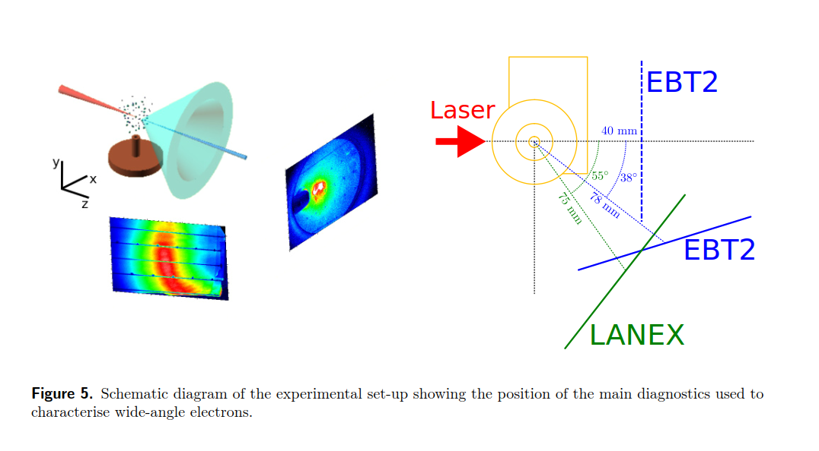
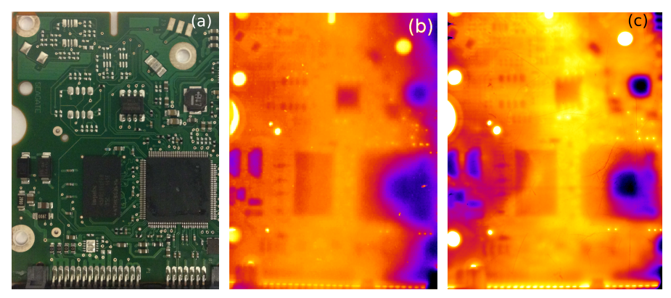
Side electron experiment: energy spectra and imaging
Hard disk controller
imaging
20 shots
1 shot
Easy to mistake high charge, oblique angled beams from injected beams – Halo can have quite high energy.

Slide 8
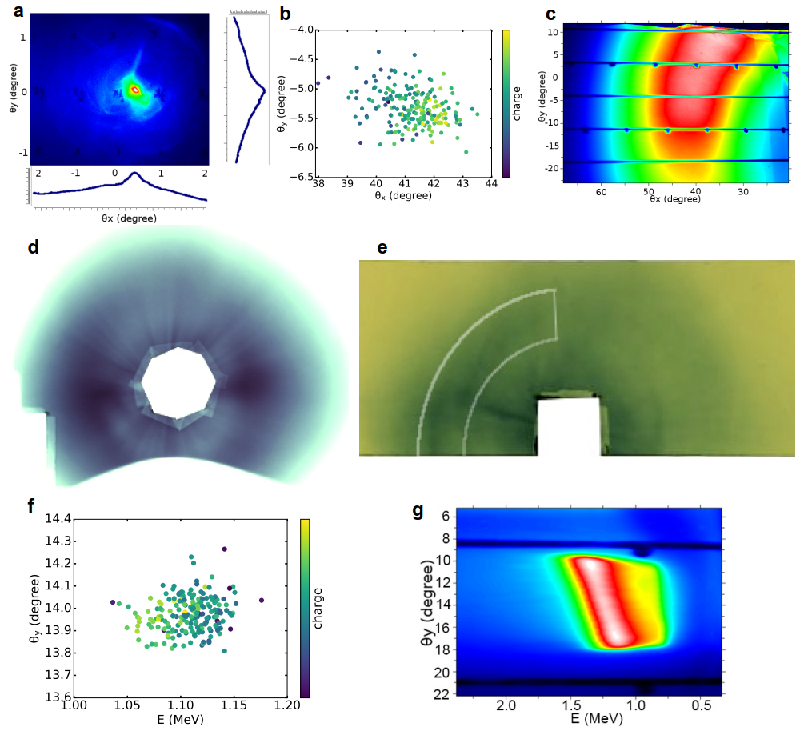
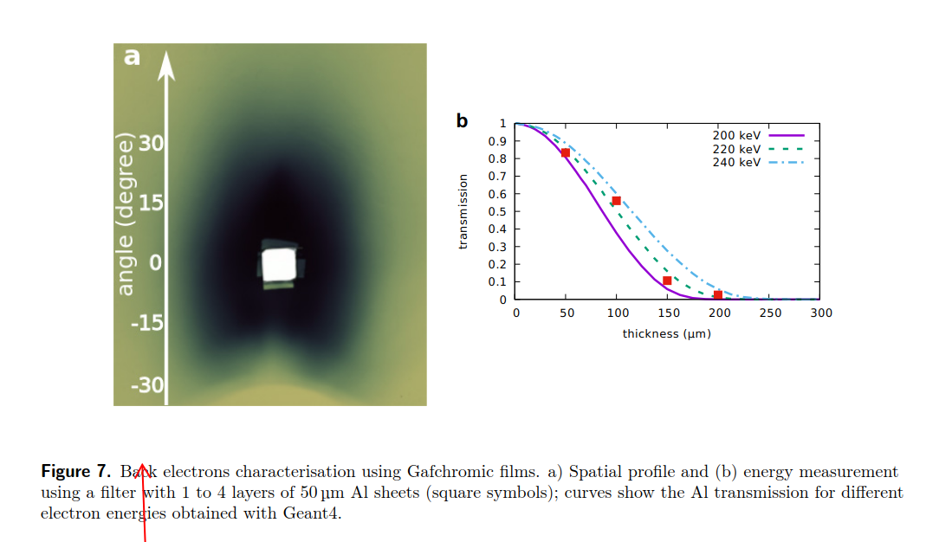
Experimental results
Backward electrons
Forward direction
Emission angle
200 shot accumulation
70 shot accumulation
Single shot
Mean energy vs angle
200 shots
Backward electrons distribution
Backward electrons energy measurement

Slide 9
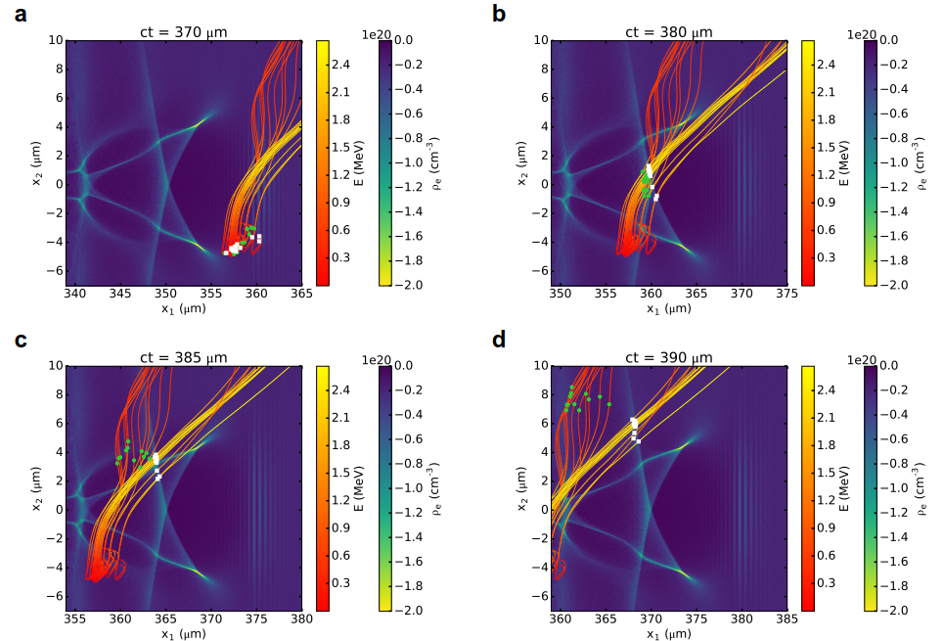
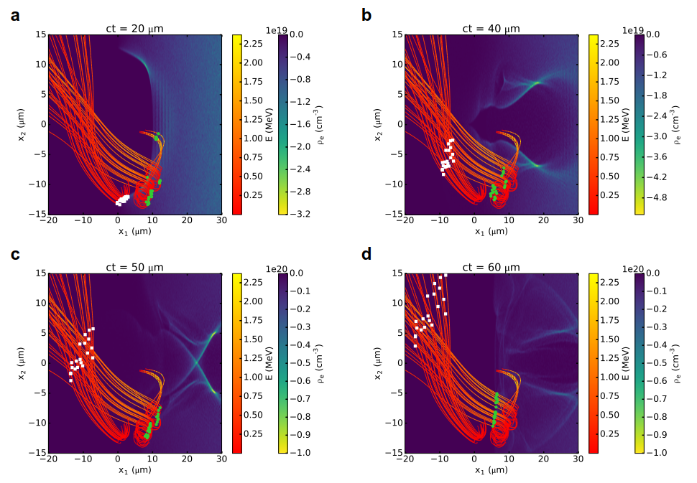
Snapshots of oblique angle and backward beams
Backward electrons
Backward beams
Oblique beams

Slide 10
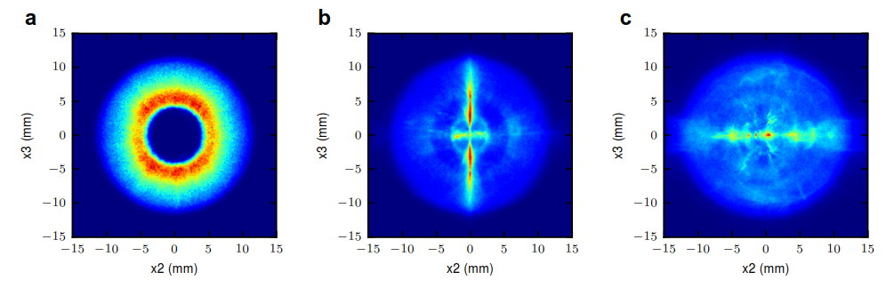
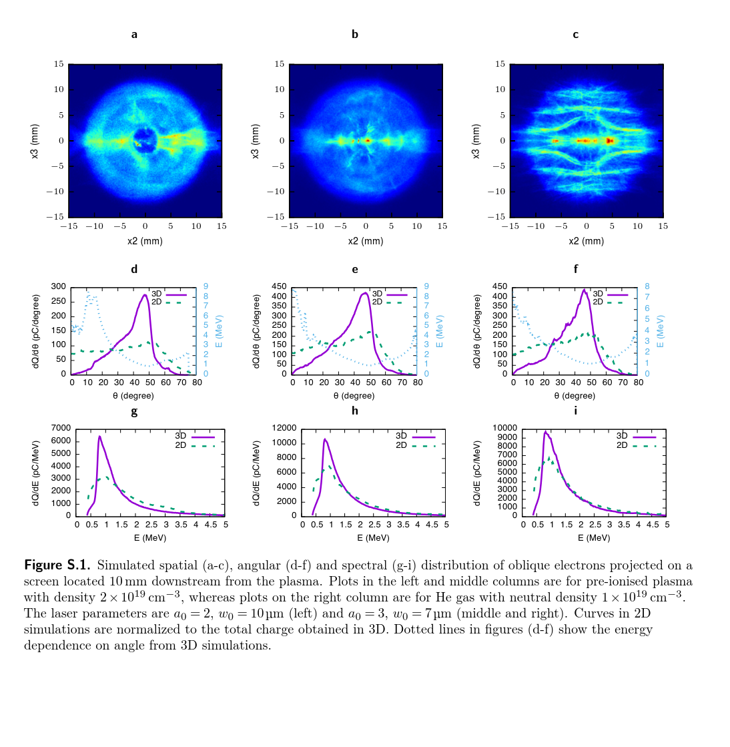
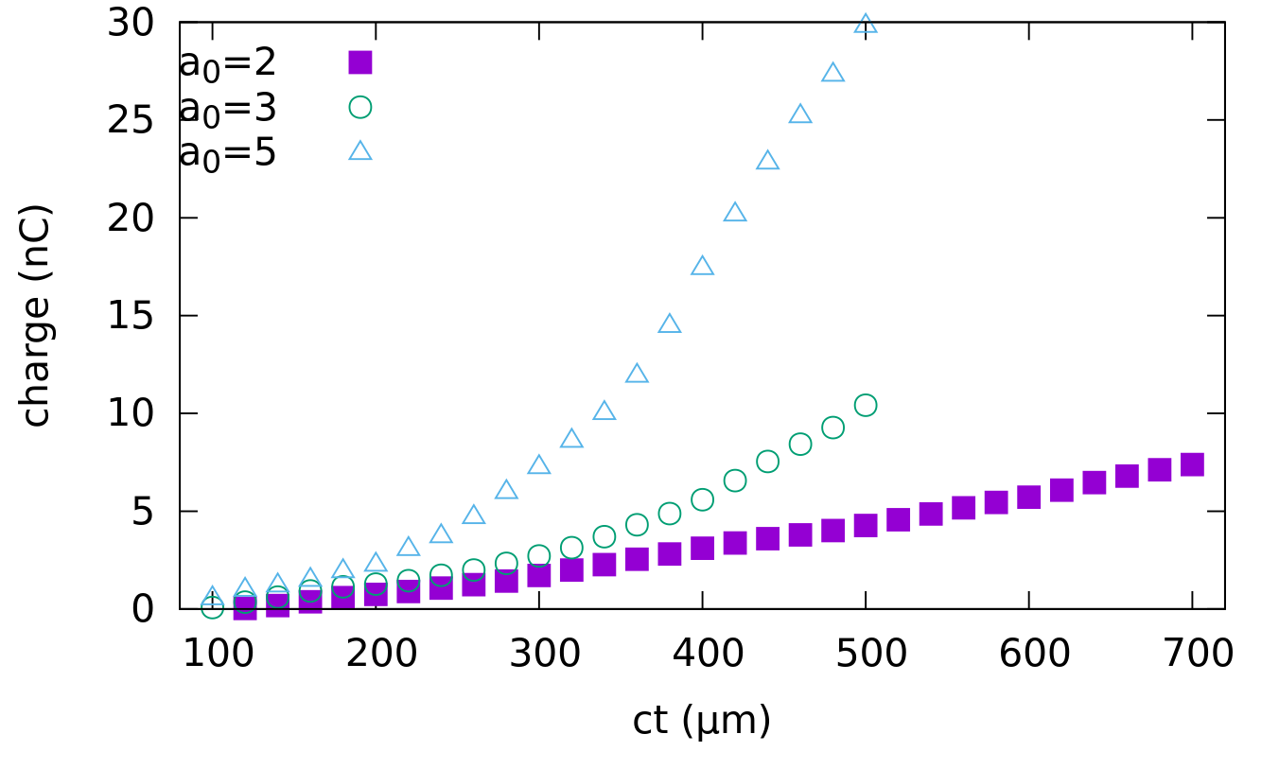
Snapshots of oblique angle and backward beams
Backward electrons
LHS: a₀ = 2; w₀ = 5 μm
Centre: a₀ = 2; w₀ = 7μm
RHS: a₀ = 3; w₀ =7 μm
LHS: a₀ = 2; w₀ = 5 μm
Centre: a₀ = 2; w₀ = 7μm
RHS: a₀ = 3; w₀ =7 μm
LHS & centre: 2x10¹⁹ cm⁻³
RHS: 10¹⁹ cm⁻³
Laser parameters
LHS a₀ = 2; w₀ = 10 μm
Centre & RHS:
a₀ = 3, w₀ = 7 μm

Slide 11
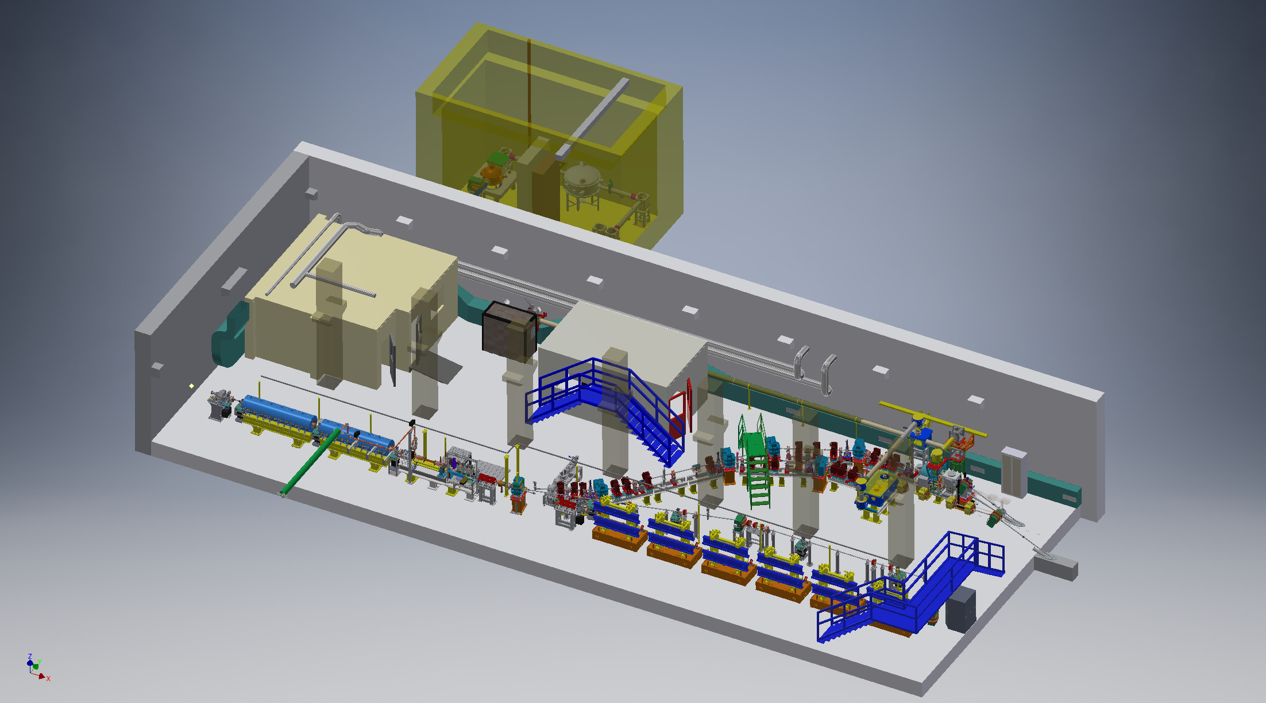
WP13.2 SPARC-INFN
Activity
Self-LWFA
TNSA
Thomson
Ext-LWFA
THz
PWFA
EOS
FEL

Slide 12
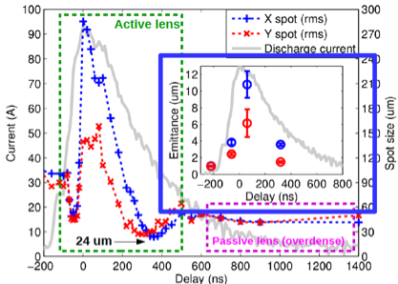
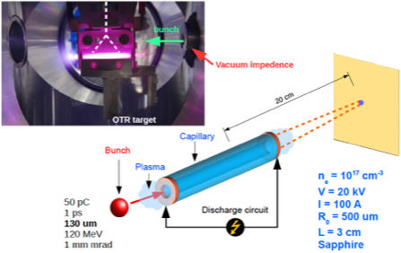
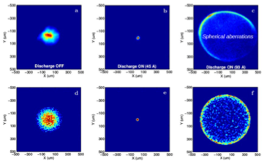
Active Plasma Lens
Discharge current in a gas-filled capillary
The bunch is focused by the azimuthal magnetic field generated by the discharge current, according to Ampere’s law
R. Pompili et al., Appl. Phys. Lett. 110, 104101 (2017)
Notes:
Active plasma lens experimental layout. The beam passes through the discharge-capillary and is then imaged on the screen downstream. The bunch is produced by the SPARC photo-injector, consisting in a 1.6 cell RF-gun followed by two accelerating sections embedded by solenoids coils. The results we report have been obtained with a 50 pC bunch at 126 MeV energy (50 keV energy spread), 1 mm mrad normalized emittance and 1.1 ps rms duration. The capillary consists in a sapphire hollow tube of 1 mm diameter, 30 mm long, filled at 1 Hz rate by H2 gas through two inlets. The pulsed operation allows maintaining the vacuum level as low as 10-8 mbar in the RF linac while flowing H2. Two electrodes, placed on each end of the capillary, are connected to a 20 kV generator producing up to 100 A peak discharge current. The arrival time of the electron beam is scanned with respect to the discharge pulse in order to change the active plasma lens focusing as shown in Fig. 2. With the discharge turned off at 0 ns, the unperturbed beam has a spot size of 90 um. By turning the discharge on, the beam is focused down to 24 um at about 300 ns.
Images recorded on the first screen downstream the capillary with the discharge turned off (σ ≈ 90 um, a) and on, at ID ≈ 45 A (σ ≈ 24 um, b) and ID ≈ 93 A (σ ≈ 280 um, c). (d-f) Simulated transverse profiles obtained on the same screen with the combined use of the GPT and Architect codes.

Slide 13
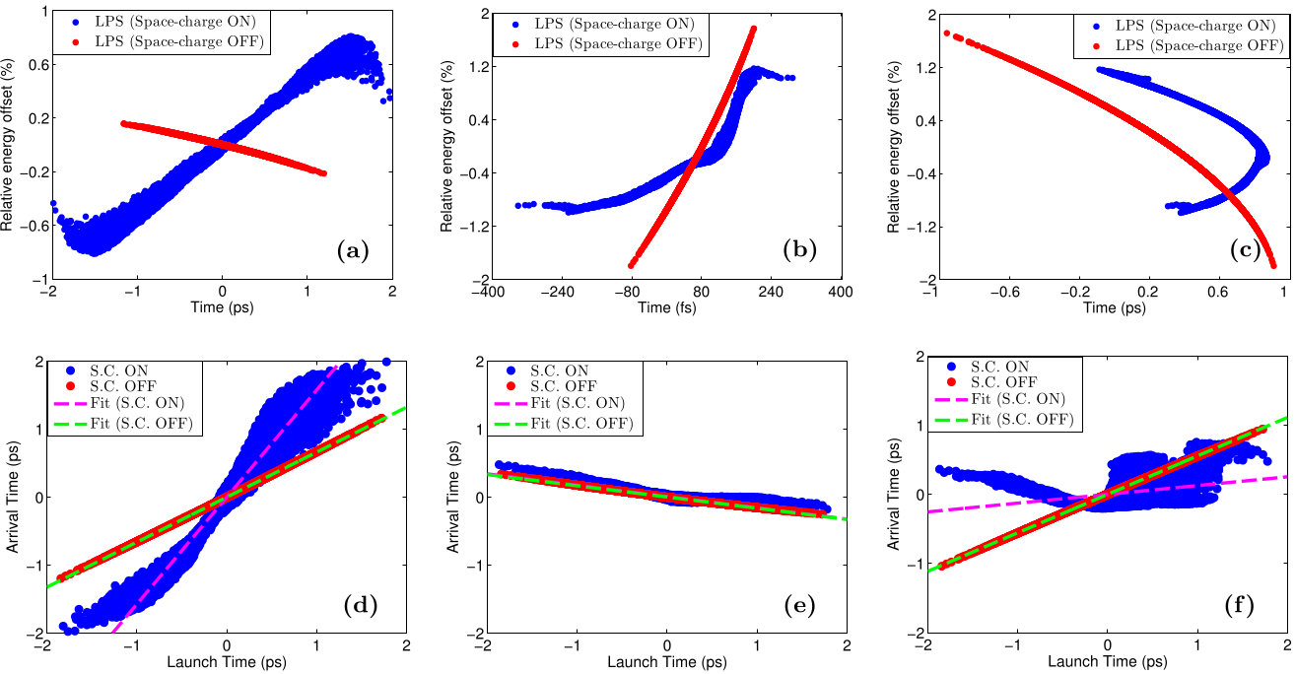
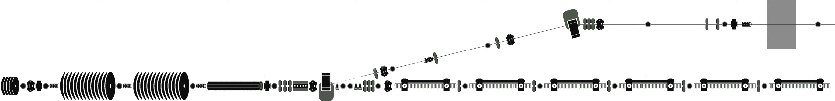
RF + magnetic hybrid compression scheme to minimize laser-bunch timing jitter
Ultra-short bunches with ultra-low jitter wrt photo-cathode laser pulses
  Seeded FELs
  External injection in laser-driven plasmas
RF compression (linac)
Jitter chirp
Photo-cathode
laser
Bunch chirp
~ 60 fs laser-bunch
timing-jitter
Bunch chirp
Jitter chirp
Velocity Bunching compression
launch time
vs
arrival time
timing linked to compressor (RF)
→ launch – arrival time correlation ~ 0
launch time
vs
arrival time
Notes:
The hybrid compression scheme allows to produce ultra-short bunches with ultra-low timing-jitters relative to the photo-cathode laser. It consists in two compression stages; the first one is performed at low energy with Velocity Bunching along the linac. The second one happens in a dogleg beamline through magnetic compression. Once emitted from the RF gun, the bunch is long and its timing is mainly linked to the photo-cathode laser (i.e. its relative timing jitter is very small). During VB the bunch is over-compressed and acquires a positive linear chirp. At the linac exit the compressed bunch has a larger relative timing-jitter because its timing is now mainly linked to the RF compressor, but a little correlation with the laser is still preserved. At this point we exploit the dogleg in order to continue the bunch compression and restore the correlation of the bunch timing to the photo-cathode laser timing. As a result we obtained a bunch duration <90 fs with <20 fs relative timing-jitter.

Slide 14
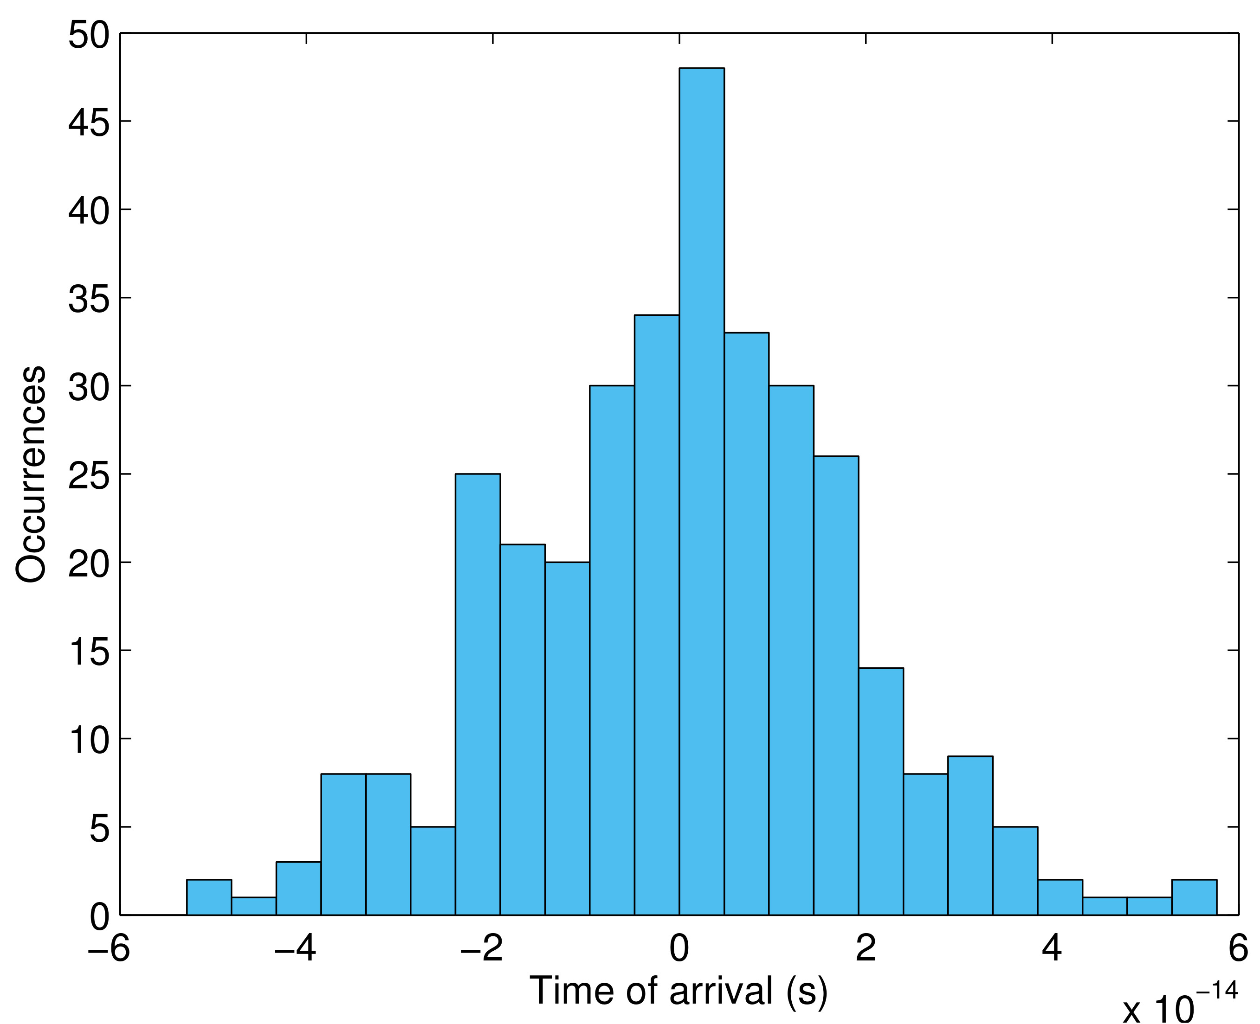
RF + magnetic hybrid compression scheme to minimize laser-bunch timing jitter
Photo-cathode laser
Magnetic compression
(dogleg)
VB compression
EOS
timing relinked to PC laser
Hybrid compression: bunch shortening and relative jitter reduction
Pompili, R., et al. "Femtosecond timing-jitter between photo-cathode laser and ultra-short electron bunches
by means of hybrid compression." New Journal of Physics 18.8 (2016): 083033.
EOS
80 fs bunch
19 fs jitter
Jitter chirp
Bunch chirp
→ launch time- arrival time correlation ~1
Notes:
The second one happens in a dogleg beamline through magnetic compression. Once emitted from the RF gun, the bunch is long and its timing is mainly linked to the photo-cathode laser (i.e. its relative timing jitter is very small). During VB the bunch is over-compressed and acquires a positive linear chirp. At the linac exit the compressed bunch has a larger relative timing-jitter because its timing is now mainly linked to the RF compressor, but a little correlation with the laser is still preserved. At this point we exploit the dogleg in order to continue the bunch compression and restore the correlation of the bunch timing to the photo-cathode laser timing. As a result we obtained a bunch duration <90 fs with <20 fs relative timing-jitter.

Slide 15
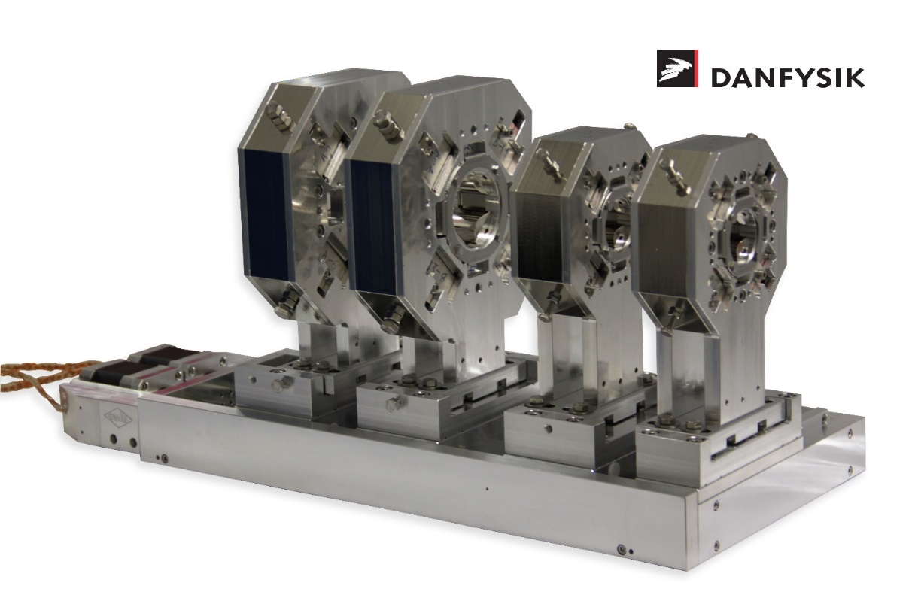
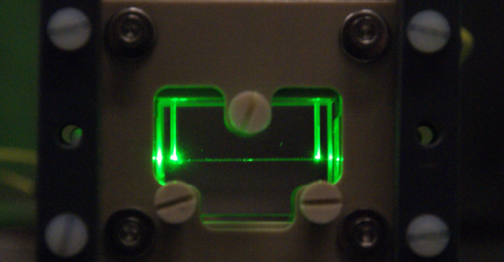
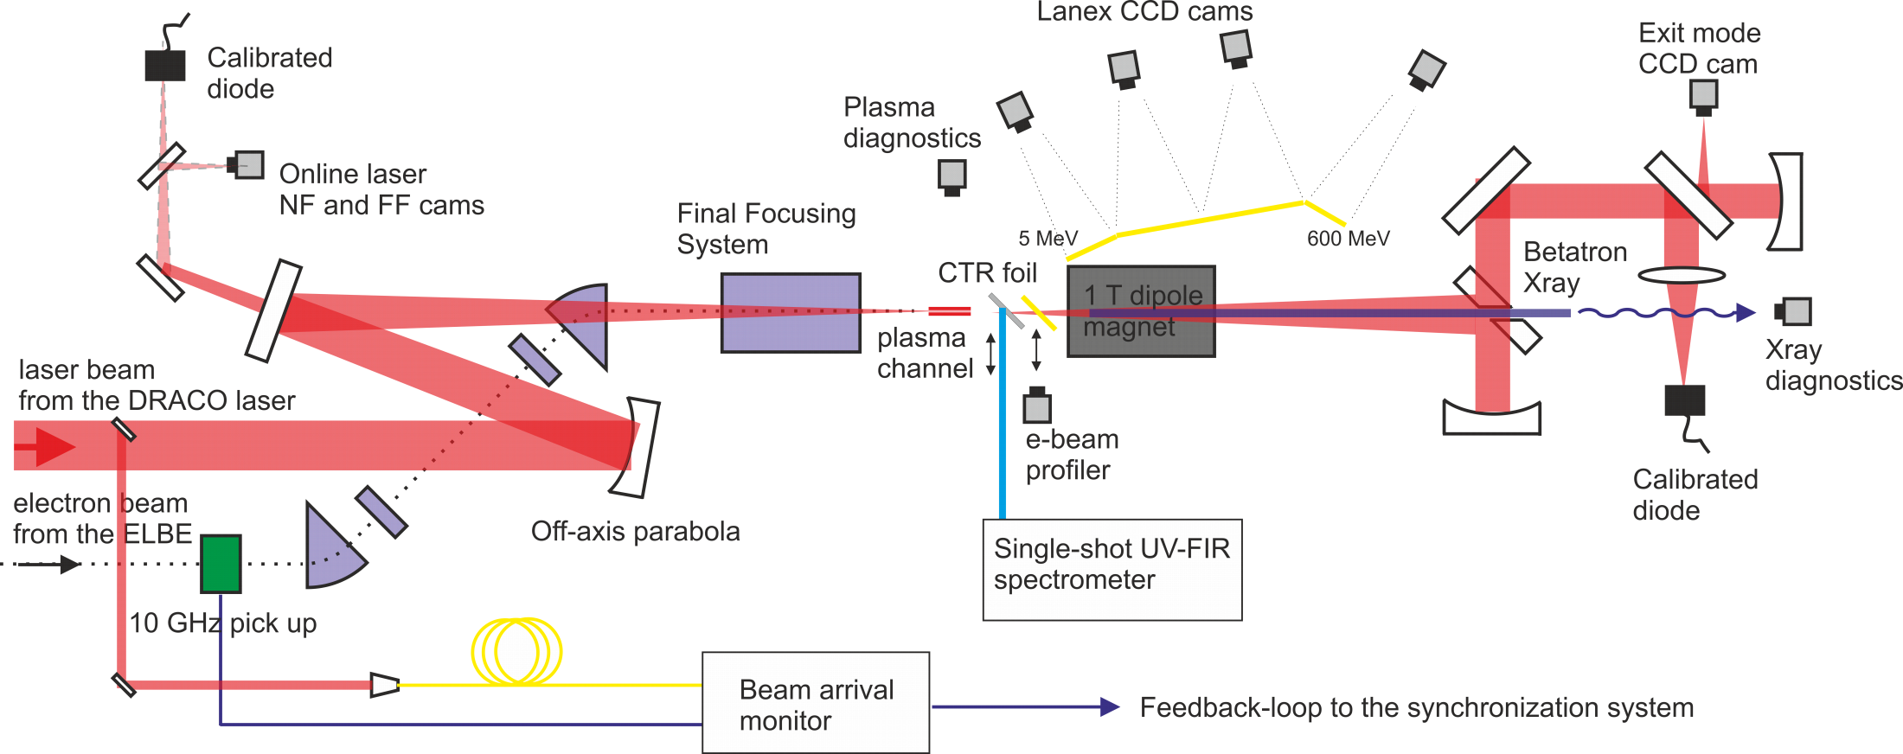
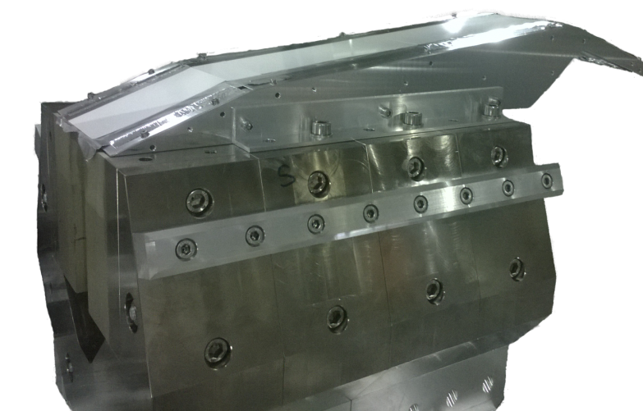
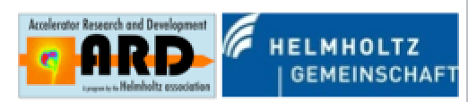
LWFA with external
bunch injection
20 cm
40 cm

Slide 16
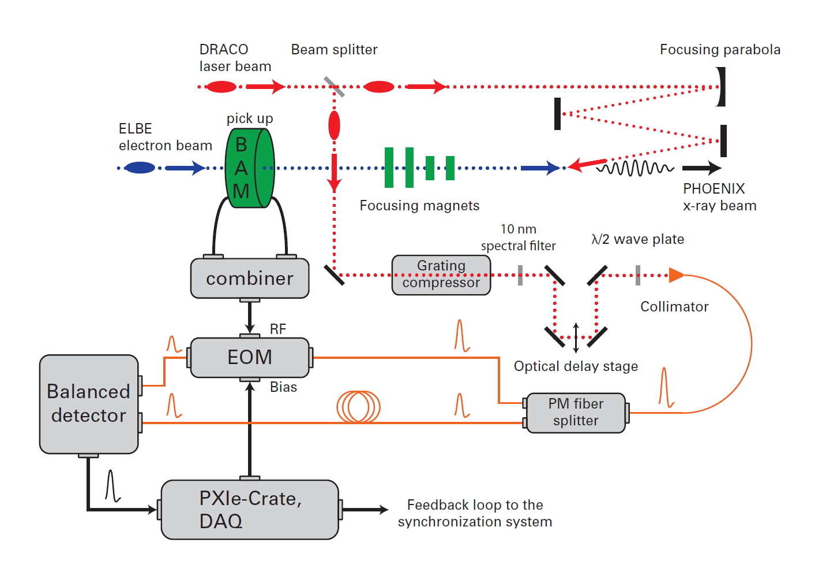
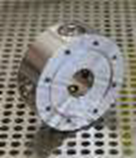
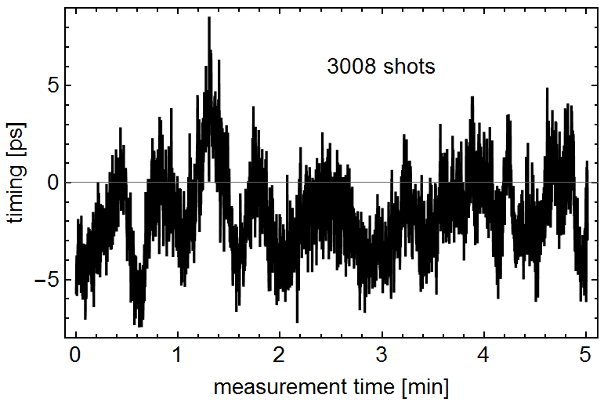
Single-shot beam arrival monitor
Measurement of single-shot arrival time jitter
ELBE beam and Draco laser beam on target
Resolution <200fs
Arrival time jitter : 2.2 ps (RMS)
Mean shot-to-shot jitter: 1.4 ps
Mainly caused by the thermionic injector

Slide 17
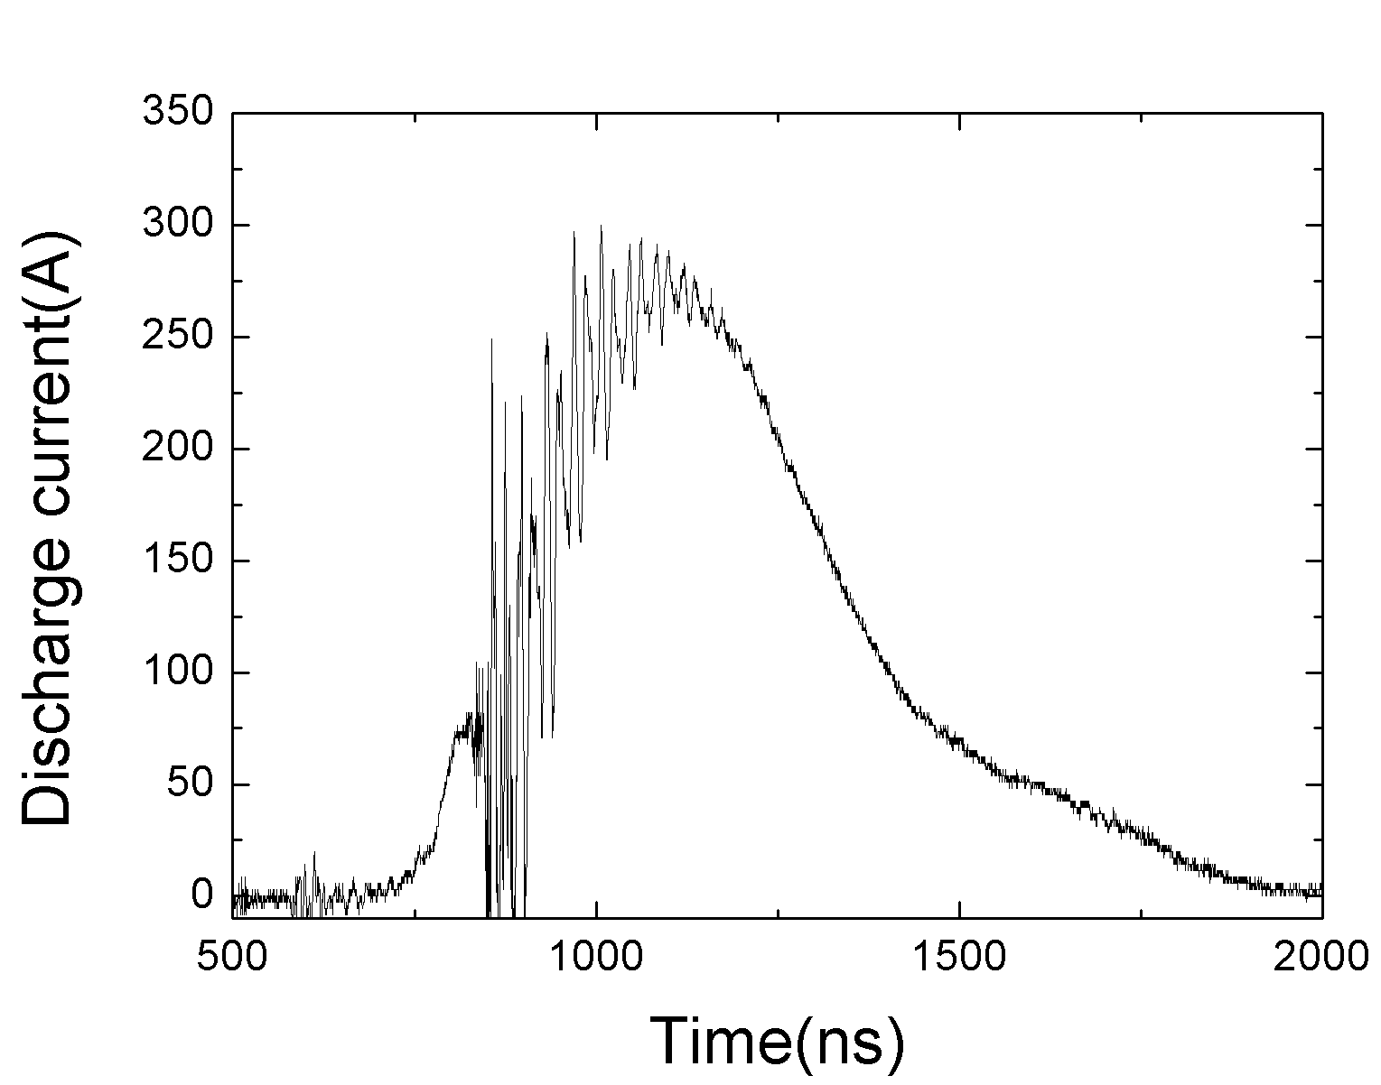
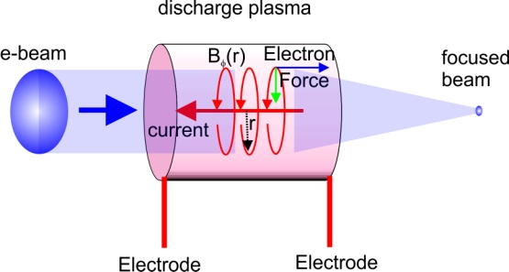




ELBE electron beam guiding
in plasma channel
Final focusing
system
CCD cam
Capillary
discharge
Lanex screen
(a)
(b)
23 MeV ELBE
Electron beam
Act like a lens
Electron beam spot on lanex versus injection delay with respect to the discharge current
(a)
(b)
(c)
(d)

Slide 18
Missions of ANAC2
The Anac2 team :
8 contractors, CNRS, DESY, UDUS, HZDR, INFN, LUND, STRATH, UCL+ One invited CERN.
Task 13.1. Coordination and Communication (V. Malka)
• Coordination and scheduling of the WP tasks and WP budget follow-up
• Monitoring the work, informing the project management and participants within the JRA
Task 13.2. Achievement of high brightness electron beam with laser plasma accelerators (O. Lundh)
• Feasibility study of external injection done at INFN and HFZD
• Optical injection done at LOA and LLC
• Two stage laser plasma accelerator done at STRATH
Task 13.3. Ultra-fast accelerator science (H. Schlarb)
• Digital intra-bunch-train feedback for femtosecond arrival-time control of electron bunches
• Determine opportunistic effects causing slow and fast femtosecond bunch arrival time variations at FLASH
• Further improvements of the low level RF regulation system for pulse superconducting accelerators towards
2.10⁻⁵ field instability
Task 13.4. Modulation of long plasmas (M. Wing)
• Concept for plasma cells for beam acceleration with a length of equal or above 10m
• Understand instabilities and modulations in long plasma, driver and accelerated beam
• Prototyping and development of diagnostics for long plasma cells to be used in CERN experiment testing
proton-driven plasma wakefield acceleration

Slide 19


WP13.3 DESY Final Results
H. Schlarb, S. Pfeiffer, M. Fakhari (Machine Beam Controls, DESY)
  Goal/Question to be addressed:
  What is the ultimate time stability reached in large scale accelerators?
Studies at the Free-electron Laser in Hamburg
Ultra-fast beam-based feedbacks for arrival time stabilization (micro-second bunch spacing)
  including bunch arrival time (BAM) and compression feedback (BCM)
⇒ key feature of all linear Superconducting RF accelerators
Laser
R56=180mm
R56=43mm
~
BC3
~
R56=0.8mm
Gun
ACC1
3rd
BC2
ACC2
ACC3
ACC4
ACC7
FLASH 1
A φ
A φ
BAM
BCM
BAM
BCM
LLRF
LLRF
LLRF
BAM
FLASH 3
FLASH 2
Notes:
Here its important to mention that the facility is operated with micro-second bunch spacing with hundreds of electron bunches which allows setting up a fast feedback system acting from bunch to bunch. By this the bunch arrival time and bunch compression can be minimized towards the sensor resolution.

Slide 20
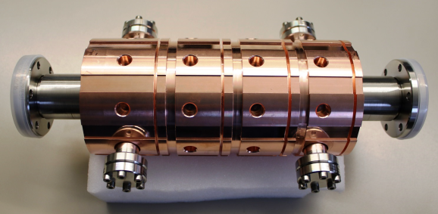
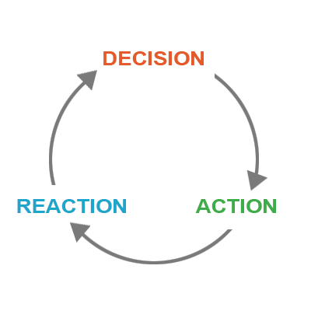
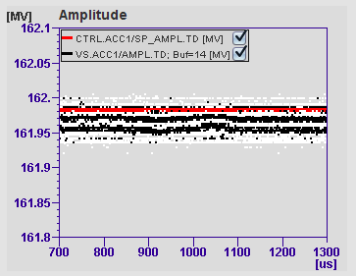
WP13.3 DESY Final Results
Working plan
Design a normal conducting energy corrector cavity
  Special requirements (frequency mode separation, adjustable half bandwidth, field flatness)
Design the signal chain (feedback loop) to drive the cavity
  MicroTCA.4 based electronics
  High power amplifier driving the cavity
Fast fiber-link communication between the sensor (bunch arrival time monitor) and the actuator (cavity) – mandatory for fast feedback
Additional developments/considerations
  Precise temperature regulation (essential for all normal conducting RF cavities)
  Digital LLRF regulation improvement towards bit level
Notes:
These are the steps which were necessary to reach the goal.

Slide 21

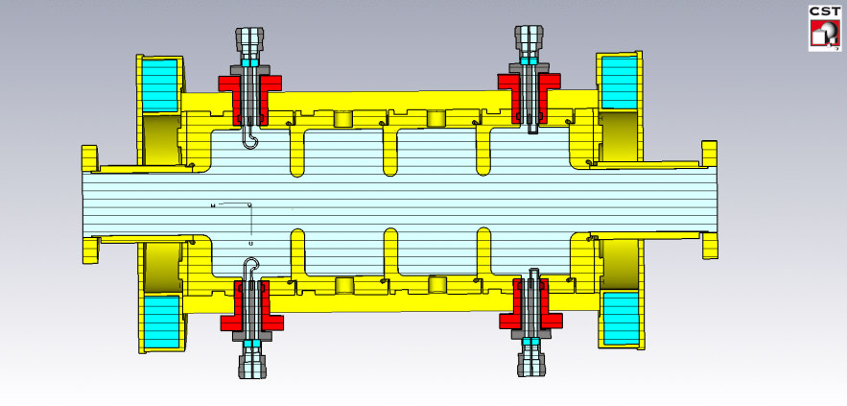
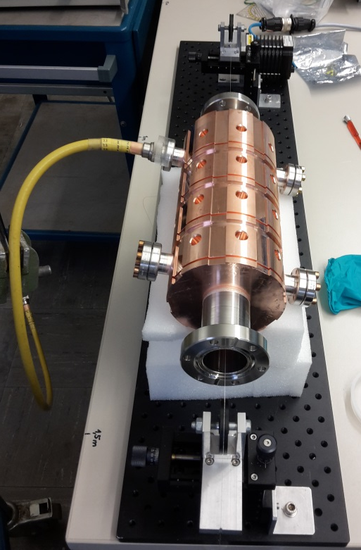
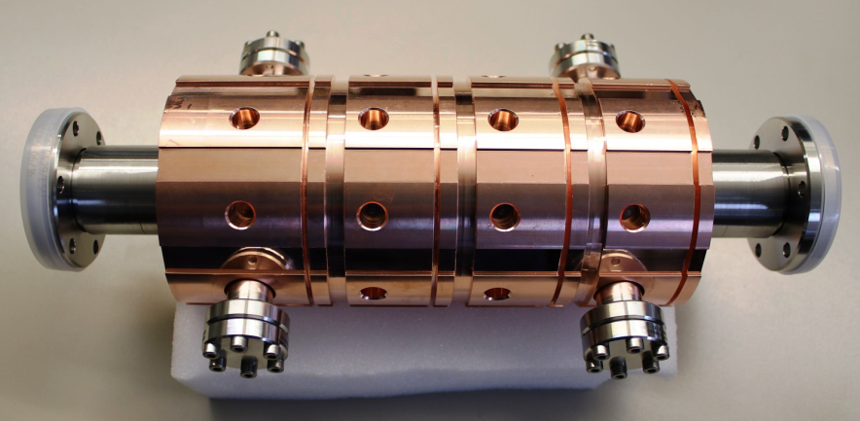
WP13.3 DESY Final Results
Normal conducting RF Cavity
Cavity design completed
Cavity production – finished
Measurements performed with network analyzer and applying bead-pull method
Some main results will be outlined.
Notes:
The normal conducting cavity was designed for the needs of a fast feedback system. Next it was produced and fully characterized using the bead-pull method where a small metal bead is pulled through the cavity using a thread. This perturb the frequency and shifts the resonant frequencies of the cavity which is tracked, recorded and used for the analysis.

Slide 22
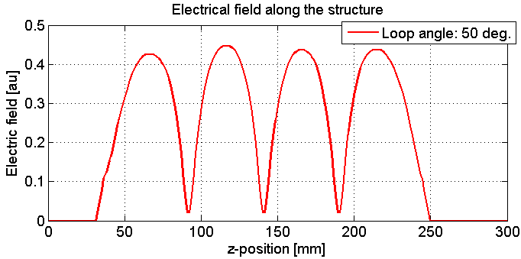


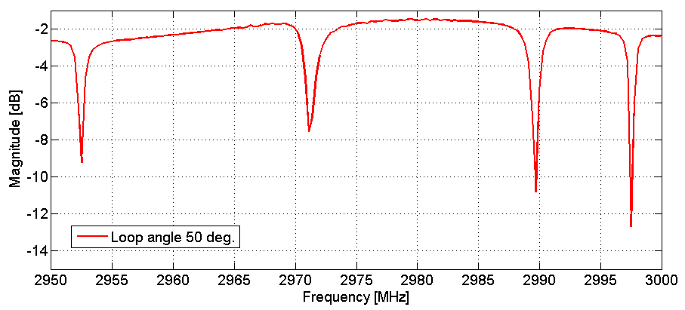
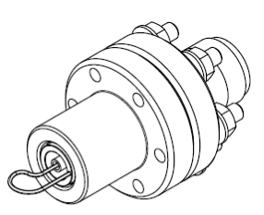
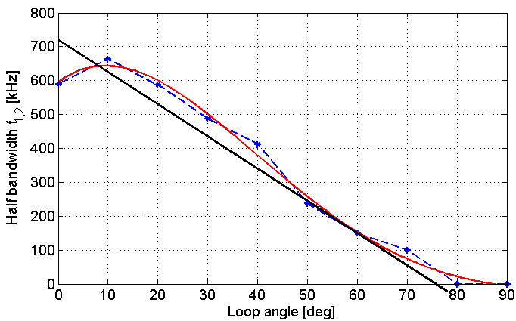
WP13.3 DESY Final Results
Mode separation of the 4 resonant modes
Only pi-mode is used for acceleration; the other should be shifted towards higher frequencies
RF field distribution
As expected flat along the structure
8MHz
26MHz
Half bandwidth as function of input loop
Measured max. half bandwidth of 650 kHz (required: 400 kHz to 500 kHz)
45MHz
The measurement results match the simulation. A slight difference is present which will not affect its operation.
Notes:
Some more comments added to the mode separation.
The RF field distribution should be as flat as possible such that the electrons gain enough energy.
The half bandwidth of the cavity need to be adjustable. The measurement shows its behavior as function of the input loop rotation. The required bandwidth is achieved.

Slide 23
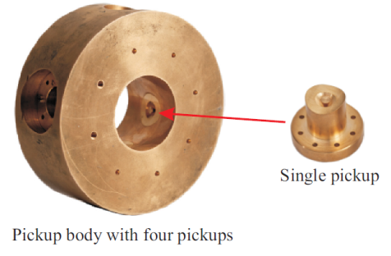
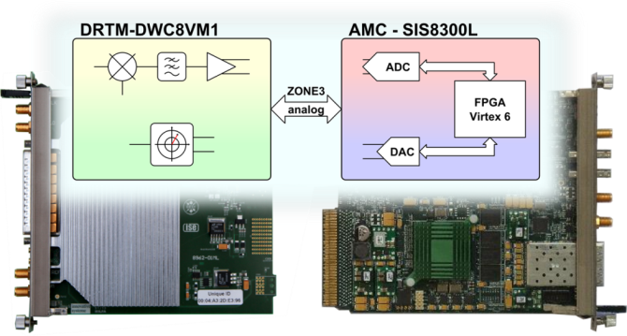
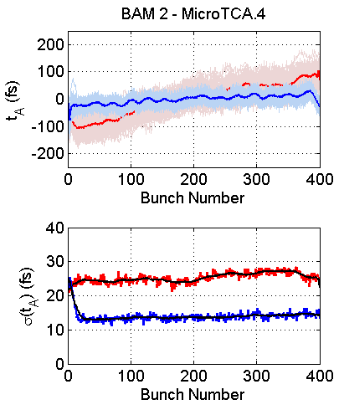
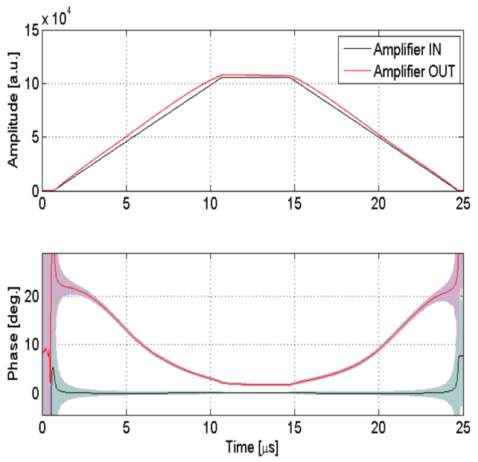

WP13.3 DESY Final Results
Fast optical communication; Tested by revival of beam-based feedback using SRF modules
Bunch arrival time monitor as sensor
All sub-components within the feedback loop were evaluated and measured
LLRF system driving the cavity
Non-linear amplifier behavior → correctable in digital system
NRF cavity as actuator
Notes:
All sub-components within the feedback loop were evaluated and measured.
The sensor, i.e. the bunch arrival time monitor, must be connected by a fast link, here optical fiber link, to the LLRF system which drives the cavity.
The LLRF drive signal is amplified from watt to kilo-watt level. This amplifier was characterized and it shows a non-linear behavior which is correctable by the digital LLRF system.
At the end the cavity is supplied with the high power and controls the arrival time of the electrons by correcting their energy.

Slide 24

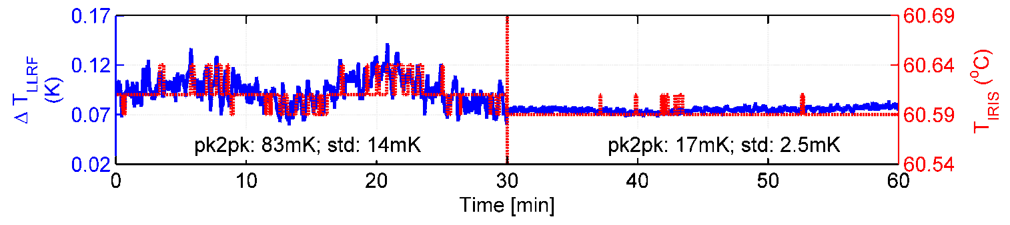
WP13.3 DESY Final Results
Precise temperature control for NRF cavities
  Essential for all NRF cavities due to limited feedback gain
Without high precision feedback
With high precision feedback
Temperature improvement
14 mK → 2.5 mK
Accepted for publication in PRST-AB
Deliverable D13.5 (04/2017) - currently finalizing the report
“FLASH NRF cavity and FB system: Report on the achievable arrival time stability and the limitations of using NRF & SRF beam-based feedbacks at FLASH”
Notes:
Beside those activities we improved several sub-systems like the temperature of the RF gun.
A precise temperature regulation is essential for all normal conducting cavities since those also affects the bunch arrival time.
We improved the temperature stability of the gun by a factor of about 6 using an advanced regulation scheme.

Slide 25
Missions of ANAC2
The Anac2 team :
8 contractors, CNRS, DESY, UDUS, HZDR, INFN, LUND, STRATH, UCL+ One invited CERN.
Task 13.1. Coordination and Communication (V. Malka)
• Coordination and scheduling of the WP tasks and WP budget follow-up
• Monitoring the work, informing the project management and participants within the JRA
Task 13.2. Achievement of high brightness electron beam with laser plasma accelerators (O. Lundh)
• Feasibility study of external injection done at INFN and HFZD
• Optical injection done at LOA and LLC
• Two stage laser plasma accelerator done at STRATH
Task 13.3. Ultra-fast accelerator science (H. Schlarb)
• Digital intra-bunch-train feedback for femtosecond arrival-time control of electron bunches
• Determine opportunistic effects causing slow and fast femtosecond bunch arrival time variations at FLASH
• Further improvements of the low level RF regulation system for pulse superconducting accelerators towards
2.10⁻⁵ field instability
Task 13.4. Modulation of long plasmas (M. Wing)
• Concept for plasma cells for beam acceleration with a length of equal or above 10m
• Understand instabilities and modulations in long plasma, driver and accelerated beam
• Prototyping and development of diagnostics for long plasma cells to be used in CERN experiment testing
proton-driven plasma wakefield acceleration

Slide 26
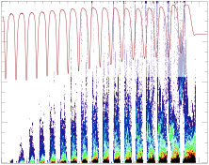
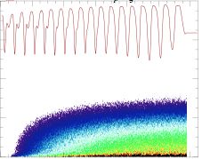
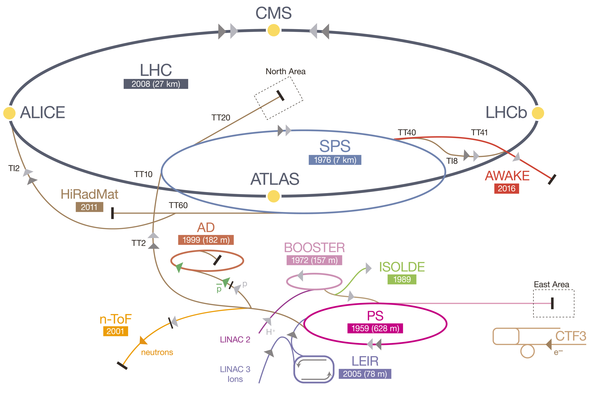
AWAKE experimental set-up
Laser
Ionizing
Laser
Pulse
Final
Focus
Rubidium Plasma
10m, 10¹⁴-10¹⁵ cm⁻³
p⁺ dump
Laser
Dump
OTR/CTR, 2-screen
Diagnostics
p⁺ from SPS
SMI
Acceleration
CERN’s Accelerator Complex
SPS bunch: 400GeV, 3x10¹¹p⁺,
10m, laser ionized Rb plasma 1-10x10¹⁴cm⁻³
2016-17: self-modulation instability (SMI) studies
Three observables
Defocused p⁺
p⁺ bunch modulation at λ_{pe}
Emission of coherent transition radiation at λ_{pe}

Slide 27
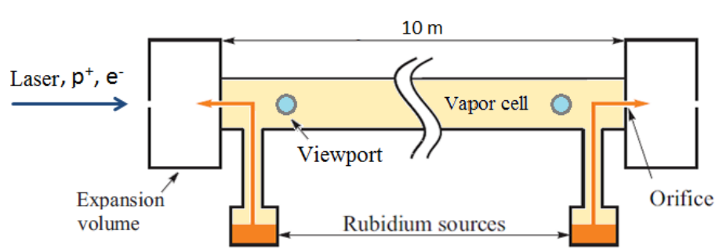
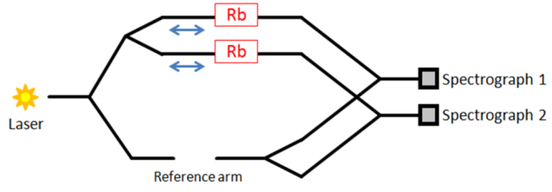
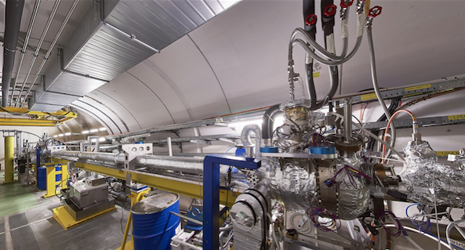
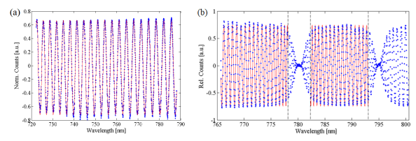
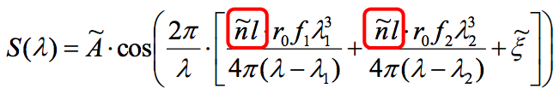
Rb Vapor/Plasma source
1x10¹⁴<n_{e}<1x10¹⁵cm⁻³
Very uniform density: ∆n_{Rb,e}/n_{Rb,e}<0.2%
Sharp ramps: a few cm
Heat exchanger + free expansion of Rb
Laser field ionization
E. Oz, F. Batsch (MPP)
WDL
E. Oz & P. Muggli., NMA 740(11), 197 (2014).
R. Kersevan (CERN)
G. Plyushchev (CERN/MPP/EPFL)
Meet density requirements
Measure n_{Rb} with <0.5% accuracy
Rb D₂ and D₁ lines
Öz et al., NIMA 829, 321 (2016)

Slide 28
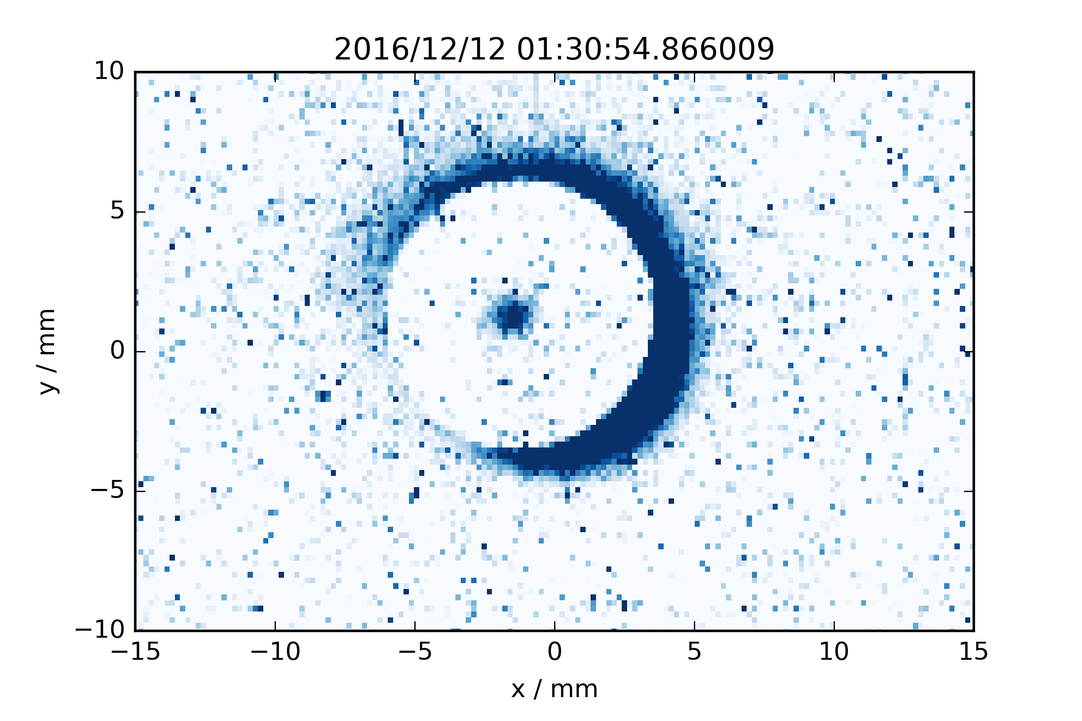





AWAKE: Results
Defocused p⁺
OTR:Modulation at 10 ps scale
CTR emission
K. Rieger, MPP
Vapor
Plasma
M. Turner, CERN
K. Rieger, MPP
M. Martyanov
F. Braunmueller, MPP
Successful first SMI physics run: 48h
Operation at low plasma density: 1.5x10¹⁴cm⁻³
Signal detected on all three diagnostics
See P. Muggli’s talk for more details

Slide 29
Liste des publications 2016-2017
1 Energy boost in Laser-Wakefield Accelerator using sharp density transitions
Döpp, E. Guillaume, C. Thaury, A. Lifschitz, K. Ta Phuoc, and V. Malka, Phys. of Plasma 23, 056702 (2016)
2 Particle-in-Cell Codes for plasma-based particle acceleration
Pukhov, CERN Yellow reports, 1 (2016), doi/10.5170/CERN-2016-001.181
3 Voronoi Particle Merging Algorithm for PIC Codes
P.T. Luu, T. Tückmantel, A. Pukhov, Comput. Phys. Commun. 202 (2016) 165-174, doi :10.1016/j.cpc.2016.01.009
4 Injection of electrons by colliding laser pulses in a laser wakefield accelerator
M. Hansson, B. Aurand, H. Ekerfelt, A. Persson, C.-G. Wahlström, O. Lundh, Nuclear Instruments & Methods in Physics Research A (2016)
5 Localization of ionization-induced trapping in a laser wakefield accelerator using a density down-ramp
M. Hansson, T. L. Audet, H. Ekerfelt, B. Aurand, I. Gallardo González, F. G. Desforges, X. Davoine, A. Maitrallain, S. Reymond, P. Monot, A. Persson, S. Dobosz Dufrénoy, C.-G. Wahlström, B. Cros, and O. Lundh,
Plasma Physics and Controlled Fusion 58, 055009 (2016).
6 Optmized stability of a modulated driver in a plasma wakefield accelerator
R. Martorelli, A. Pukhov, arXiv preprint, arXiv:1603.04326 (2016)
7 Characterization of the equilibrium configuration for modulated beams in a plasma wakefield accelerator
R. Martorelli, A. Pukhov, Physics of Plasmas 23, 053109 (2016); Laser and Particle Beams, 34, 3 (2016), 519-526, doi/10.1017/S02630346000409
8 Bright X-Ray Source from a Laser-Driven Microplasma Waveguide
L. Yi, A. Pukhov, P. Luu-Thanh, and B. Shen, Phys. Rev. Lett. 116, 115001 (2016)
9 A non-linear theory for the bubble regime of plasma wake fields in a plasma channels for special applications and control
J. Thomas, I.Y. Kostyukov, J. Pronold, A. Golovanov, A. Pukhov, Phys. of Plasmas 23, 053108 (2016)
10 Investigation of ionization-induced electron injection in a wakefield driven by laser inside a gas cell
T. L. Audet, M. Hansson, P. Lee, F. G. Desforges, G. Maynard, S. Dobosz Dufrénoy, R. Lehe, J. -L. Vay, B. Aurand, A. Persson, I. Gallardo González, A. Maitrallain, P. Monot, C.-G. Wahlström, O. Lundh, and B. Cros, Physics of Plasmas 23, 023110 (2016).
11 Supersonic jets of hydrogen and helium for laser wakefield acceleration
K. Svensson, M. Hansson, F. Wojda, L. Senje, M. Burza, B. Aurand, G. Genoud, A. Persson, C.-G. Wahlström, and O. Lundh, Physical Review Accelerators and Beams 19, (2016

Slide 30
Liste des publications 2016-2017
12 AWAKE, A proton-driven plasma wakefield acceleration experiment at CERN
AWAKE Collaboration, E. Gschwendtner et al., Nucl. Inst. Meth. A 829 (2016) 76-82, DOI/10.1016/ nima.2016.02.026
13 AWAKE, The advanced proton driven plasma wakefield acceleration experiment at CERN
AWAKE Collaboration, C. Bracco et al., Nucl. Inst. Meth. A 273-285 (2016), DOI/10.1016/ nima.2015.09.022
14 Single shot betatron source size measurement from a laser-wakefield accelerator
A.Köhler, J.P. Couperus, O. Zarini, A. Jochmann, A. Irman, U. Schramm, Nuclear Instruments and Methods in Physics Research A 829, 265-269 (2016), doi:10.1016/j.nima.2016.02.03
15 Tomographic characterisation of gas-jet targets for laser wakefield acceleration
J.P. Couperus, A. Köhler, T.A.W. Wolterink, A. Jochmann, O. Zarini, H.M.J. Bastiaens, K.J. Boller, A. Irman, U. Schramm, Nuclear Instruments and Methods in Physics Research A, 830, 504-509 (2016), doi:10.1016/j.nima.2016.02.099
16 3D printing of gas jet nozzles for laser-plasma accelerators
A.Döpp, E. Guillaume, C. Thaury, J. Gautier, K. Ta Phuoc, and V. Malka, Review of Scientific Instruments 87, 073505 (2016), http://dx.doi.org/10.1063/1.4958649
17 Quasi-stable injection channels in a wakefield accelerator
M. Wiltshire-Turkay, J. P. Farmer, A. Pukhov, Phys. Of Plasmas, 23, 5 053112 (2016), doi :10.1063/1.49508038
18 Raman amplification in the coherent wave-breaking regime
J. P. Farmer, A. Pukhov, Phys. Rev. E, 92, 6 063109 (2015), doi :10.1103/PhysRevE.92.063109
19 Three electron beams from a laser-plasma wakefield accelerator and the energy apportioning question
X. Yang, E. Brunetti, D. Reboredo Gil, G. H. Welsh, F. Y. Li, S. Cipiccia, B. Ersfeld, D. W. Grant, P. A. Grant,
M. R. Islam, M. P. Tooley, G. Vieux, S. M. Wiggins, Z. M. Sheng & D. A. Jaroszynski, Scientific Reports 7, 43910 (2017), doi:10.1038/srep43910
20 Femtosecond timing-jitter between photo-cathode laser and ultrashort electron bunches by means of hybrid compression
R. Pompili, M. P. Anania, M. Bellaveglia, A. Biagioni, G. Castorina, E. Chiadroni, A. Cianchi, M. Croia, D. Di Giovenale, M. Ferrario, F. Filippi, A. Gallo, G. Gatti, F. Giorgianni, A. Giribono, W. Li, S. Lupi, A. Mostacci, M. Petrarca, L. Piersanti, G. Di Pirro, S. Romeo, J. Scifo, V. Shpakov, C. Vaccarezza and F. Villa, New J. Phys. 18 (2016) 083033
21 Experimental characterization of active plasma lensing for electron beams
R. Pompili, M. P. Anania, M. Bellaveglia, A. Biagioni, S. Bini, F. Bisesto, E. Brentegani, G. Castorina, E. Chiadroni, A. Cianchi, M. Croia, D. Di Giovenale, M. Ferrario, F. Filippi, A. Giribono, V. Lollo, A. Marocchino, M. Marongiu, A. Mostacci, G. Di Pirro, S. Romeo, A. R. Rossi, J. Scifo, V. Shpakov, C. Vaccarezza, F. Villa, and A. Zigler, Appl. Phys. Lett. 110, 104101 (2017); doi: 10.1063/1.4977894

Slide 31
Milestones and Deliverables
Report no. (D/M) | Title | Due date | Status
DL13.1 | Technical design report on ultra-fast longitudinal feedback for FLASH | 31.10.2014 | Done
MS90 | Development and characterization of a new gas target system | 31.10.2014 | Done
MS91 | Simulation of SPS beam self-modulation in plasma with seeding by laser | 31.10.2014 | Done
DL13.2 | Simulation of external injection into bubble | 31.04.2015 | Done
DL13.2 | Optimal realizable SPS configuration | 31.04.2015 | Done
MS92 | NRF operation established with closed beam based FB loop | 31.10. 2015 | =>DL13.5
MS93 | Diagnostic system installed and performance determined | 31.10.2015 | Done
MS94 | Simulation of modular plasma configuration | 31.04.2016 | Done
DL13.4 | Experimental characterization of e-beams | 31.04.2016 | Done
DL13.5 | FLASH NRF cavity and FB system | 31.04.2017 | On going
DL13.6 | Optimum beam-plasma configuration | 31.04.2017 | On going

