Slide 1




Linac4 ion source modelling codes:
NINJA, ONIX, IBSimu
Stefano Mattei
ABP-CWG meeting 31/10/2017

Slide 2
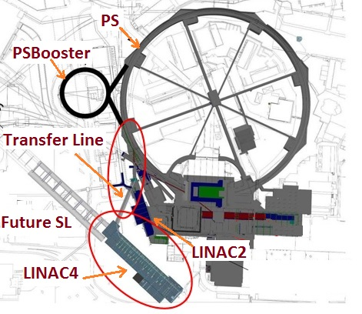
Linac4 short intro
Linac4 will be the new injector to the PSB, replacing Linac2
Linac2: 50 MeV proton beam
Linac4: 160 MeV H⁻ beam
Currently in commissioning stage
160 MeV already achieved
The ion source is the first component of the accelerator, providing the H⁻ ion current
More details: A. Lombardi THE LINAC4 PROJECT, Proceedings of HB2016, Malmö, Sweden
http://accelconf.web.cern.ch/AccelConf/hb2016/papers/moam2p20.pdf

Slide 3
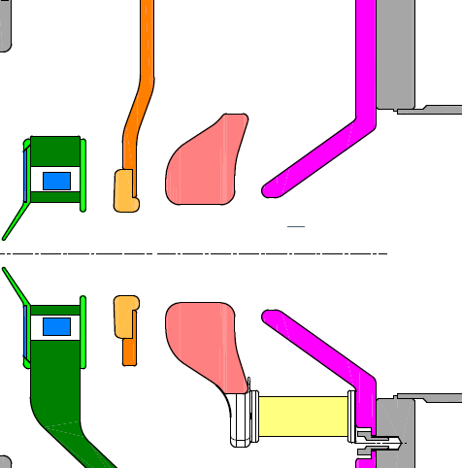

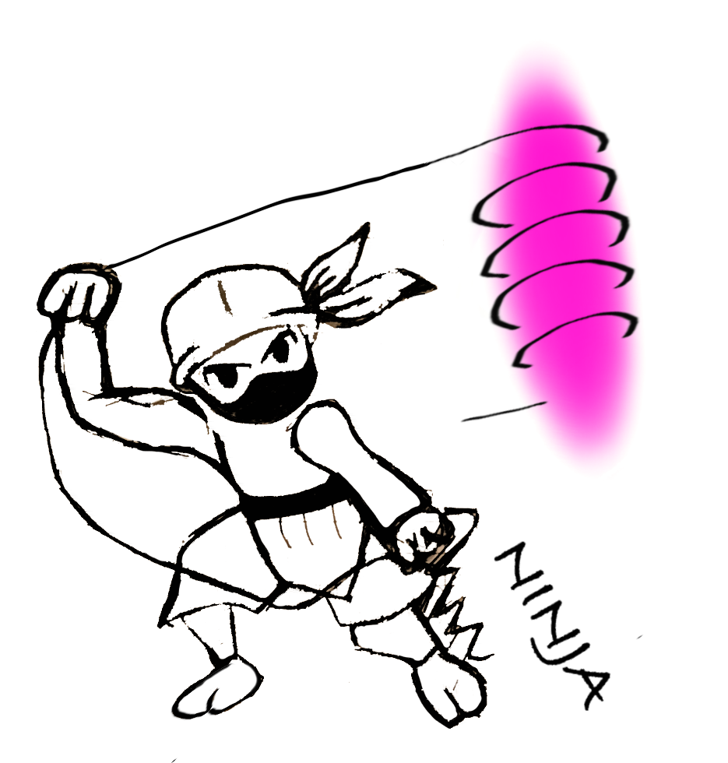
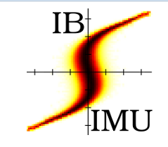
The Linac4 H⁻ ion source
0 V
0 V
Octupole cusp magnets
RF coil + Ferrites
-35 kV
+45 kV
-45 kV
Plasma
H₂ H⁻
45 keV
H⁻ beam
H₂ gas
Filter magnets
NINJA
Modelling the
RF-plasma
heating
ONIX
Detailed model of the beam formation
IBSimu
Extraction and beam transport

Slide 4
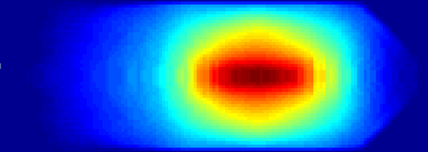
NINJA code
Kinetic code (Particle-In-Cell) for the simulation of the
RF plasma heating in inductively coupled plasmas
Code developed in close collaboration with KEIO University in Japan
Applied for the simulation of CERN’s Linac4 and CHARLIE test bed at University of Augsburg
Simulate the RF-plasma heating
Investigate the effect of design and operational parameters on the plasma characteristics
Provide inputs to beam formation simulations (ONIX)

Slide 5
NINJA code: physics
Particle-In-Cell
2.5 D in cylindrical coordinates:
2D EM field calculation (azimuthal symm.)
3D3V particle dynamics
Implicit integration scheme
Plasma species: e⁻, H⁺, H₂⁺, H₃⁺, H⁻
+ neutrals H, H₂(v)
Coupling with static magnetic field simulations (Opera VectorFields) imported via 3D fieldmap
Monte Carlo Collisions
Set of over 200 cross-sections covering the most important reactions in hydrogen
electron – neutral
electron – ion
ion – neutral
Coulomb collisions

Slide 6
NINJA code: specs
Programming language: Fortran90 + libraries Fortran77, Fortran90
OS: Linux
Compilers: successfully run with GNU, INTEL, NAG and PGI
we typically run with INTEL
Libraries: all open source
  NITSOL (Fortran77)
    BLAS (Fortran77)
    LAPACK (Fortran77)
  SPARSKIT (Fortran90)
Parallelization: MPI
Licensing: not open-source, discussion ongoing with collaborators at KEIO University
Documentation: A fully implicit Particle-In-Cell Monte Carlo code for the simulation of inductively coupled plasmas, in preparation for submission to “Journal Computational Physics”

Slide 7
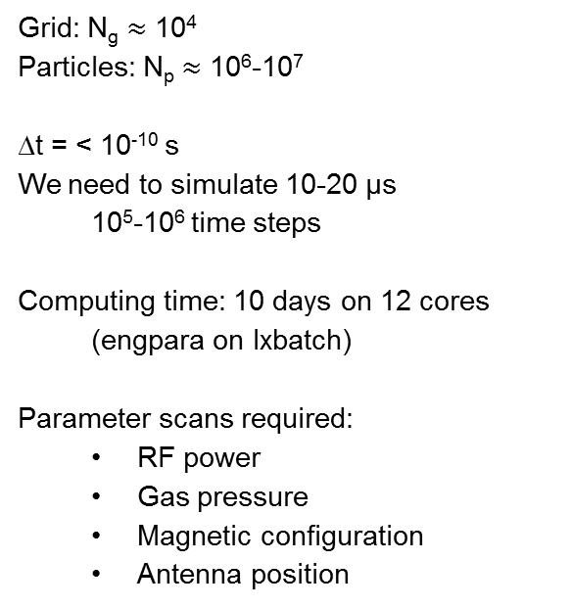
NINJA: application
Grid: N_{g} $≈$ 10⁴
Particles: N_{p} $≈$ 10⁶-10⁷
∆t = < 10⁻¹⁰ s
We need to simulate 10-20 µs
10⁵-10⁶ time steps
Computing time: 10 days on 12 cores (engpara on lxbatch)
Parameter scans required:
  RF power
  Gas pressure
  Magnetic configuration
  Antenna position
NINJA provides the plasma parameters (temperatures, densities and fluxes) over the volume of the plasma chamber

Slide 8
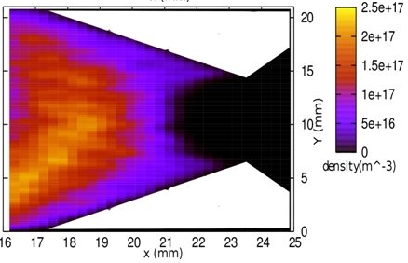
ONIX
ONIX is a 3D Particle-In-Cell code for the simulation of the beam formation in a negative ion sources
Initially developed in the laboratory LPGP, Orsay, France in order to simulate the extraction region of an ITER-like negative ion source
Applied for the simulation of the Linac4 H⁻ ion source
Study the effect of volume/surface produced H⁻ on the extracted current and beam emittance
S. Mochalskyy, J. Lettry, T. Minea, New journal of physics 2016
http://iopscience.iop.org/article/10.1088/1367-2630/18/8/085011

Slide 9
ONIX: specs
3D Particle-In-Cell Monte Carlo Collision electrostatic code
Owner: LPGP Orsay and IPP Garching
Parallelization: MPI
Performance: typical run is performed using 20 million macro particles with a meshing of 110x100×100 PIC nodes. The code performance is ~0.1 μs per day on 20 cores.
Normally 1-2 μs simulation time is sufficient to reach steady state.
Currently work in progress to reduce the cell size and improve parallelization to run on large clusters (~1000 cores)
Licensing: not open-source
Currently maintained by LPGP and IPP Garching

Slide 10
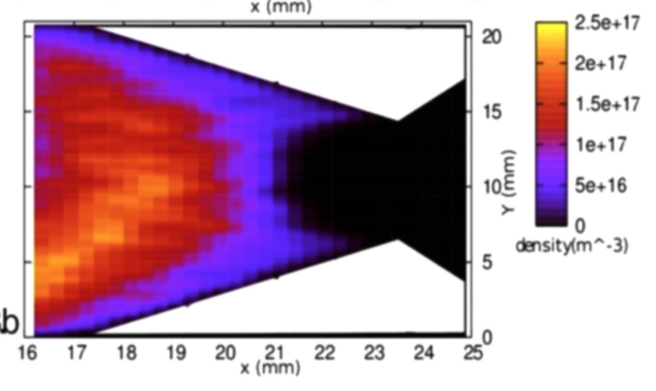
ONIX: future
OFF-line coupling between NINJA and ONIX
Extract from NINJA the plasma parameters (n_{e}, T_{e}, flux of H⁰, etc) at the entrance of the collar region
ONIX: defines the resulting beam characteristics
Goal is the optimization of the plasma electrode geometry and puller optics
Work to be done in collaboration between CERN-KEIO-LPGP-IPP provided resource availability
fluxes
Finer resolution

Slide 11
IBSimu
An ion optical computer simulation package for ion optics, plasma extraction and space charge dominated ion beam transport using Vlasov iteration.
Used at CERN for 5-6 years: Linac3, Linac4, ISOLDE
Developed by T. Kalvas @ U. of Jyväskylä (Finland)
http://ibsimu.sourceforge.net/
Solid geometry definition using 2D DXF files, 3D STL files, mathematical formulation, etc.
Finite Difference Method solver for 1D, 2D and 3D Poisson equations with edge smoothing.
Particle trajectory iteration in self-consistently calculated electric and imported magnetic fields.
Space charge density calculation from trajectories.
Vlasov iteration for self-consistent simulation of high space-charge beams.
Nonlinear plasma models for positive and negative ion extraction.

Slide 12
IBSimu: specs
Programming language: C++
OS: Linux, Windows
Compilers: GNU
Libraries: several for background functionality (graphics, math, etc.) listed on the website
Parallelization: none
Licensing: open-source, GNU General Public License
Maintained by T. Kalvas
Documentation: http://ibsimu.sourceforge.net/index.html

Slide 13
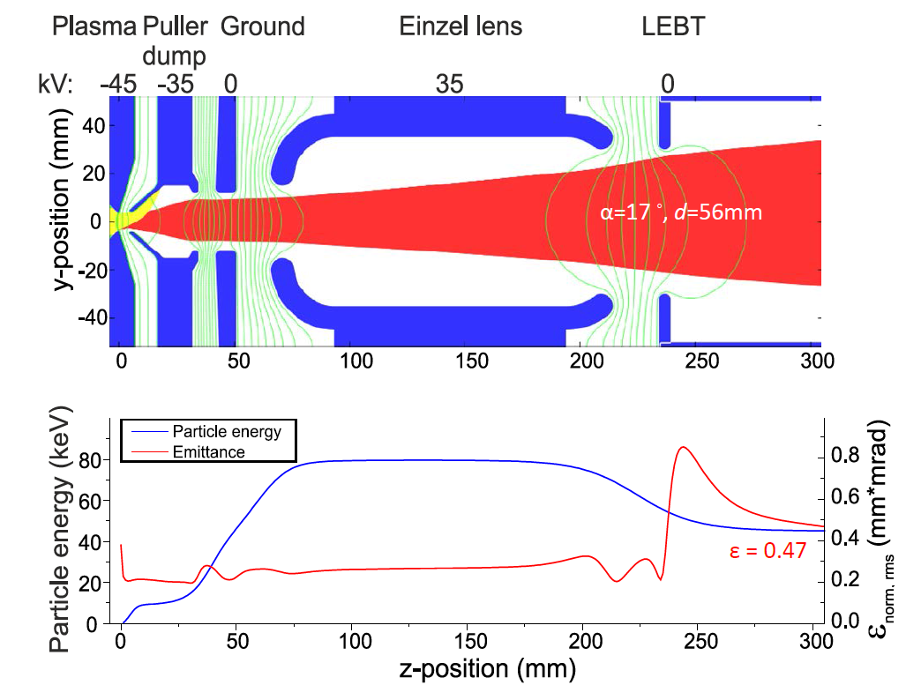
IBSimu: application
Beam transport given geometry and potentials
e⁻ and H⁻ beam
including space-charge, trajectories
Computing time: 1-2 days
Parameter variations:
Extracted currents, e⁻ / H⁻, geometry, potentials. Typically 200-300 runs
Limitation of IBSimu is the plasma model → not suited for surface produced negative ions
Linac4 H- ion source extraction optics:
Daniel Fink: http://scitation.aip.org/content/aip/proceeding/aipcp/10.1063/1.4916433
Oystein Midttun: http://scitation.aip.org/content/aip/journal/rsi/85/2/10.1063/1.4824814

Slide 14
IBSimu: future
NINJA-ONIX can provide the beam phase-space few mm from the plasma electrode
IBSimu can track it through the e⁻ beam dump section and provide input to TRAVEL and PATH
Goal is the optimization of the overall ion source emittance
NINJA
ONIX
IBSimu
TRAVEL/PATH

