Slide 1
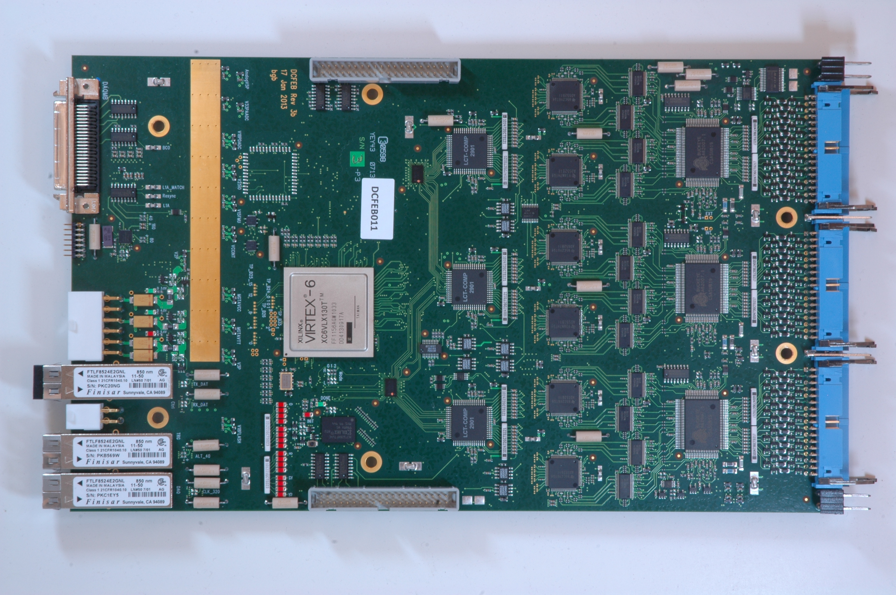
DCFEB Production for LS2
Phase II Muon Workshop
Texas A & M
Dec. 6-8, 2016

Slide 2
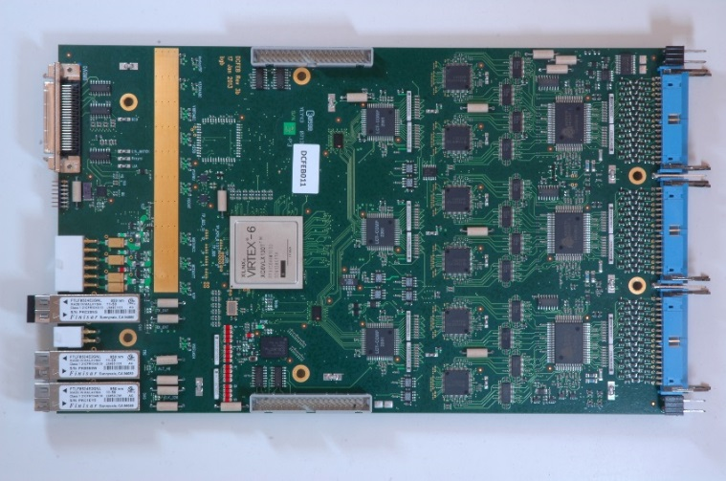
DCFEB Upgrade for MEx/1 Original Plans
Produce more DCFEBs with no design changes, only minor changes to layout
  Correct a Design Issue — JTAG path switching:
    Loss of JTAG communication with DCFEB FPGA
    Cause traced to signal connection to FPGA
    Never utilized
    Problem can be eliminated by removing the connection
  Fix Assembly Issues:
    Placement of certain components caused repeated board and component damage
    Very difficult to repair
    Easily prevented by minor change in placement and routing
  Remove Unused options:
    Increase complexity, in particular the JTAG path
    Removal reduces components, and holes
Original plan does not require R&D or rad testing

Slide 3
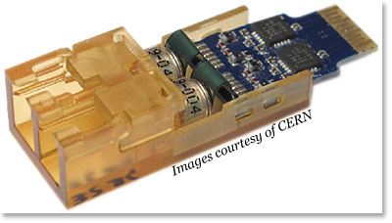
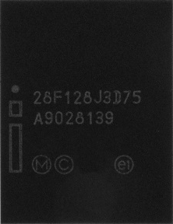

Recent Concerns Affecting Design Plans
Finisar Optical Transceiver Susceptible to SEUs
  Possible alternative — CERN’s VTTX (Versatile Link Transmitter):
    VTTX has two transmitters
    Rad tested (TID and SEUs)
    Replace 3 Finisars with one VTTX
    Cost ~60 CHF (Finisar ~$28 ea)
Xilinx Platform Flash PROM Program/Erase Issues (XCF128X)
  Cause, extent, and prognosis, still undetermined (investigation continues)
  Possible alternative — Micron PC28F128P30TF65
    Parallel NOR Flash Memory
    Asynchronous mode by default (Slow, ~450ms to program V6)
    Supports Synchronous Burst Mode, but V6 does not
    Same footprint (signal interface changes)

Slide 4
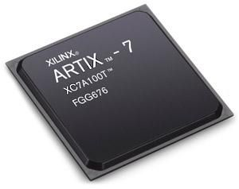
Recent Concerns Affecting Design Plans 2
Xilinx 7 Series FPGA do Support Synchronous Burst Mode
  Artix 7 may be an option for the DCFEB:
    XC7A200T FFG1156
    500 I/0 (max 240 diff pairs) 3.3V tolerant.
    Current FPGA using 541 signals (147 diff pairs) can be reduced
    Less power than V6
    Less expensive than V6

Slide 5
New Plan Needed – R&D, Rad Tests, Prototype
New Components Introduced to Design – VTTX, PC28F128, Artix 7
  More extensive layout changes than with original plan:
    Requires reroute of all FPGA connections
    Must understand Artix 7 features and limitations
    3.3 V compatible I/O will eliminate some translators.
  Radiation Testing:
    VTTX rad tested by CERN (TID and SEUs), proven to be suitable
    PROM Extensive testing needed
    Artix 7 has been tested at CHARM and reported at TWEPP 2016; more testing planned
    http://indico.cern.ch/event/489996/contributions/2291857/attachments/1345403/2028662/TWEPP_Artix7.pdf
  Build Rad Test Board for PROM and Artix 7:
    Multiple test PROMs on board?
    Gain experience with Artix 7
  Changes are significant enough to require a prototype board
Work required before production has increased, must start now

Slide 6
Upgraded DCFEB Schedule
Work Backwards from LS2 Installation Schedule:
  April 2019: All boards needed at SX5 for refurbishment
  April 2018: Start of production process
  Jan. 2018: Start Prototype production
  Nov. 2017: Start getting quotes
  Sept. 2017: Finalize design, Start final layout changes
  April - July 2017: Radiation testing
  March 2017: Start upgrade design/layout changes
  Jan. 2017: Start rad test board for PROM/Artix 7
DCFEB Production History (for LS1)
Event | ME1/1 Prod. Dates | Week
Production Review | 12/6/12 | 0
Money to OSU | 1/6/13 | 4.5
OSU OK’s Money | 1/25/13 | 7
10 bare PCBs arrive | 3/1/13 | 12
10 Boards Assembled | 3/18/13 | 14.5
PCB production starts | 4/1/13 | 16.5
Assembled boards arrive | 4/30/13 | 21
Final Board to CERN | 12/6/13 | 52
Plans are for assembled boards to be individually programmed, tested, and verified at OSU
Shipped to CERN 20-30 at a time
Testing software already in place
At CERN, boards will be mounted on chambers at SX5 and retested as a chamber system

Slide 7
Comments on Low Voltage Power
LVDB
Junction Boxes
MARATONs
OPFCs
Channel Mapping/Distribution
Rack Space
Cooling Load
Additional MARATONs (How Many?)
Compare to Station 1
Before 8 MARATONs / After 12 MARATONs
12 PCs, 108 chambers
Station 2 and 3 combined (YE2)
8 MARATONs ?
12 PCs, 108 chambers
4 additional MARATONs should be sufficient
Redistribution of channel assignment needs to happen
MEx/1 upgrade vs ME1/1 upgrade
7 DCFEBs down to 5 per chamber
LVDB7 to LVDB5
Max Cable Length is Shorter
Use 1 VTTX, and Artix7 – Less Power
All in “good” direction
Station 4 (YE3)
4 MARATONs ?
6 PCs, 54 chambers
2 additional MARATONs should be sufficient ?
Redistribution of channel assignment needs to happen
CFEB |  | DCFEB
Voltage | Current | Voltage | Current
6.0 V | 0.6 A | 5.4 V | 2.1 A
5.0 V | 1 A | 4.0 V | 0.8 A
3.3 V | 0.6 A | 3.0 V | 3.2 A
10.6 W |  | 24.1 W

