Slide 1
Overview of the GE2/1 & ME0 Chamber R&D
Production plans, synergies and Lessons Learnt from GE1/1 project
Michele Bianco (CERN) on behalf of CMS GEM group
Many thanks to: A.Sharma, R. De Oliveira, A. Conde, S. Brachet, A. Goldames Perez, M. Abbas, P. Aspel, G. De Lentdecker, P. Vitulo, L. Benussi, M. Maggi, I. Vai, J. A. Merlin, B. L. Dorney, …..

Slide 2
Outline 1
GE2/1 Motivation for improved redundancy
Performance requirements
Baseline option as triple GEM detector
GE2/1 20 degrees: general constraints
GE2/1 chamber layout
Electronics for Read Out
Services
Synergies with other projects
Production schema and schedule
µ-RWELL Option: Motivation & Concept
µ-RWELL Technology description
µ-RWELL Prototypes developed & R&D plans and studies

Slide 3
Outline 2
ME0 Baseline solution as triple GEM detector
Rate capability and discharge probability
Ongoing R&D
  Triple GEM Back-to-Back
  FTM Detector
ME0: general constraints and possible implementations
Electronics for Read Out
Synergies with other projects

Slide 4
The upgrade of the CMS muon system in high η region in Phase 2
GEM Endcap GE1/1: station to be installed in LS2, 1.6 < |η| < 2.2 → GEM technology
Muon Endcap ME0: station proposed for LS3, η < 3.8 → 2 technologies under consideration:
GEM: GE1/1-like station, with more layers to reject background - Baseline
FTM and BtoB - Option
GEM Endcap GE2/1: station proposed for LS3, η < 2.4 →
2 technologies considered:
GEM technology - Baseline
μRWELL - Option

Slide 5
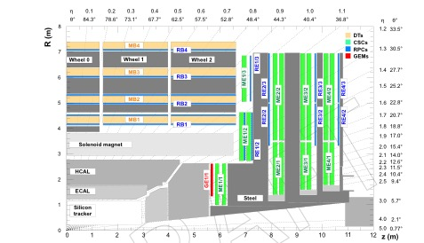
GE2/1 Motivation
The performance of the endcap muon trigger relies on the optimal performance of L1 CSC trigger
Installation of new GEM chamber provide:
  Additional redundancy in the most difficult region (low B, highest rates)
  Similar to GE1/1, allows measurement of muon direction
    Improves L1 momentum measurement for prompt muons and reduces trigger rate
    Enables triggering on displaced muons
  Additional hits to recover lost CSC stubs
  Good spatial resolution can aid in matching L1 track trigger objects with L1 muons and offline reconstruction
GE2/1:
  20 degrees chambers
  18 super chamber per disk (36 total)
  2 chamber per station (super chamber)
  → 2 extra hits

Slide 6
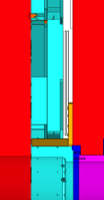
Triple GEM detector as baseline option for GE2/1
Triple GEM detector with the same “operational layout 3/1/2/1” adopted for the GE1/1 chambers has been chosen as baseline solution.
Well-known mature technology
Easy to be implemented
Match the detector requirement (GE1/1 even more demanding)
Time resolution of 8ns is adequate from simulation studies, (97% of single chamber hits associated to the correct)
Eco-friendly gas validated
88 mm
YE2
YE1
ME2/1 CSC
Shielding

Slide 7
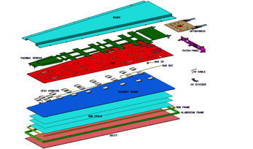

GE2/1 Geometrical constraint
The baseline GE2/1 station consists of 36 20⁰ Super Chambers, the layout will be similar to GE1/1, but covering much larger surface.
Limits in space make the GEM technology
perfect candidate for GE2/1
Same technical solution successfully
adopted for the GE1/1
Each GE2/1 Superchamber realized
with two single chambers
36.4 mm
88 mm
YE2
YE1
ME2/1 CSC
Shielding
Same thickness of GE1/1 chambers

Slide 8
GE2/1 Geometrical constraint
88 mm
1251 mm
YE2
YE1
1178 mm
ME2/1 CSC
Shielding
1837 mm
1911 mm
Similar thickness of GE1/1 chambers

Slide 9
GE2/1 20 degrees: general constraints
An ideal detectors should:
Minimize the dead area ==> to increase the acceptance
Reduce the number of components ==> to make easy the construction
A unique module solution for the GE2/1 chambers would be very welcome, but:
1251 mm
GEM foil base material limited in size (max 610 mm wide)
PCB producer usually limit the size of the PCB to ~ 60 cm; for a single and double sided board 1550mm x 600mm panel; we can have a circuit of length 1500mm x 550mm
1911 mm
Chambers realized with several module ==> Easier solution
We have to deal also with the RO PCB segmentation, which should be closest as possible to the simulation

Slide 10
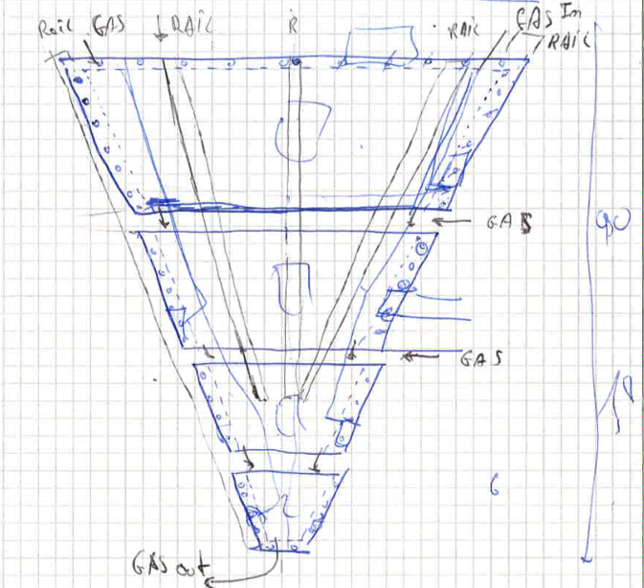

Slide 11
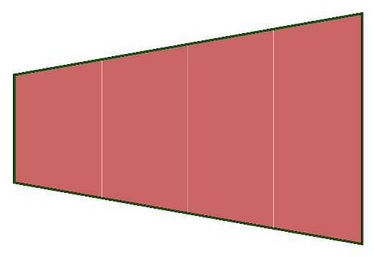
GE2/1 20 deg. 4 horizontal modules
GE2/1 chamber segmented in 4 horizontal modules
Max PCB size about 1200 mm X 600 mm (M4)
M4 size comparable with GE1/1 Long chambers possible to fit in to the actual copper box
All detectors components available on the “Market”
Chambers coupled together trough external metallic profiles
Dead area between chambers limited to 35.5 mm ( staggered second chamber to eliminate dead area)
GEM foils production to be split between two(or more) production sites (several candidates)
1178 mm
M4
M3
M2
M1
502mm

Slide 12
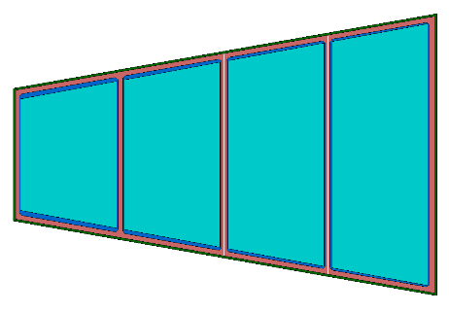
GE2/1 20 deg. 4 horizontal modules
8 modules configuration reduce the dead area
and get at least one GE2/1 hit for each muon
FOILS SENSITIVE AREA
Y₄
Y^{I}₄
Y₃
Y^{I}₃
Y₂
Y^{I}₂
Y₁
Y^{I}₁

Slide 13
Adopted segmentation: 8 Eta / 6 phi partitions
Not really projective eta segmentation
~ 0.5 mrad
1178 mm
GEB 4
M4
458.5 mm
497 mm
12 Strips groups
GEB 5
OH
12 Strips groups
GEB 3
M3
458.5 mm
497 mm
12 Strips groups
GEB 2
M2
458.5 mm
420 mm
OH
12 Strips groups
GEB 1
M1
458.5 mm
420 mm
Int
Ext

Slide 14
GE2/1 20 deg. 4 horizontal modules
Mechanical Summary
72 20 deg. Chambers == > 18 Super Chamber per end
288 Modules == > 8 different types
Max module size ~ 50 cm X 120 cm (comparable withGE1/1 long)
864 Foils == > 8 different types
42 Strips group per chambers equally distributed between the modules
Interconnections between Drift and RO PCB in modules M4, in M3 and M2 under evaluation

Slide 15
GE2/1 20 deg. 4 horizontal modules
Front Chamber active area
Back Chamber active area
Overlapping active areas

Slide 16
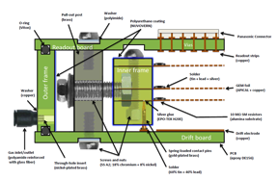
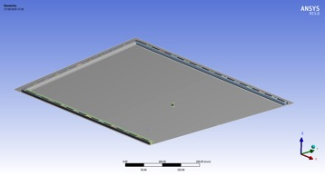
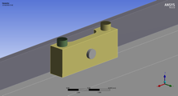
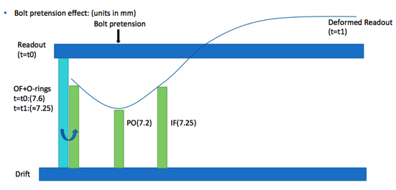
M4 Design (FEM Simulation)
Symmetry applied to reduce the number of elements

Slide 17
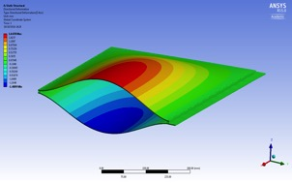
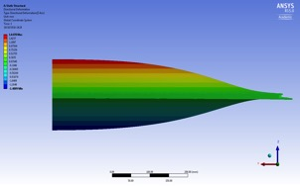
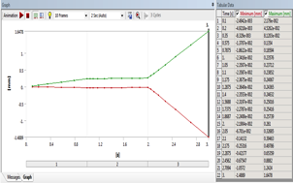
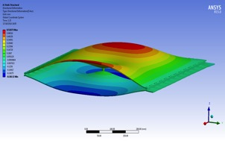
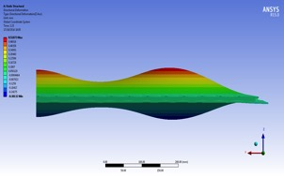
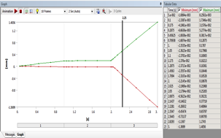
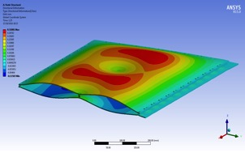
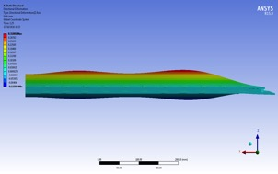
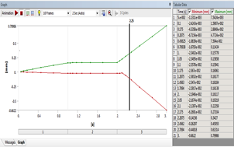
M4 Design (FEM Simulation)
Pressure results, under 5mbar for no Pillar, 2 Pillars and 3 Pillars configuration

Slide 18
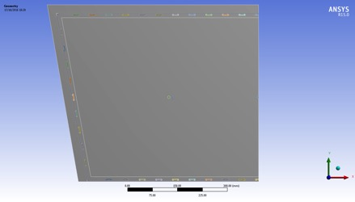
M4 Design (FEM Simulation)
Pressure results, under 5mbar for no Pillar, 2 Pillars and 3 Pillars configuration
Number of Pillars | Max Deviation at 5 mbar | Def at rest for gravity and stretching
0 | 1.65 mm | 0.1 mm
2 | 0.52 mm | 0.07 mm
3 | 0.32 mm | 0.06 mm
Results for 3 pillars: Optimal position after the iterative process:
  Vertical direction: Middle of the active area
  Horizontal direction: At the symmetry plane and at 270 mm from the symmetry plane

Slide 19
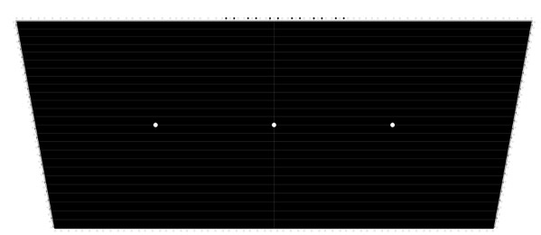
M4 Design: RO board, Foils, Frames and details
RO Board External view
50 HV Sector of about 100 cm2 each
25 Left / 25 Right
HV connection middle top
Power distribution left/right side

Slide 20
M4 Design: RO board, Foils, Frames and details
Internal frame re-designed to increase the distance between the frames and the active area and avoid Spurious Signals
GE1/1 internal frames
Milling
GE2/1 internal frames
Milling
Old shape
Internal frame

Slide 21
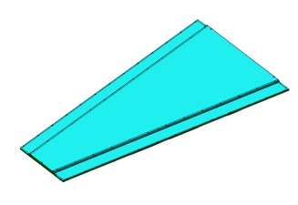
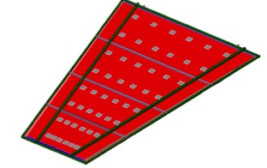
Module coupling and chamber assembly
Three stiffener bars to join the modules together
Two transversal bars, which hold the modules have been added to increase the mechanical stability of the full chambers

Slide 22
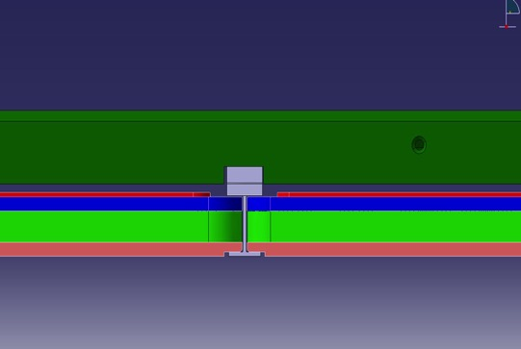
Module coupling and chamber assembly
chimney
Transversal bar
18 mm
19.5 mm
GEB
RO PCB
External frame
Drift PCB
Pocket in the Drift PCB
Alu profile between modules

Slide 23
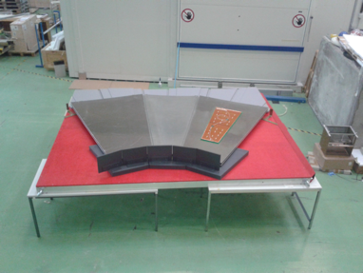
GE2/1 Baseline option: prototyping schedule
GE2/1 prototype strategy:
The detector technology is identical as GE1/1 chambers == > R&D Complete ! (performance, aging, …)
GE2/1 Mechanics very close to GE1/1
We have to optimize module coupling by building prototype
4 separate modules to be built, only one as “working module”, three dummy, enough to test the whole system from mechanics point of view.
Mechanical Mockup for integration tests completed (mid March)
ONE Prototype Schedule
Final Design Completed: 30th Nov 2016
Material Procurement: Mid Feb 2017
M4 Modules Assembly: End Feb 2017
Modules Tests in the Lab: End Apr 2017
Chamber Material Procurement: Mid June 2017
Chambers Assembly: End June 2017
Chamber Test and Cabling: End July 2017
In Time for TDR!!!

Slide 24
Electronics components
Numbers provided in next slide are based on the experience and solutions adopted with the GE1/1 chambers.
Actual GEB boards are limited in size (~ 1100 mm in GE1/1 will use GEB made by two separated pieces)
Opto-hybrid for GE1/1 can handle up to 24 VFAT chips

Slide 25
Optimization of Electronics components for GE2/1 design
Opto Hybrid
Four horizontal modules:
(components for the whole GE2/1 system)
3456 VFT3 chips (48 x 2 x 36)
144 OH with 24 VFAT3 input
5 different GEB boards per chamber: 1 x M1, 1 x M2, 1 (or 2) x M3, 2 x M4
360 (or 432 ) GEB in total for the GE2/1 project
2 GEB
1 GEB ( 2 GEB ?)
1 GEB
1 GEB

Slide 26
GE2/1 Baseline: services
2 HV Multi conductor cable
4 LV Cable from the PS to FEAST DCDC
4 Fibers to ME2/1 TMB
The TMB can’t accept more than 4 Fibers for each GE2/1 20 deg. super chamber

Slide 27
GE2/1 Baseline solution HV/LV system
The base line Power HV power source will be A1515 from CAEN.
In the finest granularity one GE2/1 super-chamber can be powered with 4 modules.
• GE2/1 Detectors for will be equipped with VFAT3 front-end chip and OH every two moduls.
• The CERN FEST DCDC converter will be integrated on the GEB boards to provide LV power for the on detector electronics
Reducing the number of LV channels (cost) per detector
Having an option to use smaller power cables, sensitive for the GEM installation regions
As result of this approach DCS software will be identical to GE1/1.

Slide 28
Synergies with other projects
The Baseline detector for the GE2/1 chambers, ( with the layouts presented here), shares several aspect with the ongoing GE1/1 project.
In the GE2/1 20 deg. the largest module will have dimensions comparable with the GE1/1 Long chambers == > tooling and setups prepared for the GE1/1 can be mostly re-used.
The new CMS GEM clean room & GEM QC Lab, in preparation in bd. 904 (Prevessin) is large enough to host the production & Quality Control of the GE2/1 chambers
Electronics developed for the GE1/1 (VFAT3) can be easily adapted to the GE2/1 chambers

Slide 29
Synergies with other projects
The triple GEM detectors, the baseline option chosen for the GE2/1 modules, is the same technology used by GE1/1 this mean:
  Well known performances (GE1/1 expected rate higher than GE2/1)
  No additional aging test needed, the GE2/1 will use the material components adopted for the GE1/1 No different materials compared to GE11
  Production & QC Tooling and setup, (some of them quite expensive: X-ray, copper boxes, cosmic ray stand, …) prepared for the GE1/1 production to be reused for the GE2/1 production and tests.
  Crew trained for the production and test of the GE1/1 will be easily moved to the production and test of the GE2/1 baseline option.
  Production sites “certified” for the production of GE1/1 chambers don’t need to be certified again
  Production of GE2/1 modules can be seen as continuation of the GE1/1 chambers

Slide 30
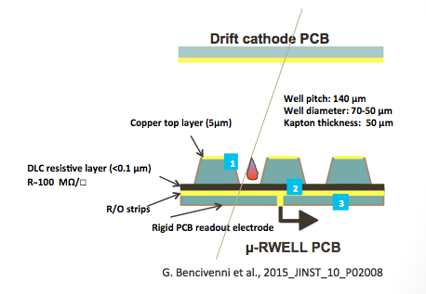
The µ-RWELL option
The µ-RWELL is composed by:
The µ-RWELL PCB and the drift cathode PCB + frame to seal the gas volume
The µ-RWELL PCB is realized by coupling:
a suitable kapton foil patterned with a µ-WELL acting as a single “amplification stage”
for discharge suppression & current sinking DLC sputtered in one Kapton surface
single resistive layer → surface resistivity ~100 MΩ/☐
expected rate capability << 100 kHz/cm²:
a standard readout PCB with strips
µ-RWELL:
Has simple assembly steps
large area coverage can be easily obtained with the standard PCB splicing technique

Slide 31
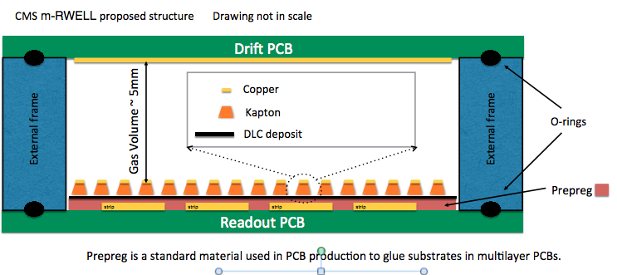
µ-RWELL Motivation & Concept
Motivation
  More efficient tiling of several modules in 20 degree GE2/1 chamber
Benefits
  Simplified mechanical structure and assembly procedure could translate in an effective cost reduction.
  Detector thickness fits space constraints for GE2/1 installation
Concept
  Single-stage amplification structure using a µ-RWELL
    Single amplification structure
    Resistive readout structure to protect the amplification stage against sparks

Slide 32
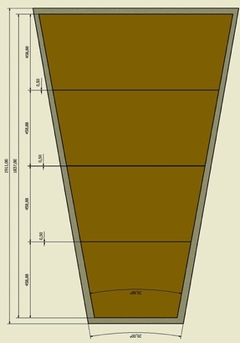
GE2/1 µ-RWELL schematic
Four PCB (M1,..,M4) assembled together using splicing technique (0.5mm dead area between each sector)
One chamber is one gas volume.
1 HV channel/chamber. Very easy to increase the number of HV channel/chamber to increase granularity
Almost negligible dead area (<0.1% of the active surface)
Electronics and services needed for µ-RWELL will be the same of the one needed as for 3-GEM option

Slide 33
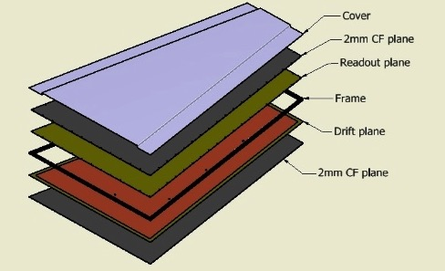

Planned R&D Studies: Mechanical Design _{(1/2)}
Mechanical design of full-size detector (20 degree option)
Started finite element simulations for:
  PCB & cathode deformation studies under gas over-pressure
  due to gas flowing during operations (see next slide)
  Mechanical structure rigidity and robustness studies
  Optimization of FEE housing/cooling/services
  (to fit the available 7.4 mm for GE2/1 installation )
Four PCB µ-RWELL modules spliced with the same technique used for large ATLAS µM + only one cathode PCB closing entire chamber

Slide 34
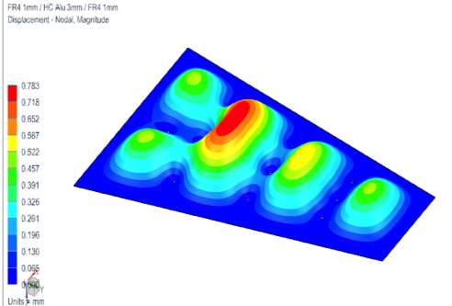
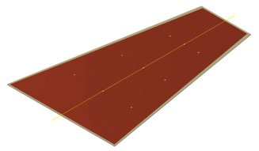

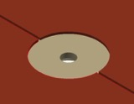
Planned R&D Studies: Mechanical Design_{(2/2)}
PCB deformation of the GE2/1 chamber (20 degree option)
Simulated structure 2x (FR4 1.6mm + HC 3mm + FR4 1.6mm) + Gap 5 mm + 9 pillars of 12 mm diameter
Max deformation 0.78 mm at 8 mbar gas over-pressure (expected 2~mbar during standard operation)
The pillars along splicing zone Pillars implementation in μ-RWELL is easy and introduces an overall dead area of <0.1%
Detail of the µ-RWELL PCB around the splicing and pillar location

Slide 35
GE2/1 µ-RWELL summary
µ-RWELL has potential to simplify construction & assembly of largest GE chambers and to recover dead space between modules: simple construction and assembly procedure can probably reduce total cost
The electronics and services needed for µ-RWELL are not different from the one needed for 3-GEM
Still a lot of R&D work to do:
  Mechanical studies: planarity of the PCB r/o over a large area => produce mechanical mock-up of the chamber setup (will allow also to study FE housing/cooling..); finalize the studies on PCB and cathode deformation due to gas overpressure.
  Measure gain uniformity, space resolution, gas distribution uniformity and time resolution (over large areas)and discharge rate probability
  Aging test at GIF++. Outgassing studies to be done for all new materials introduced, if any.

Slide 36
MEO Detector

Slide 37
ME0 baseline option
Triple GEM detector 3/1/2/1 (as per GE1/1)
Eta Coverage 2.03 – 2.82
20 Degrees – 18 ME0 stacks per endcap
Chamber dimensions smaller than GE1/1 short
To be installed during LS3
36 ME0 super-modules plus all the services in UXC and USC

Slide 38
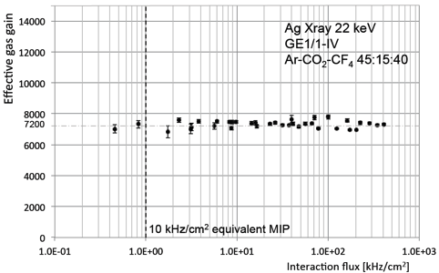
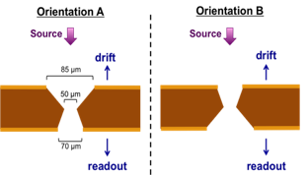
Rate capability
Rate capability:
Modification of the electric field at high rate (space-charge effects)
  Measurements done with X-ray source, charge released by a converted gamma is about 10 times larger than the charge provided by MIP
  No effects up to 10⁴ Hz/mm² (stable gain)
  Increasing of the electron transparency between 10⁴ and 10⁵ Hz/mm² (gain rise)
  Decreasing of the ions extraction around 10⁶ Hz/mm² (gain drop)

Slide 39
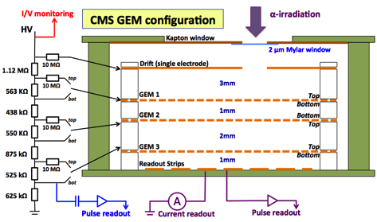
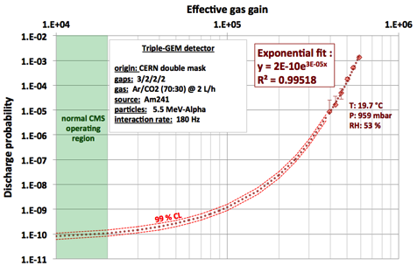
Discharge probability: J. A. Merlin Thesis
Discharge probability:
Initiation of a streamer in case of heavy ionizing event (high charge density)
Can induce long dead time or damages
Protections against discharges:
- Asymmetric sharing of the gain
- GEM foils divided in small sectors
- Use of protection resistances
Procedure:
  - Detection of α-particles from Am²⁴¹
    (perpendicular to the GEMs)
    - Identify pulses on the GEM and the RO with same polarity (typical discharge signals)
Results:
  10⁻⁵ to 10⁻³ at gains of 4-6 x 10⁵
  Expected 10⁻¹⁰ at gain 1-2 x 10⁴

Slide 40
Discharge probability: New tests
Quite large uncertainties on the J. Merlin data extrapolation.
Several data over the years, not all of them with similar results. Different (by order of magnitudes ) discharge probabilities..
Different GEM configurations and beam configurations
Small detector size (10 x 10 cm2)
Tests for ME0 seem appropriate
Test Time required
Suppose we observe no Discharge Event (DE) in ∆𝑡. Upper limit for Zero events would be n=3 ( «Rule of three» : 𝑃 0,𝑛 = 𝑒^{−𝑛} ≥ 0.05 ) @ 95% CL
To quote a Discharge Probability (DP) of 10⁻⁷ = 3/h_{𝑛}∆𝑡𝐴 , h_{𝑛} = 1 𝑘𝐻𝑧/𝑐𝑚² neutron hit rate, 𝐴 = 10² 𝑐𝑚² detector area would take ∆𝑡 = 300 𝑠 (n.b. Neutron sensitivity is about 2 10⁻³ => Neutron Flux ~ 2 10⁶ n/cm² s)
To quote a Discharge Probability (DP) of 10⁻¹⁰ would take ∆𝑡 = 3.4 𝑑 (of continuous running)
Test running time of order of 1 week .

Slide 41
New tests at CHARM facility @ CERN
Problems and Constraints
This is not a standard TEST-BEAM
First time a gas Detector @ CHARM
15 m cables from DUT to Patch-Panels
17 m cables from Patch-Panels to CRoom
50 m Gas line
gas bottle into the CHARM buffer zone
GEM
Gas Bottle
PatchPanel

Slide 42
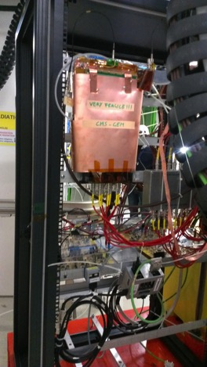
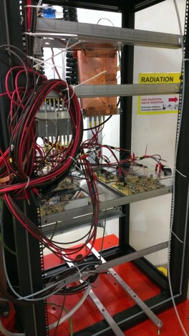
New tests at CHARM facility @ CERN
The GEM mounted on the RACK
RadMON installed by the Facility
Give information of Hadron Flux

Slide 43
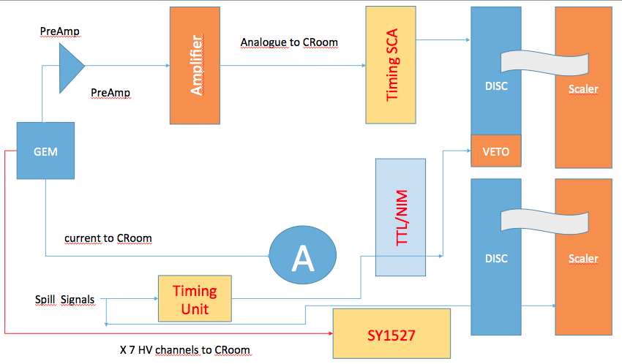
New tests at CHARM facility: DAQ
Data Analysis just started …

Slide 44
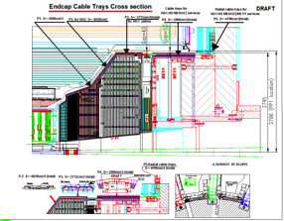
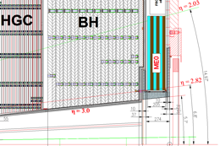
ME0 detector in CMS
Space, space my kingdom for more space
In the actual layout 205 mm are available for the stack plus 15 for the base support

Slide 45
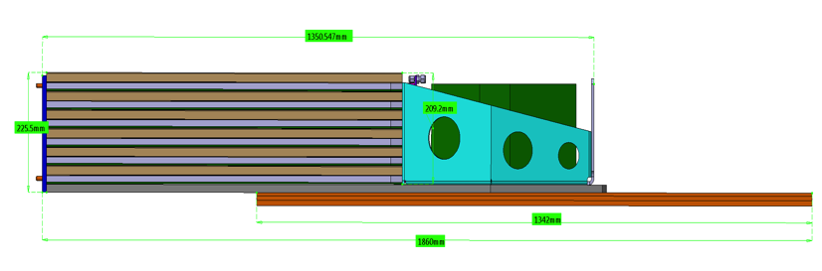
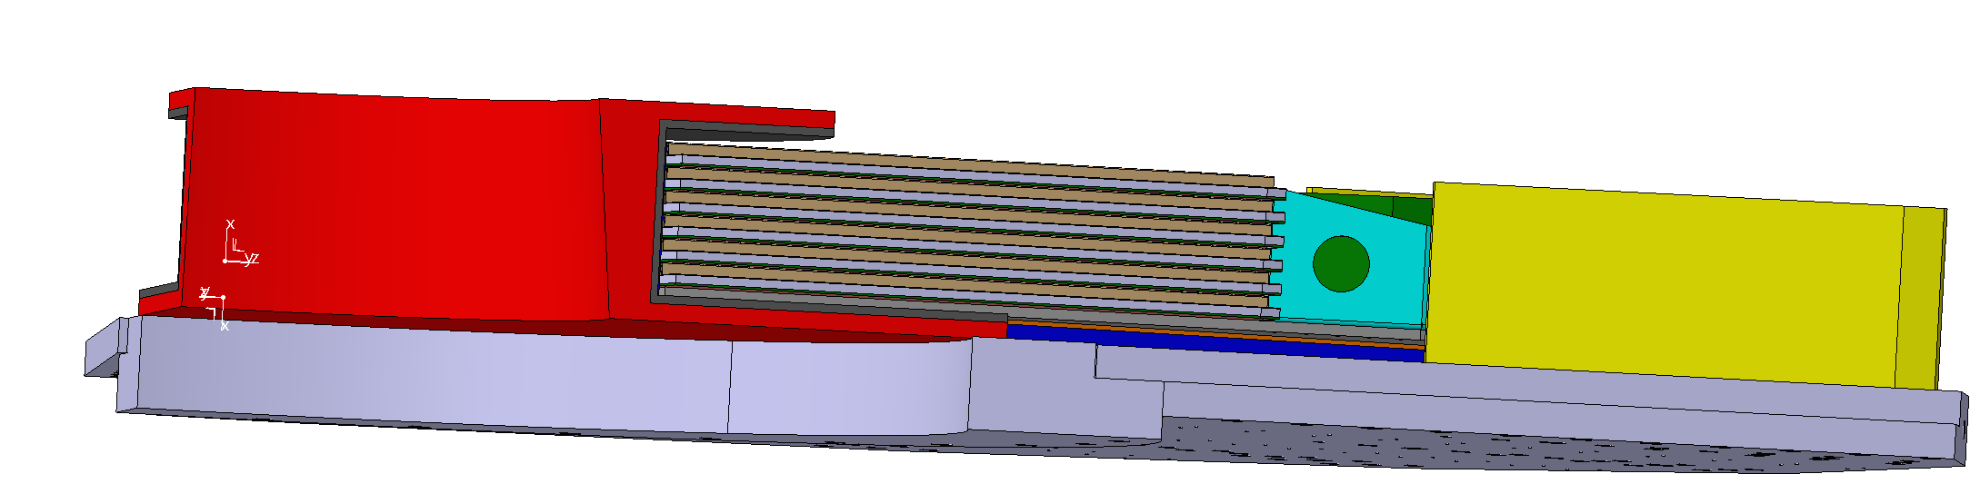
ME0 detector in CMS
Ideas to gain space: (to be investigated)
Reduce the thickness of the base support -> 15 mm to 10 mm (not Aluminum anymore, Carbon Fiber?)
Modify the nose shape, Read structure inserted in the Grey support

Slide 46
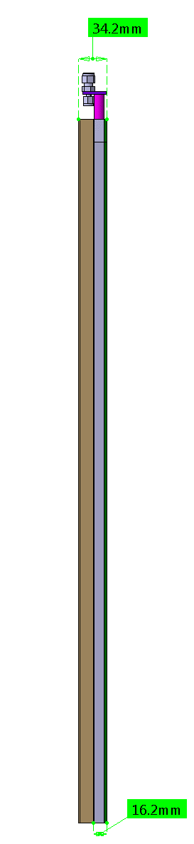
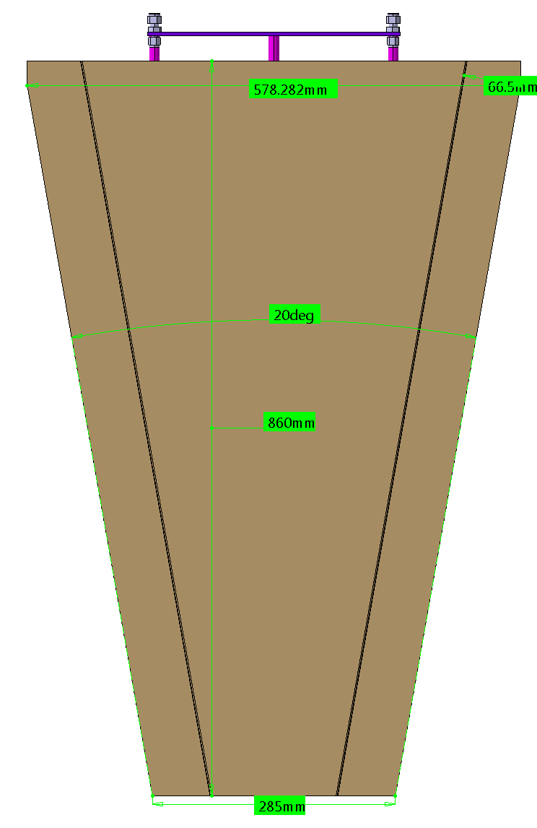
ME0 Baseline option, chamber geometry
If will not be possible to gain space than:
New design is in progress
3.2 mm Thick PCB replaced by 3 mm PCB
New chimney of 17.6 mm
Total chamber thickness 33.4 mm
Small enough to accommodate 6 chamber per stack in 205 mm
Here pictures from not updated layout, dimensions of active area and chambers surface unchanged
3 mm PCB is not standard size, an ad hoc production have to be required, feasible on large numbers as ME0 maybe will increase the chamber deformation under the gas pressure and mechanical stress

Slide 47
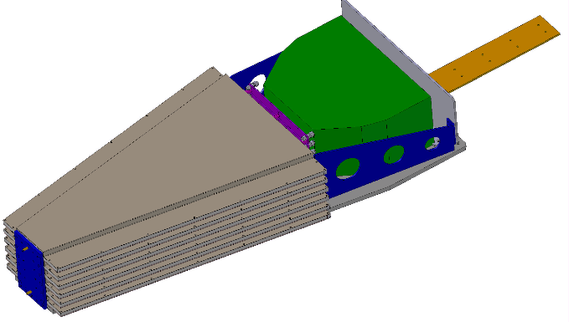
ME0 Baseline option, stack geometry
Go-Out Services path
Electronics Volume
DC/DC converter and OHs
Structure of 6 layer GEM* detectors, Base line technology is the triple GEM
* Other MPGD technologies are under study at the moment

Slide 48
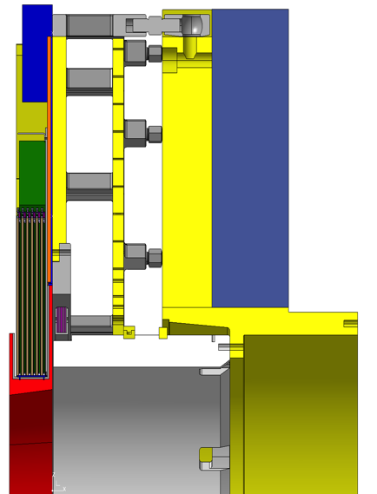
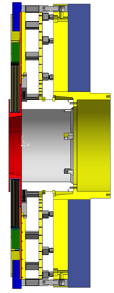
ME0 position in CMS

Slide 49
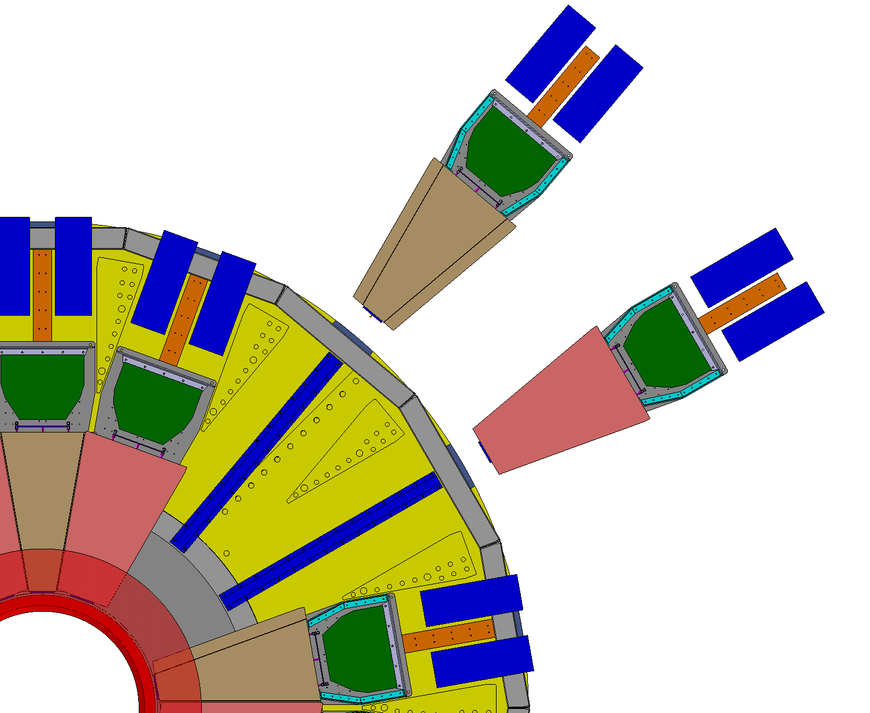
ME0 position in CMS
In order to assure overlap between two adjacent detectors, two subsequent stacks will be installed front-back each other

Slide 50
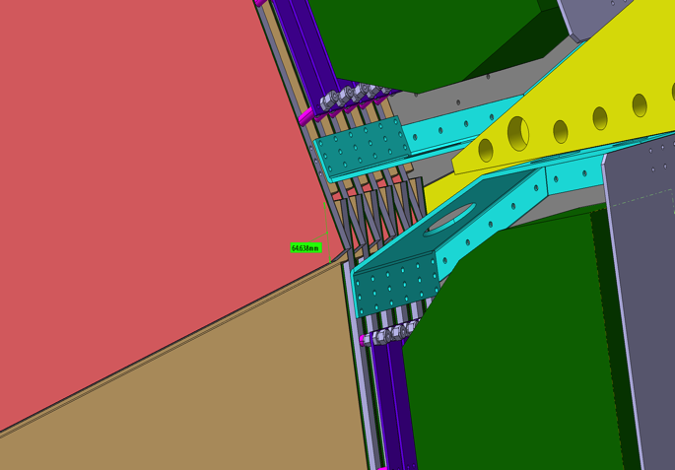
ME0 chambers overlap
The mechanical overlap between two adjacent stacks will about 6.5 cm
Detector overlaps

Slide 51

ME0 chambers overlap
Detectors overlaps

Slide 52
ME0 baseline option
Mechanical Summary
36 20 deg. Stacks == > 18 per side
216 Chambers == > unique type
Chamber size ~ 57 cm X 86 cm (Smaller than GE1/1 short)
648 Foils == > unique types
48 Strips group per chambers ( channels density twice GE1/1) to deal with the high rate and the necessary resolution performances

Slide 53
Electronics components for the ME0 baseline options
Two opto-hybrid x chamber
RO board not yet finalized
Possible option 6phi partitions x 8 partitions (48 group of 128 strip => ~0.5 mrad )
Challenging to fit 48 hybrids in such a small space (also reduced by the chimney )
10368 Front-End chips (VFAT) (48 x 6 x 36)
432 opto-hybrid with 24 VFAT input (2 per chamber or OH need to be completely redesigned)
Opto-hybrids “outside” the chamber, to be defined the available space for the OH
1 per chamber, 6 GEB per stacks
216 GEB in total for the ME0 project
48 VFAT
1 GEB

Slide 54
Synergies with other projects
The Baseline detector for the ME0 chambers, ( with the layouts presented here), share several aspect with the ongoing GE1/1 project.
No different materials are expected to be used to build the ME0 w.r.t. the GE1/1
Chambers will have dimensions comparable with the GE1/1 short chambers == > tooling and setups prepared for the GE1/1 can be mostly re-used.
The new CMS GEM clean room, in preparation in bd. 904 (Prevessin) will be large enough to host the production of the ME0 chambers,
Electronics developed for the GE1/1 can be adapted to the ME0 chambers

Slide 55
Synergies with other projects
The triple GEM detectors, the baseline option chosen for the ME0 modules, is the same technology used by GE1/1 this mean:
  Tooling and setup, (some of them quite expensive: X-ray, copper boxes, cosmic ray stand, …) prepared for the GE1/1 production can be reused for the ME0 production and tests.
  Crew trained for the production and test of the GE1/1 can easily move to the production and test of the ME0 baseline option.
  Production sites “certified” for the production of GE1/1 chambers don’t need to be certified again
  Production of ME0 modules can be seen as continuation of the GE1/1 and GE2/1 chambers

Slide 56


R&D ongoing activity (B2B)
The detector is composed of two stacked triple-GEM detectors, each one with parallel readout strips
  One GEM has 256 strips in the x – axis
  One GEM has 256 strips in the y – axis
A single HV supply powers both the triple-GEM
On detector’s board

Slide 57

B2B rate measurements
  Measurements performed with ¹⁰⁹Cd source
  On both the triple-GEMs composing the detector
  Placing the source in different positions (red markers) on the active window to test the operation of the entire active area
Results show that the detector works properly and reaches a plateau.

Slide 58
B2B tests
Gain at plateau varies between 15% (at 1435,95 µA divider current)
and 40% (at 1427,25 µA divider current)
  Measurements performed with ¹⁰⁹Cd source
  Placing the source in different positions on the active window to test the operationg of the entire active area
  (see below: values with multiple markers)
  Detector’s proper working demostrated
  Measured gain at plateau > 2000 (up to about 8000) depending on applied voltage
  Next:
  Analysis of data acquired at H2 test beam [gas mixture Ar/CO₂ 70/30)] from spatial point of view (spatial resolution, cluster size), efficiency calculation
  Test beam at H4 ongoing to test spatial and timing performance in gas mixture Ar/CO2/CF₄ 45/15/40

Slide 59

Fast Timing Micropattern (RTM) R&D
The contribution to the time resolution of the drift velocity is:
t=d/v_{d}
σ_{t}= (λv_{d})⁻¹
With a drift gap of the order of 3-4 mm and with a proper choice of the gas mixture, these detectors can reach a time resolution of the order of 5-10 ns.
The idea is to divide a single thick drift region in many thinner drift regions, each coupled to its amplification stage.
The reduction in time resolution is proportional to the number of stages ND employed
When the avalanche grows in one drift-amplification stage, the signal is induced on the top and bottom readouts.
The construction of consecutive drift-amplification stages is allowed by the use of resistive layers to polarize drift and multiplication volumes. The overall structure is then transparent to the signal, that can be extracted at every amplification stage.

Slide 60

FTM first prototype
Each amplification region is based on a pair of polyimide foils stacked due to the electrostatic force induced by the polarization of the foils:
The first foil, perforated with inverted truncated-cone-shaped holes (bases 100 μm and 70 μm, pitch 140 μm), is a 50 μm thick Apical KANECA, coated with diamond-like carbon (DLC) technique, to reach up to 800 MΩ/□ resistivity.
The second foil is 25 μm thick XC Dupont Kapton, with a resistivity of 2 MΩ/□.
The drift volumes are 250 μm thick, with planarity ensured by coverlay pillars, with diameter 400 μm and pitch of ~3.3 mm.
The detector is composed by two independent drift-amplification stages (Layer 1 & 2 in the picture above)
Reference:arXiv:1503.05330v1
European Patent Application 14200153.6
M. Maggi, A. Sharma, R. De Oliveira

Slide 61


FTM first prototype: timing results
The plots show the time distribution of the signal pickup from the drift electrode, with muon beam (top left) and pion beam (bottom right).
The time resolution is estimated from the sigma of the gaussian fit of the distribution.
The electronics chain used to readout the signals was composed by a Cividec broadband amplifier (x100) and a Lecroy linear amplifier (x7.5) → Different electronics from lab test: faster for timing measurement!

Slide 62
Production Schedule GE2/1 and ME0
Preamble:
This schedule is related only for the baseline option, with the assumption that at the time of the production at least two vendors of GEM foils will be available and four production sites, all of them with similar capacity of chamber construction
GE2/1 | Tot Chambers: 72 |  | Total Modules: 288 |  | GEM foils needed: 864 |  | Foils Prod sites:2 |  | Prod. Lines : 4
ME0 | Total Stacks: 36 |  | Total Chambers: 216 |  | GEM foils needed: 648 |  | Foils Prod sites:2 |  | Prod. Lines : 4

Slide 63
Production Schedule GE2/1
 |  | 2018 Q3 | 2018 Q3 | 2019 Q1 | 2019 Q2 | 2019 Q3 | 2019 Q4 | 2020 Q1 | 2020 Q2 | 2020 Q3 | 2020 Q4 | 2021 Q1 | 2021 Q2 | 2021 Q3 | 2021 Q4 | 2022 Q1 | 2022 Q2 | 2022 Q3 | 2022 Q4 | 2023 Q1 | 2023 Q2
 | GE2/1 Pre-prod ( CERN)
 | GE2/1 Foils Prod (Site 1)
 | GE2/1 Foils Prod (Site 2)
 | GE2/1 Module Prod (Line 1)
 | GE2/1 Module Prod (Line 2)
 | GE2/1 Module Prod (Line 3)
 | GE2/1 Module Prod (Line 4)
 | Chamber Assembly and tests
 | GE2/1 Contingency
 | GE2/1 Installation
Implication:
PRR and EDR for material procurements have to be done in second half of 2018
Final version of Readout Electronic, as well as of cooling system and services on chambers have to be ready by Q1 2021

Slide 64
Production Schedule ME0
 |  | 2021 Q4 | 2022 Q1 | 2022 Q2 | 2022 Q3 | 2022 Q4 | 2023 Q1 | 2023 Q2 | 2023 Q3 | 2023 Q4 | 2024 Q1 | 2024 Q2
 | ME0 Foils Prod (Site 1)
 | ME0 Foils Prod (Site 1)
 | ME0 Module Prod (Line 1)
 | ME0 Module Prod (Line 2)
 | ME0 Module Prod (Line 3)
 | ME0 Module Prod (Line 4)
 | ME0 Stacks Assembly and tests
 | ME0 Installation

Slide 65
Backup

Slide 66
Direction Measurement
L1 muon momentum resolution can be improved with a second detector if we can measure the “bending angle”
GE2/1 granularity:
Min Radius 136cm
Max Radius 320 cm
strips/etapartition 768
pitch@Rmax 0.14 cm --> 0.45 mrad.
pitch@Rmin 0.06 cm
Proposed granularity matches well trigger requirements and tracking requirements
  Two or Four strip pads (VFAT defaults) provide good direction measurements
    Table below shows trigger rate reduction for 20 GeV L1 muon trigger
    Good direction measurement is critical for displaced muons (next slides)
Choice | 2-strip pad (1 mrad) | 4-strip pad (2 mrad) | 8-strip pad (4 mrad) | 16-strip pad (8 mrad)
GE21 1.6<η<2.1 | 2.5+/-0.2 | 2.4+/-0.2 | 2.0+/-0.2 | 1.7+/-0.2
GE21 2.1<η<2.4 | 1.5+/-0.05 | 1.49+/-0.05 | 1.38+/-0.04 | 1.25+/-0.04

Slide 67

Trigger requirements
Charge 2b
  Another important goal is aiding in resolving ambiguities in CSC reconstruction and improving efficiency
    Timing requirements are not too strict due to multiple redundancy of spatial and timing measurements (6 CSC layers + 2 GEM layers)
    Simulation results shown for local reconstruction used ~8 ns resolution

Slide 68
Trigger requirements
Algorithms for GEM-CSC integrated triggers developed for Technical Proposal using CMSSW 62X in PU140 non-aging conditions.
^{TP} studies with GE2/1 trigger were carried out using single GE2/1 super chamber (2 hits)
Improvements to CSC stub building are significant!
Prompt Muons will be reconstructed with the tracker+muon system in Phase-II with excellent momentum resolution and dramatic rate decrease.
Triggering on non-prompt muons at L1 :
  Tracker is inefficient beyond dxy ~ 2mm
  Muon system is very efficienct up to large displacements!

Slide 69
Trigger on displaced muons
Charge 2b
L1 tracking trigger inefficient if dxy over a few mm.
Current L1Mu algorithm finds displaced muons, but the momentum assignment eliminates non-prompt muons as they look “bent” as soft muons
Can measure momentum for displaced muons by requiring muon directions to be aligned in different stations
  Need at least two direction measurements: GE2/1-ME2/1 is that second measurement (in addition to GE1/1-ME1/1)
  Requirements on precision are the same as for “bending angle”
    Proposed granularity is adequate for this purpose

Slide 70
“Non projective layout”
(closest chamber to the IP)
All strips have the same lenght ➔
Different η angle covered by the strips
Different particle rate on all strips (η partition)
δ η^{n}
δ η^{ΙΙ}
δ η^{Ι}
I.P.
δ η’ ≠ δ η’’ ≠δ η’’’ ≠ …….≠δ η^{n}

Slide 71
“Non projective layout”
( chamber far from the IP)
Strips in module 1 have same length of strips in module 2
Strips in module 3 have same length of strips in module 4
→
Different η angle covered by the strips
Different particle rate on all strips (η partition)
δ η^{n}
Module 3 and 4
Module 1 and 2
δ η^{ΙΙ}
δ η^{Ι}
I.P.
δ η’ ≠ δ η’’ ≠δ η’’’ ≠ …….≠δ η^{n}

Slide 72

Readout Board internal view
19 mm, the distance between the edge of the PCB and the first strip
Internal view
17 mm, the distance between the edge of the PCB and the first strip
10 mm
0.2 mm strips separation both in phi and eta (0.2 phi 0.5 eta in GE1/1)

Slide 73
HV schema for GE2/1 : Option A
28 ch. per chamber (56 ch. Per super-chamber)
Two HV Module, GE1/1 model, (multichannel system), to power one GE2/1 chamber.
Four HV Module for a super chamber
72 HV Modules (x 7 channel) per EndCap
144 HV Modules in total

Slide 74
HV schema for GE2/1 : Option A
14 ch. per chamber (24 ch. Per super-chamber)
One HV Module, GE1/1 model (multichannel system), to power one GE2/1 chamber.
Two modules will be necessary to power a super-chamber which will cover 20 Deg.
36 HV Modules (x 7 channel) per EndCap
72 HV Modules in total

Slide 75


Production organization
Charge 8
M4
M3
PCB production site (probably one)
Prod. Site M1
M2
M1
Prod. Site M2
Foils production site M1 / M2
Integrationsite (904)
CERN
Prod. Site M3
Foils production site M3 / M4 (CERN)
To P5
Prod. Site M4 (CERN)
Minor components procurements
(CERN)

Slide 76


Discharge probability (ME0)
Consequences of discharging:
Accumulation of 450 discharges during the entire test, in few cm2
Thin deposition of copper oxide in the irradiated region (all GEM foils)
Superficial copper etching near the rim of the holes
These effects do not affect the operation of the detector (non-destructive discharges)
Conclusions:
~ 7500 discharges expected in the whole chamber during the entire ME0 life of the detectors
expected safe operation at gas gains up to several 10⁴

Slide 77


Slide 78


Slide 79






GEM Phase 2 R&D: Neutron Discharge Probability
V-I Control and Monitor
A. Braghieri, INFN Pavia
Oct 17, 2016
NETWORK
Keithley 6487 picoamm
A laptop has been configured under Linux OS to…
CONTROL the mainframe
MONITOR PICOAMMETER (RS232)
act as DATA LOGGER (store data)
MONITOR trend of currents and Voltages
SY 1527 + A1515
GEM3 det

