Slide 1

Internal review of the 11T dipole reaction fixture and impregnation mould
Outcome of the meeting
F. Savary
19 October 2016 - CERN

Slide 2
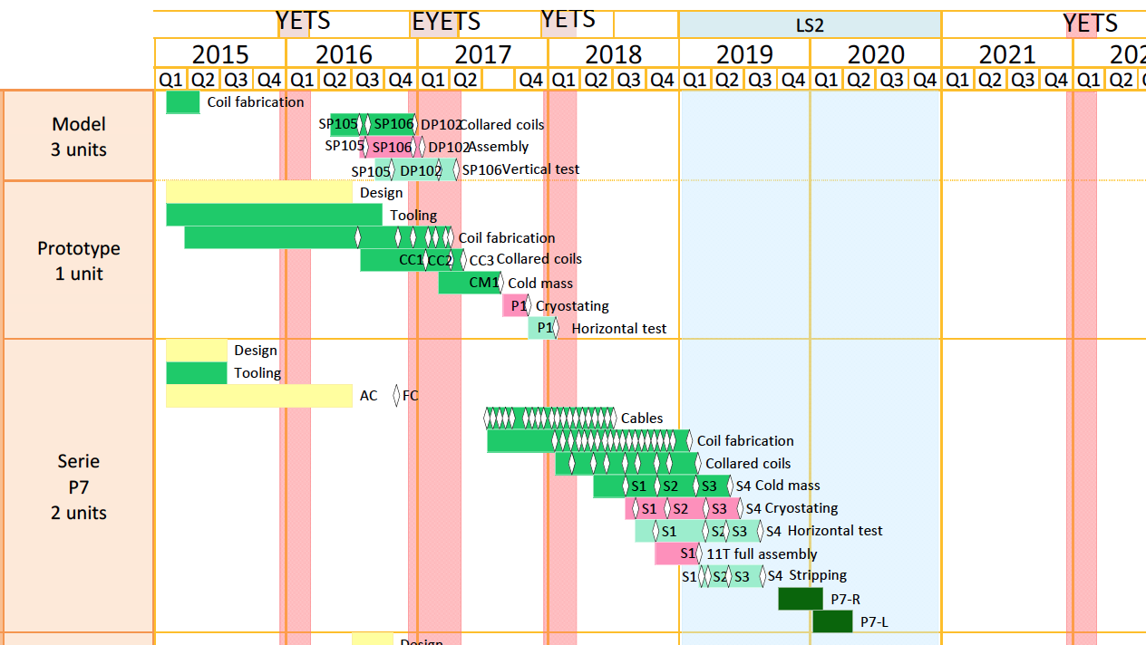
Schedule X-Section 1 – October 2016
End March 2017
Beginning October 2017

Slide 3
What we know about the coil size
All size, loading plate angle, outer radius, and azimuthal excess, vary from one coil to another even for coils which are nominally identical, and impregnated in the same mold
All size of a given coil vary along the straight part, also in the ends to a lower extent
The reason for the coil size variations is not known. Additional measurements (metrology, E-modulus on full X-section), and characterization of the cable insulation system, are needed to ‘hopefully’ understand the cause of these variations
Tolerances are proposed. At the moment, the tolerances on the outer radius and azimuthal excess are not linked
Not all the coils meet the proposed tolerances. However, such deviations do not seem to impact on the quench performance

Slide 4
Reaction 1
Reaction oven is ok. However, we need to integrate filters and replace the original oxygen sensors A15E . This is on-going work. ZrO₂ solid electrolyte sensor (Metrotec) is now available, and can be used prior to launching the heating cycle (can be used only for clean Ar)
Ar flow in the retort can be improved (and will be)
Design of reaction fixture largely based on the FNAL concept
Radial size of the reaction fixture larger than radial size of the impregnation mold by 0.1 mm. This is to allow relative movement of the coil w.r.t. the fixture during temperature ramp-up and cool-down, and Nb₃Sn compound formation
Radius of the form blocks = 62.25 mm
Radius of the coil = 60.6 mm + a layer of 0.25 mm Mica + a layer of 0.5 mm and one of 0.3 mm for the Ar grids + 0.5 mm seal foil, giving a total of 62.15 mm
Easier to close the fixture, than closing the impregnation mold
The fixture is not leak tight, and this is not a requirement
Place holders for the VAMAS samples shall be integrated, like in the QXF fixture, both at inlet and outlet

Slide 5
Reaction 2
The Ar grids put on the outer surface of the coil do not seem to work as expected (provide radial venting for Ar flow and coil degassing residues). However, they do not affect the functionality of the fixture
Cooling traps are congested by a large amount of agglomerate coming from the degassing residues (glass fiber sizing, silicon, ceramic binder), both from the fixture and from the retort (the latter likely coming from the leaking fixture)
Although residues are collected in the cooling traps, there is probably still a lot in the coil
The last three points advocate for an ‘open’ mold allowing more effective venting/cleaning of the coil. Then, one needs to make sure all the residues can be collected in the cooling traps (large ones, or several in parallel … with filtering)
Temperature sensors type K will be replaced for type N. The calibration of the T sensors is done according to standards
Almost 2 days are needed to reach the first temperature plateau. A lighter fixture would help (and/or more conductive)
The length of the coil does not change after the reaction process. However, there is a visible change after curing: the coils get shorter when they are detached from the mandrel

Slide 6
Impregnation 1
The total duration of the process is 110 hours, excluding cleaning. This translates into about 10 working days, of which 2.67 days of round-the-clock process: (1) vacuum drying (48 hours) and (2) post cure (16 hours). Then, additional 28 hours are needed for cleaning
Assuming that we have 2 resin injection systems, we can hope for a 2-week occupancy of the machine per coil
Transferring the coil from the reaction to the impregnation
mold is very delicate, as the coil tends to relax and expand when the form blocks are removed (it is like a loaded spring or accordion). Unfortunately, we cannot avoid having the coil entirely
uncovered, e.g. traces and sealing foils need to be installed.
This does not happen on short coils
The mounting and precise positioning of the loading plates
is difficult
The mounting of the form blocks is difficult in the strait part, it is
okay in the ends (over about 500 mm)
The closure of the mold is difficult in the case of the long coils, the sealing foil is not perfectly straight and it tends to move/rotate during the mounting of the form blocks. This is a major issue
There are many bolts, about 150, maybe tedious but not a major issue … are we sure we can close the mold parallel?

Slide 7
Impregnation 2
Radius of the form blocks = 61.44 mm
Radius of the coil = 60.6 mm + QH 0.1 mm + glass fiber wrap
0.1 mm + sealing foil 0.5 mm (0.54 mm if coated, 0.61 mm if Teflon film), giving a total of 61.34 mm (coated) or 61.41 mm (Teflon film)
There are differences between the model and long magnets as regards to utilization of coating or Teflon film on the surfaces in contact with the coil, e.g. Teflon coating is used on the mandrel in 927
The design of the end caps used for the short coils is better
The circumference of the seal foil is excessive in the tooling for the long coils, it is smaller (better) for the short coils
Protection strips made of ceramic are used during the splicing to reduce heat loss towards the heavy base plate
Laser cutting of glass fiber fabrics has a lot improved quality and handling of these parts
Loading plates are shot blasted on the side of the coil to ensure good adhesion through resin

Slide 8
Preliminary ideas
Use aluminum rather than stainless steel (impregnation mold)
Use thicker sealing foils for impregnation
Provide larger venting in reaction fixture
…

