Slide 1
APEL Storage Accounting
Pre-GDB – 2017-09-12
John Gordon, STFC
2017-09-12 Pre-GDB on Storage

Slide 2
Summary
APEL storage accounting is available for dCache and DPM which covers most sites
  Records LogicalCapacityUsed per VO/Group/Role and displays max/min/avg per month
  About 30 sites are now sending storage accounting records to APEL
  Data viewable in the old development Accounting Portal:
    http://accounting-devel.egi.eu/storage.php
EGI plans to move this into production RSN

Slide 3
Recent Updates
  Added Role/Group to record
  Added new GOCDB servicetype eu.egi.storage.accounting to identify publishing hosts
  Moved to production broker queue and SSL
  Correct portal averaging

Slide 4
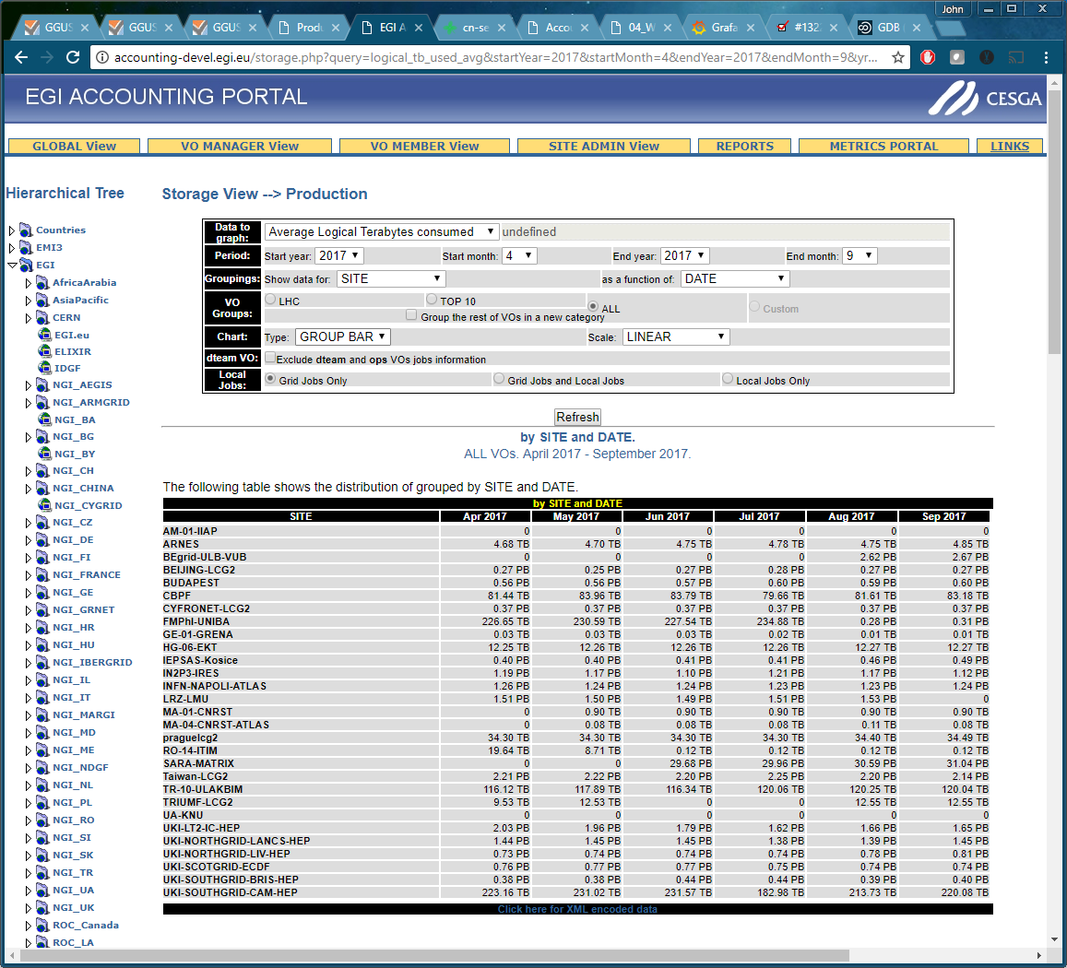
Current Storage Sites

Slide 5
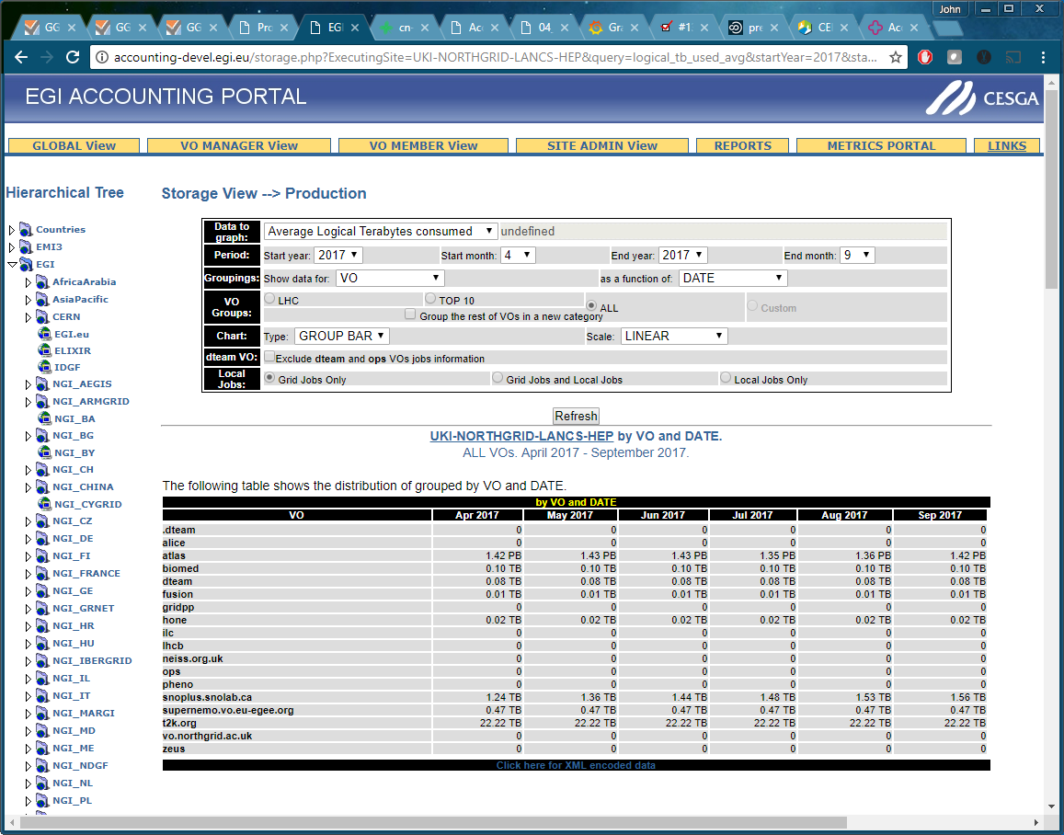
Site View

Slide 6
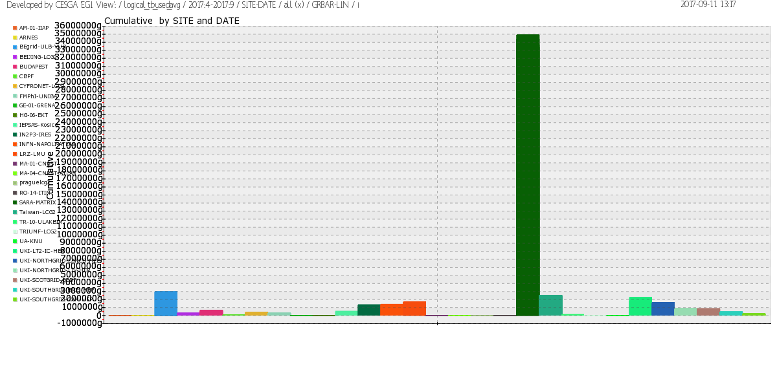
All Sites
Plots

Slide 7
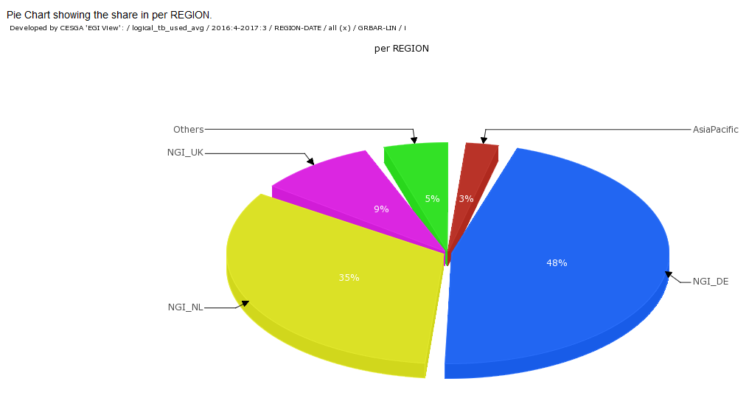
All Sites
Plots

Slide 8
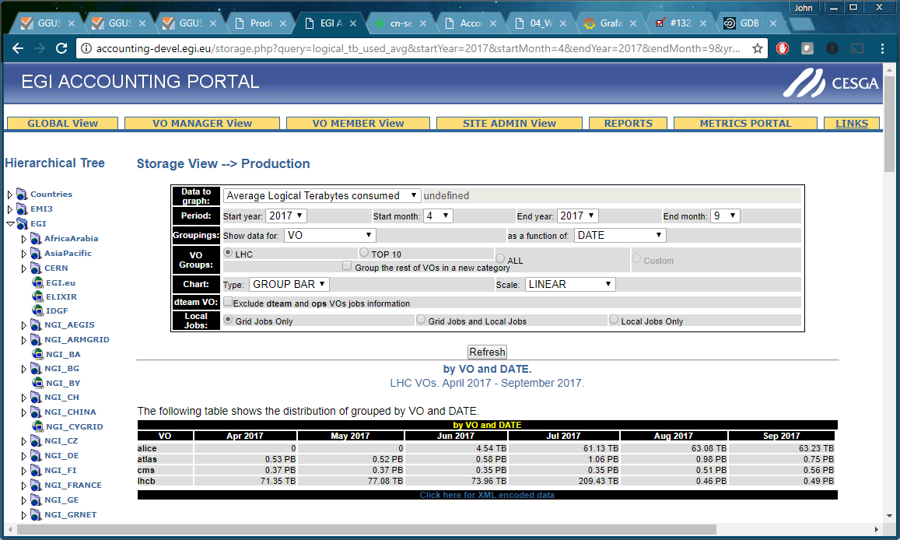
LHC VOs
Notes:
Just like CPU, one can use the tree on the left to navigate among NGIs and Sites.

Slide 9
Next Steps
Move to production
  Campaign to get dpm/dcachesites publishing
Increase range of storage systems supported
  Straightforward script to query database and fill record template
  Ingest JSON files produced by sites
    E.g ATLAS or WLCG standard format
APEL has demonstrated it can combine data from a variety of sources to give a global view.
  Developed pull model for IndigoDataCloud and Dataset accounting as well as the traditional push model of grid cpu over broker network.

Slide 10
Thank You
Questions?

