Slide 1

HNSciCloud Status Update
Helge Meinhard / CERN-IT
HNSciCloud Technical Leader
WLCG Grid Deployment Board 11-Jan-2017

Slide 2
Computing Challenges for Science
LHC upgrades: x16 in 8 years’ time
Other HEP projects: Belle II, neutrinos; FCC, ILC
Other physics: LSST, SKA, CTA
Bioinformatics: x2 per year
Photon/neutron science
All have sharply increasing data processing and storage needs beyond on-premise resources
Fluctuating demands hardly compatible with fixed on-premise resources
Potential solution: public clouds

Slide 3
Issues with Public Clouds
Disruptive to our usual way of resource provisioning
Not integrated with on-premise resources and/or publicly funded e-infrastructures
Procurements: Current organisational and financial models and technical skills and experience don’t fit
Legal impediments exist

Slide 4
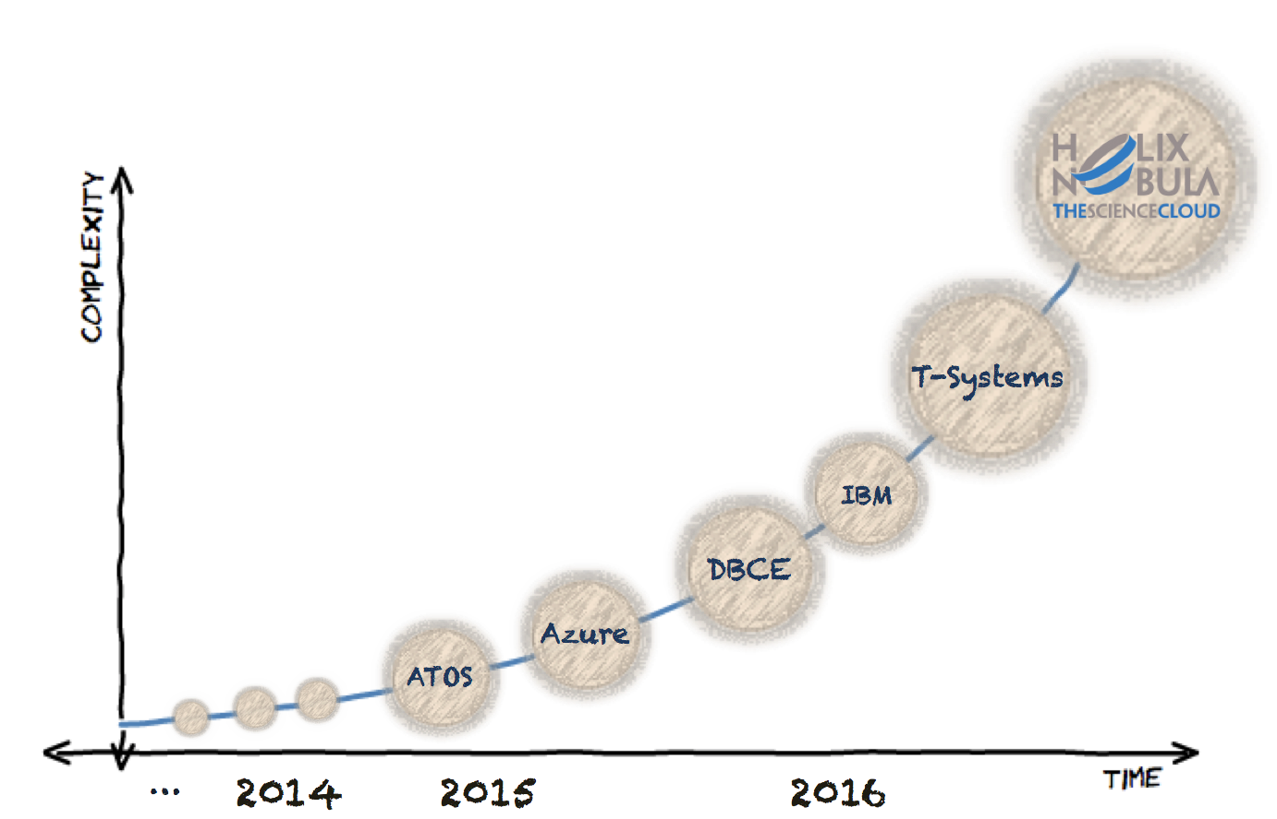

CERN Approach
Since ~2014, series of short CERN procurement projects of increasing scale and complexity

Slide 5





2nd
Mar.
6th
Nov.
1st
Aug.
End: 31st of March 2015
ATLAS simulation jobs
Single core VMs
Up to 3k VMs for 45 days
1st Cloud Procurement
End: 18th of Dec. 2015
Target all VOs, simulation jobs
4-core VMs, O(1000) instances
2nd Cloud Procurement
End: 30th of Nov. 2016
Provided by OTC IaaS
4-core VMs, O(1000) instances
500TB of central storage (DPM)
1k public IPs through GÉANT
3rd Cloud Procurement
2016
2015
Agreement between IBM and CERN
CERN PoC to evaluate:
  Resource provisioning
  Network configurations
  Compute performance
Transparent extension of CERN’s T0
End: 13th of May 2016
Sponsored Account
“evaluation of Azure as an IaaS”
Any VO, any workload
Targeting multiple DCs:
  Iowa, Dublin and Amsterdam
End: 30th of Nov. 2015
23rd
Mar.
20th
Nov.

Slide 6










HELIX NEBULA The Science Cloud
Procurers: CERN, CNRS, DESY, EMBL-EBI, ESRF, IFAE, INFN, KIT, SURFSara, STFC
  Procurers have committed funds (>1.6M€), manpower, use-cases with applications & data, in-house IT resources
  Experts: Trust-IT & EGI.eu
Objective: procure innovative IaaS level cloud services
  Fully and seamlessly integrating commercial cloud (Iaas) resources with in-house resources and European e-Infrastructures
  To form a hybrid cloud platform for science
Services will be made available to end-users from many research communities: High-energy physics, astronomy, life sciences, neutron/photon sciences, long tail of science
Co-funded via H2020 (Jan’16-Jun’18) as a Pre-Commercial Procurement (PCP) project: Grant Agreement 687614, total procurement volume: >5M€
R&D is a very important part – represents > 50% of contract volume

Slide 7
HNSciCloud – Challenges
Compute
  Mostly HTC, integrating some HPC requirements
  Full support for containers at scale
Storage
  Caching at provider’s site, if possible automatically (avoid managed storage)
Network
  Connection via GÉANT
  Support of identity federation (eduGAIN) for IT managers
Procurement
  Match of cloud providers’ business model with public procurement rules

Slide 8
HNSciCloud – Project Phases
Preparation
Analysis of requirements, current market offers and relevant standards
Implementation
Build stakeholder group
Develop tender material
and sharing
We are here
4 Designs
3 Prototypes
2 Pilots
Tender
Call-off
Call-off
Jan’16
200+ downloads
70+ requests
for clarifications
Each step is competitive - only contractors that successfully complete the previous step can bid in the next
Dec’18

Slide 9
HNSciCloud – Achievements So Far
Official start of project: Jan 2016, duration: 30 months
Tender announced in Jan 2016
17-Mar-2016: Open market consultation
21-Jul-2016: Tender issued (> 200 downloads, > 70 requests for clarification)
07-Sep-2016: Tender information day – design phase
19-Sep-2016: Deadline for tender replies
  Sufficient number of valid tenders received
  Evaluation by administrative and technical experts
07-Oct-2016: Award decision, contracts
02-Nov-2016: Kick-off meeting with Design Phase contractors
12 and 13-Dec-2016: Mid-phase review with Design Phase contractors

Slide 10
HNSciCloud – Design Phase Contractors
T-Systems, Huawei, Cyfronet, Divia
IBM
RHEA Group, T-Systems, exoscale, SixSq
Indra, HPE, Advania, SixSq
Other major players not interested or dropped out just before tender submission

Slide 11
HNSciCloud – Envisaged Solutions
HTC: Standard offerings
HPC: Mostly via specialised partners
Storage: ONEdata; GPFS/SpectrumScale and NFS
AAI: Indigo AIM; direct support of SAML 2.0
Remember: It’s early days, solutions need to be verified and submitted to ‘reality check’

Slide 12
HNSciCloud – Design Phase
30-Jan-2017: Deadline for end-of-phase reports and other deliverables
23-Feb-2017: Decision on which contractors passed design phase successfully

Slide 13
HNSciCloud – Prototype Phase
24-Feb-2017: Request for tenders out
10-Mar-2017: Deadline for tender submissions
28-Mar-2017: Decision on contracts
04-Oct-2017: Deadline for end-of-phase reports and other deliverables
26-Oct-2017: Decision on which contractors passed prototype phase successfully

Slide 14
HNSciCloud – Pilot Phase
27-Oct-2017: Request for tenders out
17-Nov-2017: Deadline for tender submissions
06-Dec-2017: Decision on contracts
13-Nov-2018: Deadline for end-of-phase reports and other deliverables
04-Jan-2019: Decision on which contractors passed pilot phase successfully

Slide 15
HNSciCloud – Contacts
Further details:
  See http://www.hnscicloud.eu/
  Subscribe to hnscicloud-announce@cern.ch

