Slide 1
Asian Network Status
Hsin-Yen Chen
GDB
8 Mar. 2017
Taipei

Slide 2
Outline
Asian NREN Infrastructure
  National/Regional R&E network
  International partners’s network
WLCG Network in Asia
  Open R&E Exchange Network
e-Science development in Asia

Slide 3
The Asia Pacific…
More than half the world’s population
  Rapidly growing proportion of global R&D
  Rapidly growing population in education at all levels
  Strong social pressures around food, health
  Immense diversity
APAN: Partnership of NRENs
    16+ Economies as primary members, 22+ Affiliates, Associates, Liaison and Industry partners
  Formed 1995, incorporated 2009
    MoU partnership became APAN Ltd (HK)
  Independent, self-governing, many investors
  Started with high speed links of 1-2Mb/s… within the region

Slide 4
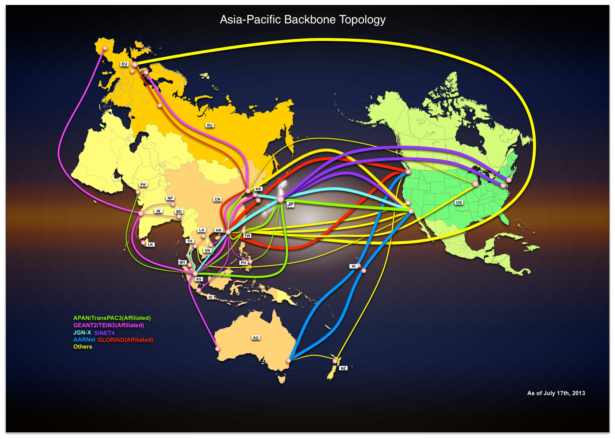
0.5Mb/s -> N*10-100Gb/s over the last fifteen years

Slide 5
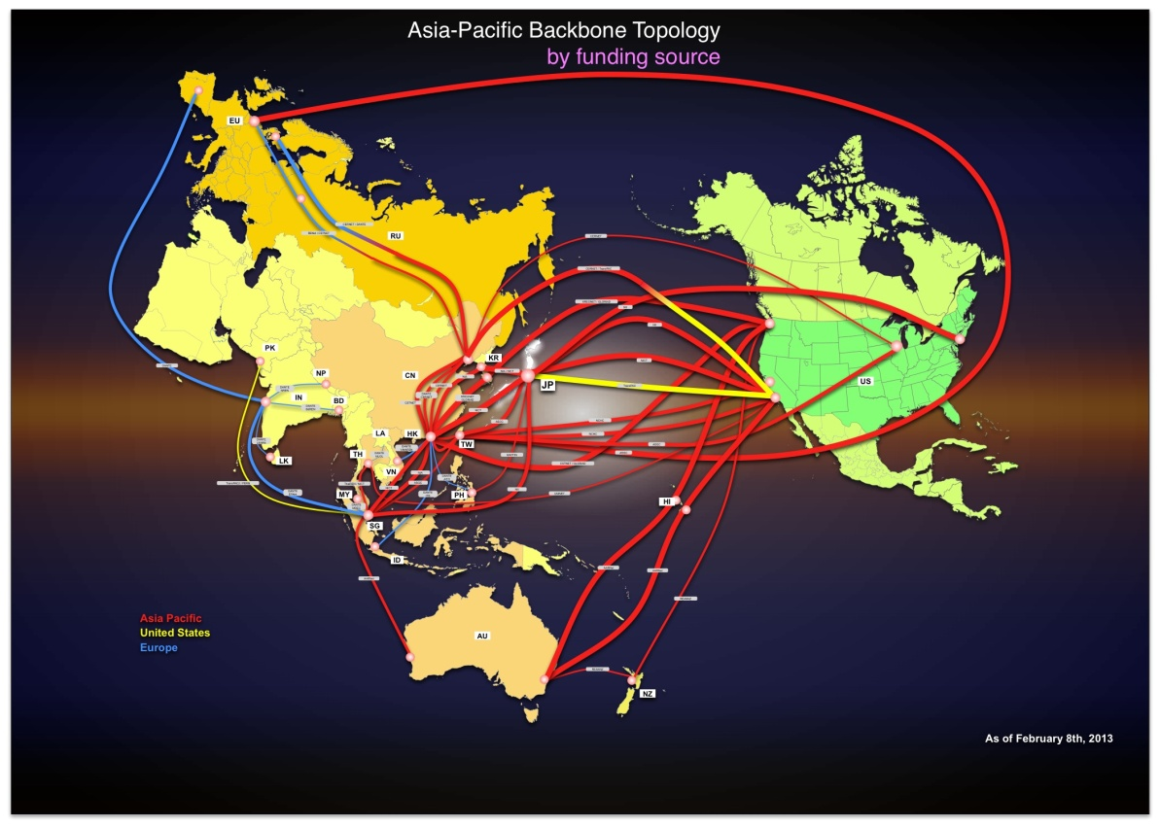

Slide 6
Domestic/international bandwidth
Domestically: few Mb/s up to 100Gb/s
Internationally: 10-100Mb/s up to 1-100Gb/s
Several 100Gb/s international paths emerging
  TransPAC4 (US/Asia,)
  Australia, Korea, Japan, Singapore, …
  Asia/EU still growing, 10Gb/s

Slide 7
NRENs and RRENs
Benefits of NRENs
  Enabling infrastructure for Research and Education
  Value scales exponentially with community size
  Provide national services to members
  Provide ‘burst’ capacity
Benefits of RRENs
  Work on common interests/needs across a region
  Aggregate demand and supply
  Support cross-border activities
    Most research and education is becoming internationally collaborative

Slide 8
Challenges for NREN/RRENs
APAN economies range from >1.2billion to <1 million people,
from very-developed to very-developing
NRENs have very diverse models – they have to!
  As companies, partnerships, government agencies, lead entities
  Funding through subscriptions, project grants, fee-for-service, …
  Offering service portfolios:
    Domestic connectivity, international connectivity
    Computing, storage, collaboration, certificates, identities, data management, training, project support, software development, …
    Harmonising is hard!
  CN( CERNET, CSTNET), IN (ERNET, NKN), JP (Sinet, GNX), KR (KOREN, KREONET), TH (UniNet, ThaiSARN), TW (AS, TWAREN), SG, MY, PH, HK, PK, VN, NP, NZ, AU,...

Slide 9
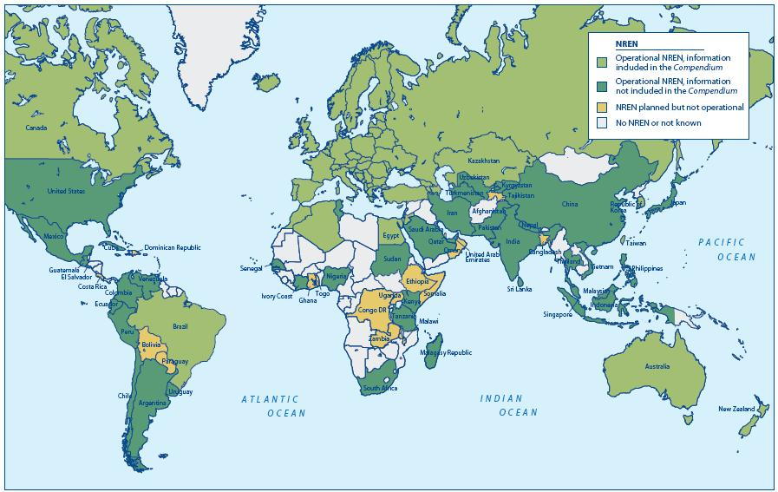
Comparing
NRENs
TERENA
NREN
Compendium
2013
Best view of all NRENs
Includes historical data
Measures on many dimensions
Services, costs, business
Needs more participation
Global effort to collect data
Trying to make it more valuable
Trying to make it much easier

Slide 10
APAN’s role
Continuity
Community
Meetings
Independence
Working Groups
Connectivity
Member-led
Research, Education,
Society
20 years
Coordination
Collaboration
Co-location
Shared Resources
Co-investment
Connected services
Common AUP
Economies of scale

Slide 11
Community: focus on users
Enhance opportunities, access, and adoption of resources
Research, Education and Societal Benefits
  Applications: Agriculture, Earth Systems and Sensing, Culture and Arts, Astronomy, HEP, Bioinformatics, Medicine, Education,
  Disaster Management (natural, medical, etc.), …
  Tech: UC, IPv6, HDTV, Future Int., SDN, IdP Fed., Grid, Cloud, …
Two major meetings each year, 300+ attendees
  APAN-42: Hong Kong, 43: New Delhi, …
Participation and engagement with many community events
  Within the region, and globally

Slide 12
Coordination
Many funding sources, many needs, many bilateral links
Coordinate planning to maximise benefits
  Connect and share backbone links
  Attract and direct investments for new links
  Demonstrate demand for capacity in emerging areas
  Co-location and peering points – internet exchanges
  …
International peering and planning
  Coherent AUPs simplify peering and routing
  Any user on any NREN globally can reach any APAN institution

Slide 13
Collaboration
With large partnerships come economies of scale
Sharing infrastructure connected to the network
  Collaboration systems, videoconferencing – unified communications, MCUs, directories, …
  High-performance computing, grid and cloud technologies
  Data hosting and movement, …
  Identity federations, eduroam, …
  People, support, operations, skills, …
  Standards, best practices, …
  …

Slide 14
Continuity
More than 20 years of meetings now
A member-owned partnership
  Governance by the interested parties
No single project dependency
  Funding is independent, flexible, and largely recurrent
No single government dependency
  Politics can be reduced…
Ongoing evolution & demonstration of value to the community
  It’s more than “just” connectivity

Slide 15
Learnings from nearly 20 years
Plan for sustainability, growth and change.
Focus on the users
  Foster the communities
  Make it easy for ordinary users
  Support advanced technologies for advanced users
Plan & build collaboratively, to maximise the benefits
Look to the Asia-Pacific region as well, where more than half the world is looking to collaborate and share with you!

Slide 16
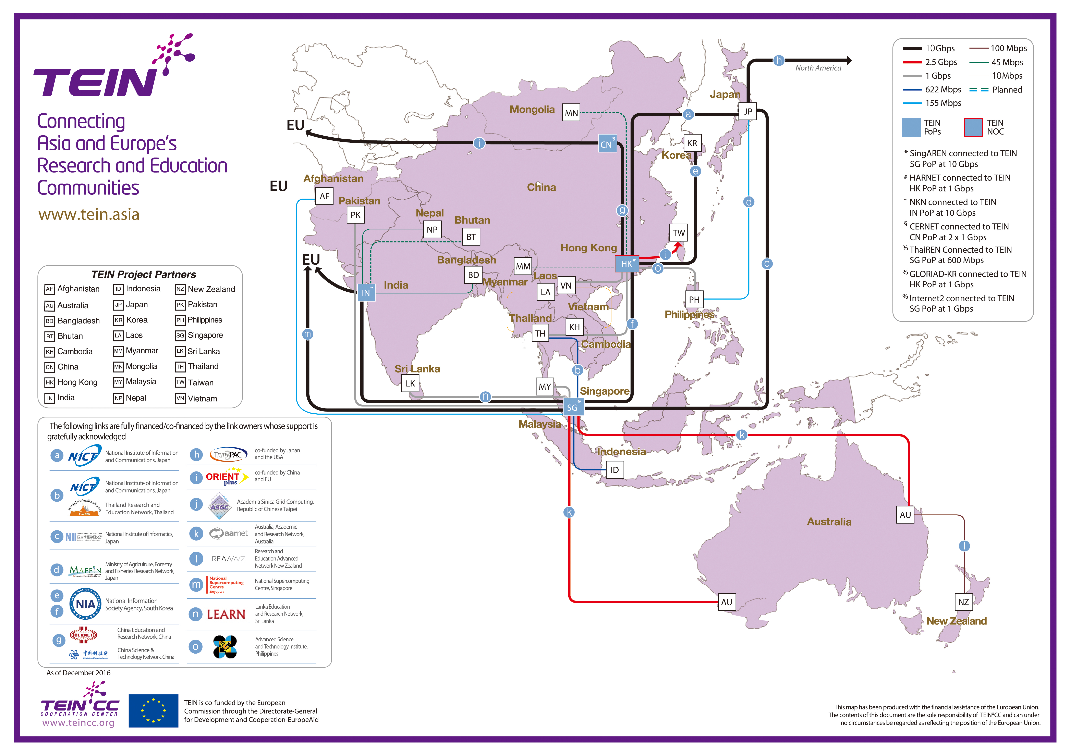

Slide 17
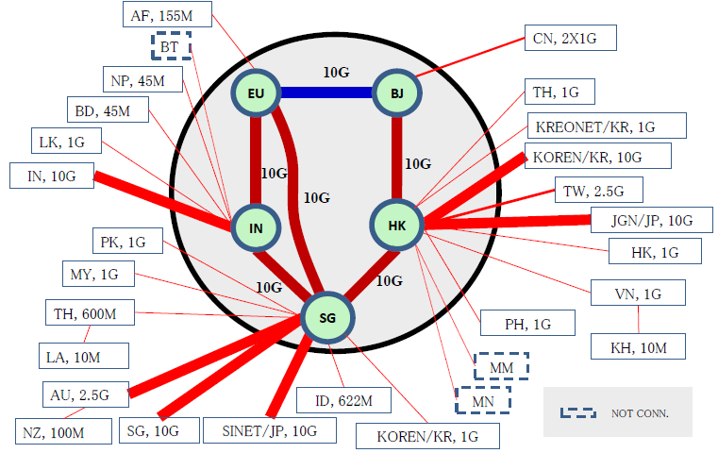
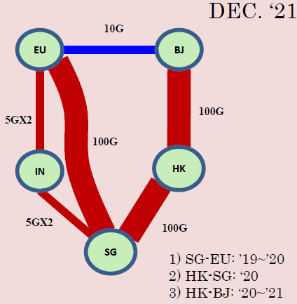
Asi@Conncet

Slide 18
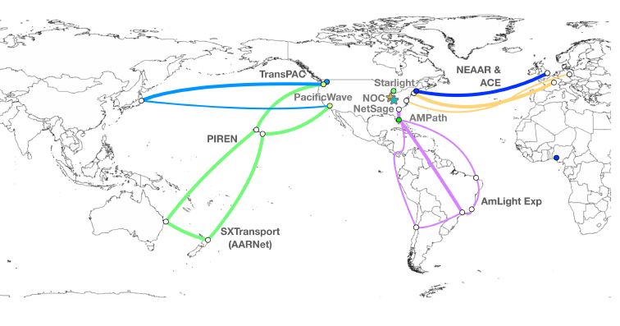
NSF IRNC: TransPAC
America Connects to Asia

Slide 19
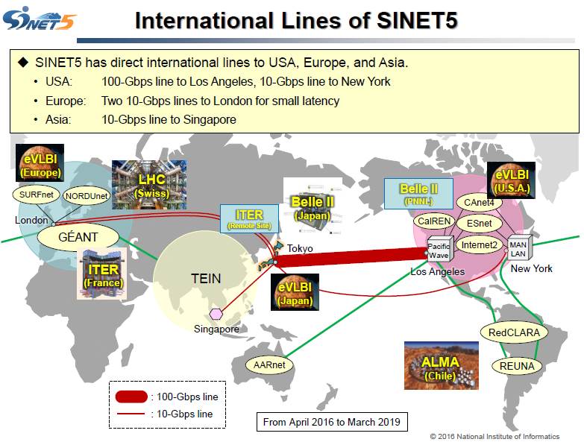

Slide 20
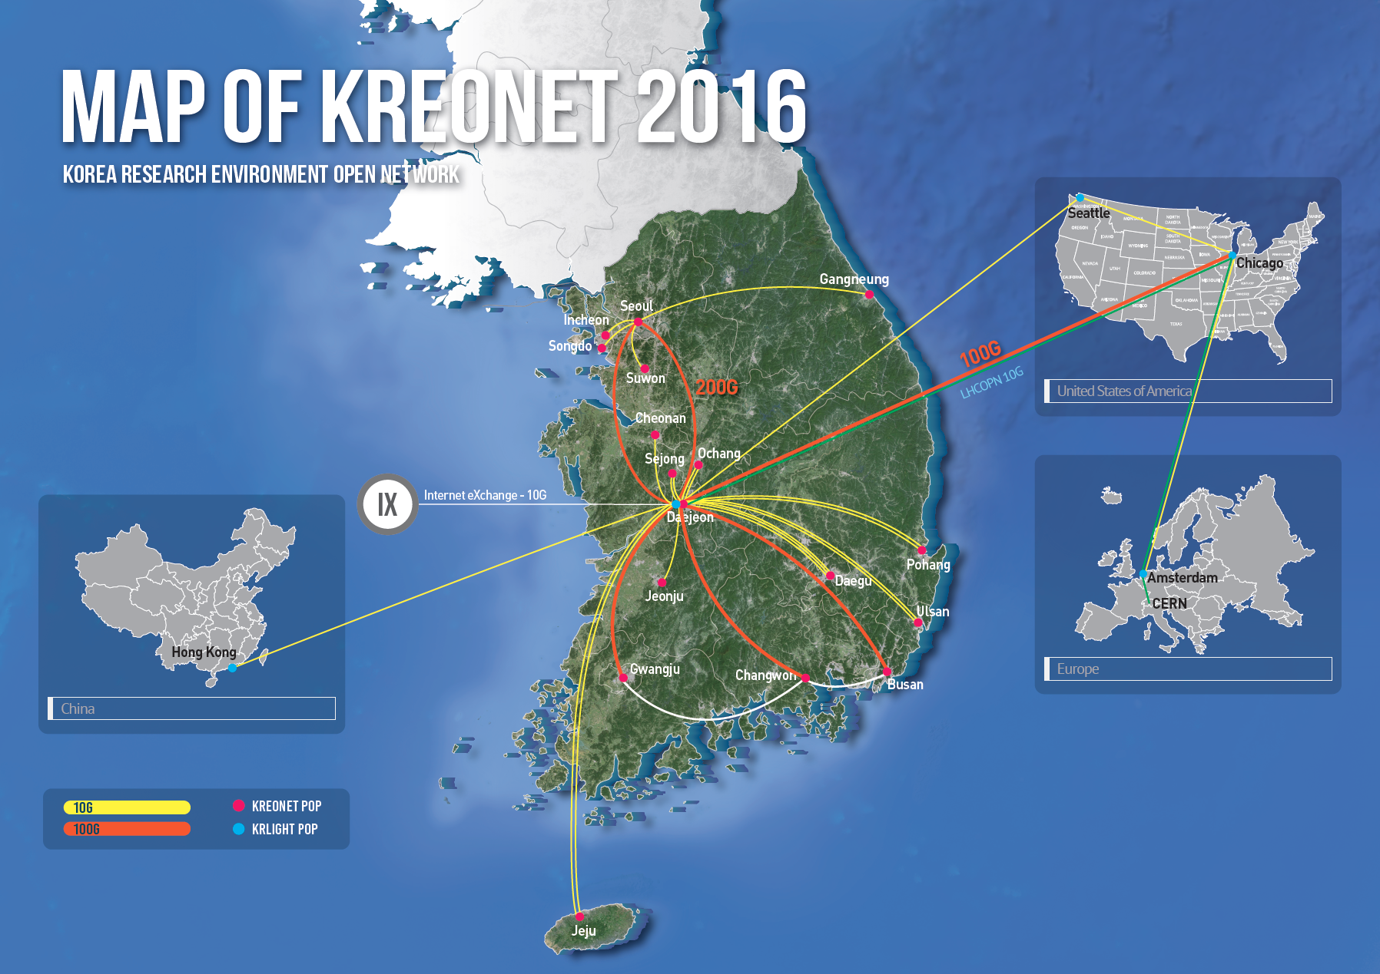
- National-wide 100Gbps National Research Network
- 17 Domestic GigaPoPs, 4 International GigaPoPs
- KREONET Backbone Availability: 99.84%(‘15)
- KREONet2/GLORIAD Backbone Availability: 100%(‘15)
- User: about 200 national research institutes, universities etc.

Slide 21
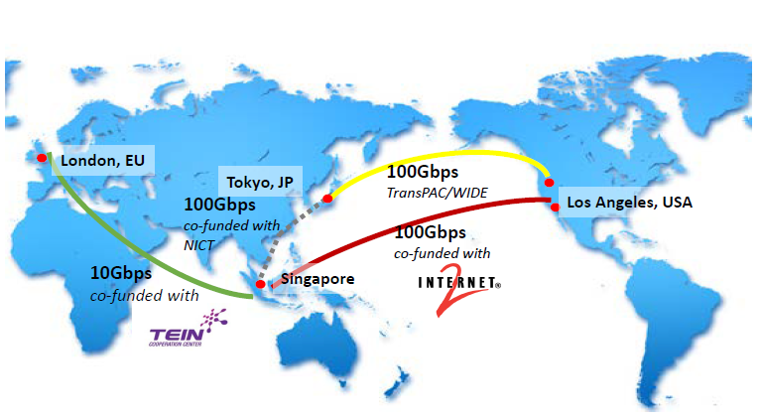
SingaREN/Internet2/NICT/Asi@Connect

Slide 22
WLCG Network in Asia

Slide 23
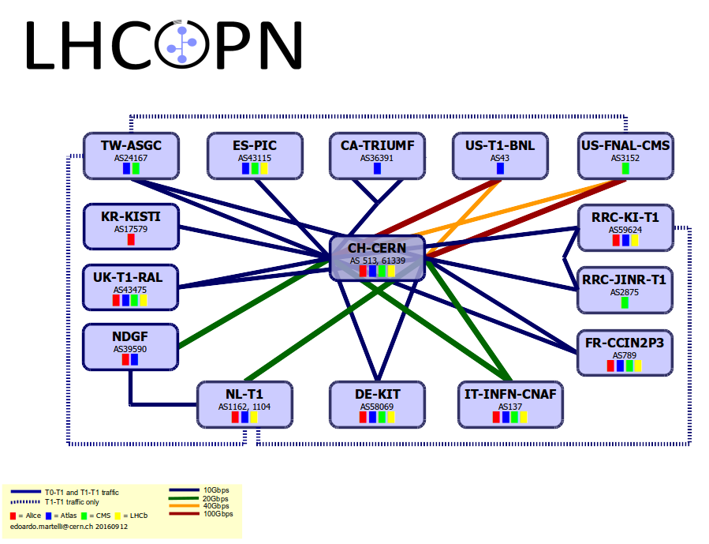

Slide 24
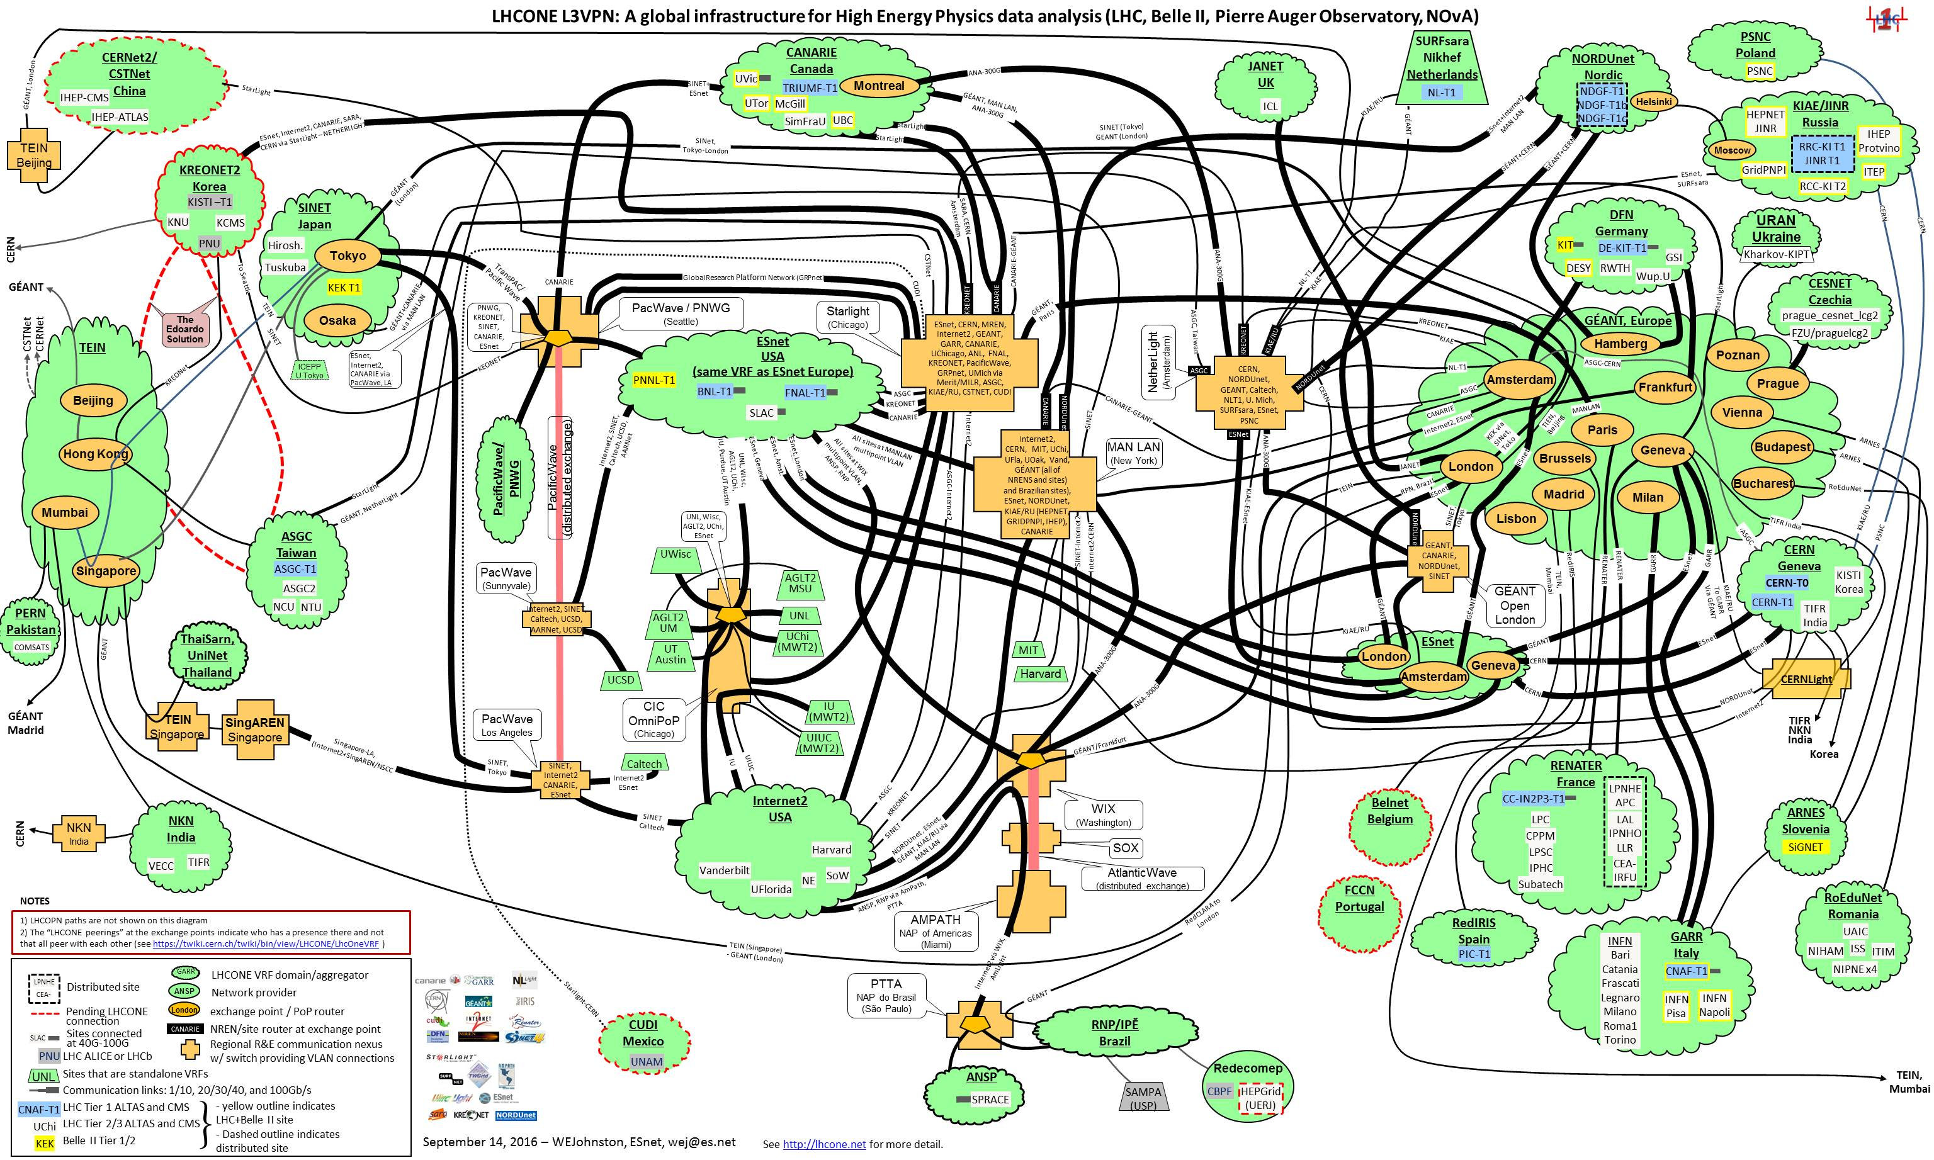
L3VPN Current topology
Asia
North America
Europe
South America

Slide 25
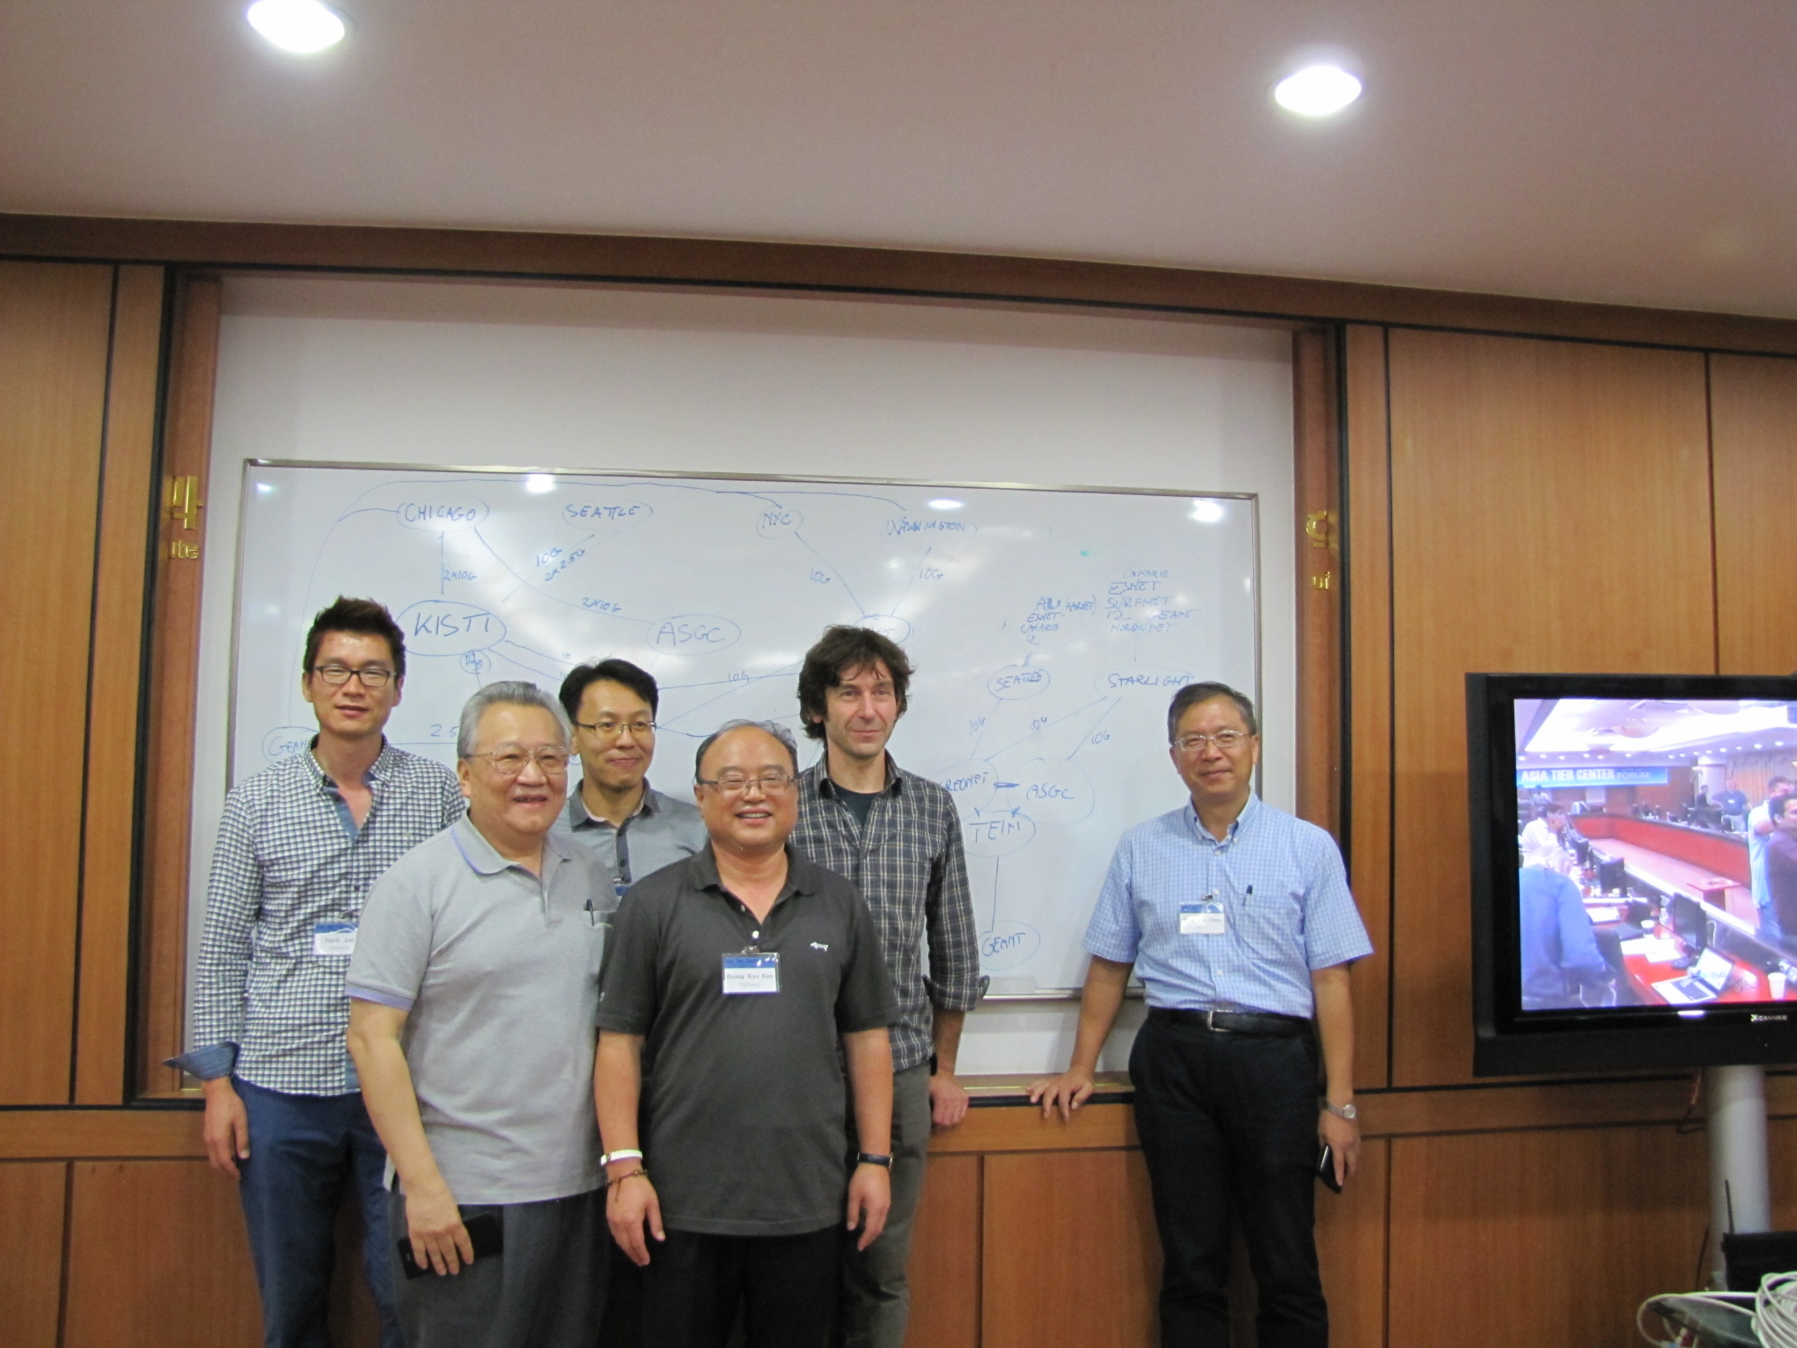
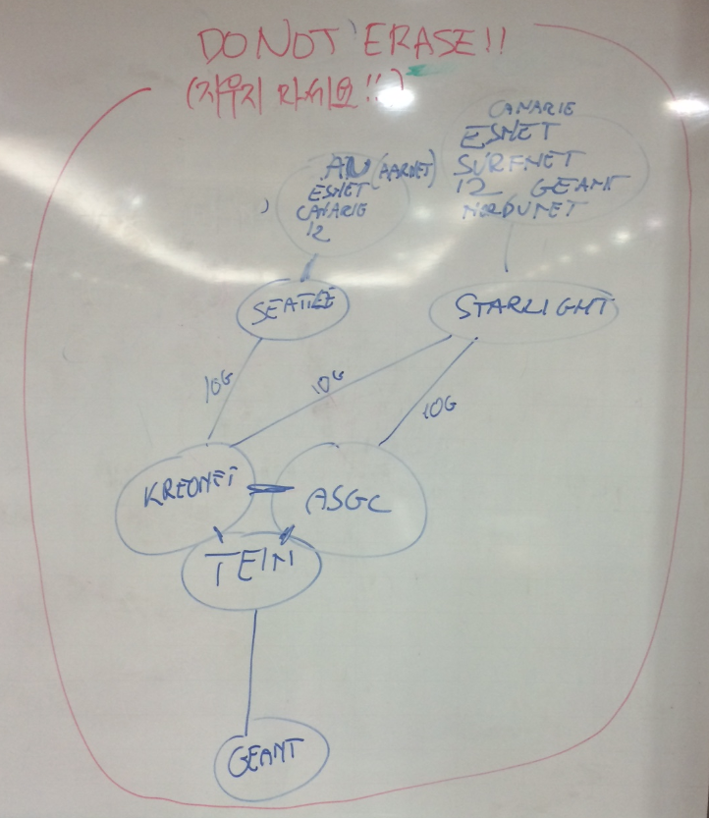
LHCONE Asia VRF
Open Exchange Point

Slide 26
Missing connections
Esnet
AS293
ThaiREN
AS24475
CERNlight
AS20641
SINET
AS2907
ASGCNet
AS24167
TEIN
AS24490
KREONET
AS17579
ERnet
AS2697
International
National
GEANT
AS20965
LHCONE peering in place
Only physical connection in place
Missing LHCONE peering

Slide 27
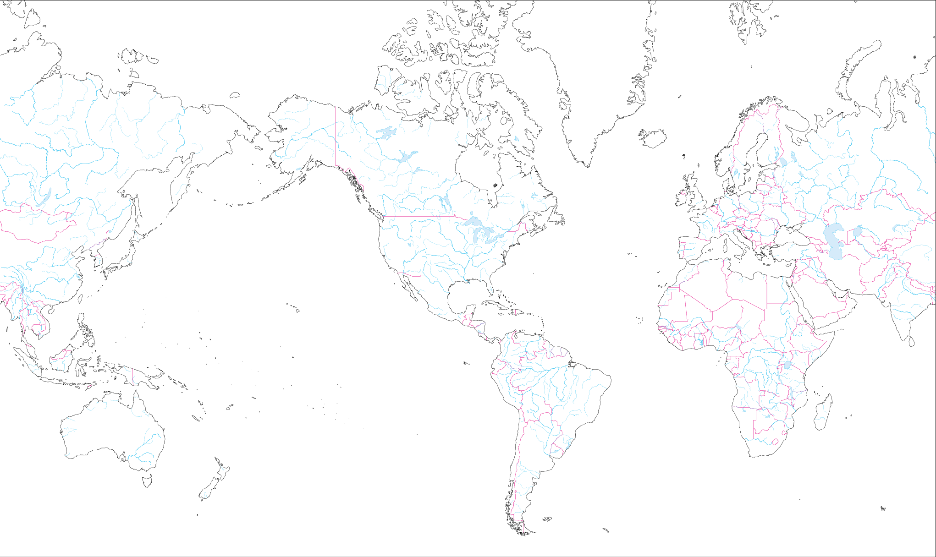
TAIWAN Global R&E Network
10G
Amsterdam
10G
Chicago
Geneva
2.5G
Tokyo
2.5G
Palo Alto
1G
New York
Hong
Kong
10G
10G
2.5G
10G + 10G
1G
10G
5G
10G
LA
10G
TAIWAN
10G
ASGCNet
ASNet
TWAREN
TANet

Slide 28
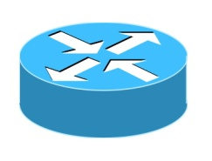
ASGCNet International Network Plan
APAN-JP
LBL
SLAC
BNL
10G
CERNET
KREONET
JP
Palo Alto (?)
New York
HKIX
1G
10G
10G
CESTNET
2.5G
Chicago
10G
2.5G
Taipei
10G
10G
10G
Amsterdam
LHCOPN
1G
10G
10G
CERN
10G
10G
Force10
10G
2.5G
HongKong
2*10G
1G
TEIN
10G
StarLight
10G
1G
10G
10Gx4
NODUnet
10G
10G
TWAREN
v
FNAL
Internet2
SURFnet
ASCC
ASGC
Data Center
ESNet
CERN Light
GEANT
1G
CANARIE
1G
CESnet
CZ
TANET
LHCONE
LHCONE
We have the new tender on 2018
ASCC provide the Link:
Plan to Recolocate 10G Link :
AMS-IX

Slide 29
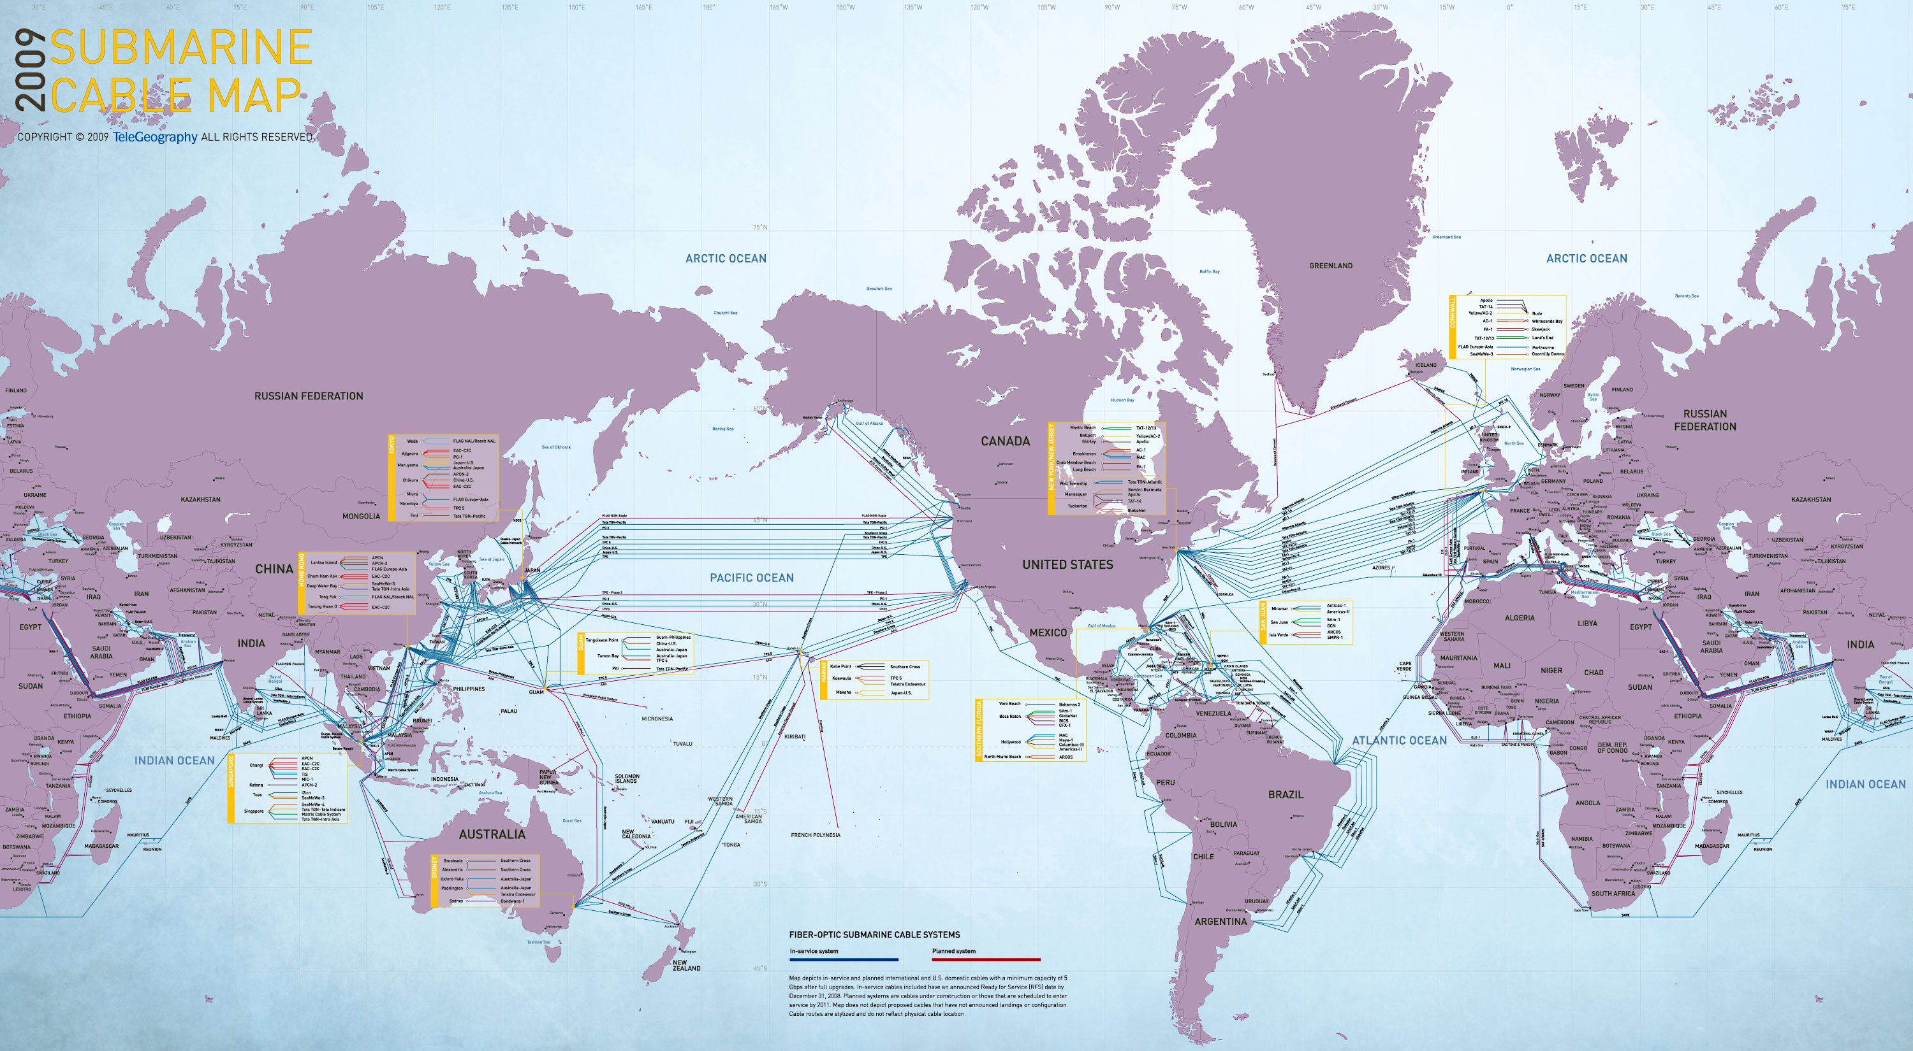

Slide 30
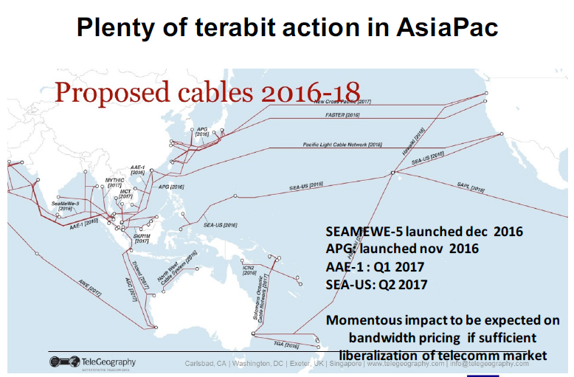

Slide 31
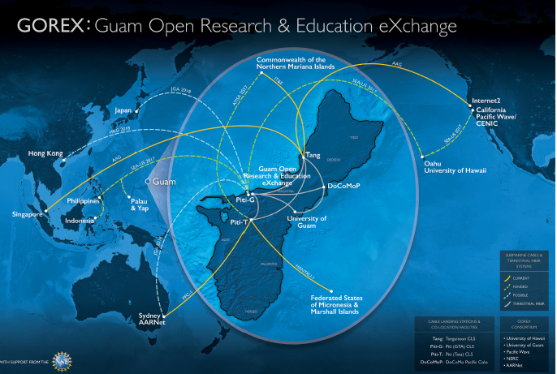

Slide 32
Development of the 100G Network in Asia
Diversity & Redundancy
Collaboration and Co-operation in Asia
  Open policy to the communities
  Open eXchange Point
HEP and Bio are the major science activities
Taiwan Deploy the 100G in Asia/US?

Slide 33
e-Science in Asia

Slide 34
Regional Distributed Computing Infrastructure Is Available
Taking advantage of EC funded e-Science flagship program (EGI and WLCG), Asia Pacific regional e-Science infrastructure, application and collaboration environment has been growing since 2005
Partner Institutes
AU: U. Melbourne
CN: iHEP, CAS
HK: HKU
ID: ITB
IN: VECC, TIFR
IR: IPM
JP: KEK, U. Tokyo
KR: KISTI, KNU, UOS
MY: UM, UPM, USM
NZ: UOA
PH: ASTI, ATENEO
PK: CIIT, NCP
SG:
TH: NSTDA, SUT, CHULA, NECTEC
TW: ASGC, NCU, NTU, NCHC
VN: IOIT, IFI
ASGC (TW) is the regional coordinator
Collaboration Model
  Site installation; Application implementation; Trust Framework; Operation Consult; User Community Engagement

Slide 35
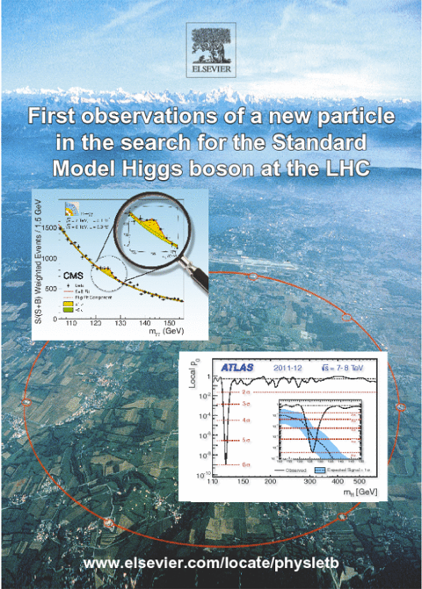
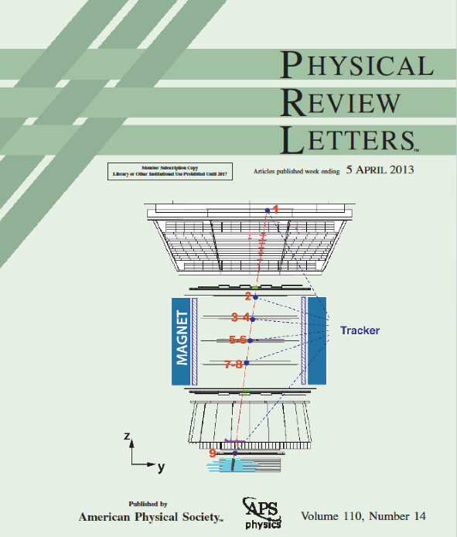
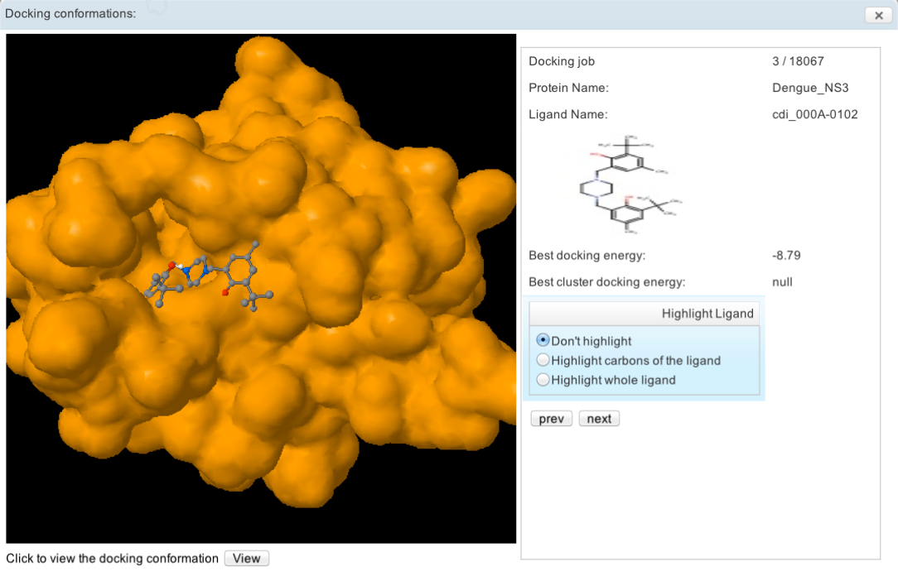
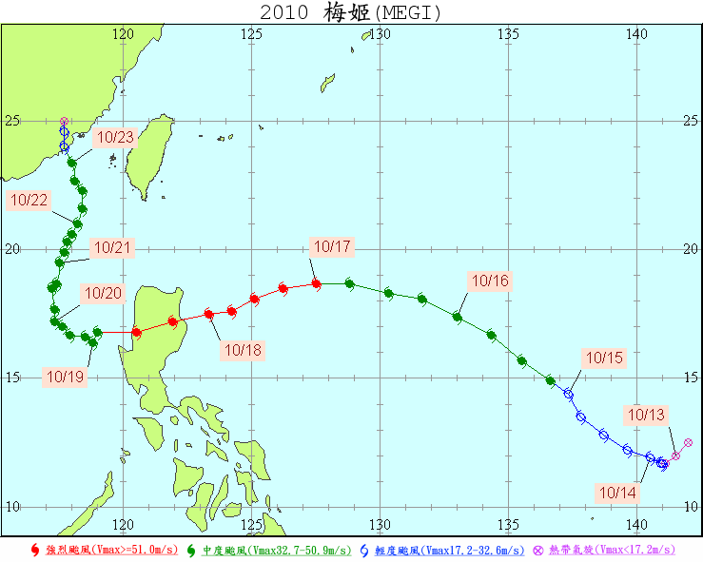
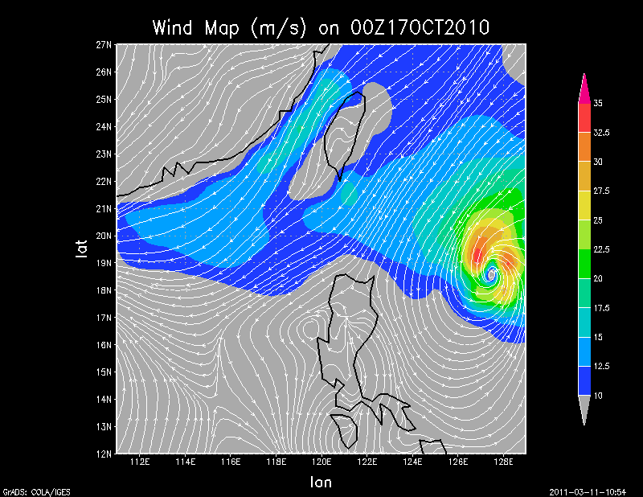
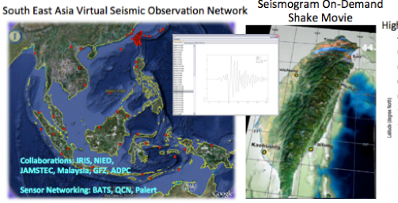
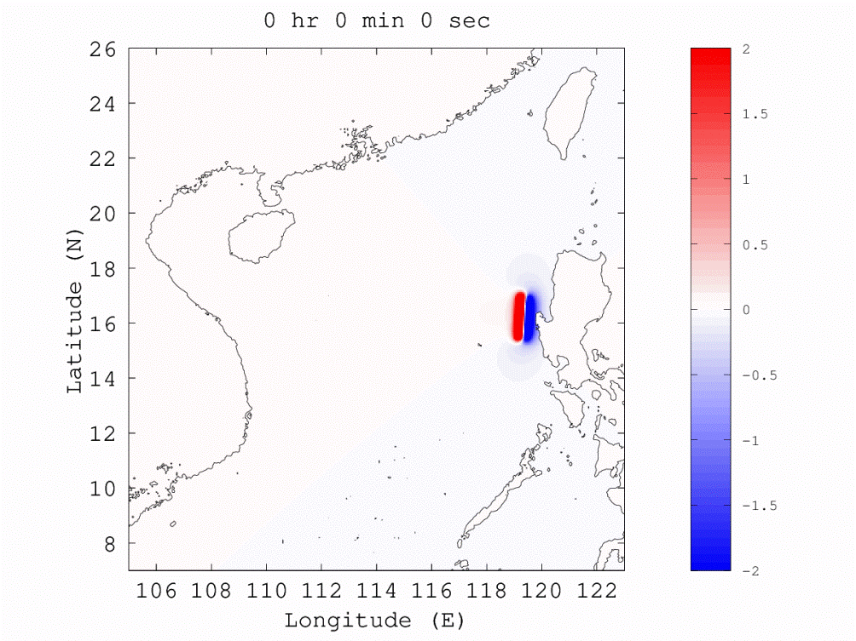
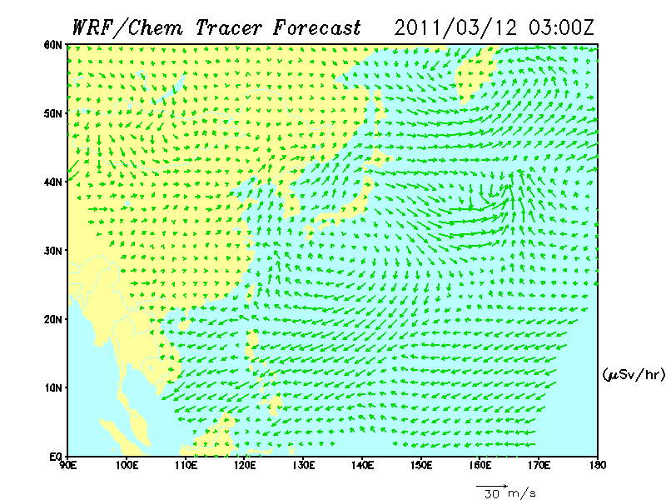
Higgs Search at ATLAS
Alpha Magnetic Spectrometer
Weather/ Climate Changes
Distributed Computing Infrastructure
(HW, SW, Networking)
Drug Discovery Application Portal
Earthquake and Tsunami Early Warning
Long-Range Dust Transportation
Notes:
AMS: Search for nuclear antimatter up to TeV and Search for dark matter signatures
More and more scientific studies today rely on analysis of huge amount of data. However, the challenges of how to efficiently analyse, manage and mobilise the big data is always there.
Based on the 15 years experiences establishing and operating one of the 11 Tier-1 Centres of the Worldwide Large Hadron Collider projects from 2000, we are extending the distributed infrastructure and big data application platform to wider disciplines such as life science, earth science, environmental changes, physics beyond the high energy physics.

Slide 36
Conclusion
Big Science lead the infrastructure development
  LHC, Belle, SKA, Bio, ….etc
e-Science for the masses evolve the global collaboration within the user communities
  EGEE, EUAsiaGrid, DMCC,… etc

Slide 37
Thanks!

Slide 38
ASGC e-Science Global Network
Internet2
ESNet
LHCONE
CANARIE
FNAL
SINET
NASA
APAN-JP
STARLight
iCAIR
U. Chi
20G
10G
AARNet/AU
EARNET/IN
INHEREN/ID
LEARN/LX
MYREN/MY
NREN/NP
PERN/PK
UNINet/TH
VinaRen/VN
SingaREN/SG
10G
US
NORDUNET
20G
TW
1G
CERNLight
HKIX
20G
10G
10G
HARNet
10G
NL
CERN
HK
10G
10G
10G
10G
TEIN
2.5G
ASNet
GEANT
LHCONE
10G
1G
SURFNet
KREONET
1G
TWAREN
100G
ASTI
AMSIX
TANet
CERNET
CSTNET
Notes:
Connect to ESNET LHCONE
Reach SINET via APAN-JP in HK

