Slide 1

Sirtfi
Addressing Federated Security Incident Response
Hannah Short
CERN, Computer Security
hannah.short@cern.ch
GDB ISGC Taipei
March 8th 2017

Slide 2
Agenda
Federated Security Incident Response
Sirtfi: a Security Incident Response Trust Framework for Federated Identity
Why does this affect me?
How do I adopt Sirtfi?

Slide 3
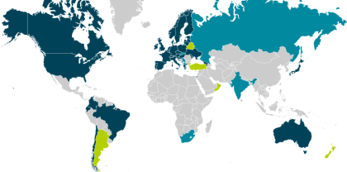
What if…?
… an incident spread throughout the federated R&E community via a single compromised identity?
https://technical.edugain.org/

Slide 4
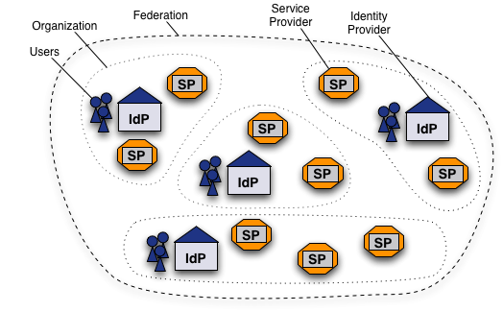
What is a Federation?
Federated Identity Mangement (FIM) is the concept of groups of Service Providers (SPs) and Identity Providers (IdPs) agreeing to interoperate under a set of policies
Federations are typically established nationally and use the SAML 2.0 protocol for information exchange
Each entity within the federation is described by metadata
https://www.switch.ch/aai/about/federation/

Slide 5
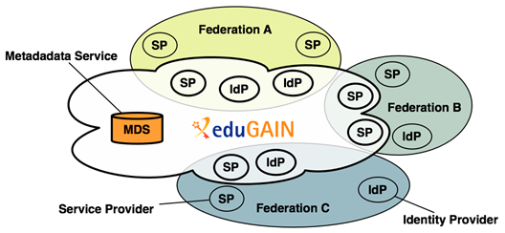
What is eduGAIN?
eduGAIN is a form of interfederation
Participating federations share information (metadata) about entities from their own federation with eduGAIN
eduGAIN bundles this metadata and publishes it in a central location.
Credit to Alessandra Scicchitano – GEANT for this slide
Notes:
eduGAIN aggregates metadata from participating federations (metadata service). This aggregate is consumed by all participating federations, such that Identity Providers and Service Providers can find each other.
Technically, this aggregate works as follows: 'export metadata aggregate’, eduGAIN aggregate,
Each participating federation produces a so called 'export metadata aggregate'; a file that contains the metadata of local Identity Providers and Service Providers that participate in eduGAIN. Note that this is often a subset of all Identity Providers and Service Providers from that federation.
eduGAIN combines all export metadata aggregates and generates an "eduGAIN aggregate"; a file that combines all metadata from all participating federations.
This eduGAIN aggregate is signed by eduGAIN and published on the internet, thereby making it available to all participating federations.
Each participating federation must consume this eduGAIN aggregate and supply it to their local Identity Providers and Service Providers.

Slide 6

WLCG
General push for research communities to benefit from eduGAIN
As WLCG adopts federated access, it becomes a just small player
  Hidden behind the CERN SP proxy (Single-Sign-On, SSO)
  From the eduGAIN perspective, the CERN SP Proxy appears like any other SP, complexity and maturity of resources are not broadcast
  We are susceptible to eduGAIN’s weaknesses!
We have less control over credential management than IGTF
  No central blocking mechanism
  No influence over federation governance
We are exposed to a new attack surface
WLCG 1
WLCG 2
WLCG 3
CERN SSO

Slide 7
What if…?
… an incident spread throughout the federated R&E community via a single compromised identity?
https://technical.edugain.org/

Slide 8
Federated Security Incident Response
What if…?
How could we determine the scale of the incident?
  Do useful logs exist?
  Could logs be shared?
Who should take responsibility for resolving the incident?
How could we alert the identity providers and service providers involved?
Could we ensure that information is shared confidentially, and reputations protected?
eduGAIN numbers
Federations: 41
All entities: 3797
IdPs: 2341
SPs: 1461
Standalone AAs: 3
Data valid as of March 2017

Slide 9
Federated Security Incident Response
The problem
An inviting possibility for malicious actors
We will need participants to collaborate during incident response – this may be outside their remit
Federation 2
SP
Federation 1
SP
IdP
IdP
SP
SP
SP
SP
SP
All I need is one identity…
IdP
Federation 3
SP
IdP
SP

SP
IdP

Slide 10
It all seems like common sense…
SP
IdP
SP notices suspicious jobs executed by a handful of users from an IdP
Notifies IdP
IdP identifies over 1000 compromised identities
IdP identifies all SPs accessed
Notifies SPs
SP
SP
SP

Slide 11
… but in reality
SP
Small IdP may not have capability to block users, or trace their usage
IdP
SP notices suspicious jobs executed by a handful of users from an IdP
Notifies IdP
X
IdP identifies over 1000 compromised identities
!
IdP identifies all SPs accessed
!
Large SP does not share details of compromise, for fear of damage to reputation
X
X
Notifies SPs
X
SPs are not bound to abide by confidentiality protocol and disclose sensitive information
SP
SP
No security contact details!
!
!
SP

Slide 12
Federated Security Incident Response
The solution
Inviting new vector of attack
Uncertainty in security capability of participants
Lack of trust
Attacks inevitable ☹
But we can make security capability transparent and build relationships between organisations and people ☺
…We need a trust framework!

Slide 13
A Security Incident Response Trust Framework
FIM4R
Issue of IdM raised by IT leaders from EIROforum labs (Jan 2011)
  CERN, EFDA-JET, EMBL, ESA, ESO, ESRF, European XFEL and ILL
Prepared a paper that documents common requirements and challenges https://cdsweb.cern.ch/record/1442597
“Security procedures and incident response would need to be reviewed. Today, each resource provider is for example responsible for terminating access by known compromised identities. With identity federation, this responsibility will be shifted to the IdP though resource providers will insist on the ability to revoke access.”
“Such an identity federation in the High Energy Physics (HEP) community would rely on:
• A well-defined framework to ensure sufficient trust and security among the different IdPs and relying parties.“
Credit to David Kelsey (STFC) for this content

Slide 14
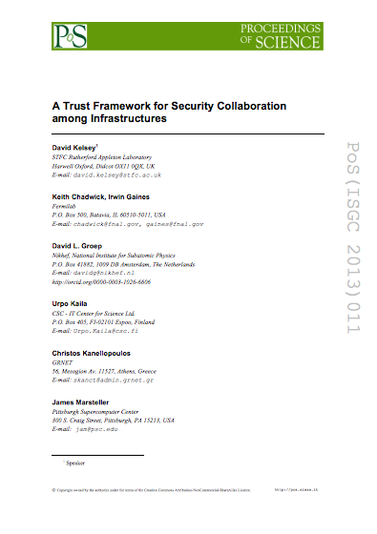
A Security Incident Response Trust Framework
Security for Collaborating Infrastructures (SCI)
A collaborative activity of information security
officers from large-scale infrastructures
  EGI, OSG, PRACE, EUDAT, CHAIN,
  WLCG, XSEDE, …
Laid the foundations for a Trust framework
  Enable interoperation (security teams)
  Manage cross-infrastructure security risks
  Develop policy standards
  Especially where not able to share
  identical security policies
Proceedings of the ISGC 2013 conference http://pos.sissa.it/archive/conferences/179/011/ISGC%202013_011.pdf
Credit to David Kelsey (STFC) for this slide

Slide 15
A Security Incident Response Trust Framework
Sirtfi status
The SCI document formed the basis for the
Security
Incident
Response
Trust Framework for
Federated
Identity
This framework has been approved by the REFEDS Community and registered as an assurance profile by the Internet Assigned Numbers Authority (IANA) https://www.iana.org/assignments/loa-profiles/loa-profiles.xhtml

Slide 16
A Security Incident Response Trust Framework
Sirtfi summary
Operational Security
Require that a security incident response capability exists with sufficient authority to mitigate, contain the spread of, and remediate the effects of an incident.
Incident Response
Assure confidentiality of information exchanged
Identify trusted contacts
Guarantee a response during collaboration
Traceability
Improve the usefulness of logs
Ensure logs are kept in accordance with policy
Participant Responsibilities
Confirm that end users are aware of an appropriate AUP

Slide 17
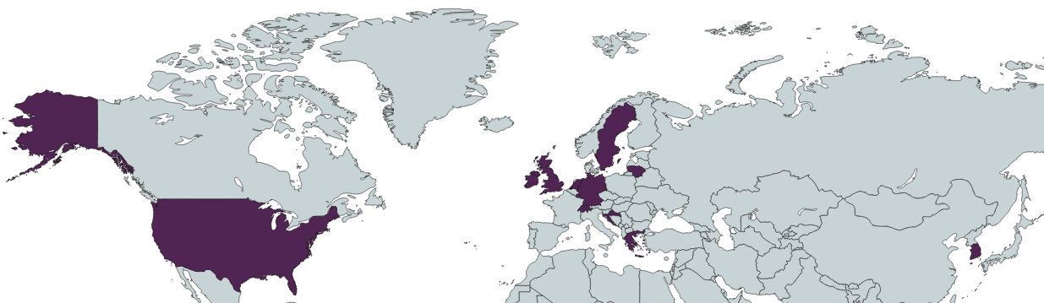
Adoption since April 2016

Slide 18
Adoption since April 2016
7
7
8
10
1
110
1
1
1
1
2
6

Slide 19
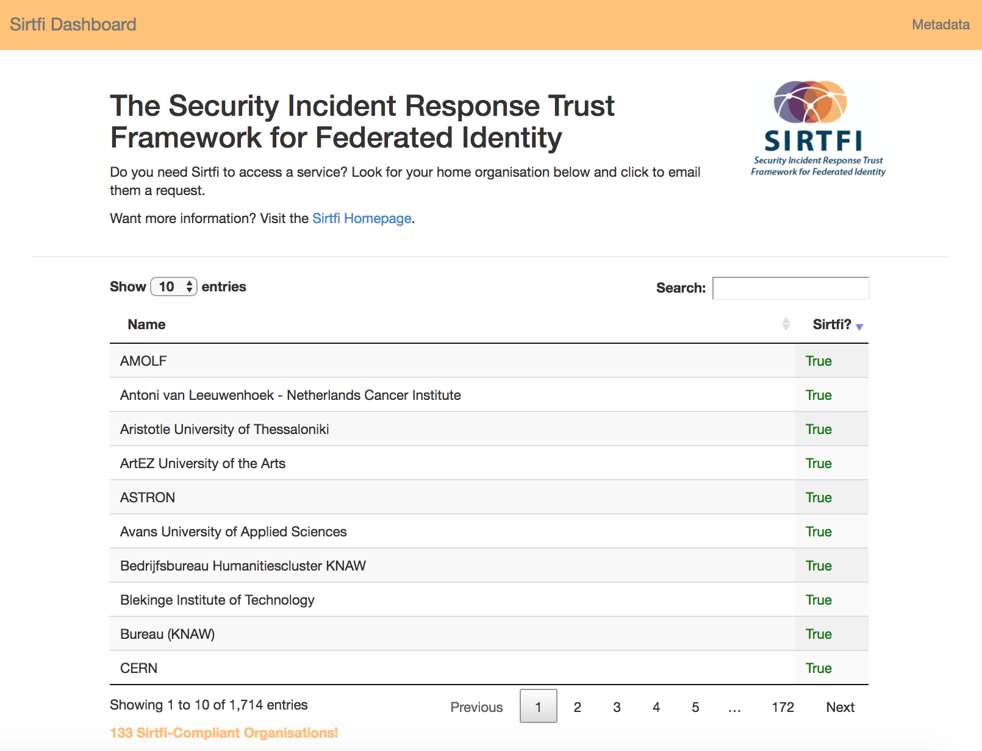
Want to check?
http://sirtfi.cern.ch/

Slide 20
Why are participants engaged?
Who? | SP | IdP | Federation | EduGAIN
SP | I should adopt Sirtfi to advertise that I am a secure service (encourage IdPs to trust me), and to broadcast my security contact information | I would like SPs to adopt Sirtfi so that I know my users are accessing secure sites, and to provide a contact point for incident handling | I would like IdPs & SPs in my federation to adopt Sirtfi to reflect the level of security provided by my constituents and to enable me to handle security incidents efficiently and effectively. | We want security incident response to work, to maintain the trust that eduGAIN participants have in eduGAIN
IdP | I would like IdPs to adopt Sirtfi so that I can identify trustworthy sources of identity to grant access to my critical infrastructure, and to provide a contact point for incident handling | I should adopt Sirtfi to advertise that I am a source of identities covered by good security practices, and to provide a contact point for incident handling

Slide 21
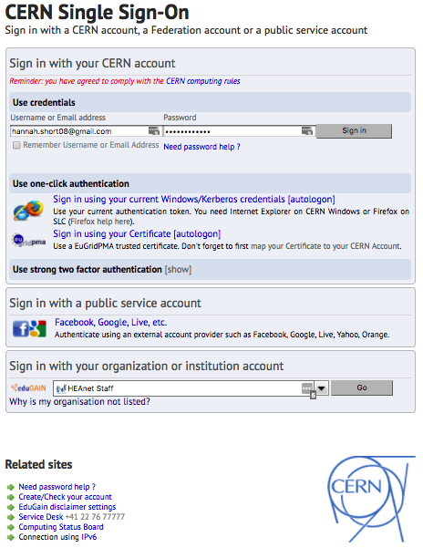
Why does this affect me?
CERN has implemented a requirement that eduGAIN IdPs must be Sirtfi compliant to have access
This includes everything behind CERN’s Single-Sign-On
  SSO-enabled WLCG web services
  Security MISP instance https://misp.cern.ch
  General CERN services, e.g. Indico
Thanks to those IdPs who have already asserted compliance, e.g. Kreonet & University of Glasgow!

Slide 22
How to adopt Sirtfi
A simple recipe
Up to date instructions can be found on the Sirtfi Wiki https://wiki.refeds.org/display/SIRTFI/Guide+for+Federation+Participants
All Federation Entities, including but not limited to IdPs and SPs, can adopt Sirtfi by following this simple recipe
  [0. Be an eduGAIN enabled IdP/SP!]
  Complete a self assessment of your entity following the Sirtfi Framework (all requirements included in the appendix of this presentation)
  Choose a security contact and include this in federation metadata
  Assert Sirtfi compliance by adding a Sirtfi Entity Attribute to your metadata
Liaise closely with your Federation Operator as they will have specific processes for updating federation metadata

Slide 23
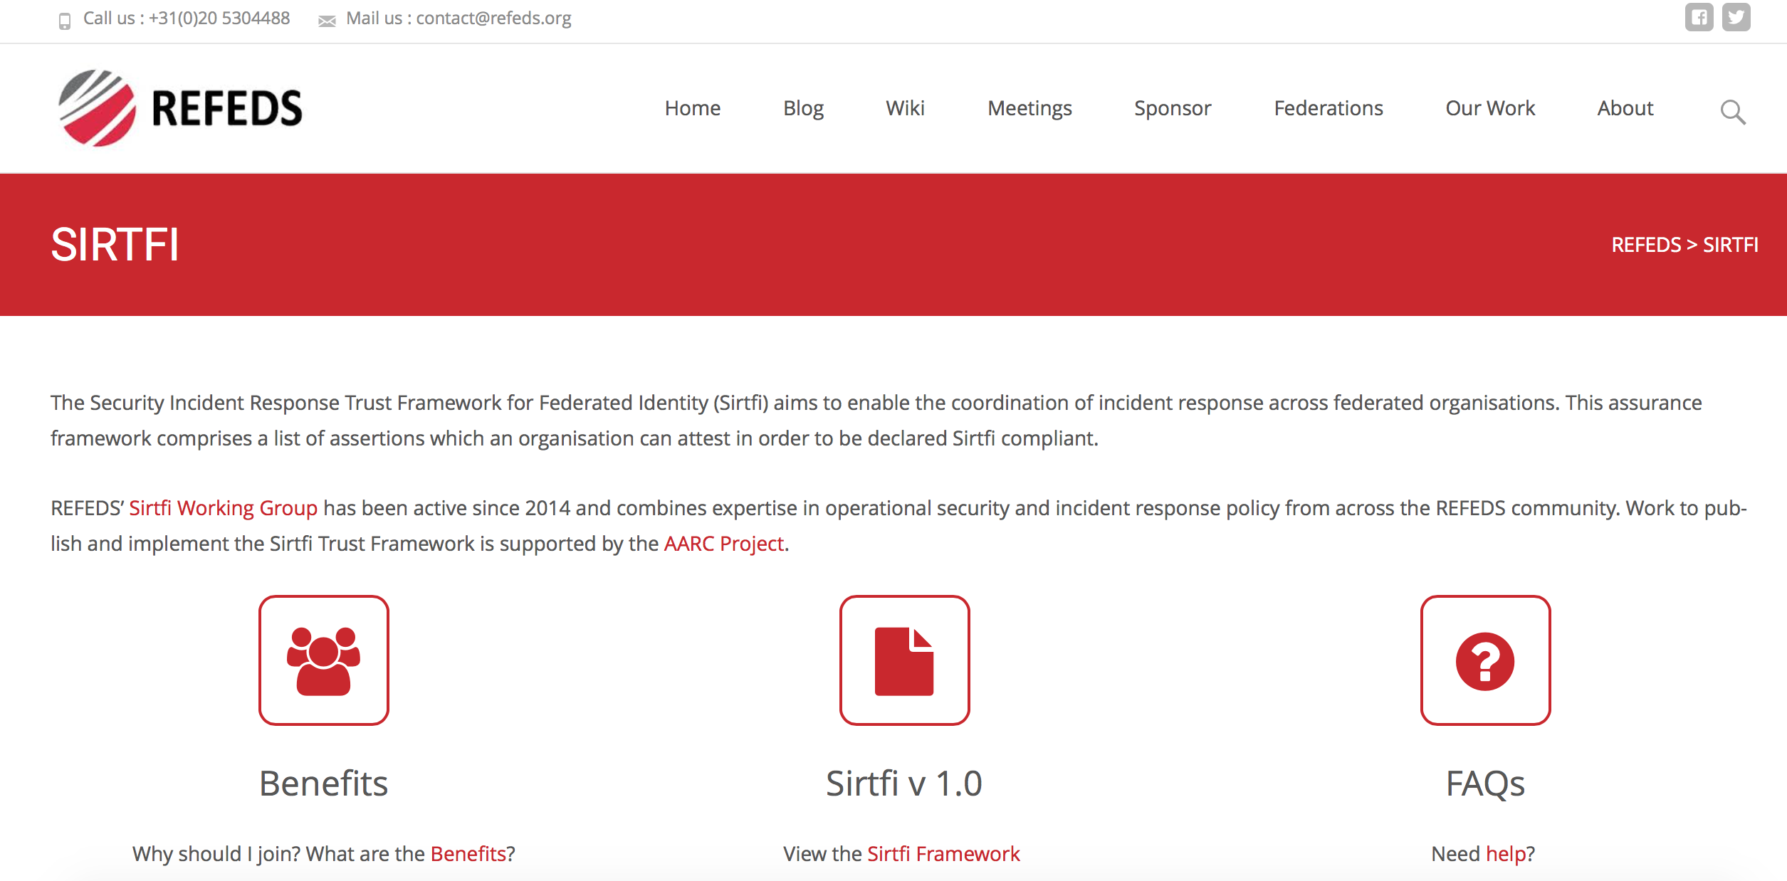
How to adopt Sirtfi
Find out more – Home Page
https://refeds.org/sirtfi

Slide 24
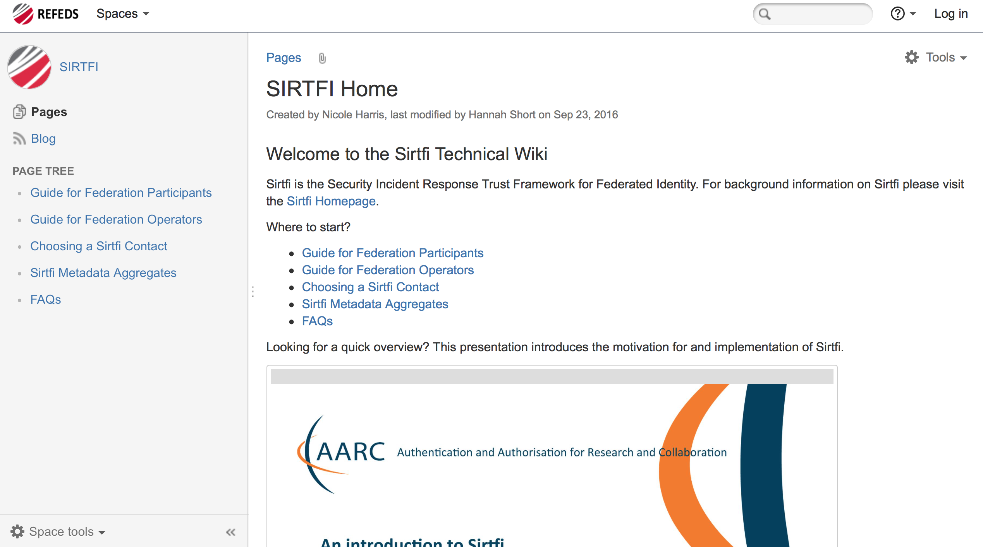
How to adopt Sirtfi
Find out more – Technical Wiki
https://wiki.refeds.org/display/SIRTFI/SIRTFI+Home

Slide 25
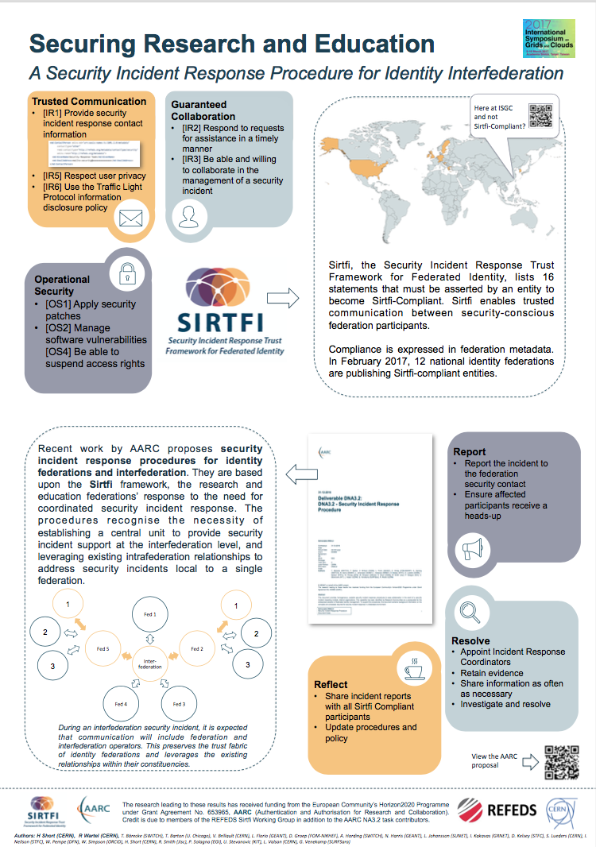
Next Steps
Sirtfi holds participants to a set of trustworthy behaviours
Next step is to adopt a joint Incident Response Procedure
AARC Project has proposed a template that will be enhanced this year
Come and see the poster for more details

Slide 26
hannah.short@cern.ch

Slide 27
WLCG Federated Access Future
Prototype developed with FTS
  Addresses Web use case but no non-web
  Have a non-web “workaround” but this does not really match grid needs
How can we make this easier?
  Develop something centrally run?
  Have funding for a pilot as part of AARC2

Slide 28
Appendix, Sirtfi Assertions

Slide 29
Operational security
[OS1] Security patches in operating system and application software are applied in a timely manner.
[OS2] A process is used to manage vulnerabilities in software operated by the organisation.
[OS3] Mechanisms are deployed to detect possible intrusions and protect information systems from significant and immediate threats
[OS4] A user’s access rights can be suspended, modified or terminated in a timely manner.
[OS5] Users and Service Owners (as defined by ITIL [ITIL]) within the organisation can be contacted.
[OS6] A security incident response capability exists within the organisation with sufficient authority to mitigate, contain the spread of, and remediate the effects of a security incident.

Slide 30
Incident response
[IR1] Provide security incident response contact information as may be requested by an R&E federation to which your organization belongs.
[IR2] Respond to requests for assistance with a security incident from other organisations participating in the Sirtfi trust framework in a timely manner.
[IR3] Be able and willing to collaborate in the management of a security incident with affected organisations that participate in the Sirtfi trust framework.
[IR4] Follow security incident response procedures established for the organisation.
[IR5] Respect user privacy as determined by the organisations policies or legal counsel.
[IR6] Respect and use the Traffic Light Protocol [TLP] information disclosure policy.

Slide 31
Traceability
[TR1] Relevant system generated information, including accurate timestamps and identifiers of system components and actors, are retained and available for use in security incident response procedures.
[TR2] Information attested to in [TR1] is retained in conformance with the organisation’s security incident response policy or practices.

Slide 32
Participant responsibilities
[PR1] The participant has an Acceptable Use Policy (AUP).
[PR2] There is a process to ensure that all users are aware of and accept the requirement to abide by the AUP, for example during a registration or renewal process.

