Slide 1

Report from WLCG Workshop 2017:
WLCG Network Requirements
GDB - CERN
12th of July 2017 edoardo.martelli@cern.ch

Slide 2

WLCG Network Requirements
The 4 major LHC experiments were asked to provide their network requirements for the coming years, in terms of:
- bandwidth
- special capabilities
- monitoring

Slide 3

ALICE
Recommendations for Tier2s:
- WAN: 100Mbps of WAN per 1000 cores
- LAN to local storage: 20Gbps per 1000 cores
- Better read data locally: CPU efficiency get a 15% penalty per 20ms RTT
ALICE depends on and strongly encourages:
- full implementation of LHCONE at all sites
- plus the associated tools (like PerfSONAR), properly instrumented to be used in the individual Grid
frameworks

Slide 4
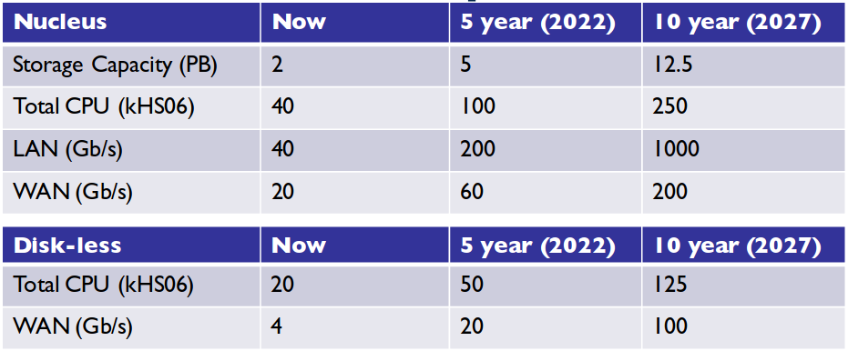

ATLAS
ATLAS moving to a Nucleus and Satellite Model
Nucleus will store primary data and act as a source for data distribution:
- Storage capacity > 1PB
- Good Network throughput
- Site availability: > 95%
ATLAS would like
- better visibility into networks to improve ability to resolve network issues
- to see network traffic data from R&E Networks

Slide 5

CMS
Site types and requirements:
- Full Tier-2, many CPUs and large disk capacity: Some 10Gbit/s or 100Gbit/s for both LAN and WAN are advisable for sites with several 1000 cores
- Disk-rich Tier-2, more storage than average, perhaps hosting disk for co-located CPU only site: Good WAN connection even more important
CMS schedules typically 10-15% of jobs with remote data access
- Penalty in CPU efficiency: drop of ~10% for remote access
- But large gain in flexibility
Computing model likely to evolve towards scenarios that require fast interconnects
Need to improve CMS transfer system and scheduling system to better
exploit network metrics

Slide 6
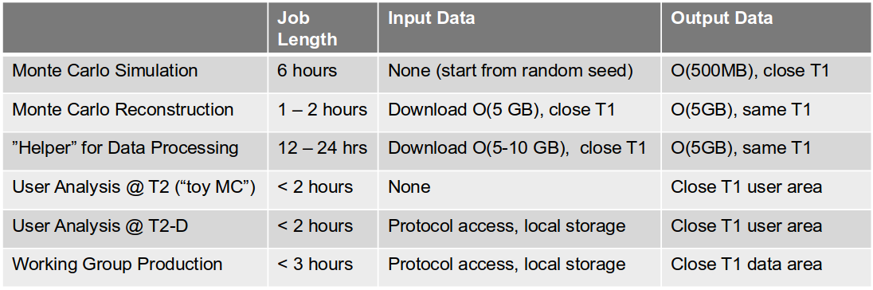

LHCb
- Majority of workflows are simulation jobs without input data
- A certain fraction are user jobs with local access to input data
- Currently small usage of working group productions. Will increase
- In case of input data, always read by default from local site
- Output data always goes to different storage areas on T1 sites
Monitoring, including network monitoring, available from within Dirac:
- for “helper data processing” sites to check the WAN connectivity to a T1 storage
- for data management to check WAN quality

Slide 7


Network throughput WG
WG has established an infrastructure to monitor and measure networks:
- proven record on fixing existing network problems and improving transfer efficiency
- stable production infrastructure
Mid-term evolution topics:
- Network capacities planning
- Network utilization monitoring, both site-level and WAN
- Evolving and integration of monitoring data: new sources, dashboards and network stream
- Network Analytics: Alerting/Notifications and anomaly detection
- SDN Networking demonstrators and testbeds

Slide 8

GEANT
GEANT is investigating ways to increase ability to differentiate, break dependence on vendors, and provide capabilities to automate/orchestrate multi-domain services
Asked the Experiments if interested in participating

Slide 9

From the discussions
Need to maintain, monitor and develop network monitoring; effort is required to:
- respond to GGUS tickets
- track service and metric status and follow up on down services, mis-configuration, etc.
- evolve the system, implementing new user interfaces, analytics, alerting and new measurements
- coordinate network activities with others
Some interest has been expressed about network programmability, especially in light of foreseen commercially driven network developments.

Slide 10

References
Presentations available here:
https://indico.cern.ch/event/609911/sessions/238341/#20170620

Slide 11
Questions? edoardo.martelli@cern.ch

