Slide 1

HEPiX Fall 2017 Workshop
KEK, Tsukuba, Japan
Helge Meinhard, CERN-IT
WLCG GDB
08 November 2017
Contributions by Manfred Alef, Tony Cass, Ian Collier, Sebastien Gadrat, Pete Gronbech, Michel Jouvin, David Kelsey, Edoardo Martelli, Shawn McKee, Michele Michelotto, Ofer Rind, Jingyan Shi, Mattias Wadenstein,Tony Wong

Slide 2
HEPiX Mission
From our Web site https://www.hepix.org:
“The HEPiX forum brings together worldwide Information Technology staff, including system administrators, system engineers, and managers from the High Energy Physics and Nuclear Physics laboratories and institutes, to foster a learning and sharing experience between sites facing scientific computing and data challenges.”
Emphasis is on site services as opposed to experiment software and middleware
Originating in HEP (particle physics), but open to other sciences
  Recent participation from life sciences, photon/material sciences, ...
  Just attend the workshops (see below)

Slide 3
HEPiX Activities: Workshops
Twice per year, one week each, in Europe, North America and Asia
  Typically 100...140 participants
  Autumn 2017 at KEK was the 56th workshop since 1991 - third Asian workshop after ASGC (Taipei) 2008 and IHEP (Beijing) 2012
Workshop style
  All plenary, no parallel sessions
  Abstracts are usually accepted - no formal Programme Committee reviewing
  No proceedings
  70...75 contributions per workshop
Honest exchanges about experience, status and plans
  People report successes as well as failures

Slide 4
HEPiX Activities: Working Groups
Active
  Migration to IPv6
  CPU benchmarking
  Batch system monitoring
  Network function virtualisation
Completed (selection)
  Data preservation
  Configuration management
  Storage
  Virtualisation
  Unix environment scripts
  AFS
  Security

Slide 5
HEPiX Governance (too strong a word), Contacts
HEPiX board: Representatives of major labs as well as organisers of past successful workshops
  Currently 26 sites represented
Two co-chairs: Helge Meinhard (CERN), Tony Wong (Brookhaven National Laboratory)
Web site: https://www.hepix.org
Mailing list: hepix-users@hepix.org (moderated)
  To subscribe, send an e-mail to listserv@listserv.hepix.org with an empty subject and the following line in the e-mail body:
  subscribe hepix-users <your first name> <your family name>
Co-chairs: Helge.Meinhard at CERN.ch, tony at BNL.gov

Slide 6
Autumn/Fall 2017 Workshop
Held 16 – 20 October at KEK, Tsukuba, Japan
KEK: Home to BELLE II, national lab, many other diverse research activities
Co-hosted with LHCOPN/LHCONE (see next presentation) and HPSS User Forum
  Common session of all three Mon morning, common sessions with LHCOPN/LHCONE Mon and Tue afternoon
  Little commonality with HUF, but common interests with LHCOPN/LHCONE – repeat?
Sponsors: Fujifilm, Lenovo, Fujitsu, IBM, Intel, Spectralogic, DDN, Sony Everspan, Tsukuba
149 registered participants for HEPiX and LHCOPN/LHCONE – very good attendance
  Many first timers, many old friends
  41 from Asia/Pacific (including 19 from KEK), 72 from Europe, 21 from North America, 15 from companies
56 (!) different affiliations, including 9 from Asia
83 (!) contributions (see later summaries)
Full details: https://indico.cern.ch/e/hepix-fall2017
Extensive workshop notes in preparation (yes, really – kindly contributed by Jérôme Belleman / CERN)

Slide 7
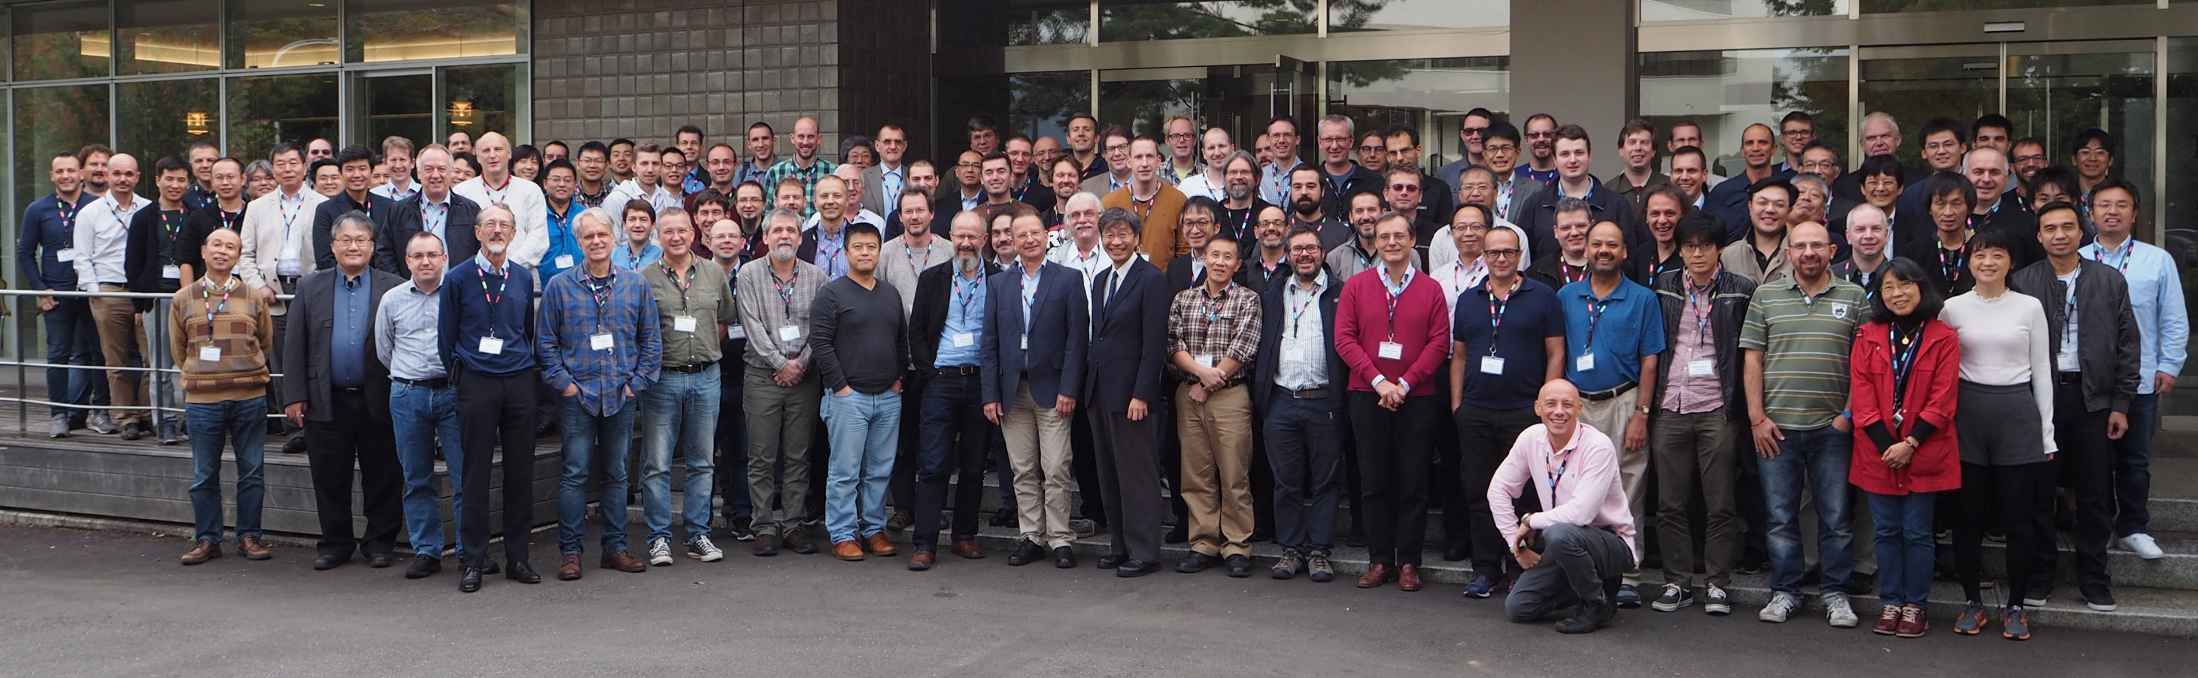
Attendees

Slide 8
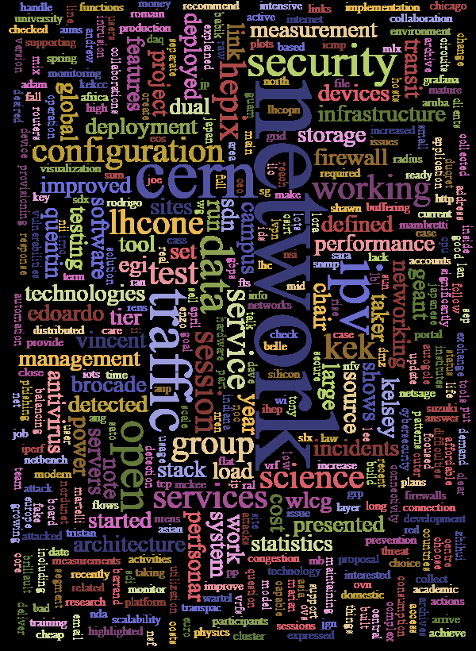
Tracks and Trends… (1)
Networking and security: 6 sessions, 23 contributions
  Content related to the joint meeting with LHCONE/LHCOPN; Wi-Fi; configuration management; new network tools
  Proposal for a new working group "Network Functions Virtualization Working Group“
  Typical updates (OSG/WLCG, IPv6, Security)
  Simulated phishing attack and the successful response by the KEK security team to block the attack

Slide 9
Tracks and Trends… (2)
Storage and file systems: 3 sessions, 7 contributions
  World’s largest erasure-coded CEPH deployment in production and effectively serving multiple VOs through purpose-developed xrootd and gridftp gateways
  Scaling up CEPH support for HPC; expanding CERNbox service roles within and outside of HEP
  DynaFed deployments on the horizon
  Strong community interest in (and concern about) archival storage roadmap; launch working group involving both facilities and experiments
Clouds, virtualisation, grids: 2 sessions, 4 contributions
  Containers (both Singularity and Docker), application to batch systems and hybrid clouds
  Dynamic federation of data stores; distributed clouds successfully running substantial work for Belle II and Atlas with cloud scheduler
  Large number of references to cloud and virtualisation in other tracks – few dedicated talks, but these tools are now embedded in much of our work (“commodity”)

Slide 10
Tracks and Trends… (3)
Computing and batch systems: 3 sessions, 8 contributions
  Fast benchmark: good progress, DB12 most promising candidate, work to understand the last scalability problems observed (mainly ATLAS reconstruction)
  Work in progress to better understand problems of HS06 scalability with applications: number of configured slots per core shown to have a strong influence
  Next generation procurement/pledge benchmark: SPEC2017 out, work in progress to identify whether it can be used to replace HS06
  Benchmarking WG welcomes new members – talk to Manfred Alef
  HTCondor used at ever more sites (community being built), GridEngine almost dropped.
  TechLab: a quite unique facility to test and evaluate new approaches for efficient use of CPUs, open to the community.
  HPC-HTC integration at several sites: room for sharing ideas and solutions, e.g. on HTCondor/SLURM integration
  Understanding “costs”: starting work in WLCG to enable an informed global optimisation of our technical choices
IT facilities and business continuity: 1 session, 1 contribution
  Collecting large amounts of facility data allows for targeted display of critical metrics and for cost-saving optimisations
  Air quality measurements important to monitor particulates in view of tape

Slide 11
Tracks and Trends… (4)
Basic IT services: 2 sessions, 9 contributions
  Stream processing and time-series databases in focus, riemann and InfluxDB hot
  BMC/IPMI security concerns and work on getting suppliers to fix them
  High-performance distributed puppet setup
  Thermal reaction system shutting down servers based on cron and webpages
End-user IT services and operating systems: 2 sessions, 5 contributions
  Document conversion service: Handling large variety of formats, offering OCR
  User portal: single entry for user-specific monitoring, documentation, user alerts, news
  CI for Linux images: automated thorough testing of images for Openstack with gitlab
  Printing at GSI: Moving all printers to dedicated VLAN connected only via dual-homed hosts
  SELinux found useful, powerful and reasonably easy to configure

Slide 12
Tracks and Trends… (5)
Site reports – 4 sessions, 20 contributions
  Network upgrades to increase the bandwidth and cope with the upcoming needs (LHC; BelleII, AMS, LIGO, multiple experiments in China); migrating main line(s) to 100Gbps (40 Gbps mentioned as well a few times)
  Volunteer computing as additional source of CPU capacity
  Multiple sites looking into SDN technology
  HPC clusters, partly with GPUs, at many sites; job flocking from HTC to HPC
  IPv6 moving slowly, but with ongoing progress
  Concerns about significant price increases of commonly used software

Slide 13
Back to the Roots
CHEP (Computing in High-Energy Physics) conference in Tsukuba (Japan), March 1991: Presentation by Les Cottrell (SLAC)
Independent activities are in progress at many HEP sites to understand and define how to support Unix.
At this meeting, people are talking in corridors, sessions etc., and recognizing common challenges & solutions in supporting Unix in the HEP community.
We are learning much from one another & feel there is much to gain from further sharing of experiences and from coordinating or aligning our Unix activities.
Most of those of us who have discussed this at this meeting feel that HEP is at an appropriate place in the Unix learning curve that it would be extremely valuable to
  SHARE UNIX EXPERIENCE between HEP sites active in Unix
  ENCOURAGE ALIGNMENT in the Unix user environment in the HEP community
There is a critical need for mechanisms to be set up to provide information exchange
  Within HEP via REAL FACE-TO-FACE MEETINGS, Email, netnews, info-servers, remote conferencing documentation, newsletters etc.
  With vendors - make sure they know about HEP needs
  With standards bodies - encourage HEP representation on critical bodies
  …
PROPOSAL: Set up a HEP Unix Coordination Group:
Brief:
  Provide information exchange
  Promote alignment of the Unix environment in the HEP community
Recommend Regular Meetings:
  Half Yearly
  Aligned with CHEP & other meetings of relevance
  1-2 people from HEP sites working on providing a Unix environment to users
Name of Group: HEPIX
First Meeting: FNAL - 1st week October 1991
Email: HEPNET::HEPIX_L (after April); HEPIX_L@HEPNET.FNAL.GOV
More Information:
Les Cottrell COTTRELL@SLACVM.SLAC.STANFORD.EDU
Judith Nicholls NICHOLLS@FNAL.GOV
Harry Renshall HRRCR@CERNVM.CERN.CH
Alan Silverman ALAN@VXCERN.CERN.CH

Slide 14
Next Meetings
Spring 2018: University of Wisconsin in Madison (WI), USA
  14 – 18 May 2018 (followed by HTCondor week starting 21 May 2018)
  Same tracks as this time
  First public announcement early in 2018
HTCondor workshop: RAL, Didcot, United Kingdom
  04 – 07 September 2018
Autumn 2018: PIC, Barcelona (Spain – or will it be another country?)
  08 – 12 October 2018
2019: tentatively at SDSC, San Diego (CA), USA and Nikhef, Amsterdam, The Netherlands
  No dates defined yet
Comfortable number of proposals received from Europe, North America and Asia/Pacific for subsequent meetings
Expressions of interest and proposals are nonetheless always welcome

Slide 15
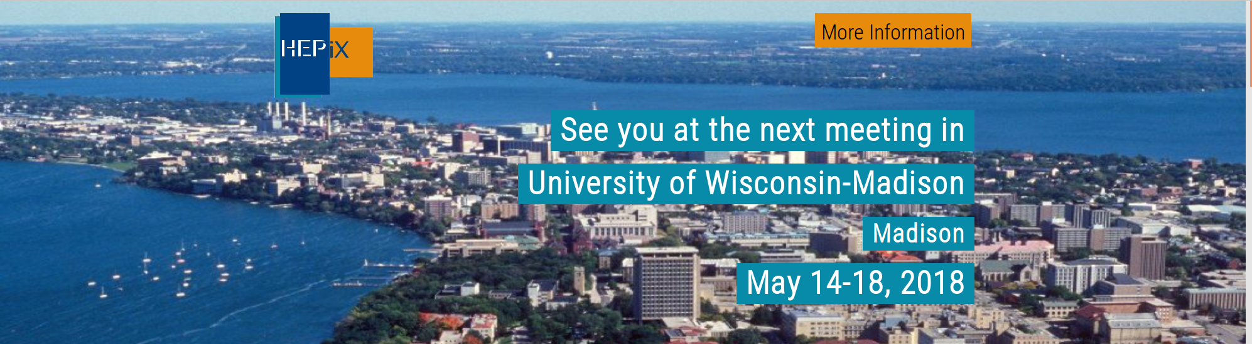
Questions, Comments?

