Slide 1
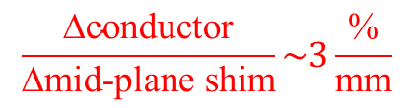
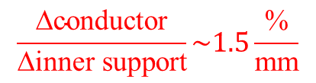
Inner support and mid-plane shim
1 mm of mid-plane shim is equivalent to 2 mm of inner support wall thickness in terms of increase of conductor needs!
$$\frac{\text{∆}\text{conductor}}{\text{∆}\text{inner} \text{support}}\sim 1.5\frac{\text{\%}}{\text{mm}}$$
$$\frac{\text{∆}\text{conductor}}{\text{∆}\text{mid}\text{−}\text{plane} \text{shim}}\sim 3\frac{\text{\%}}{\text{mm}}$$

Slide 2
Cheaper ways to fix b₃ in ECC_V15ar
ECC_V15ar: We can get rid of 4 low field turns (2.2% of conductor area), decreasing the mid-plane from 1.45 mm to 0.45 mm. You end up with 15 units of b3. With some modification on the iron, you can introduce about 10 units of geometric b3 (I didn’t do it completely, but playing a bit here and there I have the feeling you have enough space for optimization).
By making the “window” steeper, you can also reduce the change on b3 for injection to nominal due to saturation (I went down to 2-3 units from injection to nominal instead of 9 units, but I am sure you can go even lower)
Ending up in a region with b3 at nominal is about 5 units might be even better than ending up at 0, as the persistent currents will probably give in the order of 10 units at injection, so it is better to have something balanced from injection to nominal. This is just to say that you don’t need to be too obsessed for the moment on getting b3 exactly to 0

Slide 3
Block data modified
BLOCK 16
1 2 3 31 15 -90 11050 ECC89HF 2 12 0 0
2 2 21 38.2 15 -90 11050 ECC90HF 2 20 0 0
3 2 3 31 30.05 -90 11050 ECC89HF 2 12 0 0
4 2 21 38.2 30.05 -90 11050 ECC90HF 2 20 0 0
5 2 9 15.95 45.1 -90 11050 ECC89HF 2 12 0 0
6 2 22 36.65 45.1 -90 11050 ECC90HF 2 20 0 0
7 2 9 15.95 60.15 -90 11050 ECC89HF 2 12 0 0
8 2 22 36.65 60.15 -90 11050 ECC90HF 2 20 0 0
9 2 3 31 15 -90 11050 ECC89HF 2 12 1 180
10 2 21 38.2 15 -90 11050 ECC90HF 2 20 1 180
11 2 3 31 30.05 -90 11050 ECC89HF 2 12 1 180
12 2 21 38.2 30.05 -90 11050 ECC90HF 2 20 1 180
13 2 9 15.95 45.1 -90 11050 ECC89HF 2 12 1 180
14 2 22 36.65 45.1 -90 11050 ECC90HF 2 20 1 180
15 2 9 15.95 60.15 -90 11050 ECC89HF 2 12 1 180
16 2 22 36.65 60.15 -90 11050 ECC90HF 2 20 1 180
no type nco radius phi alpha current condname n1 n2 imag turn

Slide 4
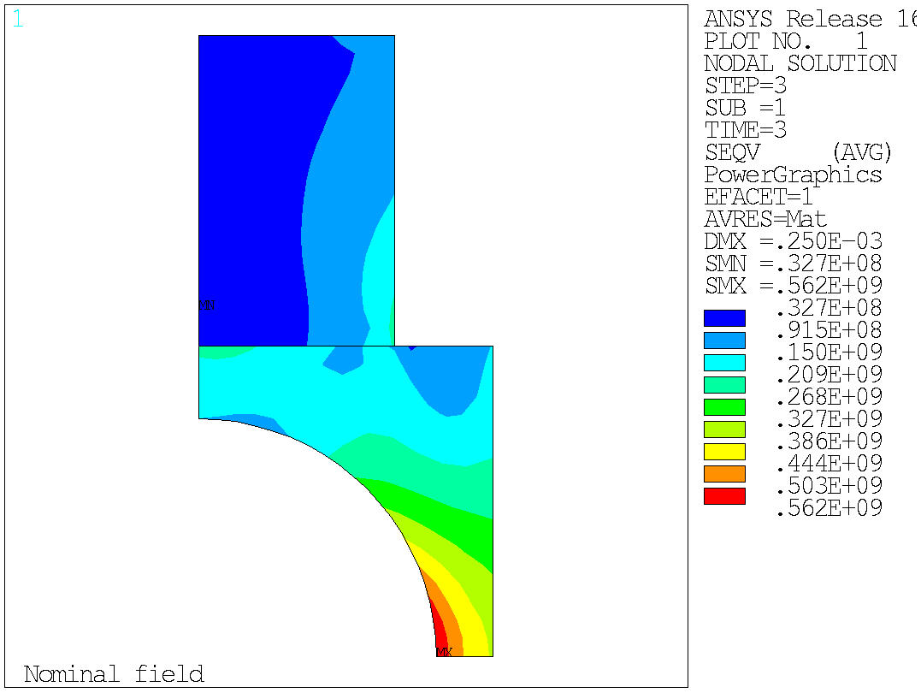
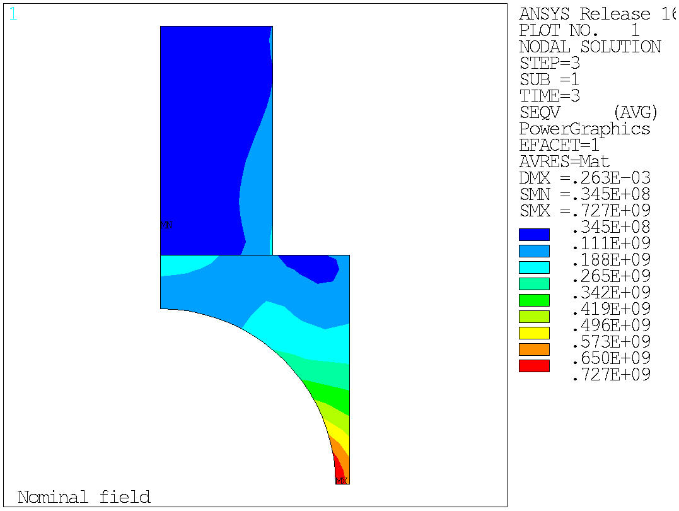
6 mm
2 mm

Slide 5
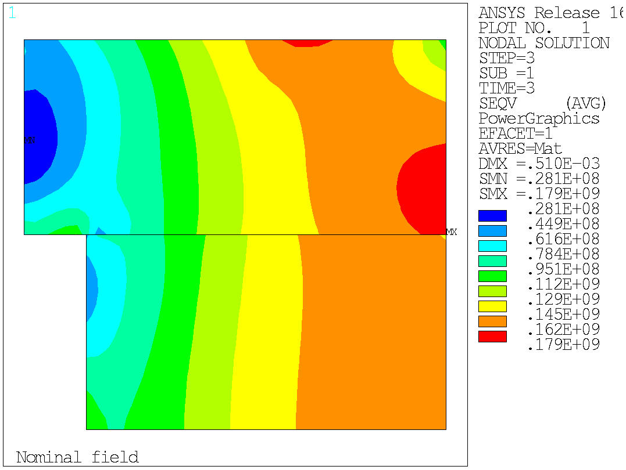
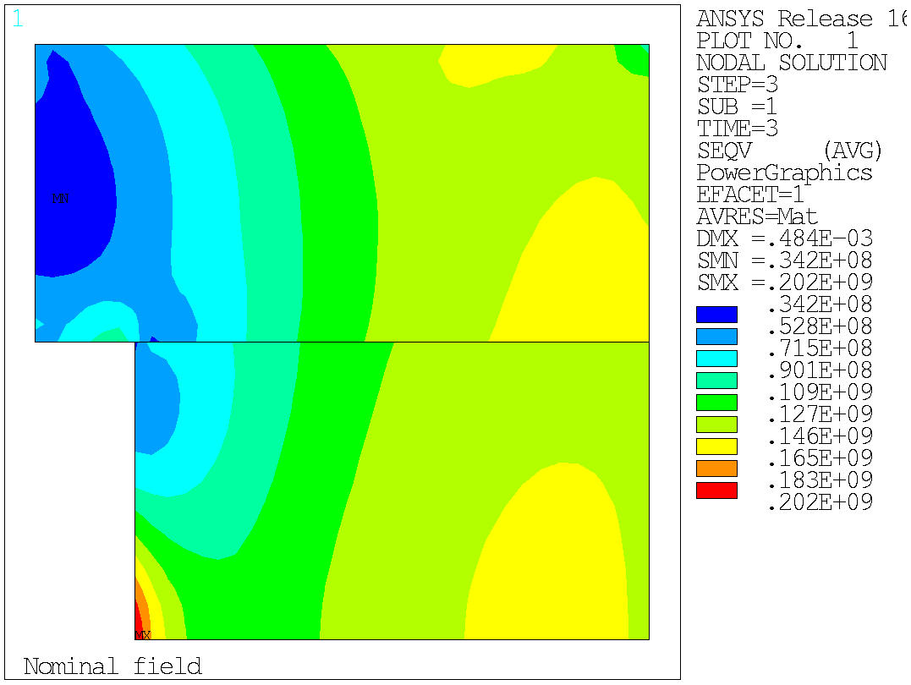
6 mm
2 mm

Slide 6
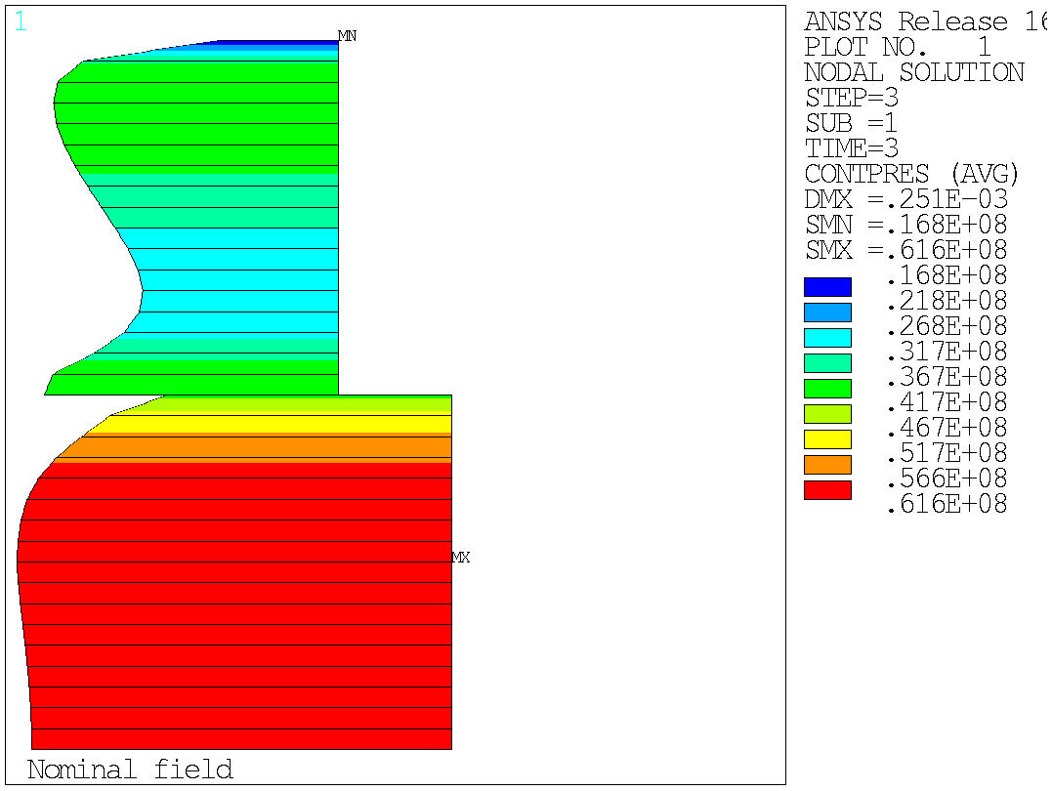
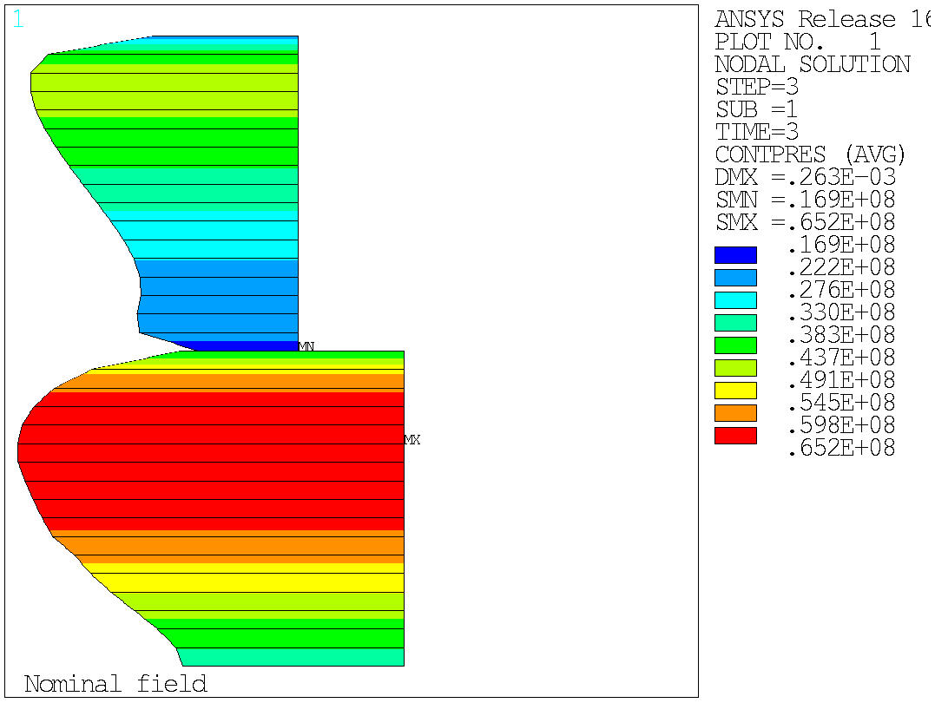
6 mm
2 mm

Slide 7
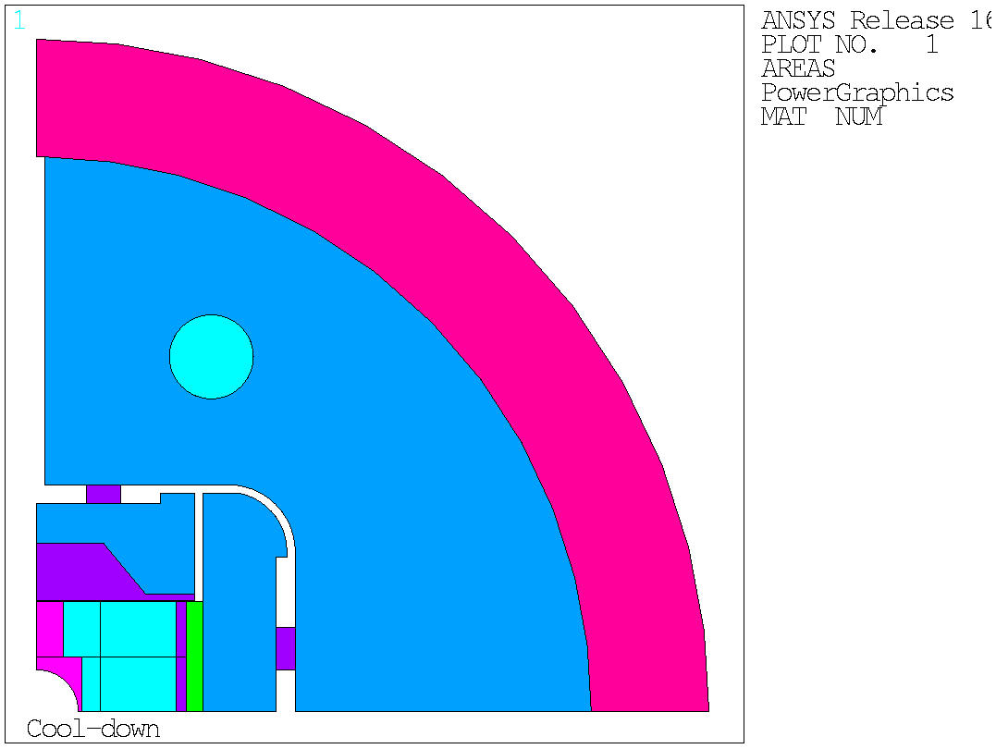
If going to 2 mm thick wall…
Dis you try to model “defects at the level of the pole”?
Important to make it rigid

Slide 8
 | Pole tip thickness [mm] | displacement [µm] |  | Δdisp [µm] | Strain [µm/m] |  | Δε [µm/m] | Δε/Δdisp [µε/µm] | Comments
RMM_graded_v21_a | 6 | -168 | -58 | 111 | -4832 | -1245 | 3587 | 32.4 | Material properties LBNL (E~44 GPa,44 GPa)
RMM_graded_v21_b | 4 | -171 | -55 | 116 | -4757 | -1115 | 3643 | 31.5 | Material properties LBNL (E~44 GPa,44 GPa)
RMM_graded_v21_c | 2 | -173 | -55 | 118 | -4666 | -1056 | 3610 | 30.5 | Material properties LBNL (E~44 GPa,44 GPa)
RMM_graded_v21_d | 1 | -174 | -56 | 118 | -4617 | -1071 | 3546 | 30.0 | Material properties LBNL (E~44 GPa,44 GPa)

Slide 9
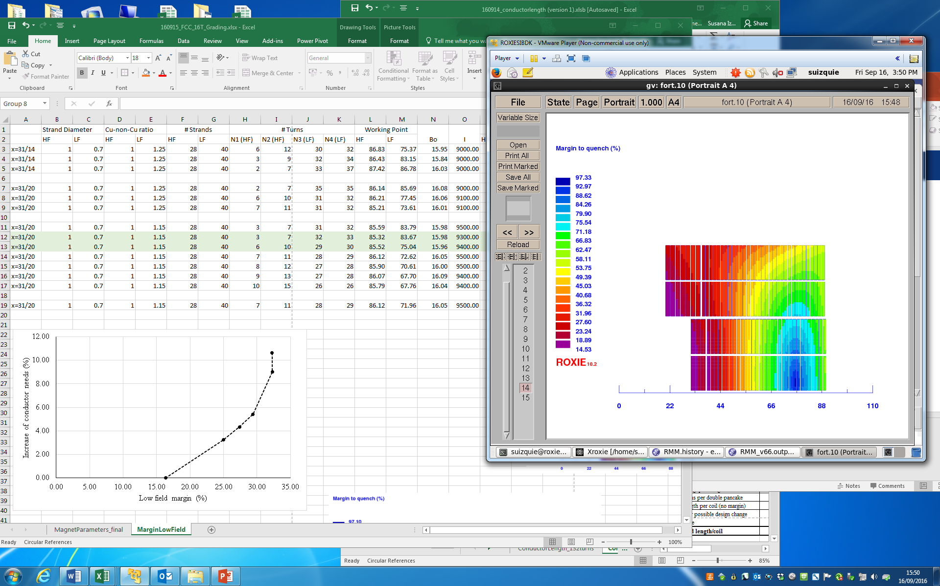
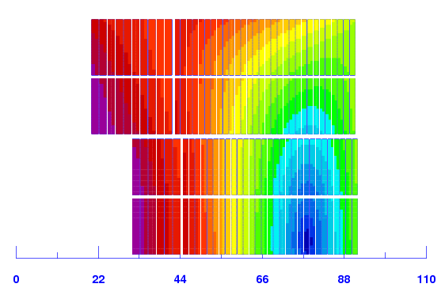
The “cost” of the low field margin
A
B
B
A

