Slide 1
Katharina Henjes-Kunst

Slide 2
SENSE – a roadmap for the ultimate low Light-level Sensor Development
SENSE was developed within Horizon 2020
funding scheme: Future and Exchanging Technologies, FET Exchange as Coordination and Support Action
Starting on 1st of September 2016 for 36 months

Slide 3
SENSE goals
to set up an expert group and facilitate the development of a European R&D roadmap to- wards the ultimate low light-level (LLL) sensors,
to monitor and evaluate the progress of the developments with respect to the roadmap,
to coordinate the R&D efforts of research groups and industry in advancing LLL sensors,
to prepare a database of light sensor spe- ci cations and lab equipment, test stands and expertise available in the different institutions,
to liaise with strategically important European initiatives and research groups and companies world-wide,
to create the Technology Exchange Platform to enable an ef cient exchange between resear- chers and developers being involved in SENSE,
to prepare training events and teaching ma- terial especially towards young researchers,
to frame up a technology training session that can be implemented in any existing summer school.

Slide 4
SENSE are...
Partners:
  DESY (Coordinator)
  University of Geneva
  Max-Planck Society
  KIT
People:
  Katharina Henjes-Kunst, Thomas Berghöfer
  Teresa Montaruli, Domenico Della Volpe, Andrii Nagai
  Razmik Mirzoyan, NN
  Andreas Haungs, Astrid Chantelauze
Experts:
  SENSE strongly relies on impact of Expert Group

Slide 5
SENSE work packages
WP 1: Roadmapping and Monitoring (MPP)
WP 2: R&D Cooperation (UNIGE)
WP 3: Outreach and Technology Exchange Platform (KIT)
WP 4: Training & Learning (DESY)
WP 5: Overall management (DESY)

Slide 6
Aims of the meeting
Overview of the next half year of work and procedures/ clarification of coming activities/ meetings/ deliverables
SENSE Team/ communication
Meetings/ results of meetings

Slide 7
Organisational/ Mailing lists
We want to prepare a mailing list ➔ who should be on it?
  Working group (Teresa, Mimmo, Andrii, Razmik, Andreas, Astrid, Thomas, Katharina, ???)
  Experts

Slide 8
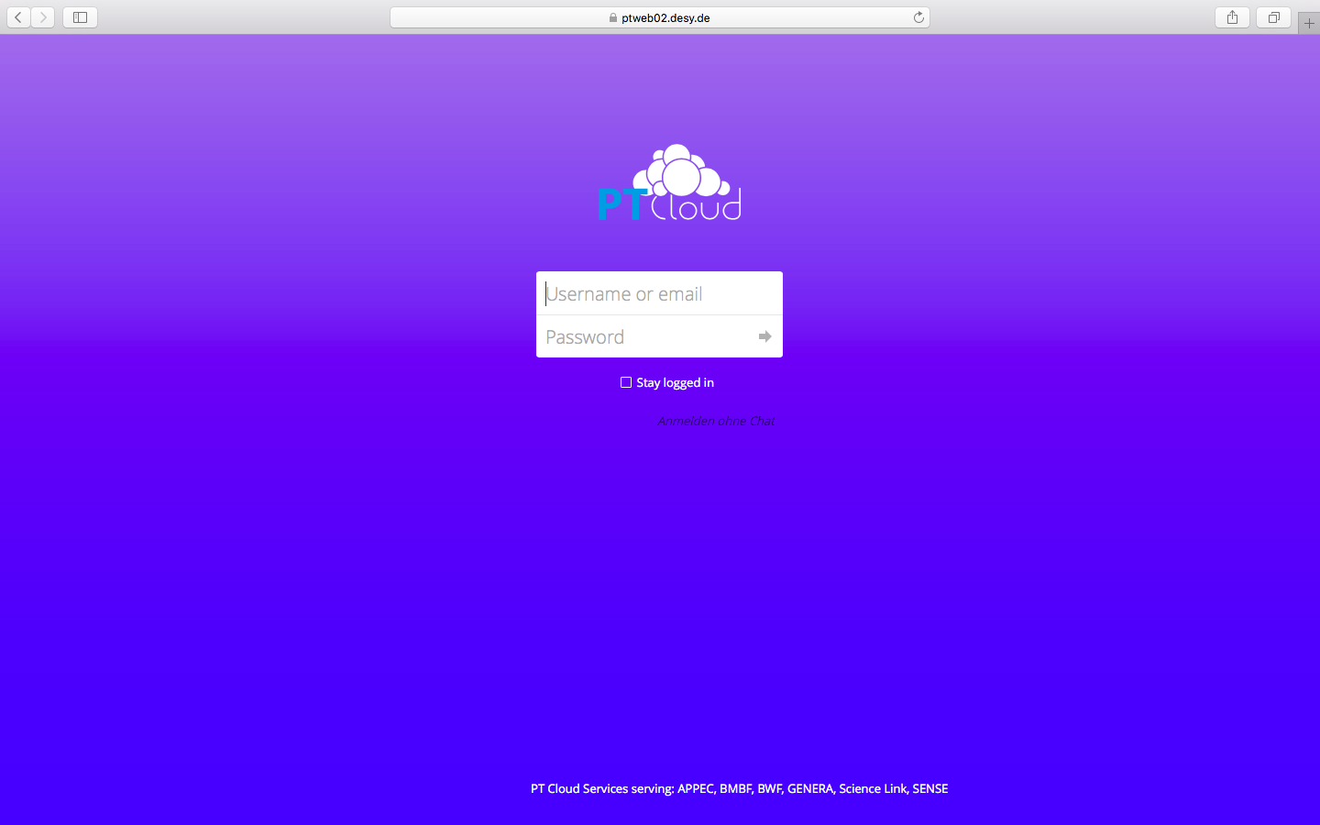
Organisational/ Cloud

Slide 9
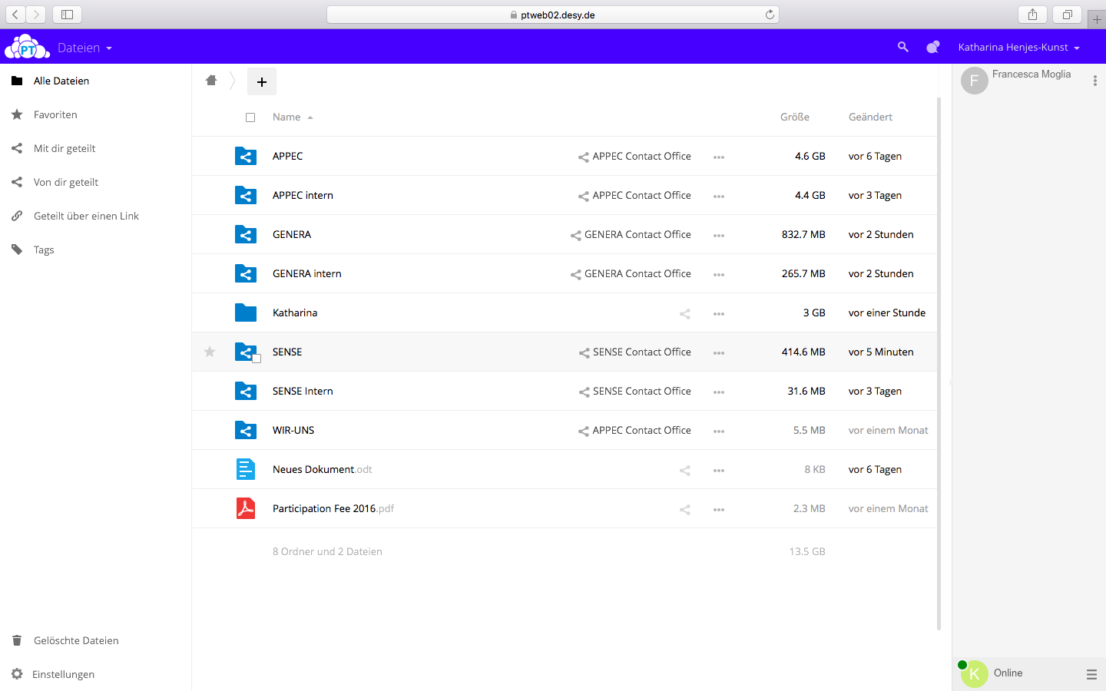
Organisational/ Cloud

Slide 10
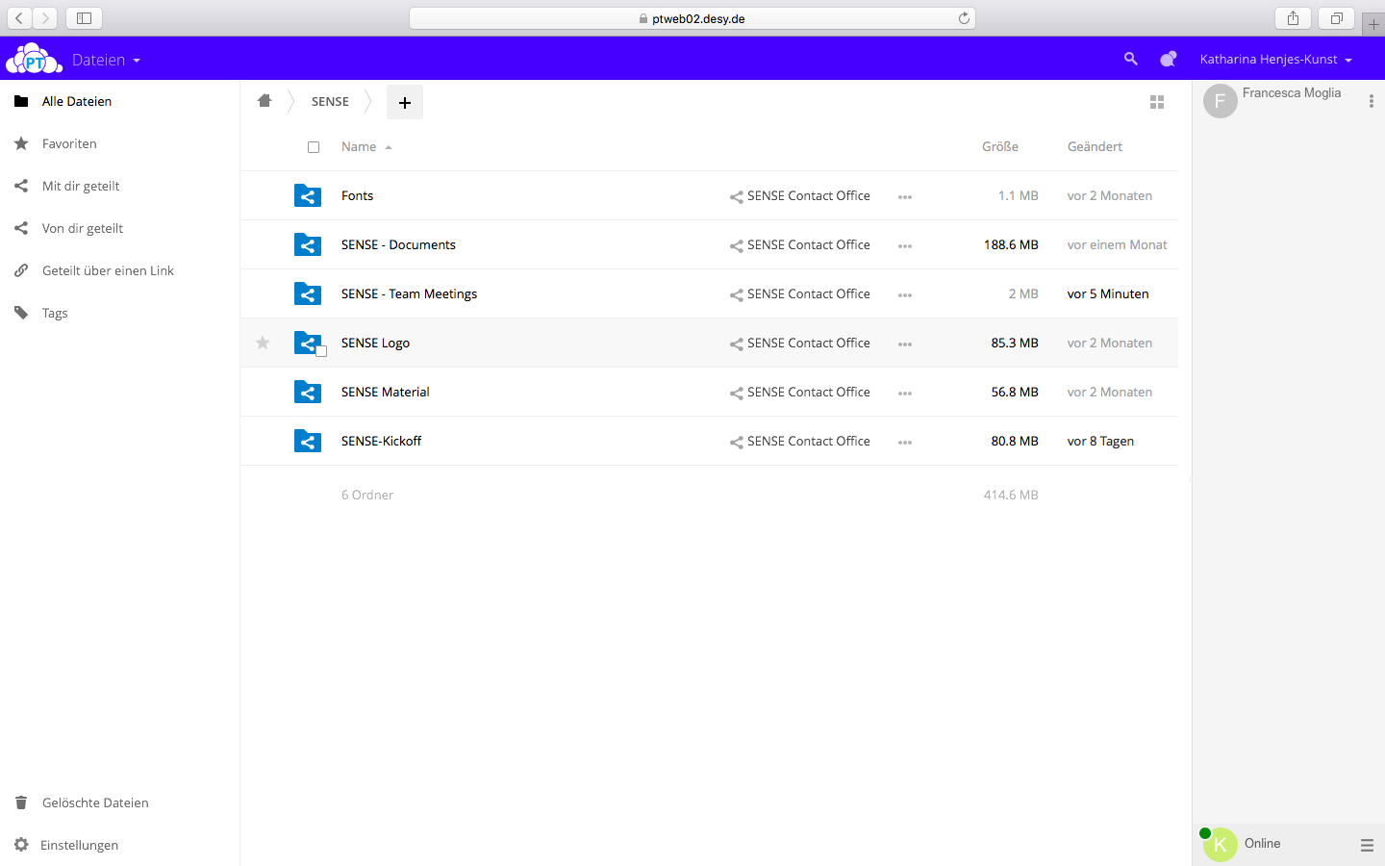
Organisational/ Cloud

Slide 11
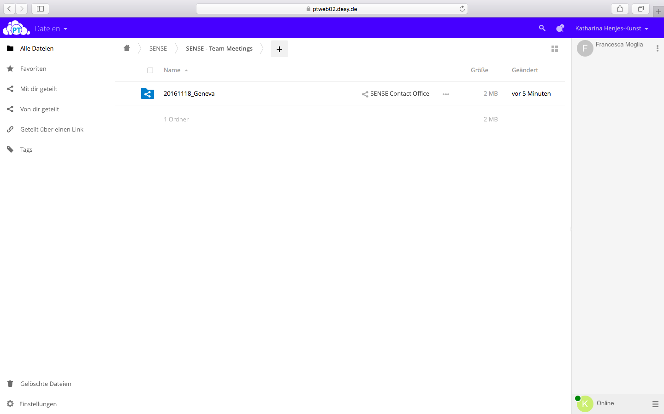
Organisational/ Cloud

Slide 12
Organisational/ Cloud
username and password from Katharina/ Thomas
Storage of all data we use

Slide 13
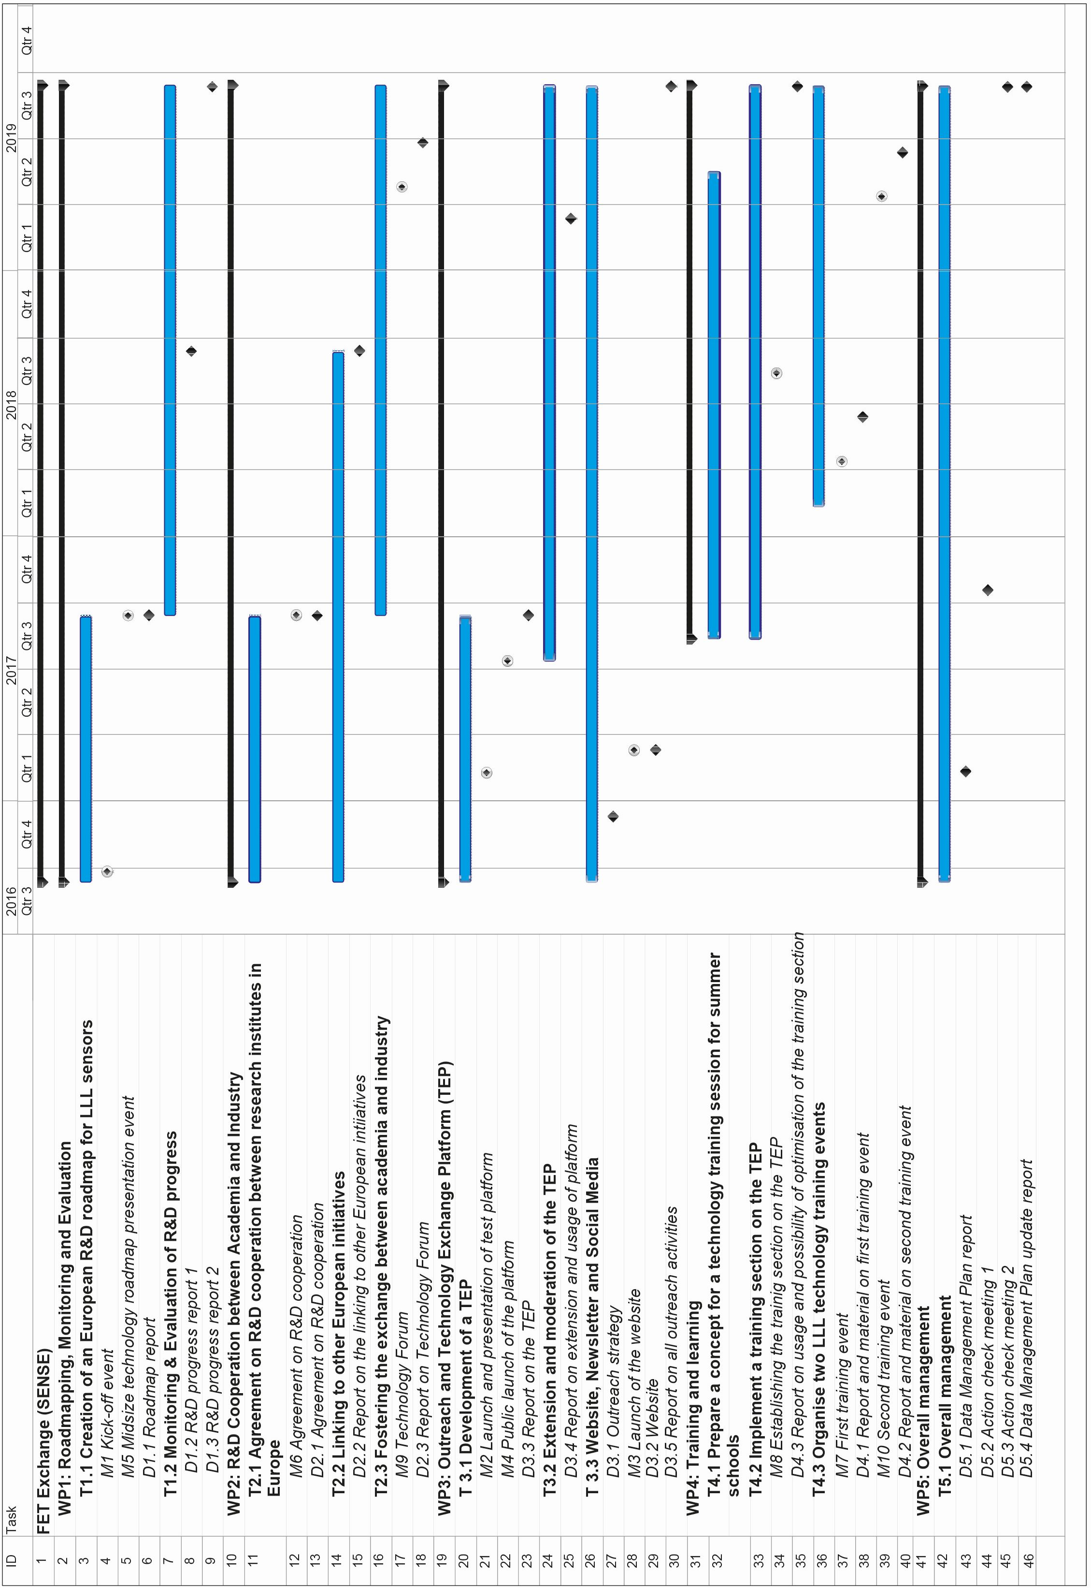
Timeframe

Slide 14
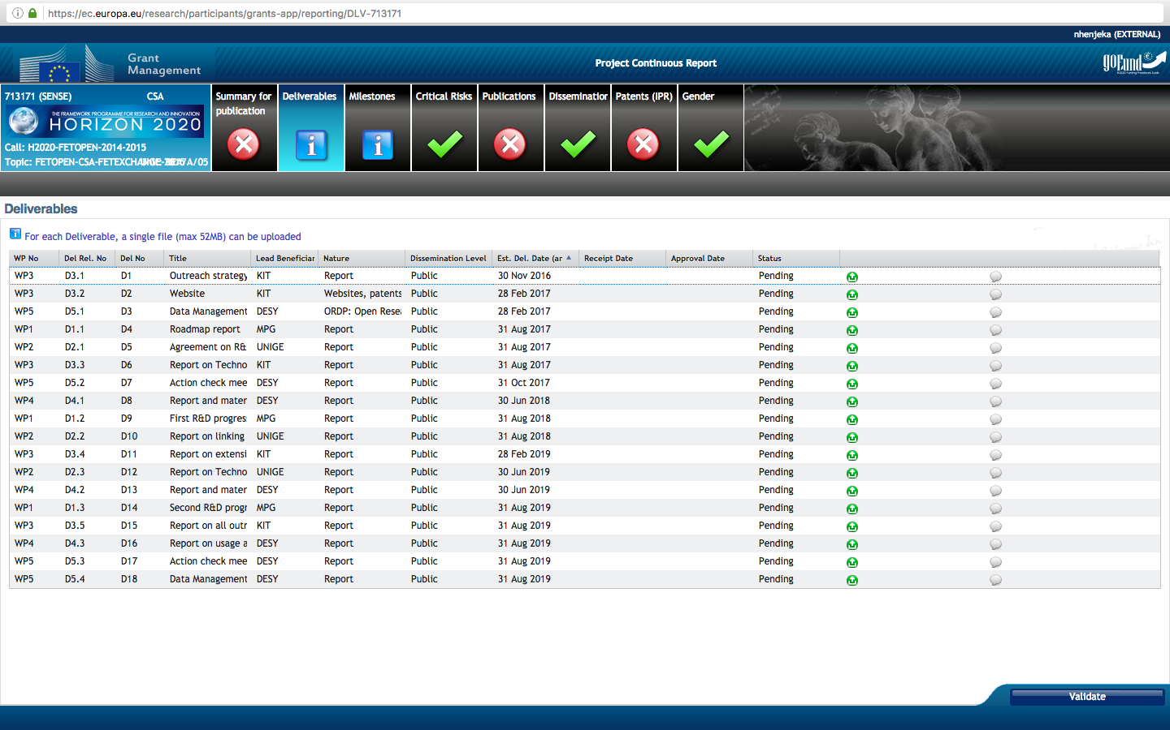
Deliverables

Slide 15
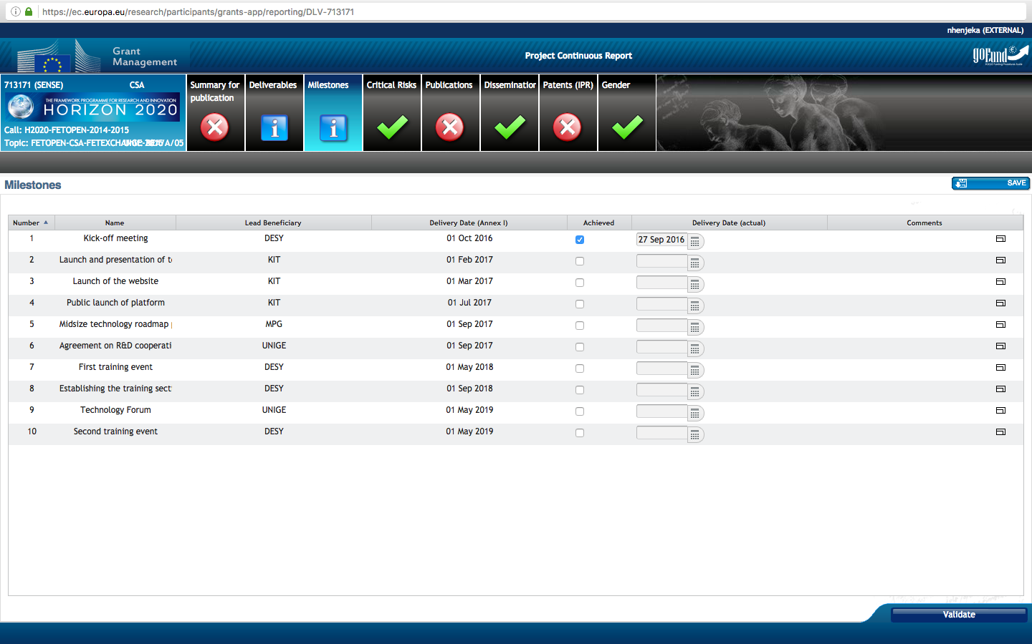
Milestones

Slide 16
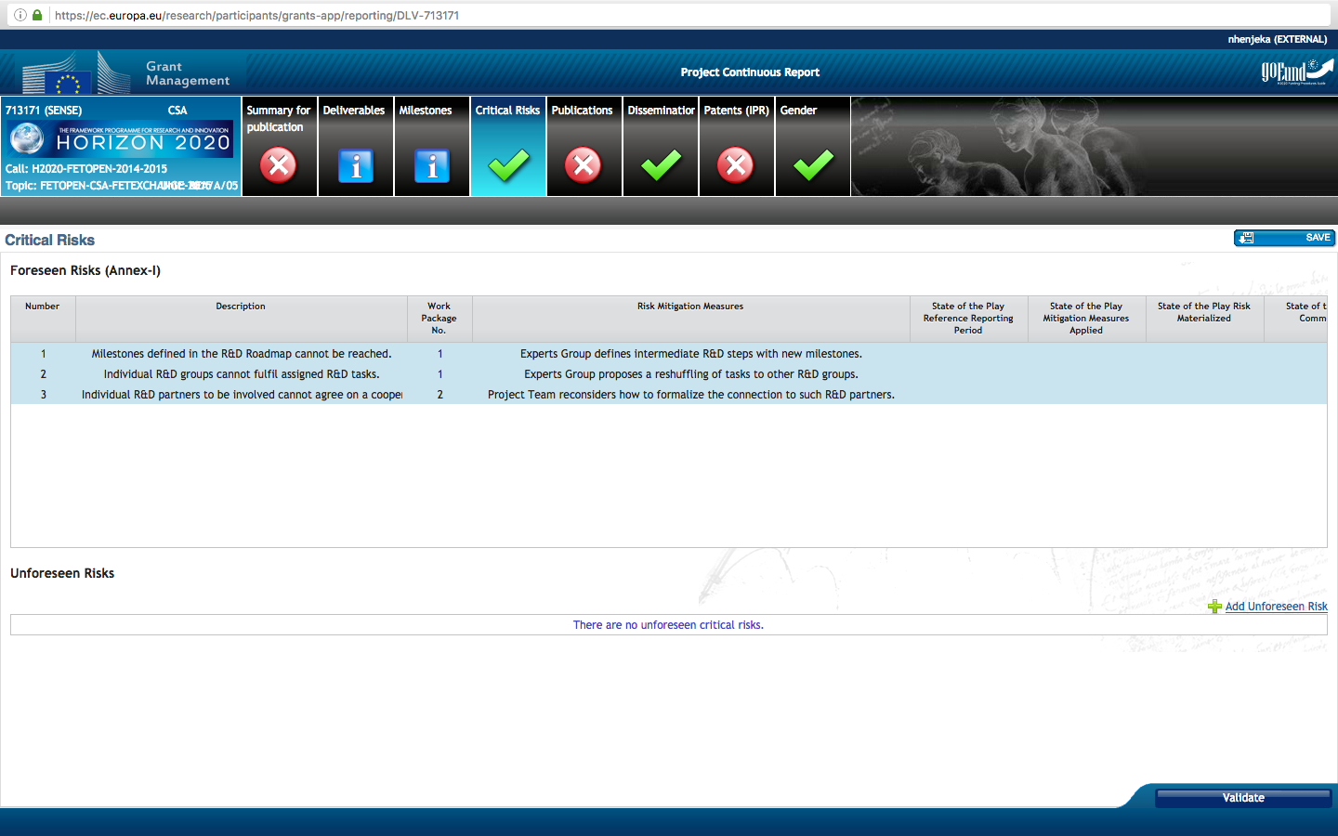
Risks

Slide 17
Expert Group
„3.2.3 Experts Group
The Experts Group (EG) comprises first-rate developers in the field of LLL sensors, representative of major research projects requiring LLL sensors as well as company representatives active in developing and manufacturing LLL sensors.
They will act as an advisory panel to the project and it will have overall responsibility for monitoring the work performed, reviewing the objectives and progress achieved towards sustained co-operation and the specific objectives set and discussing corrective actions where necessary. Regular meetings are planned at least twice a year, mostly as side meeting during other SENSE events. Further meetings required to derive fast decisions shall be organized by video conferencing. The members of the Experts Group shall be committed for the three years lifetime of the project.
The Expert Board shall be chaired by Prof. Razmik Mirzoyan (MPP). Advised by the chair all other members will be nominated by the Project Team at the beginning of the project. The members of the expert board, beside its chair Prof. Razmik Mirzoyan, who is working for beneficiary MPP, won´t have a subcontractor or contractor status and won´t be paid for their work, although their travel costs should be reimbursed. They participate in the action on an ad-hoc basis for the mentioned meetings of the expert group. “

Slide 18
Expert Group

Slide 19
SENSE perspective
Technology Roadmap event autumn 2017
Training event I spring 2018
Training event II spring 2019
Technology Forum spring 2019
Working level meetings regulary
Expert group 2 times/ Year (also as side meetings)

Slide 20
WP3: Next steps
Website online
Forum working ==> we should use it!
Outreach strategy➔ Deliverable by end November!
Brochure
Other material

Slide 21
WP 4: Training & Learning
Starting in month 12
But: UNIGE has some action before?

Slide 22
SENSE
Thank you for your attention!
Please visit sense-pro.org and stay in contact with us
Sensepro@desy.de

