Slide 1
Reconstruction news
Distortions in MC
Problems found in reconstruction:
  cookdEdx
  Low-pT matching loss due to
  large errors from TPC cov.matrix
BTG
R.Shahoyan, 03/11/2016

Slide 2
MC with TPC distortions
Inverted (distortion) maps are stored in TPC/Calib/DistortionMaps(Ref) objects.
Currently extracted privately as post-processing of centrally produced CorrectionMaps
(by PrepDistortions.sh, uses alitpcdcalibres.root and voxelResTree.root)
Can be produced directly during ResidualTrees processing afrer Cpass0
(by CreateOCDBTPCSPDistCalib.sh inputFile=… startRun=… endRun=… storage=… [corr=1] [dist=1])
Usage of distortions in MC is steered by AliTPCRecoParam::GetUseCorrectionMap()
Since distortions are specific and time dependent, exact time-stamps matched to run must be generated: AliSimulation is modified to generate an ordered list of time-stamps according to GRP start/end and run-spefic IR-profile: option is turned ON automatically if distortions correction is requested in the TPC RecoParam (AliSimulation::UseTimeStampFromGRP())
AliTPCsim.cxx applies distortions via AliTPCTransform according to event time-stamp, exactly in a same way as with corrections in reconstruction
Since distortion/correction objects are coupled to TimeDrift, the latter is taken from raw://
Z -> time-bin conversion is done with AliTPCTransform in inverse sequence of time-bin -> Z

Slide 3
Application of distortion fluctuations in MC
The degradation of reconstruction is caused mostly not by distortions (apart from the acceptance topology modification) but by the fluctuations:
We don’t have working model for fluctuations (at least which can be put in MC).
Distortions fluctuations (stored in the maps) are applied as (x,y,z)*RND ,
where RND is gRandom->Gaus() generated once per event before digitization,
e.g. 100% correlation is assumed by default.
  Option to impose fraction F of fluctuation as uncorrelated error, e.g. distortion per cluster is Dist(x,y,z) + F* (x,y,z)*RND(per_event) + (1-F)*RND(per_cluster)
  At the moment does not seem to be useful

Slide 4
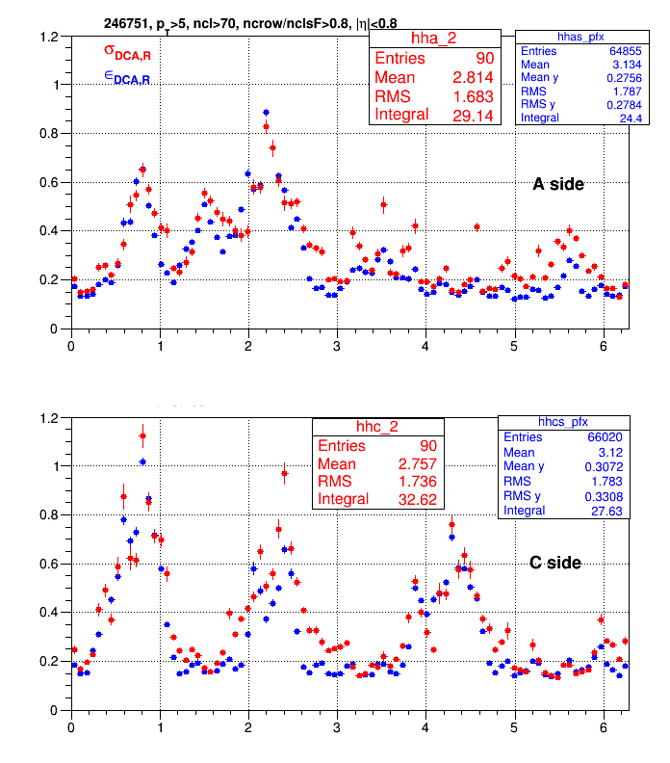
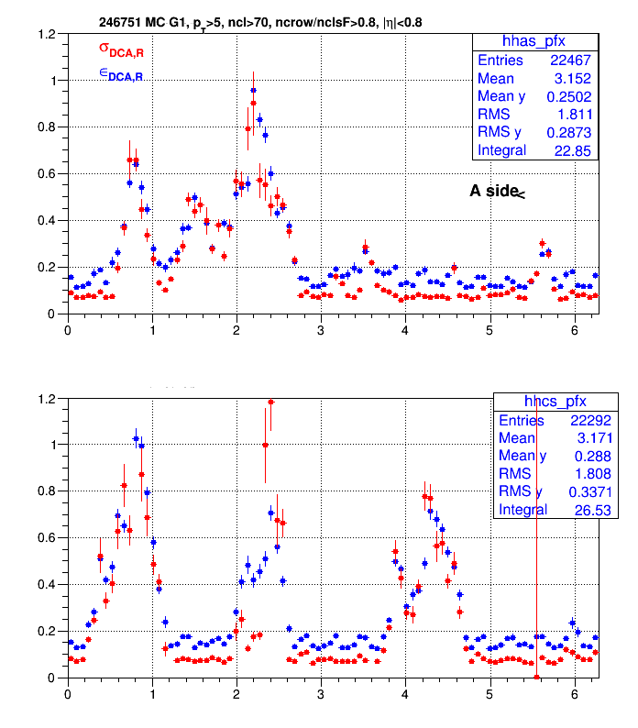
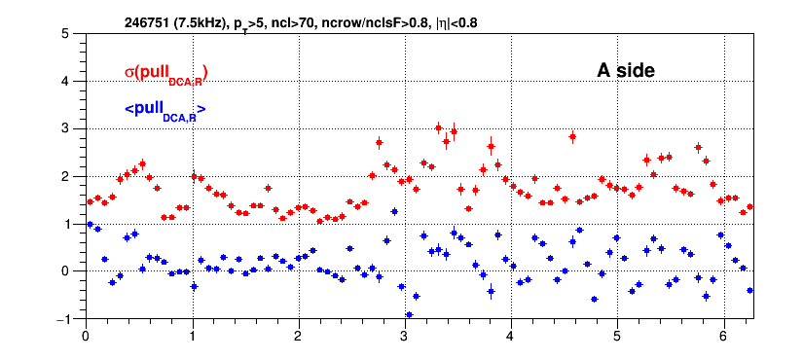
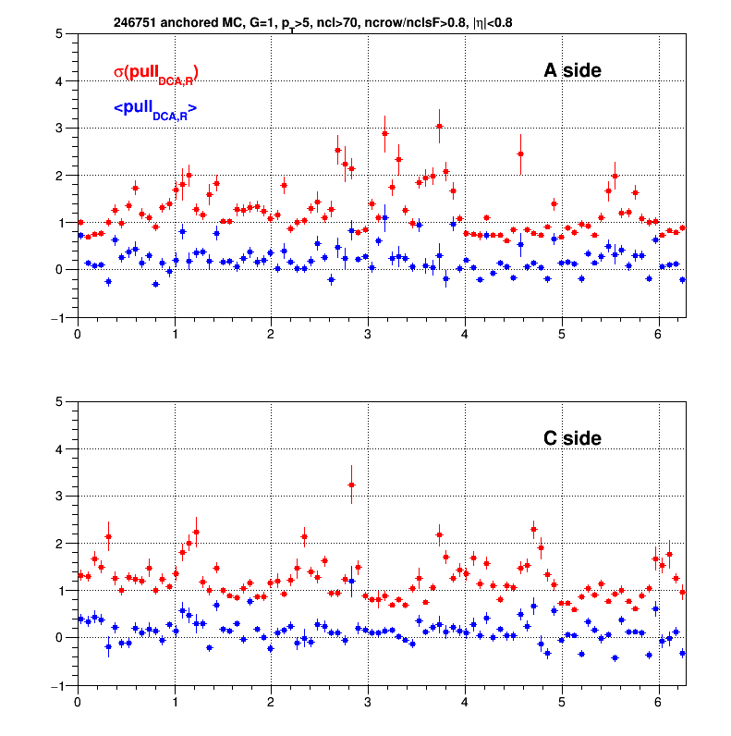
MC with TPC distortions
Main features of distortions (fluctuations) effect are reproduced:
The regions of small distortions/fluctuations have worse description due to the insufficient resolution of interpolating tracks
Pulls in MC are better than in data, effect on matching to be verified.
MC, 7.5kHz
(400 pions, flat pT)
σ DCA Y, cm
Fitted
Cov.Matrix
Data, 7.5kHz
Data, 7.5kHz
MC, 7.5kHz
(400 pions, flat pT)
DCA Y pull

Slide 5
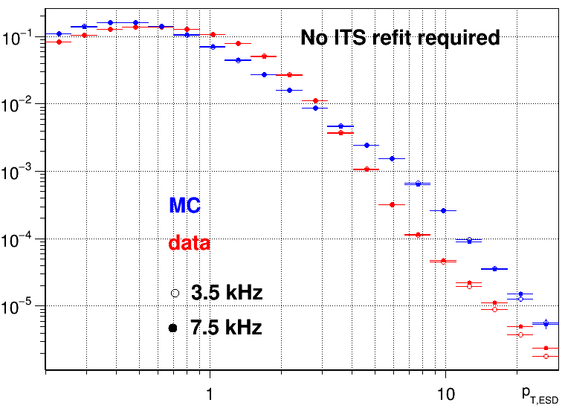
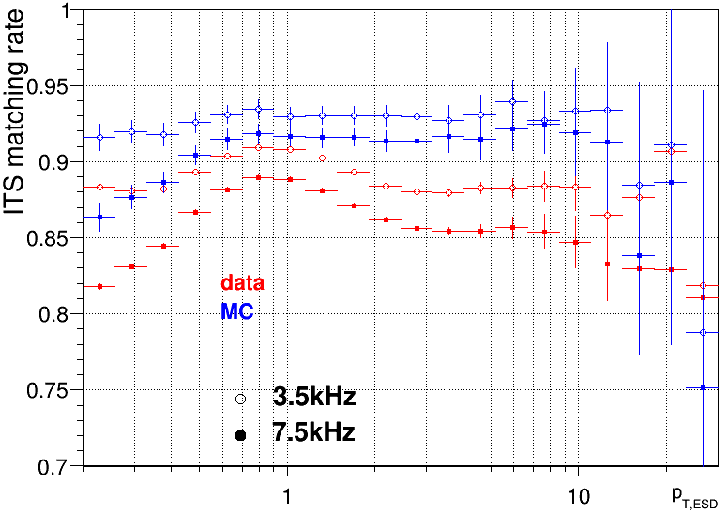
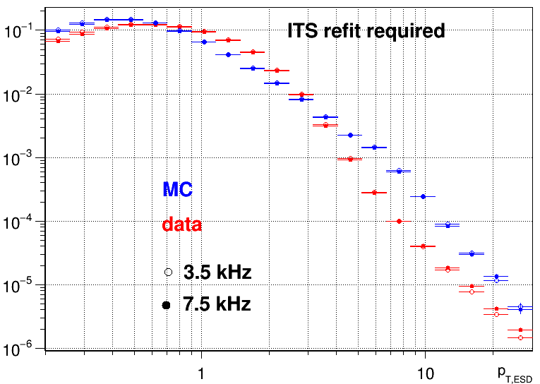
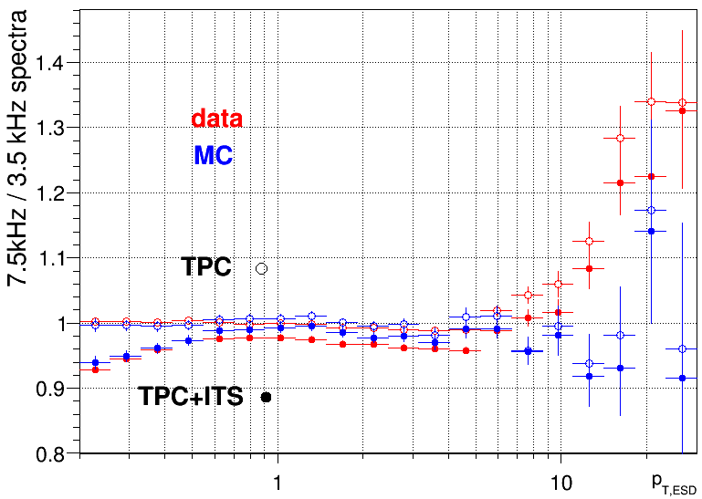
Spectra and ITS-TPC matching: Data (pass1) vs MC (LHC16j3)
246994 (2.3 kHz)
246751 (7.5kHz)
246994 (2.3 kHz)
246751 (7.5kHz)
Low-pT garbage reconstructed with high pT, not reproduced by MC, to be eliminated by cuts
246994 (2.3 kHz)
246751 (7.5kHz)

Slide 6
CookdEdx problem
During the reconstruction the tracks are propagated (i.e. material effects accounted) according ESDtrack::PIDForTracking variable.
Set by AliTPCtracker::CookdEdx method after TPCin and TPCout stages (also called after TPCrefit, but w/o update of PIDForTracking)
CookdEdx needs access to TPC clusters stored in TPCseeds
Within the memory consumption reduction campaign for LHC15o reconstruction the TPCseeds were optimized (size reduced from 8K to 3K) and the clusters are not stored anymore but attached on demand dynamically.
Supplying of clusters for CookdEdx after TPCin was missed, as a result default PID = π was assigned to PIDForTracking
⇛ tracking in ITS (ITSin step) was done with π hypothesis for all tracks, degrading low-pT matching efficiency for heavier than π particles
Problem was not spotted earlier because proper PIDForTracking was stored in the ESD (assigned after TPCout step).
Affected data sets: LHC15n, LHC15o (except low-IR pass4 done with fixed code)

Slide 7
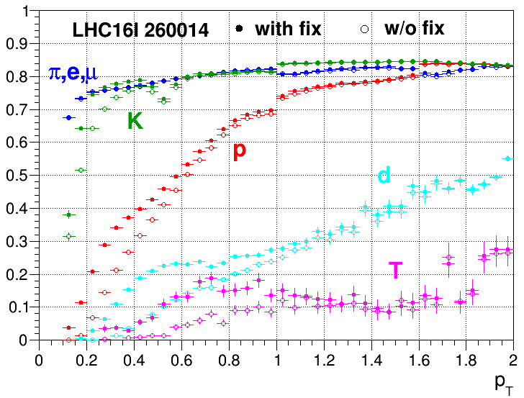
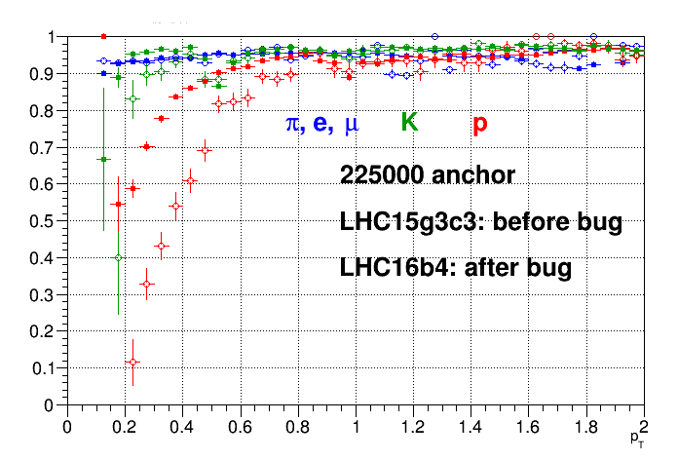
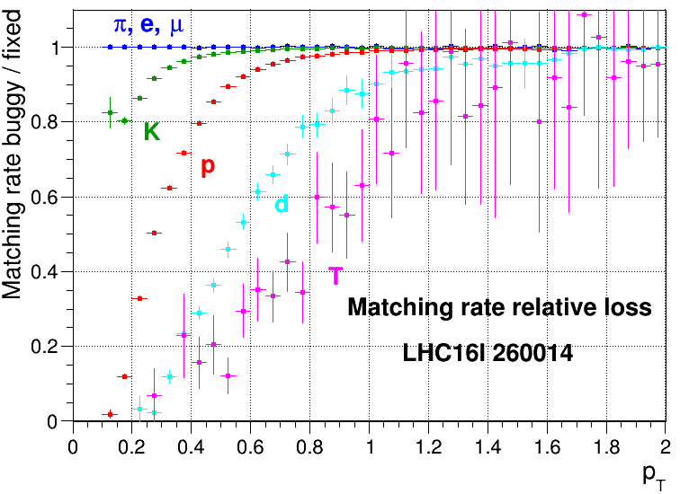
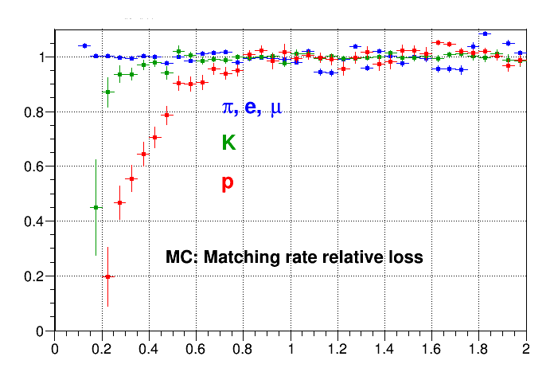
Effect of CookdEdx bug in data (LHC16l) and MC (LHC15f)

Slide 8
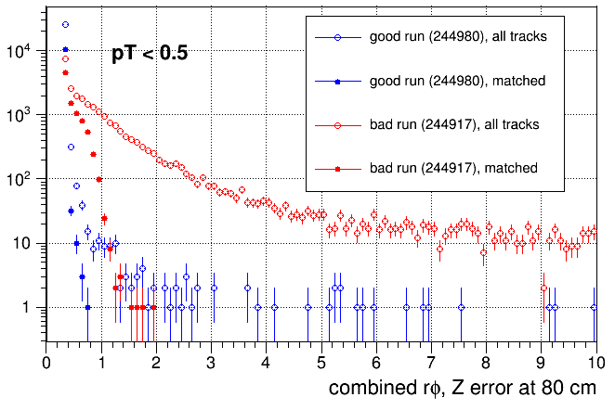
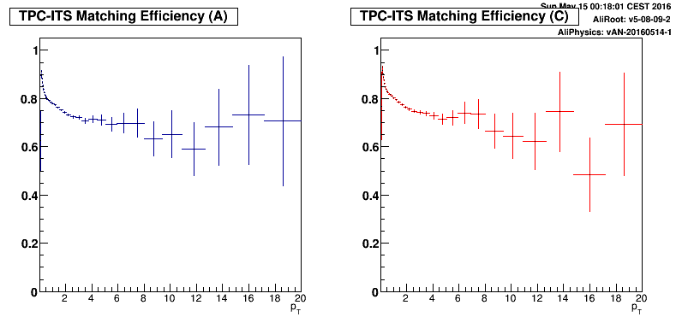
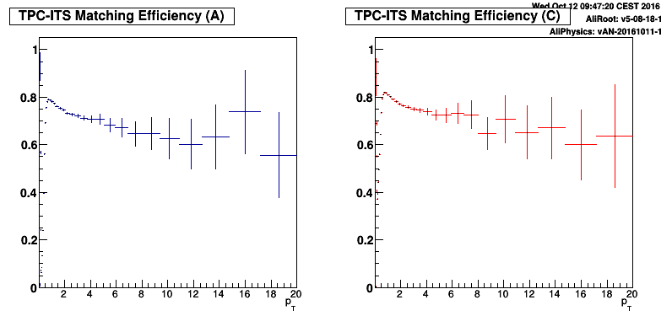
Low-pT matching
New problem observed in data reconstructed with distortions correction (ALIROOT-6949)
In some runs the additional error added to TPC clusters to account for fluctuations leads to explosion of low-pT TPC tracks extrapolation errors (>3cm) in ITS.
Such tracks are rejected as matching candidate by a fiducial cut (“Invariant”) in ITS matching.
Observed also in LowIR pass3, where the “fluctuation error” is faked in run 244917 by large dispersion of extracted distortion (no SCD-related distortions/fluctuations are expected there).
Low IR 244917, pass2
(no extra error applied)
Low IR 244917, pass3
(extra error applied)

Slide 9
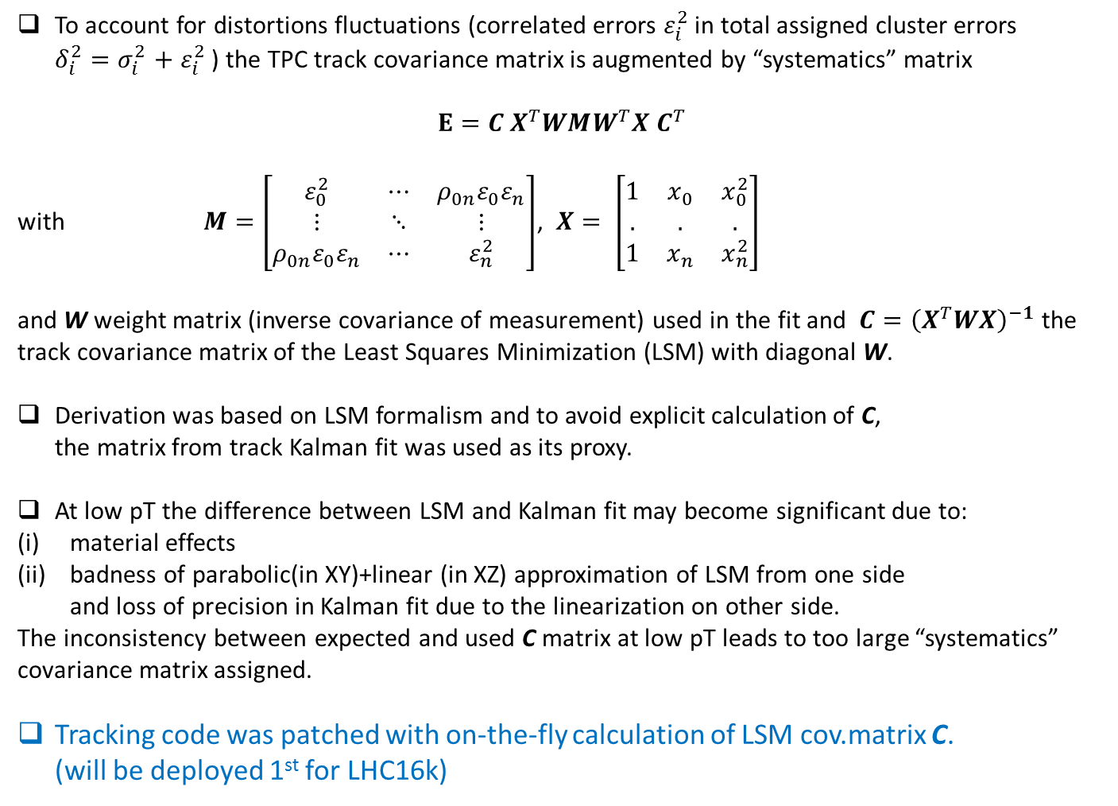
Origin of the covariance matrix explosion
To account for distortions fluctuations (correlated errors $ε_{i}^{2}$ in total assigned cluster errors $δ_{i}^{2}{=σ}_{i}^{2}+$ $ε_{i}^{2}$ ) the TPC track covariance matrix is augmented by “systematics” matrix
$$Ε=C X^{T}WMW^{T}X C^{T}$$
with $M=\left[\begin{matrix}ε_{0}^{2} & ⋯ & {ρ_{0n}ε}_{0}ε_{n} \\ ⋮ & ⋱ & ⋮ \\ {ρ_{0n}ε}_{0}ε_{n} & ⋯ & ε_{n}^{2}\end{matrix}\right]$, $X= \left[\begin{matrix}1 & x_{0} & x_{0}^{2} \\ . & . & . \\ 1 & x_{n} & x_{n}^{2}\end{matrix}\right]$
and W weight matrix (inverse covariance of measurement) used in the fit and $C={\left(X^{T}WX\right)}^{−1}$ the track covariance matrix of the Least Squares Minimization (LSM) with diagonal W.
Derivation was based on LSM formalism and to avoid explicit calculation of C,
the matrix from track Kalman fit was used as its proxy.
At low pT the difference between LSM and Kalman fit may become significant due to:
material effects
badness of parabolic(in XY)+linear (in XZ) approximation of LSM from one side
and loss of precision in Kalman fit due to the linearization on other side.
The inconsistency between expected and used C matrix at low pT leads to too large “systematics” covariance matrix assigned.
Tracking code was patched with on-the-fly calculation of LSM cov.matrix C.
(will be deployed 1st for LHC16k)

Slide 10
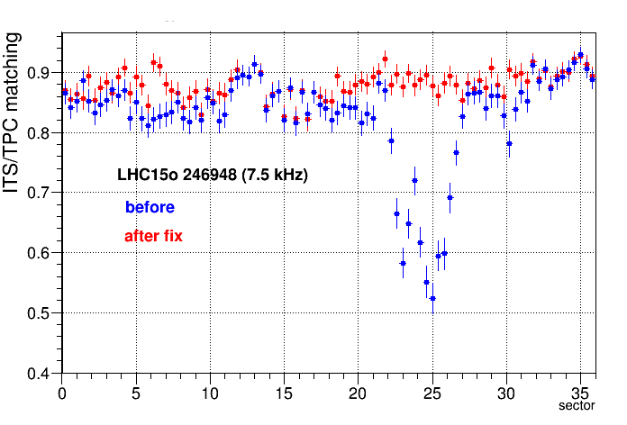
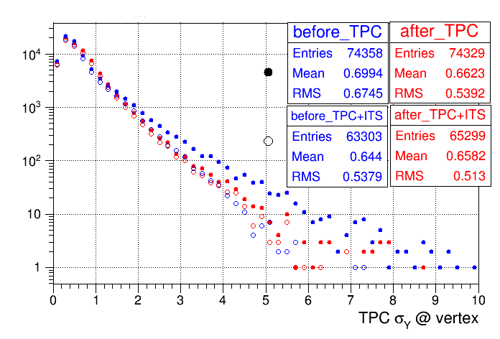
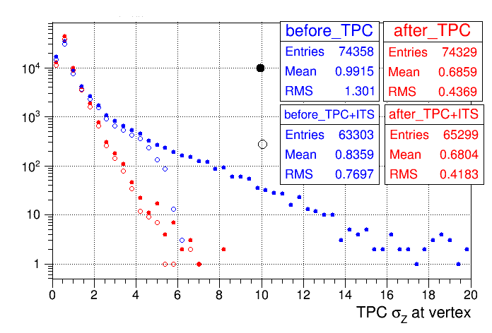
ITS-TPC matching before/after fix
Validation of patches with high IR (7.5kHz) Pb-Pb run 246948 (marked as “grey” quality due to low-pT matching problem)
TPC covariance before/after fix

Slide 11
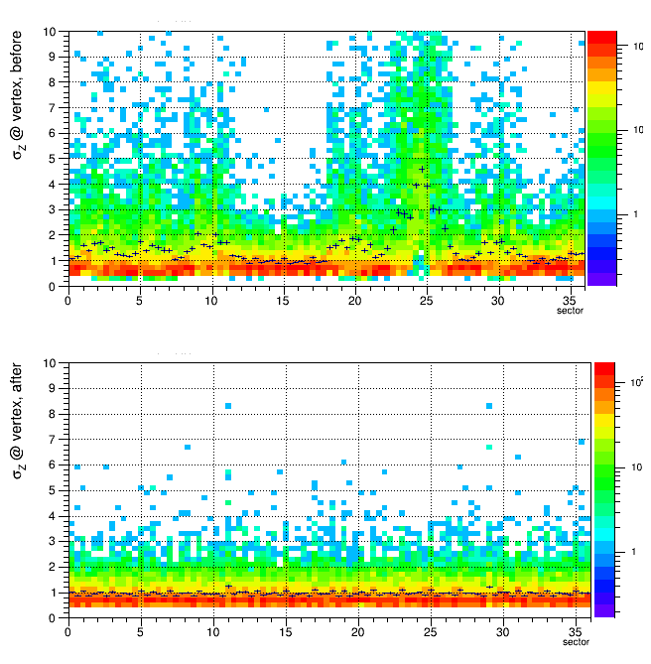
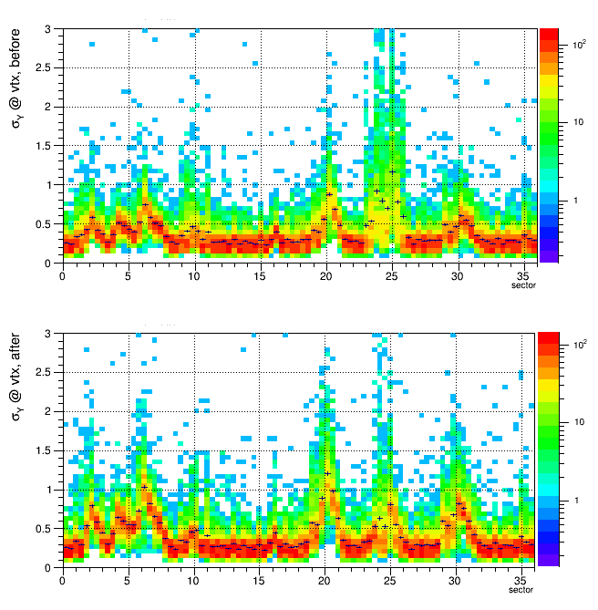
Effect of the fix on low pT tracks (pT<0.5)
Large outliers eliminated (especially Z was suffering)
σ_{Z} from TPC Cov.Matrix (@vertex)
σ_{Y} from TPC Cov.Matrix (@vertex)
before
before
after
after

Slide 12
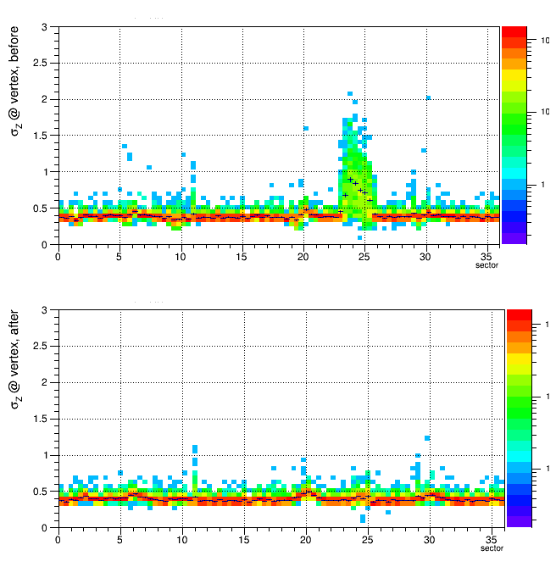
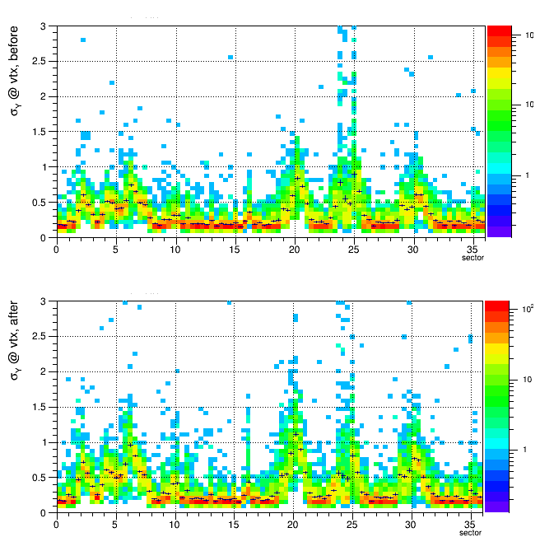
Effect of the fix on high pT tracks (pT>1)
There Z anomaly (still small enough to not affect matching)
in the hot-spot region is eliminated, Y almost unchaged
σ_{Z} from TPC Cov.Matrix (@vertex)
σ_{Y} from TPC Cov.Matrix (@vertex)
before
before
after
after

Slide 13
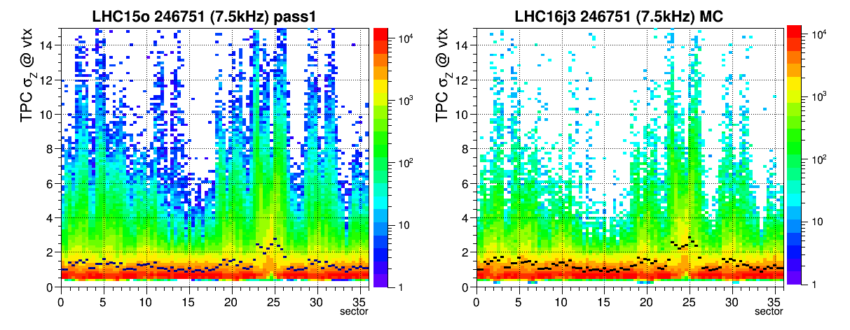
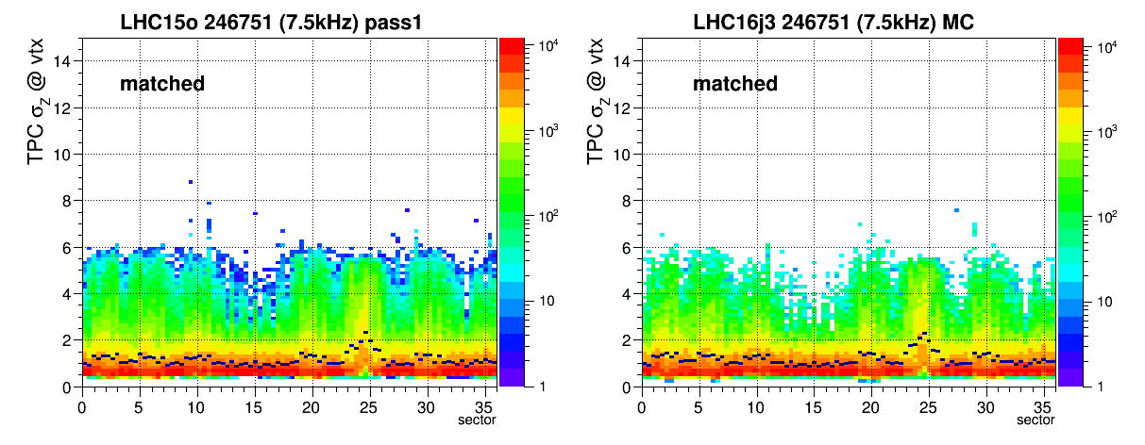
Reproduction of cov.matrix related problems in MC with distortions
pT(TPC)<0.5 GeV

Slide 14
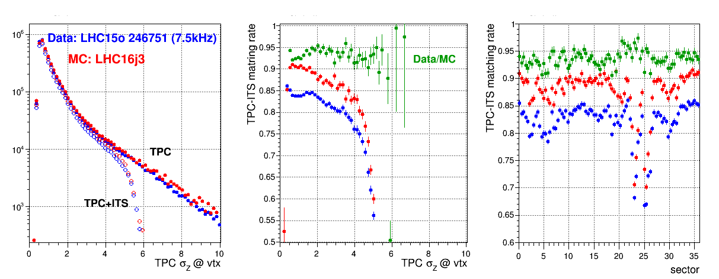
Effect of cov.matrix related problems on ITS-TPC matching rate
Data vs MC
Loose TPC track selection applied: >=70 clusters, |DCAz|<5, |DCAr|<5, |eta|<0.8
The assigned TPC track errors are well reproduced in the MC,
hence the effect of the “Invariant” cut on matching rate is also reproduced.

Slide 15
Barrel Tracking Group
Until now we were busy with preparation of the code for Run2 data: distortions, memory consumption + fixes for bugs introduced by these changes.
This race should come to end in short time from now (end of year?)
Still, the reconstruction experts will spend lot of time on DPG issues (calibration, QA…)
Few outstanding tasks in Run2:
  Requiring no particular development but rectification of high pT V0 filtering
    Including TRD into tracking
    Estimating the real pT resolution with distortions
  SP calibration in HLT: (development of TRD, TOF tracking in HLT, overlap with Run3)
  ???
We are very late with Run3 code preparation (same people involved).
What should we aim for (my personal view) ?
Minimize amount of developments not contributing to Run3 preparation
No periodical meetings scheduled:
  Problems common with BTG discussed at “calibration & tracking” meeting on Thursday 9:30
  Follow remaining Run2 issues on topical meetings (on demand) with relevant experts

