Slide 1
Grid status
ALICE Offline week
Nov 3, 2016
Maarten Litmaath
CERN-IT v1.0

Slide 2
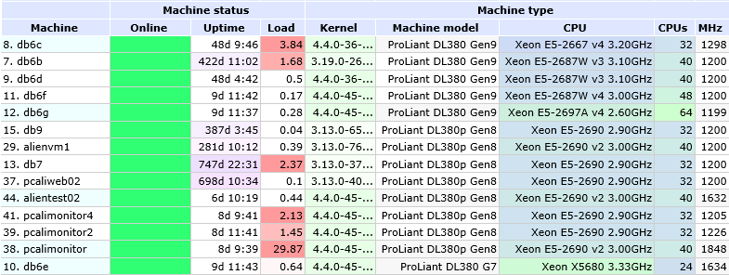
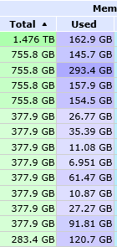
Central services
…
…
…
…
…
…
…
…
…
…
Mostly stable, a few incidents
  DB locks, connection leaks, MySQL hangs
  API server slowdown due to catalog bug (fixed)
  One broken gcc/alienv update
  Maintenance not always transparent
Unavailability Sep 14-15 due to big network intervention
  All user and grid activity had to be stopped
  In parallel the File Catalog was moved to a new, more powerful machine!

Slide 3
New sites
Vienna: up to 1500 job slots!
UPB (Bucharest): in progress
New CERN “sites” for redundancy and load sharing, submitting to the steadily increasing HTCondor resources (currently 30% vs. 70% LSF)
  CERN-CORONA
  CERN-MIRAGE
Altaria: CERN extension into T-Systems cloud
  Details further in this presentation

Slide 4

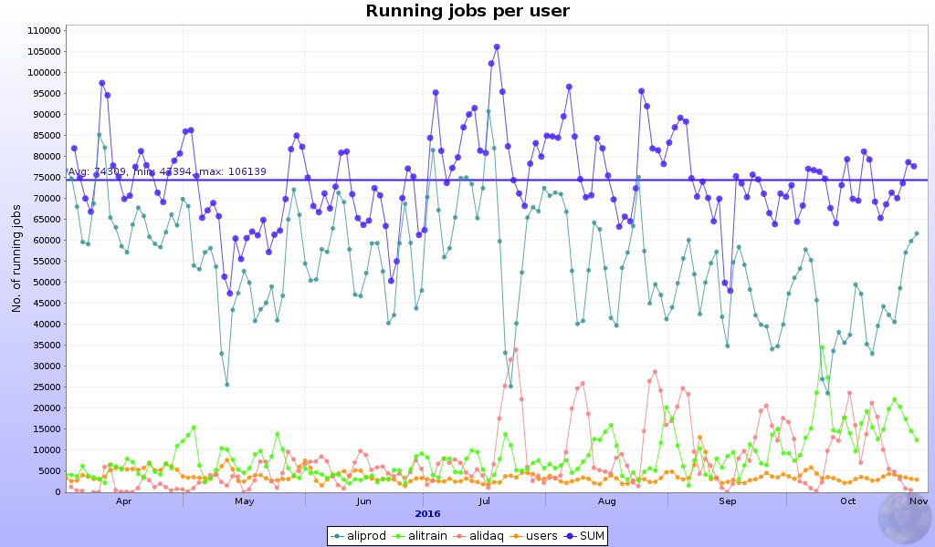
High activity
102190 running jobs Apr 10
110636 Jul 18
2015 heavy-ion reco campaign
really got started by Jul 19

Slide 5
Storage at CERN and beyond
CASTOR
  Mostly stable, a few incidents
  Disk pool setup for the proton-ion run and beyond agreed with CASTOR team
EOS
  Mostly stable, a few incidents
  New head nodes with 512 GB memory were rolled in transparently
EOS crashes at CERN and other sites on Oct 13
  Clients unexpectedly used signed URLs instead of encrypted XML tokens
  The switch was due to one DB table being temporarily unavailable plus a wrong default (fixed)
  The EOS devs have been asked to support the new scheme and avoid that unexpected requests crash the service

Slide 6
Issues at sites or with jobs
CERN: multiple incidents affecting CREAM CEs
  Currently the gateways to 70% of the resources at CERN
  One time it was our fault: the sandbox partitions filled up with debug logs (fixed)
KISTI: CVMFS Squid services incident
  “Random” job failures for 5 days
Asian sites: CVMFS issues involving the Stratum-1 at ASGC
  Mitigated and being investigated for a real fix
CERN-AURORA upgrade to broken AliEn version
  Non-trivial upgrades will be announced better
…
Occasional high error rates due to jobs themselves
  Badly behaved code, e.g. using way too much memory
  Output from previous attempts not cleaned up
  …

Slide 7
Altaria
A virtual site to drive a temporary extension of CERN resources located in a cloud at T-Systems, Germany
  A common project to test how cloud resources can be procured and used efficiently
Up to 3500 cores were available, shared by the 4 experiments
ALICE were the first to start using them as of July 28
The project ended on Oct 31
The resources were used for reco, MC and user analysis
  Trains were excluded to reduce the load on the 10-Gbit link to CERN
The exercise has helped the IT cloud team gain useful insights
  And allowed 630k ALICE jobs to complete successfully!
  The error types and rates were compatible with those of the CERN “sites”

Slide 8
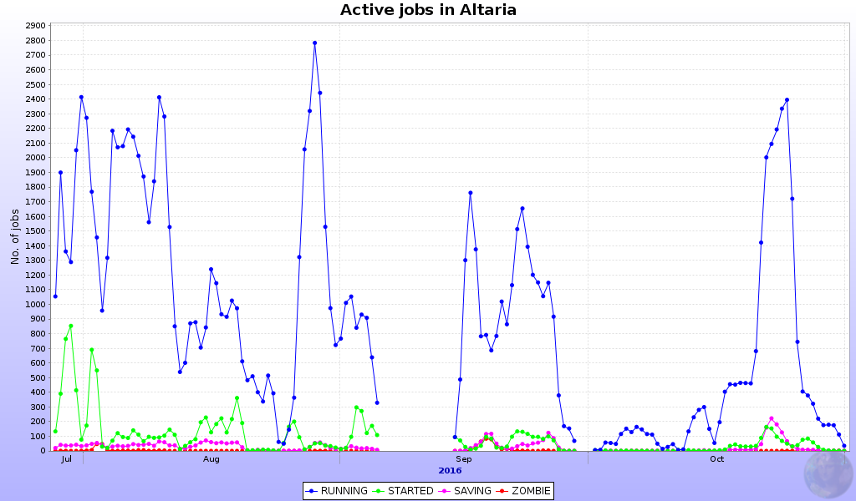
Started jobs are reco jobs that were waiting for their input files to be downloaded from CASTOR
Other experiments sometimes had priority to run their test cases

Slide 9
Middleware
SL5 has been deprecated for MW as of May
CentOS/EL7 is becoming more important
  Some services already available
  CREAM expected by Dec
    VOBOX will follow
SL6 still the default, but the experiments are preparing for physical worker nodes running CentOS/EL7
  Containers (or VMs) could still provide SL6
  ALICE jobs have been tested OK on CentOS/EL7

Slide 10
SAM
New Availability / Reliability profile based on selected MonALISA metrics in use since May
So far no big issues were reported
  And it allowed NDGF-T1 to appear at last !
Reminder: SE test failures will reduce the A / R!
Corrections can always be applied as needed
Test job submission to the HTCondor CE still to be added

Slide 11
Xrootd reminder
Sites should continue upgrades to Xrootd >= 4.1
  Half of the sites have done that already, thanks!
  Required for IPv6 support
Communication via LCG Task Force list as usual for expert advice
SL6 hosts can have xrootd for ALICE installed through rpms!
  http://linuxsoft.cern.ch/wlcg/
  Thanks to Adrian Sevcenco!

Slide 12
Tips for sites – thanks!
Possible issues on VOBOX, CE, WN
  CVMFS problem, CE not ready for jobs,
  myproxy running low, myproxy type wrong, …
  Absence of “system” library
    HEP_OSlibs rpm helps avoid that
Jobs may fail due to SE problems
Admins please check site issues page
  http://alimonitor.cern.ch/siteinfo/issues.jsp
Subscribe to relevant notifications
  http://alimonitor.cern.ch/xml.jsp

