Slide 1
Miscellanea
ALICE Offline Week, 02 Nov 2016
F. Prino, C. Zampolli

Slide 2
Outline
AliPIDResponse
Centrality Calibration
Twiki for analysis
Event selection class
Latest reconstruction passes: summary
Statistics
Event plane calibration files

Slide 3
AliPIDResponse
Y. Pachmayer
P. Antonioli
M. van Leeuwen
AliPIDResponse and AliAnalysisTaskPIDqa classes in AliRoot
They use the centrality framework, which used to be steered by AliCentrality (in AliRoot), and now is in AliMultSelection (in AliPhysics)
  AliRoot cannot depend in compilation on AliPhysics
  AliMultSelection varies often, sometimes requiring a daily tag for analysis → cannot go to AliRoot
  AliPIDResponse is used by several classes in AliRoot
    Some are strictly PID related (e.g. AliTRDPIDResponse.cxx))
    Some are not strictly PID related (e.g. AliInputEventHandler.h)
    Difficult to judge if the whole PID-related classes can be moved to AliPhysics
    Note that the PID framework uses the OADB, which is in AliPhysics

Slide 4
Centrality Calibration
A. Toia
D. Chinellato
A. Morsch
Centrality task should be run for AOD analyses only for runs that were calibrated after the moment of the AOD creation (→ no centrality info in AODs):
  Newly calibrated runs: 244947 245061 245096 245099 245100 245101 245103 245148 246469 246543 246553 246567 246568 246575 246583 246639 246648 246671 (in bold: runs w/o ZDC in data taking)
    nothing changed for those already calibrated in June (from muon_calo pass)
  Runs with issues in the ZDC in data taking did get calibrated
Centrality experts suggest to:
  Run the multiplicity task in the analysis when using fine centrality bins
  Use SetUseDefaultCalib(kTRUE) in order to have a default centrality calibration if no calibration was done (it will be good within <1%)
  Always check the centrality distribution
    Pay attention especially to the plots with the tracklet density vs. V0 percentile: data and MC should be consistent
Memory footprint reduced recently to use ~25 MB (from 450)
  Further improvement from the OADB framework possible (and true for every OADB object)
    Relying on accessing and keeping in memory only the object valid for the current run

Slide 5
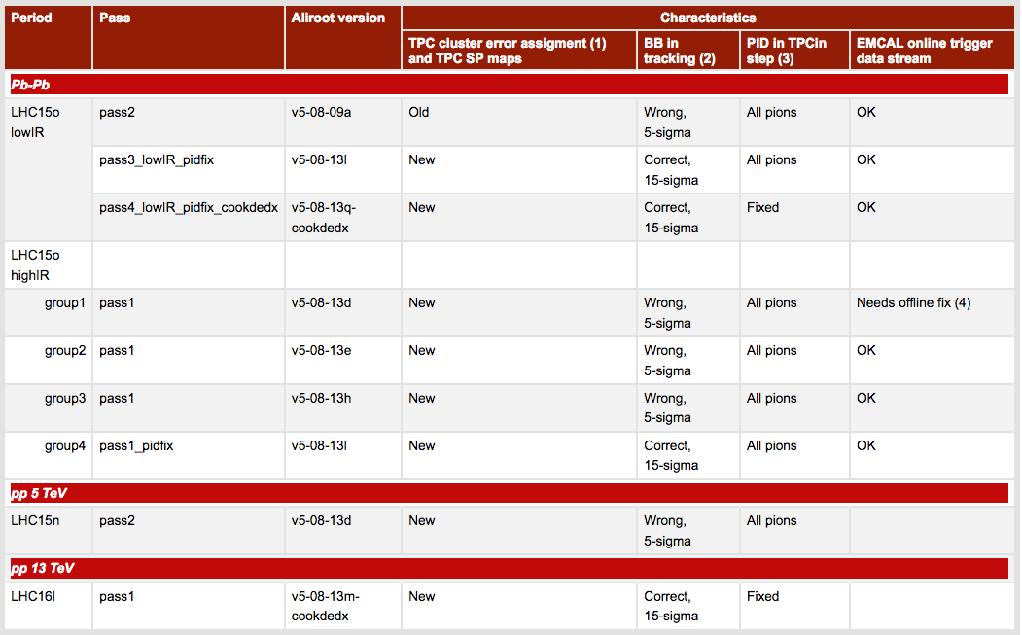
Latest reconstruction passes

Slide 6
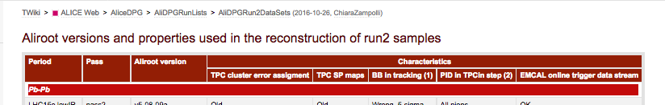
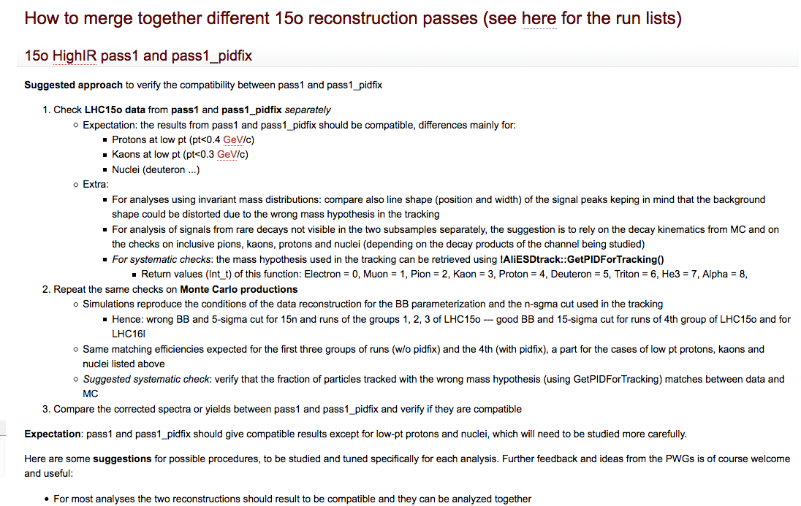
Guidelines for analyses using Run2 data
https://twiki.cern.ch/twiki/bin/view/ALICE/AliDPGRun2DataSets
…

Slide 7
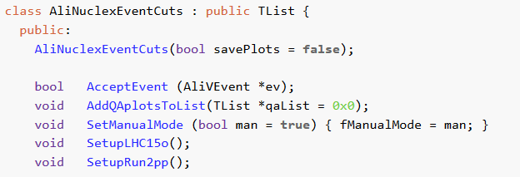
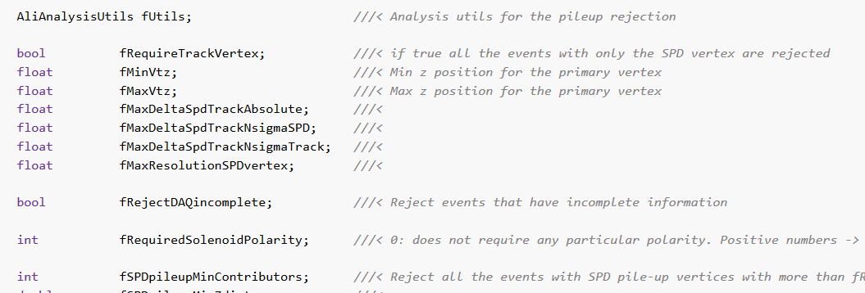
Event selection class
M. Puccio
Develop a class for event selection which can be used in all analyses
  Simple to apply standard selections + flexible for user-specific cuts
Candidate: PWGLF/NUCLEX/Nuclei/NucleiPbPb/AliNuclexEventCuts
  Discussed on Jira: ALPHY-69
  Next steps:
    move to OADB
    advertise to PWGs
    Maintain and keep up2date

Slide 8
Statistics of good runs (CentralBarrel)
pass | N. Run (tot) | N. Ev (tot) (M) | N. Ev with TPC (tot) (M) | N. kINT7 (tot) (M) | Anchored Gen Purp MC
Golden runs (→ requiring full TPC acceptance)
pass2_lowIR | 12 (12) | 9 (9) | 8 (8) | 5 (5) | n/a
pass3_lowIR_pidfix | 11 (12) | 9 (9) | 8 (8) | 5 (5) | LHC16g1(a, b, c)
pass4_lowIR_pidfix_cookdedx | 11 (12) | 9 (9) | 8 (8) | 5 (5) | LHC16j7(a, b)
pass1 | 78 (108) | 299 (406) | 111 (154) | 71 (100) | LHC16g1(a, b, c)
pass1_pidfix | 6 (42) | 15 (140) | 6 (55) | 5 (44) | LHC16g1(a, b, c)
Golden runs (→ requiring full TPC acceptance), no ZDC
lowIR (all passes) | 1 (1) | 0.1 (0.1) | 0.1 (0.1) | 0.1 (0.1) | LHC16g1(a, b, c) , LHC16j7(a,b)
pass1 | 4 (8) | 17 (27) | 6 (9) | 4 (7) | LHC16g1(a, b, c)
pass1_pidfix | 1 (1) | 0.2 (0.2) | 0.2 (0.2) | 0.2 (0.2) | LHC16g1(a, b, c)
Golden runs (→ requiring full TPC acceptance), fix ZDC
pass1 | 3 (9) | 13 (34) | 6 (14) | 5 (12) | LHC16g1(a, b, c)
LHC15o, PbPb, 5 TeV

Slide 9
Statistics of good runs (CentralBarrel)
pass | N. Run (tot) | N. Ev (tot) (M) | N. Ev with TPC (tot) (M) | N. kINT7 (tot) (M) | Anchored Gen Purp MC
Not full TPC acceptance
pass1 | 6 (108) | 14 (406) | 6 (154) | 5 (100) | LHC16g1(a, b, c)
pass1_pidfix | 33 (42) | 120 (140) | 46 (55) | 38 (44) | LHC16g1(a, b, c)
Not Full TPC acceptance, no ZDC
Not Full TPC acceptance, fix ZDC
pass1 | 6 (9) | 21 | 8 | 6 | LHC16g1(a, b, c)
LHC15o, PbPb, 5 TeV
N.B.:
The runs with “Not Full TPC Acceptance” are excluded by definition in the “Golden runs lists”
The “Golden run lists” are defined asking for full ITS, V0, ZDC, TPC
Only runs with full ITS, TPC, TRD in data taking are considered (in “tot” numbers)

Slide 10
Statistics of good runs (CentralBarrel)
pass | N. Run (tot) | N. Ev (tot) (M) | N. Ev with TPC (tot) (M) | N. kINT7 (tot) (M) | Anchored Gen Purp MC
Golden runs (→ requiring full TPC acceptance)
pass2 | 27 (27) | 187 (187) | 138 (138) | 13 (13) | n/a
LHC15n, pp, 5 TeV
LHC16l run lists being prepared

Slide 11
Event plane calibration
V. Gonzales
C. Loizides
J. Onderwaater
Calibrations available for LHC15o pass1:
  10 event plane estimators (TPC, SPD, T0A, T0C, FMDA, FMDC, ZDCA, ZDCC, V0A and V0C) and harmonics 1, 2, 3 and 4
  Files stored on a per run basis in /alice/cern.ch/user/v/victor/TESTS/LHC15oHIR
  Size ~ 4.5 MB per run -> total size for LHC15o pass1 ~ 400 MB
For HF and DQ, 3 additional estimators being worked out:
  V0 “full” (better resolution than V0A and V0C) and TPC split in 2 halves
  About 30% increase of calibration file size
Runs of pass1_pidfix still to be calibrated -> expected size ~200MB
Where do we store these large calibration files?
  Possibilities: MORE TOMORROW AT 15:15
    Commit to AliPhysics waiting for new repo in February → practical for the user when doing analysis, increase the size of the repository
    Keep the files on the Grid → works on the grid, needs connection when running locally
    Use CVMFS → works on the grid, not locally if you don’t have CVMFS

Slide 12
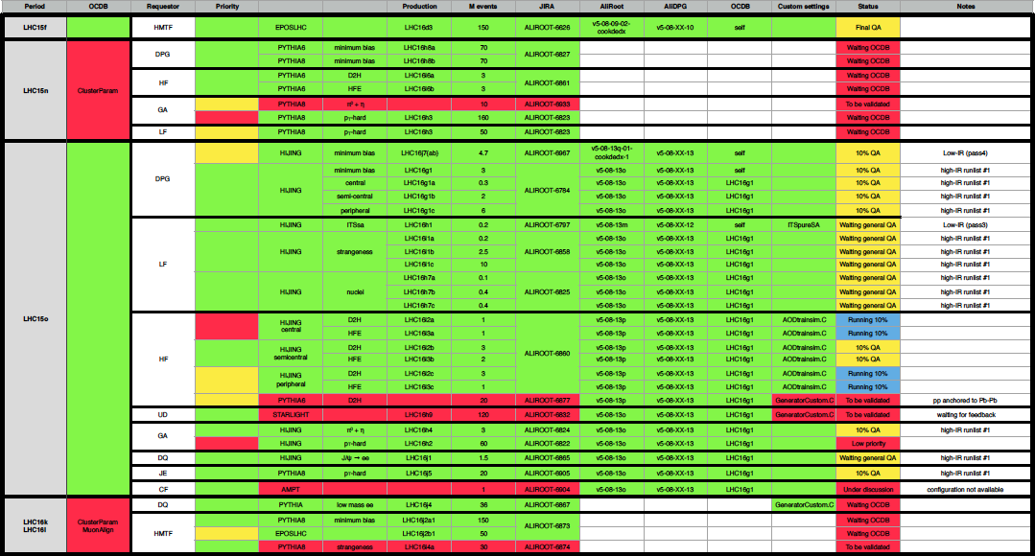
Monte Carlo for Quark Matter
R. Preghenella
C. Ristea

Slide 13
Conclusions
In its 6.5 months of activities, the DPG has dealt with several and many aspects of the data processing
  Not all mentioned here or in the previous talks (improved QA feedback and information collection, systematic studies on the track selections…)
  Not everything finalized (macros for data processing from AliDPG, RCT improvements, interface for QA, definition of cuts for analysis of data with TPC SP distortions…) but work is in progress on most of the fronts
  Crucial interaction with Barrel Tracking Group (e.g. R. Shahoyan), detector experts (e.g. J. Wiechula): Thanks!
  Crucial interaction with PWGs and analyzers to define the analysis tools (e.g.: A. Dobrin): Thanks!
  Crucial interaction with Offline (to which DPG belongs) for code development and frameworks (e.g. C. Grigoras): Thanks!
  Many thanks to all the DPG members, with a special mention to QA and MC people
  → From April: “The DPG will function as a glue between the several different parties involved in the data processing”
  → To now: “The DPG is functioning as a glue between the several different parties involved in the data processing”

Slide 14
Backup

Slide 15
More information
Good runs ordered per IR
  https://twiki.cern.ch/twiki/pub/ALICE/AliDPGRunLists/OrderedGoodRuns_IR_LHC15o_20161027_Sheet1.pdf
  Runs with non full TPC acceptance included → they will go to MC
Splines for 15o: released for pass1, checks ongoing for pass1_pidfix
  ~2 weeks

Slide 16
Ongoing Monte Carlo
General-purpose Monte Carlo productions anchored to Pb-Pb 5.02 TeV runs (LHC15o) – ALIROOT-6784
  LHC16g1(minbias), LHC16g1a(central), LHC16g1b (semicentral), LHC16g1c (peripheral)
pi0 and eta particles embedded in HI MC events anchored to LHC15o – ALIROOT-6824
  LHC16h4
Pb-Pb central barrel simulation with injected J/psi signals – ALIROOT-6865
  LHC16j1
jet-jet Pythia events anchored to LHC15o – ALIROOT-6905
  LHC16j5, 20 sub-cycles per pt bin
Pb-Pb 5020 GeV, Hijing+injected (multi-)strange 0-90% cent, LHC15o anchors – ALIROOT-6858
  LHC16i1{a,b,c}
Pb-Pb, 5020 GeV, Hijing plus injected nuclei, hypernuclei and exotica, LHC15o anchors – ALIROOT-6825
  LHC16h7{a,b,c}
HF MC productions for 2015 PbPb central barrel analyses – ALIROOT-6860
  HF2had: LHC16i2[a..c], HF2ele: LHC16i3[a..c]
General-purpose Monte Carlo production anchored to pp 13 TeV runs (LHC15f, EPOS-LHC) – ALIROOT-6626
  LHC16d3
PbPb
pp 15f
More runs to be injected after good runs lists have been updated (yesterday)

Slide 17
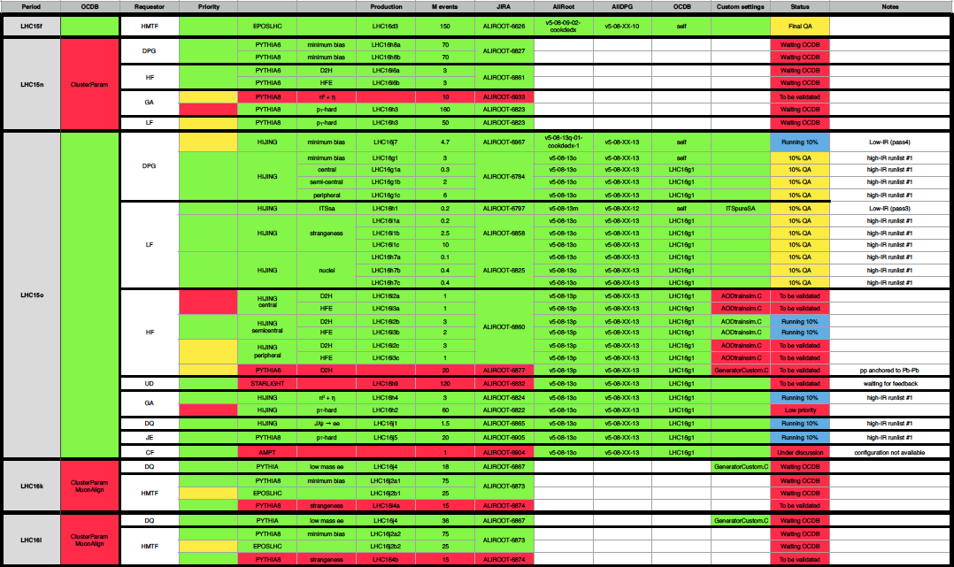
Status of MC

Slide 18
LHC15o
Runs QA’ed manually:
  Runs without ZDC (to go in dedicated lists)
    246543, 246553, 246567, 246568, 246575, 246583, 246648, 246671, 245148
    In contact with ZDC + spectra team to evaluate the effect of not having the ZDC in the data taking
  Runs with issues in ZDC signal
    245729, 245731, 245738, 245752, 245759, 245766, 245775, 245785, 245793
  Run for which the merging failed (ongoing)
    245453
245148 246543 246553 246567 246568 246575 246583 246648 246671

Slide 19
Other productions
LHC16l, 90 runs
  260014, 260011, 260010, 259979, 259961, 259888, 259868, 259867, 259866, 259860, 259842, 259841, 259822, 259792, 259789, 259788, 259781, 259756, 259752, 259751, 259750, 259748, 259747, 259713, 259711, 259705, 259704, 259703, 259700, 259697, 259668, 259650, 259649, 259477, 259473, 259469, 259396, 259395, 259394, 259389, 259388, 259382, 259381, 259378, 259342, 259341, 259340, 259339, 259336, 259334, 259307, 259305, 259303, 259302, 259274, 259273, 259272, 259271, 259270, 259269, 259264, 259263, 259261, 259257, 259204, 259164, 259162, 259118, 259117, 259099, 259096, 259095, 259091, 259090, 259088, 259086, 258964, 258962, 258931, 258926, 258923, 258921, 258920, 258919, 258890, 258889, 258886, 258885, 258884, 258883
Reco failing – missing MUON OCDB, 7 mins run
Low stat, no TPC calibration possible
TPC sparse readout tests, low nb of bunches, high mu
Low nb of bunches, high mu

Slide 20
LHC15o: groups of runs
Group 1: 31 runs
  245683, 246807, 246808, 246809, 246810, 246844, 246845, 246846, 246847, 246851, 246855, 246858, 246859, 246864, 246865, 246867, 246870, 246871, 246928, 246930, 246937, 246942, 246945, 246948, 246949, 246980, 246982, 246984, 246989, 246991, 246994
Group 2: 34 runs
  245692, 245700, 245702, 245705, 246424, 246428, 246431, 246434, 246487, 246488, 246493, 246495, 246540, 246543, 246553, 246567, 246568, 246575, 246583, 246648, 246671, 246675, 246676, 246750, 246751, 246757, 246758, 246759, 246760, 246763, 246765, 246766, 246804, 246805
Group 3: 20 runs
  246087, 246089, 246113, 246115, 246148, 246151, 246152, 246153, 246178, 246180, 246181, 246182, 246185, 246217, 246222, 246225, 246271, 246272, 246275, 246276
Group 4: 27 runs
  245729, 245731, 245738, 245752, 245759, 245766, 245775, 245785, 245793, 245829, 245831, 245833, 245923, 245949, 245952, 245954, 245963, 246001, 246003, 246012, 246036, 246037, 246042, 246048, 246049, 246052, 246053
Group 3+4: 47 runs
  245729, 245731, 245738, 245752, 245759, 245766, 245775, 245785, 245793, 245829, 245831, 245833, 245923, 245949, 245952, 245954, 245963, 246001, 246003, 246012, 246036, 246037, 246042, 246048, 246049, 246052, 246053, 246087, 246089, 246113, 246115, 246148, 246151, 246152, 246153, 246178, 246180, 246181, 246182, 246185, 246217, 246222, 246225, 246271, 246272, 246275, 246276
Group 5: 42 runs
  245145, 245146, 245148, 245151, 245152, 245231, 245232, 245233, 245259, 245343, 245345, 245346, 245347, 245349, 245353, 245396, 245397, 245401, 245407, 245409, 245410, 245411, 245439, 245441, 245446, 245450, 245452, 245453, 245454, 245496, 245497, 245501, 245504, 245505, 245507, 245535, 245540, 245542, 245543, 245544, 245545, 245554

Slide 21
Run list LHC15o – high IR – Purged list
245145, 245146, 245148, 245151, 245152, 245231, 245232, 245233, 245259, 245343, 245345, 245346, 245347, 245349, 245353, 245396, 245397, 245401, 245407, 245409, 245410, 245411, 245439, 245441, 245446, 245450, 245452, 245453, 245454, 245496, 245497, 245501, 245504, 245505, 245507, 245535, 245540, 245542, 245543, 245544, 245545, 245554, 245683, 245692, 245700, 245702, 245705, 245729, 245731, 245738, 245752, 245759, 245766, 245775, 245785, 245793, 245829, 245831, 245833, 245923, 245949, 245952, 245954, 245963,, 246001, 246003, 246012, 246036, 246037, 246042, 246048, 246049, 246052, 246053, 246087, 246089, 246113, 246115, 246148, 246151, 246152, 246153, 246178, 246180, 246181, 246182, 246185, 246217, 246222, 246225, 246271, 246272, 246275, 246276, 246424, 246428, 246431, 246434, 246487, 246488, 246493, 246495, 246540, 246543, 246553, 246567, 246568, 246575, 246583, 246648, 246671, 246675, 246676, 246750, 246751, 246757, 246758, 246759, 246760, 246763, 246765, 246766, 246804, 246805, 246807, 246808, 246809, 246810, 246844, 246845, 246846, 246847, 246851, 246855, 246858, 246859, 246864, 246865, 246867, 246870, 246871, 246928, 246930, 246937, 246942, 246945, 246948, 246949, 246980, 246982, 246984, 246989, 246991, 246994
First bunch – 302087, 98M events (35.6M with TPC)
Second bunch – 328630 chunks, 102M events (36M with TPC)
Third bunch – 358780 chunks, 104M events (39M with TPC)
Fourth bunch – 342503 chunks, 108M events (45M with TPC)
Fifth bunch – 592677 chunks, 140M events (55M with TPC)

Slide 22
Runs with no TRD, SPD, SDD, SSD
No SDD:
  246942, 246937, 246930, 246855 (first group)
No SPD:
  None
No SSD:
  None
No TRD:
  None
For the statistics, use:
Group 1: 27 runs
  245683, 246807, 246808, 246809, 246810, 246844, 246845, 246846, 246847, 246851, 246858, 246859, 246864, 246865, 246867, 246870, 246871, 246928, 246945, 246948, 246949, 246980, 246982, 246984, 246989, 246991, 246994
Group 2: 34 runs
  245692, 245700, 245702, 245705, 246424, 246428, 246431, 246434, 246487, 246488, 246493, 246495, 246540, 246543, 246553, 246567, 246568, 246575, 246583, 246648, 246671, 246675, 246676, 246750, 246751, 246757, 246758, 246759, 246760, 246763, 246765, 246766, 246804, 246805
Group 3+4: 47 runs
  245729, 245731, 245738, 245752, 245759, 245766, 245775, 245785, 245793, 245829, 245831, 245833, 245923, 245949, 245952, 245954, 245963, 246001, 246003, 246012, 246036, 246037, 246042, 246048, 246049, 246052, 246053, 246087, 246089, 246113, 246115, 246148, 246151, 246152, 246153, 246178, 246180, 246181, 246182, 246185, 246217, 246222, 246225, 246271, 246272, 246275, 246276
Group 5: 42 runs
  245145, 245146, 245148, 245151, 245152, 245231, 245232, 245233, 245259, 245343, 245345, 245346, 245347, 245349, 245353, 245396, 245397, 245401, 245407, 245409, 245410, 245411, 245439, 245441, 245446, 245450, 245452, 245453, 245454, 245496, 245497, 245501, 245504, 245505, 245507, 245535, 245540, 245542, 245543, 245544, 245545, 245554
All:
  245683, 246807, 246808, 246809, 246810, 246844, 246845, 246846, 246847, 246851, 246858, 246859, 246864, 246865, 246867, 246870, 246871, 246928, 246945, 246948, 246949, 246980, 246982, 246984, 246989, 246991, 246994,
  245692, 245700, 245702, 245705, 246424, 246428, 246431, 246434, 246487, 246488, 246493, 246495, 246540, 246543, 246553, 246567, 246568, 246575, 246583, 246648, 246671, 246675, 246676, 246750, 246751, 246757, 246758, 246759, 246760, 246763, 246765, 246766, 246804, 246805,
  245729, 245731, 245738, 245752, 245759, 245766, 245775, 245785, 245793, 245829, 245831, 245833, 245923, 245949, 245952, 245954, 245963, 246001, 246003, 246012, 246036, 246037, 246042, 246048, 246049, 246052, 246053, 246087, 246089, 246113, 246115, 246148, 246151, 246152, 246153, 246178, 246180, 246181, 246182, 246185, 246217, 246222, 246225, 246271, 246272, 246275, 246276,
  245145, 245146, 245148, 245151, 245152, 245231, 245232, 245233, 245259, 245343, 245345, 245346, 245347, 245349, 245353, 245396, 245397, 245401, 245407, 245409, 245410, 245411, 245439, 245441, 245446, 245450, 245452, 245453, 245454, 245496, 245497, 245501, 245504, 245505, 245507, 245535, 245540, 245542, 245543, 245544, 245545, 245554

Slide 23
OADB improvements
A. Morsch
Standard procedure for reading OADB objects
  read the AliOADBContainer instance from a file
  Use GetObject(run) to obtain object for a given run
Issue: The OADB objects for all runs stay in memory. This can be problematic if OADB objects are very large.
  First thing to do: try to understand why they are so big.
  Solution
    Write collection of objects (TObjArray) separately into the same file.
    root [1] AliOADBContainer* container = _file0->Get("MultSel");
    root [2] TObjArray* array = container->GetObjArray();
    root [3] container->SetToZeroObjArray();
    root [4] TFile *_file0 = TFile::Open("OADB-LHC15o-new.root");
    root [5] container->Write();
    root [6] array->Write();
    GetObject(run) will check whether the OADBContainer has a pointer to the TObjArray. If not it will read the object directly via its key from the file. Only the object needed for the current run is in memory.
    Caveat: When reading the object for another run in the same task one has to change the current directory to the file containing the OADBContainer.

