Slide 1


KEK Participation in the LHC Injector Upgrades
Chihiro Ohmori
KEK/J-PARC

Slide 2
Contents
LIU & RF collaboration
Present Status of RF collaboration
  PSB
  Finemet® FT3L Mass Production in Japan
  Radiation issues of MOSFET
  PS Damper
Others
Summary

Slide 3
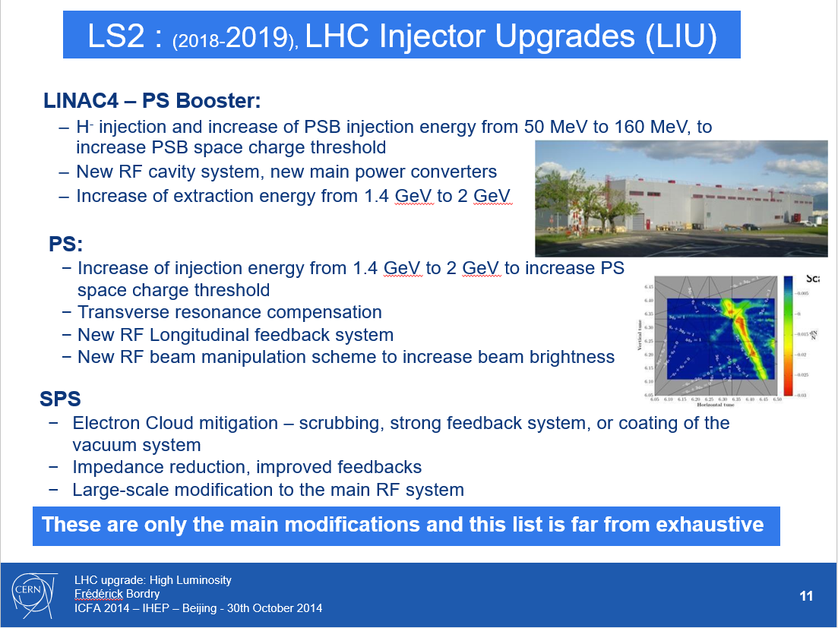

Slide 4
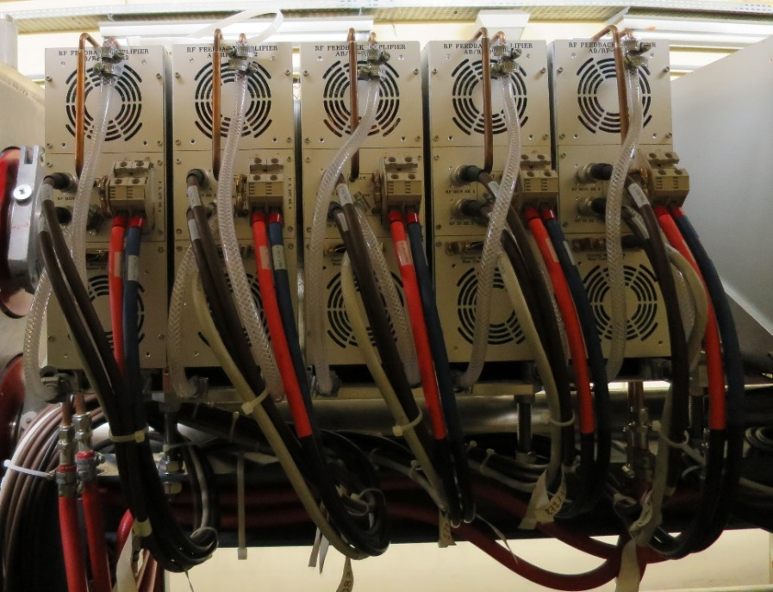
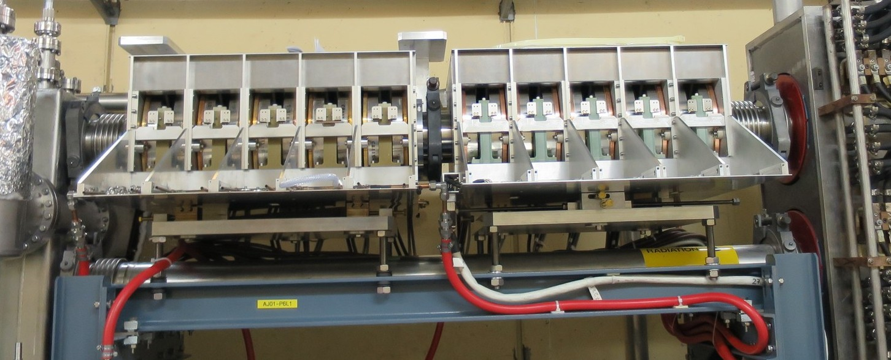
PSB FINEMET TEST CAVITY RING 6L1
Present Status
Operational gap voltage per cell 700 V_{pk}. (total available from 10 cell prototype 7 kV_{pk})
Accelerated 800•10¹⁰ protons when used as h=1 (C04 as second harmonic).
Accelerated 900•10¹⁰ protons when used as h=2 (C02 as fundamental).
Reliable operation for production over few months.
New: + C16 blow-up cavity use as a new application
Cavity 10 Cell
Amplifier Finemet

Slide 5
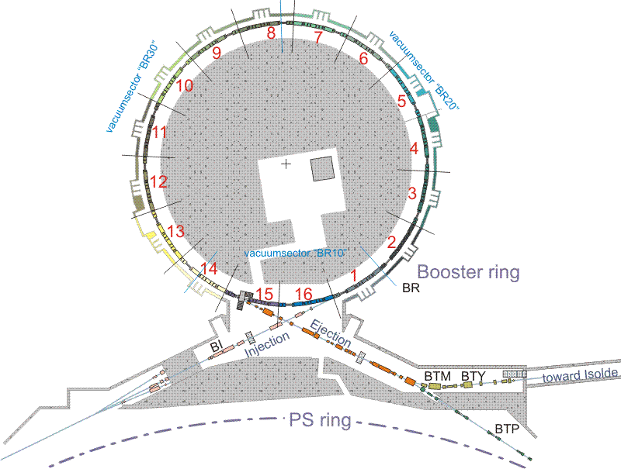
  Available space in the machine.
Three sections presently attributed to the C02 and C04 RF systems: 7L1, 10L1 and 13L1
C02 Rings 2 and 4
C02 Rings 1 and 3
C16 All rings
C04 All rings
M. Paoluzzi
September 14th - 2015

Slide 6
  Proposed layout in the ring.
All sections covering C02 and C04 ranges
Multi-harmonic operation including h1, h2 and h10: no need of preliminary function attribution.
C02, C04 C16
Finemet
Finemet
Finemet
M. Paoluzzi
September 14th - 2015

Slide 7
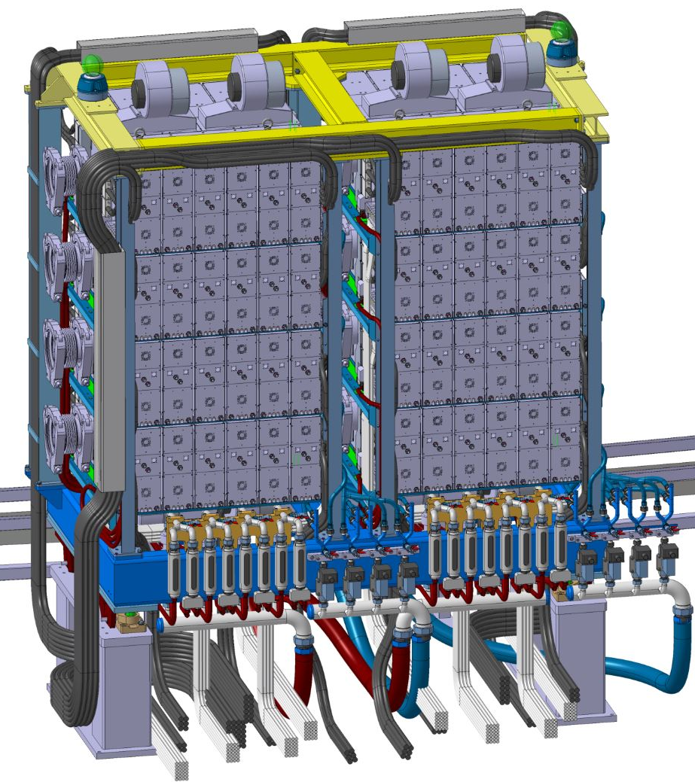
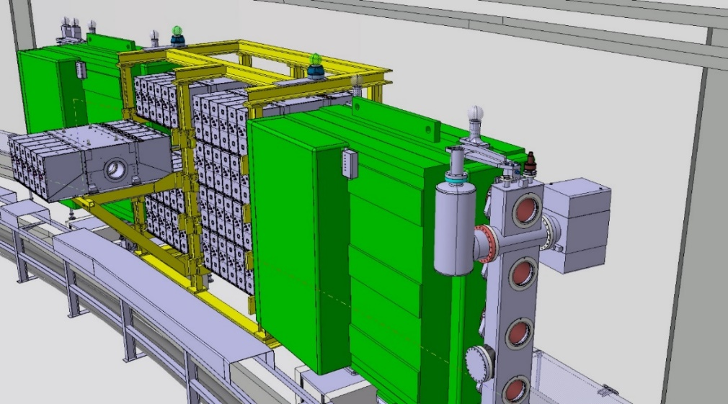
  Cavities arrangement.
Ring4
Ring3
Ring2
Ring1
New Systems will be installed in 3 straight sections in LS2.

Slide 8
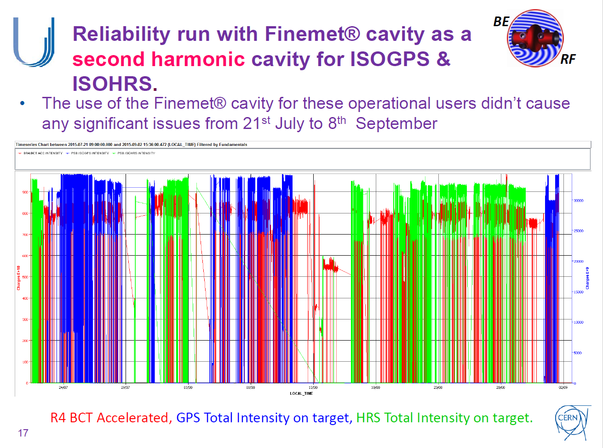
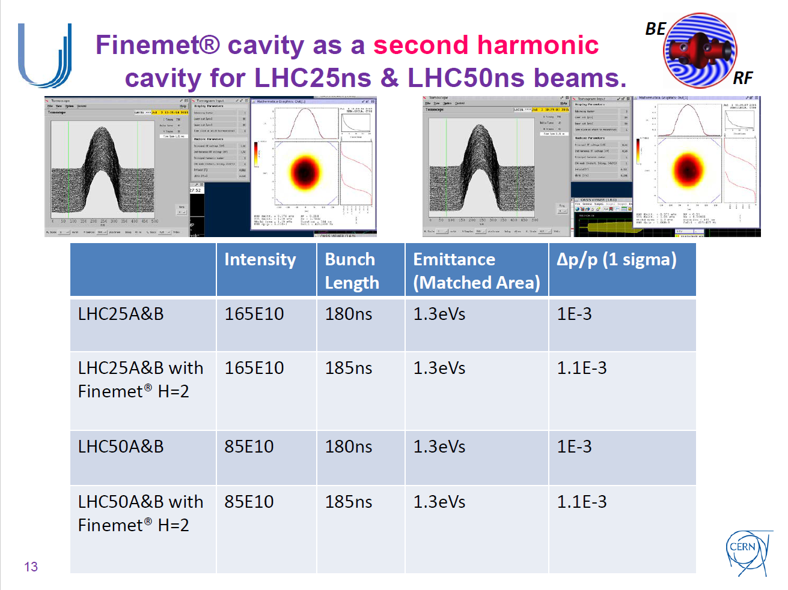
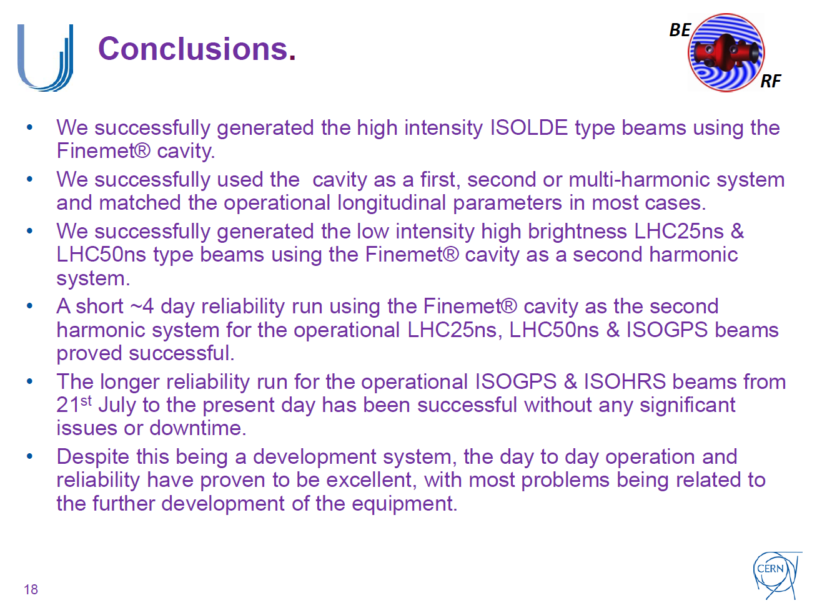
Beam Test
Fundamental RF -- OK
2nd harmonic RF -- OK
2nd harmonic Cavity use for ISOGPS & ISOHRS for reliability run -- OK
2nd harmonic cavity for LHC25ns & LHC50ns type beam -- OK
Hardware: Good Reliability !
A. Findlay Finemet Review 2015

Slide 9
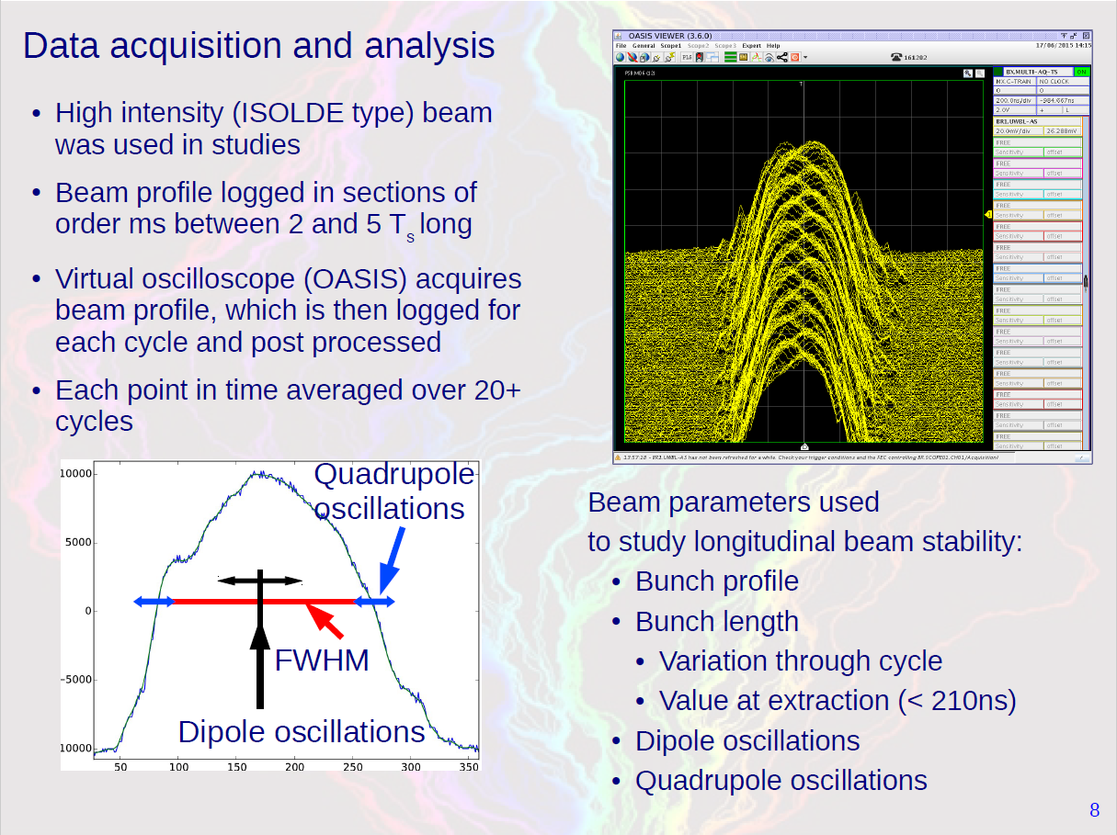

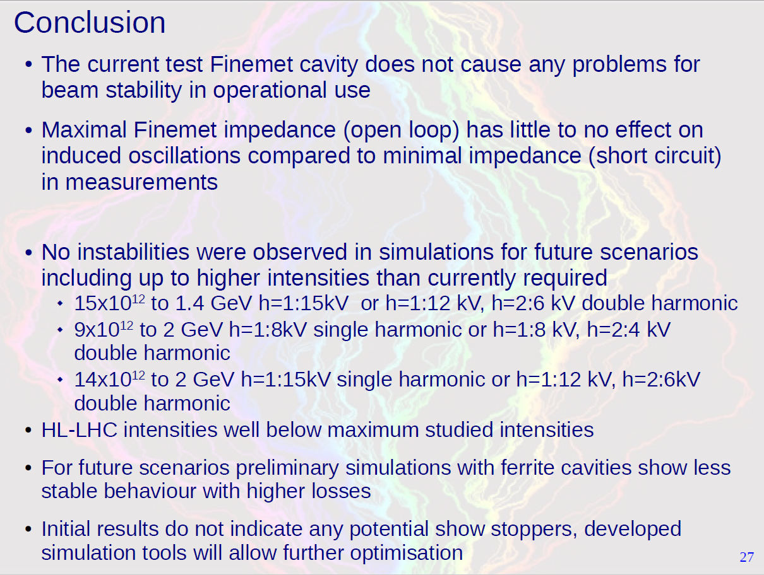
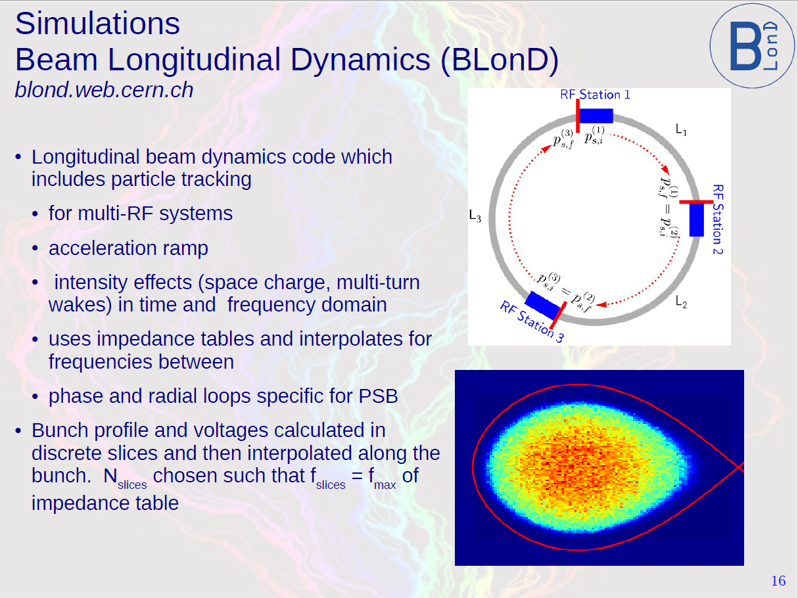
Beam Instability Study
S. Albright, Finemet Review 2015

Slide 10
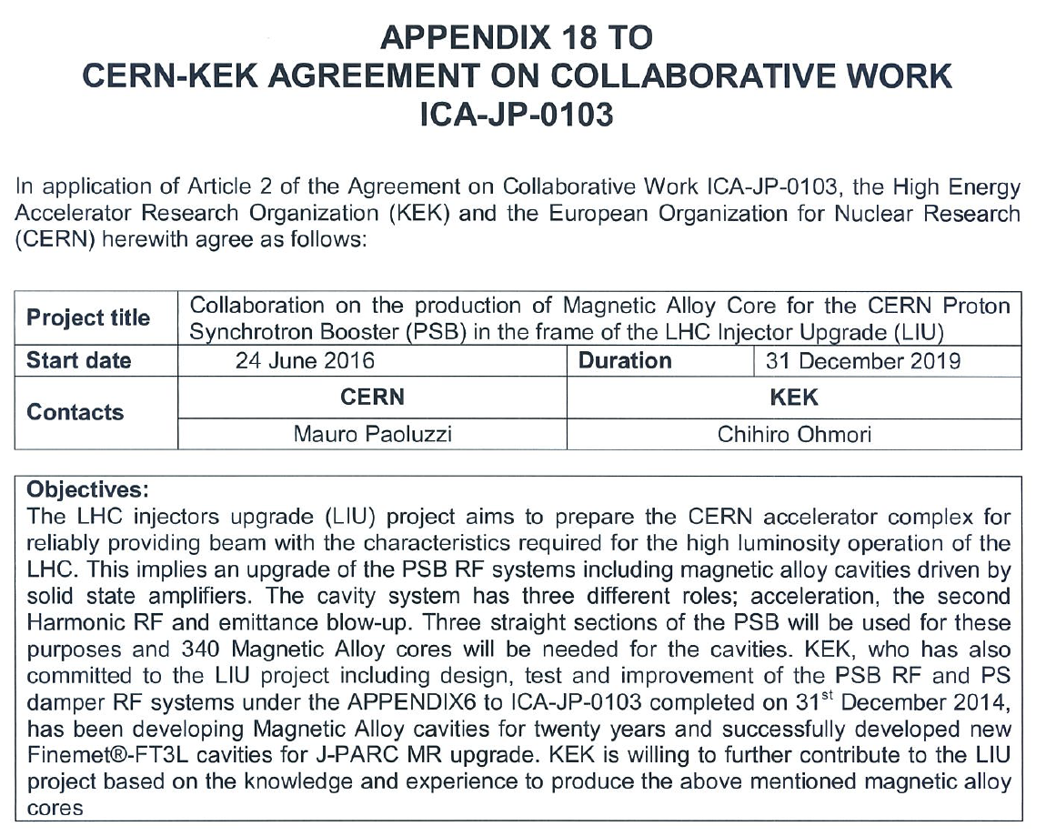
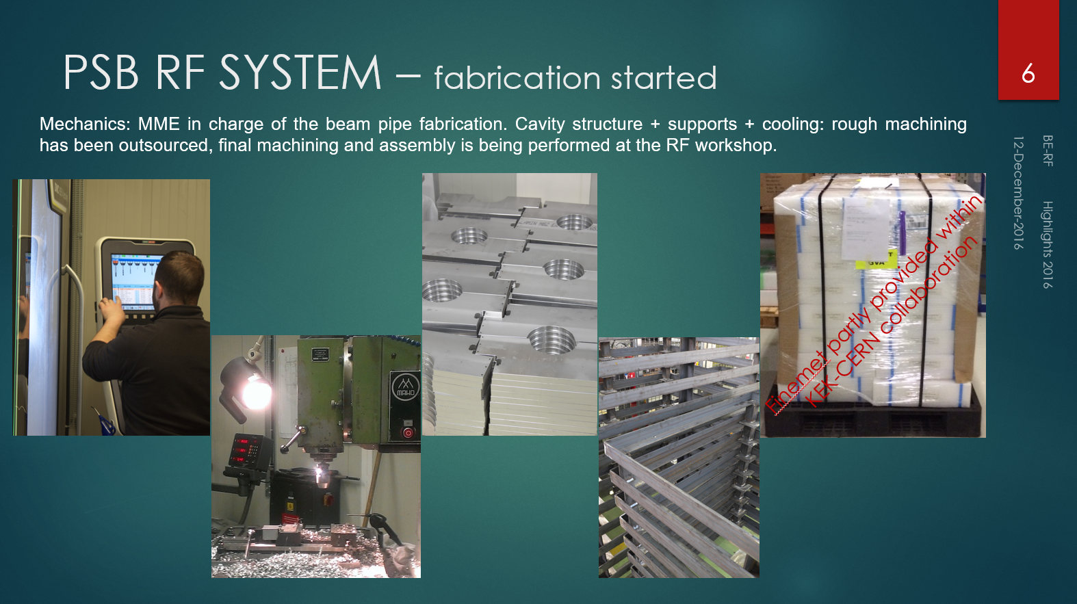
Contributions for FT3L preparation
Why core? Not AMP?
Original plan was supply of SSAMPs as an in-kind contribution.
  2 sets of SSAMP for PS Damper as KEK contribution
KEK supplies 132 FT3L cores. CERN purchase 208 cores.
  SSAMP needs maintenance work, but core does not.
Pros: KEK has a lot of knowledge for the material and production systems and for quality control of mass production.
Company uses the KEK-made oven and KEK-advised scheme.
“Teething troubles” in mass production can be solved in a short time.
Con: No significant disadvantage
73 cores have been arrived.
C. Rossi

Slide 11
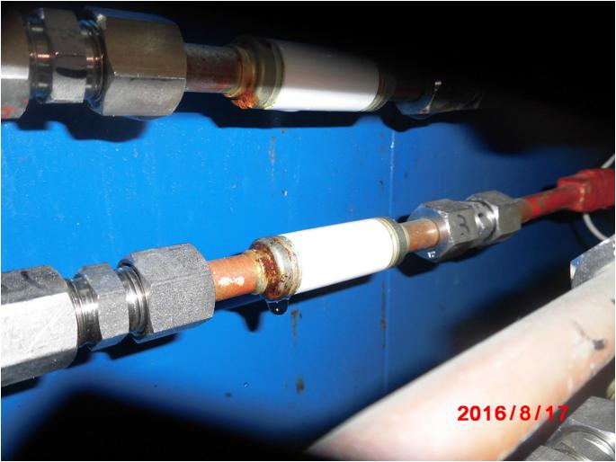
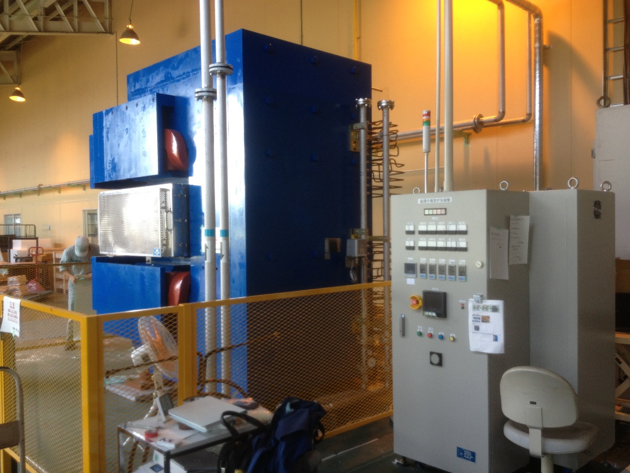
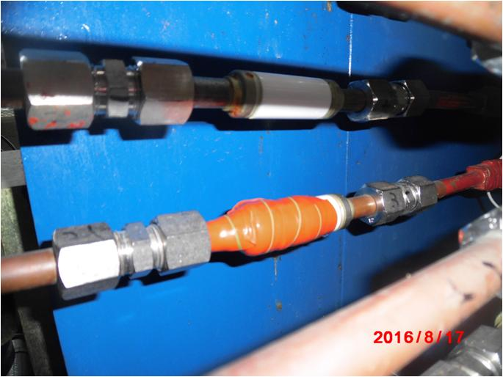
Trouble shooting before production
KEK-made System at Hitachi Metal Co.
(Magnet, oven, PS, etc.)
We did a maintenance work on the oven unit but water leak from a ceramic break of the magnet happened just before production and it was repaired.

Slide 12
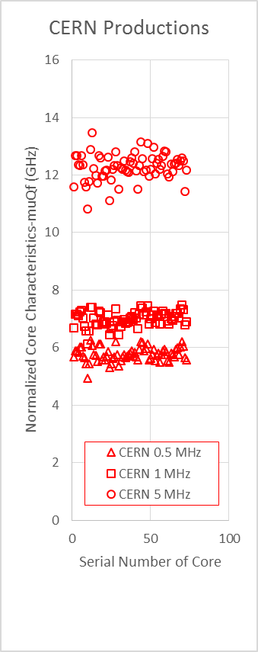
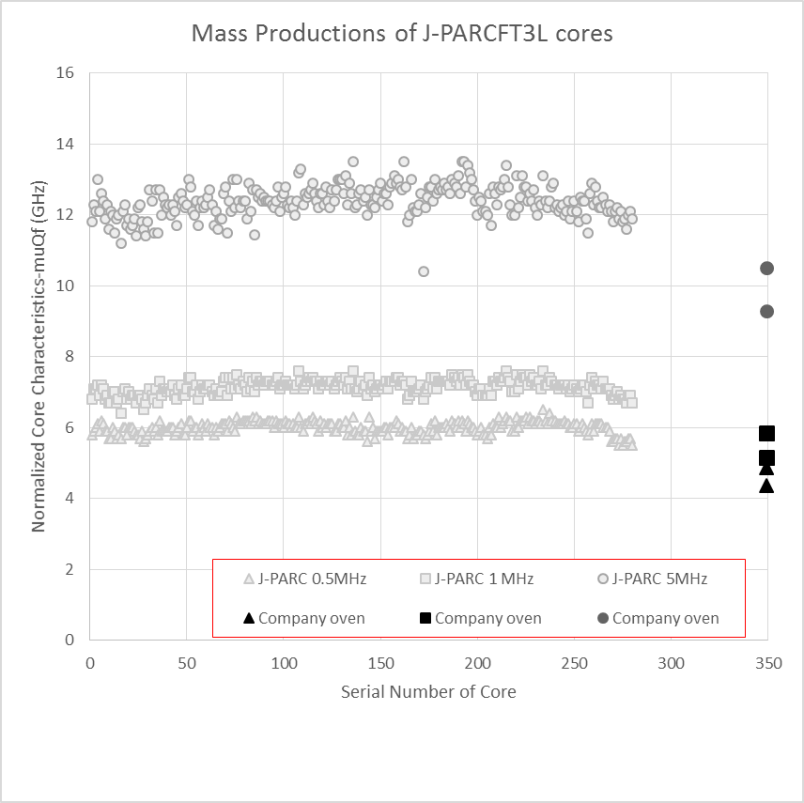
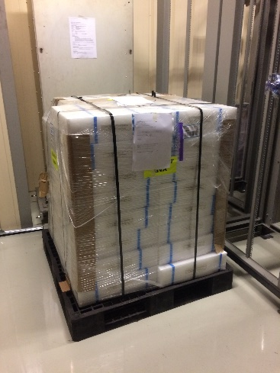
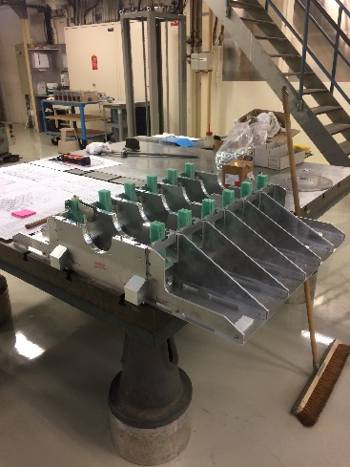
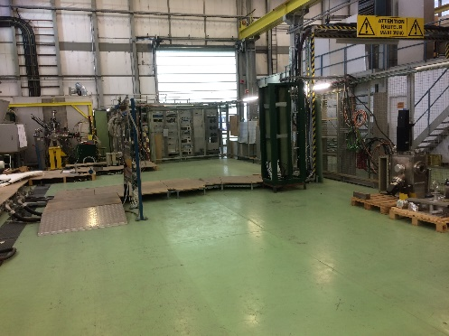
FT3L core production
73 Cores were delivered.
  KEK 72/132
  CERN 1/208
Same quality as J-PARC 80cm core production (gray markers).
Adjustment was done at early stage of production.
KEK-advised preparation scheme to flatten ribbon surface before coating insulation on ribbon
winding scheme to form the core
Use of KEK-made magnetic annealing oven
KEK-advised annealing temperature for the “0” Magnetostriction
KEK-advised core inspection procedure to confirm the insulation of ribbons
5MHz
5MHz
1MHz
1MHz
.5MHz
.5MHz

Slide 13
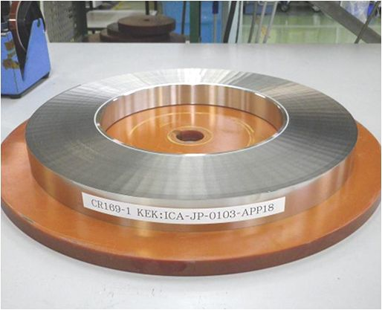
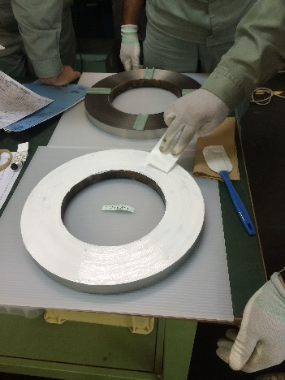
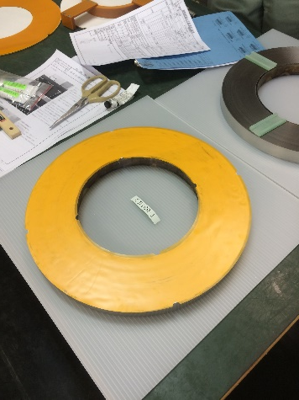
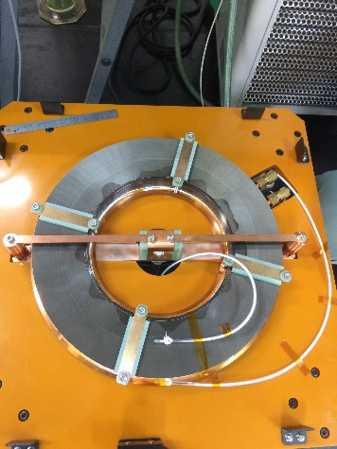
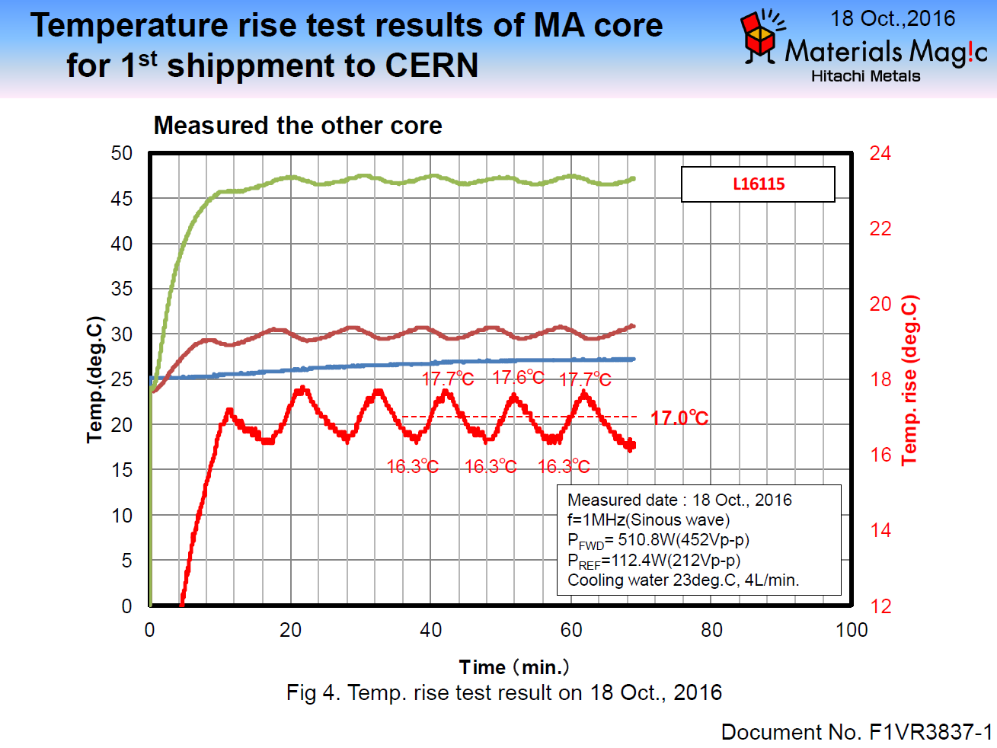
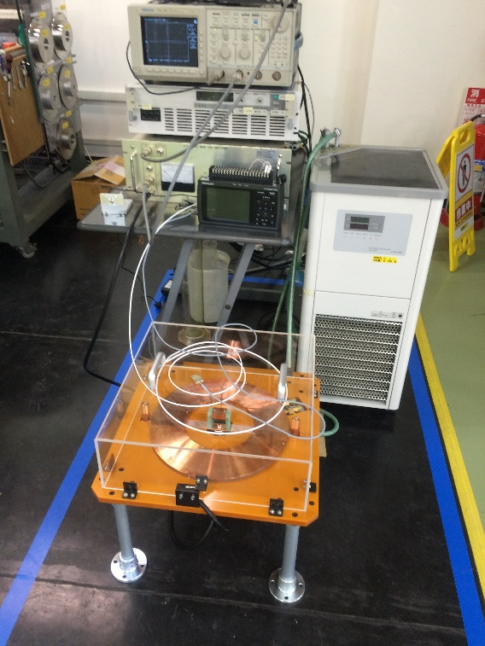
The first FT3L core
Approved as below 25C
Approval test for 1st core
with 400 W RF power .

Slide 14
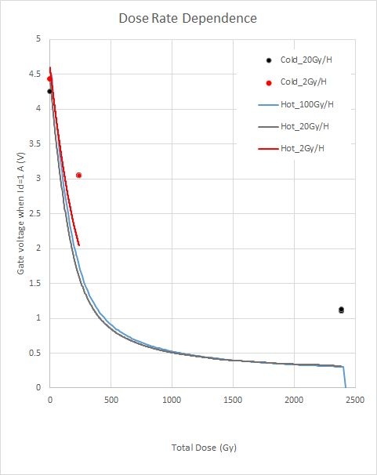
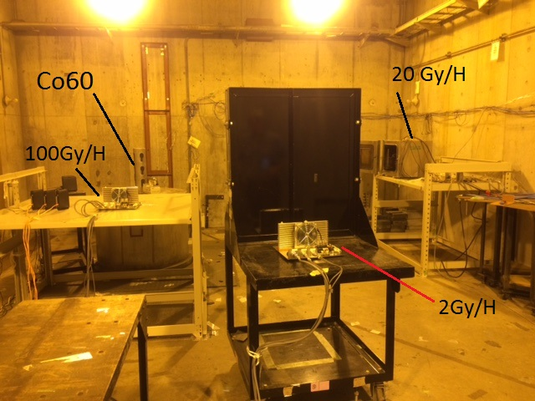
“Hot“ Radiation test of MOSFET
So far, we tested MOSFET under cold conditions: J-PARC and Fraunhofer. MOSFETs were tested under hot condition.
MOSFETs were irradiated under hot condition!
RF cavities will be installed at low dose place (1-40 Gy/yr)
& rad. compensation is used.
hot
cold
Radiation effects become worse under the hot condition, but still small in PSB.

Slide 15
Next Radiation Damage Test
Temperature Effect on MOSFET was observed. How about RF?
  MOSFET test under RF ON based on a comment from an expert on radiation effects on mosfet.
  Auto-level-control circuit simulates the RF operation while beam acceleration.
    Hot & RF amplification
The test circuits will be modified by ATLAS-Japan budget in this year.
The test will be done in next FY.

Slide 16
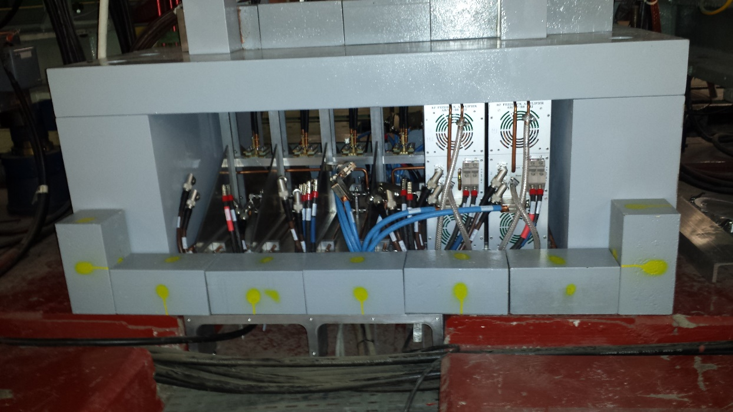
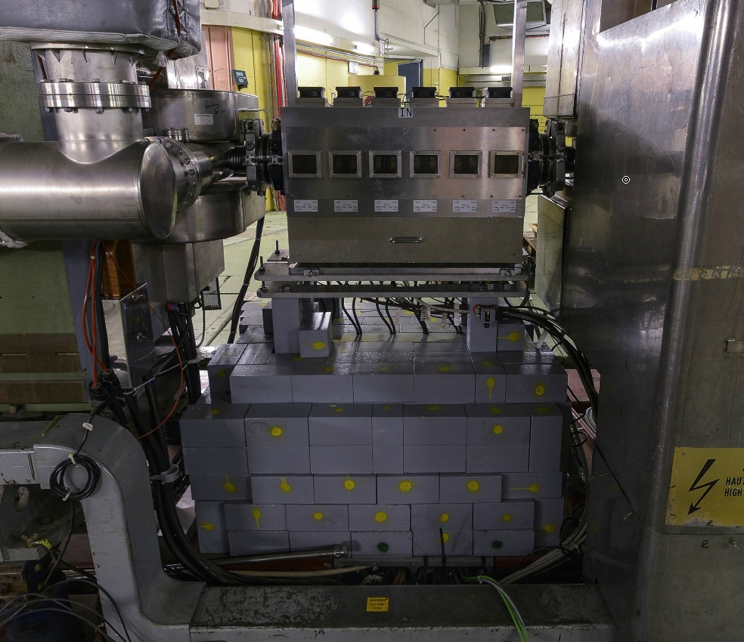
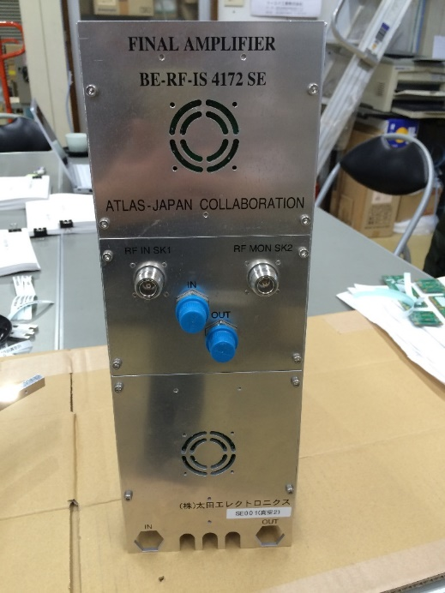
PS FINEMET LONGITUDINAL CAVITY SS02
Cavity 6 Cell
Amplifier
KEK Contribution:
2 set of AMP
M. Hasse, Finemet Review, September 14th - 2015

Slide 17
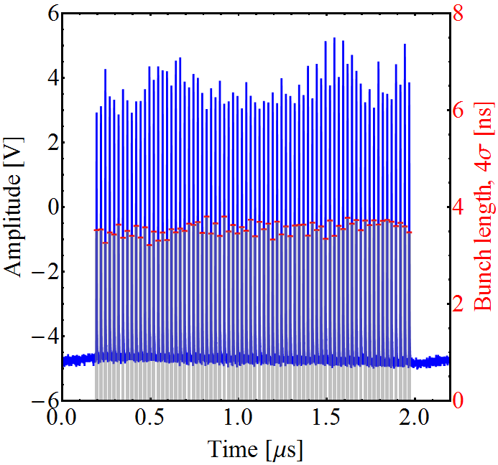
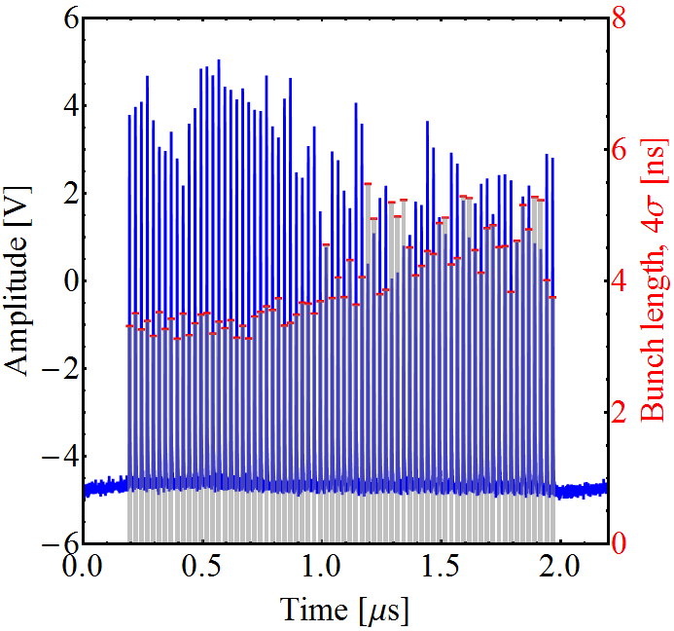
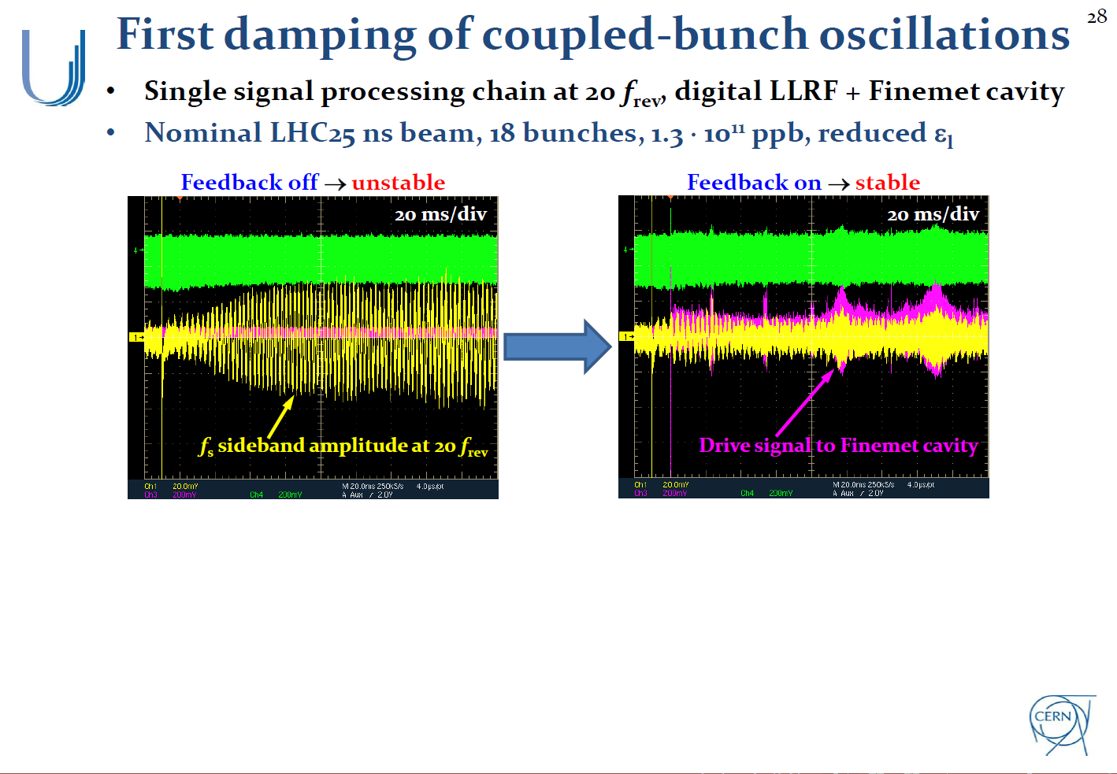
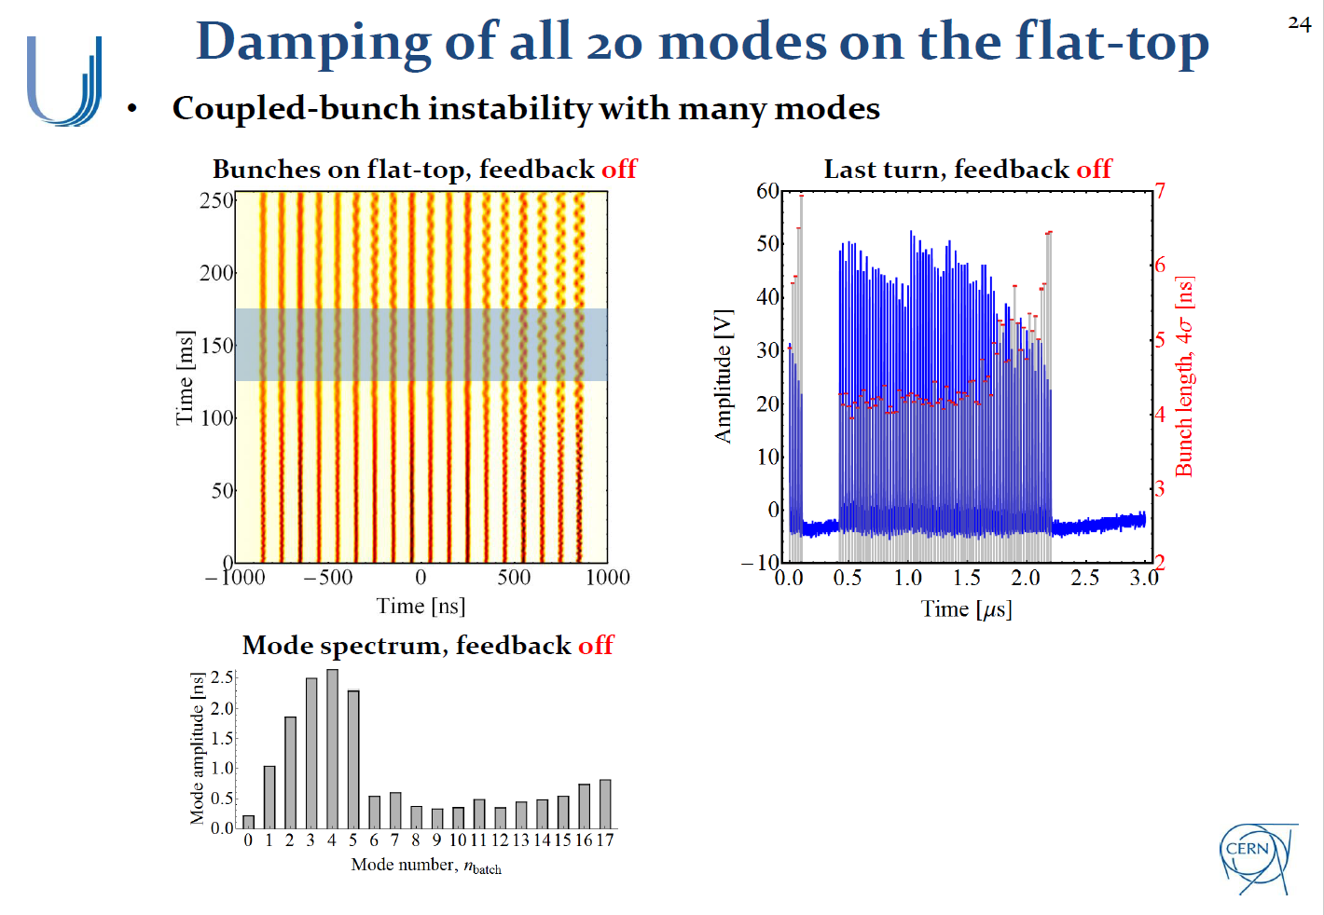
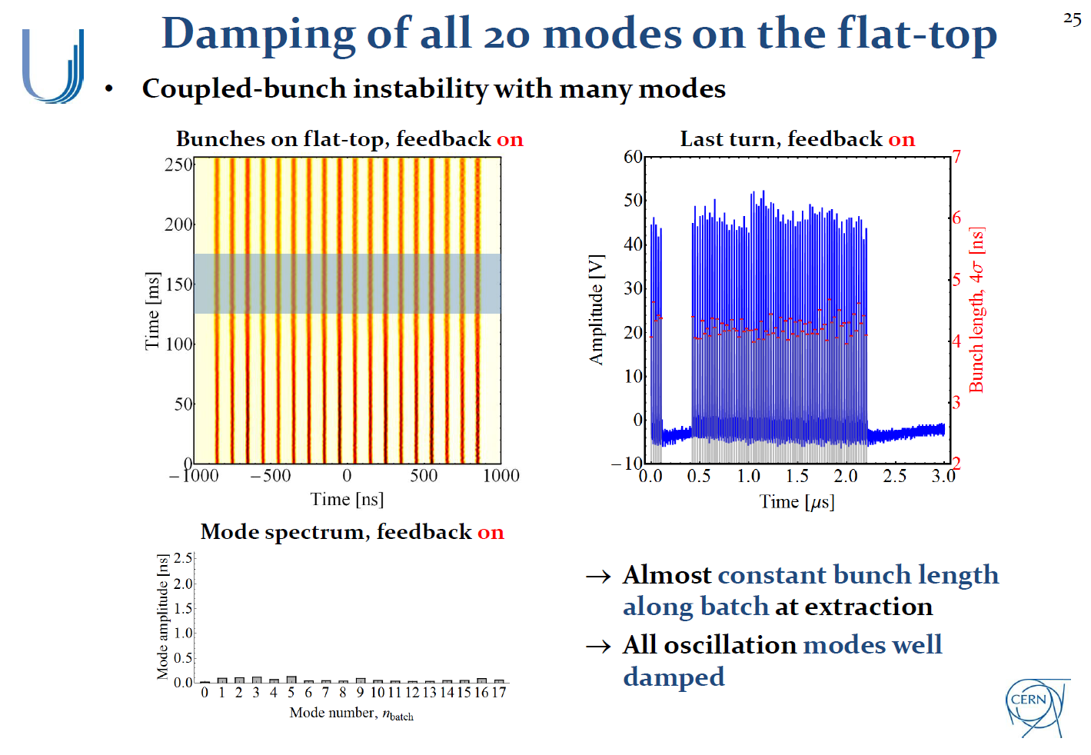
PS Instability Damper Operation
H. Damerau HB2014
Latest Result in 2016
All 10 signal processing chains are working and we have regularly delivered 2 10^11 ppb (72 bunches spaced 25 ns) with very good longitudinal beam quality for tests in the SPS.

Slide 18
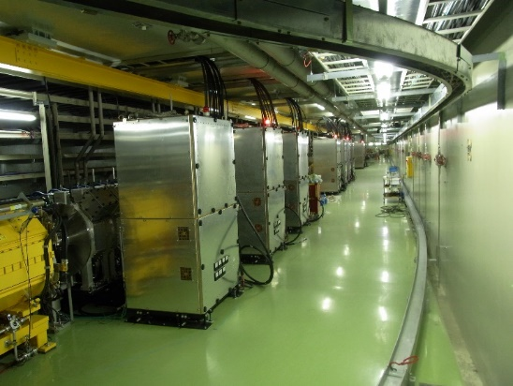
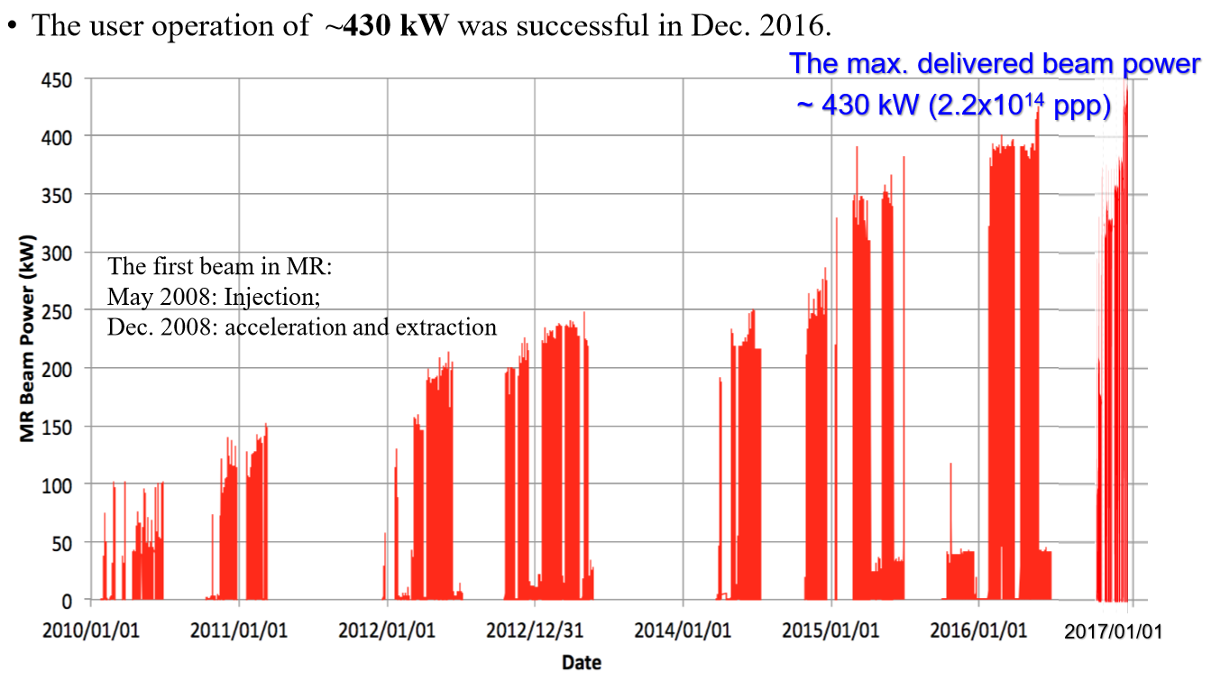
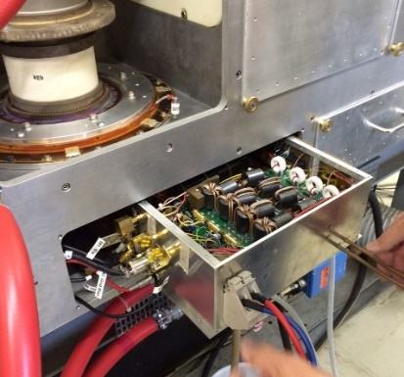
Others:
Mid-Term Upgrade of J-PARC RF
Replacement of all cavities to new FT3L ones was finished in this summer.
430kW beam with new RF in this month!
About 1 sec. cycle operation will start in FY2018 after replacing magnet power supplies for MW beam.
  FT3L cavities will provide required voltage.
Now 2.2E14 ppp is accelerated. Goal is 3.2E14 ppp for MW beam. Need consolidation of Power Supplies & beam loading compensation. FF-> FF + FB
  PSB FB Scheme is under consideration for J-PARC
MR RF System
PSB FB System

Slide 19
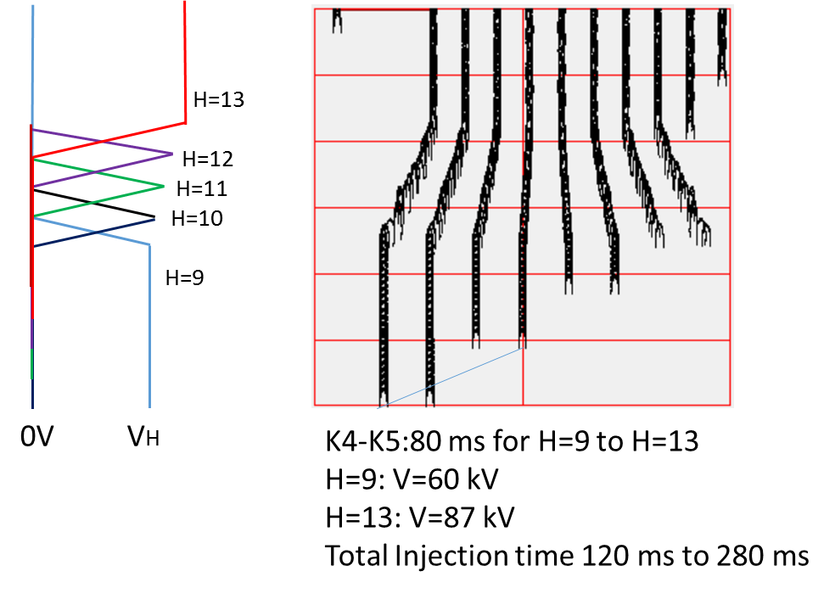
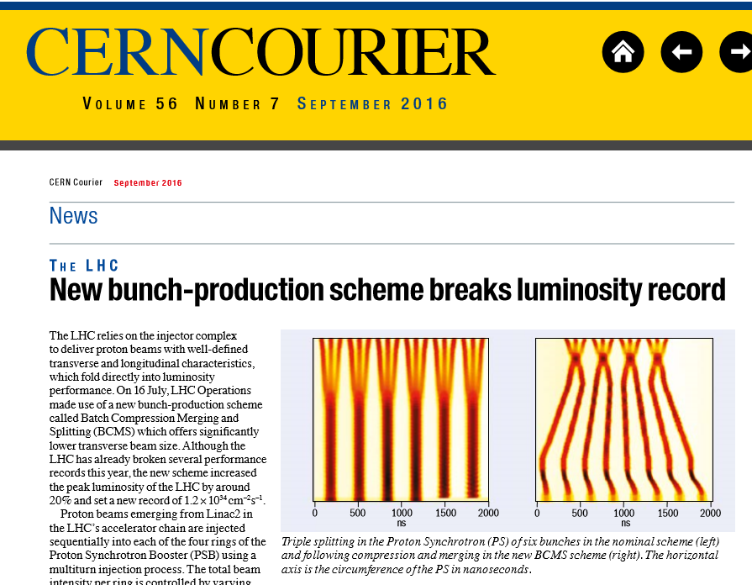
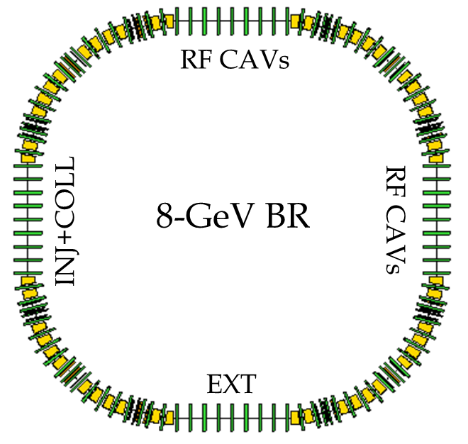
Long-term plan of J-PARC
KEK load-map includes 3 MW beam for T2K.
  Tsukuba base: SCC in KEK-B tunnel
  J-PARC base :6-8 GeV booster
My Idea is Bunch manipulation + 6 (8) GeV booster scenario for >3 MW.
  3GeV RCS has a capability for >1.6 MW by FT3L cavities and consolidation of Anode PS
  3 GeV is low for multi-MW MR
Batch compression is already used at CERN PS !
Batch Compression at J-PARC MR
By a new booster:
2 MW eq. RCS + 1.16 s cycle ->2.6 MW
By new booster & manipulation:
2 MW eq. RCS + Manipulation -> 3.5 MW
J-PARC New Booster

Slide 20
J-PARC
In 2016, J-PARC and CERN updated the agreement on both accelerators for cooperation including Beam Dynamics, commissioning and RF for Linac & ring.
  More participation from J-PARC to CERN for LIU should be encouraged.
We think CERN-J-PARC collaboration will be also very fruitful.

Slide 21
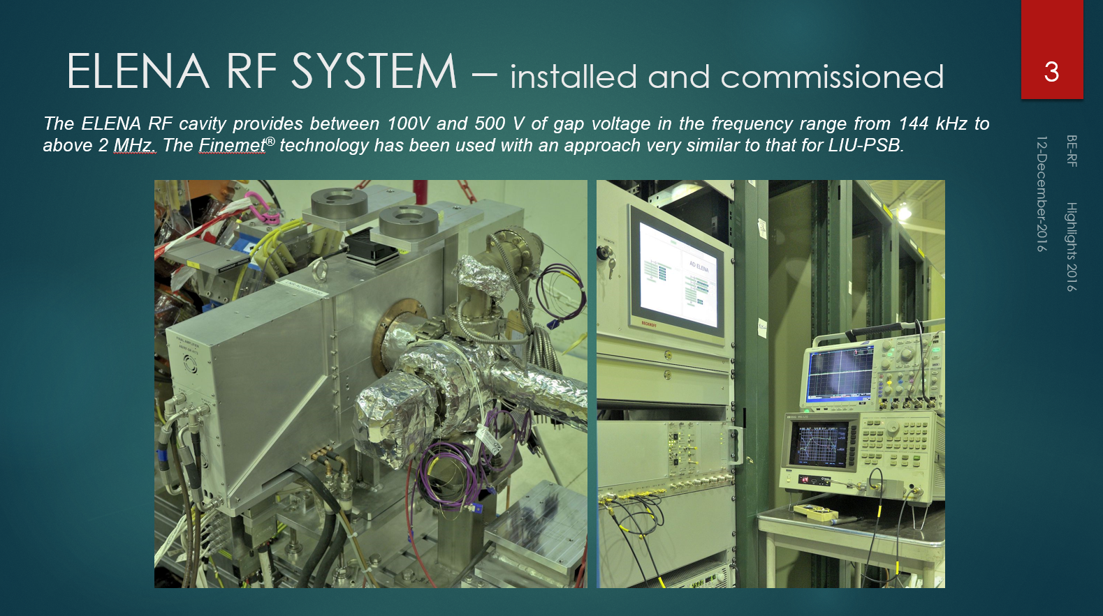
Summary
C. Rossi
KEK/J-PARC contributes LIU RF upgrade.
PSB RF upgrade has launched.
PS Damper works very well.
The FT3L cavity technology is spreading from J-PARC and PSB/PS to the other accelerators: AD and ELENA at CERN, and Medical use-MedAustron.
CERN’s Feedback Amplifier techniques will be necessary for MW beam acceleration.

