Slide 1


Progress on Beam Separation Superconducting Dipole Magnet (D1) R&D for HL-LHC
Tatsushi NAKAMOTO (KEK)
On behalf of CERN-KEK Collaboration for D1 Development for HL-LHC
CERN-KEK Committee, CERN, Dec. 13, 2016

Slide 2
Human resource, Participants
KEK
Core members: T. Nakamoto, M. Sugano, S. Enomoto
Participants: K. Sasaki, N. Kimura, M. Yoshida, T. Ogitsu
Eng./Tech. Supports: H. Kawamata, N. Okada, Y. Ikemoto, R. Okada
CERN
HL-LHC WP3 Leader: E. Todesco
D1 Link Person: A. Musso
Cold mass, cryostat design: D. Ramos, H. Prin, C. Garion

Slide 3

IR Upgrade for HL-LHC
LHC (2008-2022): 300 fb⁻¹, 1x10³⁴ cm⁻² sec⁻¹
IP
HL-LHC (2024-2035):
3000 fb⁻¹, 5x10³⁴ cm⁻² sec⁻¹
Crab cavities
For new beam separation dipole (D1)
Large aperture to obtain smaller β* : φ70 mm → φ150 mm
Stronger kick for shorter distance between D1 and D2:
Field integral 26 Tm → 35 Tm by SC magnet

Slide 4
Scope
Beam separation dipole (D1) by KEK
  Participation to the design study of the HL-LHC upgrade since 2011
    framework of the CERN-KEK collaboration
    in the context of enhancing the Japanese contribution to the physics outcome from the ATLAS experiment.
150 mm single aperture, 35 Tm (5.6 T x 6.3 m), Nb-Ti technology.
  2 m long model magnets: 2 + 1?
    >> 1st model was constructed and tested in 2016, succeeded to be energized beyond the nominal current.
  Prototype: 1
  A series production: 4 + 2 spares

Slide 5
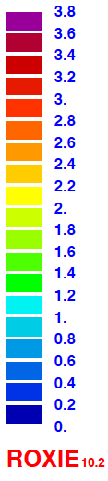
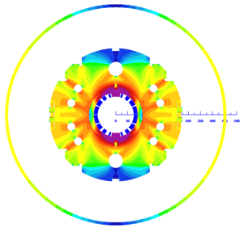
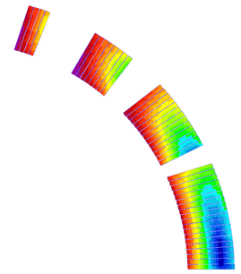
Design overview (w/ 2 HX holes)
 | A series production | 2 m model
Coil aperture | 150 mm
Field integral | 35 T m | 9.8 T m
Nominal field | 5.57 T
Peak field | 6.44 T (SS), 6.56 T (coil end)
Operating current | 12.0 kA
Operating temperature | 1.9 K
Field quality | <10⁻⁴ w.r.t B₁ (R_{ref}=50 mm)
Load line ratio | 75.4%（SS）, 76.6%(coil end） at 1.9 K
Differential inductance | 4.0 mH/m
Conductor | Nb-Ti: LHC-MB outer cable
Stored energy | 340 kJ/m
Magnetic length | 6.33 m | 1.73 m
Coil mech. length | 6.57 m | 2.00 m
Magnet mech. length | 6.72 m | 2.15 m
Heat load | 135 W (Magnet total) 2 mW/cm³ (Coil peak) > 25 MGy
Radiation dose
4
8
13
4 blocks
44 turns
19
Technical challenges
・Large aperture： Management of coil size and pre-stress.
・Radiation resistance：Radiation resistant material for coil parts. Cooling capability.
・Iron saturation：Good field quality from injection to nominal current

Slide 6
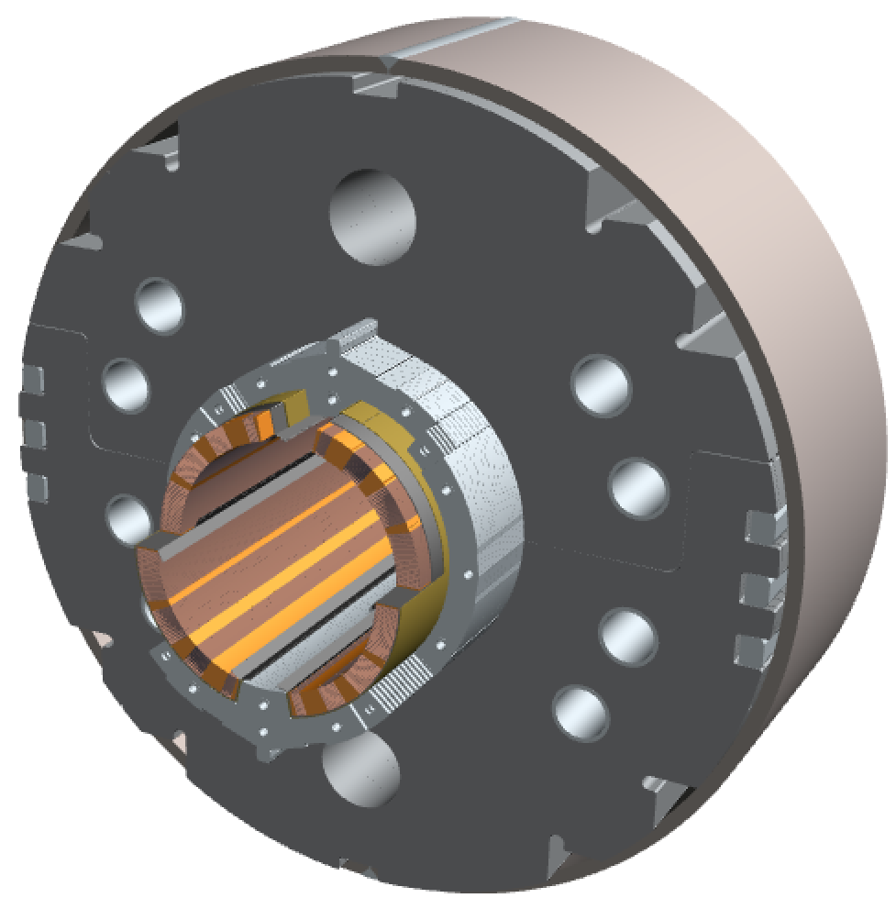
Cutview of D1
Field tuning hole
φ60 mm HX hole
Shell (SUS304L)
4-way split stainless steel collars
(NSSC130S)
Stack tube (S45C)
Brass shoe
QPH + Insulations
key (S45C)
Cu/NbTi cable (LHC MB outer) +
Apical insulation
Iron yoke
(EFE by JFE steel )
Radiation resistant
GFRP wedge for dose of 25 MGy
(S2 glass + BT resin)
Nb-Ti/Cu cable with APICAL and PIXEO insulations, same as MB outer cable.
Collared yoke structure to increase amount of iron yoke.
Design features for better cooling (Heat load 135 W in total, 2 mW/cm³ at local peak).
  A single layer coil.
  Void spaces and packing factor of collar and yoke: less than 100% for passage of superfluid helium.

Slide 7
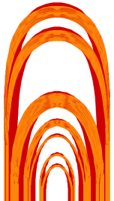
Design overview: Magnetic design
Field computation by ROXIE
2D:
  coil blocks optimization
  minimizing iron saturation effects by pole notch and holes.
  all normal multipole coefficients controlled within 1 unit at nominal.
3D:
  Coil end was also optimized to minimize multipole component integrals in 7-m production magnet.
  2-m models have the same coil ends.
Coil-end model
Cross section of D1
Variation of multipole components at excitation

Slide 8
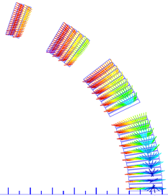
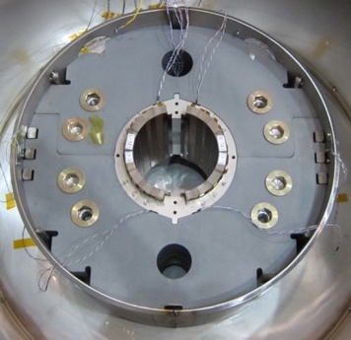
Design overview: Mechanical design
FEM Analysis (ANSYS)
  Fabrication, cooling and excitation (110%)
  Pre-stress of pole at assembly: 80 MPa
200 mm long mechanical model
  Validation of mechanical design.
  Check of assembly tooling and procedures.
E.M. Force on coil
2D Model for ANSYS
200-mm mechanical model for structural validation
Coil stress calculated by ANSYS

Slide 9
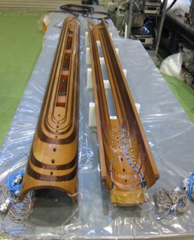
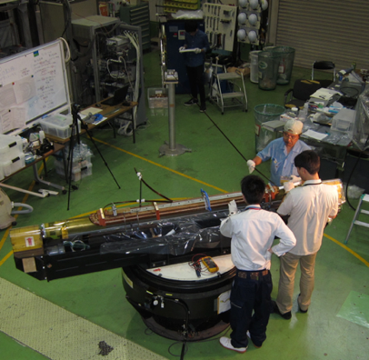
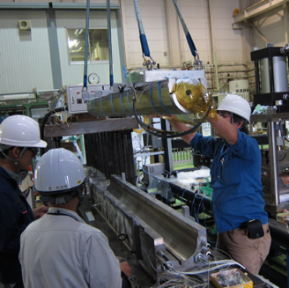
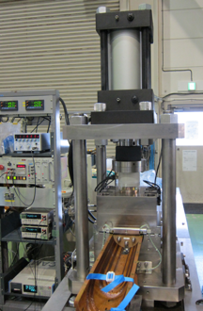
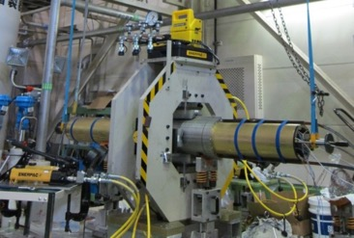
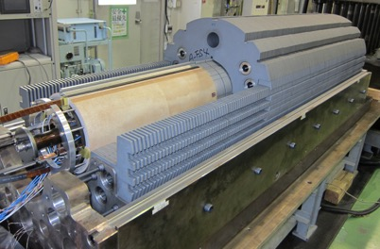
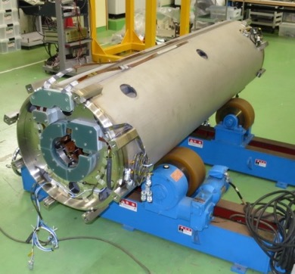
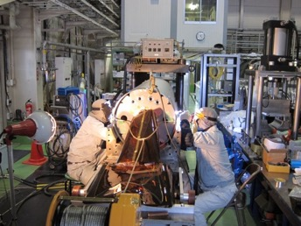
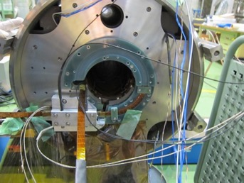
Fabrication of the 1st 2 m model (MBXFS01) in KEK
Jul 2015 – Mar 2016
Coil winding
Coil size
meas.
Collaring
Curing
Yoking
Shell welding
Splice work
Completed magnet
  Some minor technical issues found. But they were basically solved, or improvement will be applied to the 2nd model.

Slide 10
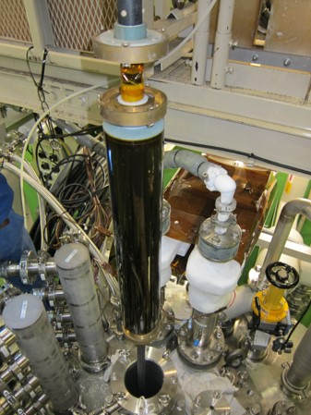
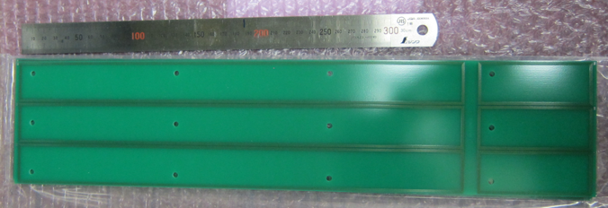
Excitation tests
1st cycle: April 2016
2nd cycle: May – June 2016
Temperature: 4.45 K and 1.9 K
Energy extraction with a dump resistor of 73 mΩ
Threshold voltage: 0.1 V
Detection time: typically 10 msec
Ramp rate to quench: 10 A/sec
MFM
  DC loop: I=0–10 kA
  z scan: I=688(injection) , 3, 5, 7, 10 kA
1st 2-m D1 model and 9-m vertical cryostat at KEK
Rotating coil for MFM

Slide 11
Training Quench
First quench at 4.45 K at 68% of SSL.
Quench current (Iq) exceeded the nominal current of 12 kA at 1.9 K at 15th quenches.
Max. quench current = 12.6kA, 105% of I_{nom}, but lower than the ultimate
Erratic behavior soon after. Quench tests at 4.45 K suggest no cable damage (Iq > 90% of ISSL at 4.45 K).
Iq recovered to 12 kA at the last two quenches.

Slide 12
Coil Stress Variation at Excitation
Location of Collar Stress Gauges.
View from LE
T-b
T-a
B-a
B-b
Quench performance: not good enough
  Complete stress release even around 8kA.
  Insufficient preload during assembly.
    Coil stress at cold should be increased by 35 MPa.
  Lower coil modulus in mechanical design was wrong…
Modification with enhanced preload is applied to MBXFS01b. To be tested in Jan. 2017.

Slide 13
MFM results: Field integral at 10 kA
Normal dipole field
Measurement
(ROXIE cal.)
ROXIE3D calculations generally agree with the measurement.
  Need improvement of ROXIE models for b₃ and b_{5.}
Skew and un-allowed multipoles are sufficiently small.

Slide 14
MFM results: Variation of b₃ along excitation
MFM at magnet center
Mismatch at low current: error of coil geometry
Saturation effects on b₃ beyond 6 kA:
Large aperture (end effects), iron saturation and stray field.
  Careful check of coil geometry in the 2nd model.
  Improvement of ROXIE model in collaboration with CERN.
  Benchmarking with OPERA3D.

Slide 15
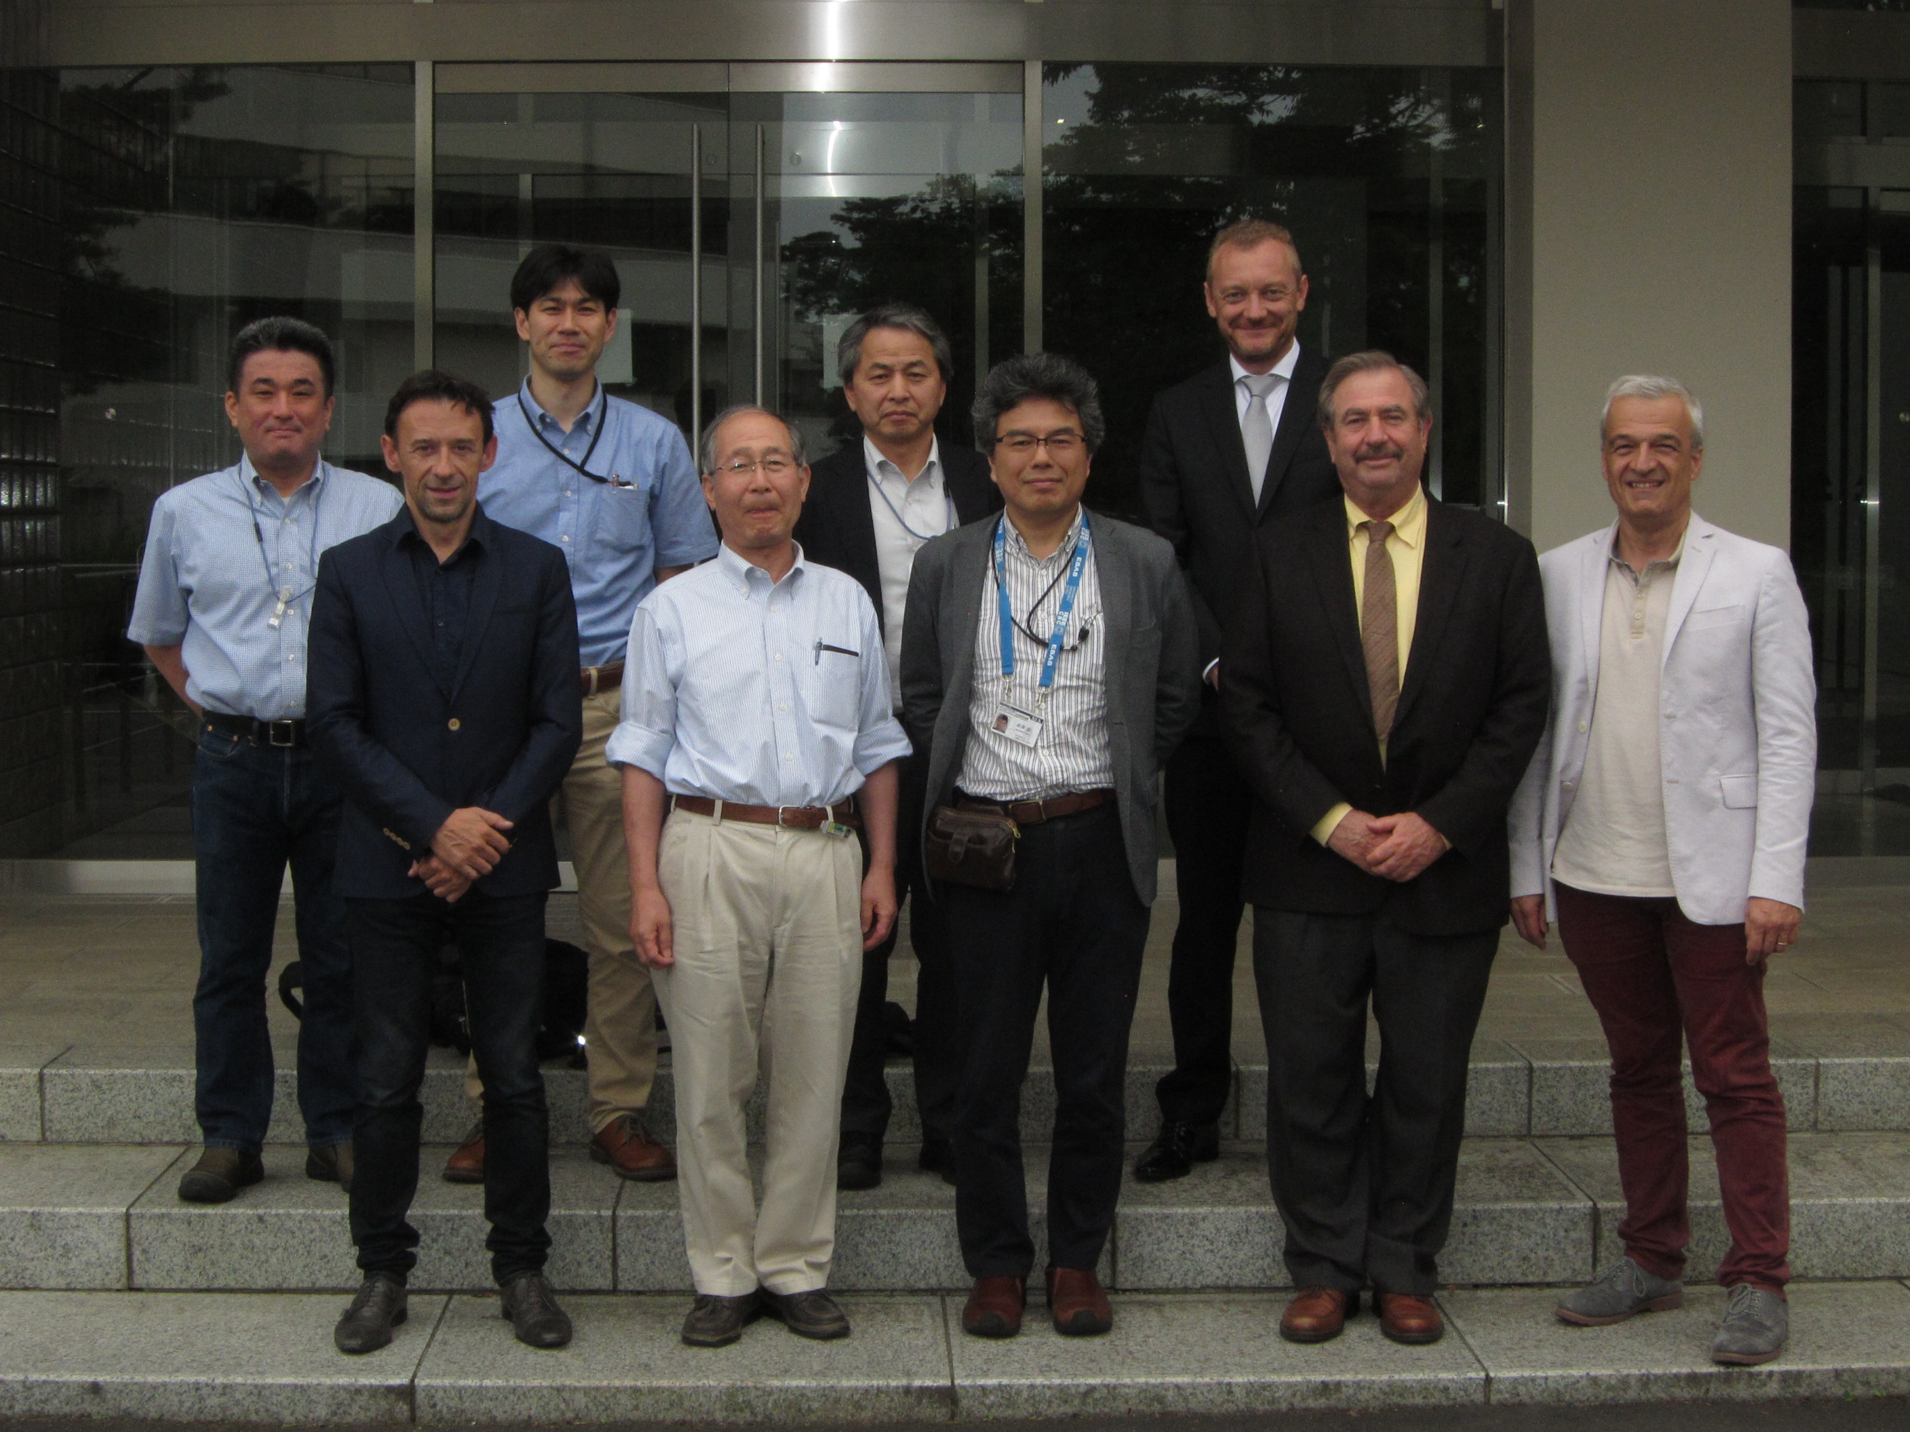
D1 Review
June 30 & July 1, 2016 at KEK
Reviewers: Shlomo Caspi (LBNL), Toru Ogitsu (Chair, KEK), Davide Tommasini (CERN), K. Tsuchiya (KEK)
Recommendations:
  … Priority should be given to the re-assembly of the 1st model magnet. At this time we do not see a reason to change the basic design concept of the first model…

Slide 16
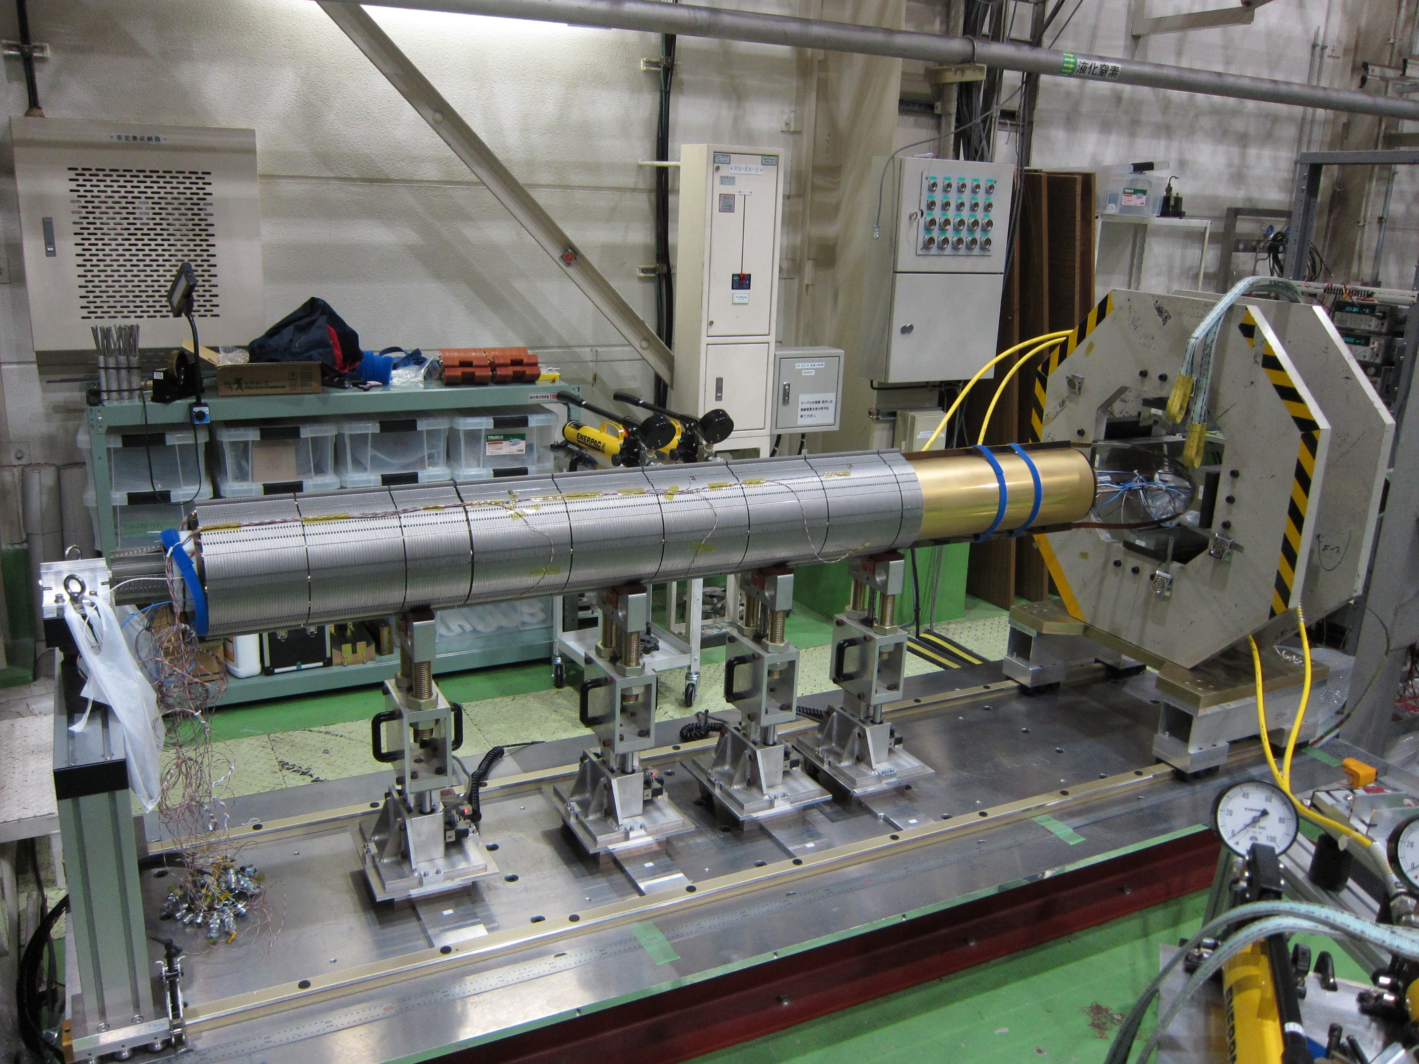
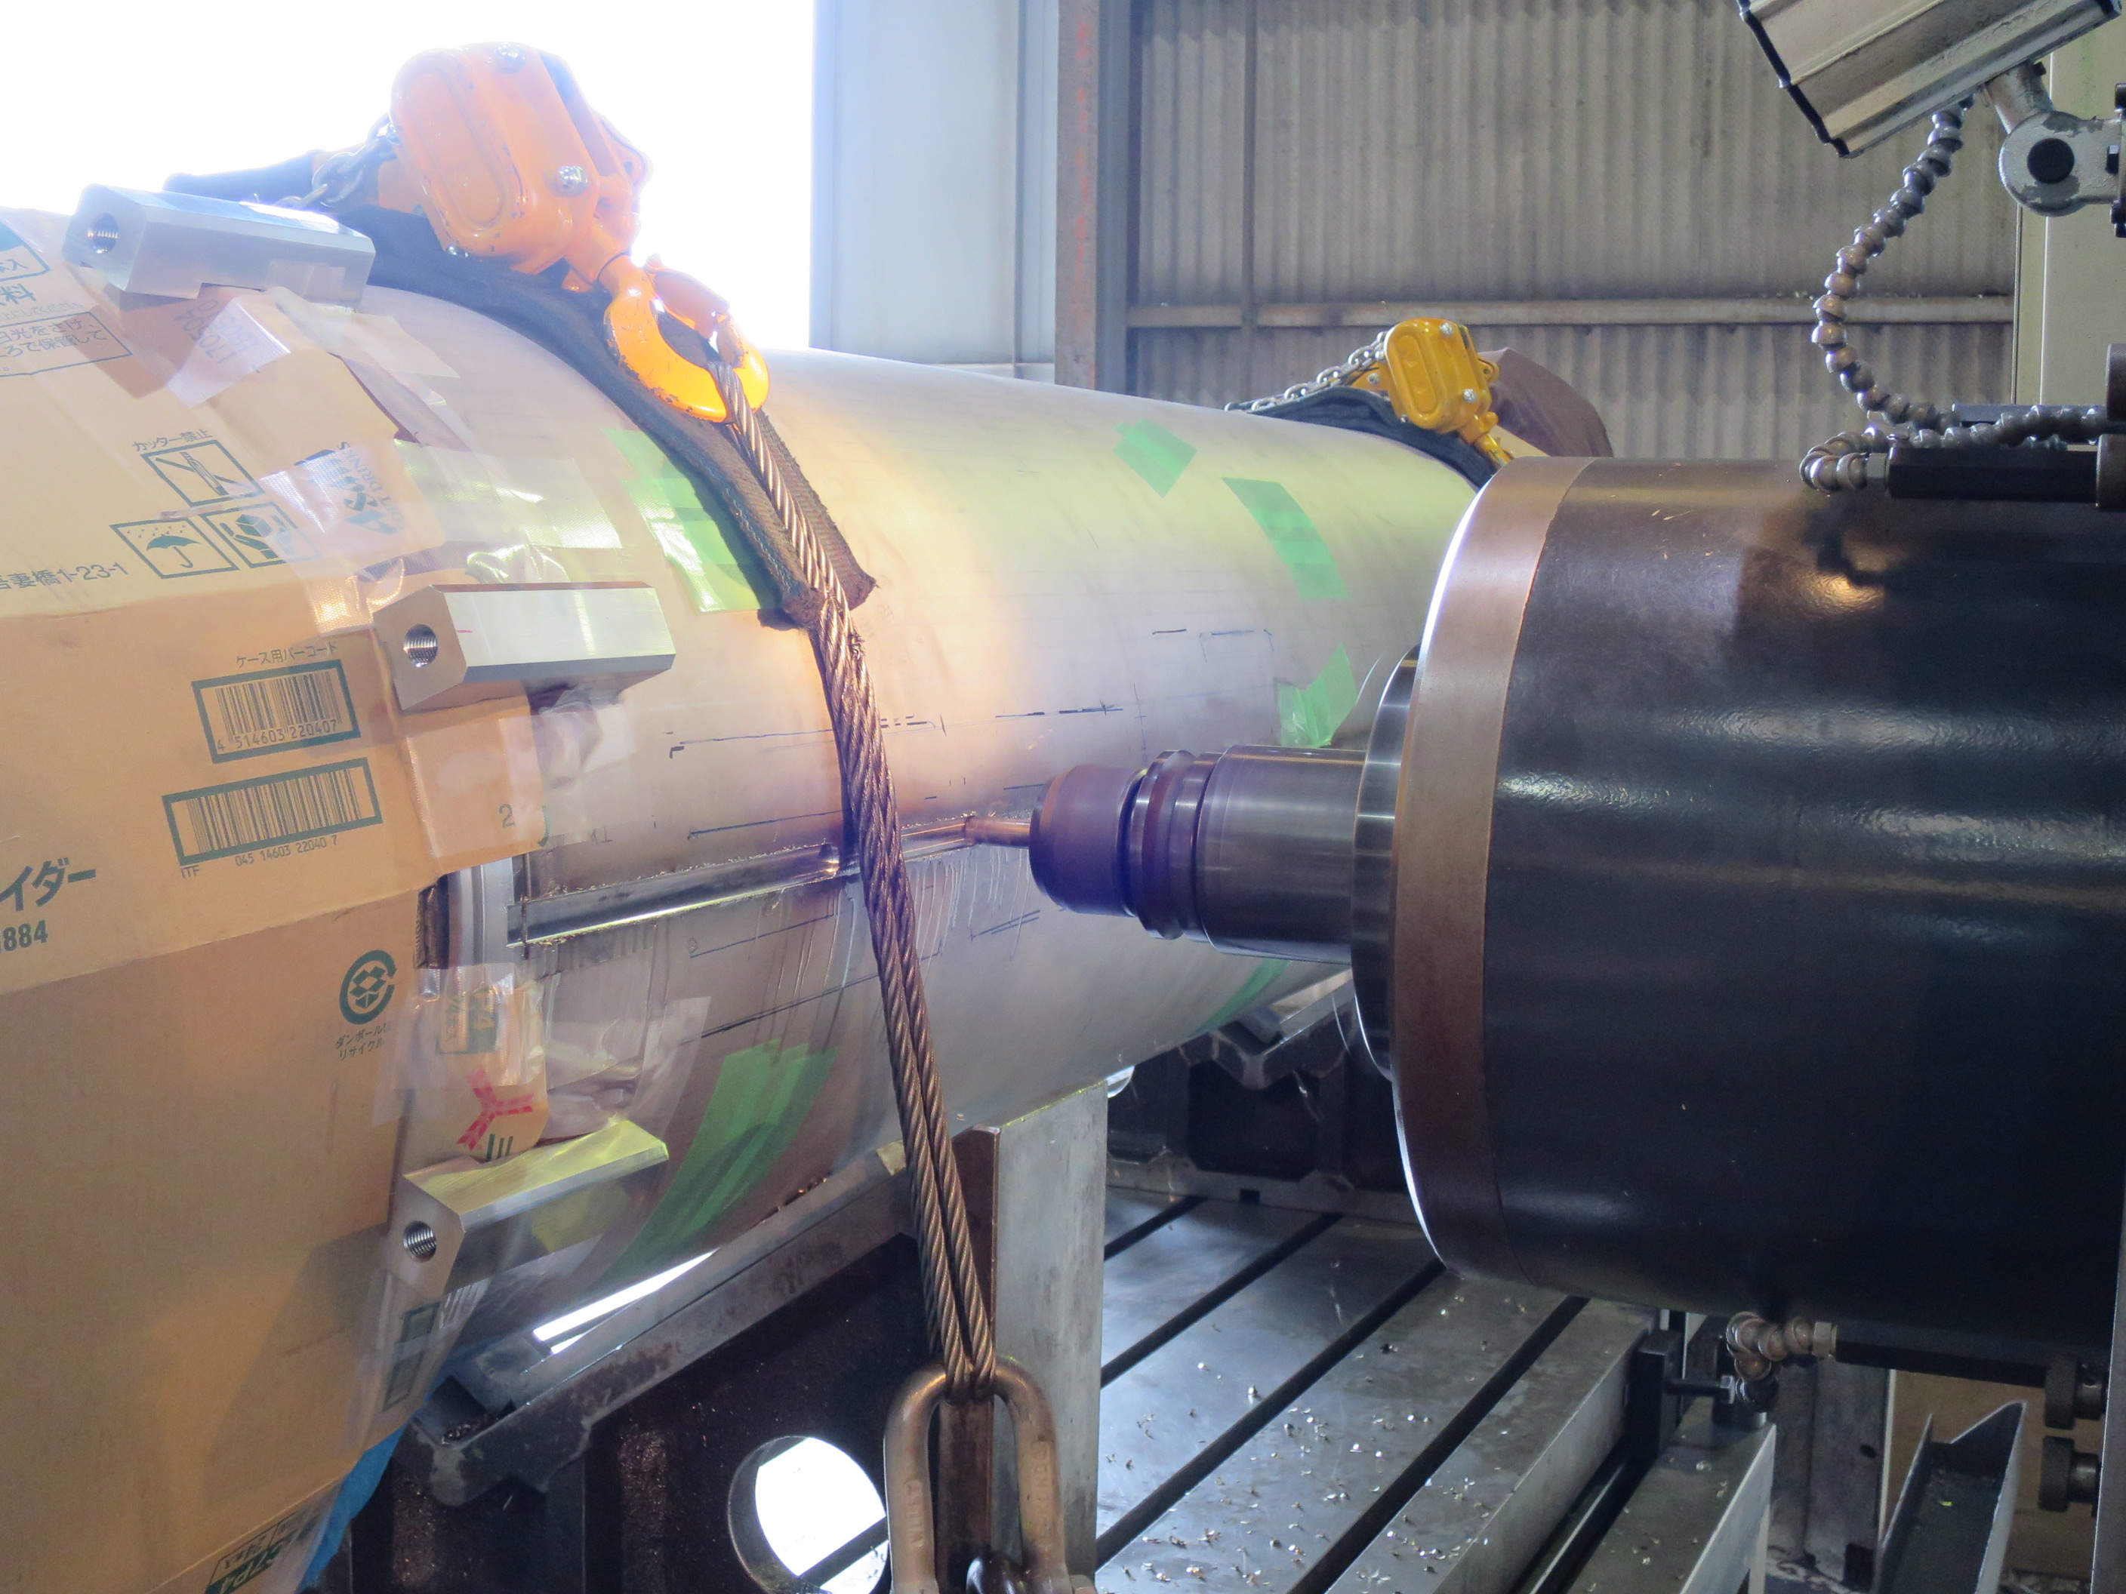
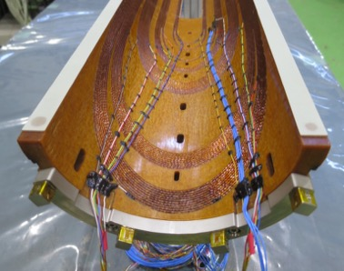
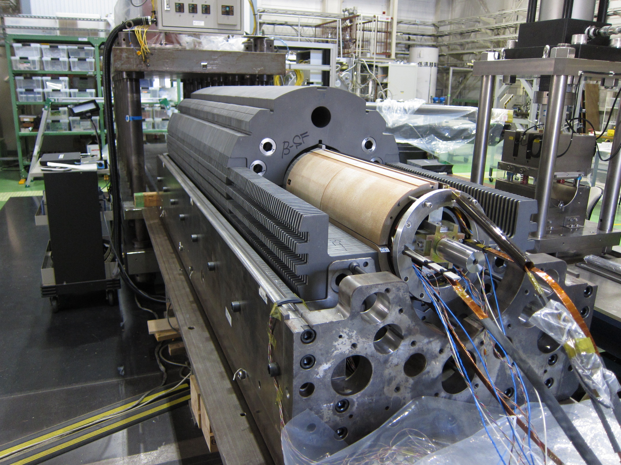
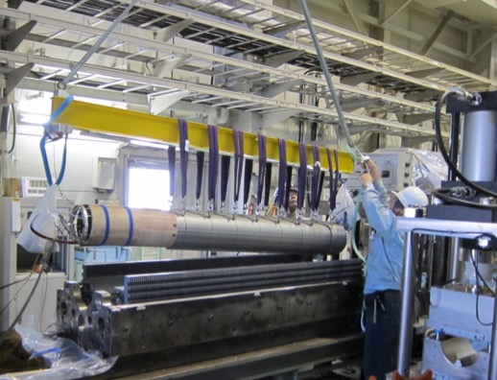
Current status of MBXFS01b
MBXFS01 was disassembled and 0.8 mm-thick G10 shims were bonded to the MP of each coil to increase pre-stress.
Implementation of strain gauges to monitor axial pre-stress
Increase of the number of voltage taps on the coils (29 → 42 per coil)
A coil for MBXFS01b with additional MP shims and axial strain gauges at coil end.
Disassembly of MBXFS01
Collared coil (top) and yoking preparation (Bottom)

Slide 17
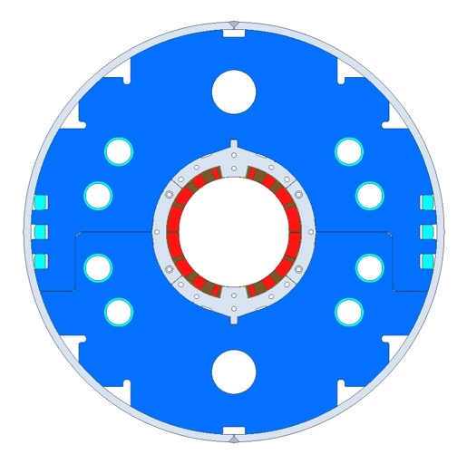
New Design Requirement from CERN
June 2016: Positions of Heat-Exchanger (HX) holes should be same as MQXF.
  Need of design study for new cross section. (field quality, structure).
1st 2m model in 2016: Previous design w/ 2 Heat EX holes.
2nd 2m model and later: New design w/ 4 Heat EX holes.
  Modification of design of wedges and end spacers to realize sufficient pre-stress and good field quality simultaneously
  Reproducibility could be checked by the 2nd and 3rd models (option).
HX hole
Field-tuning
hole
Previous cross section (MBXFS01)
New cross section (tentative) (2017-)
MBXFS02 -

Slide 18
Near-term Schedule
MBXFS01b (w/ higher pre-stress)
  Reassembly: Nov 2016 - Jan 2017
  Cold test: End of Jan - Mar 2017
  Shipping to CERN
  (Agreement in the commissioned research contract)
MBXFS02 (w/ new cross section)
  Design: Sep. 2016 - Jan. 2017
  Construction: Jan. 2017 – Sep. 2017
  Cold test: Oct. 2017 – Nov. 2017
MBXFS03 (w/ new cross section) >> TBD
  Nov. 2017 - July 2018

Slide 19
Log-term Schedule
Baseline + Option
2m model magnet development and design of magnet system until 2018.
7 m long prototype and a series production;
  Assuming a funding from April 2019.
  Magnets and cryostats will be constructed by a manufacturer.
  Vertical tests of the magnets at KEK.
  Magnet in a cryostat will be shipped to CERN for horizontal tests.
    Also considering the possibility of horizontal tests at KEK with test stand upgrades.
Option: Development of the 3rd model (MBXF03) in 2017-2018.

Slide 20
Summary
Development of beam separation dipole (D1) for HL-LHC has been carried out by KEK.
The first 2 m model of D1 (MBXFS01) was fabricated and tested at cold in KEK.
Quench current reached the nominal current, but the ultimate current was not achieved.
Unsatisfactory quench performance will be attributed to insufficient coil pre-stress.
Generally, good agreement was confirmed between measured and calculated magnetic field quality. But to fully understand the measured results, further analysis is needed.
Reassembly with higher pre-stress has been already started and cold test of MBXFS01b is scheduled in early 2017.

