Slide 1
CERN and KEK LC activities
Activities
CERN-KEK co-operation agreements covering accelerator studies (ATF and Xband) and physics detector&physics studies, as well as recent initiative to establish CERN office at KEK (supported also by EJADE – see below)
European LCC common fund and LCC hosting covered by CERN
ATF2 (KEK) and also relevant general beamdynamics studies at SLAC
  Substantial R&D contracts with UK supporting (among others) their LC efforts related to ATF2 (CLIC and ILC)
  Participation in ATF2 programme and BDS studies by CERN team (for CLIC and ILC)
  Direct support to ATF2 operation in 2014
Formal participation in ILC preparation team:
  BDS: Beam delivery system (linked to ATF2) – main links at CERN: Rogelio Tomas (and Michele Modena (magnets))
  RTML: Ring to main linac (Andrea Latina) – covers more widely beamdynamics studies as well
  Cryogenics: LHC cryosystems vs ILC (Dimitri Delikaris), highly transferable experience, lessons learned for design
  CFS – civil engineering studies (John Osborne) – 50% funding of ARUP (used in the past by CERN) for studies of the ILC collision point
  SCRF: Tuner and coupler studies with KEK and DESY co-financed by CERN (Eric Montesinos)
  Cryomodule cost study for the TDR
Coordinate – supported by DESY - the EJADE Marie Curie network EJADE for European staff exchange with Japan (relevant for ILC preparation (lead DESY) and ATF2 (lead Orsay): http://www.e-jade.eu/home/

Slide 2
ILC Action Plan
Okada:
“Producing a EAP (European Action Plan) for the ILC in timely manner is very important.
After having established a discussion group with DOE, discussions with Europe are likely to become the next important topic for MEXT. MEXT is closely monitoring ILC-related activities and EAP is yet another evidence of the European interest in the project.”
Preparing a European Plan for next phases (assuming Green Light in Japan):
Currently: several existing activities with relevance for ILC (mainly funded for other reasons) – see figure on the left
2019-2022: Preparatory phase (main focus of document)
2023 - : Construction phase
Will use EJADE WP3 as framework for this and gradually include more participants in the discussion (this approach is agreed with LCC)
Will also – with this work – attempt to provide important input to European Strategy ~ 2019 concerning capabilities, resources, timelines, etc
Work started in October, complete in 2017
EJADE participants:
CERN; Stapnes (Scient Coord)
CEA: Napoli, DESY: Walker
CNRS: Bambade/Jeremi
UK: Burrows, CSIC: Faus-Golfe
EJADE WP3 and centrally: Schoerner-Sadenius, Stanitzki
LCC: Foster
One addition so far not in EJADE: INFN Zoccoli
Reps from KEK

Slide 3
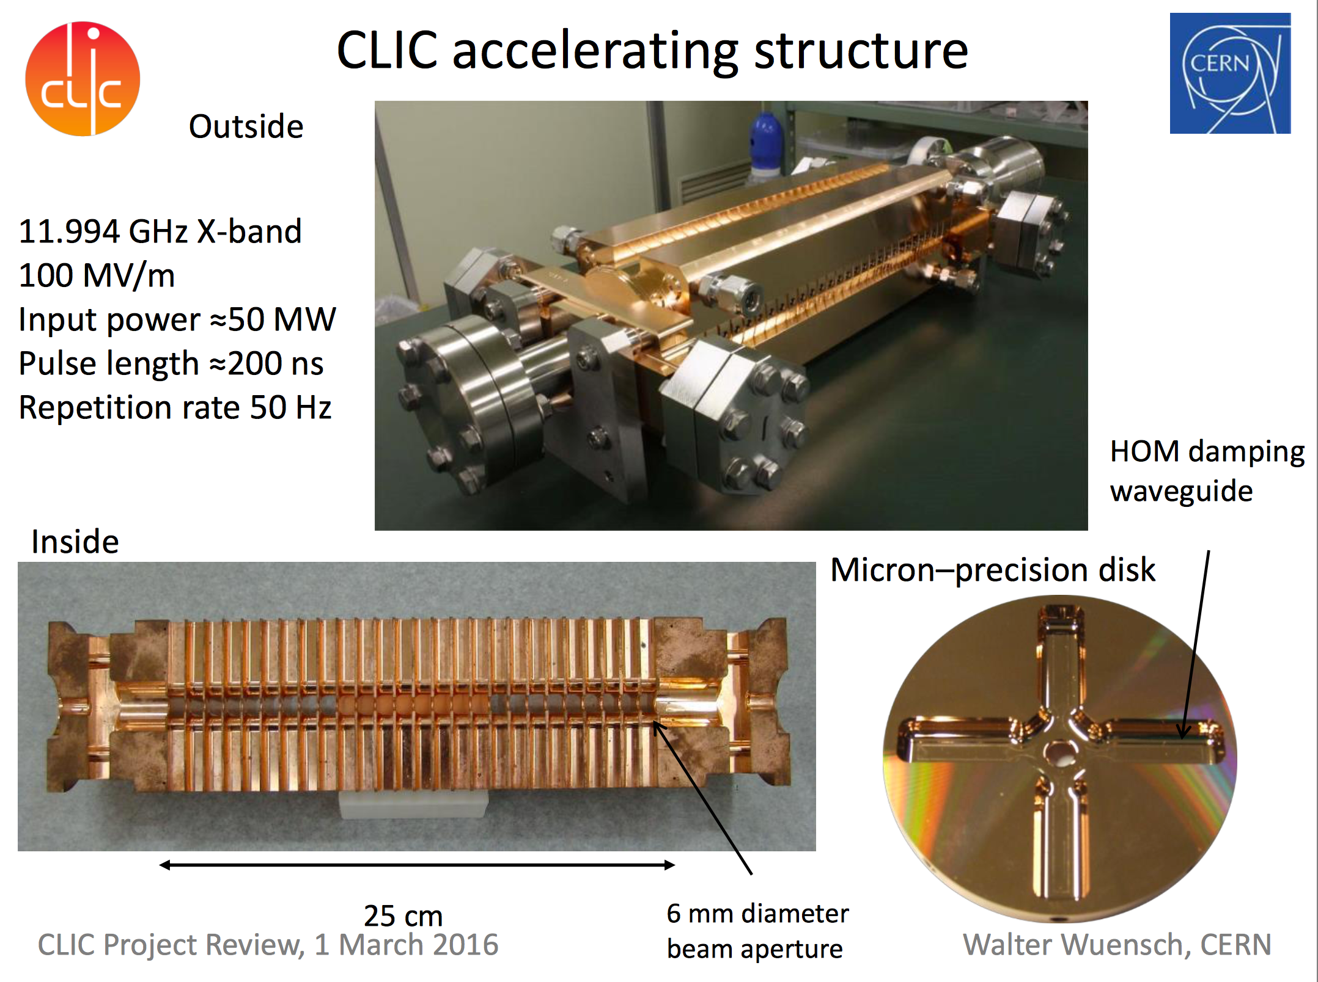
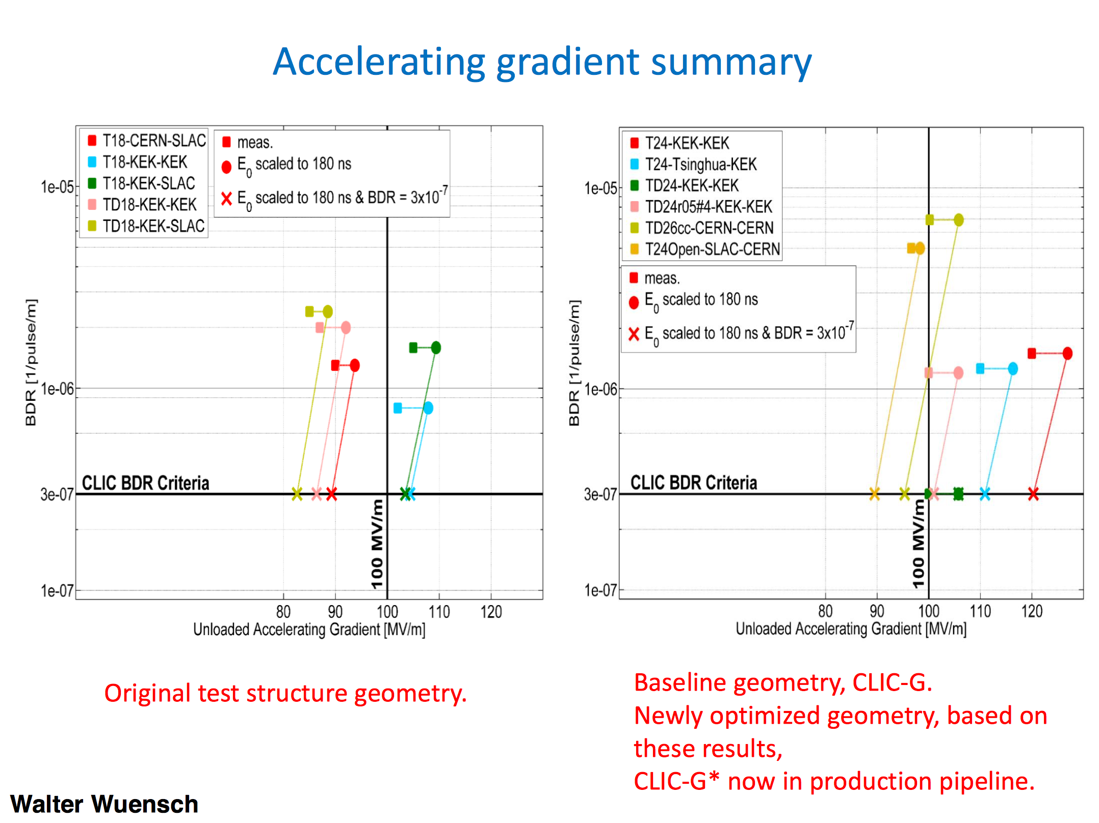

Slide 4
Existing and planned Xband infrastructures
CERN | XBox-1 test stand | 50 MW | Operational
 | Xbox-2 test stand | 50 MW | Operational
 | XBox-3 test stand | 4x6 MW | Commissioning
KEK | NEXTEF | 2x50 MW | Operational, supported in part by CERN
SLAC | ASTA | 50 MW | Operational, one structure test supported by CERN
 | Design of high-efficiency X-band klystron | 30 MW | Under discussion
Trieste | Linearizer for Fermi | 50 MW | Operational
PSI | Linearizer for SwissFEL | 50 MW | Operational
 | Deflector for SwissFEL | 50 MW | Planning
DESY | Deflector for FLASHforward | 50 MW | Planning (note first two may share power unit)
 | Deflector for FLASH2 | 50 MW | Planning
 | Deflector for Sinbad | 50 MW | Planning

Slide 5
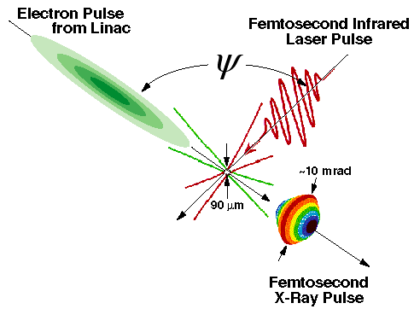
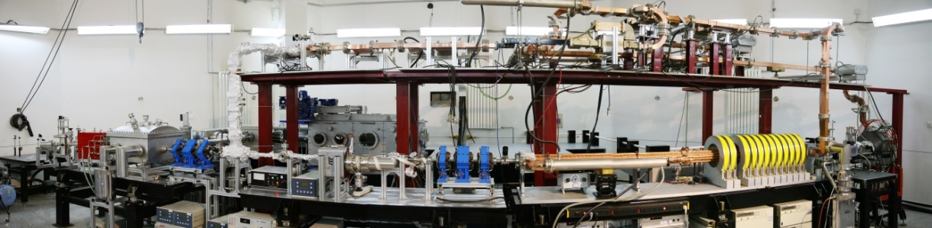
Existing and planned Xband infrastructures
Australia | Test stand | 2x6 MW | Proposal, loan agreement from CERN
Eindhoven | Compact Compton source | 6 MW | Proposal, request for loan from CERN
Uppsala | Test stand | 50 MW | Proposal, request for loan of spare klystron from CERN
Tsinghua | Deflector for Compton source | 50 MW | Ordered
 | Linearizer for Compton source | 6 MW | Planning
SINAP | Linearizer for soft X-ray FEL | 6 MW | Ordered
 | Deflectors for soft X-ray FEL | 3x50 MW | Planning
Valencia | S-band test stand | 2x10 MW | Under construction
STFC | Linearizer | 6 MW | Under discussion
 | Deflector | 10 MW | Under discussion
 | Accelerator | tbd | Under discussion

Slide 6
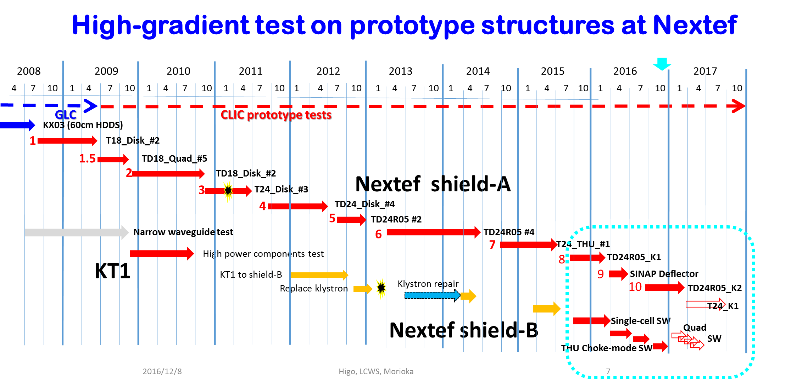
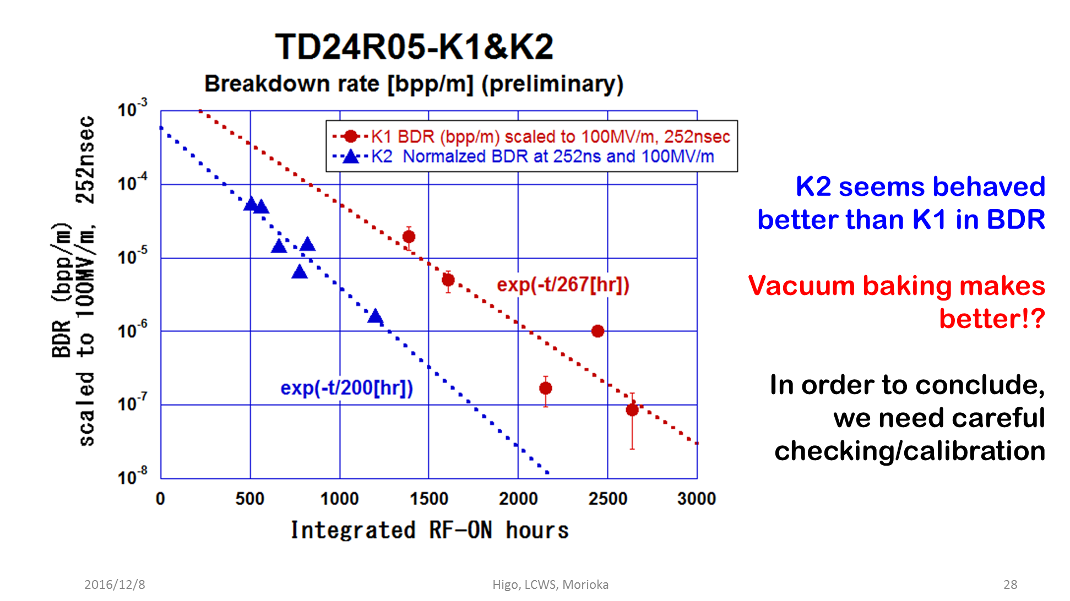
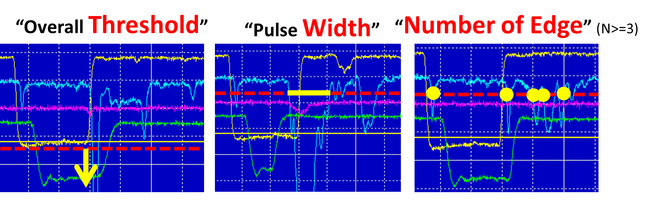
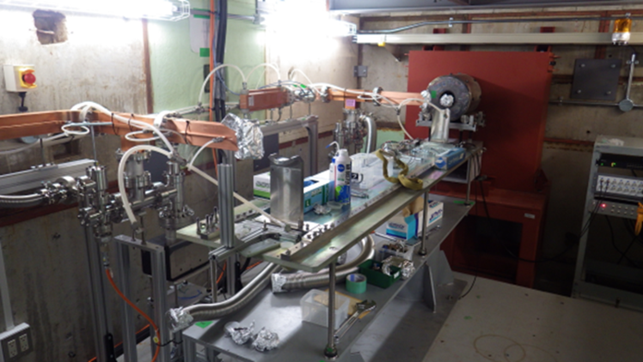
KEK
Test stations Nextef-A,B
LC and Basic studies
From Toshi Higo (KEK) presentation
Nextef-A dedicated to LC for ten years and
Nextef-B recently established for basic study
Vacuum baking effect??
S-band study
based on X-band experience
Small-size Basic study
Developing sophisticated pulse shape study

