Slide 1
Superconducting magnet developments at KEK for future accelerators
Toru Ogitsu
On be half of Cryogenics Science Center

Slide 2
R&D Items
High Field Magnet
  Nb3Sn development:
    Funded by CERN
    Two companies: Furukawa, JASTEC/Kobelco
    Collaboration with Tokai Univ. and Tohoku Univ.
  HTS very High Field Magnet R&D (proposal)
    Collaboration with Tohoku Univ. etc
    Develop 30-50 T Magnet for High Field Science
    KEK mainly work on quench protection
    Submitted to JSPS

Slide 3
R&D Items
High Radiation Resistant Magnet
  Funded by JSPS
  HTS mineral insulation etc
High Efficiency Magnet
  HTS medium field manget
    Funded by JST medical use
  Transmission Line Magnet
    Possibilities for J-PARC upgrades

Slide 4
R&D Items
High Field Magnet
  Nb3Sn development:
    Funded by CERN
    Two companies: Furukawa, JASTEC/Kobelco
    Collaboration with Tokai Univ. and Tohoku Univ.
  HTS very High Field Magnet R&D (proposal)
    Collaboration with Tohoku Univ. etc
    Develop 30-50 T Magnet for High Field Science
    KEK mainly work on quench protection
    Submitted to JSPS

Slide 5
Scope:
CERN, KEK and Tohoku university have jointly launched a R&D program
The scope of the program is to develop, produce in representative lengths and characterize Nb₃Sn wire with enhanced characteristics.
The final goal is to achieve in representative unit lengths of material the development targets defined, on the basis of magnets performance, for the Future Accelerator Nb₃Sn conductor:

Slide 6
Final Target Properties
A non-copper critical current density at 4.2 K and 16 T (Jc(4.2 K, 16 T)) of at least 1500 A/mm²;
A wire diameter of not more than 1 mm;
A fraction of stabilizer to superconductor in the wire of at least 1;
An equivalent diameter of the superconducting Nb₃Sn filaments of less than 50 μm;
A low electrical resistivity of the copper stabilizer of the wire, i.e. a Residual Resistivity Ratio (RRR) of the copper after wire reaction of above 150.

Slide 7

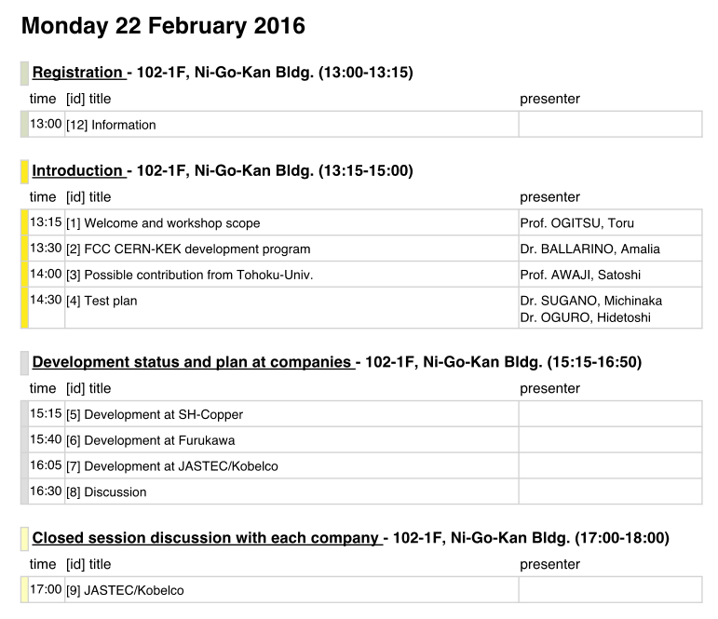
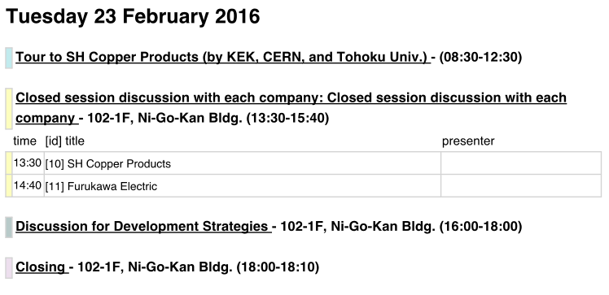
R&D Plan
4 Years Plan
Task1
Review past technologies and select.
First review meeting in Feb. 2016
Task2
Design wire layout and composition
Procure material (possible trial billets)
Task4
Select candidate
Produce 5km wire
Heat treatment study
Task5
Production of 20km wire
with unit length > 100m
Task3
Production of R&D billets
L>3km * N>3

Slide 8
Team Organization
KEK
MoU for Nb3Sn Study
CERN
Program coordination
Defining specification
Conceptual design
Addendum for Jap. Nb3Sn conductor development
CERN Contact:
A. Ballarino
Partner:
S. Awaji
(Tohoku Univ.)
PI: T. Ogitsu
Steering Committee
incl. external members
Specification
Design
Samples
Report
R&D billets
Characterization
Nb₃Sn Manufacturer A
H. Oguro/Tokai Univ.
TEM,SEM
Neutron Diffraction
Heat Treatment Optimization
M. Sugano/KEK
Mech. property
Jc
Nb₃Sn Manufacturer B
Nb₃Sn Manufacturer C

Slide 9
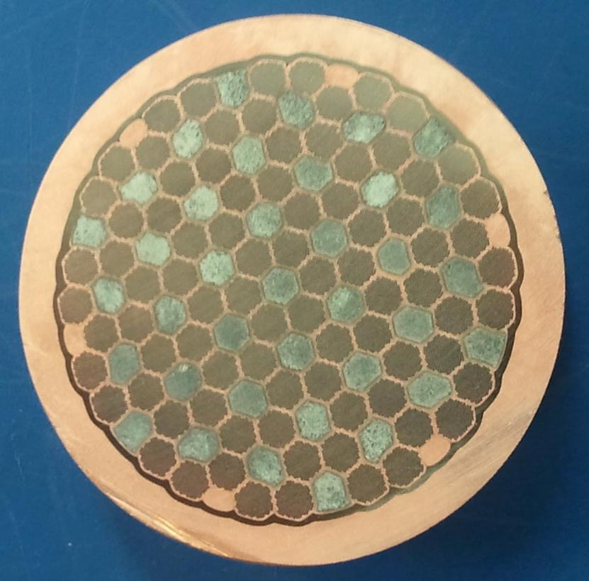
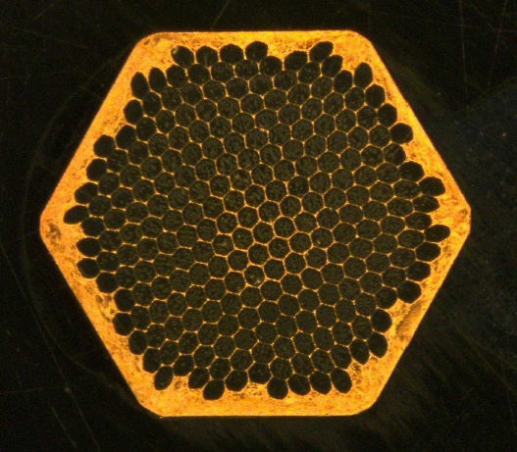
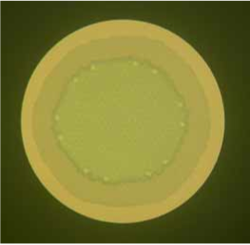
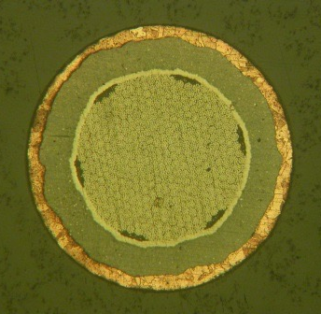
Companies
JASTEC/Kobe Steel
  Distributed Tin
Furukawa
  Under Discussion
Cu/Nb
192 filaments in a module
Multi fimament
Sn in Cu tube
(a)Nb-rod method
(b)In-situ method
CuNb reinforced Nb₃Sn wires

Slide 10
R&D Items
High Field Magnet
  Nb3Sn development:
    Funded by CERN
    Two companies: Furukawa, JASTEC/Kobelco
    Collaboration with Tokai Univ. and Tohoku Univ.
  HTS very High Field Magnet R&D (proposal)
    Collaboration with Tohoku Univ. etc
    Develop 30-50 T Magnet for High Field Science
    KEK mainly work on quench protection
    Submitted to JSPS

Slide 11
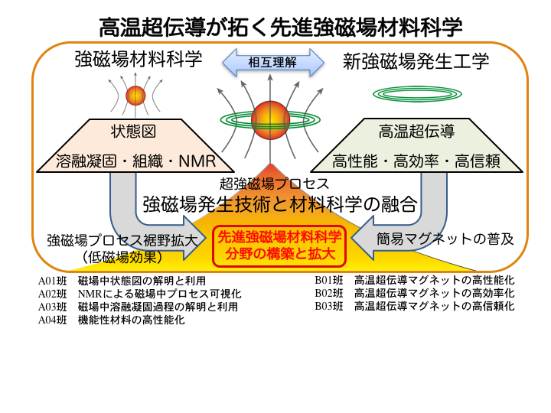
HTS very High Field Magnet Development
Proposal Submitted to JSPS

Slide 12











Key Members (tentative)
A: Material Science under very High Field
  A01:Phase Diagram
  A02:High Field NMR
  A03:Melting or Coagulation under High Field
  A04:Nano Material Control
B: HTS High Field Magnet Engineering
  B01: High Performance HTS High Field Magnet
  B02: Efficient HTS High Field Magnet
  B03: Reliabilities of HTS High Field Magnet
  Coil Manufacturing Method
  High Current RE123 Cable
  High Current Bi2223 Cable
  Strand reproducibility
  Quench Detection and Protection

Slide 13
R&D Items
High Radiation Resistant Magnet
  Funded by JSPS
  HTS mineral insulation etc
High Efficiency Magnet
  HTS medium field manget
    Funded by JST medical use
  Transmission Line Magnet
    Possibilities for J-PARC upgrades

Slide 14
R&D of Radiation-Resistant HTS Magnet
Superconducting magnet for next-generation particle physics experiment (~20 T, >200 MGy)
High magnetic field:
- NbTi → HTS (ReBCO tape)
Radiation-resistant:
- Conduction Cooling
- Neutron Irradiation
→ Radiation-resistant
Cryocooler
→ Mineral Insulation
(AlN, Al2O3, …)

Slide 15
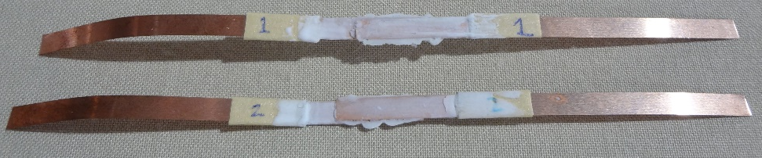
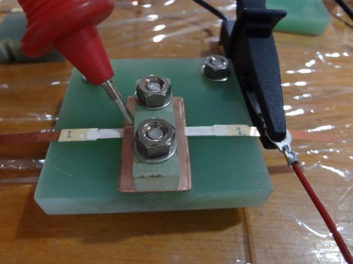
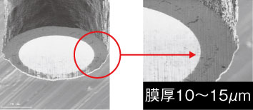
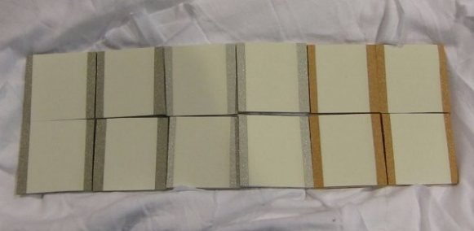
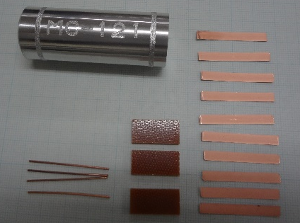
R&D of Radiation-Resistant HTS Magnet
R&D of Ceramic Coating
Effect of heat treatment
Contact probes
(measurement)
I(+)
I(-)
76 MPa
Voltage taps
(protection)
R=1.8 MΩ
@250 V (5 min)
TC
Collaboration with companies
77 K (S.F.)
220 deg.C, 2h
Thermal spray
φ50μm SUS
Ultrafine Coating
Condition | Ic/Ic0 (77K, S.F.)
180 deg. C, 2H | 0.956
220 deg. C, 2H | 0.727
300 deg. C, 2H | 0.000
Neutron Irradiation
Capsule → BR2 (Belgium)
Return to IMR-Oarai
In Spring, 2017

Slide 16
R&D Items
High Radiation Resistant Magnet
  Funded by JSPS
  HTS mineral insulation etc
High Efficiency Magnet
  HTS medium field manget
    Funded by JST medical use
  Transmission Line Magnet
    Possibilities for J-PARC upgrades

Slide 17
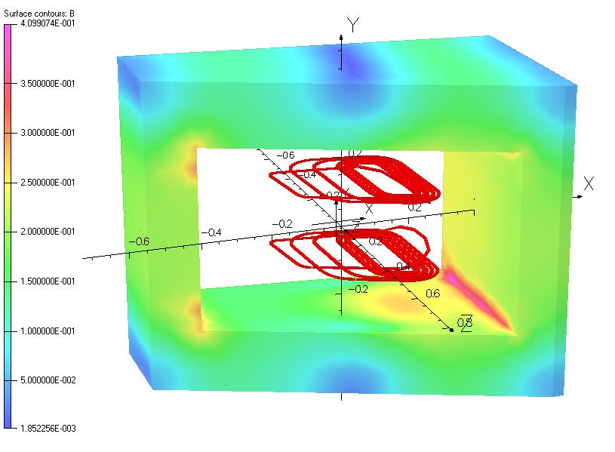
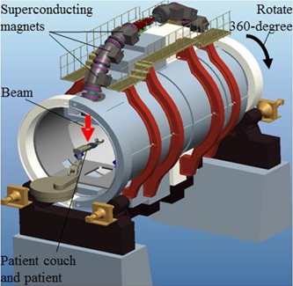
HTS medium Field magnet R&D for accelerator applications
S-Innovation project
  Funded by JST / MEXT
  Kyoto U., Toshiba, KEK, KURRI, NIRS, JAEA
  Fundamental technology R&D
  Still on going till 2018
A-MED (NIH like org.) project
  Toshiba, Kyoto U., KEK
  Dipole magnet for rotating gantry for carbon cancer therapy
  End by Mar. 2016
  Model magnet at KEK plan for extensive tests
N. Amemiya
2014 FCC@ASC
Model Magnet for FFAG (TOSHIBA)
Medium Field Applications for Small Accelerators
Superconducting Gantry (TOSHIBA)

Slide 18
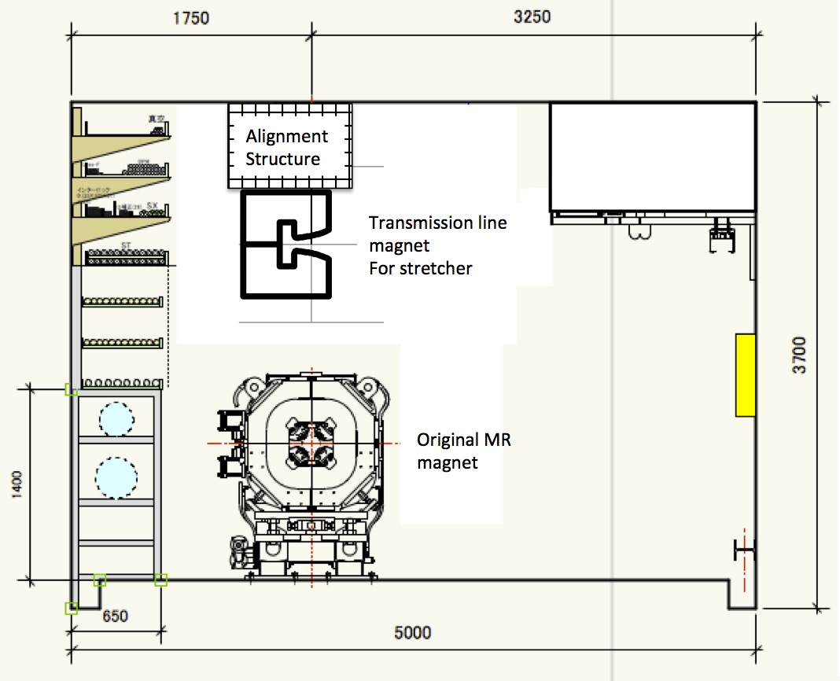
Transmission Line Magnet
J-PARC
Upgrade Proposals
Various proposals for future Intensity Frontier Experiments
  All need low field but very efficient magnet
  Superferic magnet based on Transmission Line Technologies
  R&D just started.
30 GeV MR for Fast Extraction
3 GeV RCS
Neutrino
Facility
Hadron
Facility
30 GeV Stretcher
for Slow Extraction
8 GeV Booster
for Beam Power
Proton Driver in
KEKB tunnel
Stretcher Magnet in J-PARC MR

Slide 19
Summary
High Field Magnet
  Nb3Sn development:
    Funded by CERN on going
    Two companies: Furukawa, JASTEC/Kobelco
    Collaboration with Tokai Univ. and Tohoku Univ.
  HTS very High Field Magnet R&D (proposal)
    Proposal Submitted to JSPS
    Tohoku Univ. etc
  High Radiation Resistant Magnet
    Funded by JSPS on going
    HTS mineral insulation etc.
  High Efficiency Magnet
    HTS medium field magnet
      Funded by JST till 2018, Kyoto Univ., Toshiba etc
    Transmission Line Magnet
      Proposal Submitted to JSPS

