Slide 1
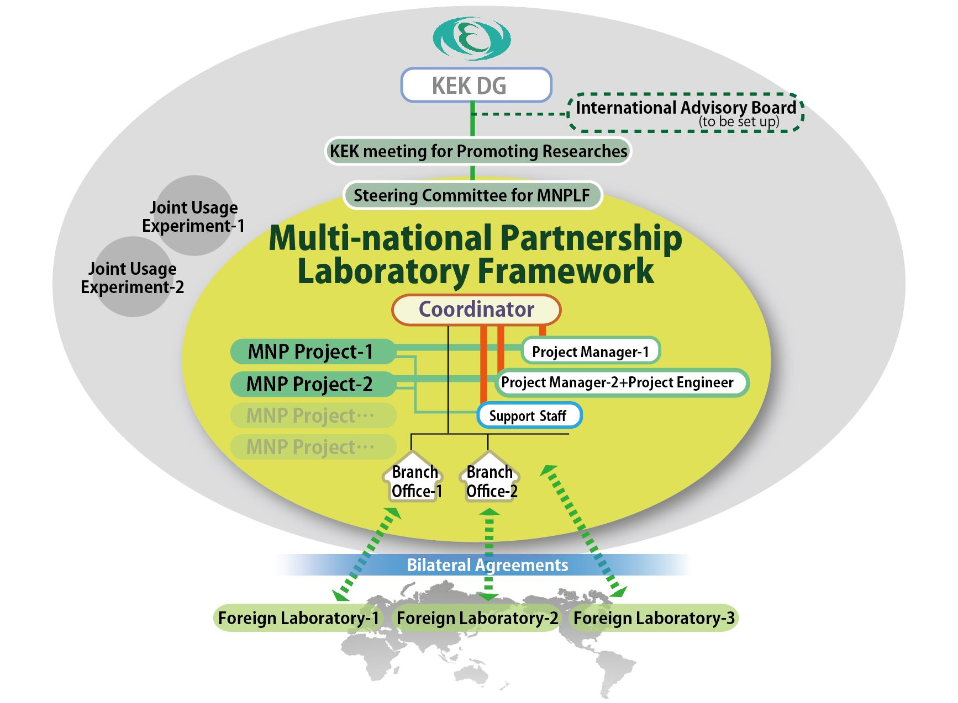
Activity of Multi-National Partnership Laboratory (MNPL)
at KEK and its Approved Project (MNPP)
Research Administration Department
International Cooperation Office
Multi-national Partnership Laboratory Coordinator
Junji Urakawa

Slide 2
Ingredients of MNPL (Multi-National Partnership Laboratory):
Steering Committee for MNPLF
Select MNP - projects (MNPP) and “MNPL Associate - Staff”
Composed of KEK directors of lab. and facility representatives.
International Advisory Board (to be set up)
Gives advice to KEK-DG.
Coordinator
Coordinates MNP-Projects
Serves as a member of the Steering Committee.
Project Managers (and Project Engineers)
Each project has its own Project Manager (and Project Engineer).
Associate Staff
Participating researchers who stay at KEK may be given a status similar to KEK staff.
Support Staff
Give various supports to researchers to facilitate their research at KEK.
Branch Office
Formed by bilateral agreements between KEK and corresponding Institute.

Slide 3
Examples of MNPP’s:
Necessary condition; KEK staff as Project Manager, Infrastructure for R&D at
KEK, Contribution to KEK Research or future project
R&D project for high electric field acceleration technology (using ATF +
X-band Test Facility---)
2) Advanced R&D on 1.3 GHz superconducting acceleration cavity technology
(using STF +COI Facility---, High-Q and High Gradient acceleration R&D)
3) R&D project using advanced superconducting magnet (using KEK
Infrastructure , for HL-LHC, FCC + ---)
4) Construction of distributed computing infrastructure in the multinational
participating open framework (using KEK computer system)
5) T2K-related project (not covered by experimental collaboration), Neutron
beam line in J-Parc, Operation of Super-KEKB and some more ideas are welcome.
The project related “Operation of Super-KEKB” was approved as the project
on “R&D for high luminosity colliders (MNPP-01)” last September.

Slide 4
Approved Project (MNPP-01) by KEK DG
,which is described the Annex-1 of bilateral MoU , Appendix under umbrella MoU or
simple agreement.
Title: R&D for high luminosity colliders (MNPP-01)
“Project Manager”； Makoto Tobiyama
Following 4 R&D tasks are set-up to realize the performance.
Development of IP feedback systems, Development of advanced bunch feedback systems
Minimization of gap transients, Beam commissioning of the SuperKEKB accelerators
SLAC, INFN-LNF, Jefferson Lab, California Polytechnic State University, CERN, LAL
By March 2021
Many bilateral MoU’s are necessary to proceed this project, which takes time after the
approval.
Candidate for next Project (MNPP-02)
Title: Revolutionary high-efficiency superconducting magnet R&D toward the high-intensity
accelerator frontier using advanced superconducting technologies (MNPP-02)
“Project Manager”； Toru Ogitsu
This project will be approved if the project manager will submit again without strong
connection to fix the future of present research program.

Slide 5
Concept of Multi-National Partnership Laboratory (MNPL)
Institution-based Partnership of World Accelerator Laboratories
Categories of KEK experiments
Joint Usage Experiments
Invite application for experiments using KEK facilities.
Form collaboration.
Apply proposal.
Judge by Program Advisory Committee (PAC).
KEK user registration
International Joint Research (New MNPP has to make many bilateral MoU’s with the
explanation on the project)
KEK takes initiatives to form international joint research programs using KEK facilities
or improving/creating facilities.
Based on agreements (MoU) between KEK and participating Institutes (bilateral MoU or
Appendix or simple agreement)
Call it “MNP-Project”
Purpose of MNPL:
Offers a framework to coordinate the MNP-Projects and to support the participating
researchers from abroad.
Integrate the bilateral cooperation to form a unified framework for partnership.

Slide 6

31 Aug. 2016
Multi-National Partnership Laboratory (MNPL)
International Advisory Board
(to be set up)
KEK DG
Joint Usage Experiment-1 like Belle-2
MNPL
Steering Committee for Multi-national
Partnership Laboratory Framework
Coordinator
Joint Usage Experiment-2 like T2K
MNP Project-1
Project Manager-1
MNP Project-2
Project Manager-2
+Project Engineer
Support Staff
Branch Office-1
Branch Office-2
Bilateral Agreements
Foreign Laboratory-1
Foreign Laboratory-3
Foreign Laboratory-2

Slide 7
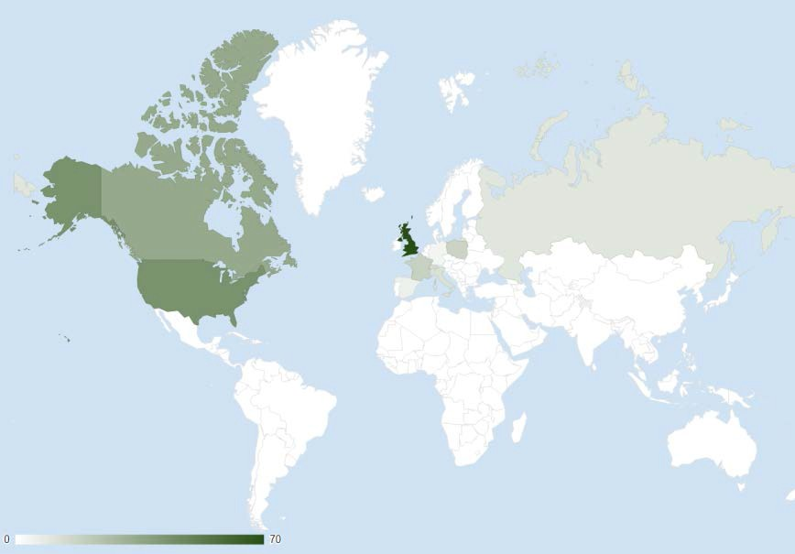
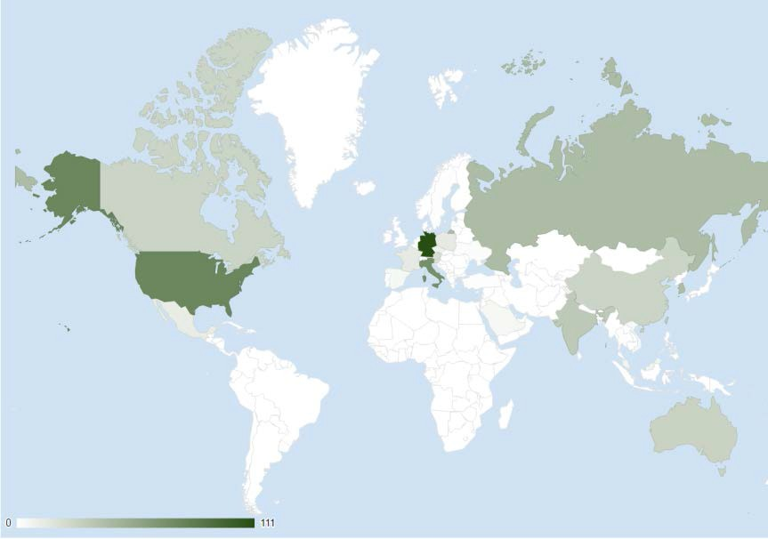
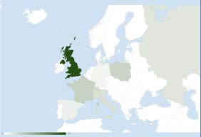
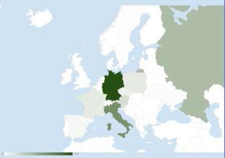

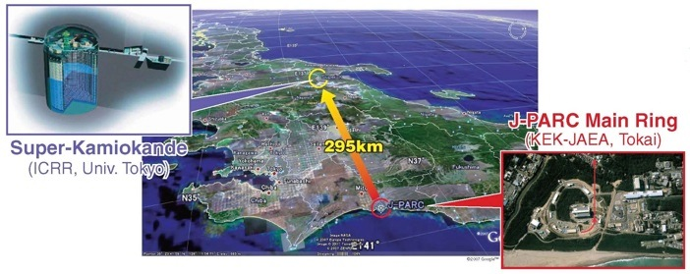
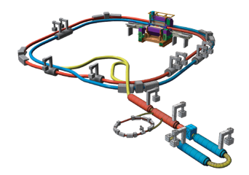



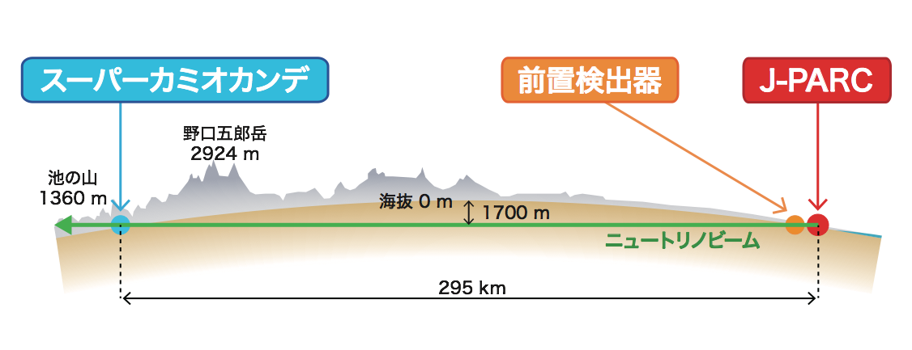
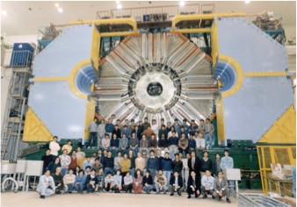
International Research Projects (Joint Usage Experiments)
T2K Experiment @J-PARC (Neutrino),Tokai
SuperKEKB project @KEK, Tsukuba
Canada, 38
Russia, 10
Canada,27
Russia 42
USA, 43
USA,76
メキシコ,12
トルコ,1
イスラエル,2
China,27
S.Korea,42
メキシコ,12
サウジアラビア,5
India, 38
タイ,1
Taiwan,32 ベトナム,4
マレーシア,7
England, 70
Poland, 17
Germany
4
France 18 Swiss 14
Spain 6 Italy 12
Germany
111
フランス,13
ポーランド,13
チェコ,9 ウクライナ,2 オーストリア,21
Australia,28
スペイン,5
スイス,1
Italy, 70
300 scientists
from 12 countries
more than 700 scientists from 23 countries

Slide 9
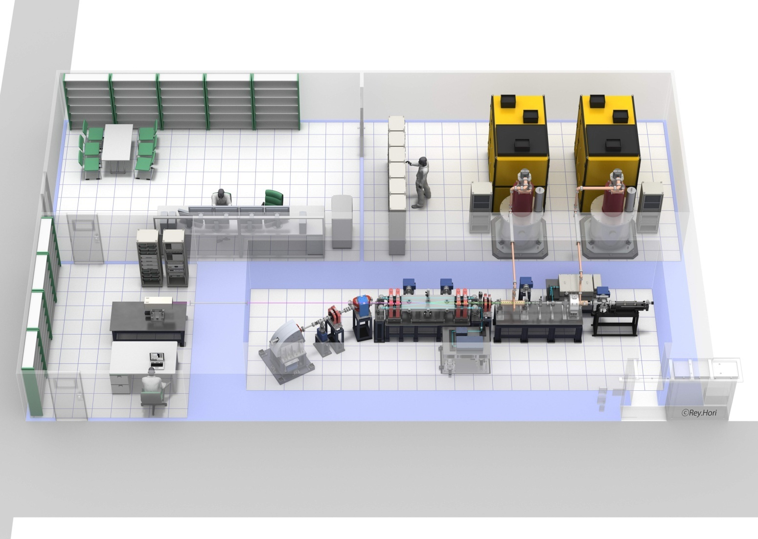
To get clear X-ray imaging every second, we have to increase
the X-ray flux by factor 300 ~ 600 based on present technology.
High brightness X-ray facility based on LCS
Normal conducting accelerator system for compact high
brightness X-ray under design
Thank you for your attention!
Downsizing
to 6m x 8m
by new
technologies
～８ｍ
～１２ｍ

