Slide 1


PSB RF bypasses
On behalf of:
J. Bento - Taking over the responsibility of the RF-bypasses
F. Chapuis - In charge of the RF-bypasses since 2000
J. Hansen – Design of the bypasses in the injection line
B. Riffaud – Design of the bypasses in the injection line
L. Zuccalli – Design of the bypasses in the injection line

Slide 2
PSB RF bypasses
Executive summary:
For the new injection line, 24 new collars including 76 new rf-bridges are presently being produced. It will then require 20 man-days on the rf side for preparation work + installation + tests
For the PSB ring excluding the injection region, the existing 128 existing PSB isolated vacuum collars just need the reception of 500 little ceramic boards in order to be changed to cope with an expected 2.5 E13 ppp beam
This change still implies around 50 man-days on the rf side + unknown effort on the vacuum side
The maximum intensity is now specified at 1.6 E13 instead of 2.5 E13 after LS2. So in order to avoid a useless effort, a test needs to be carried out to check if the present bypasses could handle 1.6 E13 ppp without a change

Slide 3
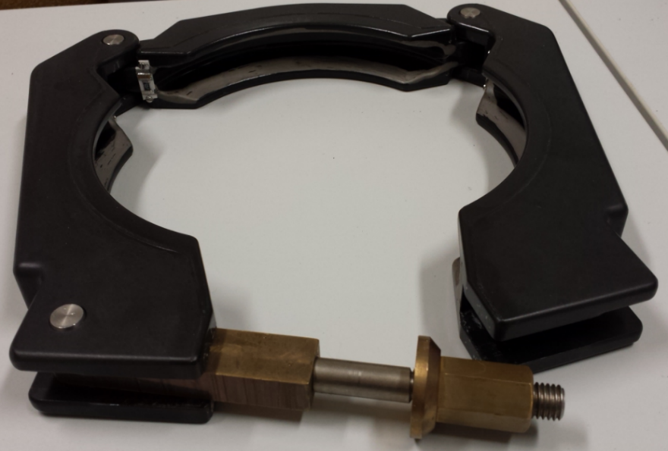
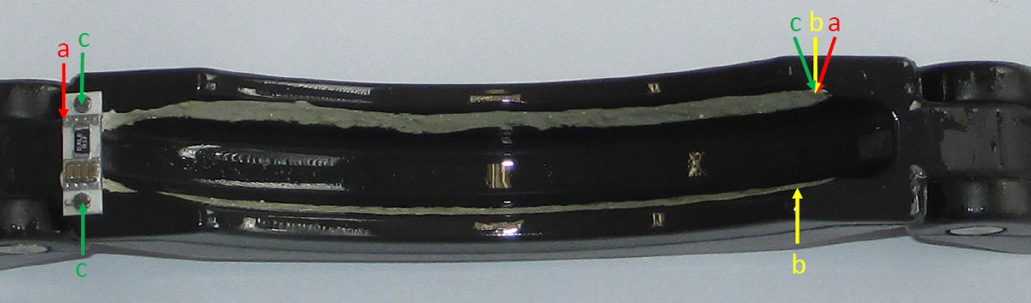
PSB RF bypasses
128 special vacuum collars installed downstream the bendings
100 spares without metallic paint and R-C circuit (handled by TE-VSC and P. Demarest)
500 new ceramic circuits to be ordered
3 times
0.5Ω in series with
4 x 100nF //
=> 384 circuits

Slide 4
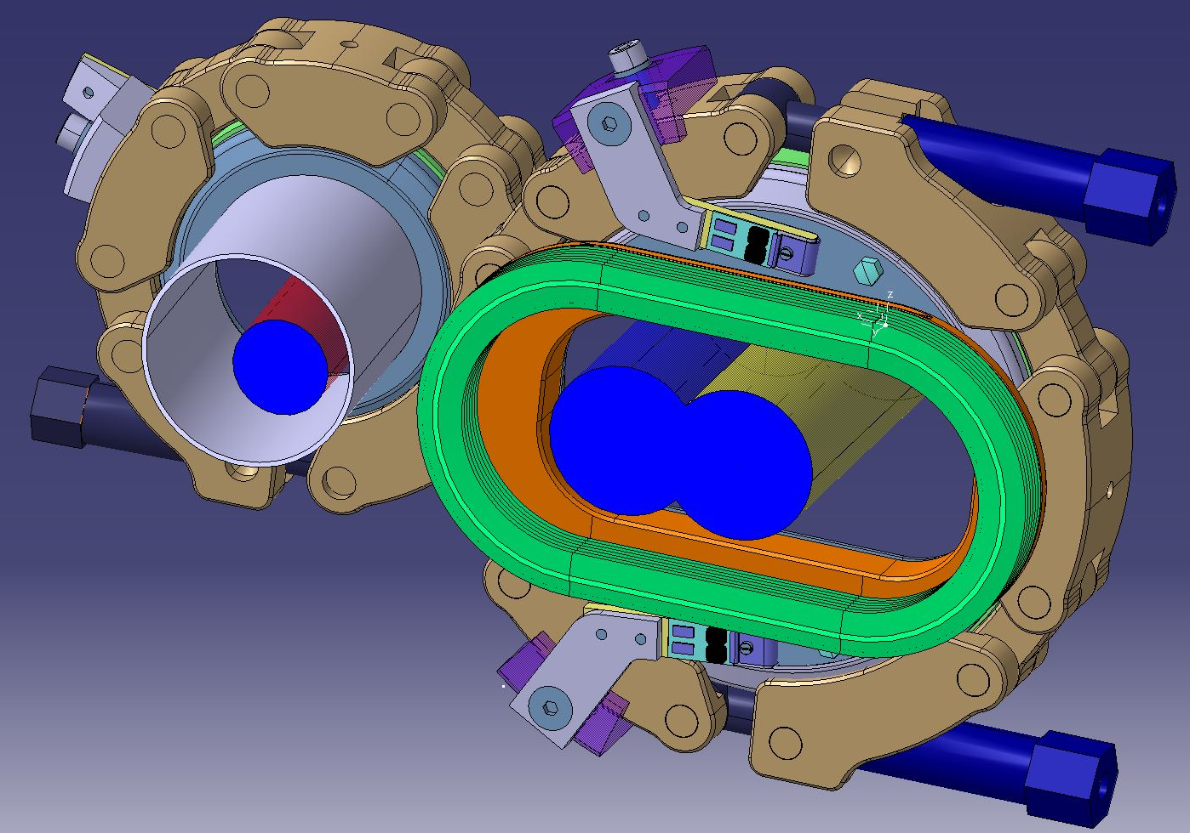
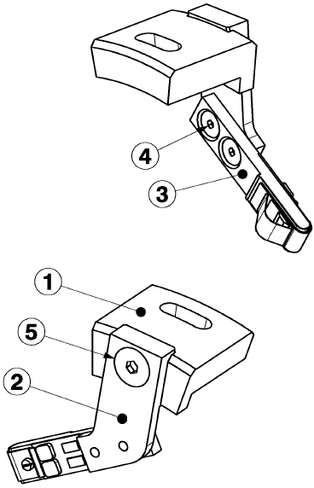
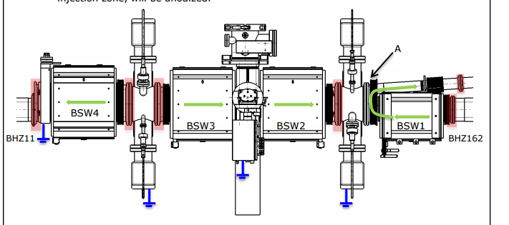
PSB RF bypasses
In the injection region:
24 new special vacuum collars
including 76 special rf bridges
Production launched
Courtesy L. Zuccalli

Slide 5
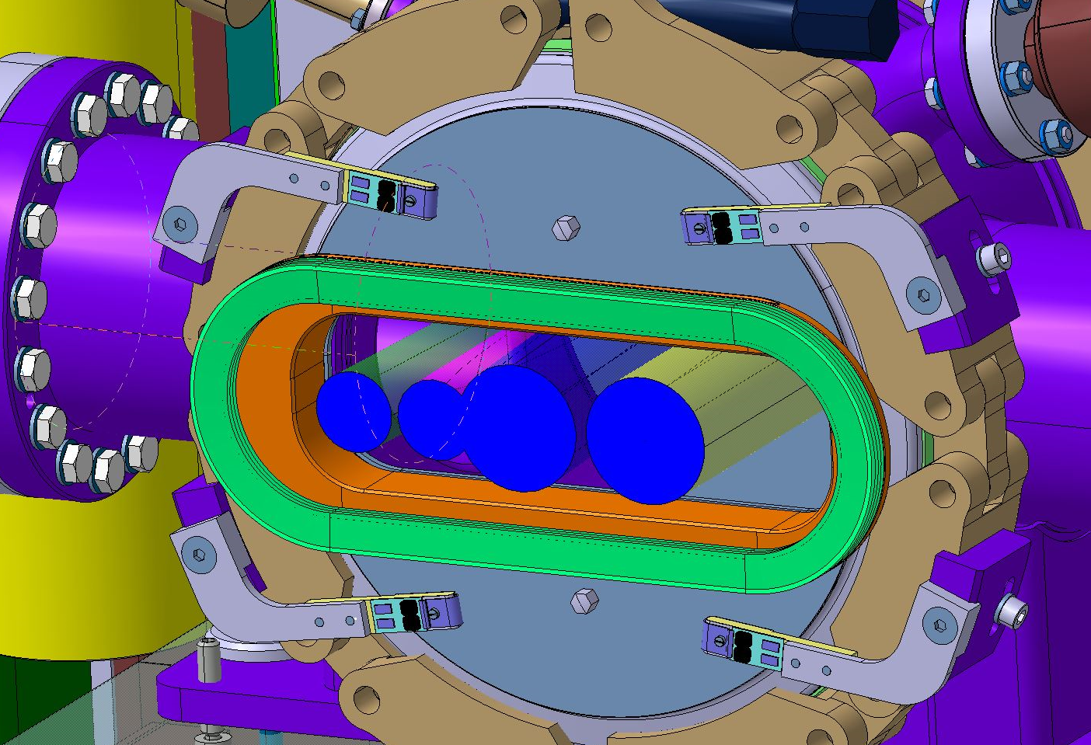
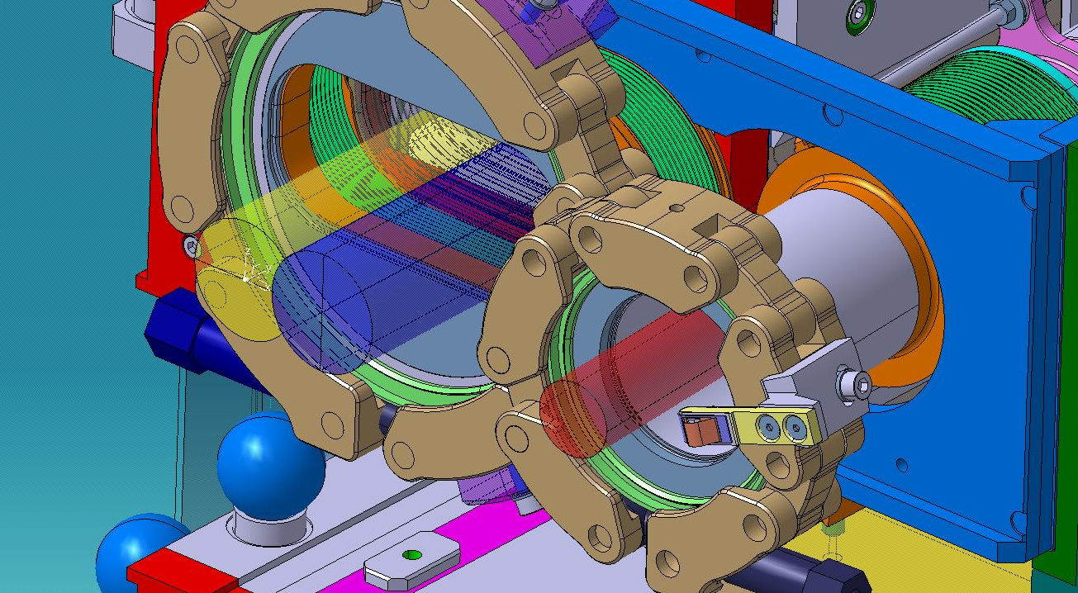
PSB RF bypasses
In the injection region:
24 new special vacuum collars
including 76 special rf bridges
Production launched
Delivery: Jan 2017

Slide 6
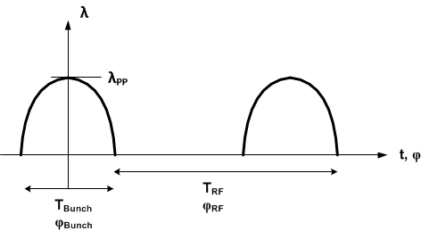
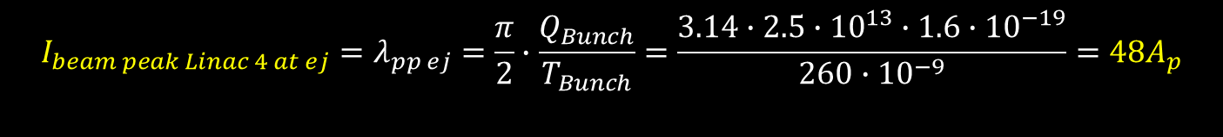
PSB RF bypasses
The rf bypasses have to deal with:
I_{beam} = 48 A_{p} with 2.5 E13 ppp
I_{beam} = 31 A_{P} with 1.6 E13 ppp
The Max peak beam intensity will be considered with
2.5E13 ppb and 130 ns bunch length
$${I_{beam peak Linac 4 at ej}=λ}_{pp ej}=\frac{π}{2}∙\frac{Q_{Bunch}}{T_{Bunch}}=\frac{3.14∙2.5∙{10}^{13}∙1.6∙{10}^{−19}}{260∙{10}^{−9}}=48A_{p}$$

Slide 7
PSB RF bypasses
For the resistor, we need:
0.5 Ω resistor – as presently
0.5 W in continuous mode – 1W presently mounted
1150 W in pulsed mode (48A_{p} and 24 V_{p} ) – unknown specification for the present resistors
Dimensions compatible with present setup

Slide 8
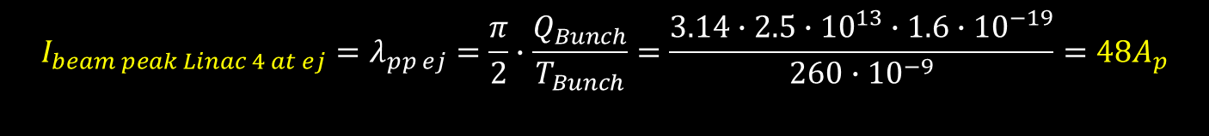
PSB RF bypasses
The present resistors - 0.5Ω /1 W – are (were) supposed to stand at least 1.4 A (for 1W) < 48 A
No detailed specifications found for peak surges… but at least they did cope with the present centered beam => 4.6 A with 1E13 ppp and 180 ns bunch length
$${I_{beam peak Linac 4 at ej}=λ}_{pp ej}=\frac{π}{2}∙\frac{Q_{Bunch}}{T_{Bunch}}=\frac{3.14∙2.5∙{10}^{13}∙1.6∙{10}^{−19}}{260∙{10}^{−9}}=48A_{p}$$

Slide 9
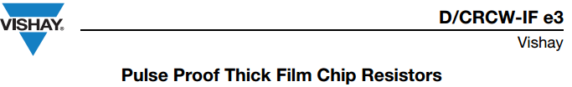
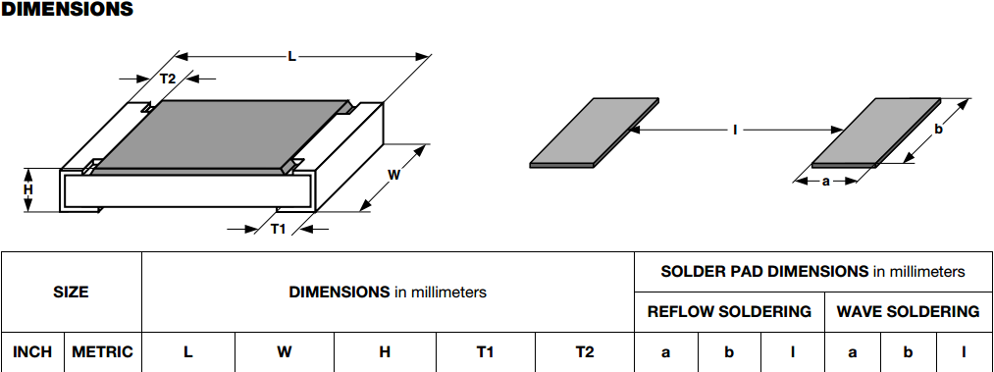
PSB RF bypasses
Some resistors are specified for pulsed power.
Here below is the resistor that has been selected
The length of this resistor (3.2x2.5x0.45mm) is half of the one used at present (6.5x3.2x0.42 mm)… so is the power (0.5 W instead of 1W)
www.vishay.com/docs/20024/dcrcife3.pdf

Slide 10
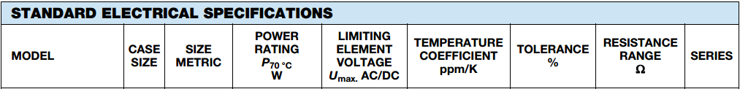
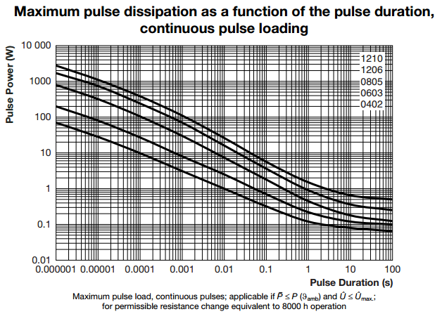
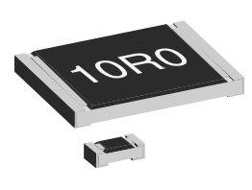
PSB RF bypasses
www.vishay.com/docs/20024/dcrcife3.pdf
This resistor can stand 3000 W during 1 us
(1150 W required during 130 ns)
It can stand 0.5 W CW – as required – but still we will install 2 in //

Slide 11
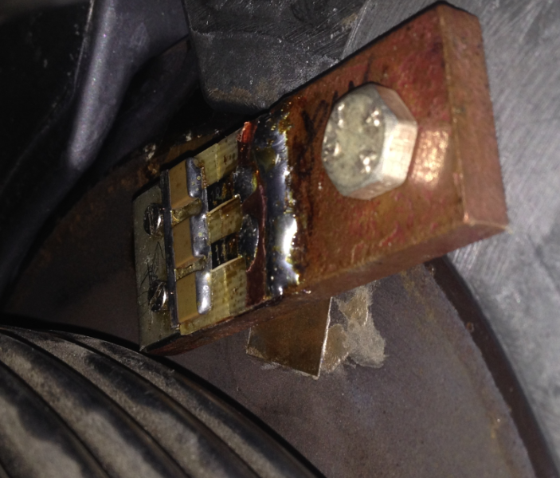
PSB RF bypasses
Successful test ( J. Bento) in the PS with a peak current of 100 A
(48 A needed in the PSB with 2.5E13, 31 A with 1.6 E13)

Slide 12
PSB RF bypasses
Summary:
The design of RF-bypasses (L. Zuccalli) in the new injection line has been completed and the production has started (delivery in Jan 2017). There is still 20 man-days to be invested for the installation and test on the rf side.
New resistors for the PSB rf-bypasses have be tested with success in the PS ( J. BENTO) with 100 A (48 A or 31A required)
50 man-days + ordering of 500 ceramic boards is required for the PSB upgrade (excluding the injection line) on RF side only – vacuum not included .
A test on the present bypasses' resistors should show if the latter change is required assuming a lower beam intensity (1.6 E13 instead of 2.5 E13) – New bypass to be installed in the PS during the following 2016-17 EYETS

Slide 13
PSB RF bypasses
References:
Past measurements made by F. Chapuis
\\cern.ch\dfs\Users\c\chapuisf\Public\
Preparation manual for the 128 collars by F. Chapuis
https://edms.cern.ch/ui/#!master/navigator/document?D:1385242604:1385242604:subDocs
Mechanical project for the injection line by L. Zuccalli,
Accessible using: Smarteamv -> project ST0731260

Slide 14
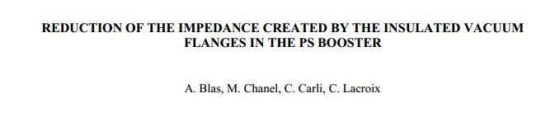

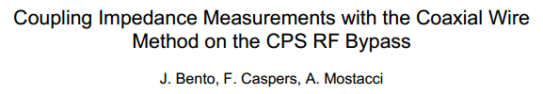
PSB RF bypasses
http://cds.cern.ch/record/447073/files/ps-2000-025.pdf
http://cds.cern.ch/record/960437/files/cer-002626722.pdf
http://indico.cern.ch/getFile.py/access?contribId=0&resId=1&materialId=slides&confId=59490

