Slide 1
TECHNICAL CHALLENGES OF ACCELERATOR COMPONENTS
FOR MECHANICAL DESIGN
Tommi Mikkola on behalf of CERN EN/MME

Slide 2
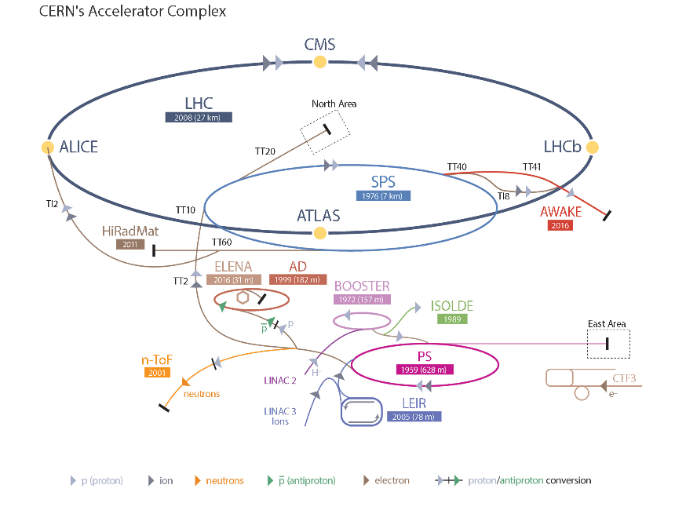

Slide 3
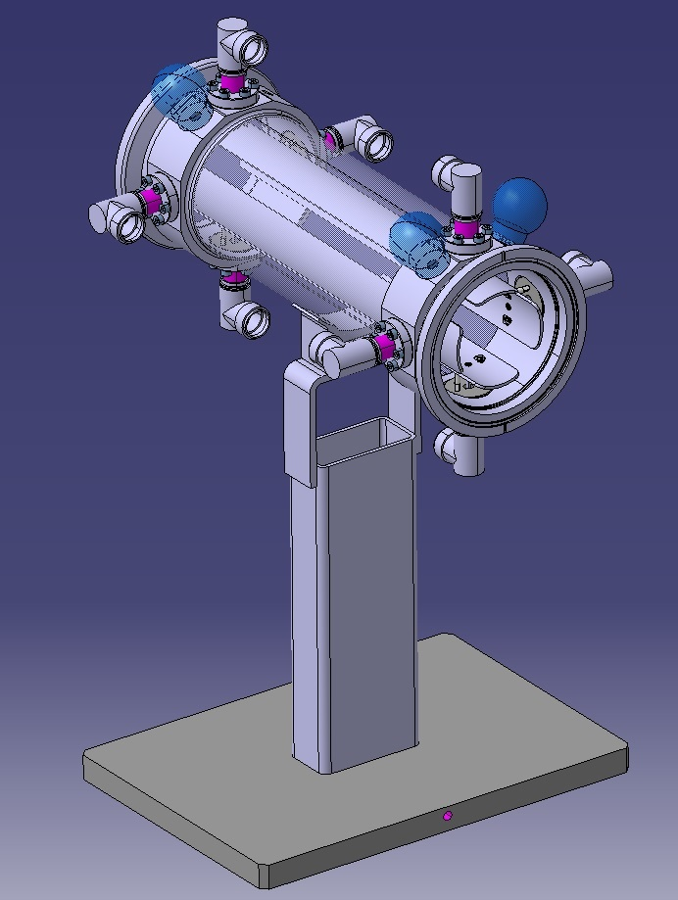
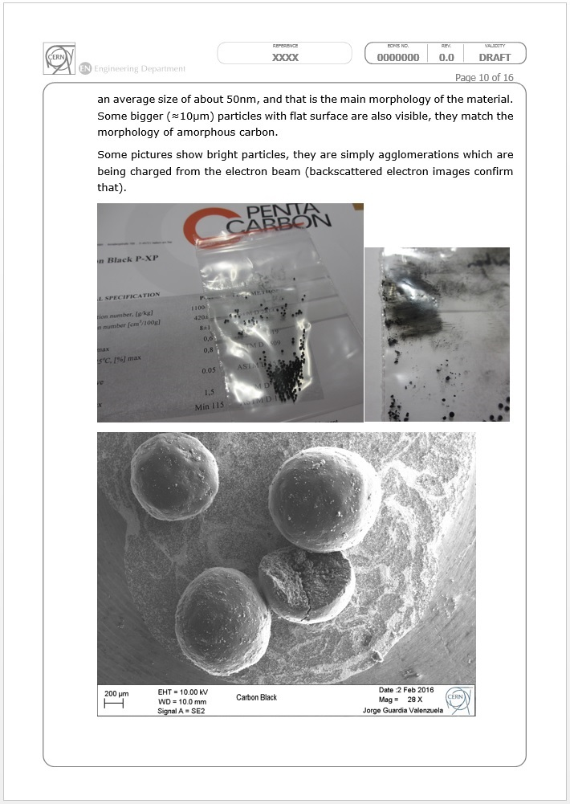
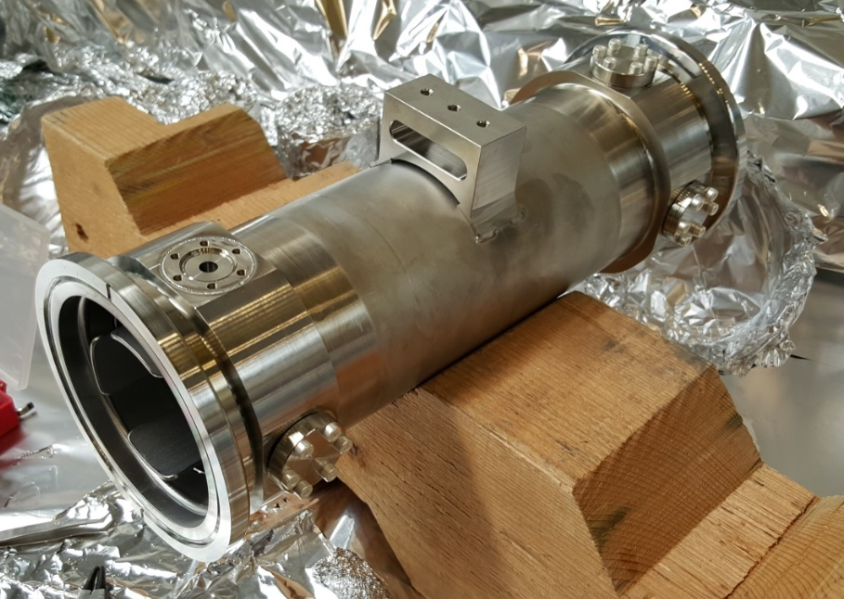
CERN EN-MME
“The mandate of the MME group is to provide to the CERN community specific engineering solutions combining mechanical design, fabrication and material sciences.”

Slide 4
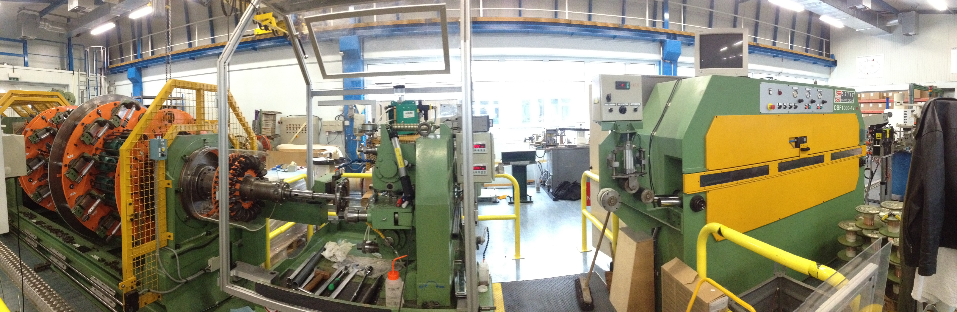
ANALYSIS
MACHINE TO WIND SUPERCONDUCTING WIRES INTO CABLES
PROCESS CAUSES HIGH DEFORMATIONS TO WIRES LEADING TO
DECREASED ELECTRICAL PERFORMANCE
FEA MODEL CREATED TO IMPROVE THE PROCESS

Slide 5
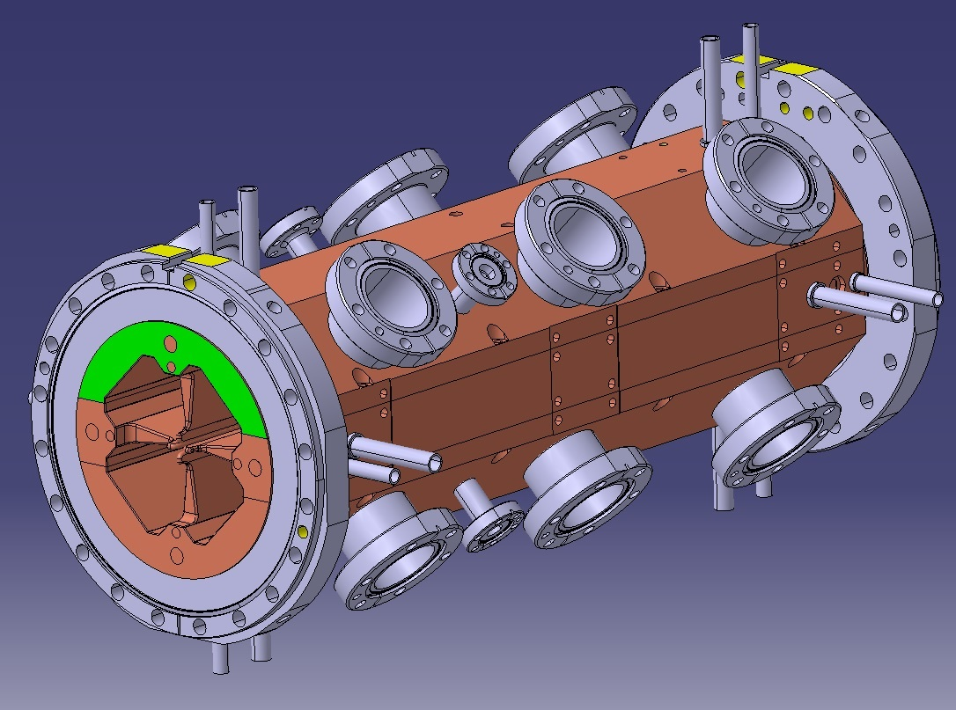
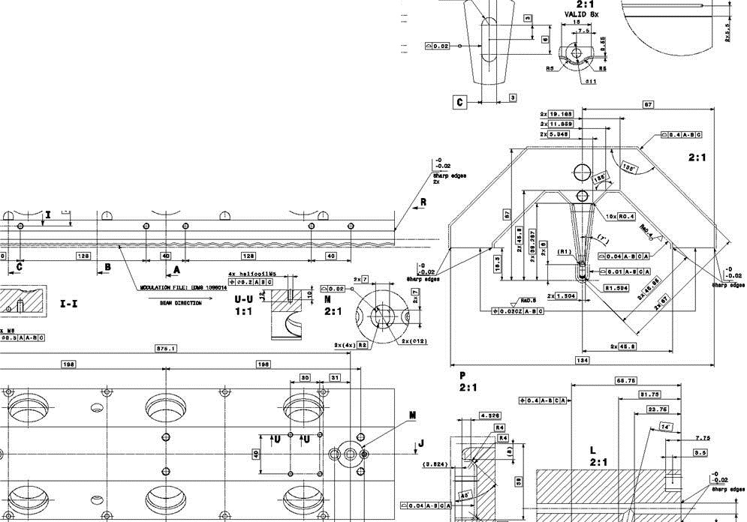
COMPLEX GEOMETRIES
CREATE THE GEOMETRY IN 3D
DEFINE TOLERANCING FOR 2D
CHALLENGING MANUFACTURING
STATE-OF-ART MEASURING
ADJUSTMENT OF GEOMETRY

Slide 6
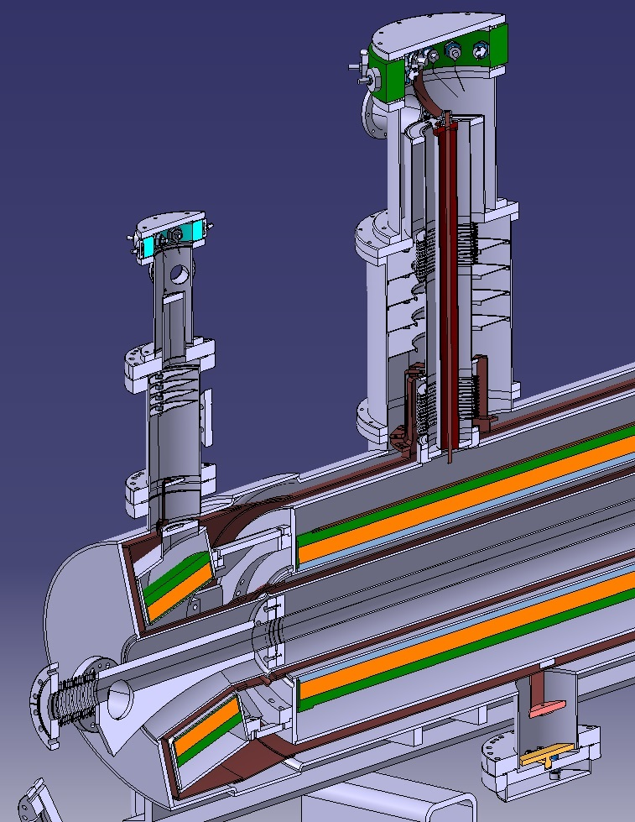
SUPERCONDUCTING MAGNETS
COMBINES THREE TECHNOLOGIES:
  SUPERCONDUCTIVITY
  CRYOGENICS
  VACUUM
HEAT LOAD – 1 W inside = 1000 W outside
STORED ENERGY
  Beam = High speed train
  Magnets = Air craft carrier @ 20 km/h
THERMAL CONTRACTION/
EXPANSION
  ΔT 250ºC => ~ 4 mm expansion in stainless steel 316LN
MAGNETIC FORCES BETWEEN COILS

Slide 7
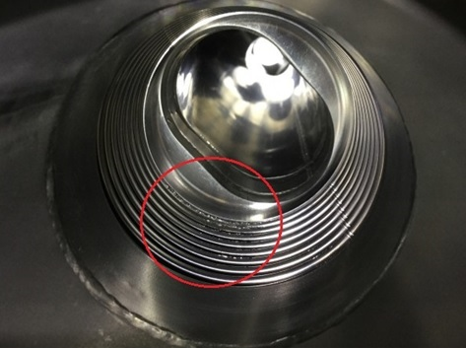
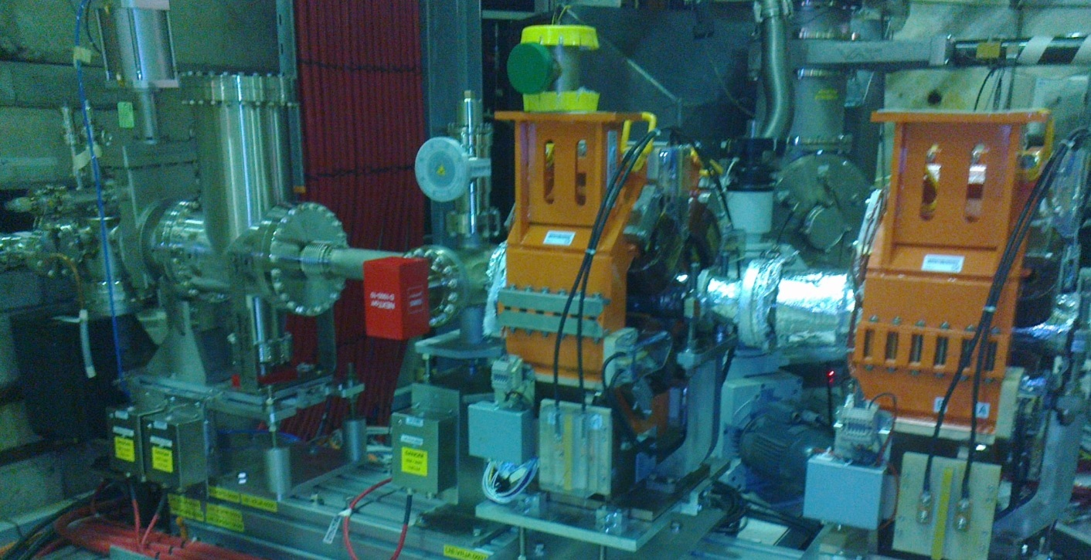
VACUUM
UHV UP TO 10⁻¹⁰ mbar ~ MOON PRESSURE
OUTGASSING & RESIDUAL GAS & LEAKAGES
  MATERIAL SELECTION
  RAW MATERIAL PRECONDITIONING
  AVOID TRAPPED VOLUMES
  JOINT DESIGN & QUALITY
  CLEANING & VACUUM FIRING
  NEG COATING
  CRYOGENIC PUMPING
Courtesy of Antonios Sapountzis CERN TE/VSC

Slide 8
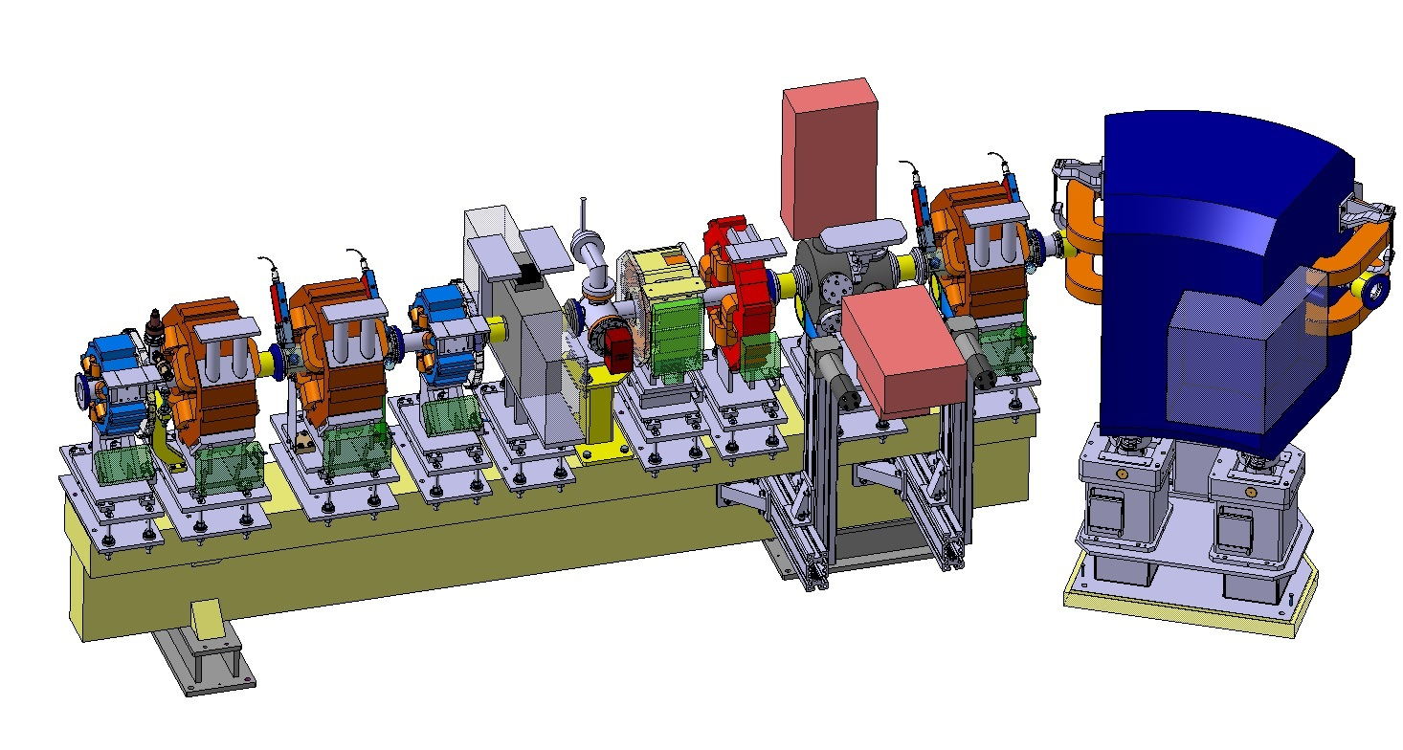
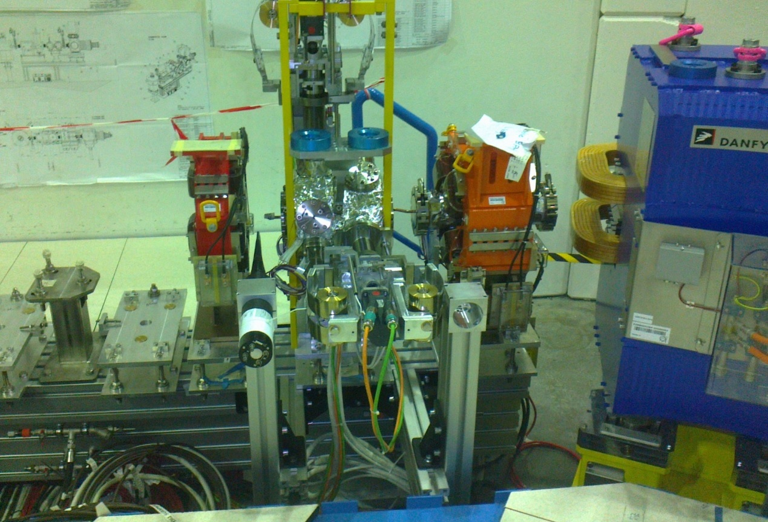
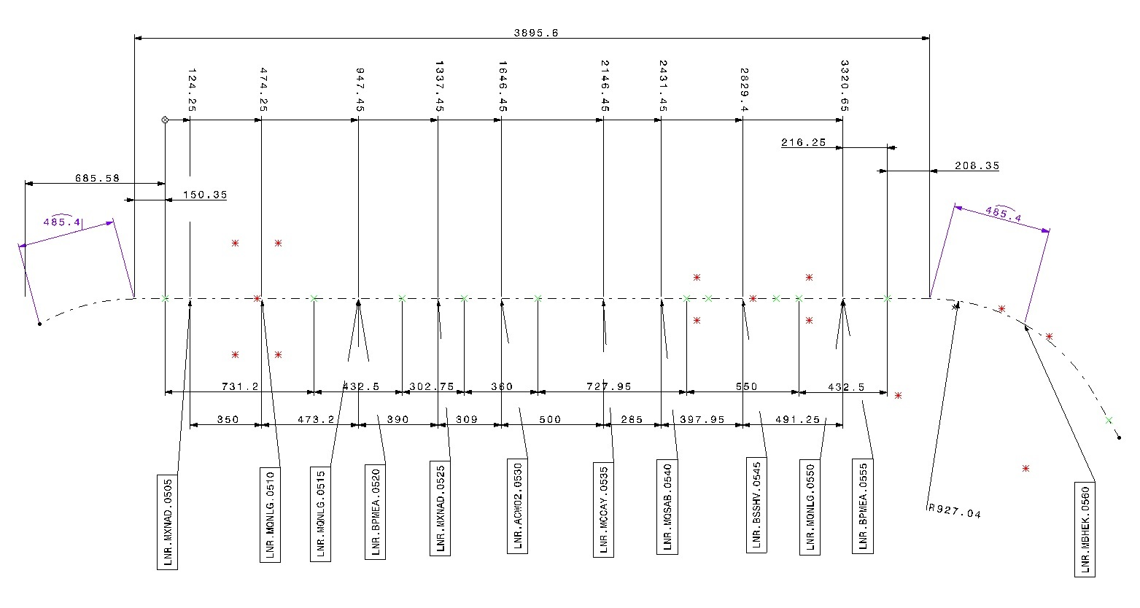
INTEGRATION
LAY-OUT → DETAILED DESIGN → INSTALLED ACCELERATOR

Slide 9
? / !
QUESTIONS / THANK YOU FOR YOUR ATTENTION

