Slide 1




Studies on the beam induced effects in the FCC-hh
Ignasi Bellafont
WP4 Meeting 05
November 07th 2016

Slide 2
OUTLINE
1. Previous status
2. Expanded thesis proposal
3. High power density issue in the beam screen - Absorber design
4. Low pumping speed issue - Beam screen optimization
5. Roughness role in the reflector design
6. Heat load on the cold bore
7. Pumping speed improvement
8. Reflectivity and PSD future studies
9. Conclusions, next steps

Slide 3
LAST MEETING STATUS
The 6 months training of the resource allocated at CERN was already completed, according to the foreseen plan
ANKA setup synchrotron radiation power distribution, slits aperture, and pressure level were studied and found, including its variants, in a preliminary way. No major issues were found, and the pressure levels it will achieve were found to be adequate for the experiments
The power and flux distribution and the vacuum status of the FCC-hh bending magnets were studied, and the first simulations were performed. Some major issues were identified, as some high power density areas and a low pumping speed, meaning a high scrubbing time of operation until being able to achieve the necessary molecular density levels

Slide 4
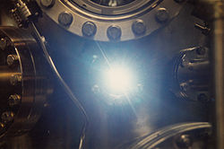
THESIS PLAN DETAILED PROPOSAL
After the received training, the project necessities were better identified and therefore the working plan and necessary studies were further detailed:
  FCC-hh cryogenic vacuum system - The pressure contribution of the beam induced effects will be studied, resulting in one total equivalent molecular density inside the BS for different system conditions of the FCC-hh
Beam induced vacuum effects
Photon stimulated desorption
Electron cloud
Ion induced desorption
Photon-stimulated desorption + Ion induced desorption
+ Electron induced desorption + Thermal outgassing
Total Pressure (P) =

Slide 5
THESIS PLAN DETAILED PROPOSAL
  A final viability report regarding the vacuum status due to the beam induced effects, for the steady state status, will be then written, mainly focusing in the PSD effect
  ANKA prototype - The pressure evolution and the photon flux distribution will be analyzed for different prototype configurations and design options. These simulated results will be thus compared with the experimental ones, allowing their correctness a higher confidence with the simulations of the FCC-hh vacuum system
  General suggestions for the future work, mitigating measures for the identified issues and a comparison with the LHC cryogenic vacuum system will be included in the final report

Slide 6
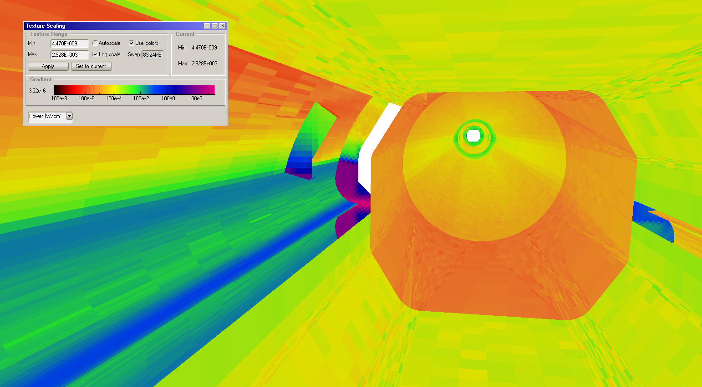
RADIATION ABSORBER
Due to the secondary chamber design and angle between dipoles, there is one region at the end of the beam screen where the radiation could reach power densities higher than 3kW/cm², due to the forward reflection and direct radiation impact (for ideal beam). This could raise too much the temperatures and generate an excessive thermal stress
To deal with this high density, an absorber has been designed. Focusing the SR on this absorber would also improve the cooling efficiency and would lower the PSD
W/cm²
Another spot of 40W at the end
61 W SR power
Power distribution at the end of the FCC-hh beam screen
Beam direction
Affected area
FCC-hh DIPOLE
FCC-hh DIPOLE

Slide 7
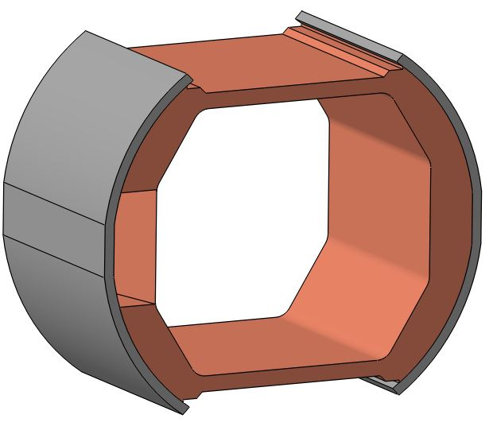
RADIATION ABSORBER
SS covers
Cu main absorber
This 22mm long Cu/Glidcop absorber, would be placed out of the cryogenic region, at the beginning of the bending magnets interconnection
Its design and final position is still tentative, the final geometry of the interconnection still has to be defined
It can be symmetrical to avoid reverse mounting errors
Slope
Main idea proposed by C. Garion

Slide 8
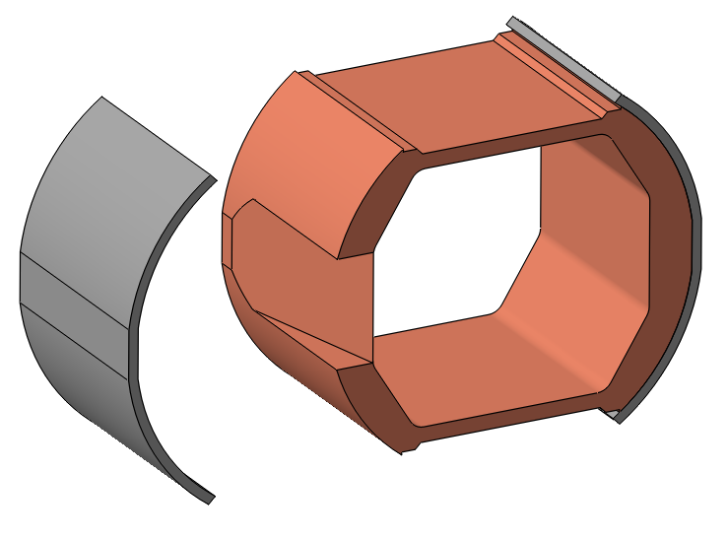
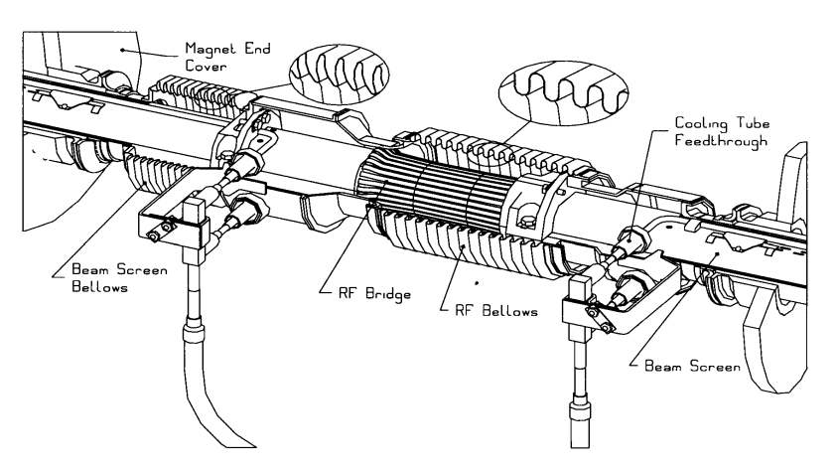
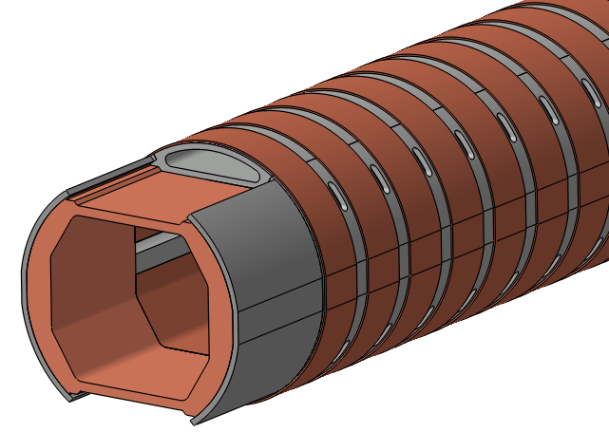
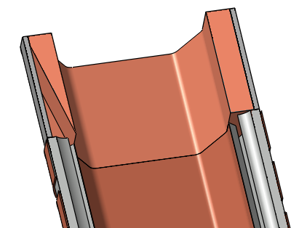
RADIATION ABSORBER
S. steel, welded to the BS and brazed to the Cu
Possible absorber location
22mm long, 12.8º slope
Beam direction

Slide 9

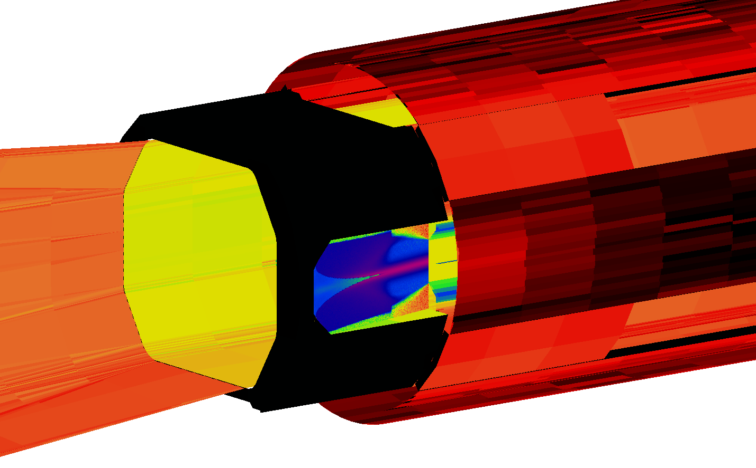

RADIATION ABSORBER
W/cm²
For an ideal beam, this end absorber can reduce the maximum power density more than 4 times on the slope area, reducing the possibility to have a thermomechanical failure
61 W (12.6% T P)
800W/cm² max
$$K\left(T\right)=\frac{T_{c}}{T_{H−}T_{C}}$$
Beam direction
Redirecting as much SR as possible to the absorber, not only the cooling efficiency improves, the total outgassing is also decreased. It can be done changing the reflector’s shape or reducing its roughness
Carnot efficiency of refrigerators

Slide 10
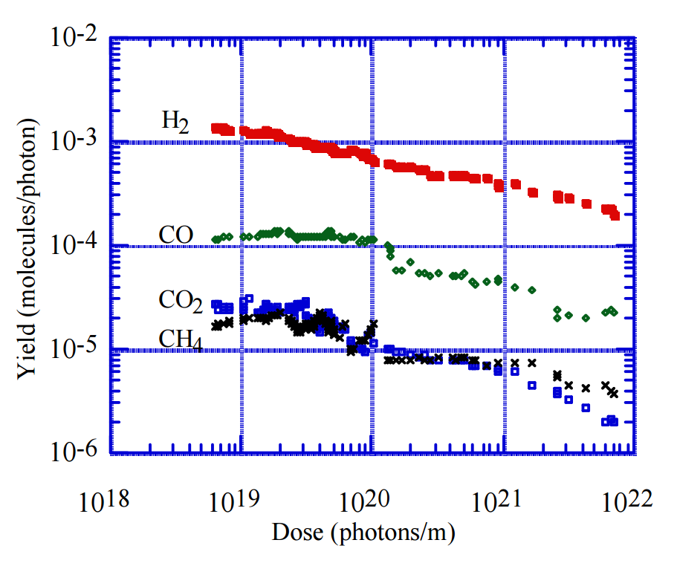
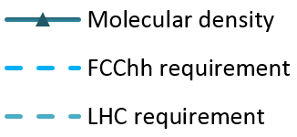

LOW PUMPING SPEED ISSUE
Molecular desorption yield tendency example
$$\text{MD}\text{ (}\text{H}\text{2}\text{/}\text{m}\text{3}\text{) }\text{≈}\frac{\text{3.}\text{4}\text{∙10}\text{15}}{\sqrt{t(h)}}$$
336h (2 weeks)
1.86∙10¹⁴ H₂/m³
In the last meeting we saw the molecular density coming from the PSD effect was too high, and the time to achieve the pressure requirements would take longer than acceptable
We had then to optimize the system to reduce the molecular density

Slide 11
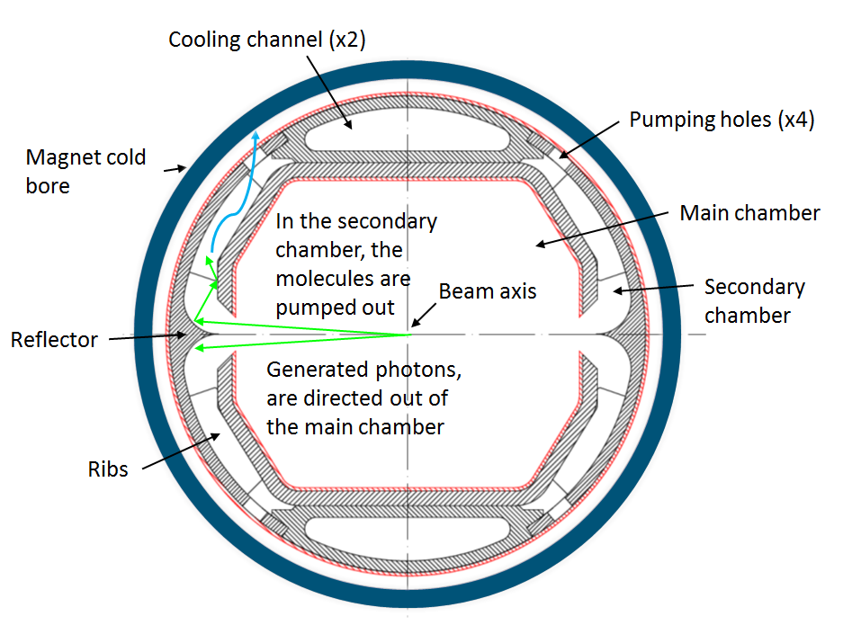
BS PUMPING SPEED OPTIMIZATION
To reduce the total molecular density inside the beam screen coming from the PSD contribution, we can:
  Trigger the PSD effect as far as possible from the main chamber
  Lower the outgassing, by redirecting the radiation to be absorbed in high flux density areas, or using low PSD yield materials
  Increase the conductance of the main chamber to the cold bore, increasing the pumping speed
One of the initial FCC-hh BS cross sections

Slide 12
BS PUMPING SPEED OPTIMIZATION
For now, the most effective and with most potential solution is to increase the pumping speed of the system, easing the pass of the molecules to the cold bore:
  Increasing the size of the slot which divides the primary chamber and the secondary one, where photons are absorbed
  Increasing the size of the pumping holes. This size has a limit, since too much radiation can be leaked towards the cold bore surpassing its limit
One of the initial FCC-hh BS cross sections

Slide 13
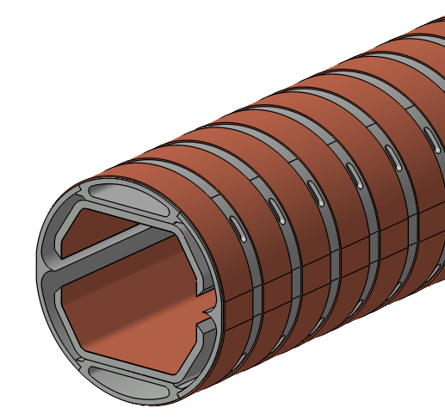
PUMPING HOLES OPTIMIZATION
The bigger they are, the higher the pumping speed, as the molecules have more probability to pass trough them towards the cold bore, were they are pumped.
However, we have three limitations:
  The beam cannot see the pumping holes, they have to be screened, as this could increase the impedance
  We can’t have asymmetry and make bigger the side where we don’t have SR, to reduce the risk of mounting the BS in a wrong way
  The bigger they are, the more radiation is also leaked and reaches the cold bore. So we had to find a maximum thermal radiation budget which will limit the slots shape and aperture
A previous FCC-hh beam screen geometry, with the pumping holes distribution

Slide 14
PUMPING HOLES OPTIMIZATION
LHC cold bore heat load
FCC-hh cold bore heat load
Beam gas scattering, average
0.035 W/m
0.046 W/m
Max conduction, sliding rings
0.0043 W/m
0.049 W/m
Leaked radiation power
< 0.001 W/m
?
Gray body thermal radiation
< 0.0001 W/m
0.0023 W/m
Total heat load
< 0.05 W/m
< 0.1 W/m
The total thermal budget for the 1.9K cold bore is the 0.1W/m/aperture, (given by C. Kotnig, cryogenics team, internal communication)
Due to the electron shield in the LHC and the design of the FCC-hh BS, the thermal load due to the electron cloud in the CB has been neglected
For the leaked radiation, we have around 0.0027 W/m budget left, around 0.038W per dipole and beam

Slide 15
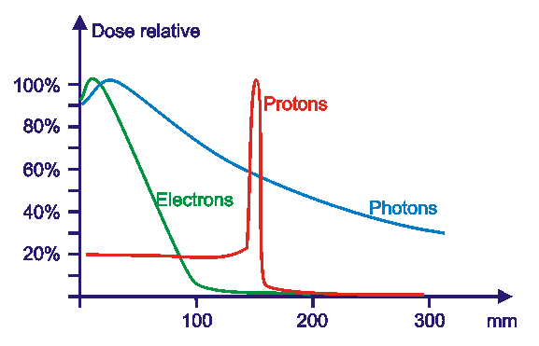

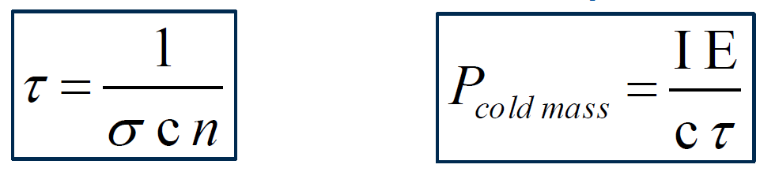
PUMPING HOLES OPTIMIZATION
For a hydrogen equivalent density of 2∙10¹⁴ H₂/m³, the total amount of scattered power is 0.05 W/m, with a beam gas lifetime of 463h
Around the 8% of this power is absorbed in the beam screen, though (M.I Besana, 2015), so the resulting power in the cold bore is 0.046 W/m
Molecular
density
+
+
Scattered protons warm up the cryogenic magnets
Cross-section area,
around 100mbarn for H₂
+
+
+
Beam
energy
+
Proton (charge +)
Gas molecule

Slide 16


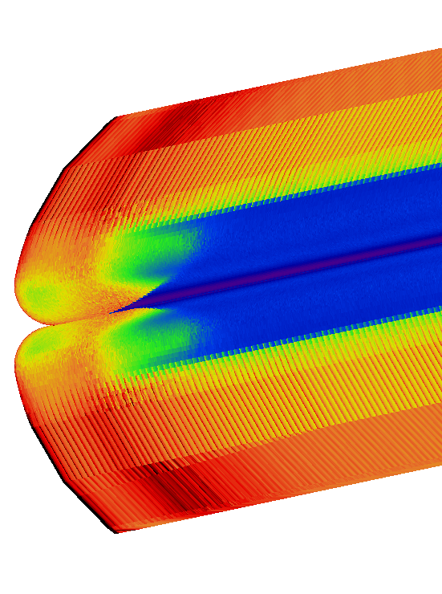
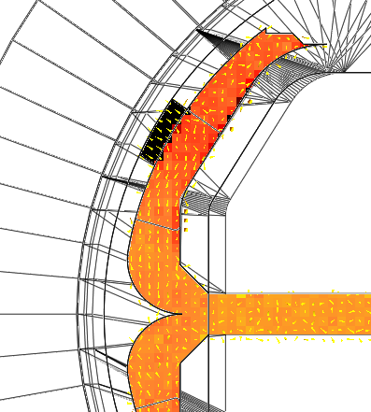
PUMPING HOLES OPTIMIZATION
W/cm²
H₂/m³
M. density order of magnitude
Exponential increase of power density
p+ beam
High radiation density area
Best area to place the pumping holes
We need to reduce the number of Cu rings!
Molecular density, in H₂/m³
Power distribution in the reflector, in W/cm²

Slide 17
PUMPING HOLES OPTIMIZATION
0.038 W budget limit
Limit to the high radiation area, where there is no shadow from the ribs, change of slope
P(W) ≈ 2E-05x³ + 6E-05x² + 0.0011x
10mm
best size
Taking advantage as much as possible of the thermal budget we found, the resulting holes found size has been 10mm, with a changed and optimized copper ring distribution allowing a 23.75mm length
Making the holes axially longer takes advantage of the space more efficiently

Slide 18
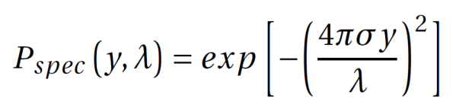
REFLECTOR ROUGHNESS IMPACT
Increasing the roughness in the reflector, makes the radiation to be scattered in a more diffuse way, not being stopped by the ribs and being leaked to the cold bore
With higher reflector roughness, the budget is surpassed! So it should be polished
σ
T
σ/T
Cold bore P
Reflectivity used data - Pure Fe/Cu
Reflector roughness
10nm
3100nm
0.0032
2.38 mW/m
Other areas
200nm
5500nm
0.036
Reflector roughness
200nm
5500nm
0.036
5.31 mW/m
Specular probability of the incident radiation
Other areas
200nm
5500nm
0.036
(2.7mW/m budget)
Higher pumping speed
Less pressure, less heat leaked to the cold bore and reduced operating costs!
Better polished reflector
Lower BS temperature
A recommended manufacturing roughness shall be fixed!

Slide 19
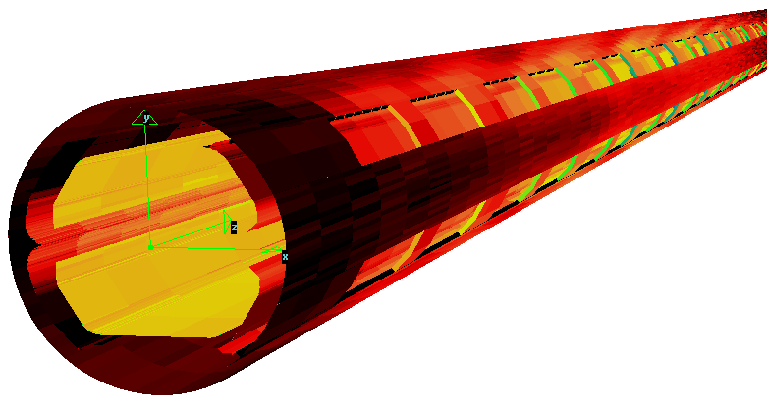
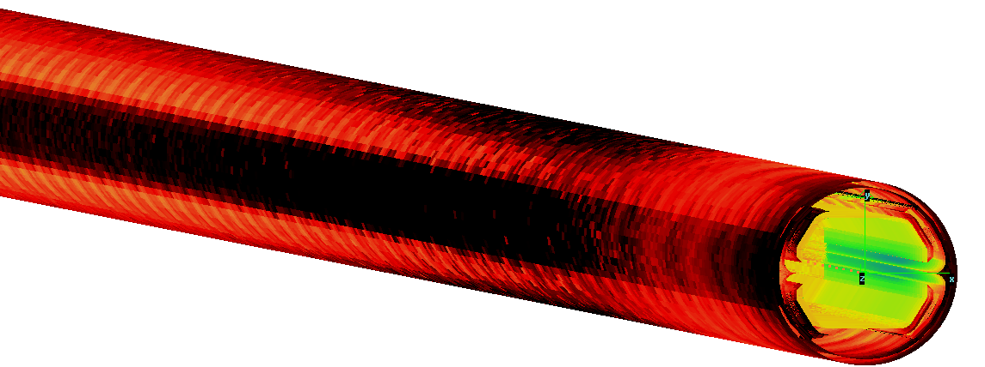
LEAKED RADIATION TO THE CB
BS external surface, with the pumping holes
On the other hand, increasing the roughness of the ribs, could reduce the leaked radiation, decreasing their reflectivity
Cold bore leaked radiation ray tracing - The openings marks of the pumping slots are easily noticeable
2.38 mW/m SR power
The transversal sides of the drilled holes act as a 2nd barrier to the radiation, as it hits them perpendicularly, keeping safer the cold bore
Cold bore internal irradiated surface
W/cm²

Slide 20

TOTAL HEAT LOAD DISTRIBUTION
FCC-hh cold bore heat load
Beam gas scattering, average
0.046 W/m
Max conduction, sliding rings
0.049 W/m
Leaked radiation power
0.00238 W/m
Gray body thermal radiation
0.0023 W/m
Total heat load
0.09968 W/m
Under 0.1W, OK!
The first estimations show it is possible to achieve reasonably the maximum budget
The heat load with the highest potential to be reduced is the conduction of heat from the beam screen to the cold bore through the metallic supports, as it is highly geometry and material dependent

Slide 21
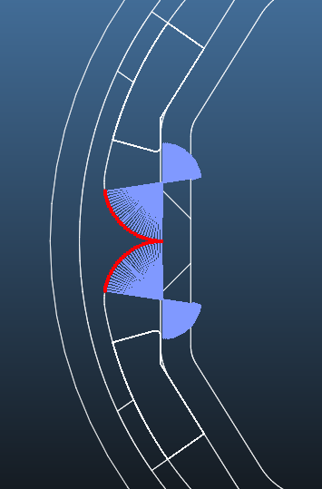
MAIN BEAM SCREEN SLOT SIZE
The slot can’t be indefinitely increased, as opening it too much would result in an excess of radiation being backscattered to the main chamber
Besides, opening it worsens the impedance and the mechanical resistance during a quench
It has to cover, at least, most part of the main reflected radiation, while guaranteeing an optimal conductance
Monte Carlo simulation tools can help us to find an optimal size
Plane normals
Slot size
Specular reflection
Diffuse reflection

Slide 22
MAIN BEAM SCREEN SLOT SIZE
After testing many configurations, it was seen the optimal size for a 72h max photon dose is around 4.2mm
However, as Synrad does not take into account the photon energy, and the scattered radiation to the main chamber has low one, the effect of the backscattered radiation is in fact lower. Taking also into account possible misalignments, we would recommend a 5mm slot
5mm best size, for now
PSD data
Bk. 316SS H₂ 293K 4 keV
Pumping holes size
7mm
Time lapse
72h
Reflector roughness
σ/T = 0.0032

Slide 23
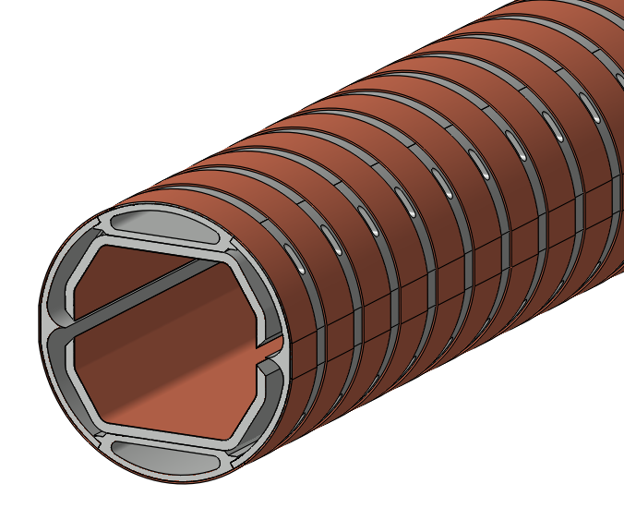
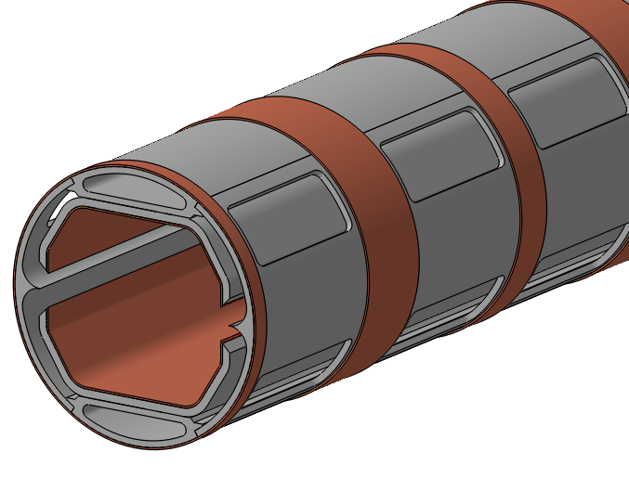

GEOMETRY COMPARISON
Previous geometry, July 2016
WP4 5th meeting November 2016
Previous
Current
Holes length
∼5.3mm
10mm
$$S_{av}\left[l/s\right]= \frac{Q const\left[mbar∙l/s\right]}{P \left\lfloor mbar\right\rfloor }$$
Holes width
1.5mm
23.75mm
Central slot
2.28mm
5mm
Av. H₂ p. speed 50K
∼127 l/s/m
∼ 530 l/s/m
x4!

Slide 24
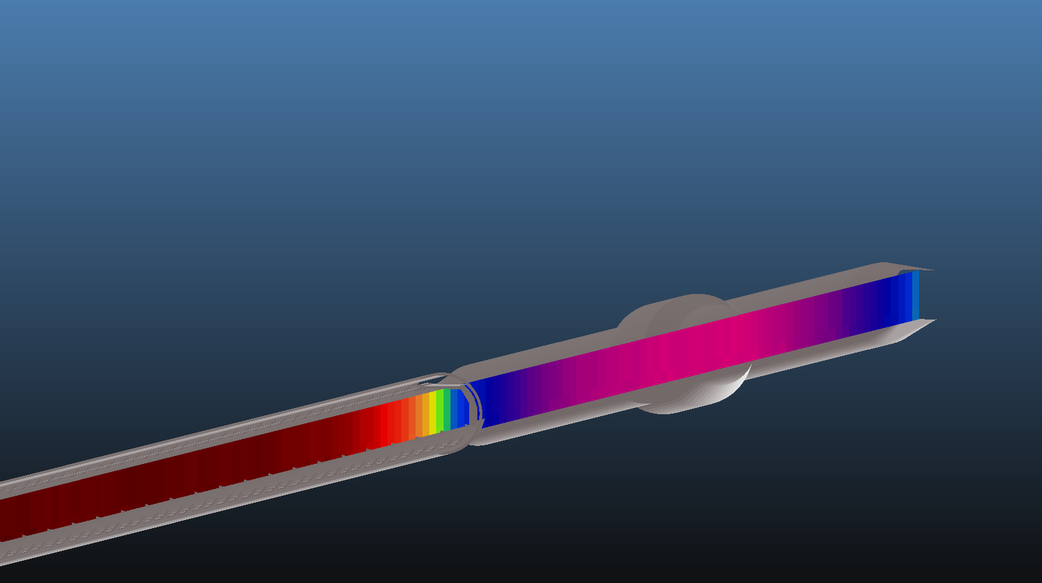
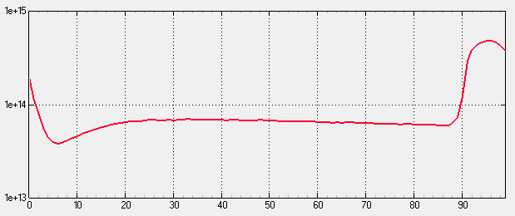
MOLECULAR DENSITY RESULTS
Main slot aperture
Pumping Holes length
Holes area coverage
Reflector roughness
5mm outwards
10mm
67’6 %
σ/T = 0.0032
Molecular density
profile only PSD H₂
Temperatures
Ribs
60K
Drift space between dipoles
1.43m
Main reflector
60K
Cold bore
1.9K
Inner copper
47K
End absorber
100K
Other areas
50K
Beam direction
Outgassing per BM
Bending magnet 14.3m
4.97·10⁻⁶ mbar·l/s
Average arc density
9.88·10¹³ H₂/m³
PSD data
Average arc pressure
6.56 ·10⁻¹⁰ mbar
Bk. 316 SS H₂ 293K 4 keV
Time lapse
72h

Slide 25
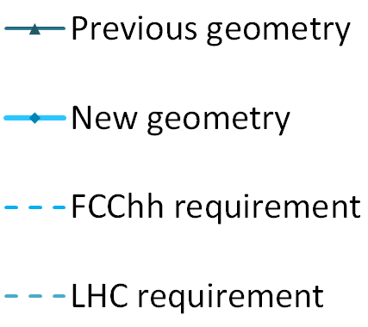


PUMPING SPEED IMPROVEMENT
Due to the cleaning effect, the PSD decreases gradually with time
If only this effect was rising the pressure, and counting only hydrogen, in less than one day of maximum dose in nominal conditions, the required density would be met (SS room temperature PSD data)
Further studies with all gases and the remaining effects will be carried out
$$\text{MD}\text{ (}\text{H}\text{2}\text{/}\text{m}\text{3}\text{) }\text{≈}\frac{\text{3.}\text{4}\text{∙10}\text{15}}{\sqrt{t(h)}}$$
336h (2 weeks)
1.86∙10¹⁴ H₂/m³
∼17h
1.90∙10¹⁴ H₂/m³
$$\text{MD}\text{ (}\text{H}\text{2}\text{/}\text{m}\text{3}\text{) }\text{≈}\frac{\text{7.8}\text{∙10}\text{1}4}{\sqrt{t(h)}}$$

Slide 26
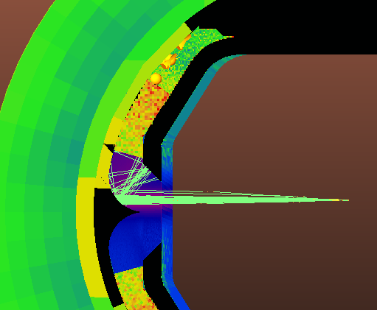

MISALIGNEMENT STUDY
W/cm²
To perform an approach to the real geometry conditions, a misalignment study has been carried out, moving the beam 1mm upwards
The leaked power is slightly lower, while the molecular density is slightly worse
The radiation is directed forward with a narrower angle, increasing the absorber power
Aligned
Misaligned
Stretching the sharp point of the reflector can produce the same effect in ideal conditions
Molecular density 72h
9.88·10¹³ H₂/m³
9.93·10¹³ H₂/m³
Cold bore power
0.034 W
0.032 W
Absorber power
63 W
86 W
Inner copper power
3.3 W
3.7 W
Ribs power
165 W
73 W

Slide 27
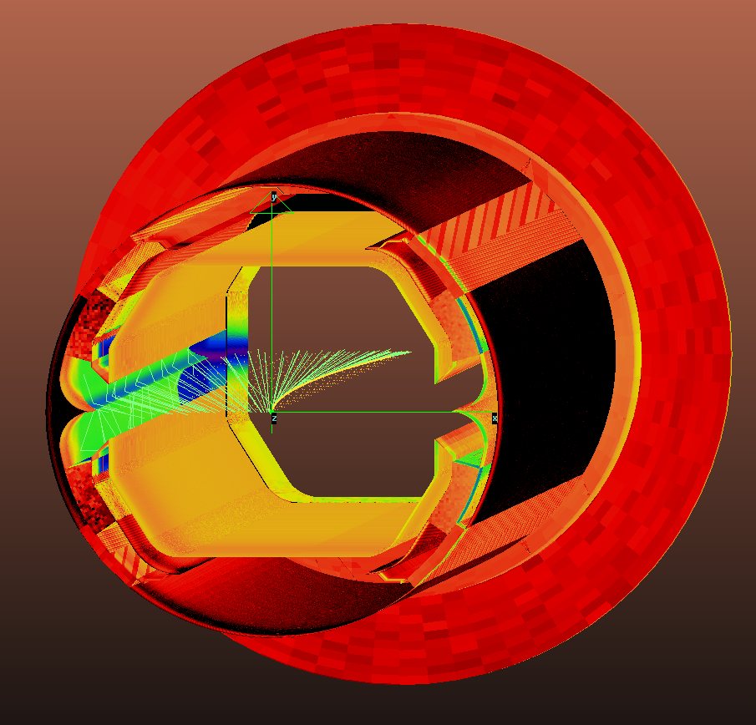
RAY TRACING FAST RESULTS
W/cm²
% of Total BM Power, 502W
Ribs
32.9%
Reflectors
29.3%
Cold bore
0.007%
Inner copper
6.56%
End absorber
12.6%
Drift space
8.1%
68% of the incident power is reflected on the reflector

Slide 28
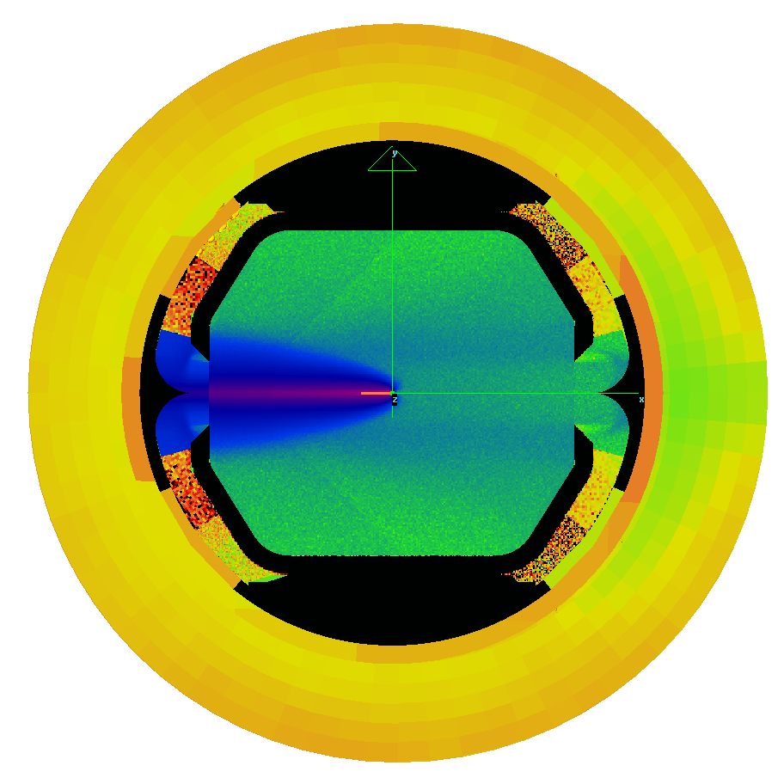

RAY TRACING FAST RESULTS
Photons/s/cm²
% of Total BM Flux, 2.1E18 ph/s
Ribs
29.6%
Reflectors
21.4%
Cold bore
0.27%
Inner copper
4.9%
End absorber
12.8%
Drift space
5.9%
78% of the incident flux is reflected on the reflector

Slide 29
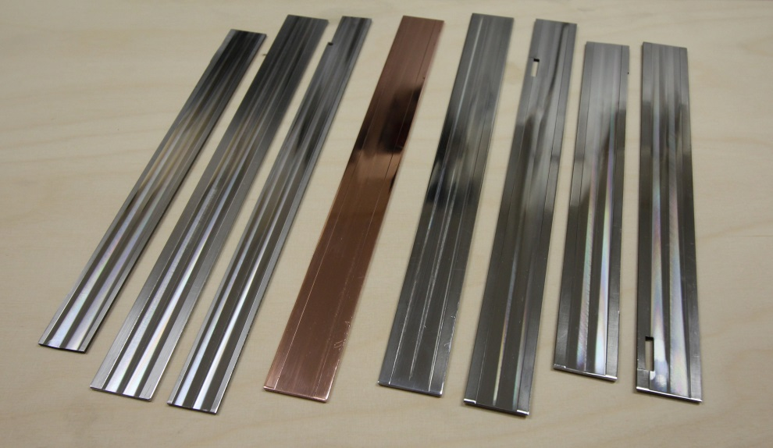
REFLECTIVITY STUDIES
There is no experimental data of the reflectivity of the FCC-hh’s beam screen steel in the X-Ray range. Knowing accurately its reflectivity properties would increase the reliability of the performed simulations
Special thanks to H. Kos for the machining
Some measurements are foreseen to be performed at BESSY II, Germany, by the end of the year by R. Cimino with the samples provided by CERN, and if allocated the beamtime, more measurements will be done next year
Three materials with different roughness will be analyzed: SS P506 (FCC and LHC steel, most important one), 316LN (ANKA steel) and copper with SALT treatment

Slide 30
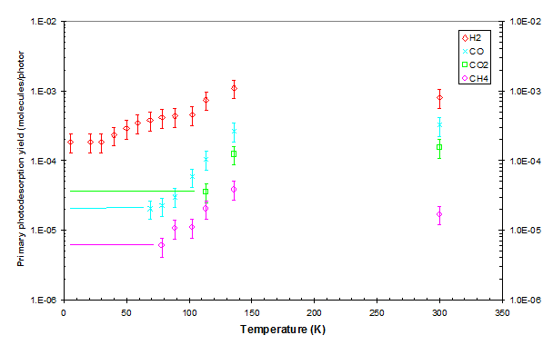
PROJECT NEEDS - FURTHER DATA
All these molecular density simulations have been performed with the SS data for room temperature, so they are still not very accurate
As done for the LHC, we should characterize the PSD yield at the BS cryogenic temperatures, around 40K-70K, for stainless steel (P506 better..)! The difference could be of an order of magnitude
Ideally, the critical energy should be as close as possible to 4.3keV
The initial yield would be lower, but the cleaning rate would be slower, too
PSD yield dependence of temperature example
(V. Baglin et al, Vacuum 67, 421-428)

Slide 31
CONCLUSIONS
The FCC-hh beam screen pumping speed has been increased, being the new design capable of meeting the pressure requirements for nominal conditions in a much shorter amount of time
The heat load on the cold bore has been analyzed, still existing potential to reduce it
The surface finishing plays an important role in the manufacturing specifications, it should be rough were the radiation has to be absorbed, and smooth were reflected
The future reflectivity measures, and a possible PSD yield measurement for P506 stainless steel, will allow a higher reliability and accuracy in the simulations

Slide 32
NEXT STEPS
Detailed design of the end absorber, and the drift space design, to deal with the directly irradiated areas
The total pressure contribution of the electron and ion induced desorption shall be studied, as done with the PSD, to completely study all the beam induced vacuum effects
The beam screen design will be further improved and reanalyzed, following possible future geometry changes, to maximize the pumping speed and thus reducing the pressure
The pressure contribution of the outgassing generated when warming up some possible beam screen coatings will be studied

Slide 33
THANK YOU FOR YOUR ATTENTION !

