Slide 1

Task 4.3: Mitigate beam-induced vacuum effects (STFC, CERN)
O.B. Malyshev, R. Valizadeh,
Taaj Sian and Rūta Širvinskaitė
ASTeC Vacuum Science Group,
STFC Daresbury Laboratory, UK
7th Nov 2016

Slide 2
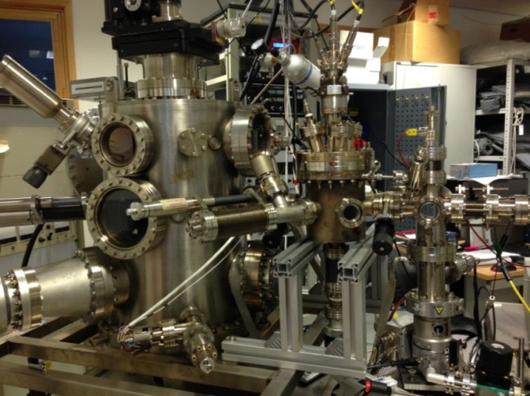
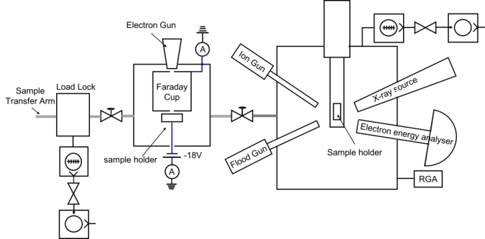
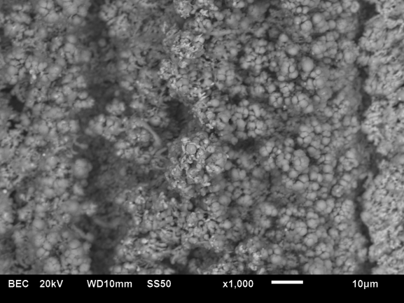
Low SEY studies
Current work:
  Several new surfaces were produced by different laser and their SEY were measured
    To be reported by Reza Valizadeh
  The data acquisition on the SEY facility is fully automated with LabVIEW
  Design on a new cold stage (LN₂) facility has been almost completed
  Design on a new cold stage (4-300K) facility started
  Some parts are in a process of procurement
    To be reported by Taaj Sian
Next Steps
  Building the new cold stage facility
  Production of samples for other EuroCirCol partners (subject to the funds availability)
Showstoppers
  Finance to produce of samples for other EuroCirCol partners.
  A delivery of a new electron gun for the new cold stage facility (there is none at the moment)

Slide 3
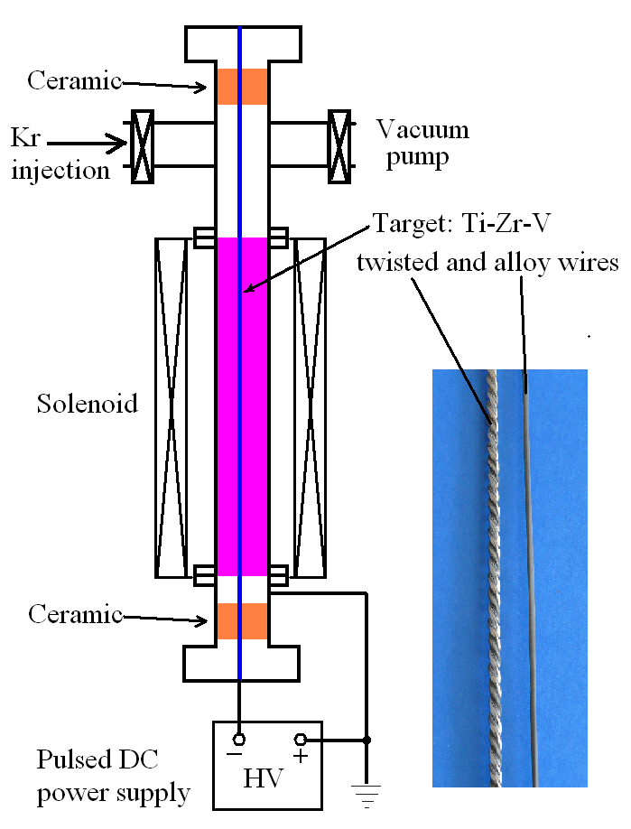
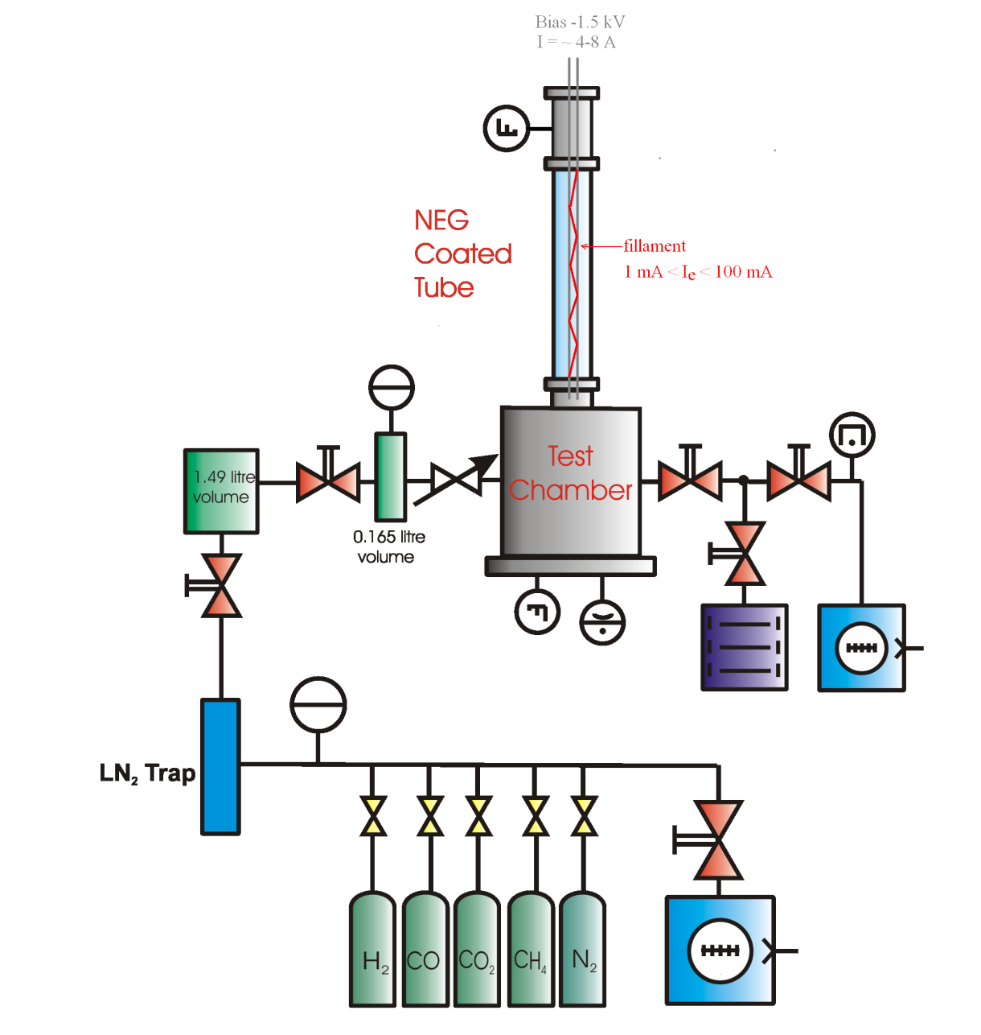
NEG coating studies
Current work
  PhD student Rūta Širvinskaitė:
    July – Sep 2016 – familiarisation vacuum basics, literature survey, introduction to NEG depositions and evaluation facilities
    Secondary calibration of UHV gauges
    In-situ calibration of RGAs against the UHV gauges
  Other activities (Reza and Oleg)
    A study of dual NEG coatings completed
      A dual-layer NEG coating consisting of a 0.5- μm-thick dense layer covered by a 1-μm thick columnar layer was evaluated for EDS and pumping activated at different temperatures.
      The paper has been submitted to JVSTA
    A study of NEG impedance (not a part of EuroCirCol but relevant to it)
      The surface resistance of two types of NEG coating (dense and columnar) was investigated at 7.8 GHz. The bulk conductivity was obtained with the analytical model: 𝜎_{𝑑} = 1.4×10⁴ 𝑆/𝑚 for the columnar NEG coating and 𝜎_{𝑑} = 8×10⁵ 𝑆/𝑚 for the dense NEG coating.
      The paper has been submitted to NIMA
    To be reported by Oleg later
Next Steps
  Deposition of Zr on a sample tube, ESD and pumping measurements
  Design of a facility for cryogenic (LN₂ and LHe) measurements
Showstoppers
  None at this stage
DC,
pulsed DC, RF power supply,
HiPIMS

Slide 4
Milestone report
Proposal on surface engineering
to mitigate electron cloud effects
A report describes two coupled problem: meeting vacuum specification on a beam vacuum and to mitigating electron cloud. Two most promising technologies were identified:
Low SEY laser treated surface. A recent invention that allows obtaining surfaces with SEY < 0.6 for complete eradication of the BIEM and e-cloud.
NEG coated surface. NEG film can be deposited to provide SEY < 1. After activation this film also provides a reduced PSD and ESD and distributed pumping speed.
Before choosing between these two options, both technologies have to be verified at cryogenic temperature and under synchrotron radiation bombardment.

Slide 5
TABLE OF CONTENTS
PROBLEM DECRIPTION
  1.1. Gas density along a cryogenic vacuum chamber under SR
    1.1.1. Model
    1.1.2. PSD and ESD from cryogenic surface
    1.1.3. Equilibrium pressure
    1.1.4. Ion induced pressure instability
    1.1.5. Calculations for the FCC
  1.2. SUGGESTED SOLUTIONS
OPTION 1: LOW SEY LASER TREATED SURFACE
  2.1. Beam and e-cloud
  2.2. Salt – surface optimised for accelerator applications
  2.3. What else we need to study
3. OPTION 2: NEG COATED SURFACE
  3.1. NEG coating as a solution for a long narrow vacuum chambers
    3.1.1. What is NEG coating
    3.1.2. NEG deposition
    3.1.3. NEG surface characterisation
    3.1.4. Vacuum characterisation
    3.1.5. Surface resistance
    3.1.6. NEG at low temperature
  3.2. What we else need to know
CONCLUSIONS
5. REFERENCES

Slide 6
Main highlights for Option 1: SALT
What is known:
  The surface with SEY < 1 can be produced using laser treatment, the SEY may further be reduced with dose to ~0.6.
  It has no vacuum problems at room temperature
    ESD, TD, ultrasound wash
  Surface impedance increases by factor 3
What is required to study:
  PSD data for SALT at room temperature
  Data at cryogenic temperature
    PSD and ESD
    PEY and SEY
    Effect of cryosrobed gases on PSD, ESD, PEY and SEY
    Surface impedance

Slide 7
Main highlights for Option 2: NEG
What is known:
  The surface with SEY < 1 (after NEG activation) can be produced.
  Vacuum:
    Ti-Zr-V PSD data at room temperature only
    Ti-Zr-Hf-V ESD is an order of magnitude lower than for Ti-Zr-V
      The same reduction is expected for PSD
    Ti-Zr-Hf-V ESD on vacuum fired tubes is two orders of magnitude lower than for the Ti-Zr-V film
      The same reduction is expected for PSD
    Dense vs columnar film
  Surface impedance
    increases with thickness and frequency
    the bulk conductivity was obtained with the analytical model:
      𝜎_{c} = 1.4×10⁴ 𝑆/𝑚 for the columnar NEG coating
      𝜎_{𝑑} = 8×10⁵ 𝑆/𝑚 for the dense NEG coating

Slide 8
Main highlights for Option 2: NEG
Modelling das density for H₂ after dose D = 10²² photons/m
  Ti-Zr-V
    n_{Ti-Zr-V} = 1×10¹⁸ molecules/m³
  Ti-Zr-Hf-V (dense)
    n_{Ti-Zr-Hf-V} = 1×10¹⁷ molecules/m³
  Ti-Zr-Hf-V (dense) on vacuum fired tubes
    n_{Ti-Zr-Hf-V} = 1×10¹⁶ molecules/m³
  Including photon induced pumping allows to reduce 10 times lower:
    n_{Ti-Zr-Hf-V} = 1×10¹⁵ molecules/m³ on vacuum fired tubes

Slide 9
Main highlights for Option 2: NEG (cont.)
What is required to study:
  PSD data for dense and columnar Ti-Zr-Hf-V film at room temperature
  Data at cryogenic temperature
    PSD, ESD and sticking probability
    PEY and SEY
    Effect of cryosrobed gases on PSD, ESD, PEY and SEY
    Photon induced activation
    Surface impedance
  Further reducing of NEG activation temperature
  Possibilities of reducing of NEG surface impedance

Slide 10
Conclusions:
Two possible solutions could be used for the FCC beam chamber. These solutions should meet the specification to a maximum gas density, ion induced instability suppression and e-cloud and BIEM mitigation.
Two most promising technologies were described in this report:
  Option 1: A beam screen with pumping holes and low SEY laser treated surface.
  Option 2: A beam screen without pumping holes with NEG coated surface.
Both technologies are potentially feasible but both require further study at cryogenic temperatures.

Slide 11
Visit to Budker Institute of
Nuclear Physics (Novosibirsk, Russia)
SEY measurements in a weak magnetic field (~ 300 Gs)
  Time-of-flight energy measurements of secondary electrons
    Available now
SEY measurements in a strong magnetic field (up to 10 T)
  Update is possible
Installing of either above on a SR beamline is possible

Slide 12
Following presentations
Reza Valizadeh –
  Low SEY laser treated surface results
Taaj Sian
  Laser treated surface vs microparticle
  Design of cryogenic systems for SEY measurements
NEG coating results - Oleg Malyshev

