Slide 1



WP4 Meeting, ALBA
Cryogenic SEY measurements
7/11/2016
Taaj Sian
Reza Valizadeh, Oleg Malyshev

Slide 2
Outline
We need to measure the SEY of materials at Cryogenic temperatures
To do this we will need to cool the samples to these temperatures
We will also need to desorb gas onto the samples

Slide 3
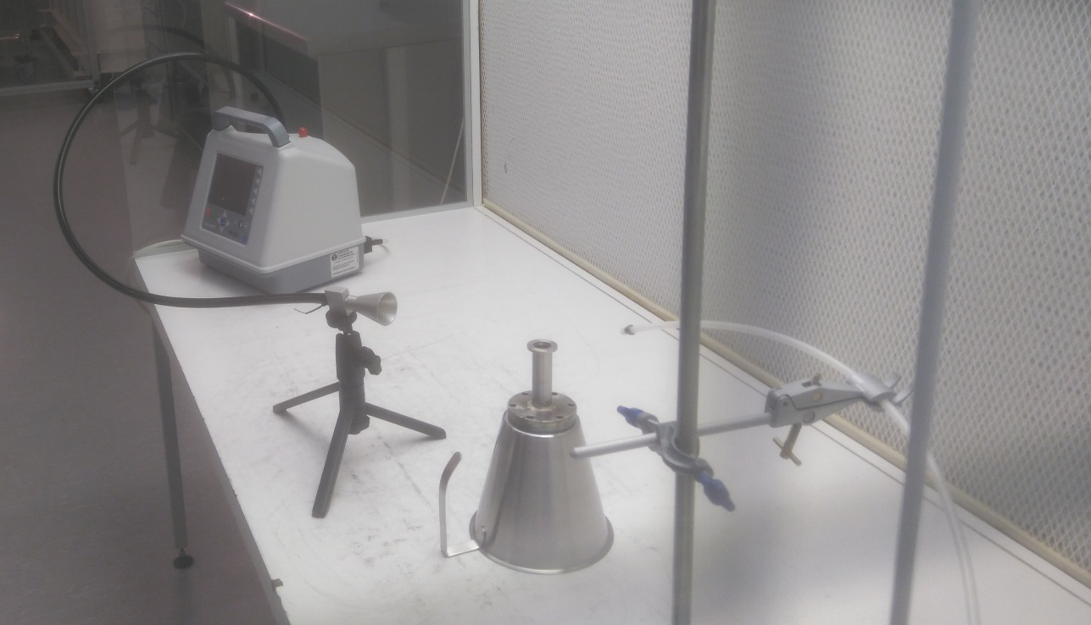
Particle Counts
Measurements taken with 0.5 bar of filtered N2 onto sample 50 mm away from the sample
The measurements were taken for 1 minute and the counts were averaged over 3 measurements

Slide 4
Particle Counts
Largest particle size measured was 1 micron
The sample prepared in Ar had the lowest counts
Polished and untreated samples were used as reference
The detector could measure particles up to 25 microns

Slide 5
Current SEY system
Electron gun
8
85
100
350
125
225
10
35
60
Current bellows go from 120 to 65 mm during normal operation
150

Slide 6
Un upgrade to current system for cooling sample to 77 K
Electron gun
CO₂ injection via leak valve
8
350
85
100
225
125
10
35 mm
Flexible hose
60
LN
120 - 65
150

Slide 7
A new system with sample temperature between 3.5 and 80 K
Option 1:
Electron gun
Injecting gas to the test chamber at a pressure P_{tc} for a period of time t_{inj}
8
A flow of injected gas q:
q [mbar⋅l/s] = V_{g} dP_{g}/dt
Pumping speed:
S [l/s] = Q / P_{tc}
then concentration of cryosorbed gas s on the sample surface:
200
P_{tc}
20
P_{g}, V_{g}
s[mbar⋅l/cm²] =P_{tc} S t_{inj} /A_{sample} (1)
A less accurate method:
flow of gas q to the surface A_{sample} is
q = v(M,T) A_{sample} P_{tc}
then
s[mbar⋅l/cm²] = α P_{tc} v(M,T) A_{sample} t_{inj} (2)
Sticking probability should α me measured or use literature data.
Since α ≤ 1, then α = 1 gives maximum possible s.

Slide 8
A new system with sample temperature between 3.5 and 80 K
Option 2:
Electron gun
Fill with a set amount of gas
from a defined volume V_{g}
at known pressure P_{g}.
Majority of gas should cryosorb to the sample as it is the only part of that is cold besides the gap which has low conductance.
8
P_{tc}
200
s[mbar⋅l/cm²] =P_{g}V_{g}/A_{sample}
20
P_{g}, V_{g}
This method is more precise, the total amount of cryosorbed gas Q can be checked by heating the sample and measuring P_{tc}
Q [mbar⋅l] = P_{tc}V_{tc}
and
s[mbar⋅l/cm²] =P_{tc}V_{tc}/A_{sample}

Slide 9
A new system with sample temperature between 3.5 and 80 K
Option 2: accuracy
D
d
For d = 20 mm and D = 21 mm
Area ratio is 10 thus maximum uncertainty in the total amount of cryosorbed gas Q is 10%
Gap
Sample
d
D

Slide 10
Thanks
Questions?

