Slide 1

Progress in NEG Coatings for Particle Accelerators
O.B. Malyshev and R. Valizadeh,
ASTeC Vacuum Science Group,
STFC Daresbury Laboratory, UK

Slide 2
Outlook
Introduction
Desorption properties
Surface resistance
Summary

Slide 3
What NEG coating does
Reduces gas desorption:
  A pure metal (Ti, Zr, V, Hf, etc.) film ~1-μm thick without contaminants.
  A barrier for molecules from the bulk of vacuum chamber.
Increases distributed pumping speed, S:
  A sorbing surface on whole vacuum chamber surface
  S = α⋅A⋅v/4;
where α – sticking probability,
A – surface area,
v – mean molecular velocity
Vacuum NEG Bulk
Coating

Slide 4
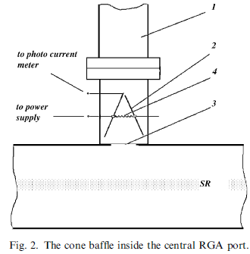
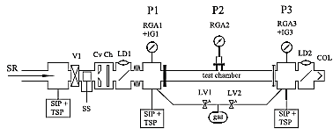
Earlier experiments with NEG coating
Samples coated with Ti-Zr-V at CERN (Switzerland)
Experiments SR beam line at BINP (Russia)

Slide 5
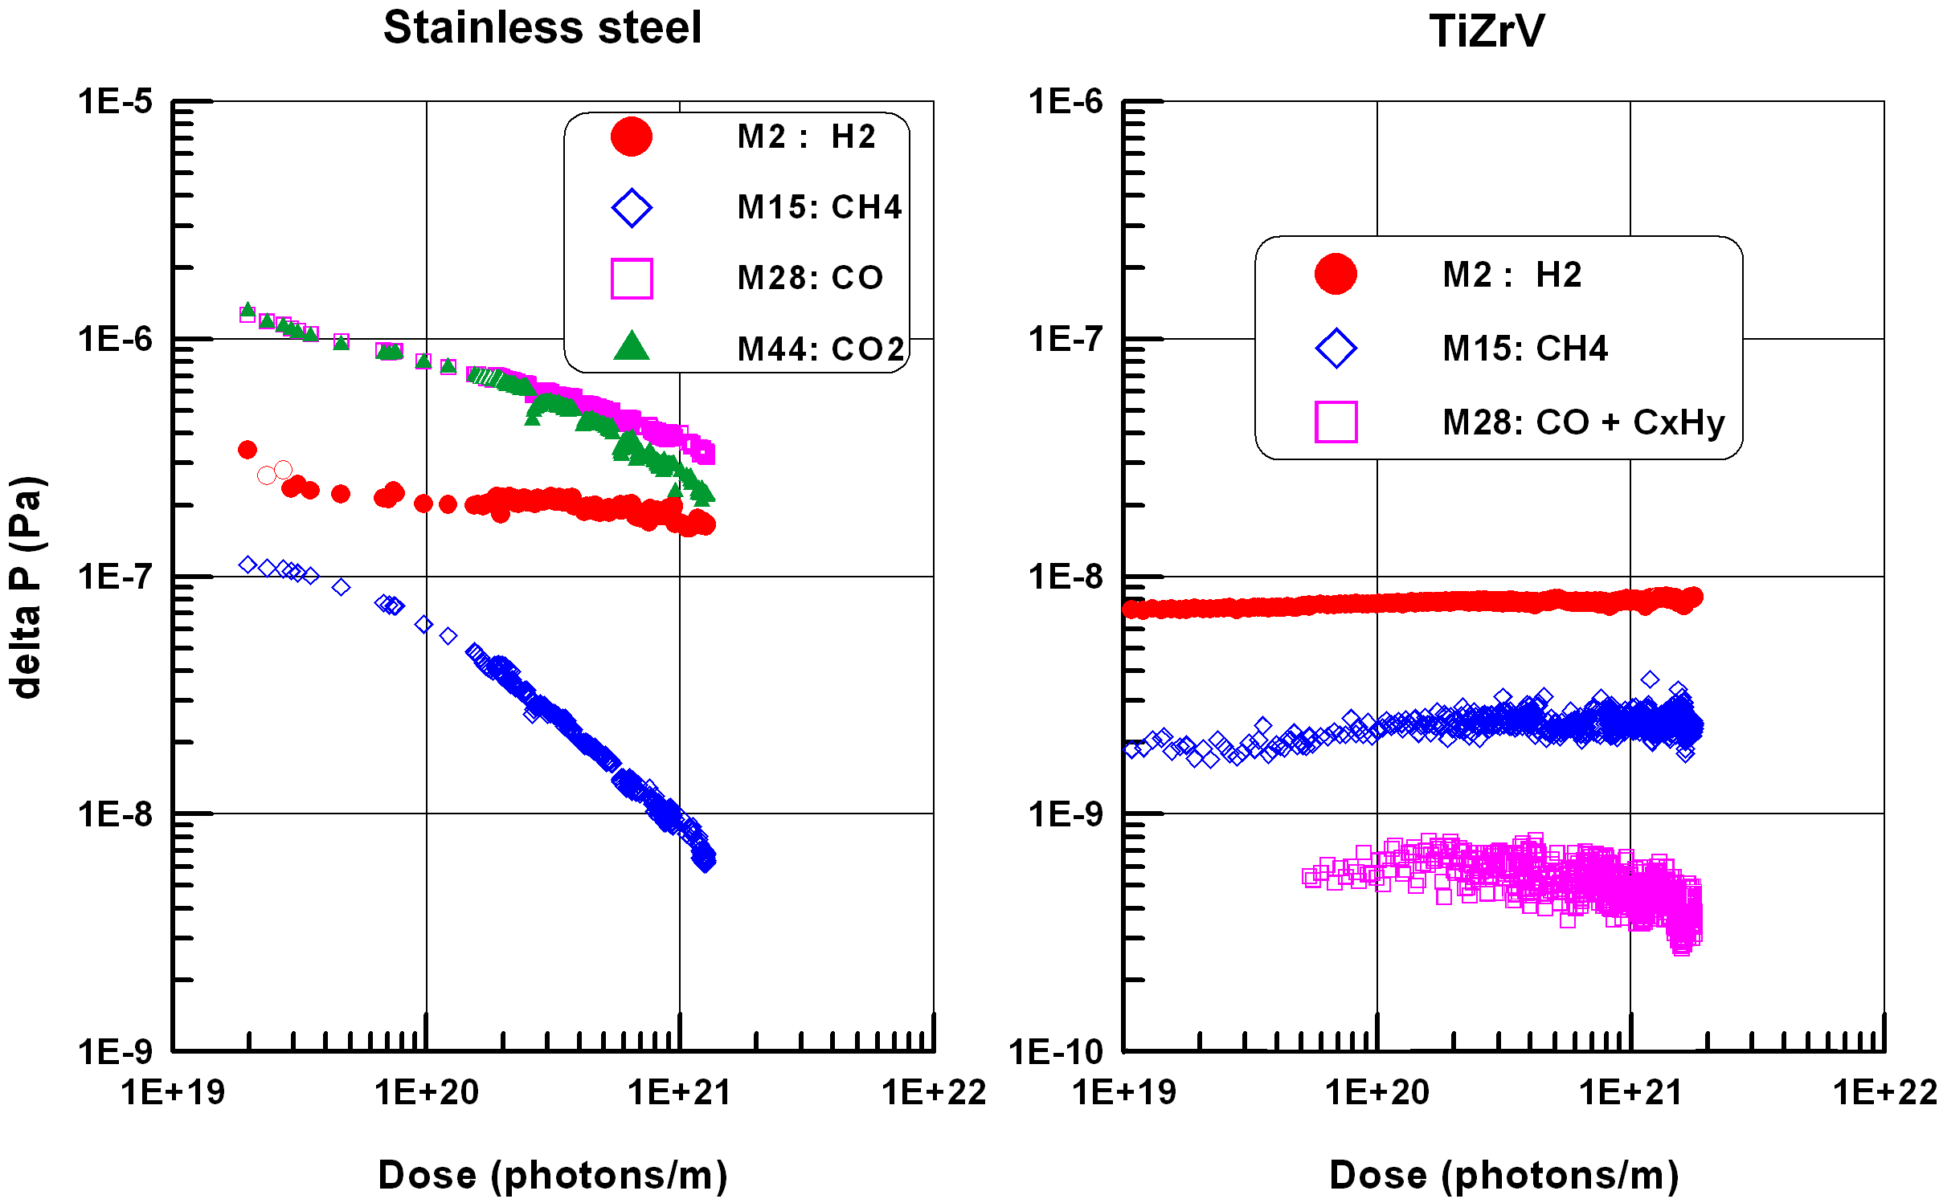
Comparison of PSD from 316LN and NEG
Dynamic pressure rise for the Stainless Steel (baked at 300°C for 24 hrs) and TiZrV coated vacuum chambers (activated at 190°C for 24 hrs)
V.V. Anashin et al, Vacuum 75 (2004) p. 155.

Slide 6
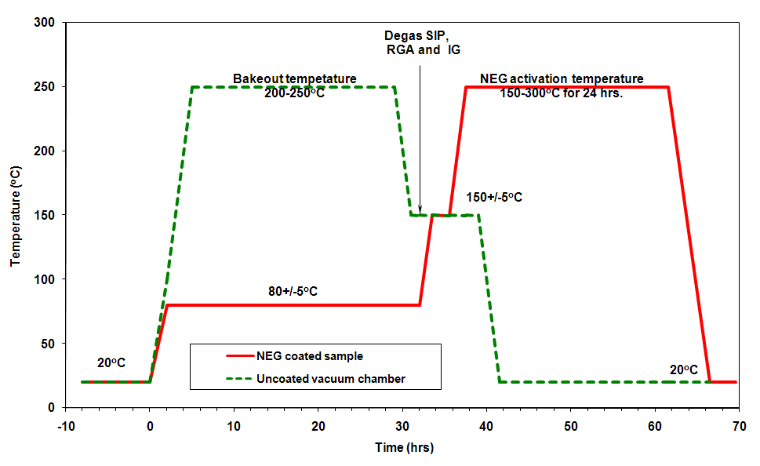
ASTeC activation procedure
O.B. Malyshev, K.J. Middleman, J.S. Colligon and R. Valizadeh. J. Vac. Sci. Technol. A 27 (2009), p. 321.

Slide 7
Pressure in the accelerator vacuum chamber
Improving pumping properties is limited:
α ≤ 1
  0.005 < α_{H2} < 0.02
  0.1 < α_{CO} < 0.5
  0.4 < α_{CO2} < 0.6
Reducing the desorption yields η in orders of magnitude was our aim
where
η - desorption yield (photon, electron or ion stimulated desorption)
α - sticking probability

Slide 8
Reducing the gas desorption from the NEG coatings
Main gases in the NEG coated vacuum chamber are
H₂ and CH₄
  Only H₂ can diffuse through the NEG film under bombardment or heat
  CH₄ is most likely created on the NEG surface from diffused H₂ and C (originally from sorbed CO and CO₂)
  Therefore the H₂ diffusion must be suppressed
    Where H₂ come from?
Notes:
8

Slide 9
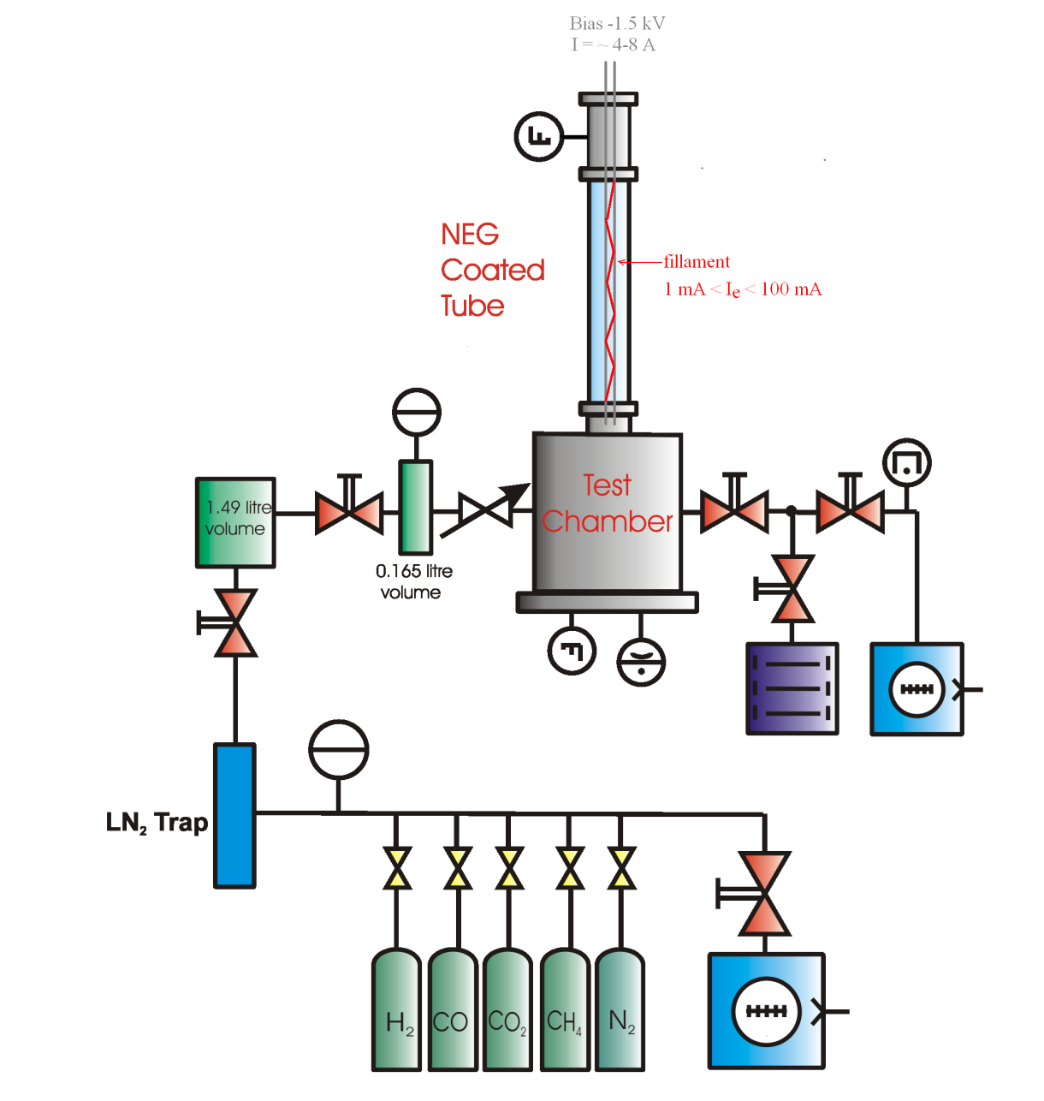
Electron stimulated desorption facility
ESD is studied as a function of
  Electron energy
  Dose
  Wall temperature (-5 to +70°C)
  Activation/bakeout temperature
Can be used for samples with:
  Specially treated samples
    Vacuum fired, polished, etc.
  Low desorption coating
  No coatings
  NEG coating
    ESD measurements
    Sticking probability measurements
O.B. Malyshev, A.P. Smith et al. J. Vac. Sci. Technol. A 28 (2010), p. 1215.
Notes:
9

Slide 10
Reducing the gas desorption from the NEG coatings
Gas molecules are contained
  on the NEG coating surface
    after exposure to air
      minimise exposure to air
  inside the NEG coating
    trapped during deposition
      purity of discharge gas
      background pressure
  in subsurface substrate layer
      substrate bakeout before NEG deposition
  in the substrate bulk
      vacuum firing
Notes:
10

Slide 11
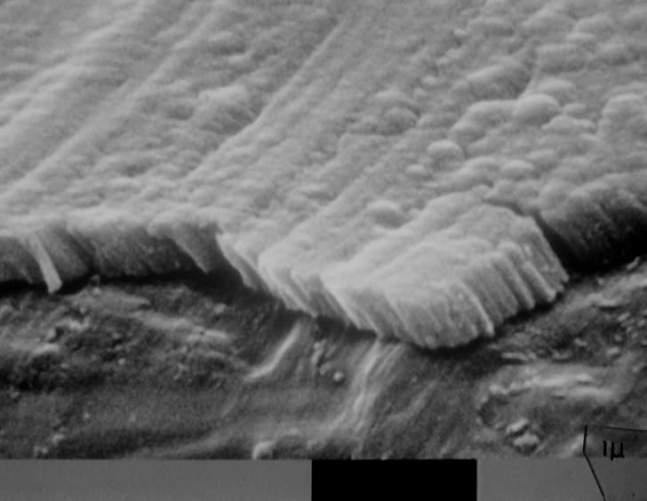
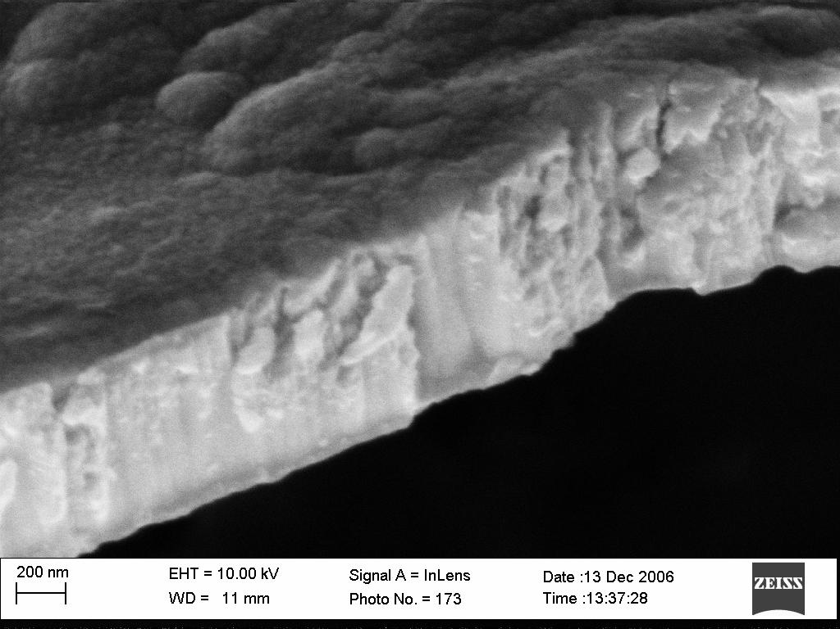
SEM images of films (film morphology )
columnar dense
Best for pumping A first candidate for a barrier
O.B. Malyshev, R. Valizadeh, J.S. Colligon et al. J. Vac. Sci. Technol. A 27 (2009), p. 521.

Slide 12
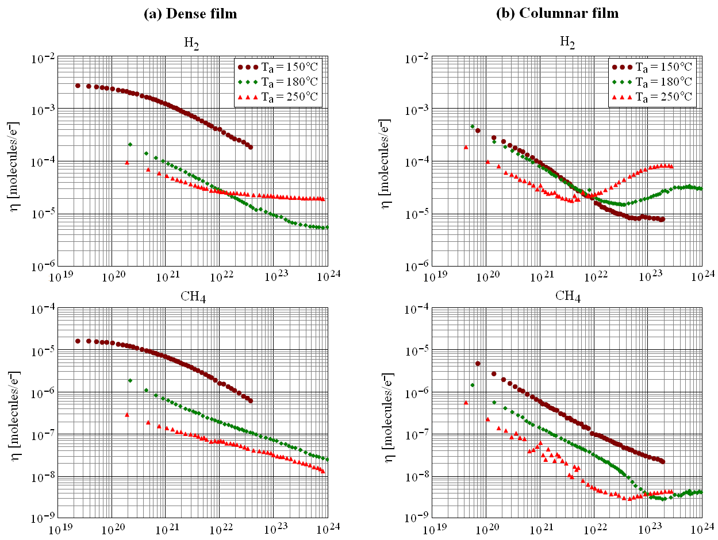
ESD yield from NEG coated samples
316LN
T_{b}=250°C

Slide 13
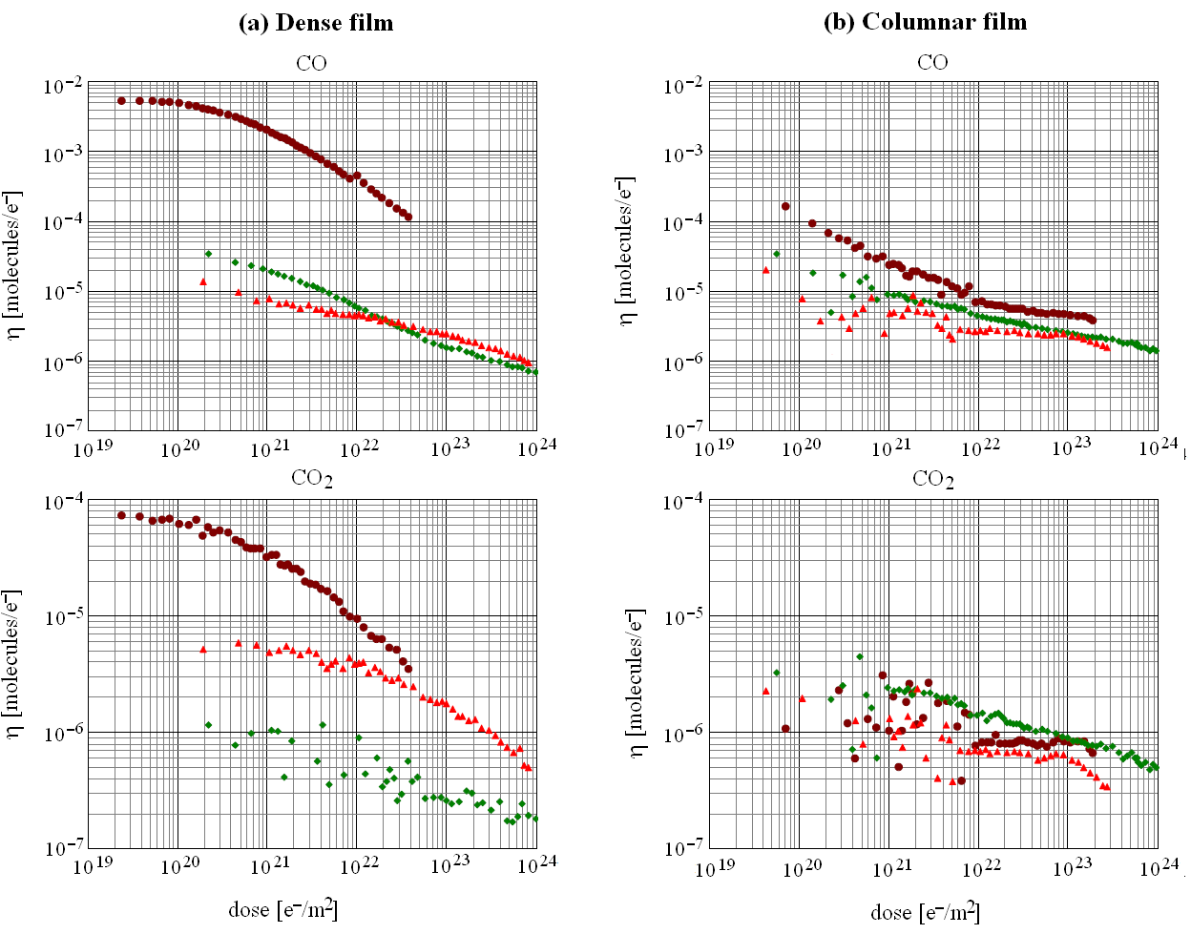
ESD yield from NEG coated samples

Slide 14
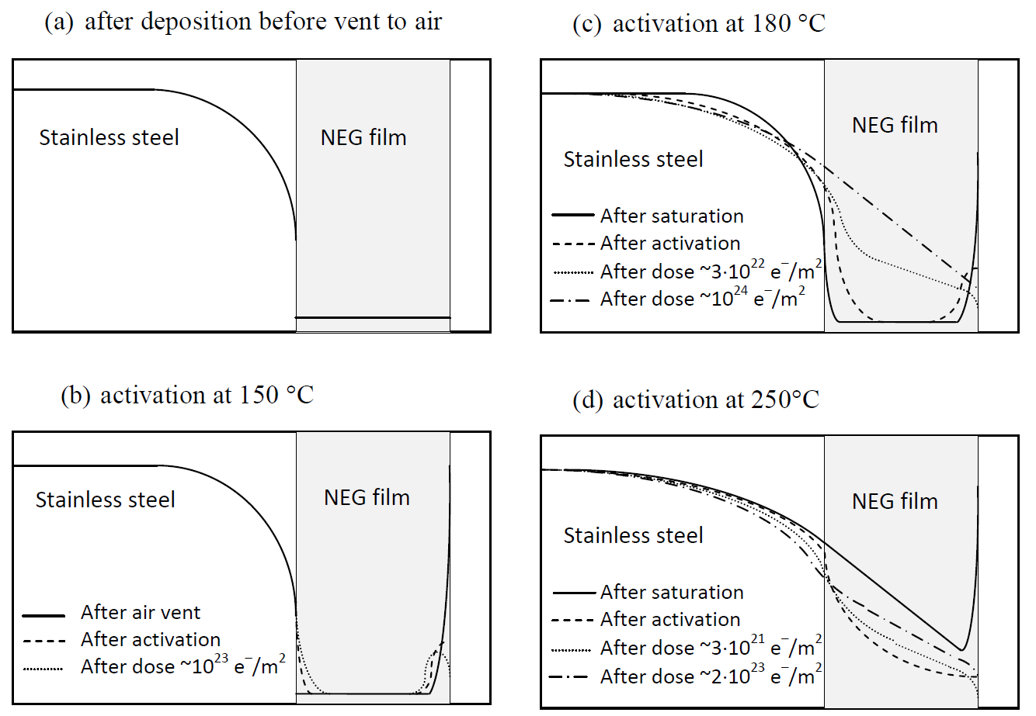
ESD yield from NEG coated samples
O.B. Malyshev et al. Vacuum (2012) doi.: 10.1016/j.vacuum.2012.04.033

Slide 15
H₂ ESD from NEG coated vacuum fired 316LN
316LN
T_{b}=250°C

Slide 16
Dual layer
Columnar layer:
  Activated at lower temperature
  Provides higher sticking probability and pumping capacity
Dense layer:
  Provides lower ESD
Dual Layer:
  Combines benefit of both
  For more details: see A. Hannah’s poster EM286 on Thursday
Vacuum
Columnar NEG Coating
Dense NEG Coating
Bulk metal

Slide 17
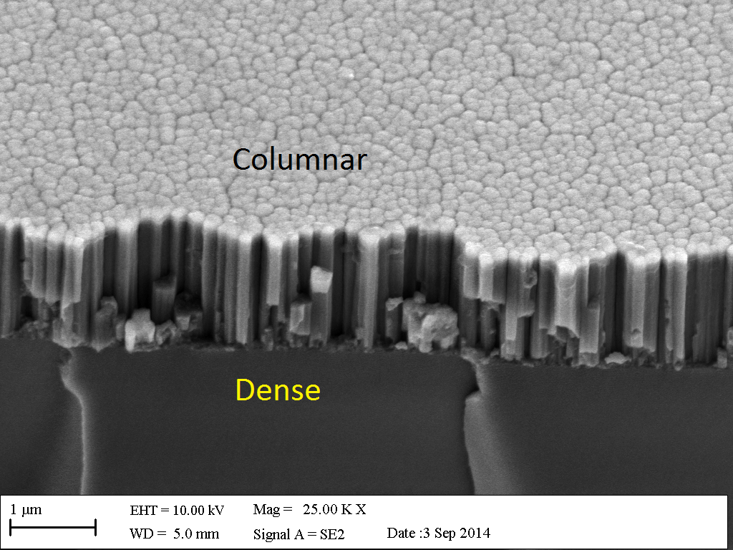
Dual layer

Slide 18
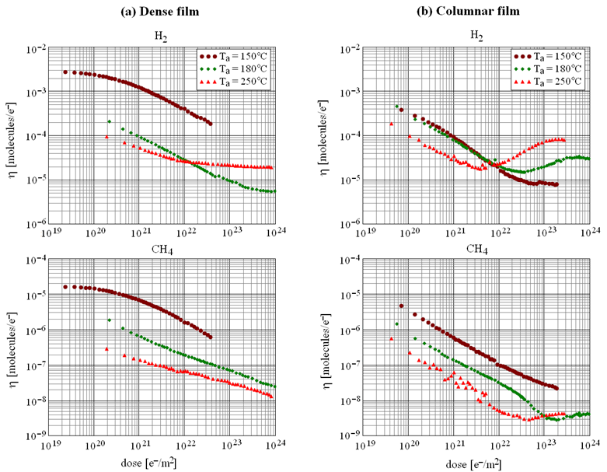
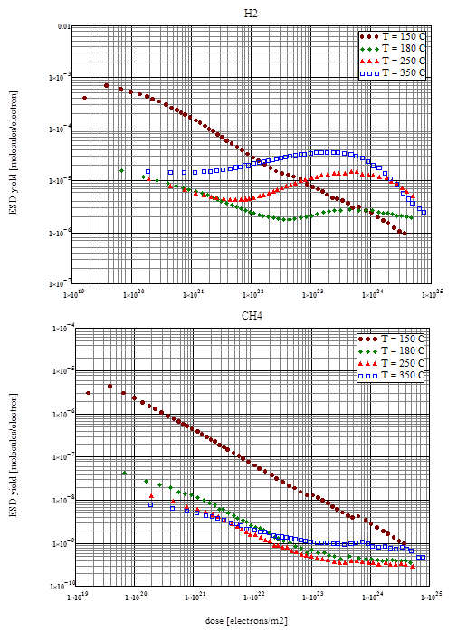
ESD for dense, columnar and dual layer NEG
(c) Dual layer
Dual layer combines both benefit:
  ESD yields are like for dense film with
  pumping properties of columnar film

Slide 19
Surface impedance: method
The cavity geometry consists of two parts:
  a body of the cavity
  a planar sample,
  separated by an air gap.
Contactless
RF chokes in order to keep the RF power within the cavity
Modelled with CST Microwave Studio.
G = 235 Ω.
The field ratios p_{c} = 0.625 and p_{s} = 0.375 for perfect electric conductor boundary conditions.

Slide 20
Analytical model
The expressions for the surface impedance of a planar metallic film deposited on a substrate (dielectric or metallic) are derived by following the standard approach employed in calculating the transmission and reflection coefficients in layered media

Slide 21
NEG coatings
NEG films
  columnar
  dense
Deposited on:
  polycrystalline copper
  silicon Si(100) substrates.
The substrate size was 100 mm × 100 mm × 2 mm
Sample thickness:
  from 0.7 to 18 μm

Slide 22
The surface resistance RS of dense and columnar NEG coatings on copper and silicon substrates as a function of film thickness
The bulk conductivity was obtained with the analytical model:
𝜎_{𝑑} = 1.4×10⁴ 𝑆/𝑚 for the columnar NEG coating
𝜎_{𝑑} = 8×10⁵ 𝑆/𝑚 for the dense NEG coating

Slide 23
The surface resistance R_{S} as a function of NEG film thickness on copper at various frequencies

Slide 24
Conclusion
NEG coating is a technology that allows to meet UHV/XHV vacuum specification win long narrow vacuum chambers.
  PSD and ESD After NEG activation at 180°C the initialη(316LN)/η(Ti-Zr-V) =
    =20 for H₂, =1000 for CH₄ and =200 for CO.
    Vacuum firing = an order of magnitude lower ESD
    η(Ti-Zr-Hf-V) < η(Ti-Zr-V).
    Best results is for the dense and dual layer NEG activated at 180 °C
  Often the only vacuum solution
  Lower cost of pumping system
It require activation at 150-180 °C in stead of 250-300 °C usual bakeout:
  Shorter or less bellows
  Wider choice of material for vacuum chamber and components
The bulk conductivity:
  𝜎𝑑 = 1.4×104 𝑆/𝑚 for the columnar NEG coating
  𝜎𝑑 = 8×105 𝑆/𝑚 for the dense NEG coating
SEY < 1.1can be obtained after activation or by conditioning

