Slide 2
5th EuroCirCol meeting:
FCC Test Line 4rd Update
Outline:
Test bench evolution
Test-Line 4rd update
Design & Purchase progress
Mechanical analysis
Installation
Present & Future Steps

Slide 3
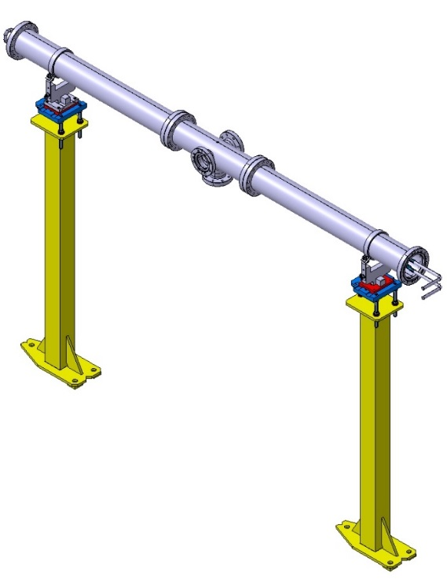
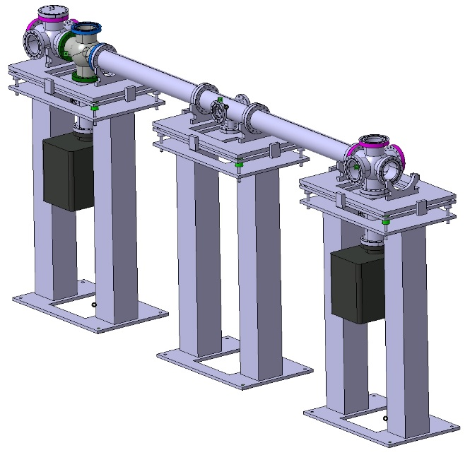
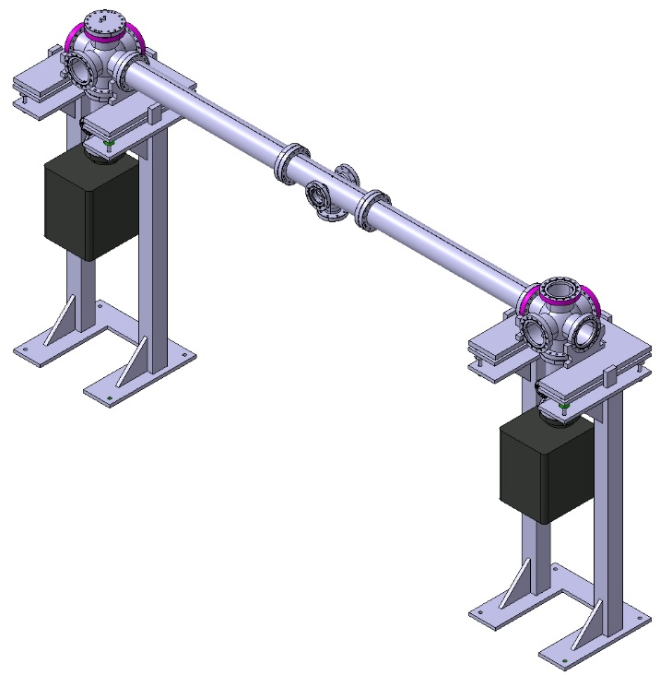
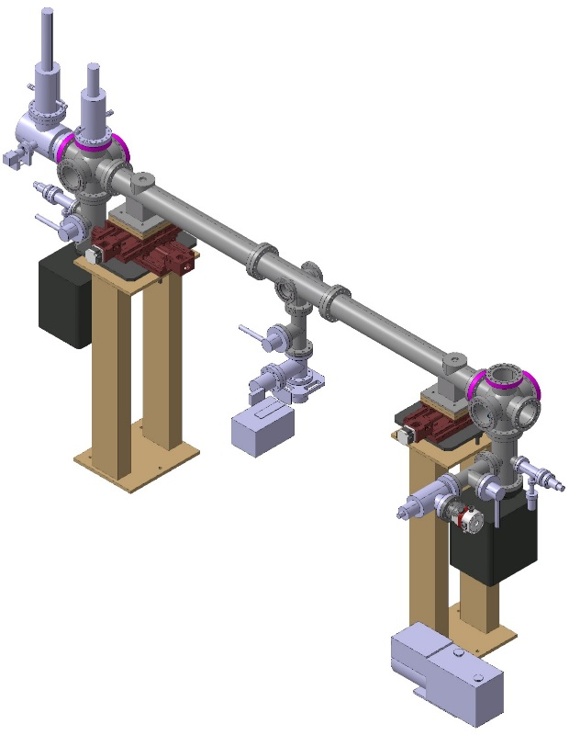
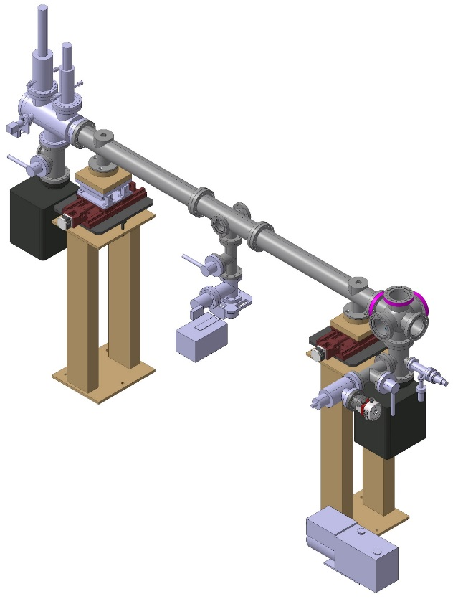
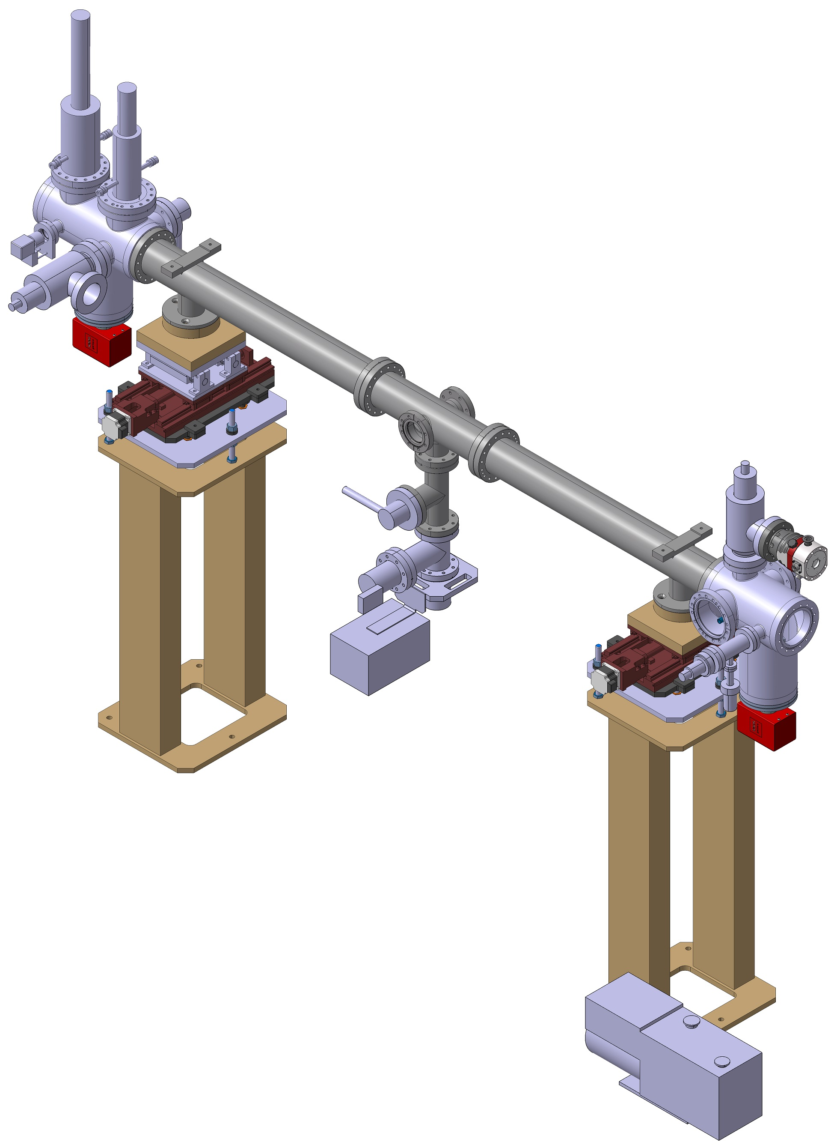
1 - Test bench evolution
November 2015
January 2015
February 2016
*Design presented in Orsay Dec/2015
March 2016
April 2016
July 2016
*Design presented during ANKA visit March/2016
*Design presented at CERN July/2016

Slide 4
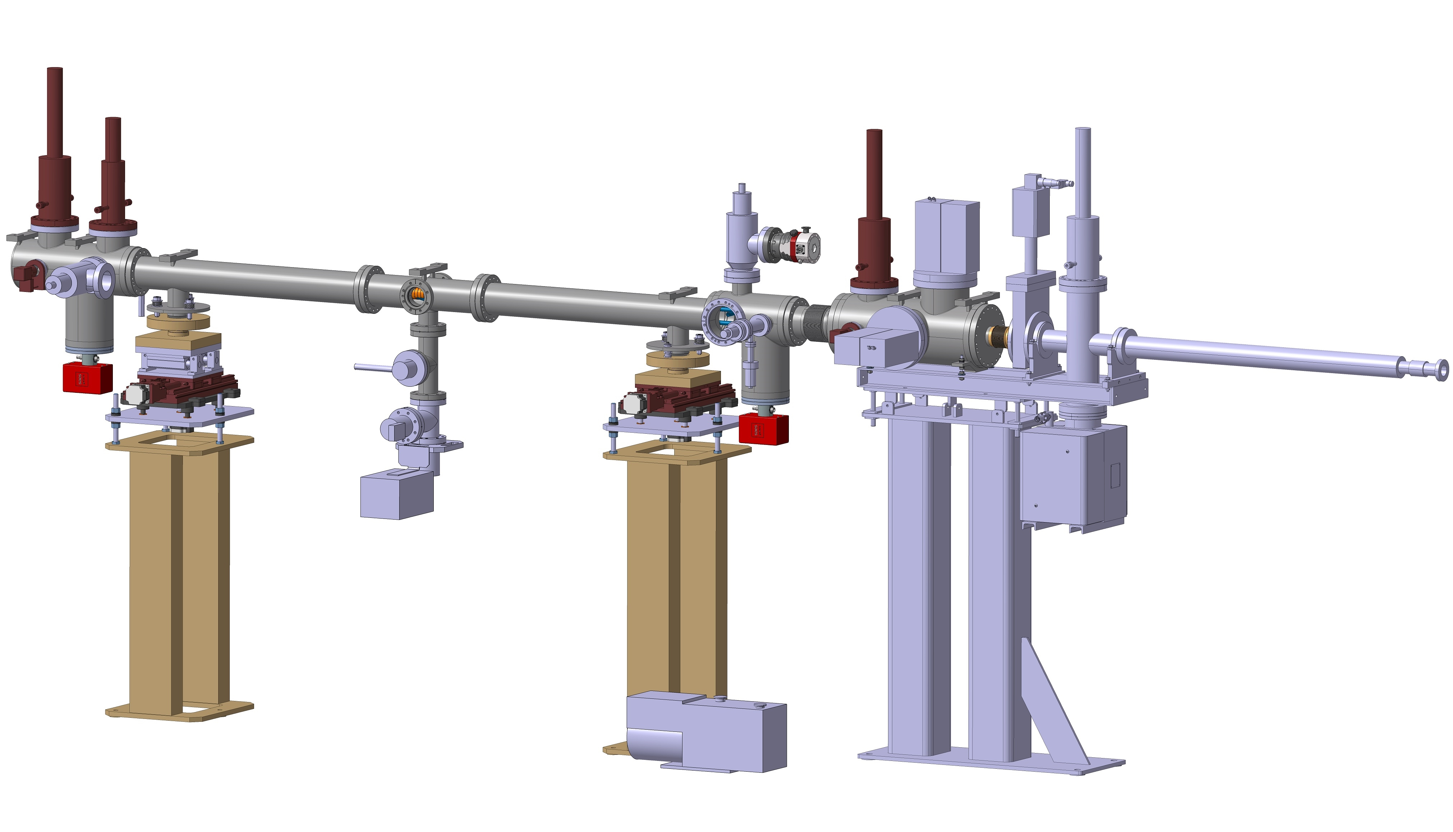
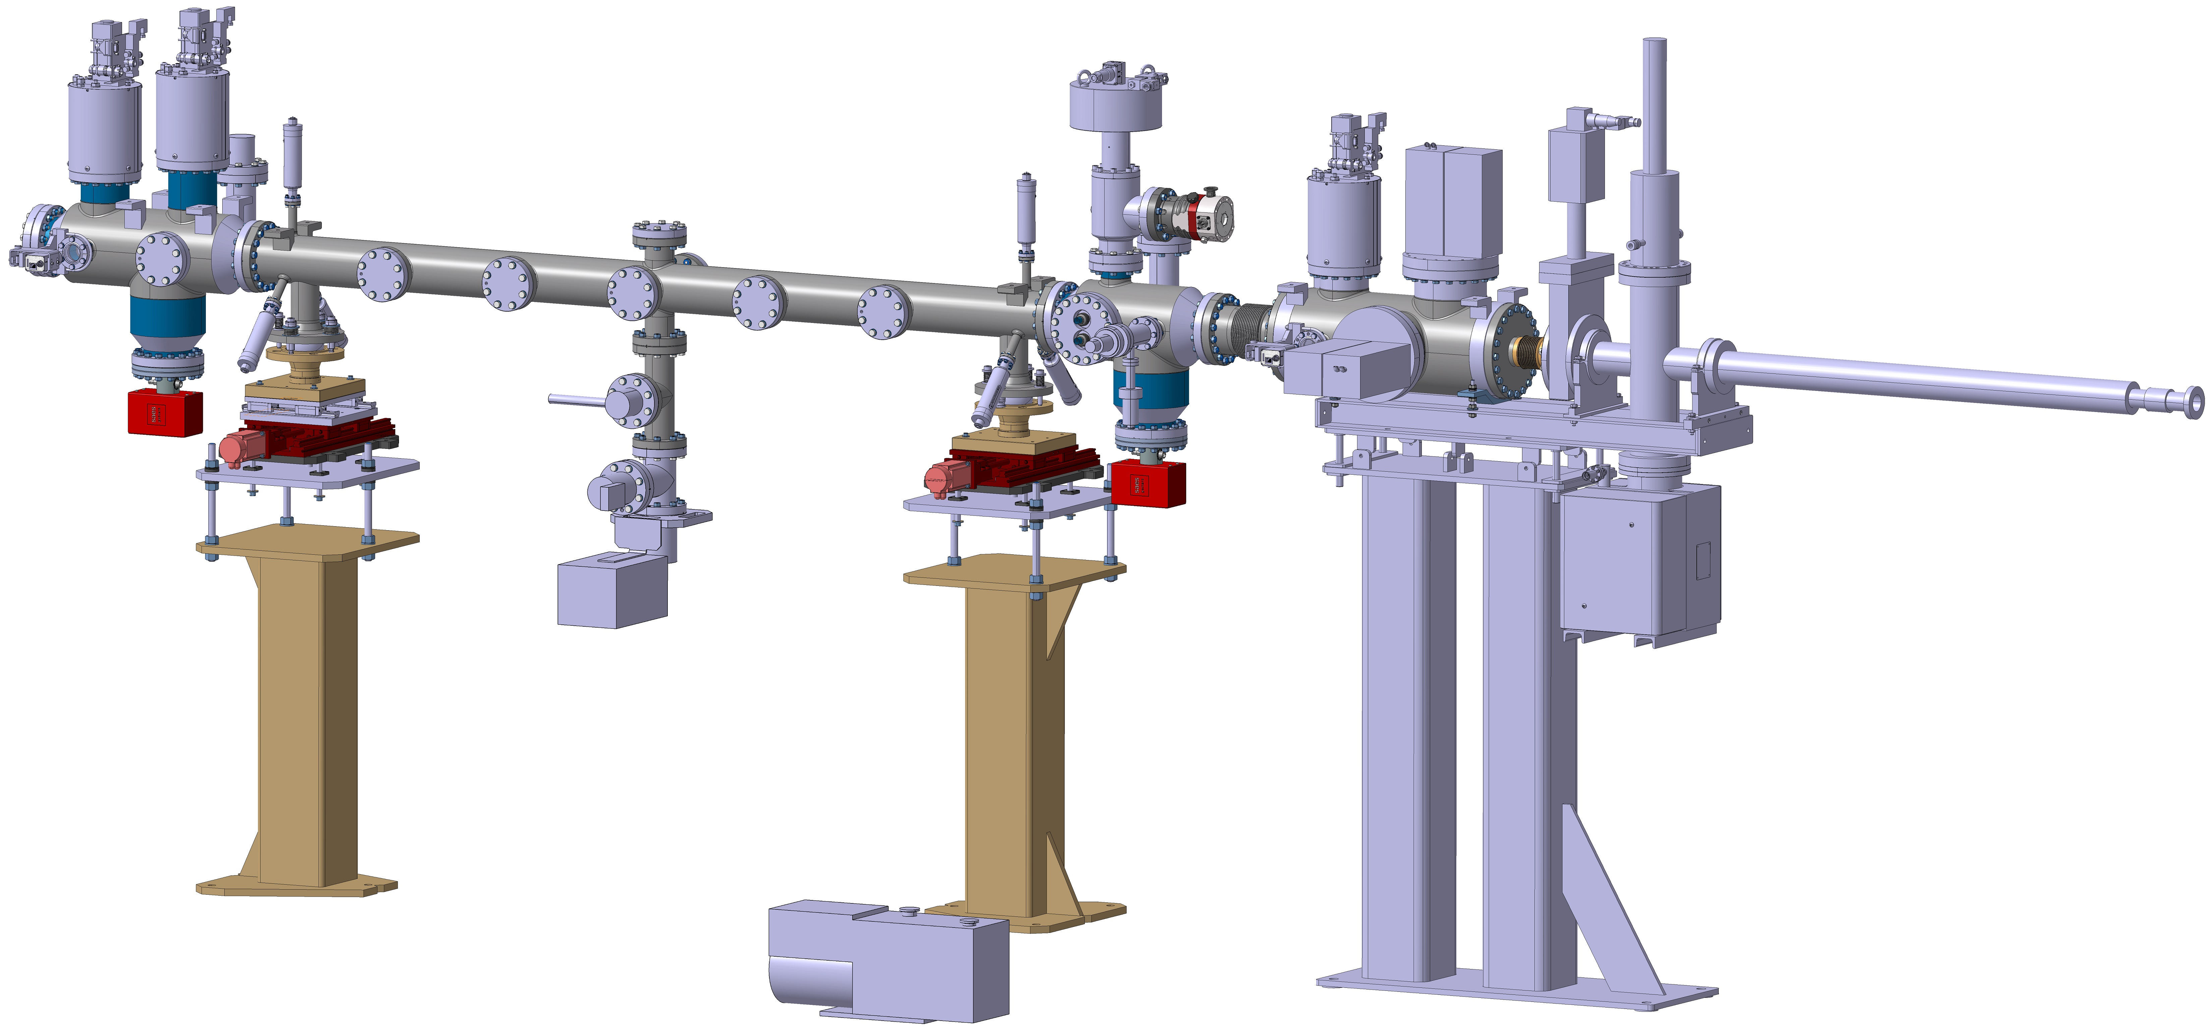
2 - FCC Test Line 4rd Update

Slide 5
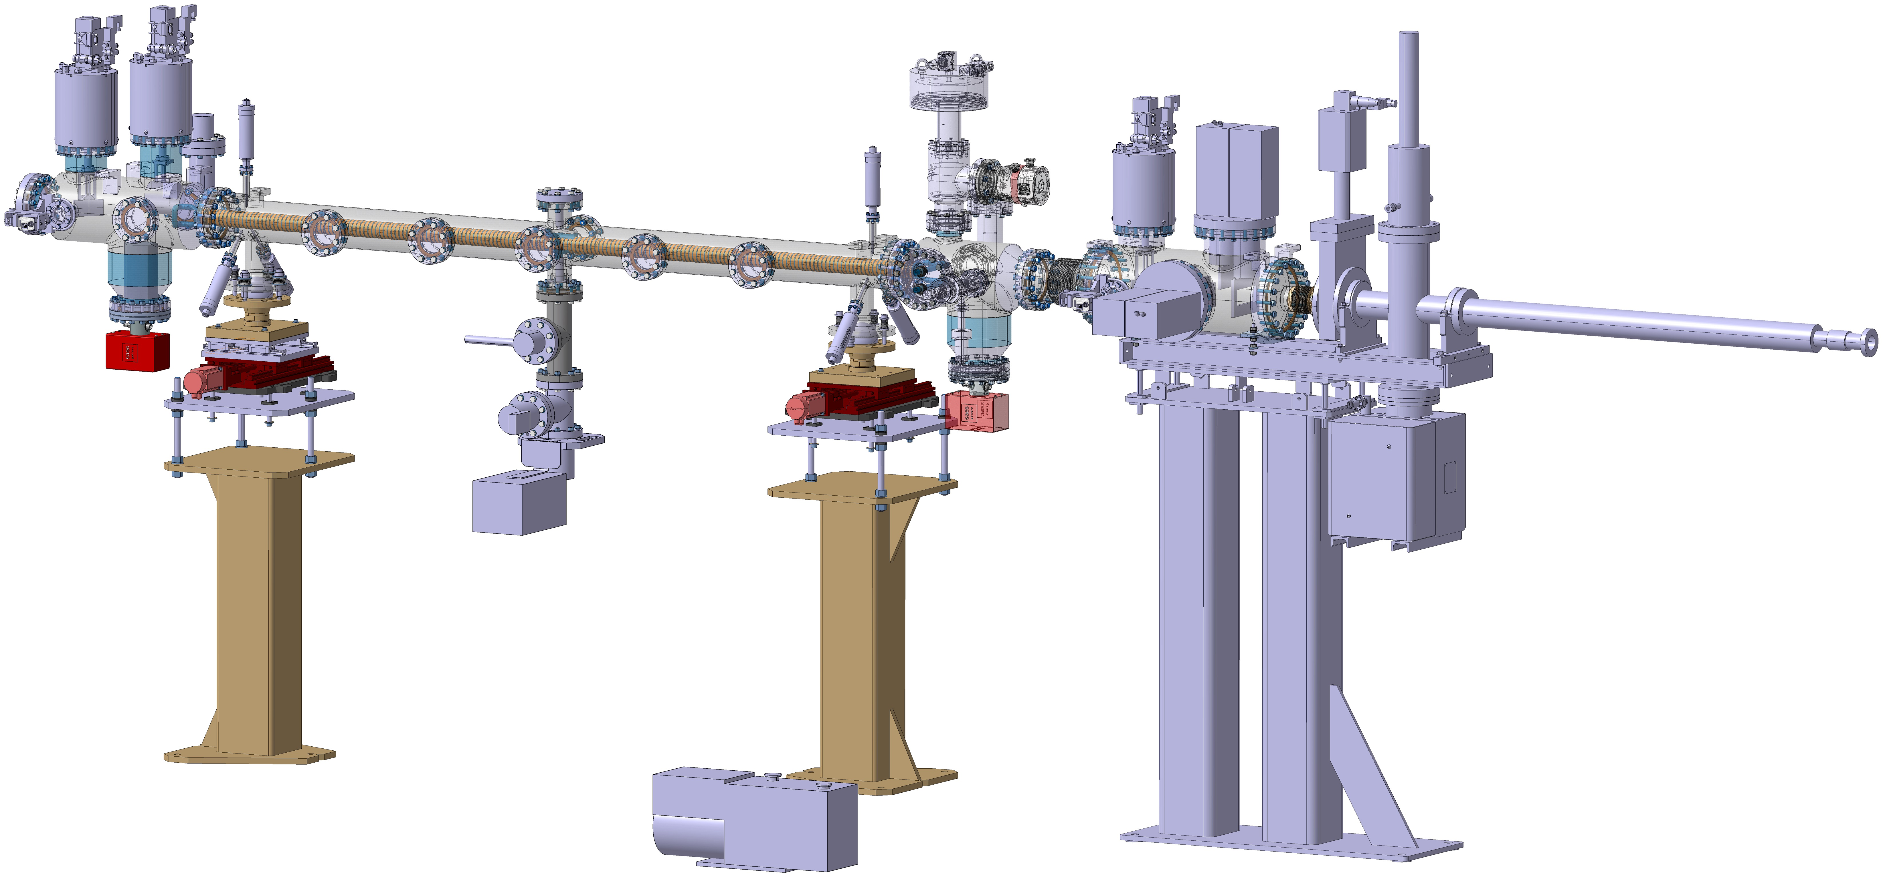
2 - FCC Test Line 4rd Update

Slide 6
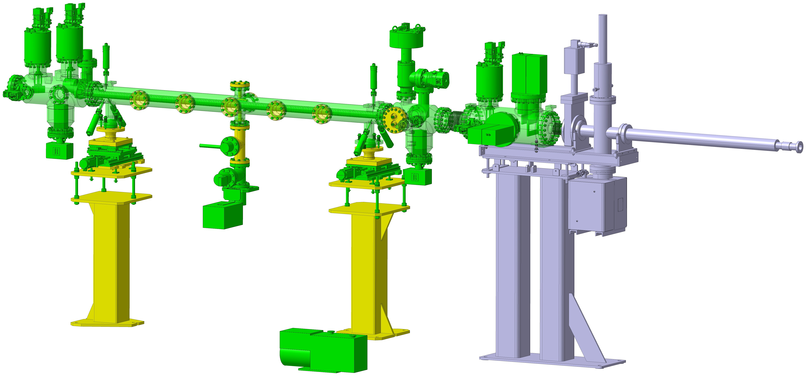
3 - Design & Purchase progress
6

Slide 7
3 - Design & Purchase progress
Back Instrumentation Assembly |  | Test Bench Vessel |  | Test Bench Supports |  |  | Front Instrumentation Assembly |  | Slits Assembly
Chamber | Ordered | Chamber | Ordered | Rotating stages | Rotative flange | Design phase | Chamber | Ordered | Chamber | Ordered
Bayard Alpert | Existent | Actuators | Received |  | Rolling bearing | Received | Valve | Ordered | Slits | Existent
Fluorescent screen | Ordered | Thermocouple feedthroughs | To be ordered |  | Base | Design phase | Turbo-Pump | Ordered | Fluorescent screen | Ordered
Photon collector | Ordered | Alignment pin-flange | Design phase | Free linear stage | Linear guides | Ordered | Penning-piranni | Ordered | Rupture disc | To be ordered
NEX-Torr pump | Ordered | Chimney | Design phase |  | Base | Design phase | NEX-Torr pump | Ordered
 |  | Interconnection Tee piece | To be ordered | Motorized linear stages | Linear stage | Ordered | Water feedthrough | Design phase
 |  | Bayard Alpert | Existent |  | Motor + coupling | Ordered
 |  | RGA | Existent |  | Fiducial base | Design phase
 |  |  |  | Planar alignment stages | Guiding shafts | Ordered
 |  |  |  |  | Bushings | Ordered
 |  |  |  |  | Height tunning screw | Design phase
 |  |  |  |  | Base | Design phase
 |  |  |  | Fixed support | Base | Design phase
*Standard elements from CERN store have not been included (screws, metal sheets, etc)
7

Slide 8
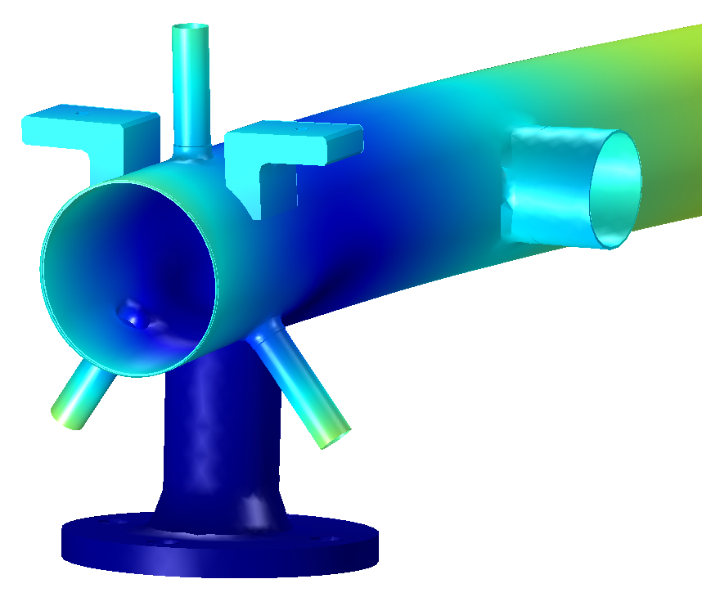
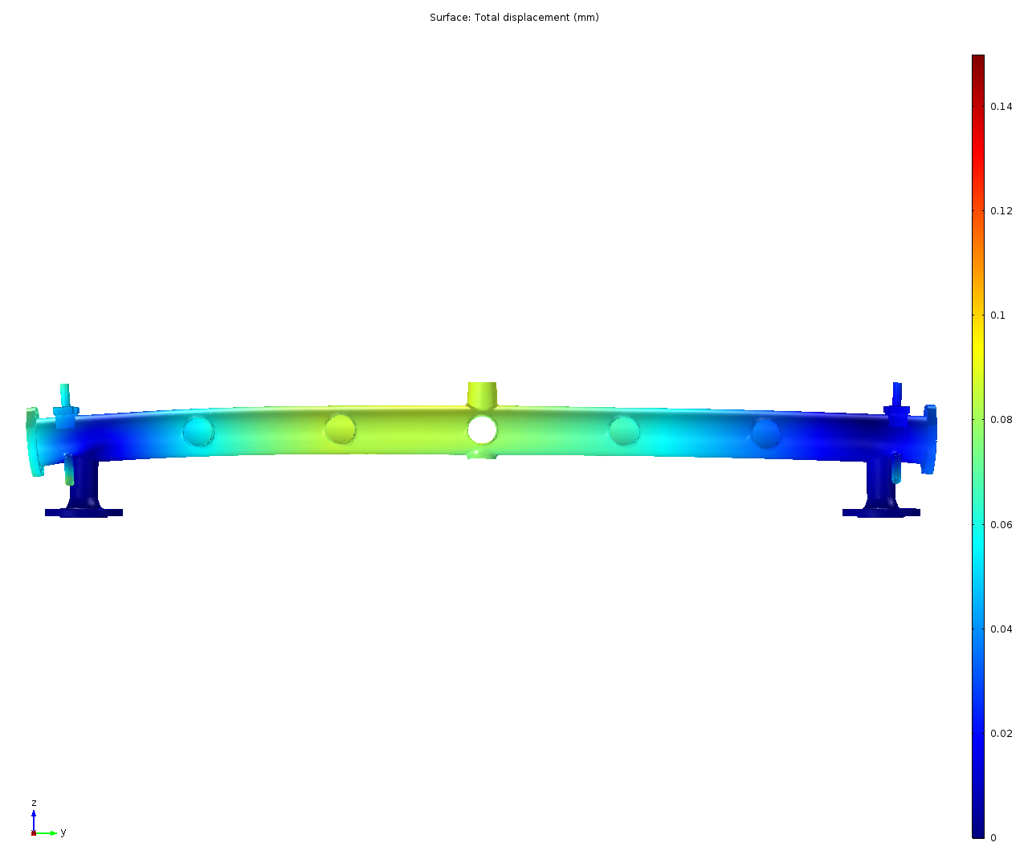
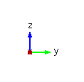
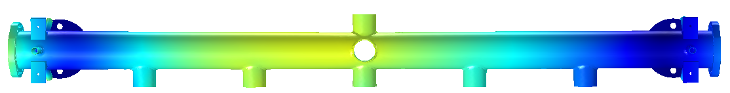

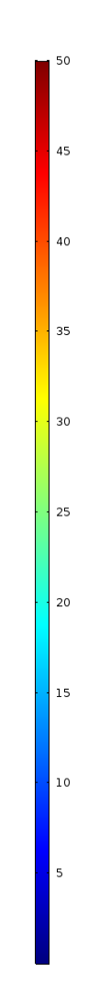
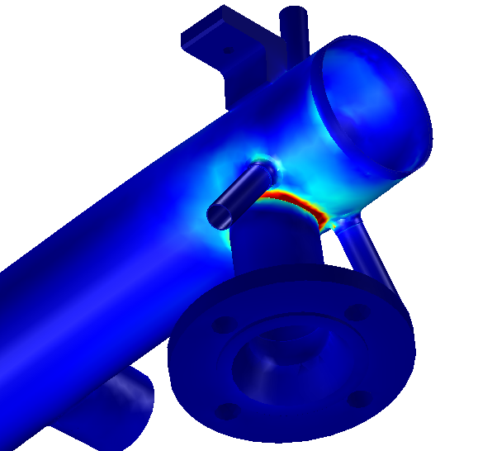
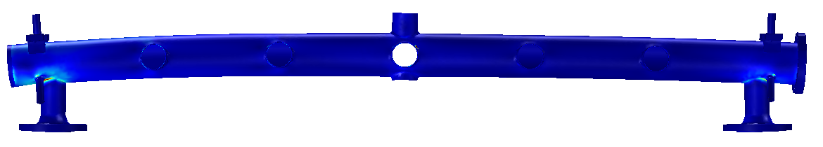
4 - Mechanical analysis
DEFORMATION
Z=-0.029 mm
Z=-0.014 mm
Z=-0.058 mm
Z=-0.032 mm
Z=-0.026 mm
Z=-0.013 mm
Z=-0.026 mm
Z=-0.014 mm
STRESS

Slide 9
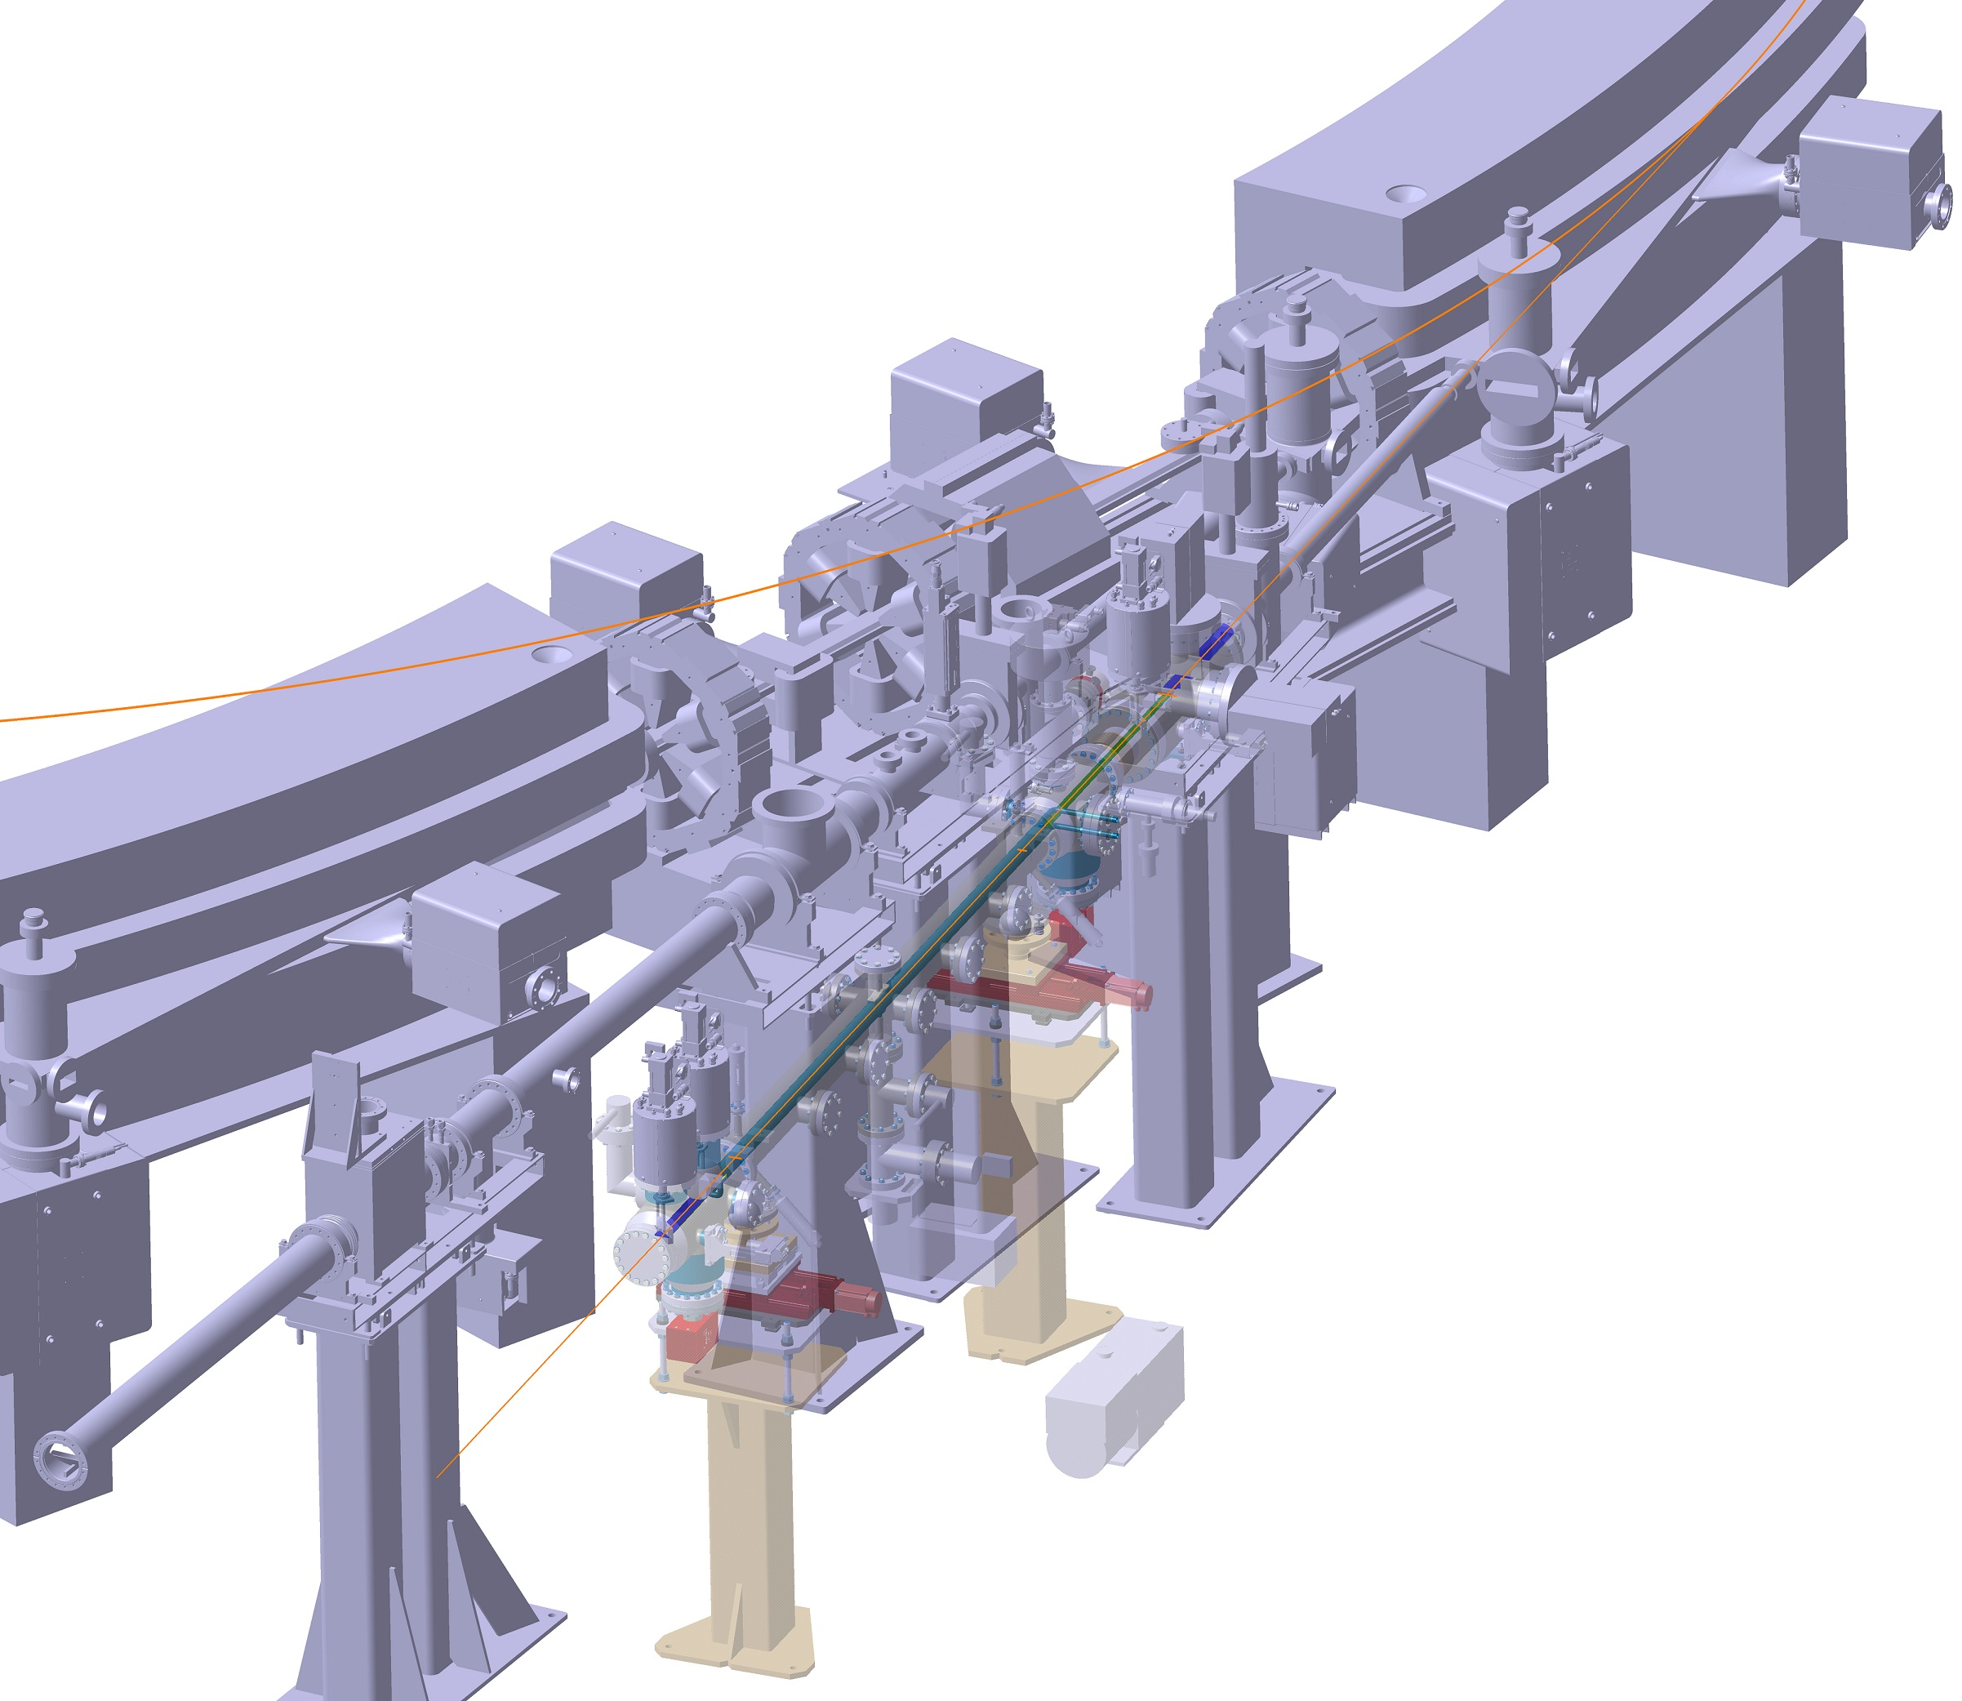
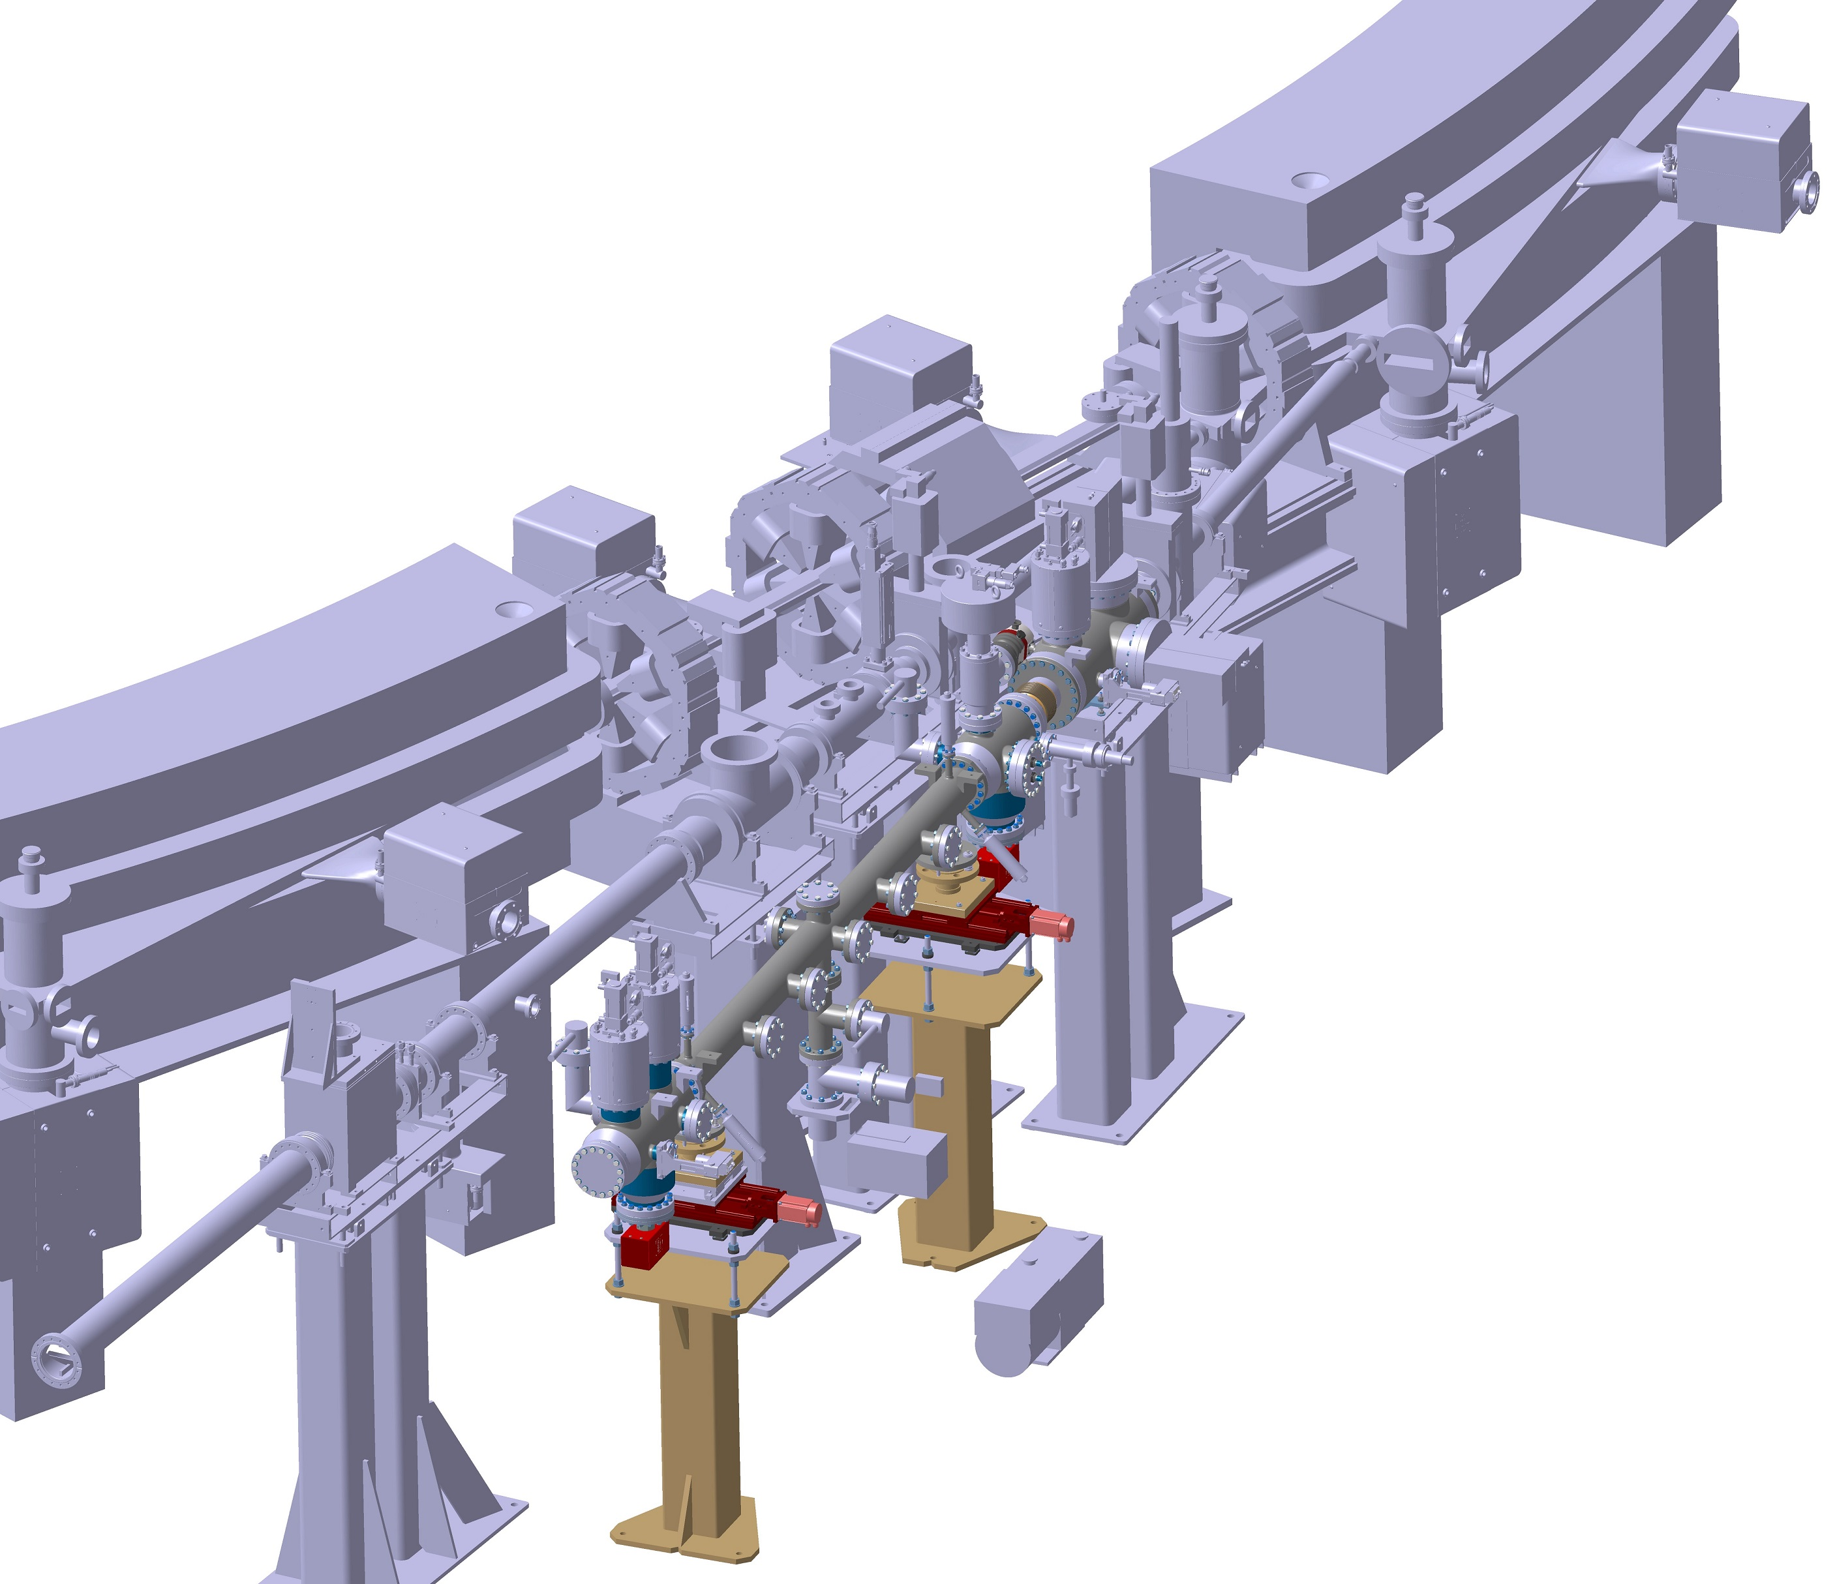
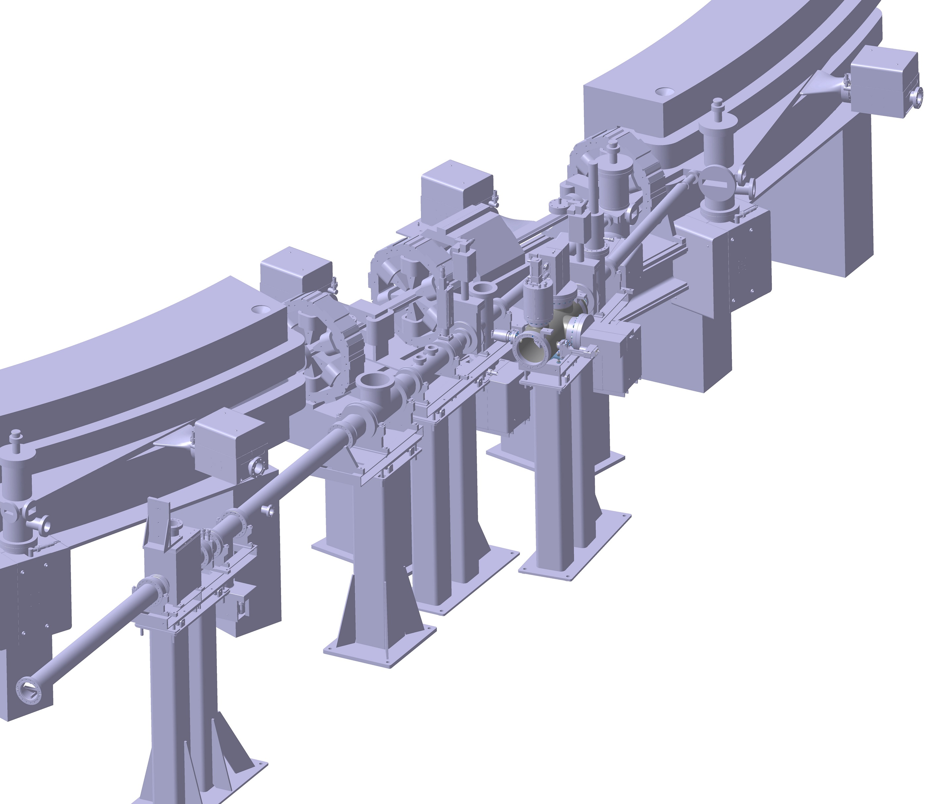
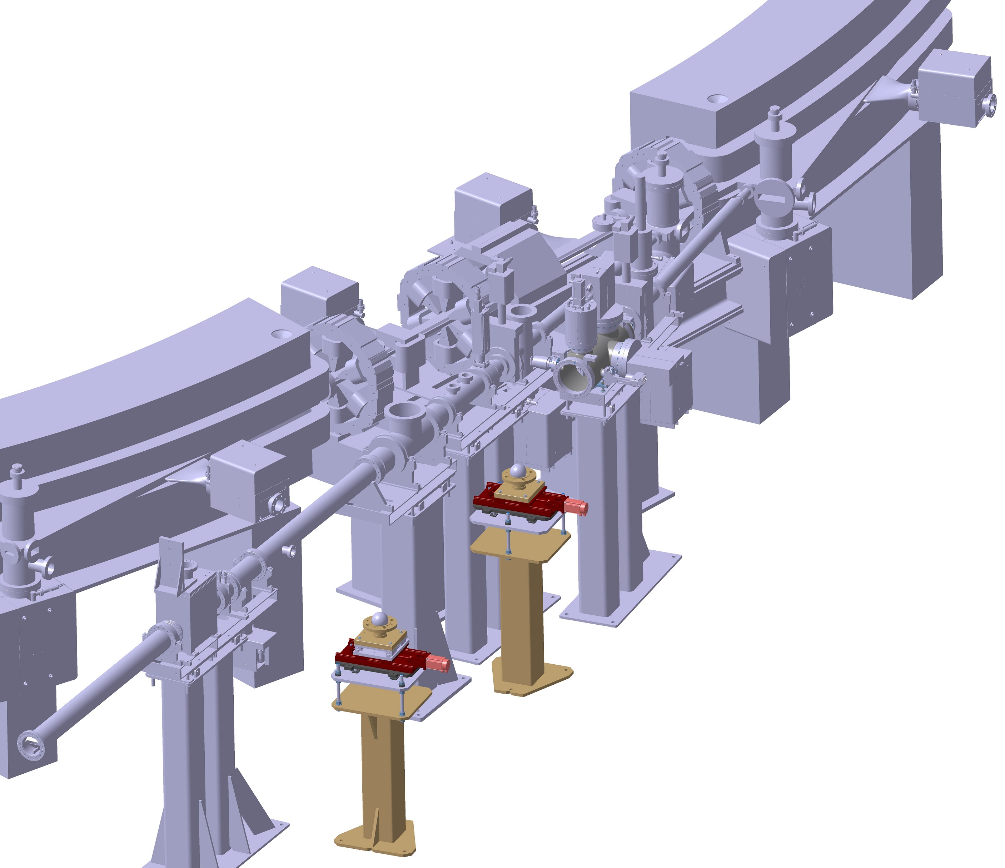

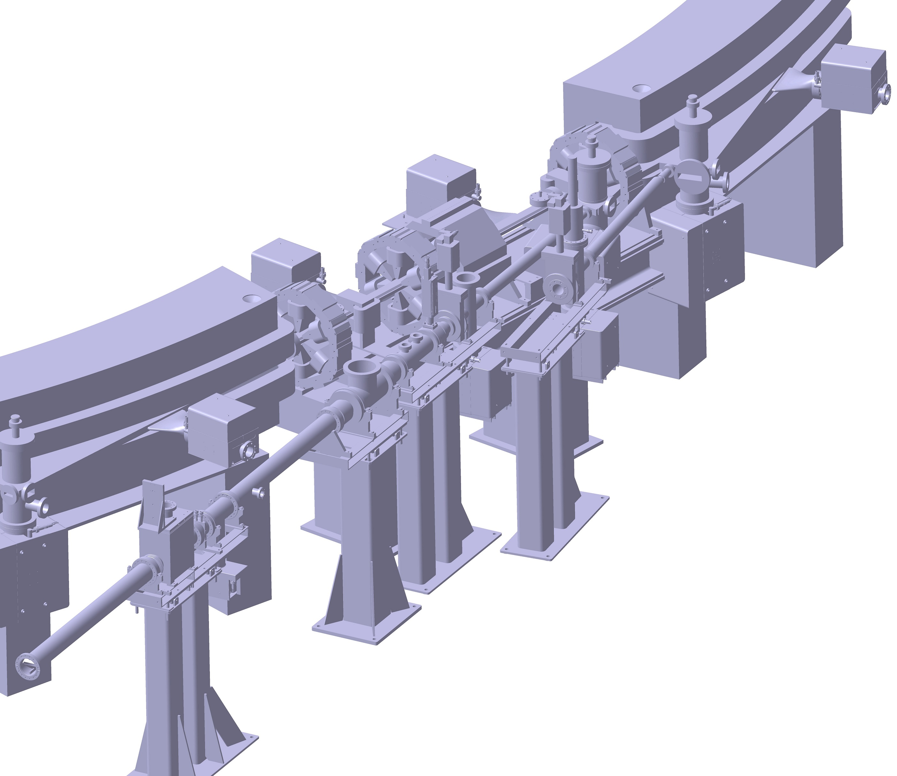
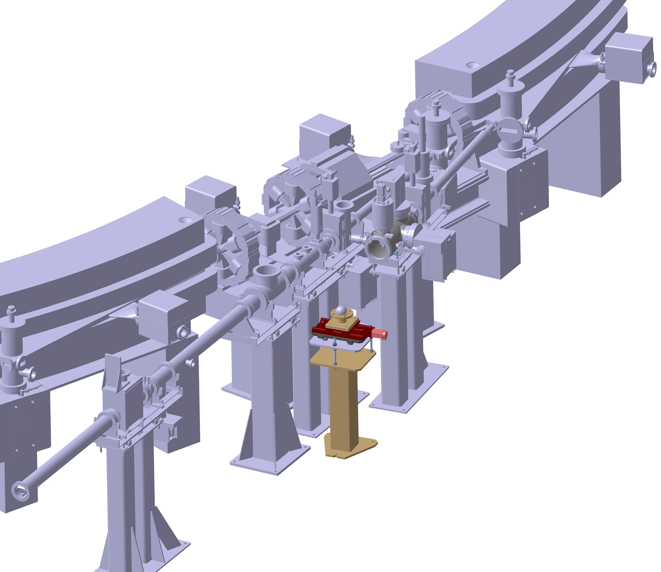

5 - Installation

Slide 10
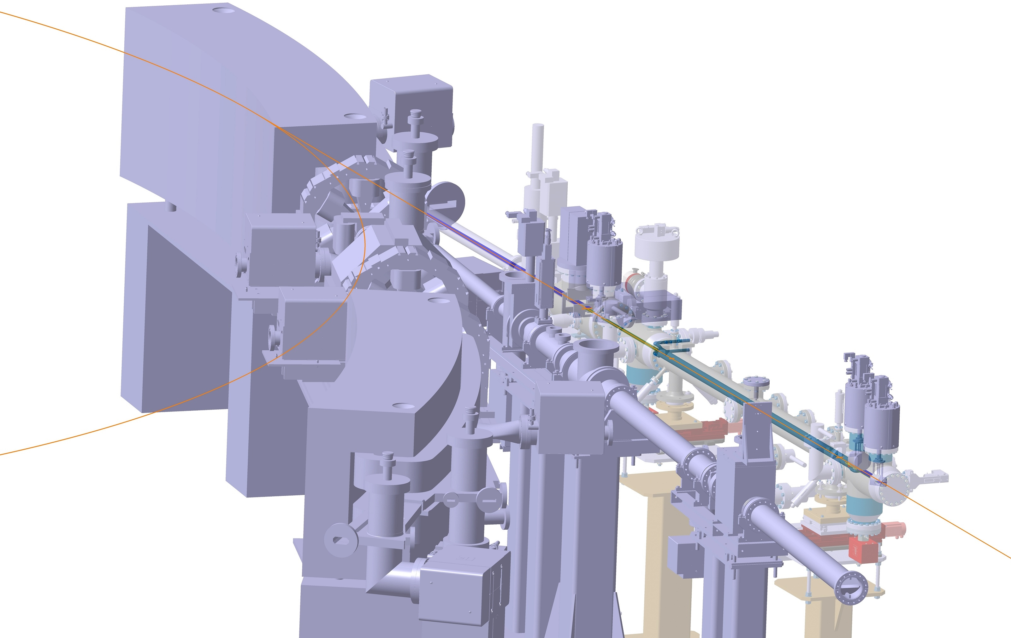
5 - Installation

Slide 11
6 – Present & Future Steps
Finished:
  Detailed 2D of chambers + purchase order
  Purchase order of fluorescent screens and photon collector
  Most part of standard elements and material ordering
Ongoing:
  Re-design of
    Support legs
    Water feedthrough
    Alignment flange
    Chimney
    Bases
Future:
  Finish re-design / orders
  Production of supports elements, assembly and testing
  Follow-up of chambers (Trinos) and Fluorescent Screens+Photon Collector (FMB Oxford)
  Pre-assembly and qualification test at CERN

Slide 12
Thanks for your attention

Slide 13
EXTRA SLIDES

Slide 14
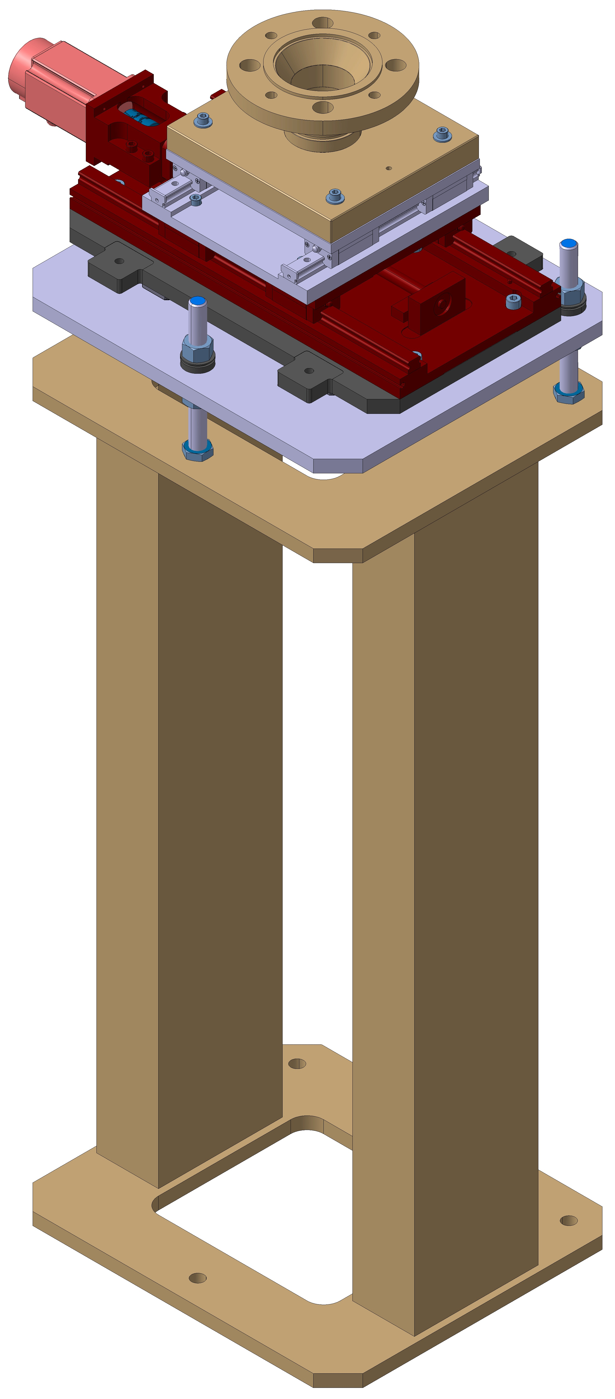
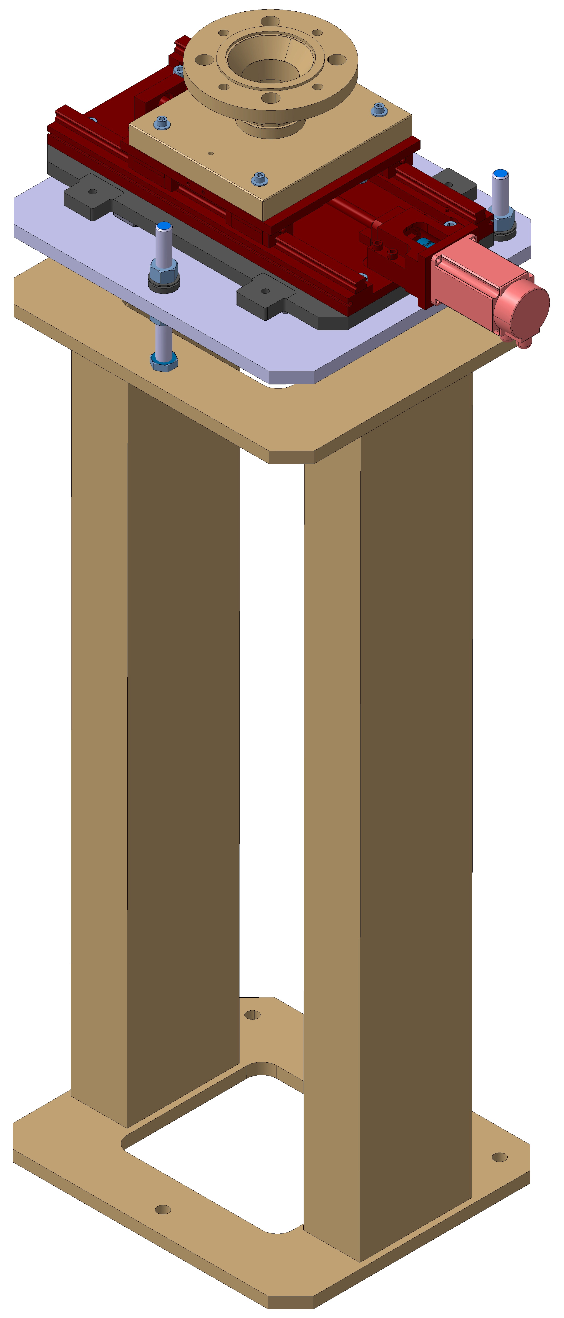
Extra Slide – Supports

Slide 15
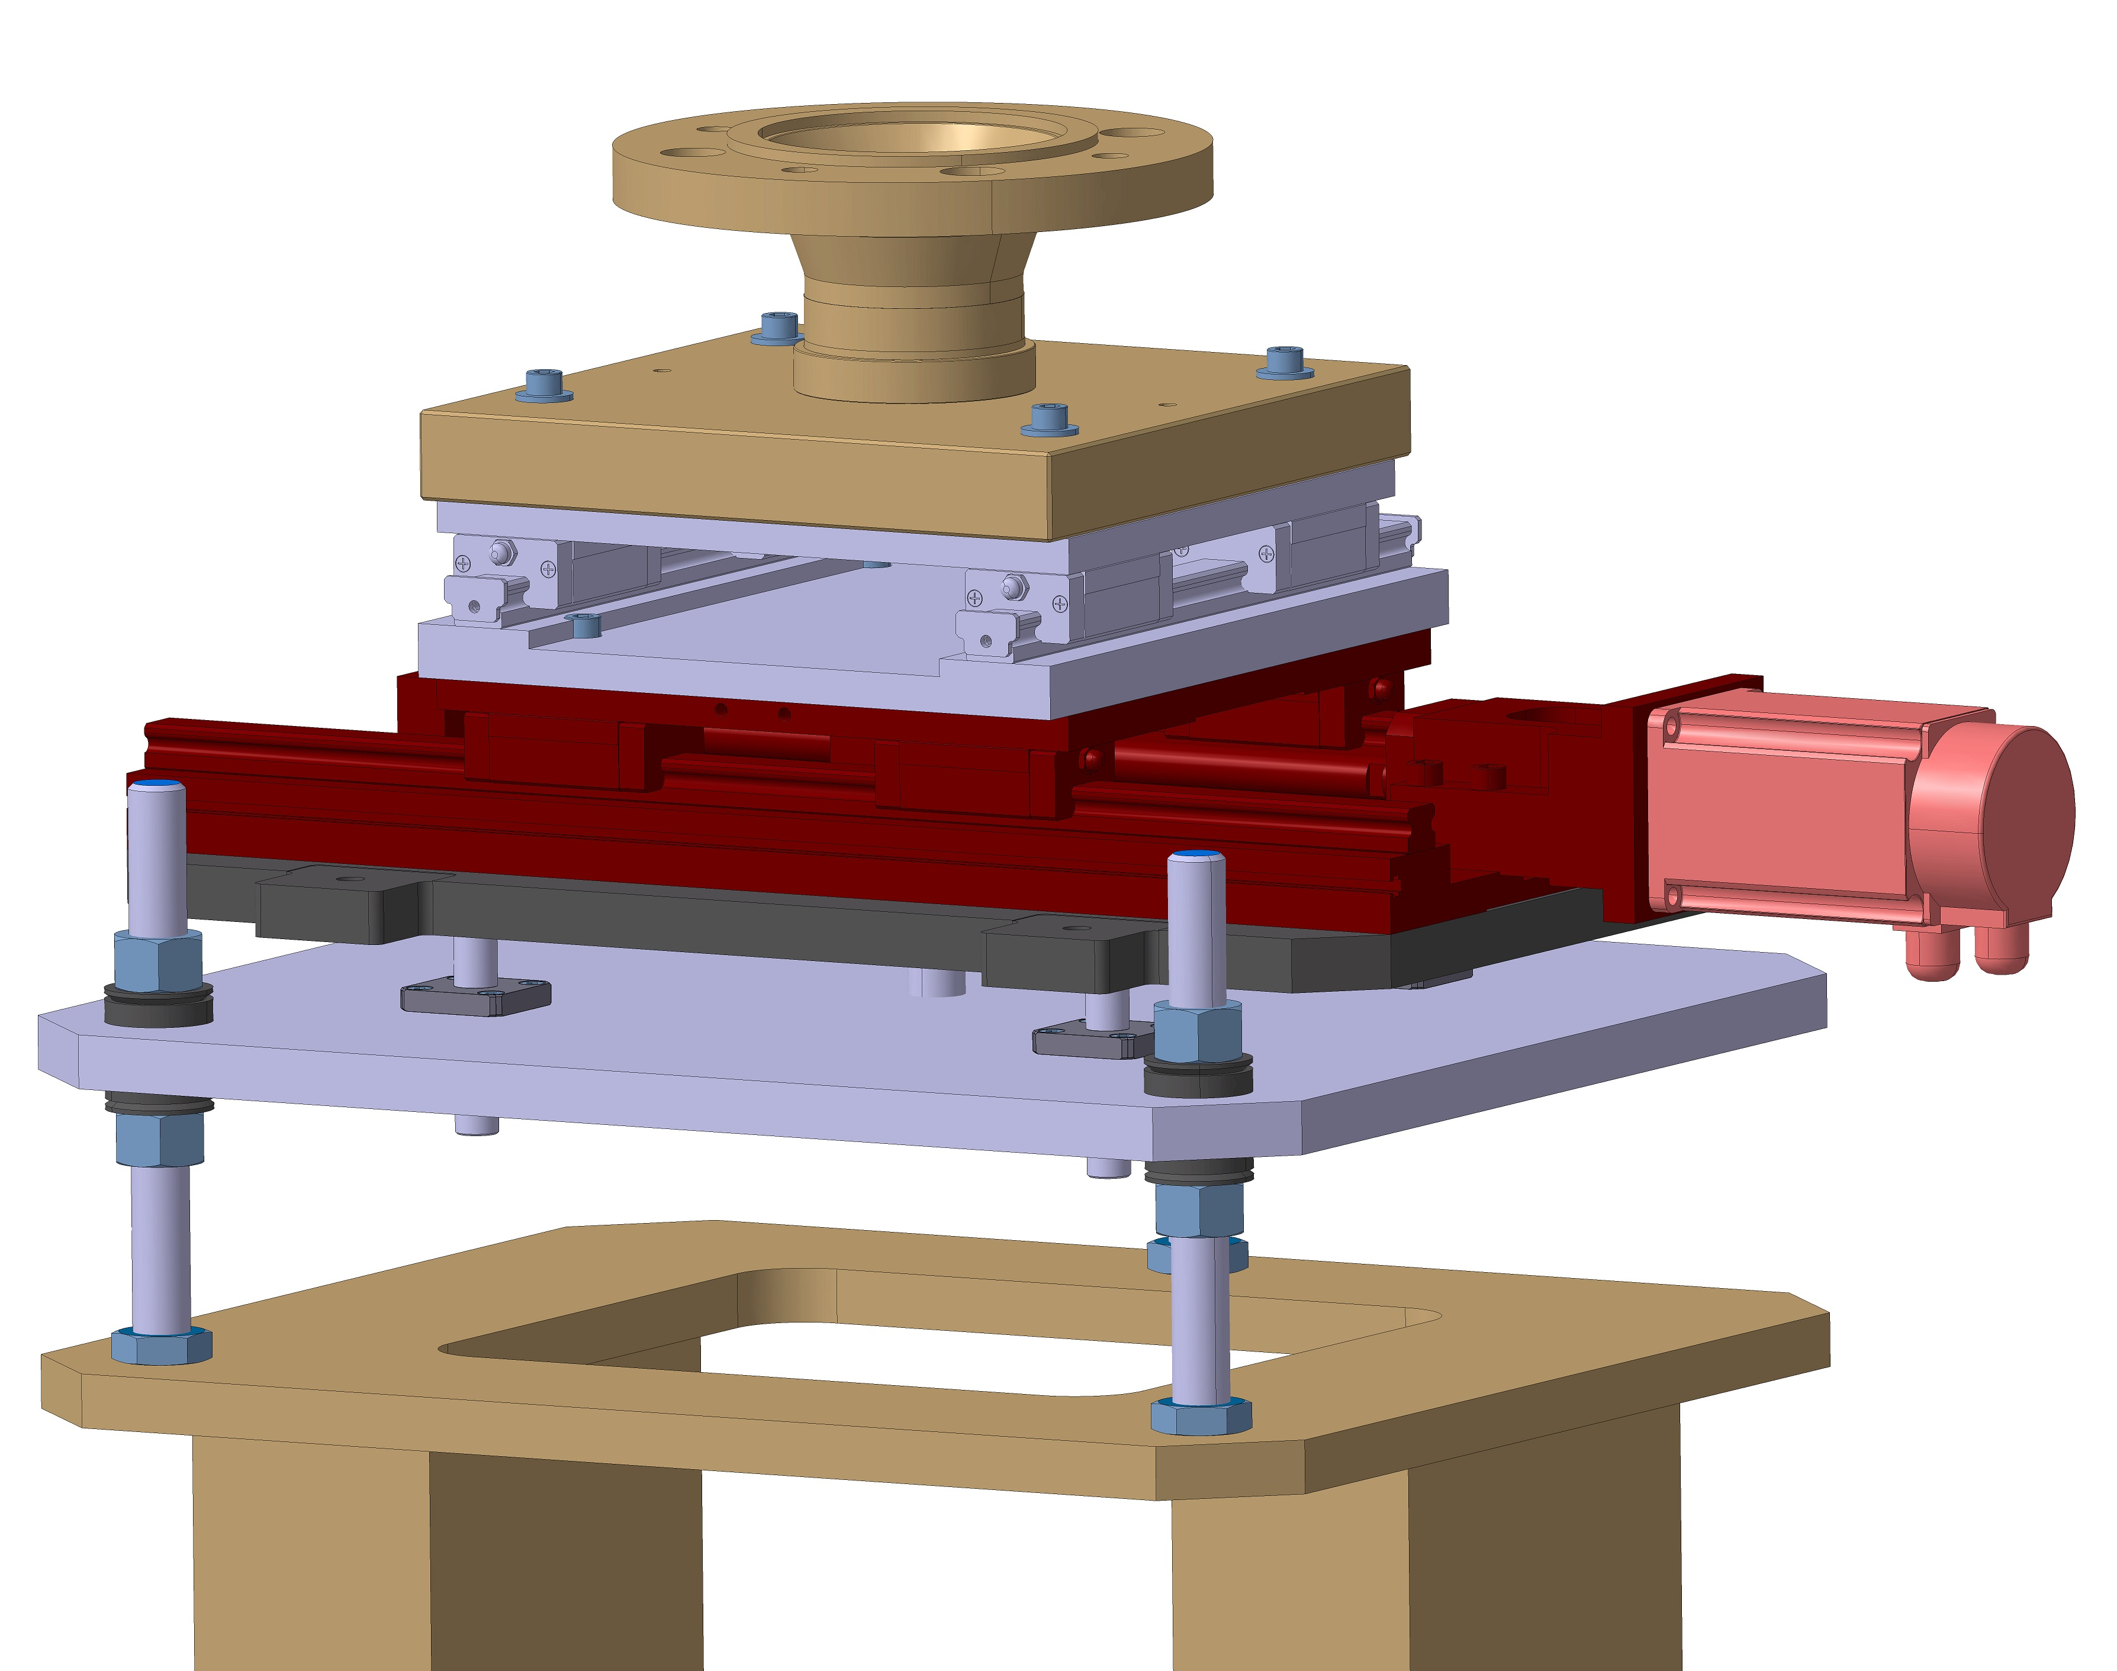
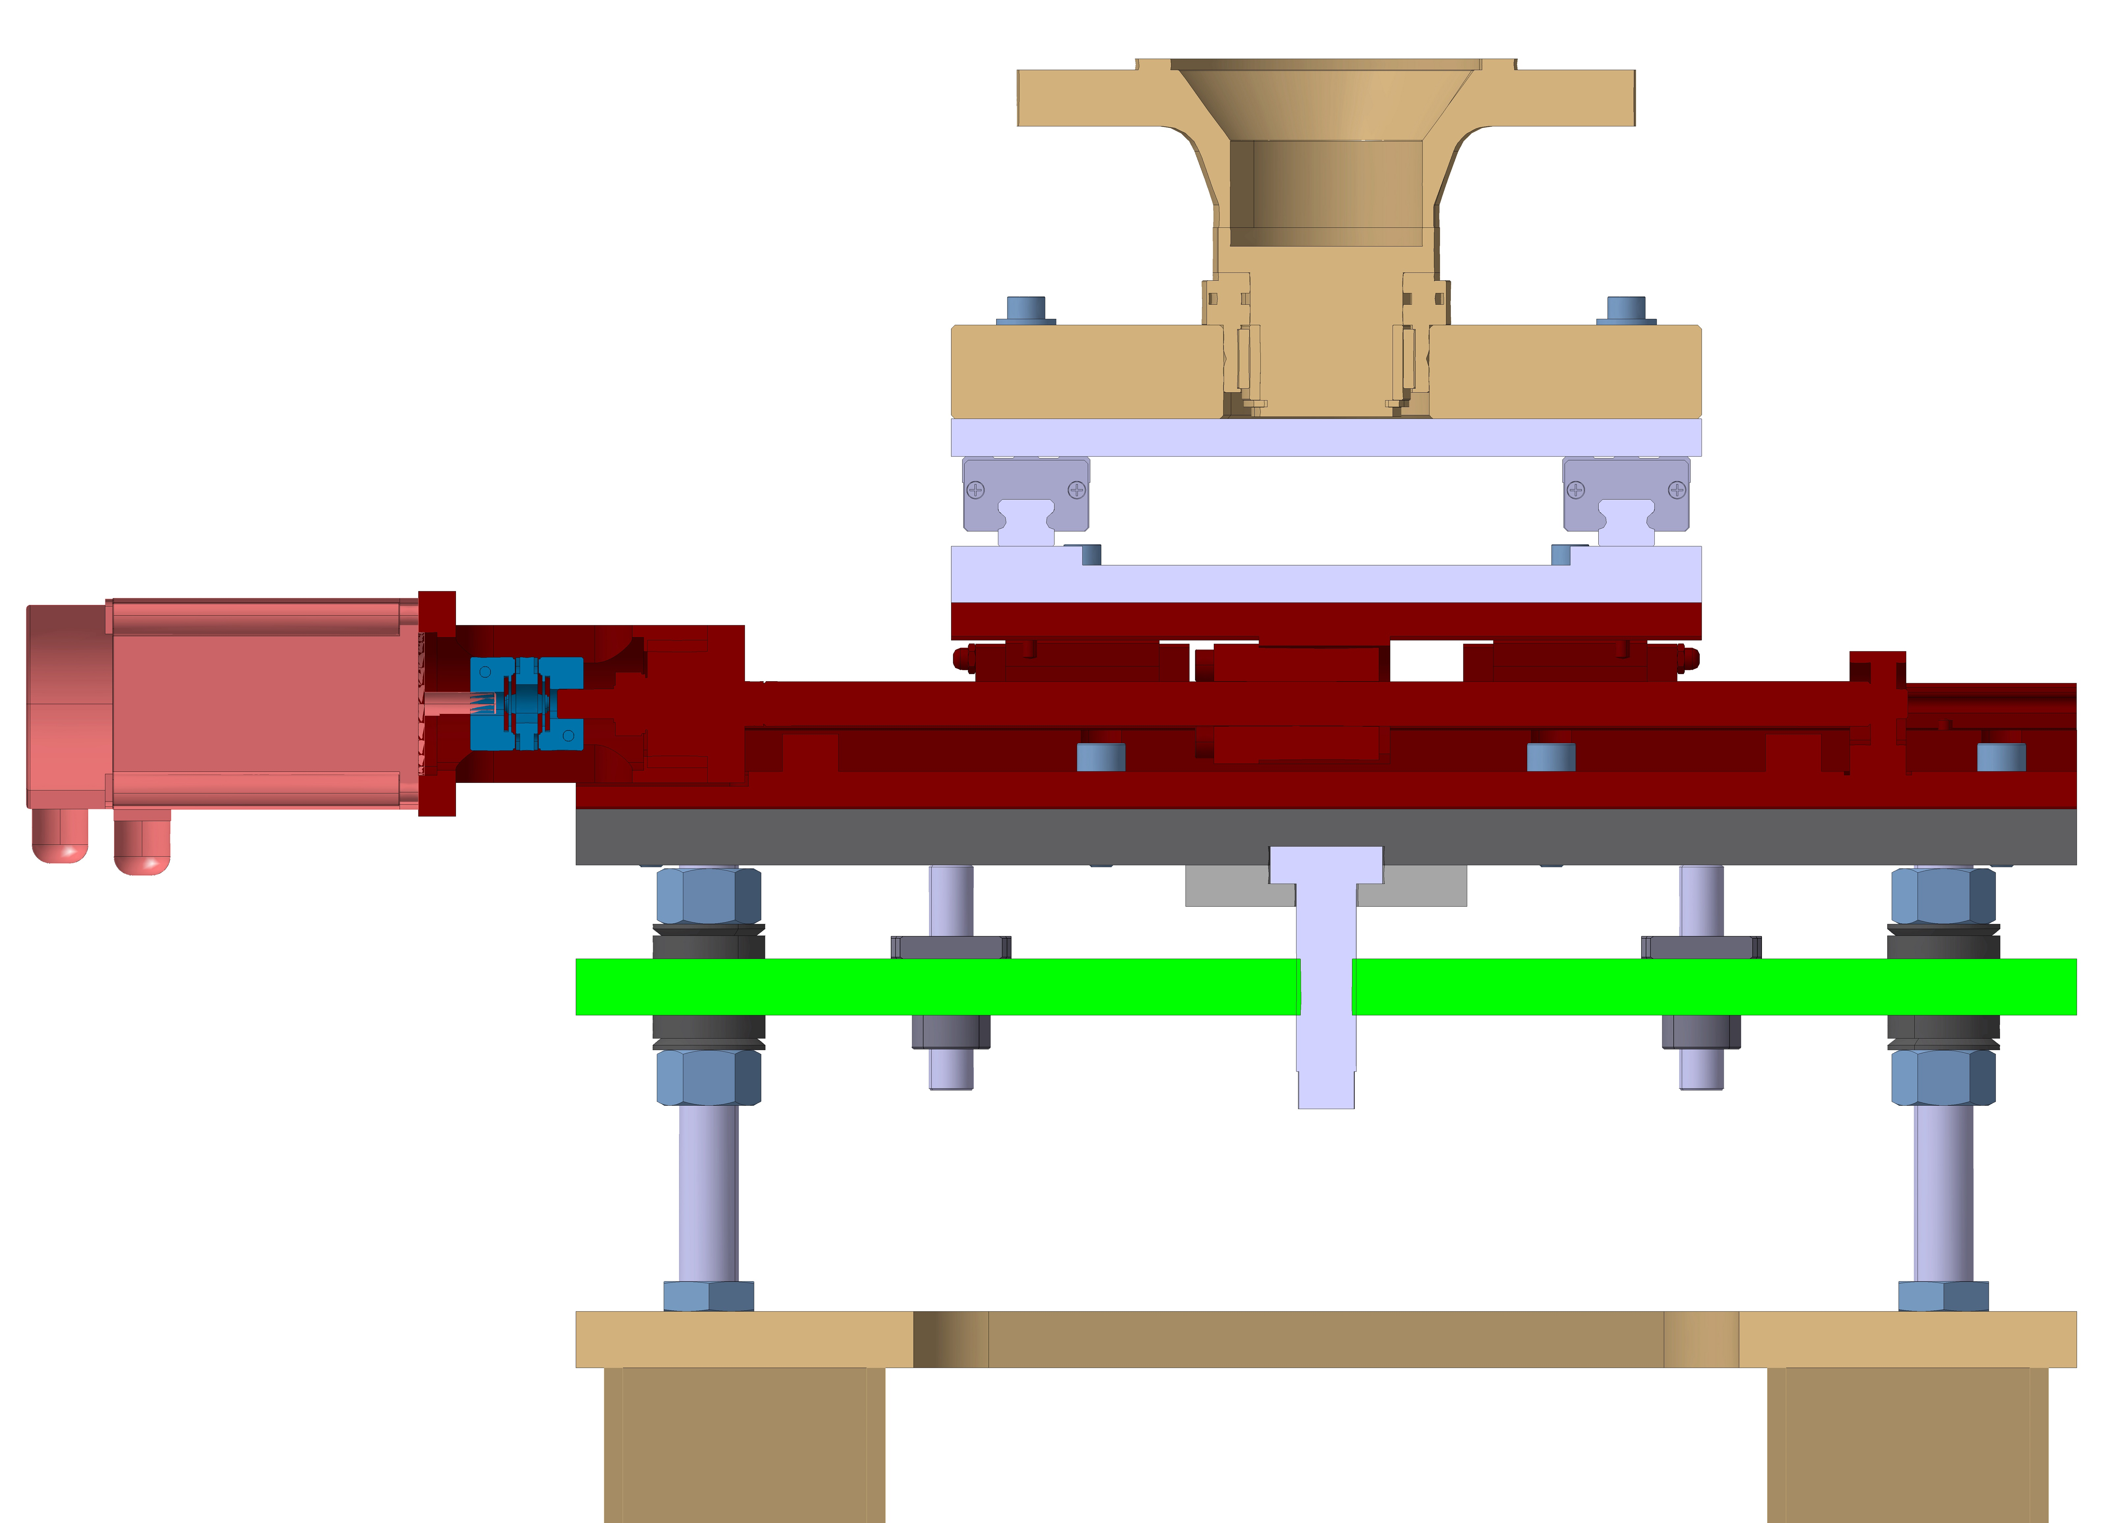
Extra Slide – Supports
CERN Stores
41.01.38 - WELDING NECK FLANGES
123 roulement.com
Bille BA-80
APPLIED MOTION
HD23-601DC-ZAC
MISUMI
MCSLC25-6.35-8
SKF
NKXR45 Z + IR 45X40X20
MISUMI
2x SX2R24-220-TMS
MISUMI
KUB1204L-400-200-N2
FLI
4x SMK-12
MISUMI
4x PSSFUN12-60-F14-B11-P8

