Slide 1
Optimisation of the CLIC Damping rings for the project re-baselining
H. Ghasem, S. Papadopoulou,
F. Antoniou and Y. Papaphilippou
CLIC implementation meeting
November 4th, 2016

Slide 2
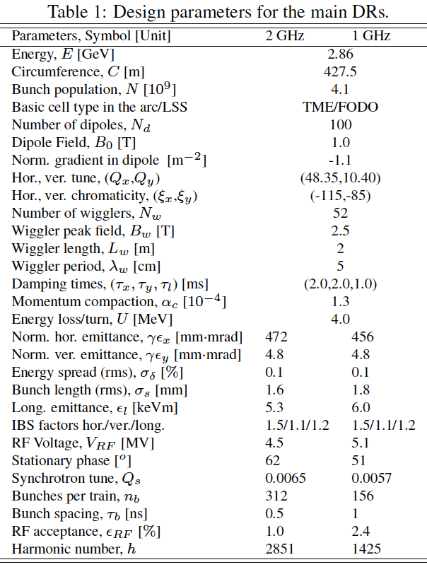
CLIC DR challenges and adopted solutions
High-bunch density in all three dimensions
  Intrabeam Scattering effect reduced by choice of ring energy, lattice design, wiggler technology and alignment tolerances
  Electron cloud in e⁺ ring mitigated by chamber coatings and efficient photon absorption
  Fast Ion Instability in the e⁻ ring reduced by low vacuum pressure and large train gap
  Space charge vertical tune-shift limited by energy choice, reduced circumference, bunch length increase
  Other collective instabilities controlled by low –impedance requirements on machine components
Repetition rate and bunch structure
  Fast damping times achieved with SC wigglers
  RF frequency reduction @ 1GHz considered due to many challenges @ 2GHz (power source, high peak and average current, transient beam loading)
Output emittance stability
  Tight jitter tolerance driving kicker technology
Positron beam dimensions from source
  Pre-damping ring challenges (energy acceptance, dynamic aperture) solved with lattice design

Slide 3
Adapting the DR complex to a new CLIC baseline
Pre-damping rings revision
  Potentially remove the electron pre-damping ring
  Potentially replace the positron pre-damping ring with a booster ring
Review DR based on recent design developments and collaboration effort in the low emittance rings community (both beam dynamics and technology)
    New DR arc cell (longitudinally varying bends) and SC wigglers for circumference reduction (collective effects)
    RF frequency choice and LLRF technical development
    Stripline kicker + pulser tests
    SC wiggler tests and developments

Slide 4
1 vs. 2 GHz RF system
The cost difference due to the RF frequency choice in the DR (scaled with the total voltage) is minor
The cost impact of an additional delay loop for 1 GHz is small (but non negligible)
The technological risk of choosing the 2 GHz option, after conceptual design of A. Grudiev, is equivalent with the train recombination for the 1 GHz option
Choose 2 GHz as baseline and work with low emittance rings community to prove efficient handling of beam loading transients
  Collaboration with ALBA (F. Perez et al.) and LBNL (J. Byrd et al.) for the conceptual design of a 1.5 GHz active RF system
  Collaboration with T. Mastorides (CalPoly) for longitudinal beam dynamics and LLRF (T. Argyropoulos, A. Grudiev)

Slide 5
Emittance targets
2008

Slide 6
Emittance targets
2016

Slide 7
The aim
Current design of the main CLIC DRs, E=2.86 GeV
Parameters, Symbol [Unit] | uniform
Circumference, C [m] | 427.5
Norm. horiz. emittance , γε_{x} [nm-rad] * | 657
Reduce the number of arc TME cells->longitudinally variable bends
Reduce the number of wigglers->higher wiggler field
500 nm (700 nm) required output emittance
*The emittance is calculated using the Bjorken-Mtingwa formalism through MADX.
Using the Piwinski form., the original design (with the uniform dipoles) reaches the target horizontal emittance.

Slide 8
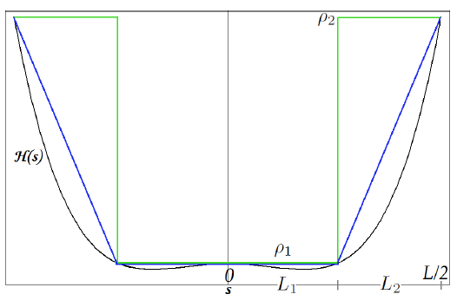
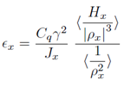



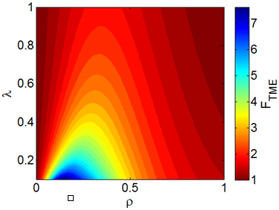
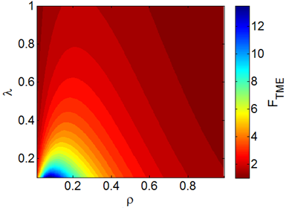



Longitudinally variable bends
Bending radii ratio
Step profile
Trapezium profile
Lengths ratio
Emittance reduction factor
The parameterization of the emittance reduction factor FTME with the bending radii ratio ρ and the lengths ratio λ, always for λ>0.1.

Slide 9
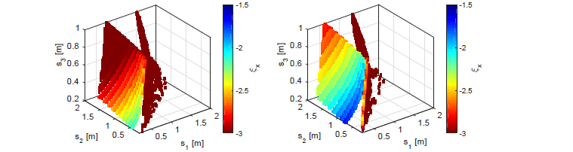

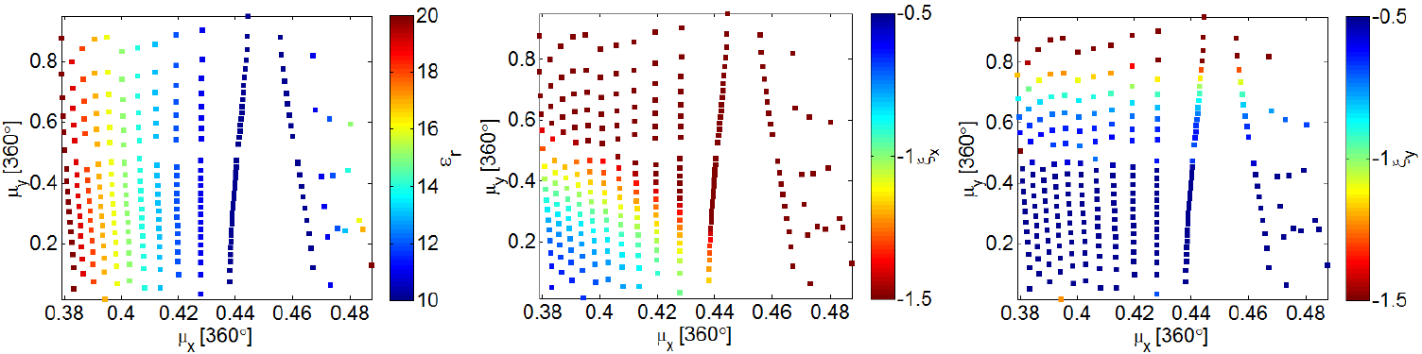
Optimization of the arc TME cell
Parametrization with the drift lengths
The horizontal chromaticity ξ_{x} is parameterized with the drift lengths s₁, s₂, s₃ for the TME, for the step (left) and the trapezium (right) profile
Parametrization with the phase advances
The parameterization of the detuning factor ε_{r} (ε_{r} = ε_{x} /ε_{TME}) and of the horizontal and vertical chromaticities (ξ_{x} and ξ_{y}) with the horizontal and vertical phase advances μ_{x} and μ_{y} , only for the trapezium profile.

Slide 10
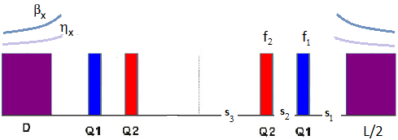
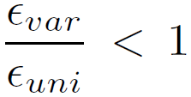


Optimization of the arc TME cell
When properly using the variable bends, lower emittances than the current design’s ones are reached. This gives us the flexibility to reduce the existing arcs’ TME cells, till the point we get the required output parameters (because the aim is not only to get a lower emittance, but also a shorter ring).
procedure followed in MADX
removing TME cells
checking the output parameters
The optimal solutions are found to be N_{d}=96 for the step and N_{d}=90 for the trapezium profile, instead of the existing arc’s cell that are N_{d}=100.

Slide 11

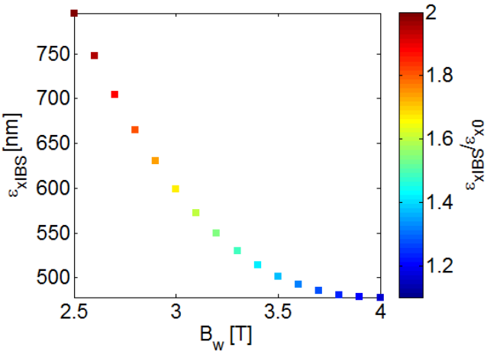
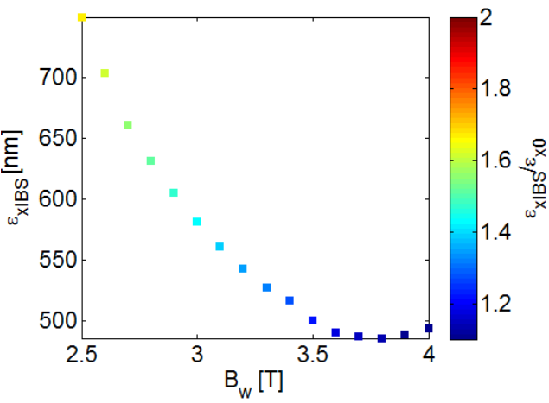
Optimization of the wiggler FODO cell
Nb=4.07e+09
Results obtained after the optimization of the arc TME cell.
When increasing the wigglers’ peak field B_{w} up to a certain point, the emittance and the IBS effect are lowered ^{[3]}.
Based on the technological restrictions, a new working point for the damp. wiggler is proposed to be at 3.5T (prev. 2.5T), with 49mm period length^{[4]}
Removing some FODO cells from the existing straight section (N_{FODO}=13 per section) is possible.
N_{FODO}=10 per straight section
Step profile
Trapezium profile
Parametrization of the steady state emittance and the IBS effect with the wiggler’s peak field B_{w}

Slide 12
Nb=4.07e+09
DRs parameters, 2GHz and E=2.86 GeV
Parameters, Symbol [Unit] | uniform | step | trapezium
Number of arc cells/wigglers | 100/52 | 96/40 | 90/40
Dipole field (max/min), B [T] | 0.97/0.97 | 1.77/1.01 | 1.77/0.73
horiz. /vert. chromaticities ξ_{x}/ξ_{y} | -113/-82 | -135/-76 | -126/-72
Wiggler peak field B_{w} [T] for length L_{w} =2m | 2.5 | 3.5 | 3.5
Wiggler period, λ_{w} [cm] | 5.0 | 4.9 | 4.9
Mom. compaction, α_{c} [10⁻⁴] | 1.3 | 1.3 | 1.2
Energy loss/turn, U [MeV/turn] | 4 | 5.7 | 5.7
Energy spread (rms), σ_{δ} [%] | 0.12 | 0.13 | 0.13
Bunch length (rms), σ_{s} [mm] | 1.8 | 1.6 | 1.6
Long. emittance , ε_{l} [keV m] | 5.9 | 6.1 | 6.0
Damp. times, (τ_{x}, τ_{y}, τ_{l}) [ms] | (2.0, 2.0, 1.0) | (1.2, 1.3, 0.6) | (1.2, 1.2, 0.6)
IBS factors hor./ver./long. | 2.2/1.5/1.2 | 1.4/1.5/1.1 | 1.4/1.5/1.1
Norm. horizontal emittance (with IBS), γε_{x} [nm] | 681 | 502 | 500
Norm. vertical emittance (with IBS), γε_{y} [nm] | 5 | 5 | 5
Circumference, C [m] | 427.5 | 374.1 (-14%) | 359.4 (-19%)
-Collaboration with the Advanced Light Source ALS (LBNL) for their machine upgrade.
-Magnet design, based on the variable bends specifications, is studied in CIEMAT, Spain.

Slide 13
Nb=5.7e+09
DRs parameters, 2GHz and E=2.86 GeV
Parameters, Symbol [Unit] | uniform | step | trapezium
Number of arc cells/wigglers | 100/52 | 96/40 | 90/40
Dipole field (max/min), B [T] | 0.97/0.97 | 1.77/1.01 | 1.77/0.73
horiz. /vert. chromaticities ξ_{x}/ξ_{y} | -113/-82 | -135/-76 | -126/-72
Wiggler peak field B_{w} [T] for length L_{w} =2m | 2.5 | 3.5 | 3.5
Wiggler period, λ_{w} [cm] | 5.0 | 4.9 | 4.9
Mom. compaction, α_{c} [10⁻⁴] | 1.3 | 1.3 | 1.2
Energy loss/turn, U [MeV/turn] | 4 | 5.7 | 5.7
Energy spread (rms), σ_{δ} [%] | 0.12 | 0.13 | 0.13
Bunch length (rms), σ_{s} [mm] | 1.8 | 1.6 | 1.6
Long. emittance , ε_{l} [keV m] | 5.9 | 6.1 | 6.0
Damp. times, (τ_{x}, τ_{y}, τ_{l}) [ms] | (2.0, 2.0, 1.0) | (1.2, 1.3, 0.6) | (1.2, 1.2, 0.6)
IBS factors hor./ver./long. | 2.8/1.8/1.2 | 1.6/1.8/1.1 | 1.3/1.8/1.1
Norm. horizontal emittance (with IBS), γε_{x} [nm] | 883 | 568 | 541
Norm. vertical emittance (with IBS), γε_{y} [nm] | 6 | 6 | 6
Circumference, C [m] | 427.5 | 374.1 (-14%) | 359.4 (-19%)
-Collaboration with the Advanced Light Source ALS (LBNL) for their machine upgrade.
-Magnet design, based on the variable bends specifications, is studied in CIEMAT, Spain.

Slide 14
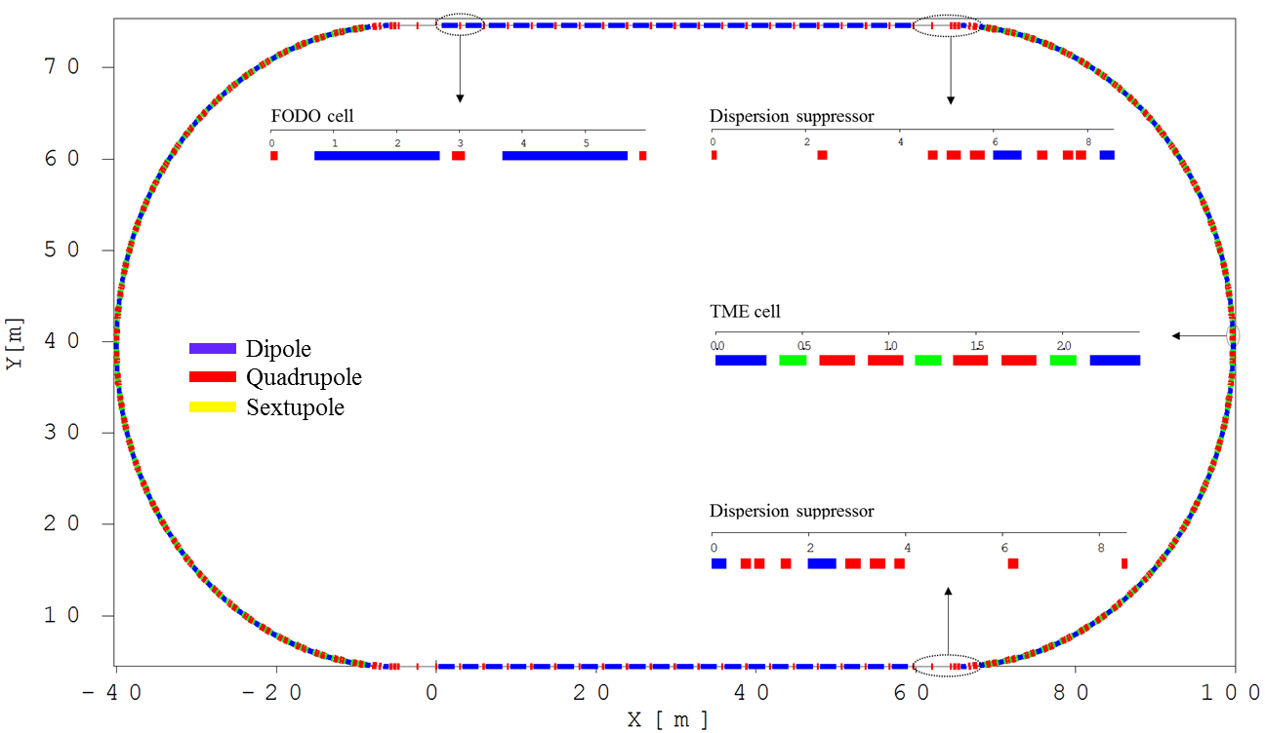
General layout of CLIC damping ring (DR)
The DRs’ layout has a racetrack shape and consists of two arcs and two long straight sections.
The arcs are composed of theoretical minimum emittance (TME) cell with longitudinally variable bends and the straight sections are based on FODO cell filled with high field super conducting damping wigglers.
Each arc/straight section includes of 42 TME/10 FODO cells and there are totally 90 dipoles and 40 superconducting wiggler magnets in the whole DR.
There are four matching sections grouped in two types to match the optics of straight section to the optics of arc section and vice versa.

Slide 15
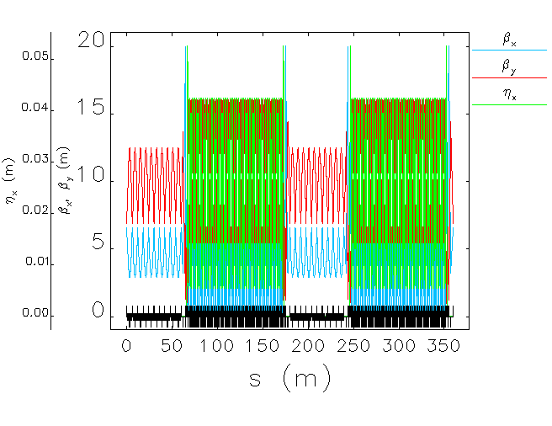
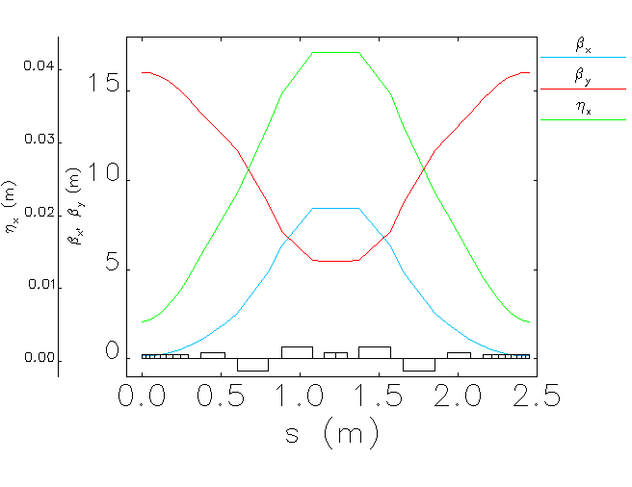
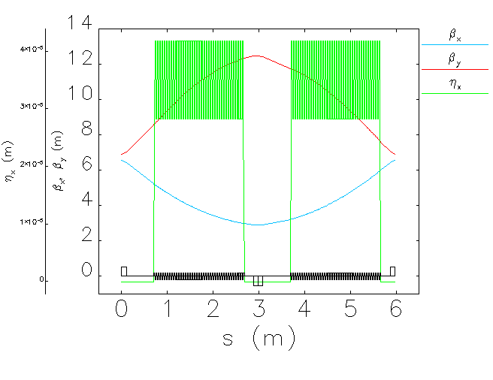
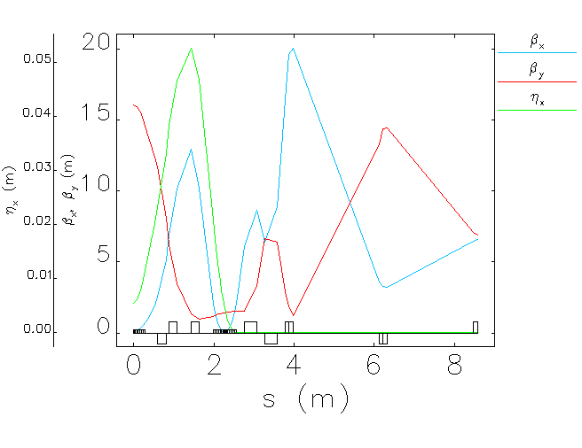
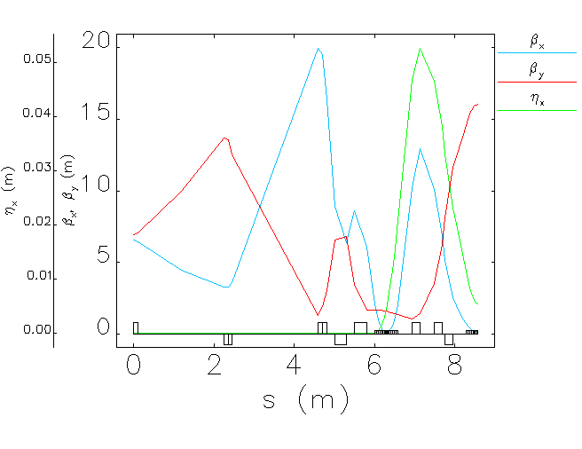
Optical functions and parameters
Parameters | Value
Energy (GeV) | 2.860
Circumference (m) | 359.440
Tune (-/-) | 45.2895/8.3133
Natural emittance (pm.rad) | 75.8924
Natural chromaticity | -128.789/-61.832
1st order mom. com. factor | 1.2478E-4
Energy spread | 1.2745E-3
Energy loss per turn (MeV) | 5.721
Damping time (ms/ms/ms) | 1.179/1.199/0.604
TME cell;
Length= 2.45 m
ψ_{x}/2π= 0.442
ψ_{y}/2π= 0.042
FODO cell;
Length= 5.969
ψ_{x}/2π= 0.238
ψ_{y}/2π= 0.096
wiggler (l=2 m, B=3.5 T, λ=49 mm)
Dispersion suppressor;
Length=8.57
ψ_{x}/2π= 0.851
ψ_{y}/2π=0.726
Dispersion suppressor;
Length= 8.56
ψ_{x}/2π= 0.851
ψ_{y}/2π= 0.709

Slide 16
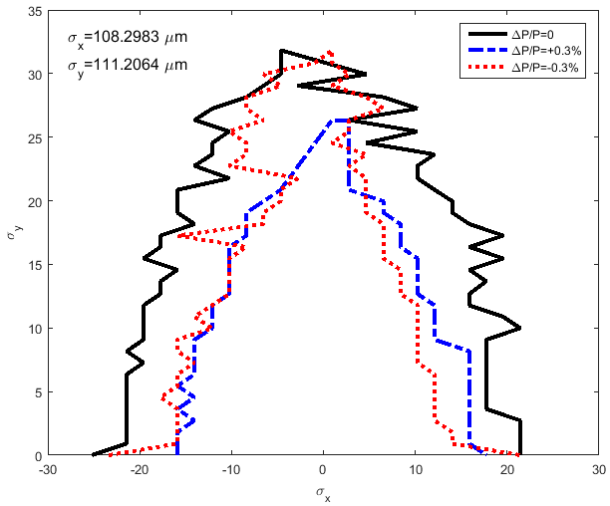
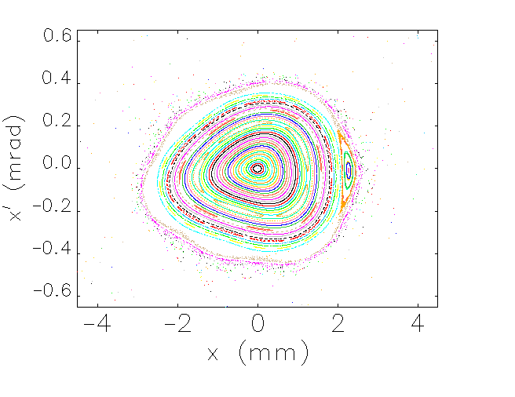
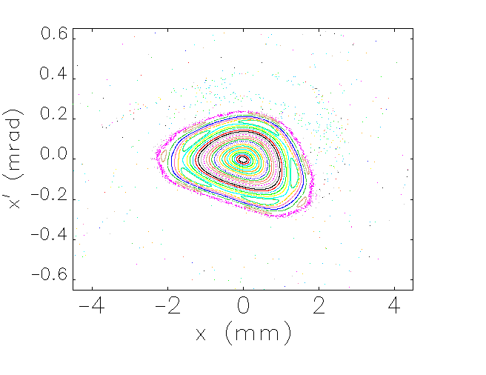
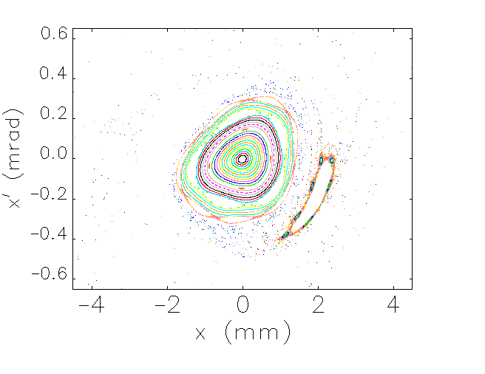
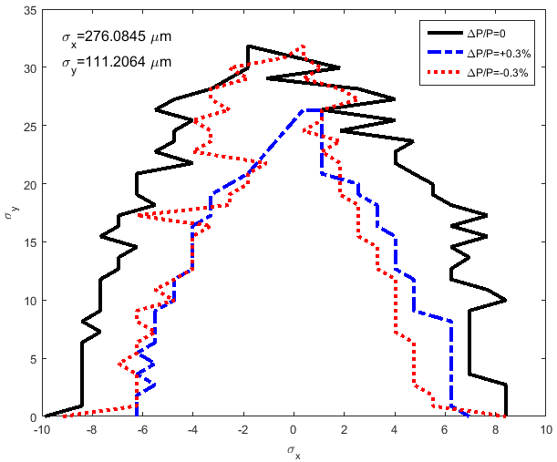
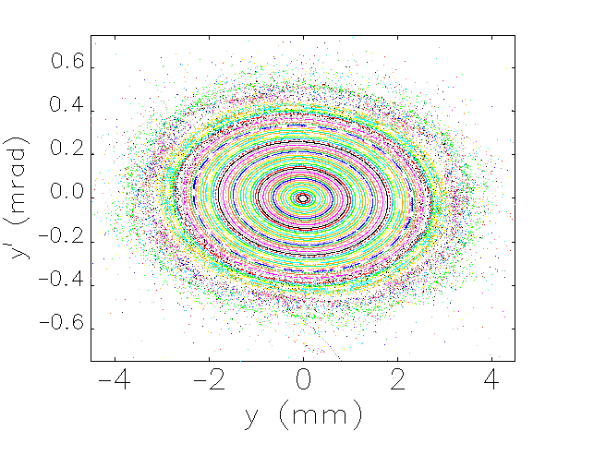
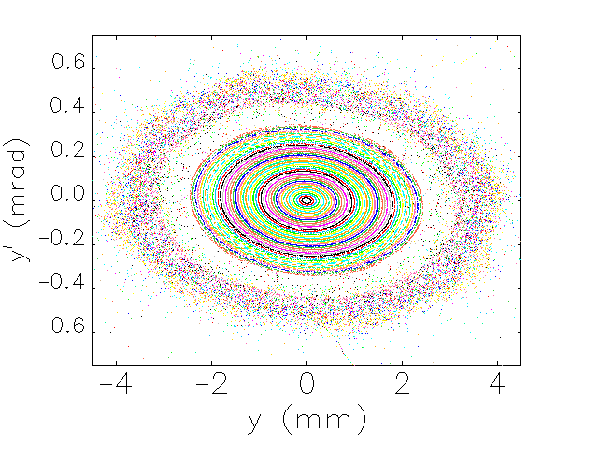
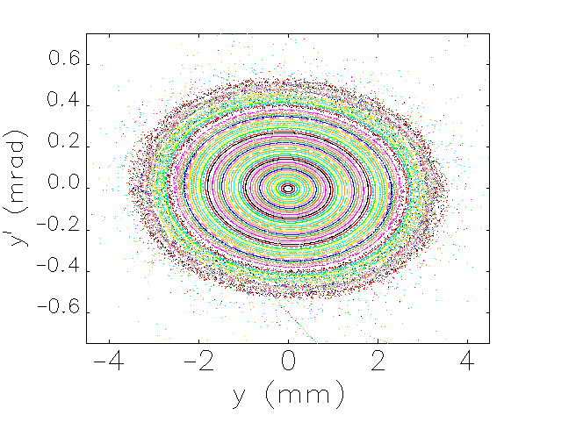
Phase space & DA
DA: The Physical stable space for the particles
The injected beam normalized emittance and energy spread;
For electron DR: ε_{xn}=10 μm and ε_{yn}=10 μm, δ=0.1%
For positron DR: ε_{xn}=65 μm and ε_{yn}=10 μm, δ=0.1%
Electron DR
ΔP/P=0
ΔP/P=0.3%
ΔP/P=-0.3%
Positron DR

Slide 17
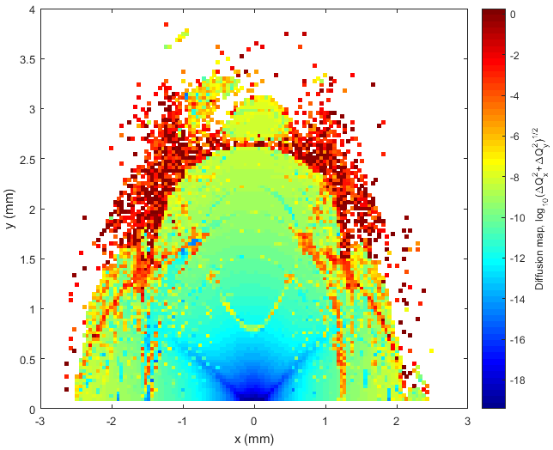
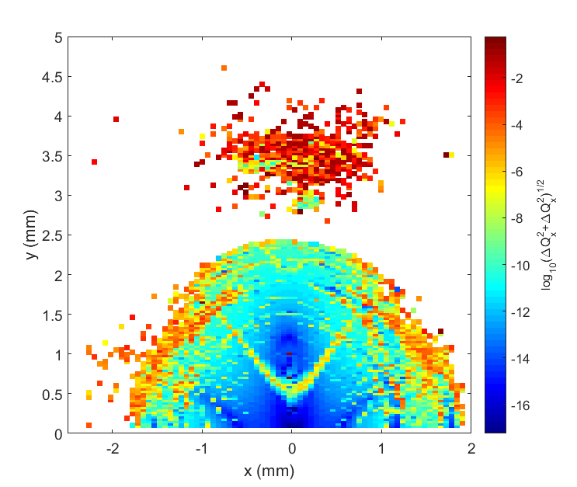
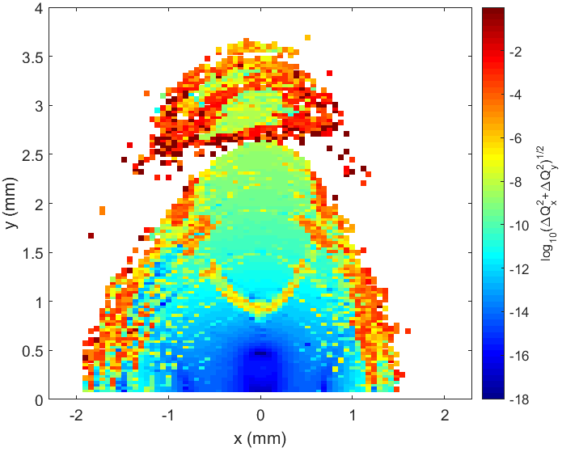
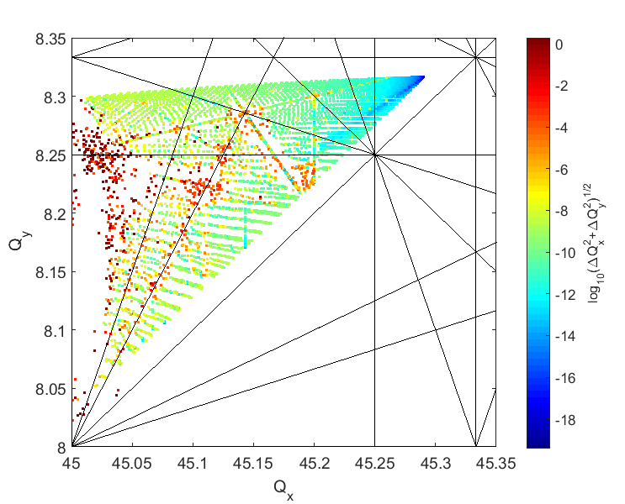
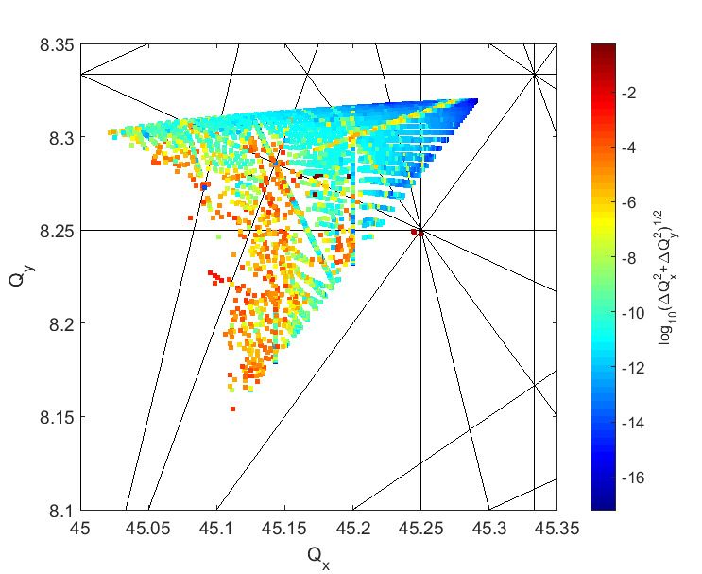
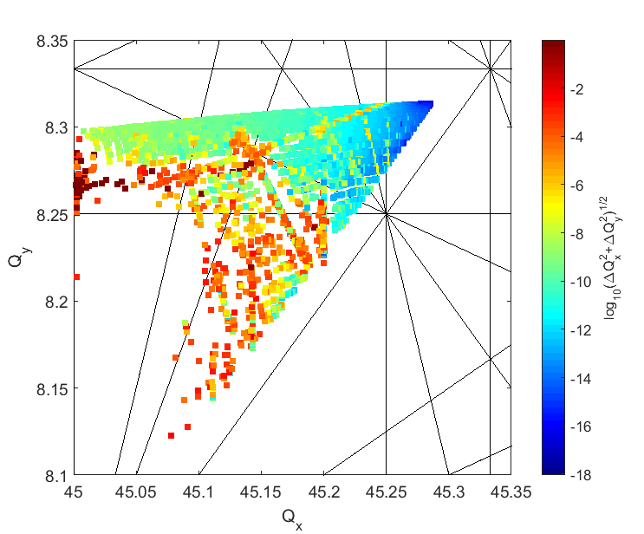
Frequency Map Analysis
ΔP/P=0
ΔP/P=0.3%
ΔP/P=-0.3%

Slide 18
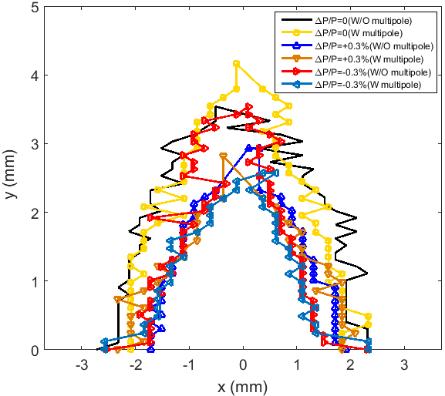
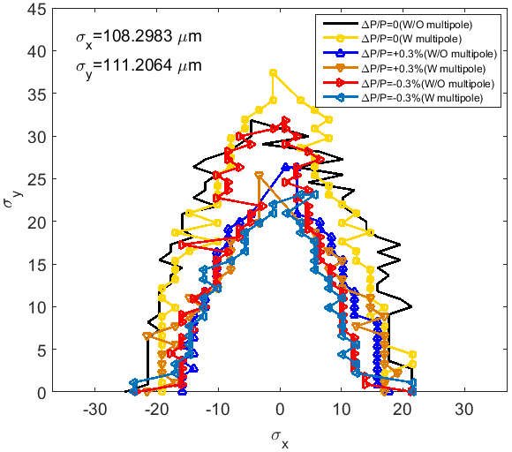
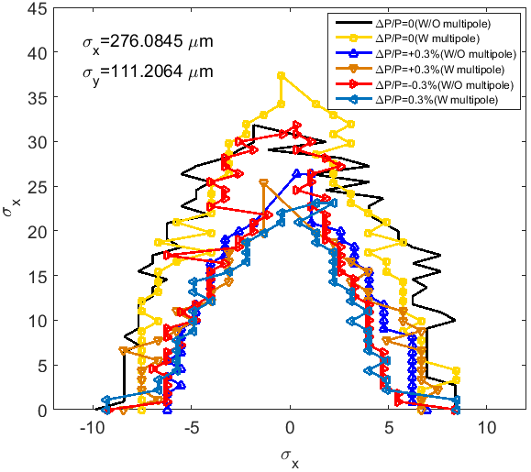
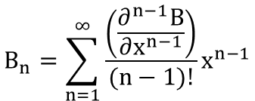
DA & multipoles
 | Order | Multipole | Systematic | Random
Dipole, B_{n}/B₁ @ 10 mm | 2 | Quadrupole | 1.00 *10⁻⁴ | 1.00*10⁻³
 | 3 | Sextupole | 1.50*10⁻⁴ | 1.00*10⁻³
 | 4 | 8-pole | 0.00 | 1.00*10⁻³
 | 5 | 10-pole | 5.00*10⁻⁵ | 1.00*10⁻³
 | 6 | 12-pole | 0.00 | 1.00*10⁻³
 | 7 | 14-pole | 5.00*10⁻⁴ | 1.00*10⁻³
 | 8 | 16-pole | 0.00 | 1.00*10⁻³
Quadrupole, B_{n}/B₂ @ 10 mm | 3 | Sextupole | 0.00 | 1.00*10⁻³
 | 4 | 8-pole | 0.00 | 1.00*10⁻³
 | 5 | 10-pole | 0.00 | 1.00*10⁻³
 | 6 | 12-pole | 1.00*10⁻⁶ | 1.00*10⁻³
 | 7 | 14-pole | 0.00 | 1.00*10⁻³
 | 8 | 16-pole | 0.00 | 1.00*10⁻³
 | 9 | 18-pole | 0.00 | 1.00*10⁻³
 | 10 | 20-pole | 1.00*10⁻⁷ | 1.00*10⁻³
 | 11 | 22-pole | 0.00 | 1.00*10⁻³
 | 12 | 24-pole | 0.00 | 1.00*10⁻³
 | 13 | 26-pole | 0.00 | 1.00*10⁻³
 | 14 | 28-pole | 1.00*10⁻⁸ | 1.00*10⁻³
 | 15 | 30-pole | 0.00 | 1.00*10⁻³
 | 16 | 32-pole | 0.00 | 1.00*10⁻³
 | 17 | 34-pole | 0.00 | 1.00*10⁻³
 | 18 | 36-pole | 1.00*10⁻⁸ | 1.00*10⁻³
Sextupole, B_{n}/B₃ @ 10 mm | 4 | 8-pole | 0.00 | 1.00*10⁻³
 | 5 | 10-pole | 0.00 | 1.00*10⁻³
 | 6 | 12-pole | 0.00 | 1.00*10⁻³
 | 7 | 14-pole | 0.00 | 1.00*10⁻³
 | 8 | 16-pole | 0.00 | 1.00*10⁻³
 | 9 | 18-pole | 1.00*10⁻⁶ | 1.00*10⁻³
 | 15 | 30-pole | 1.00*10⁻⁷ | 1.00*10⁻³
 | 21 | 42-pole | 1.00*10⁻⁶ | 1.00*10⁻³
 | 26 | 54-pole | 5.00*10⁻⁷ | 1.00*10⁻³
 | 33 | 66-pole | 1.00*10⁻⁷ | 1.00*10⁻³
 | 39 | 78-pole | 5.00*10⁻⁸ | 1.00*10⁻³
 | 45 | 90-pole | 1.00*10⁻⁸ | 1.00*10⁻³
$$B_{n}=\sum_{n=1}^{∞}{\frac{\left(\frac{∂^{n−1}B}{∂x^{n−1}}\right)}{(n−1)!}x^{n−1}}$$
Electron DR
Positron DR

Slide 19

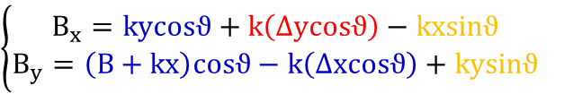
Misalignments- Combined dipole
Combined Dipole bare magnetic field
$$B_{x}=ky$$
$$B_{y}=B+kx$$
Combined Dipole magnetic field in presence of alignment errors (Δx, Δy, θ)
$$\left(\begin{matrix}B_{x} \\ B_{y}\end{matrix}\right)=\left(\begin{matrix}cosϑ & −sinϑ \\ sinϑ & cosϑ\end{matrix}\right)\left(\begin{matrix}k\left(y+∆y\right) \\ B+k(x+∆x)\end{matrix}\right)⇒\left\{\begin{matrix}B_{x}=kycosϑ+k\left(∆ycosϑ−∆xsinϑ\right)−kxsinϑ \\ B_{y}=\left(B+kx\right)cosϑ+k\left(∆ysinϑ−∆xcosϑ\right)+kysinϑ\end{matrix}\right.$$
Ignoring Δxsinθ and Δysinθ terms
$$\left\{\begin{matrix}B_{x}=kycosϑ+k\left(∆ycosϑ\right)−kxsinϑ \\ B_{y}=\left(B+kx\right)cosϑ−k\left(∆xcosϑ\right)+kysinϑ\end{matrix}\right.$$
Combined horizontal dipole
generated by
Horizontal displacement (Δx), Roll (θ)
Vertical constant term dipole
generated by
Vertical displacement (Δy), Roll (θ)
Skew quadrupole
generated by
Roll (θ)

Slide 20


Misalignments- Quadrupole
Quadrupole magnetic field
$$B_{x}=ky$$
$$B_{y}=kx$$
Quadrupole magnetic field in presence of alignment errors (Δx, Δy, θ)
$$\left(\begin{matrix}B_{x} \\ B_{y}\end{matrix}\right)=\left(\begin{matrix}cosϑ & −sinϑ \\ sinϑ & cosϑ\end{matrix}\right)\left(\begin{matrix}k\left(y+∆y\right) \\ k(x+∆x)\end{matrix}\right)⇒\left\{\begin{matrix}B_{x}=kycosϑ+k\left(∆ycosϑ−∆xsinϑ\right)−kxsinϑ \\ B_{y}=kxcosϑ+k\left(∆ysinϑ+∆xcosϑ\right)+kysinϑ\end{matrix}\right.$$
Ignoring Δxsinθ and Δysinθ terms
$$\left\{\begin{matrix}B_{x}=kycosϑ+k∆ycosϑ−kxsinϑ \\ B_{y}=kxcosϑ+k∆xcosϑ+kysinϑ\end{matrix}\right.$$
Orthogonal quadrupole
generated by
Roll (θ)
Horizontal/vertical constant term dipole
generated by
Horizontal/vertical displacement (Δx/Δy), Roll (θ)
Skew quadrupole
generated by
Roll (θ)

Slide 21
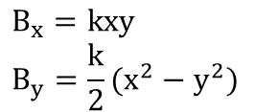
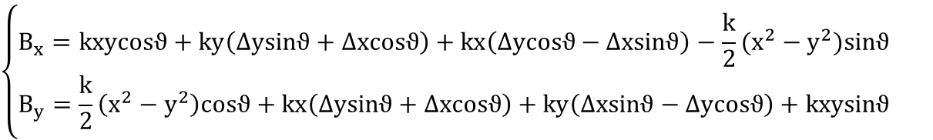
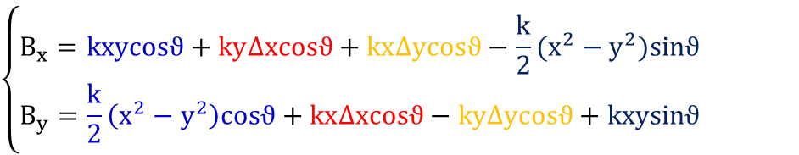
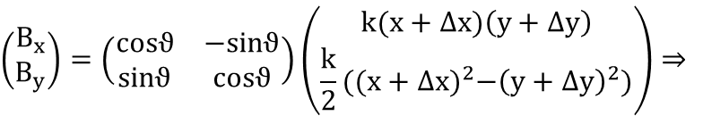
Misalignments- Sextupole
$$B_{x}=kxy$$
$$B_{y}=\frac{k}{2}(x^{2}−y^{2})$$
Sextupole magnetic field
Sextupole magnetic field in presence of alignment errors (Δx, Δy, θ)
$$\left(\begin{matrix}B_{x} \\ B_{y}\end{matrix}\right)=\left(\begin{matrix}cosϑ & −sinϑ \\ sinϑ & cosϑ\end{matrix}\right)\left(\begin{matrix}k(x+∆x)\left(y+∆y\right) \\ \frac{k}{2}({(x+∆x)}^{2}−{\left(y+∆y\right)}^{2})\end{matrix}\right)⇒$$
$$\left\{\begin{matrix}B_{x}=kxycosϑ+ky\left(∆ysinϑ+∆xcosϑ\right)+kx\left(∆ycosϑ−∆xsinϑ\right)−\frac{k}{2}(x^{2}−y^{2})sinϑ \\ B_{y}=\frac{k}{2}\left(x^{2}−y^{2}\right)cosϑ+kx\left(∆ysinϑ+∆xcosϑ\right)+ky\left(∆xsinϑ−∆ycosϑ\right)+kxysinϑ\end{matrix}\right.$$
Ignoring Δxsinθ and Δysinθ terms
$$\left\{\begin{matrix}B_{x}=kxycosϑ+ky∆xcosϑ+kx∆ycosϑ−\frac{k}{2}(x^{2}−y^{2})sinϑ \\ B_{y}=\frac{k}{2}\left(x^{2}−y^{2}\right)cosϑ+kx∆xcosϑ−ky∆ycosϑ+kxysinϑ\end{matrix}\right.$$
Orthogonal sextupole
generated by
Roll (θ)
Orthogonal quadrupole
generated by
Horizontal displacement (Δx), Roll (θ)
Skew quadrupole
generated by
Vertical displacement (Δy), Roll (θ)
Skew sextupole
generated by
Roll (θ)

Slide 22
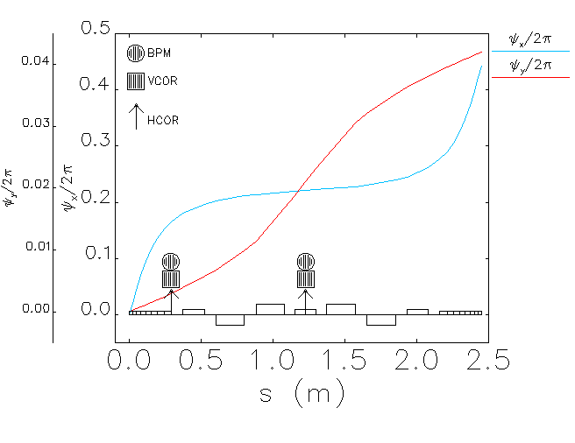
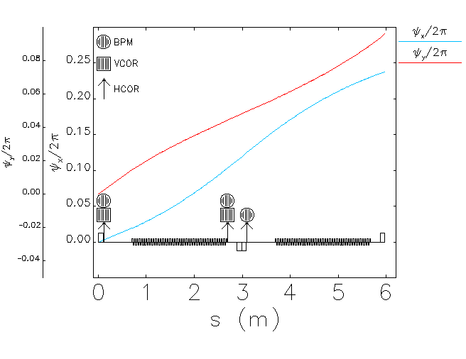
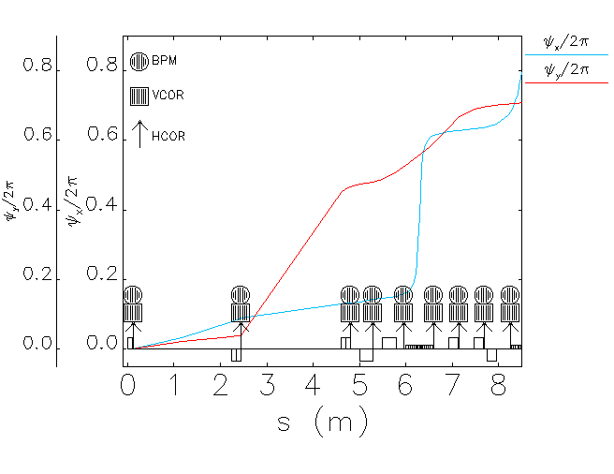
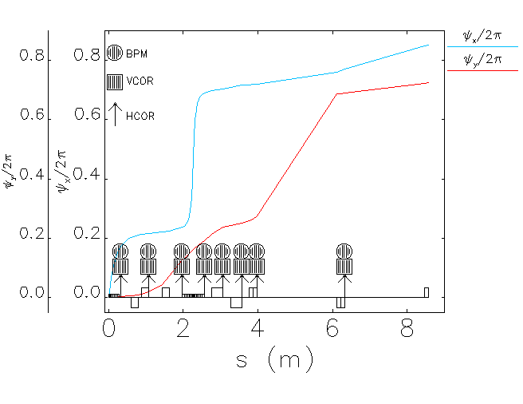
Correctors
Correctors installed
242 vertical; (84 per arc, 8 per DS-I, 9 per DS-II, 20 per LSS)
262 horizontal; (84 per arc, 8 per DS-I, 9 per DS-II, 30 per LSS)
Monitors installed
262 BPM; (84 per arc, 8 per DS-I, 9 per DS-II, 30 per LSS)
Skew quads
2 sextupole families in the arcs
Skew quads installed as windings in the sextupoles.

Slide 23


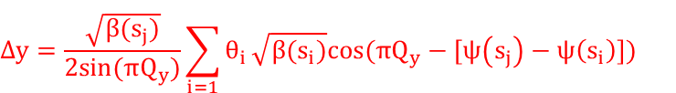
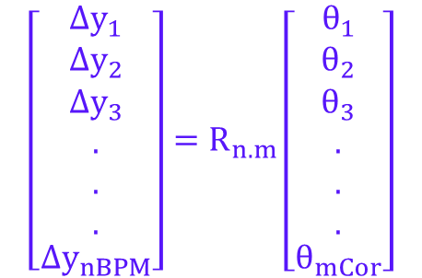
Correction method – orbit response matrix
The variation of the vertical orbit at the BPM position s_{j} resulting from the corrector kick θ_{i} at s_{i} is expressed by;
$$∆y=\frac{\sqrt{β(s_{j})}}{2sin⁡(πQ_{y})}\sum_{i=1}{θ_{i}}\sqrt{β(s_{i})}cos⁡(πQ_{y}−[ψ\left(s_{j}\right)−ψ\left(s_{i}\right)])$$
$$\left[\begin{matrix}{Δy}_{1} \\ {Δy}_{2} \\ \begin{matrix}\begin{aligned}{Δy}_{3} \\ . \\ . \\ .\end{aligned} \\ {Δy}_{nBPM}\end{matrix}\end{matrix}\right]=R_{n.m}\left[\begin{matrix}θ_{1} \\ θ_{2} \\ \begin{matrix}\begin{aligned}θ_{3} \\ . \\ . \\ .\end{aligned} \\ θ_{mCor}\end{matrix}\end{matrix}\right]$$
Feed misalignment error
$$Y_{Meas.}+R.Θ_{Cor}=0$$
$$Θ_{Cor}= R^{−1}(−Y_{Meas.})$$

Slide 24





Correction method- vertical dispersion
The differential equation for vertical dispersion with coupling (to first order, corrector kick neglected) is
$$η_{y}^{"}+K.η_{y}=\left(2φk+S\right)η_{x}$$
which assumes quadrupole rolls and skew quadrupoles as major coupling contributors, ϕ is the roll angle of a normal
quadrupole, S is the skew quad strength and η_{x} is the horizontal dispersion at the coupling source point.
The self-consistent solution of dispersion when a skew quad strength changes by Δ(kl) is
$$\left[\begin{matrix}{Δη}_{y1} \\ {Δη}_{y2} \\ \begin{matrix}\begin{aligned}{Δη}_{y3} \\ . \\ . \\ .\end{aligned} \\ {Δη}_{ynBPM}\end{matrix}\end{matrix}\right]=R_{n.m}\left[\begin{matrix}k_{1} \\ k_{2} \\ \begin{matrix}\begin{aligned}k_{3} \\ . \\ . \\ .\end{aligned} \\ k_{mCor}\end{matrix}\end{matrix}\right]$$
$$∆η_{y}=Δ(kl)η_{x}\frac{\sqrt{ββ_{0}}}{2sin⁡(πQ_{y})}cos⁡(πQ_{y}−[ψ−ψ_{0}])$$
This is the response of dispersion function to a unit change in skew quad strength.
Feed misalignment error
$${η_{y}}_{Meas.}+R.k_{Skew}=0$$
$$k_{Skew}= R^{−1}(−{η_{y}}_{Meas.})$$

Slide 25
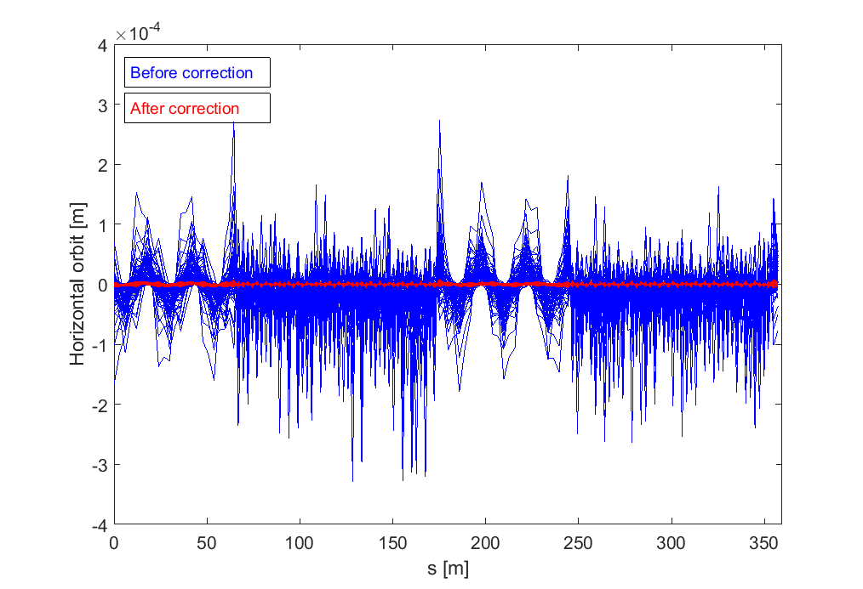
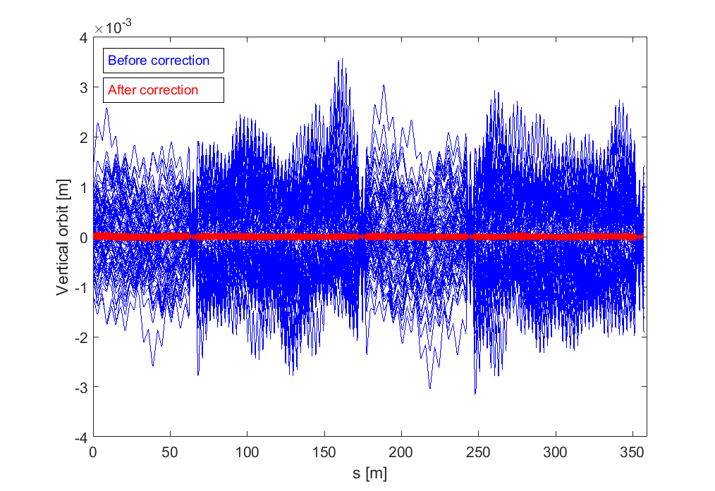
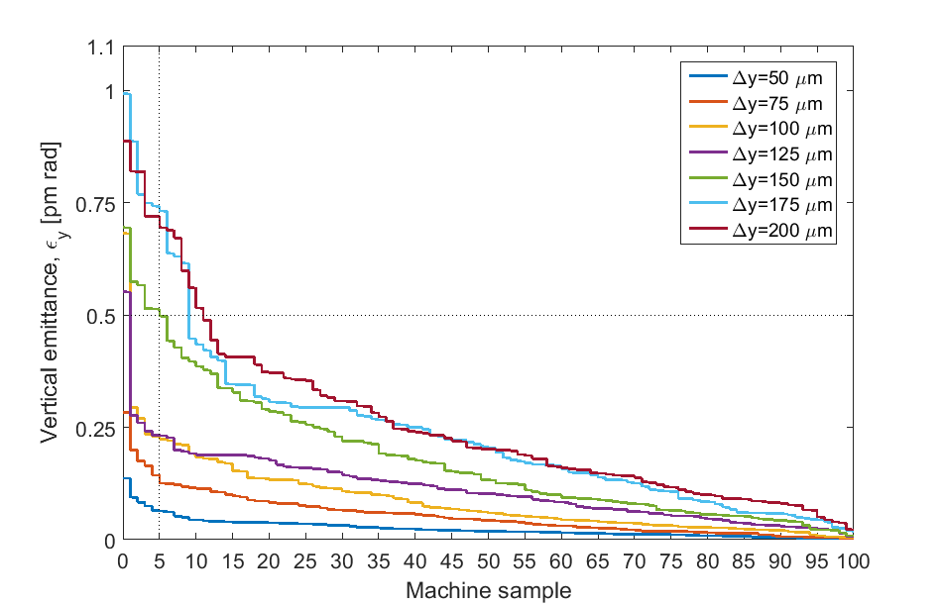


Dipole vertical offset
For the case of Δy = 150 μm;
Accumulated histogram;
For 100 machine samples, the vertical emittance due to the dipole vertical displacement up to 200 μm is below than 1 pm rad.

Slide 26





Dipole roll
For the case of Δϕ = 500 μrad;
Accumulated histogram;
Dipole roll up to 1 mrad is tolerable.

Slide 27





Quadrupole vertical offset
For the case of Δy = 20 μm;
Accumulated histogram;
Vertical emittance is very sensitive to misalignment of quads.
Vertical emittance due to the quad vertical offset up to 20 μm is below than 1 pm rad for 100 machine samples.

Slide 28





Quadrupole roll
For the case of Δϕ = 150 μrad;
Accumulated histogram;
For 100 machine samples, the vertical emittance up to 200 μrad quadrupole roll is below than 1 pm rad.

Slide 29





Sextupole vertical offset
For the case of Δy = 25 μm;
Accumulated histogram;
Vertical emittance is very sensitive to misalignment of sextupoles.
For 100 machine samples, vertical emittance due to the sextupole vertical offset up to 20 μm is below than 1 pm rad

Slide 30





Sextupole roll
For the case of Δϕ = 250 μrad;
Accumulated histogram;
The vertical emittance for the 100 machine sample s is below than 1 pm rad.

Slide 31

Vertical emittance
Error | Unit | Value
Dipole/quadrupole/sextupole/BPM vertical misalignment | μm | 35/20/20/50
Dipole/quadrupole/sextupole roll | μrad | 80/50/50
BPM roll | μrad | 50
BPM noise | nm | 200
For 95% of machine samples,
vertical emittance is below than 0.7 pm rad.

Slide 32
Next steps
Complete analysis of collective effects with new DR parameters
  Ions, space-charge, e-cloud, impedance budget, feedback specs
Investigate the possibility to replace e-linac by a booster
Continue collaboration with low emittance rings community for experimental tests
  Modeling and protyping of variable dipole bends with CIEMAT (F. Toral)
  Test existing wiggler at ANKA and finalise Nb₃Sn short wiggler model
  Test stripline and pulser at ALBA
  Design of a 1.5 GHz active harmonic RF system for ALBA and adapt it to 2 GHz CLIC DR RF system

Slide 33
Back up slides

Slide 34
CLIC DR complex challenges
Injected Parameters | e⁻ | e⁺
Bunch population [10⁹] | 4.7 | 6.4
Repetition frequenzy [Hz] | 50 | 50
Bunch length [mm] | 1 | 9
Energy Spread [%] | 0.1 | 1
Long. emittance [eV.m] | 2000 | 257000
H/V norm. emittance [nm-rad] | 100 x 10³ | 7 x 10⁶
DR complex challenges
  Large injected emittances and energy spread → Requirement of large DA and MA
  Ultra low emittance at extraction
  Repetition time of 20 ms → Fast damping requirement
PDR → efficient injection of the large incoming beams
Main DR → ultra-low emittance generation
The positron beam needs at least 8 damping times to reach equilibrium (w/o taking into account injection, IBS, etc)
  → The positron PDR is necessary!
Extracted Parameters | PDR e⁻/e⁺ | DR e⁻/e⁺
Bunch population [10⁹] | 4.1-4.4 | 4.1
Bunch length [mm] | 10 | 1.4
Energy Spread [%] | 0.5 | 0.1
Long. emittance [eV.m] | 143000 | 5000
Hor. Norm. emittance [nm-rad] | 63000 | 500
Ver. Norm. emittance [nm-rad] | 1500 | 5
F. Antoniou

Slide 35


Electron linac requirements
For non-Gaussian beams the minimum required acceptance:
To avoid an e⁻ PDR:
  In horizontal R_{min} < 1 mm-rad
  In vertical R_{y}^{min} < 1.2 mm-rad
Required emittances from the electron injection linac in order to remove electron PDR
  ε_{x}^{rms}= 25 μm-rad
  ε_{y}^{rms}= 50 μm-rad
DA of the main DR
F. Antoniou

Slide 36

The CLIC DR CDR design
Performance parameters of the CLIC DR for the 1 GHz and 2 GHz options in comparison to the V06
  Increased energy (2.424→2.86 GeV)
  Reduce the circumference by 15%
  Ultra-low emittances in all 3 planes
  Reduced IBS effect (from 3 to 1.5)
  Reduced space charge tune shift (-0.2 → -0.1)
  Lower RF stable phase (70º→51º (62º))
F.Antoniou

Slide 37

Trapezium field profile dipole
The dipole total length is set to L = 0.58 m as the optimized value.
Each trapezium field profile dipole bends the beam 4 Degrees.
Parameters | Highest field section | Lowest field section
Length (cm) | 4.1825 | 5.0550
Field (T) | 1.7666 | 0.8366
Radius (m) | 5.4000 | 11.4028
Def. angle (Deg.) | 0.4438 | 0.2540
K (m⁻²) | -1.1000 | -1.1000
Gradient (T/m) | -10.4937 | -10.4937

Slide 38






Chromaticity correction-Tune shift with energy
Two families of sextupole magnets both with the same length of 15 cm in the TME cell are considered to correct the natural chromaticity of ring to +1.
Parameters | SF | SD
Length [cm] | 15
Pole radius [mm] | 15
Sextupole strength [m⁻²] | -362.6698 | 416.5494
B” (T/m⁻²) | -3459.7589 | 3973.7531
Pole tip field (T) [R=15 mm] | -0.3892 | 0.44705
Small variation of tune point up to ±0.3 % energy deviation reveals that present sextupole arrangement was good a starting point to perform nonlinear beam dynamics.

Slide 39






DA & lost particles
ΔP/P=0
ΔP/P=0.3%
ΔP/P=-0.3%
Electron DR
Positron DR

Slide 40






Acceptance
Electron DR
Positron DR
RF frequency: 2 GHz
Natural radiation loss per turn: 0.57 MeV
Parasitic energy loss per turn: 50 keV
Harmonic number: 2398
RF voltage: 6.055 MV
Over voltage factor: 9.74
RF acceptance: 6.17 %
$${Ring acceptance}_{i}=\sqrt{2β_{i}ε_{i}}+η_{i}δ$$
ε_{i} is assumed to be 10 times larger than the injected beam and the “i” indicates horizontal and vertical directions.
No essential requirement for the aperture for the DR vacuum system in view of acceptance.
10 mm residual vertical dispersion and 1.5% momentum acceptance are assumed.

Slide 41


Intra beam scattering
The IBS algorithm is based on the Bjorken and Mtingwa’s * formula.
Assumed parameters;
No. Particles:4E9
Bunch charge:0.72 nC
Vertical emittance: 0.73 pm
RF voltage=6.055 MV
Harmonic=2398
Length=1.577 mm
Calculated with ELEGANT
Parameters | Without IBS | With IBS | Growth rate (%)
Natural emittance (pm.rad) | 73.752 | 89.847 | 21.823
Energy spread | 1.275E-3 | 1.303E-3 | 2.196
Bunch length (mm) | 1.577 | 1.612 | 2.194
* J.D. Bjorken, S.K. Mtingwa
Intrabeam Scattering, Part. Acc. Vol. 13, 1983, 115-143.

Slide 42









Closed orbit & vertical dispersion

Slide 43


Corrector’s strength

Slide 44








Coupling coefficients

Slide 45


Tune shift

Slide 46



Corrected chromaticity

Slide 47



Misalignments- Vertical offset & roll
Dipole
$$\left.\begin{matrix}B_{x}=k\left(y+∆y\right)=ky+k∆y \\ B_{y}=B\end{matrix}\right\}⇒\text{Horizontal} \text{dipole}\text{ + }\text{Focusing} \text{term}\text{+ }\text{constant} \text{term} \text{vertical} \text{dipole}$$
$$\left(\begin{matrix}B_{x} \\ B_{y}\end{matrix}\right)=\left(\begin{matrix}cosϑ & −sinϑ \\ sinϑ & cosϑ\end{matrix}\right)\left(\begin{matrix}0 \\ B\end{matrix}\right)=\left(\begin{matrix}−Bsinϑ \\ Bcosϑ\end{matrix}\right) ⇒\text{Horizontal} \text{dipole}\text{ + }\text{vertical} \text{dipole}$$
Quadrupole
$$\left.\begin{matrix}B_{x}=k\left(y+∆y\right)=ky+k∆y \\ B_{y}=kx\end{matrix}\right\}⇒\text{Ortogonal} \text{quad}\text{ + }\text{constant} \text{term} \text{vertical} \text{dipole}$$
$$\left(\begin{matrix}B_{x} \\ B_{y}\end{matrix}\right)=\left(\begin{matrix}cosϑ & −sinϑ \\ sinϑ & cosϑ\end{matrix}\right)\left(\begin{matrix}ky \\ kx\end{matrix}\right)=\left(\begin{matrix}kycosϑ−kxsinϑ \\ kxcosϑ+kysinϑ\end{matrix}\right)⇒\text{Ortogonal} \text{quadrupole}\text{ + }\text{skew} \text{quadrupole}$$
Sextupole
$$\left.\begin{matrix}B_{x}=kx\left(y+∆y\right)=kxy+kx∆y \\ B_{y}=k(x^{2}−{\left(y+∆y\right)}^{2}=k\left(x^{2}−y^{2}\right)−2kyΔy−{Δy}^{2} \end{matrix}\right\}⇒\text{Ortogonal} \text{sextupole}\text{ + }\text{skew} \text{quadrupole}$$
$\left(\begin{matrix}B_{x} \\ B_{y}\end{matrix}\right)=\left(\begin{matrix}cosϑ & −sinϑ \\ sinϑ & cosϑ\end{matrix}\right)\left(\begin{matrix}kxy \\ k\left(x^{2}−y^{2}\right)\end{matrix}\right)=\left(\begin{matrix}kxycosϑ−k\left(x^{2}−y^{2}\right)sinϑ \\ k\left(x^{2}−y^{2}\right)cosϑ+kxysinϑ\end{matrix}\right)$ $⇒\text{Ortogonal} \text{sextupole}\text{ + }\text{skew} \text{sextupole}$

Slide 48

Error | Unit | Value
Dipole/quadrupole/sextupole/BPM vertical misalignment | μm | 80/17/17/50
Dipole/quadrupole/sextupole roll | μrad | 250/80/80
BPM roll | μrad | 50
BPM noise | nm | 200
For 95% of machine samples,
vertical emittance is below than 0.7 pm rad.

Slide 49










Slide 50



Slide 51









Slide 52



Slide 53




