Slide 1
A Detector for Millicharge Particles for the MoEDAL Upgrade
Albert De Roeck

Slide 2
MAPP Detector for MoEDAL
MoEDAL considers a detector for millicharge particle detection.
proposes a simpler version compared to MilliQan so likely with reduced sensitivity, maybe up to~ 0.01e?
Most of the material (scintillator, electronics) seems available/recycled. No real details given.
Discussed at the LHCC closed session, positive reaction.
No detailed studies started yet on sensitivity, background, trigger details, etc. Cavern option explored
Manpower to work on it seems limited so far, due to present other priorities in MoEDAL

Slide 3
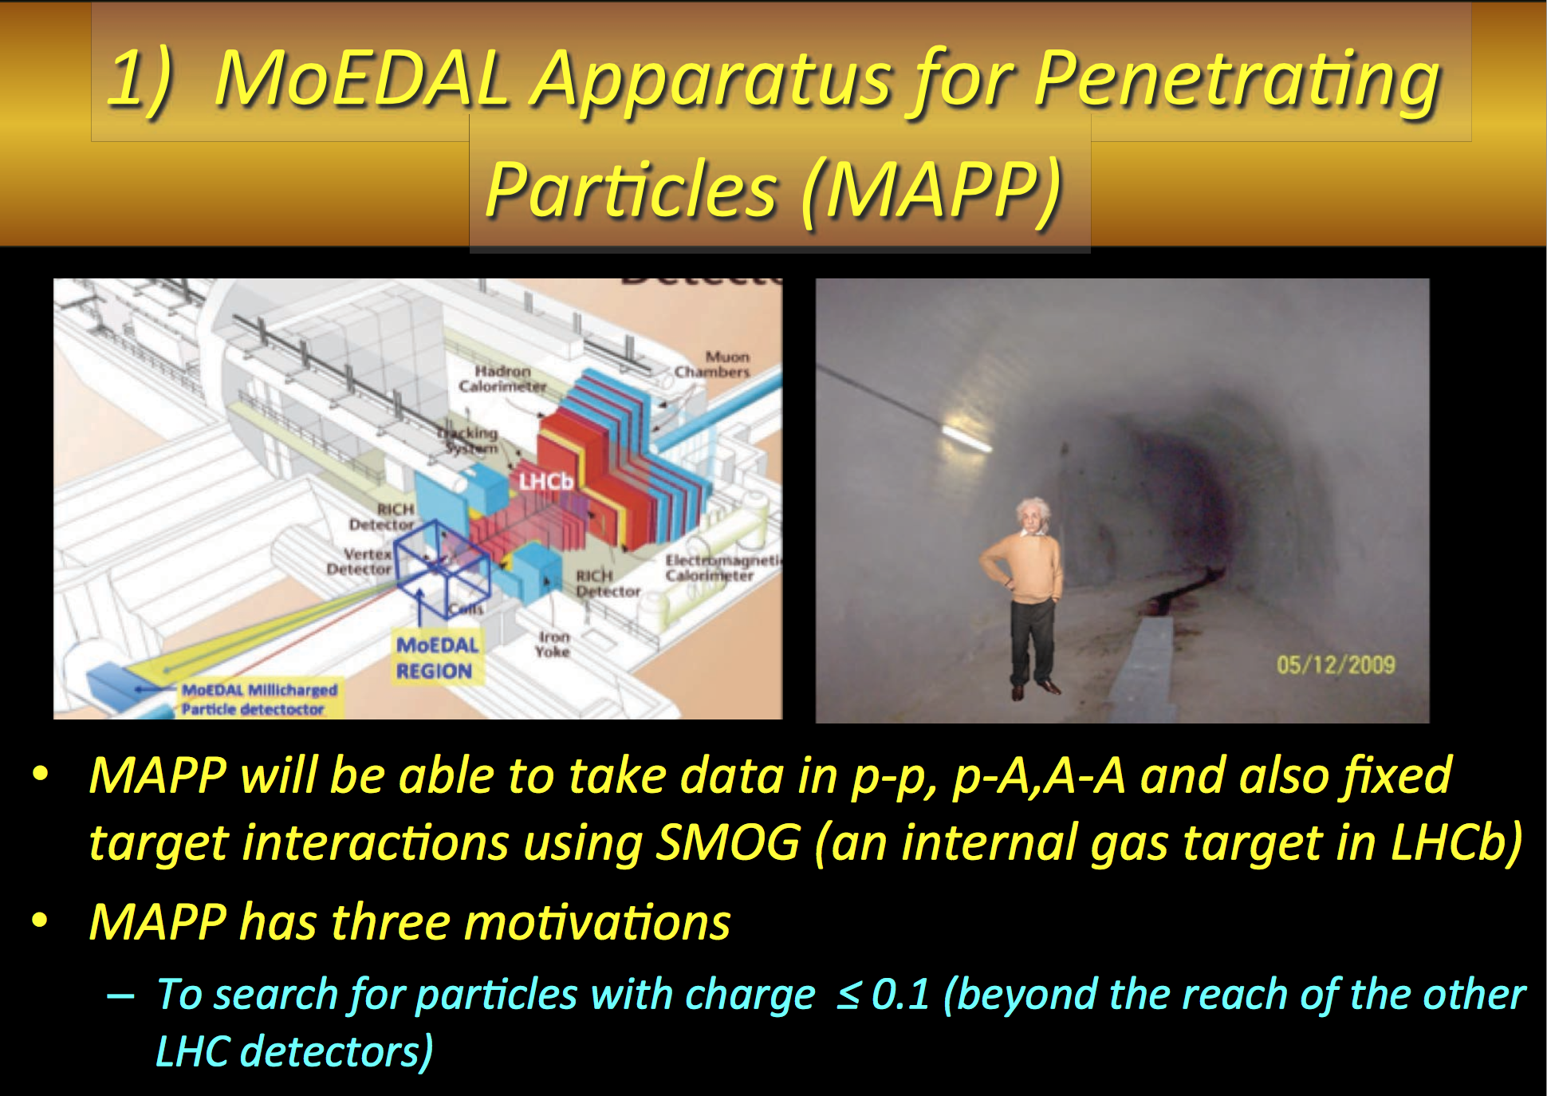

Slide 4
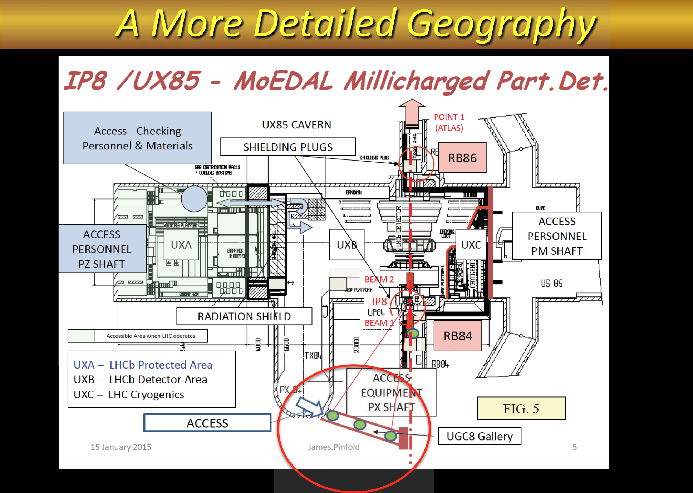

Slide 5
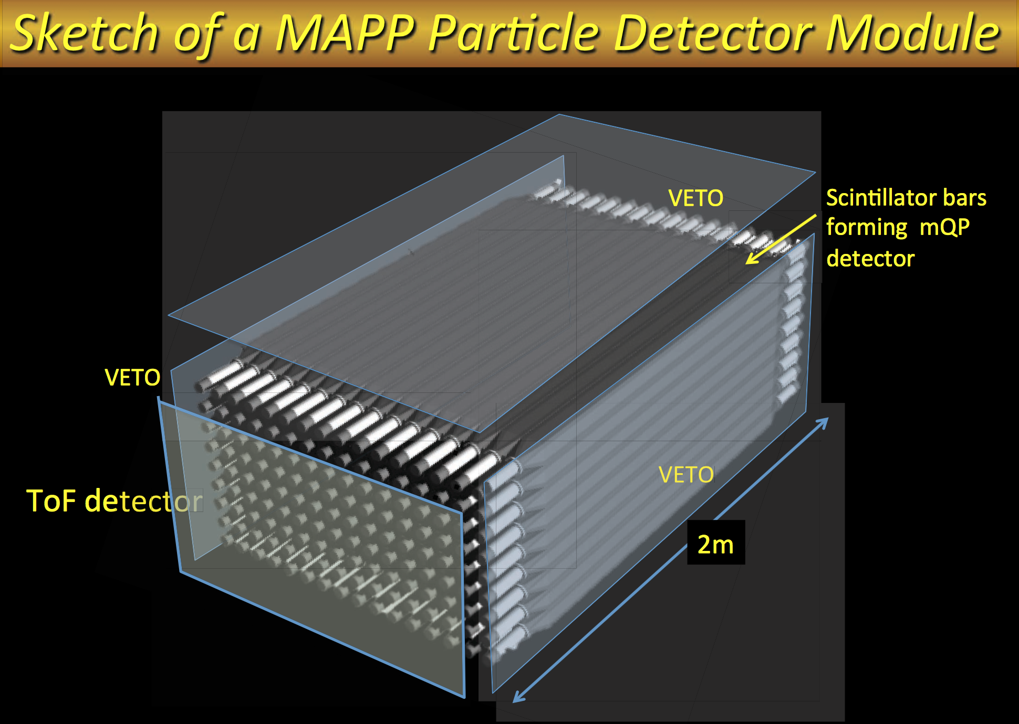

Slide 6
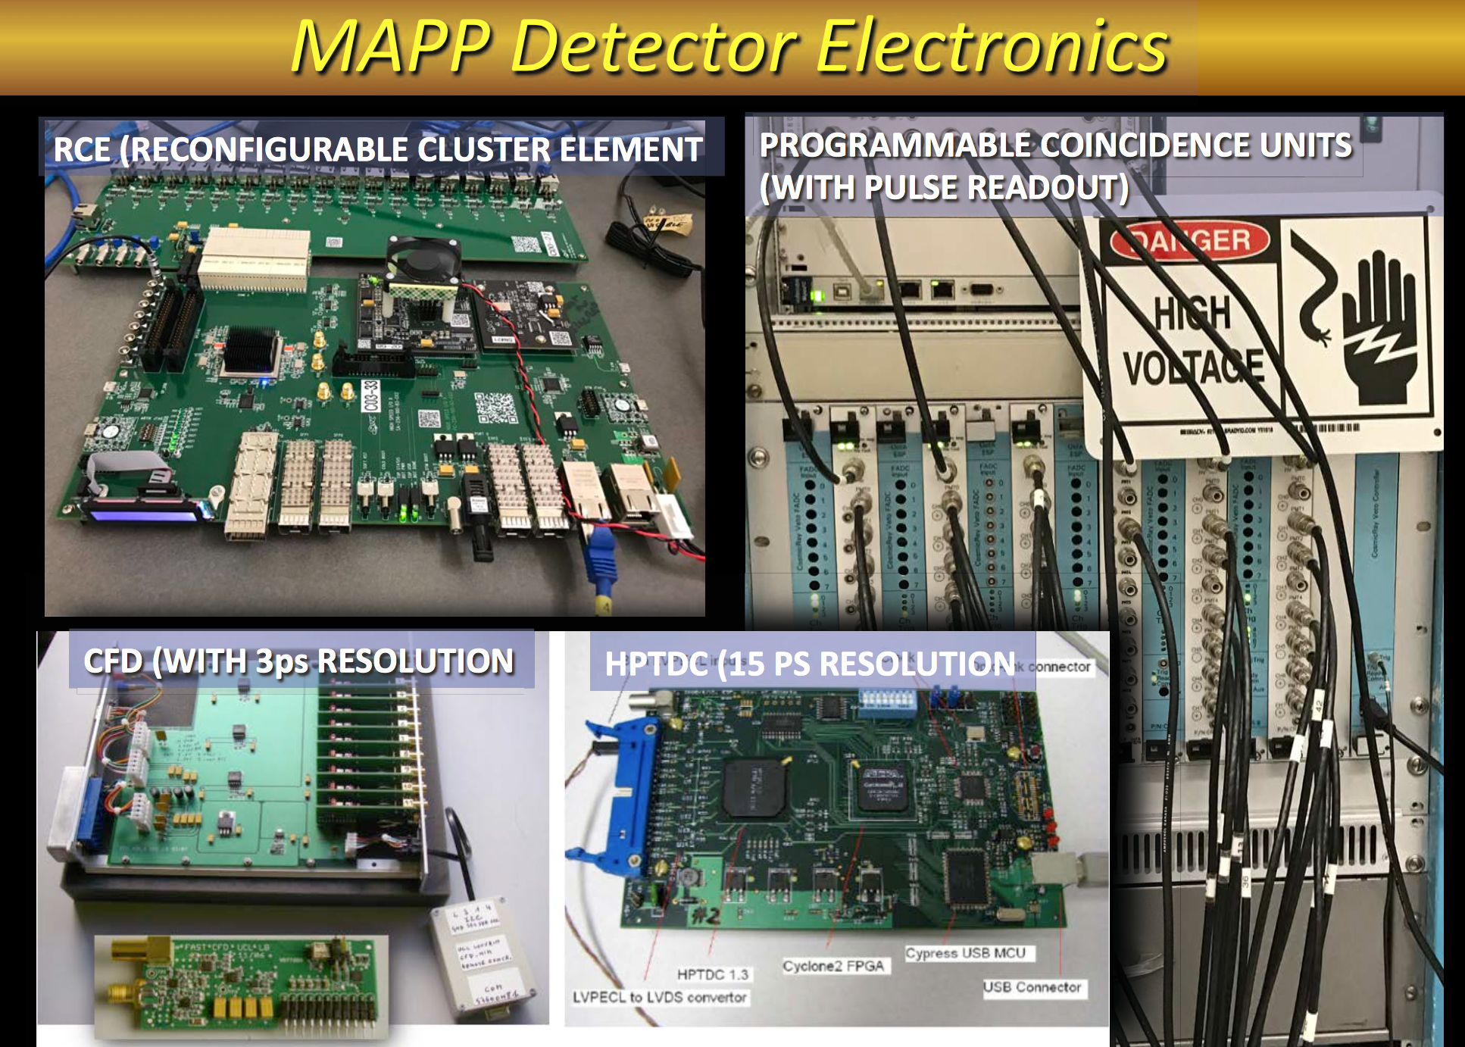

Slide 7
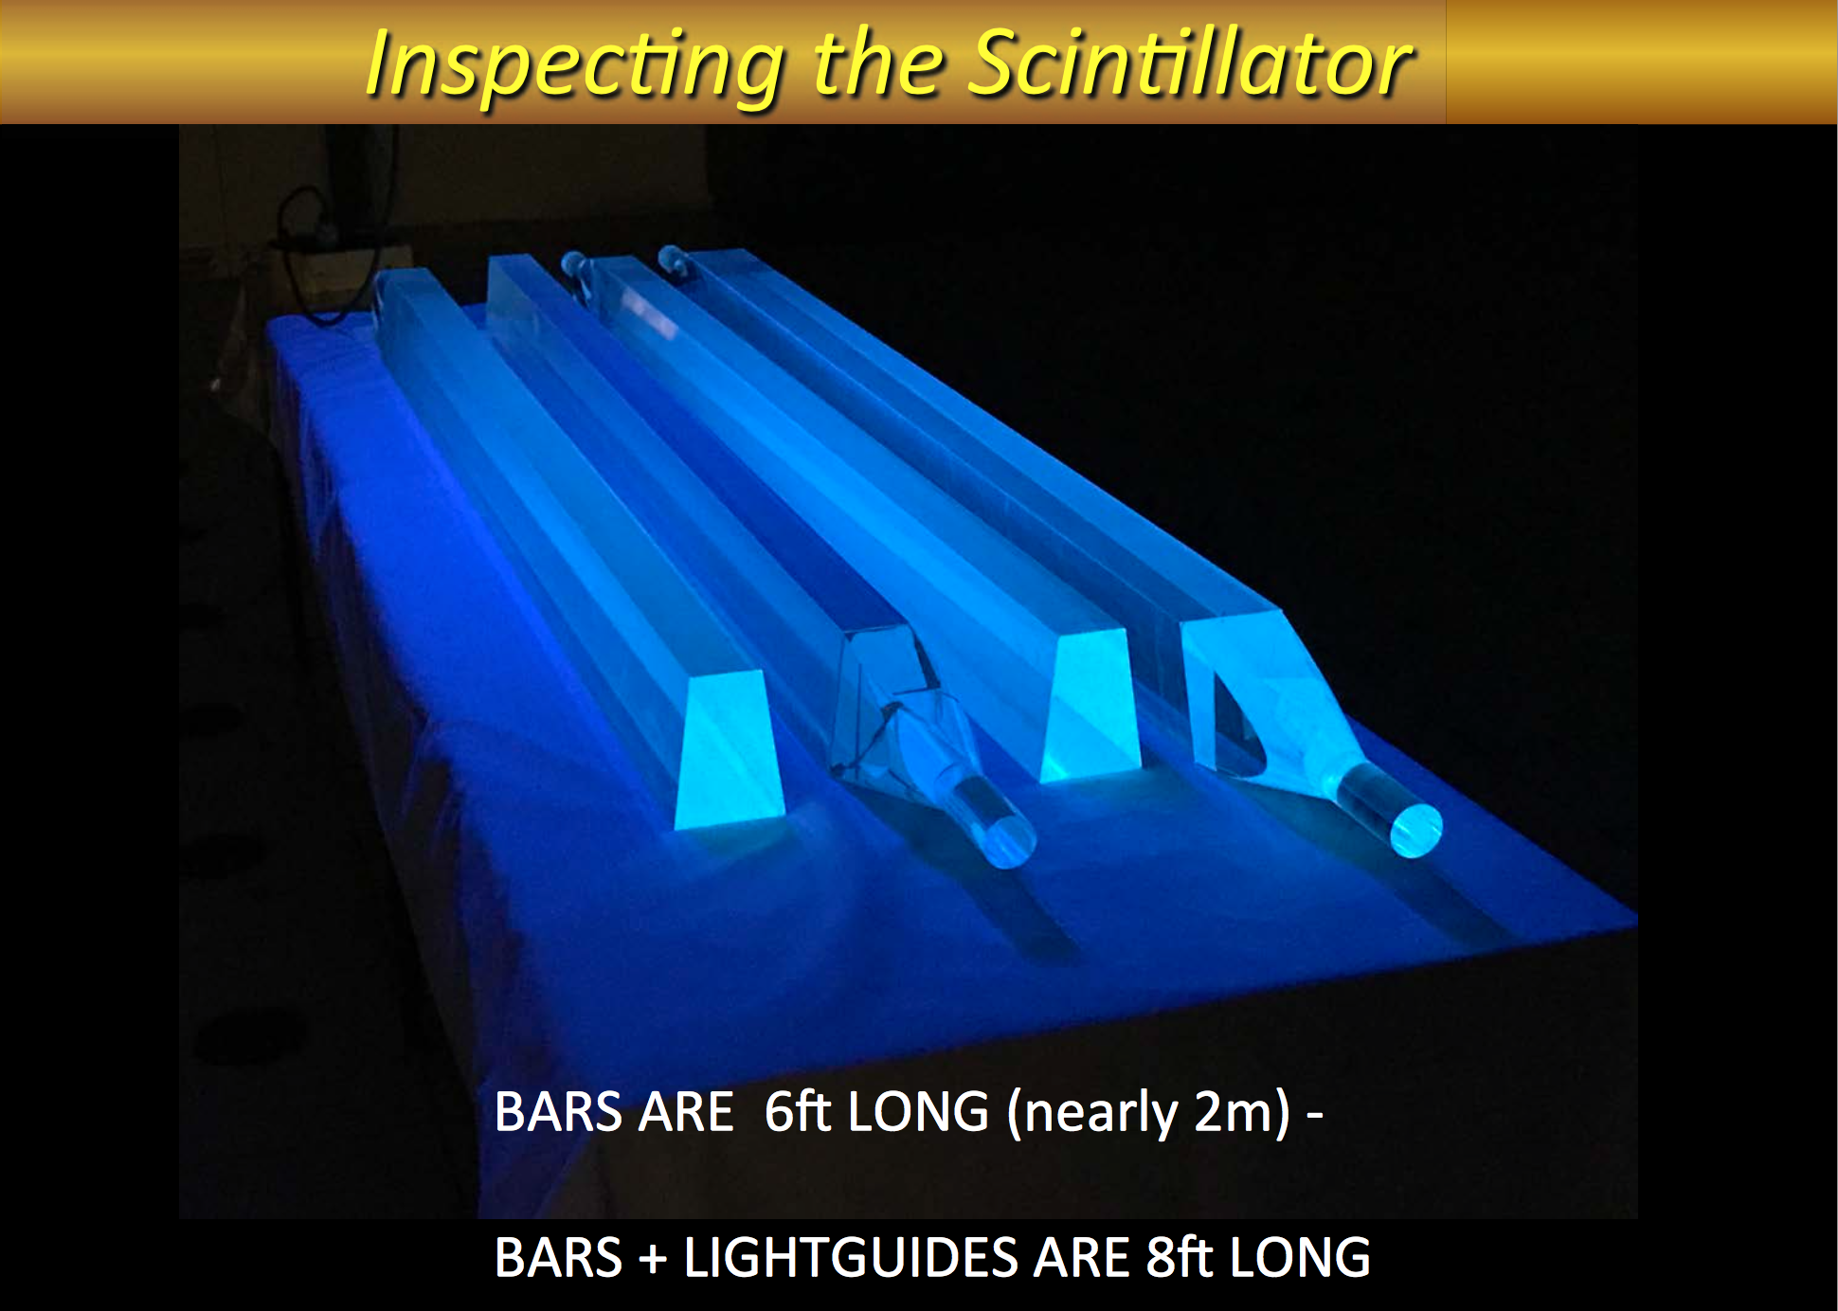

Slide 8
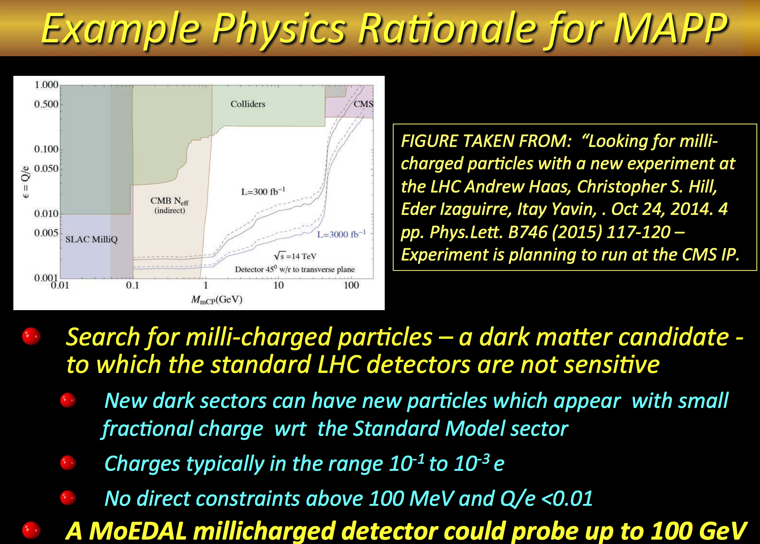

Slide 9
Observations
Let’s not loose momentum on the planning together with CMS/LHCC for MilliQan!!
Options for other physics processes to look into, eg long lived neutrals with decays way out of the central detector (a la MATHUSLA)
Funding: Two EC proposals under discussion in Europe for MilliQan/submission in spring 2017 if followed up

Slide 10
MilliQan
Question: do we want a full scale wooden mock-up? Study service routing, cavern constraints, the support structure...
Could be organized by the CERN group (M. Gastal) with collaborating groups (U. Lebanon) on technical matters
Time frame:
  start (design) ~ February
  Completed: end of summer
Makes only sense if the project is relatively stable and well defined in some detail

