Slide 1
Detection of antiprotons using GRACE
A new facility for the extraction of very low energy antiprotons at the CERN AD
Nicola Pacifico - For the AEgIS and Medipix Collaborations
nicola.pacifico@cern.ch

Slide 2
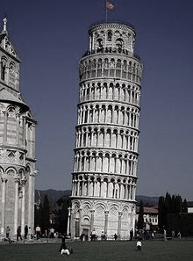
Outline
    Motivation
    AEgIS and a need for a direct annihilation detector.
    Indirect and direct detection of antiproton annihilations
    First tests in AEgIS
    Monolithic, Hybrid pixel sensors
    GRACE
    A new facility for the extraction of low energy antiprotons
    Timepix as a direct annihilation detector
    Work in progress
    Summary

Slide 3
PART I:
motivation
The Aegis experiment

Slide 4

Why do antimatter research?
Why there is a matter/antimatter asymmetry in the universe?
Looking for fundamental asymmetry sources
CP
violations in
weak interaction
Gravitational
asymmetries?
AOB… ?

Slide 5
Why do antimatter research?
Why there is a matter/antimatter asymmetry in the universe?
Looking for fundamental asymmetry sources
CP
violations in
weak interaction
Gravitational
asymmetries?
AOB… ?

Slide 6
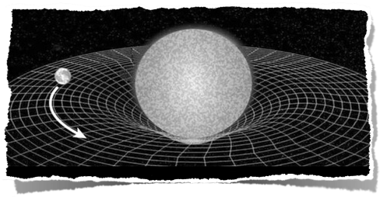
Einstein Equivalence Principle
  The Einstein Equivalence Principle is summarised by the following 3 principles
    Weak Equivalence Principle (mi=mg) [More details on this in next slides] +
    and, for any non-gravitational experiment:
    Lorentz Local Invariance (independence from any free falling frame of reference)
    Local Position Invariance (independence from position in the universe)
        Verified e.g. through gravitational red shift

Slide 7
Einstein Equivalence Principle
  The Einstein Equivalence Principle is summarised by the following 3 principles
    Weak Equivalence Principle (mi=mg) [More details on this in next slides] +
    and, for any non-gravitational experiment
    Lorentz Local Invariance (independence from any free falling frame of reference)
    Local Position Invariance (independence from position in the universe)
        Verified e.g. through gravitational red shift

Slide 8
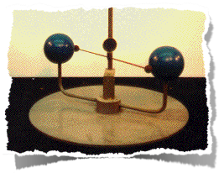

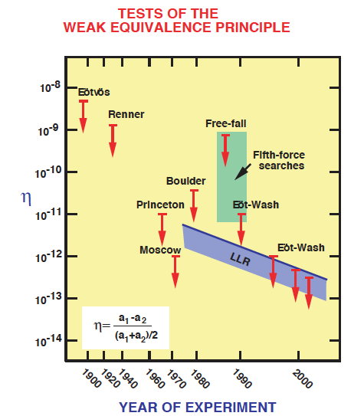
WEP and matter
Weak Equivalence Principle (WEP)
“The vacuum world line of a body immersed in a gravitational field is independent of all observable properties.”
Verification of the WEP for matter attained to 10⁻¹³
No precise verification to date for antimatter.
Clifford M. Will
http://www.livingreviews.org/lrr-2006-3

Slide 9
We cannot build a torsion pendulum made of antimatter...
We have to “borrow” another way of doing the WEP measurement from atomic physics
Split and recombine the atomic wave function in presence of gravity
Quantum interference if
Very cold atoms are needed with a very collimated beam
A. Peters et al, Nature 400 (1999) 849

Slide 10
We cannot build a torsion pendulum made of antimatter...
We have to “borrow” another way of doing the WEP measurement from atomic physics
Split and recombine the atomic wave function in presence of gravity
Quantum interference if
Very cold atoms are needed with a very collimated beam
A. Peters et al, Nature 400 (1999) 849
Are we there? Almost…

Slide 11
From atoms to antiatoms interferometry
  We cannot get to uK / nK temperatures required for quantum interference
  Difficult to have good collimation
The AEgIS way:
  Use a two grating configuration with classical interferometry (grating pitch ~ 40 um)
  Aiming at an initial accuracy of 1%
  Good collimation of the beam is not necessary (advisable only for statistical arguments)
  And now a small parenthesis on the AD…

Slide 12
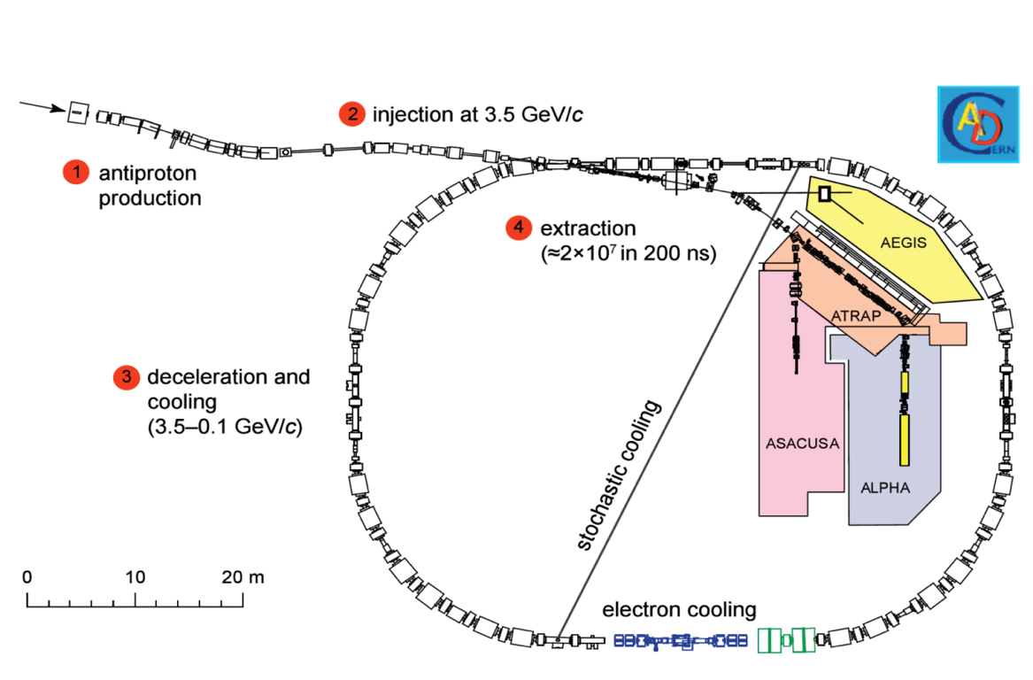
The Antiproton Factory: The CERN AD

Slide 13



“Cooling” the antiprotons… ?
  Three stages:
    RF cooling
    Stochastic cooling
    Electron cooling

Slide 14
A short history of antihydrogen production
Antiproton decelerator started operation in 2000
2002: ATHENA (and then ATRAP) successfully produce millions of Hbars
temperature few tens to hundred K (Athena Collaboration - Nature 419, 456-459 (2002)
Current experiments for Hbars studies at CERN
ALPHA, ATRAP (trapping Hbar for spectroscopy)
ASACUSA - Beam for HFS spectroscopy, exotic atoms (antiprotonic He)
AEgIS: Production of a ultra-cold Hbar beam for gravity measurements and HFS
And the “antiproton only” cousin…
BASE: Measuring antiproton characteristics such as the magnetic dipole momentum

Slide 15
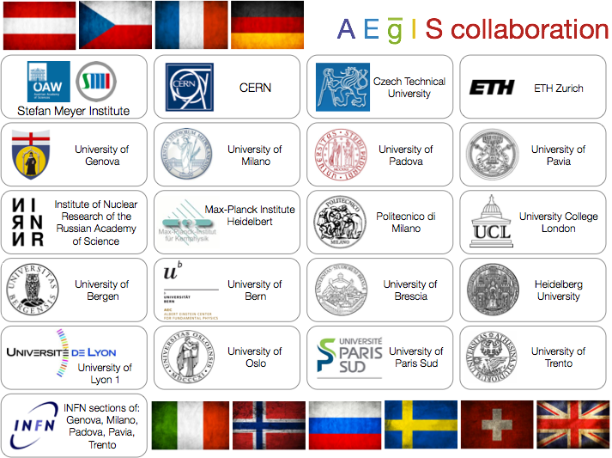

Slide 16
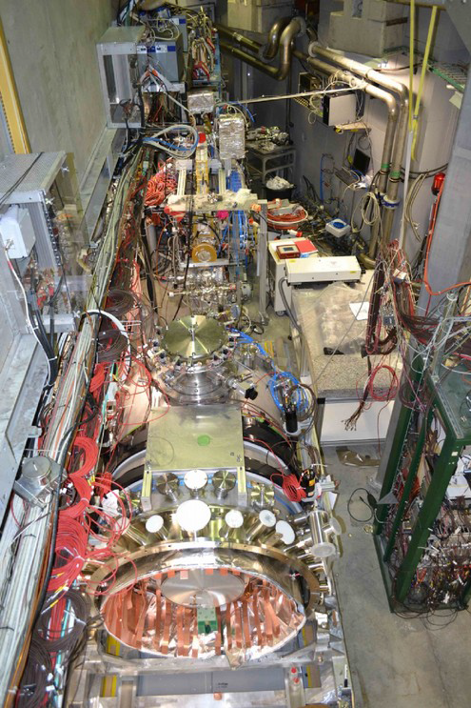
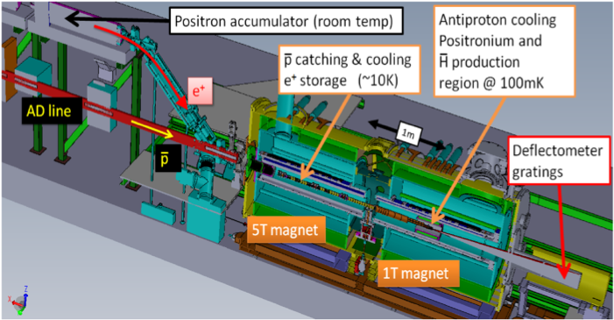
AEgIS
Antimatter Experiment: gravity, Interferometry, Spectroscopy
  Aim: measure the gravitational acceleration for antihydrogen in Earth’s gravitational field
  Aim: Hyperfine Spectroscopy of antihydrogen
  Aim: Spectroscopy of 1s->2s transition

Slide 17
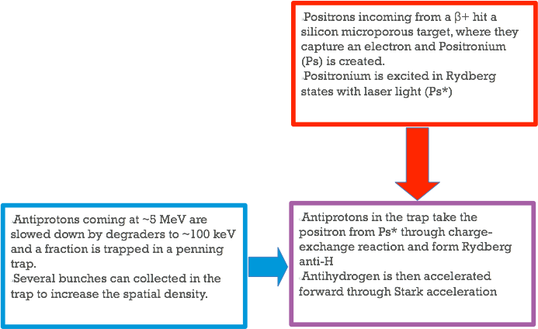
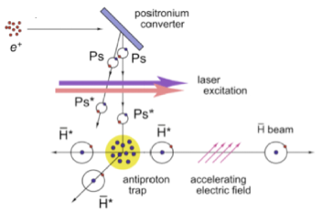
Antihydrogen production

Slide 18
INTO THE Gravity measurement

Slide 19
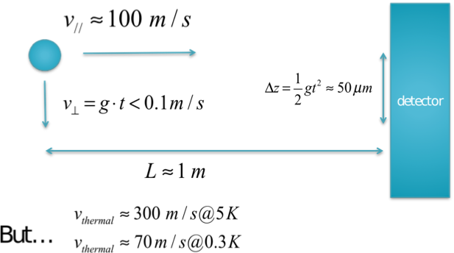
Is it so difficult?
We have to introduce a path selection mechanism and be able to measure deflections as small as tens of micron…

Slide 20
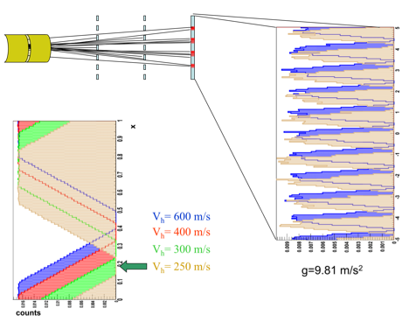

The moire fringe pattern: the needed path selection
Antihydrogen can pass only through holes in the grating.
Observe the number of particles arriving at a distance L from the second grating (N(x))
N(x) shows a periodical structure with a period
Needed: deflection magnitude, time of flight
Not needed: collimated beam, quantum regime, hyperfine gratings

Slide 21
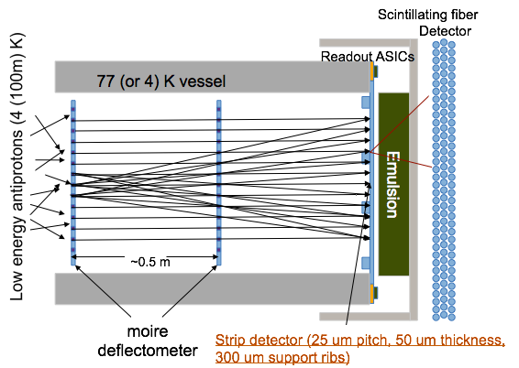
The AEgIS gravity module
Detection of anti hydrogen through a hybrid detector:
Silicon (position, TOF) - resolution down to ~7 um
Emulsion (position) - resolution of ~2 um
Scintillating fiber detector (TOF)

Slide 22
PART Ii:
silicon as a direct annihilation detector

Slide 23




Antimatter detection
Neutral antimatter
Charged antimatter
@ rest
E>~keV
Destructive detection
(annihilation)
Non-destructive
dE/dx detection
Leptons
Hadrons
gamma
photon detectors
(PET style)
Particle tracking detectors (semiconductor, gas detectors, scintillators, etc.)

Slide 24




Antiproton-nucleus interaction
(similar process for neutrons)
Pions can fragment the destabilised nucleus
Detection through annihilation products!

Slide 25


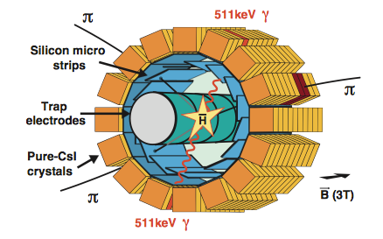
The indirect way: the ATHENA silicon detector
First production of Antihydrogen in 2012
Antiprotons capturing a positron formed neutral Hbar which escaped the penning trap confinement and annihilated on the walls of the chamber.
Gammas from positron-electron annihilation were detected by a scintillator barrel.
Vertex resolution ~ 4 mm
[https://arxiv.org/pdf/physics/0401034.pdf]

Slide 26
How to improve the annihilation vertex resolution?
Getting closer to the vertex…

Slide 27
How to improve the annihilation vertex resolution?
Getting closer to the vertex…
… using the detector as an annihilation plane!

Slide 28
How to improve the annihilation vertex resolution?
Getting closer to the vertex…
… using the detector as an annihilation plane!
But there are two problems to solve:
The detector and the antiprotons (antihydrogen) have to share the same UHV environment.
What is the detection signature for anti-hydrogen (antiprotons) detection?

Slide 29
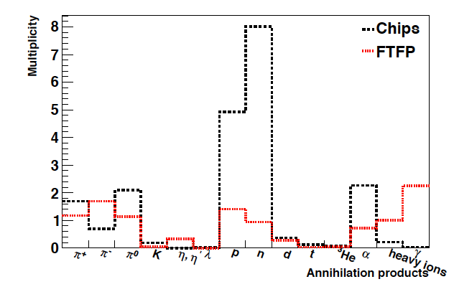
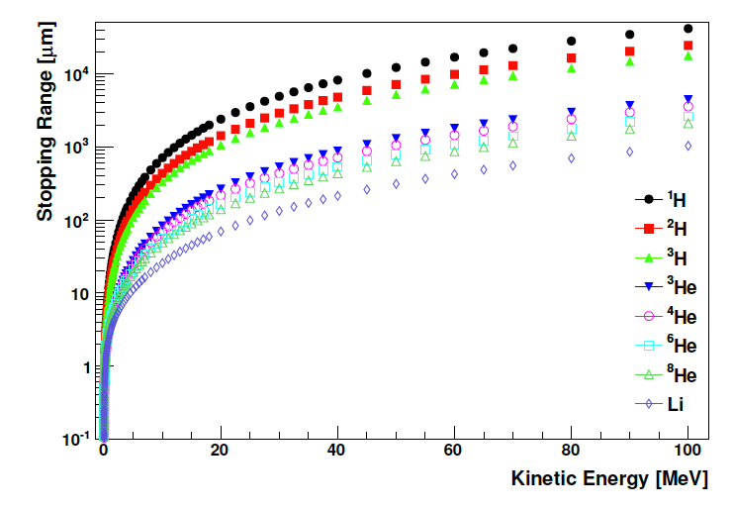
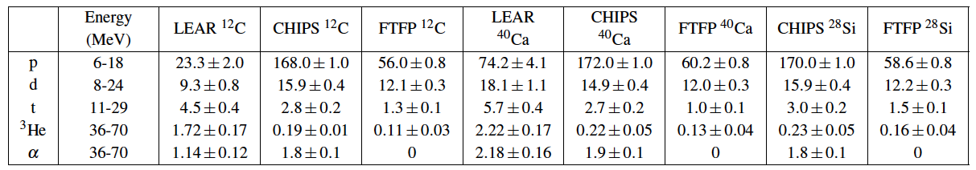
What are we supposed to see?
Total Energy available @ Annihilation ~ 2 GeV
Simulations predict energies for the products in the order of ~ 10-100 MeV.
Massive fragments with high energy: possible detector saturation.

Slide 30
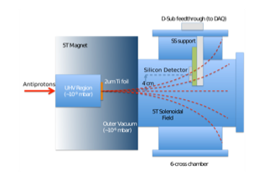
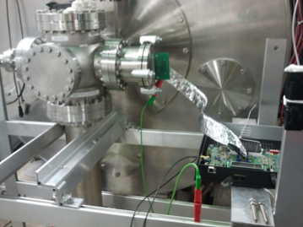
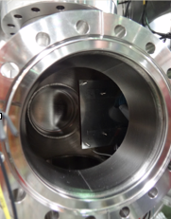
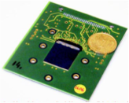
First trials - MIMOTERA
Monolithic pixel detector - Mimosa-based, for beam monitoring applications
14 um thickness, 128x128 pixels with size 153x153 um
High dynamic range (up to ~10 MeV)
2.5 MHz total analog readout without zero suppression (offline cut of noise events)

Slide 31
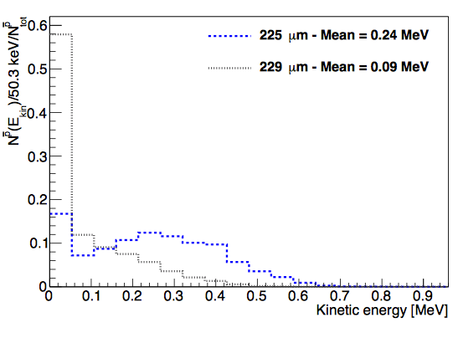
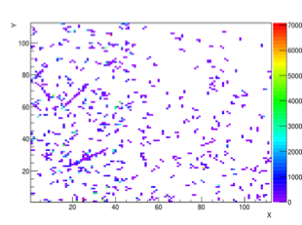
First trials - MIMOTERA
Moderation of the antiproton beam with thin foils =>
Background due to annihilations in the moderator.
First ever (successful) attempt to measure antiproton annihilations directly on a segmented silicon sensor.
S. Aghion et al. http://iopscience.iop.org/1748-0221/9/06/P06020/

Slide 32
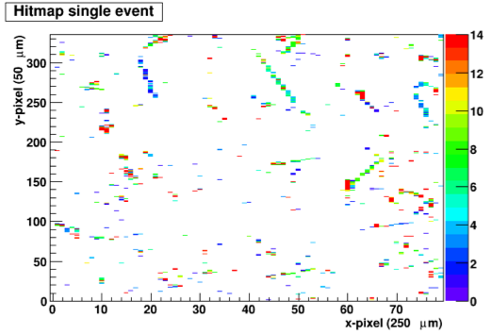
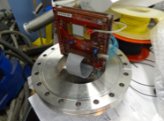
FE-I4
Using a standard ATLAS upgrade 3D pixel detector for antiproton annihilation detection
Events observed in the form of tracks: a thicker sensor allows observation of secondary prongs)
Energy deposition from pions distinguishable from heavier fragments - producing saturation
Fast collection and readout, avoid saturation by fast background.
Calibration: ~2,500 e / ADC count
N. Pacifico et al. NIM A - DOI: 10.1016/j.nima.2014.06.036

Slide 33
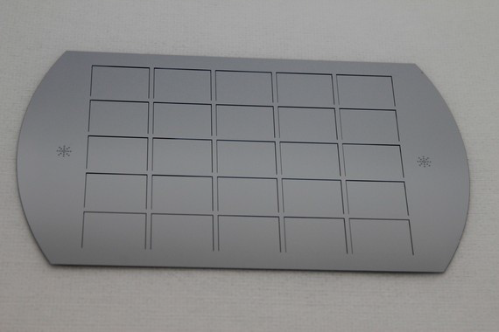
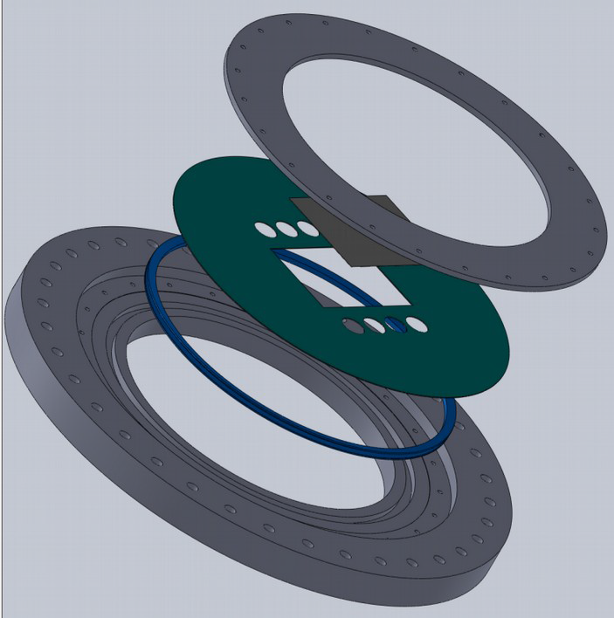
The AEgIS silicon annihilation detector
Silicon annihilation detector to be operated under challenging conditions
Covering a wide area (10x7 cm)
25 um strip pitch, 50 um thickness on wide areas (low scattering on secondaries for downstream emulsion detection)
Cryogenic operation (< 77K)
The silicon sensor is a vacuum separation window between OVC and XHV
Tagging is provided by downstream emulsion detector.

Slide 34
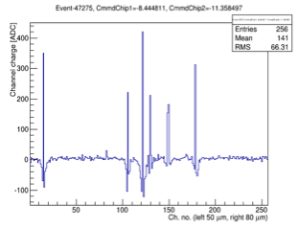
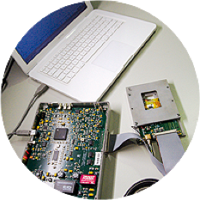

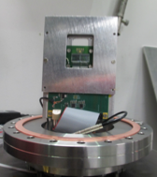
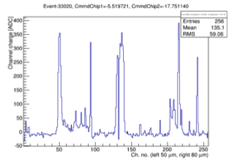
Preliminary tests with a strip sensor
Observation of ~100 keV pbars annihilation events on silicon ministrip sensors, p-on-n, standard 300 um thickness, Vdep~150 V
Alibava readout (LHCb beetle chip)
Sensors tested at depletion and extreme underdepletion.
Observation of effects due to space charge plasma (“volcano” effect) at lower bias voltages
Sensitivity to different annihilation products can be tuned through thickness tuning.
N. Pacifico et al. NIM A - DOI: 10.1016/j.nima.2014.06.036

Slide 35
The reason for a new testing facility
    As of 2012, AEgIS is not providing anymore downstream antiprotons (installation of an MCP for plasma diagnostic)
    We need to qualify sensors for low energy antiprotons/antihydrogen -> penetration depth at most < 1 um
    We need low background: having some 1e7 antiprotons annihilating in front of (or inside) your sensor doesn’t help much…
35

Slide 36


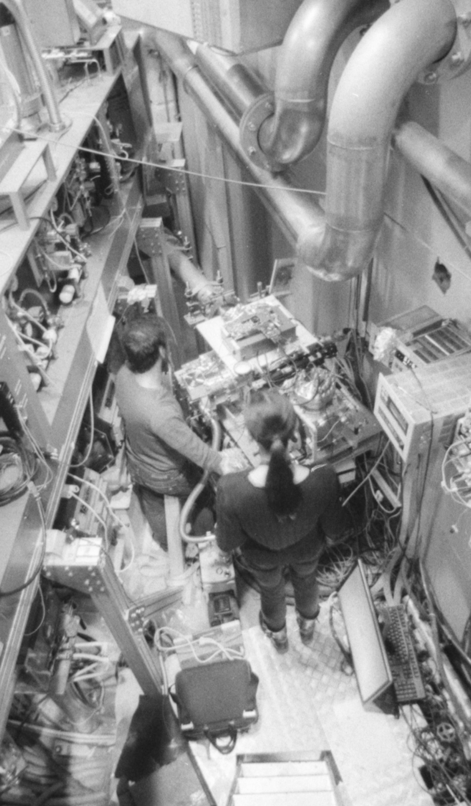
GRACE
A facility for extra low energy antiproton extraction
36

Slide 37



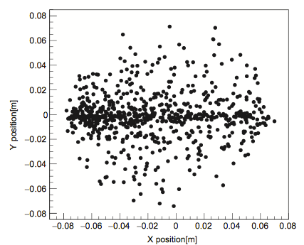
GRACE - A beamline dedicated to detector tests (and more) - from 2015 onwards!
5 MeV antiprotons moderated with Al foils (46 um) to 0-100 keV energy
Delivery of low (tunable) energy antiprotons, 0-16 keV
Fully electrostatic optics: 2 Einzel lenses + Electrostatic deflector
(Beam optics simulation with IBSimu)
Vacuum down to 1e-7 mbar!

Slide 38


Electrostatic beam optics
1st Einzel Lens + Electrostatic Deflector
2nd Einzel Lens

Slide 39
Characterization of grace using the timepix3

Slide 40

Timepix3
Detector and readout provided courtesy of the CERN Medipix group
General purpose hybrid pixel detector (wide dynamic range)
Extremely good time resolution (1.2 ns on TOA)
Concurrent TOA and TOT capabilities
High density pixel matrix (55 um)
5 Gbit/s data rate through Spidr readout (VHDCI connector)
Data driven readout
Sensors employed:
1 x 300 um, p-on-n, depletion @ ~ 50 V
1 x 675 um, p-on-n, depletion @ ~200 V

Slide 41
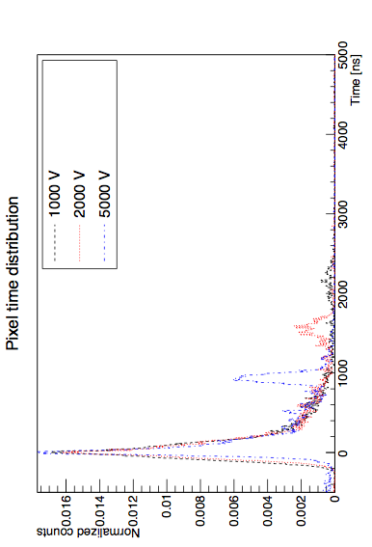

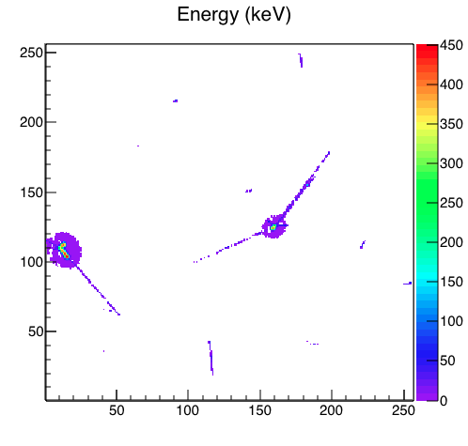
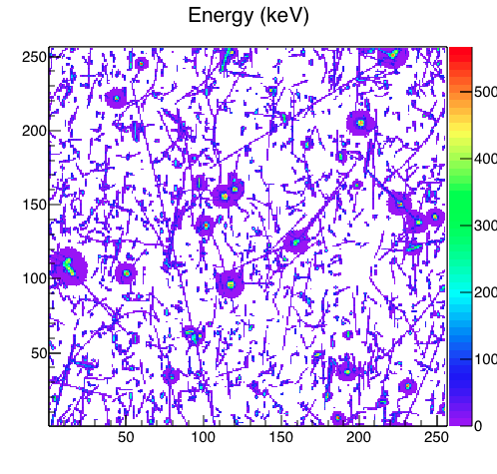

Time topology
Background (fast gaussian, pions and fast fragments from beam annihilations on chamber walls and moderators) is extinguished before the arrival of late antiprotons.
Time delay of slow antiprotons - indication for their energy. E.g. 500 ns delay - 40 keV; 1 us - 10 keV; 2 us - 2555 keV.

Slide 42
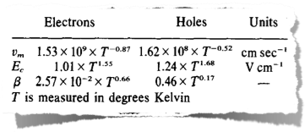
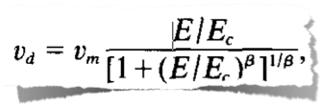
How else can we use the TOA information?
When the energy deposition along the track is uniform, the time delay at which the TOT exceeds threshold can be used as an indicator of the track direction along the detector thickness.
In particular, if the TOT threshold is set right below the pixel energy of the track, what we get is the actual drift time of the particle.
C. Jacoboni et al. (1976) come to help with a nice drift velocity parametrisation in silicon:
42

Slide 43
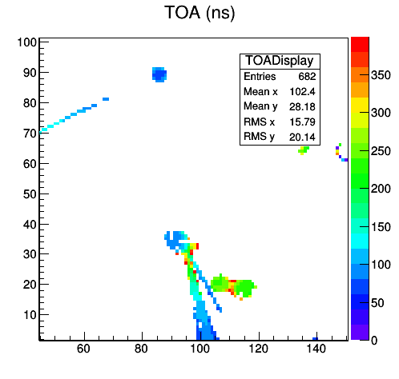
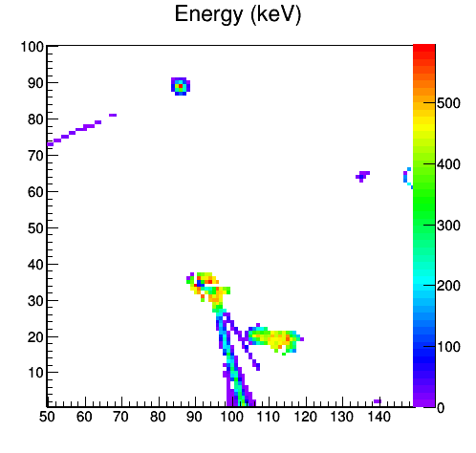
Tests with low energy antiprotons (E=8 keV)
- ID through Heavy Fragments -
300 um sensor
Pros: Easiest signature to detect. Typical star shape and lots of energy deposited
Cons: Ions are produced less frequently and resolution is limited by track width and multiple scattering
Evidence of plasma effect

Slide 44
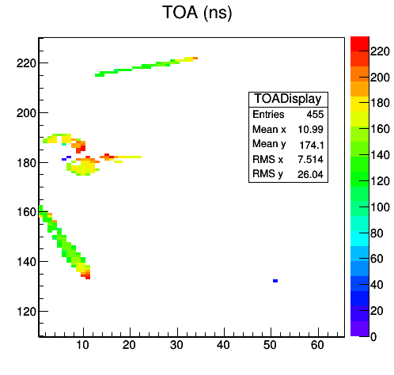
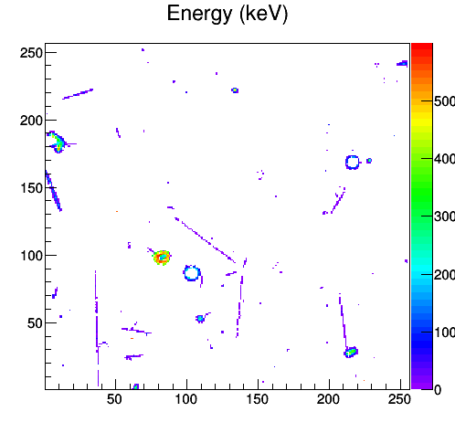
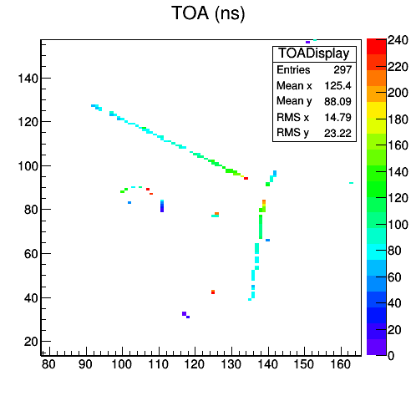
Tests with low energy antiprotons (E=8 keV)
- ID through pion tracks -
675 um sensor
Annihilation on PCB
Surface annihilation

Slide 45
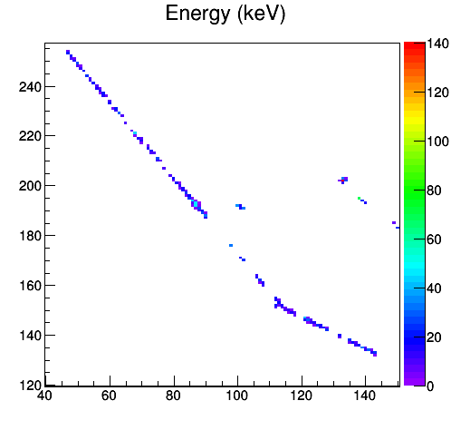
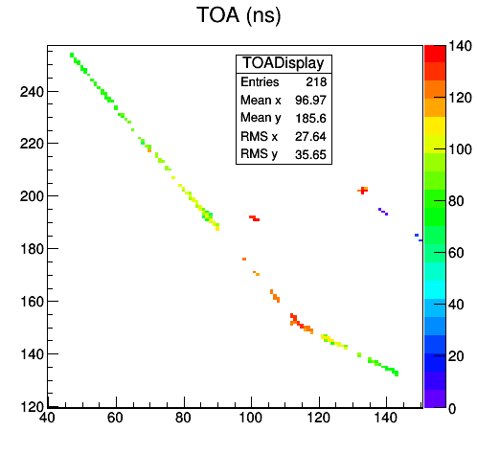
Tests with low energy antiprotons (E=8 keV)
- ID through pion tracks -
Tracks length in excess of several mm are observed for many annihilation events.

Slide 46
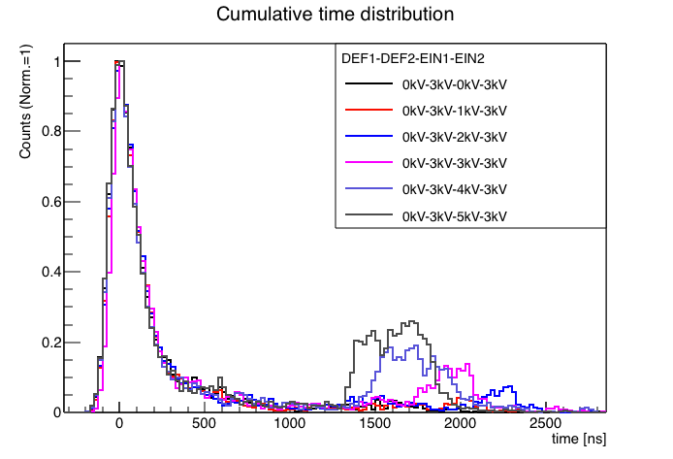
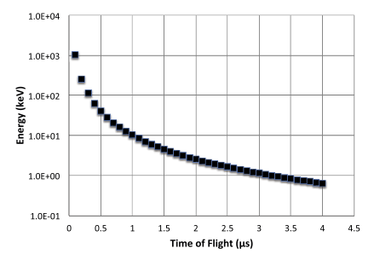
Energy tuning

Slide 47
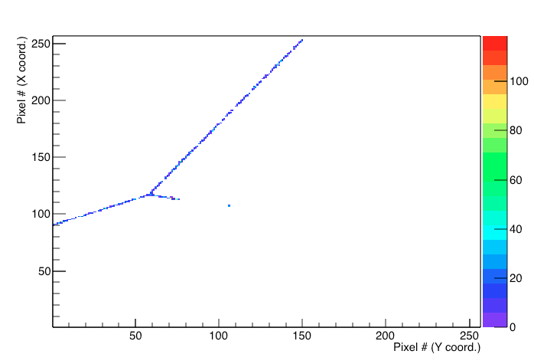
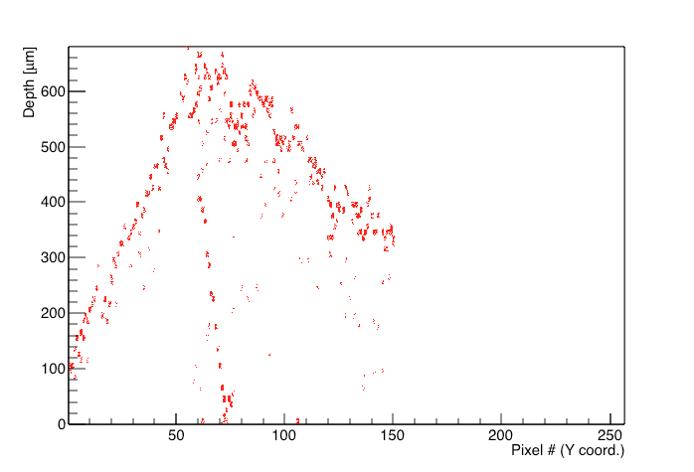
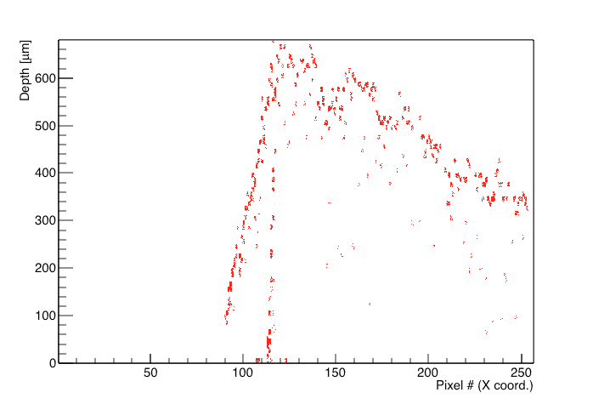

3D Reconstruction Capabilities
Reconstruction of an annihilation event and estimation of the annihilation depth from TOA information
XY plane
YZ plane
XZ plane
3D view of the annihilation

Slide 48


Does it work cold?
Yes! At least until
- 85°C (work in progress…)
Preliminary lab tests show promising results down to even lower temperatures.
Thanks to J. Alozy and A. Gligorova for all the ongoing Timepix3 cryo effort!
And for the material in this slide…

Slide 49
Why time tagging is important

Slide 50
Movie time…

Slide 51

TOA in action
300-700 ns:
main burst of secondaries coming from annihilation in the moderators
700-1200 ns: scattered antiprotons
1200-1500 n:
energy-selected antiprotons.

Slide 52

Work in progress for GRACE
Estimation of vertex resolution on the Timepix3
Test of the final large-area thin silicon strip sensor at room and LN temperature
Antiproton scattering and cross section studies
Validation of simulation models for annihilation-induced fragmentation in materials
The final AEgIS annihilation detector, mounted on along with its flex, ready for the installation in GRACE (this weekend :-))

Slide 53
Summary
Within AEgIS we have proven for the first time how a silicon detector can be used for detecting the direct annihilation of antiprotons.
The tagging capability is connected to the ability to distinguish tracks of fragments leaving the annihilation site
We developed a new extraction beamline, capable of selecting antiprotons of a given energy, with a reduced background
The Timepix has proven its potential as a antiproton annihilation detector, particularly when coupled to a thick sensor (-> longer tracks)

Slide 54
Backups

Slide 55
Motivation - new physics?
General relativity is a classic (non quantum) theory
EEP violations may appear in some quantum theories
New quantum scalar and vector fields are allowed in some models (Kaluza Klein …)
  Einstein field: Tensor graviton (spin 2)
  + Gravi-vector (spin 1)
  + Gravi-scalar (spin 0)
  These fields may mediate interactions violating the equivalence principle.
  M. Nieto and T. Goldman - Phys. Rep. 205, 5 221-281 (1992)
  Scalar: “charge” of particle equal to “charge” of antiparticle (attractive force)
  Vector: charge of particle opposite to charge of antiparticle (repulsive/attractive force)
  Cancellation between vector and scalar components is possible for matter!

