Slide 1
Velopix, a new hybrid pixel readout ASIC for the LHCB VELO LS2 upgrade
CERN, NIKHEF and USC

Slide 2
Outline
Introduction to the VELO upgrade (Martin)
The VeloPix chip (Martin):
  Velopix FE (Rafa)
  Digital pixel (+eCDRPLL) (Xavi)
  Super Pixel, EOC, periphery and GWT (Tuomas)
Measurements (Jan)
Conclusion (Jan)

Slide 3
M. Van beuzekom

Slide 4
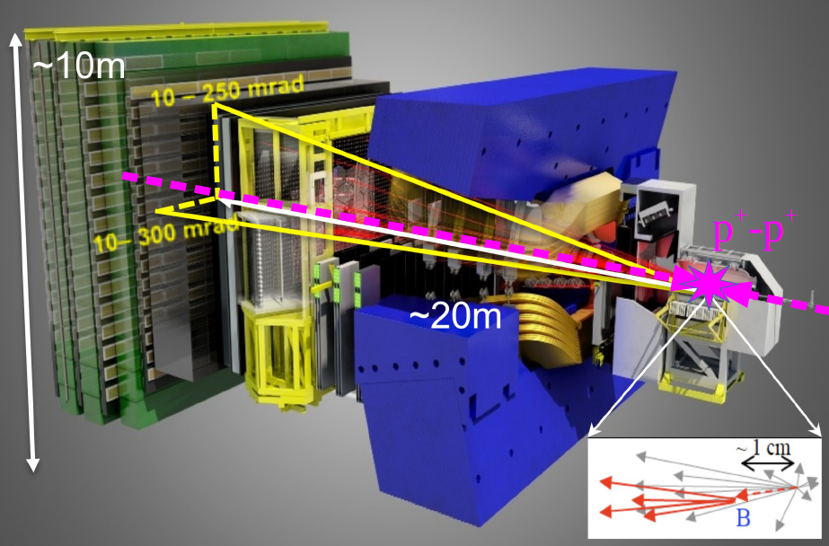
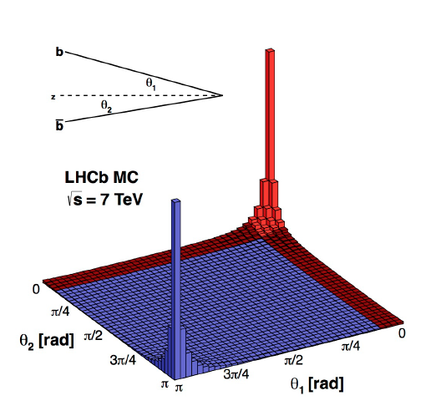
Introduction to LHCb and its upgrade
LHCb is a dedicated experiment searching for new physics by studying CP violation and rare decays of b and c quarks
Forward angle spectrometer with excellent vertex resolution and PID
Detector upgrade in 2019→2020 for 5x higher luminosity and improved efficiency
No more hardware trigger → all data data read out and sent to CPU farm

Slide 5
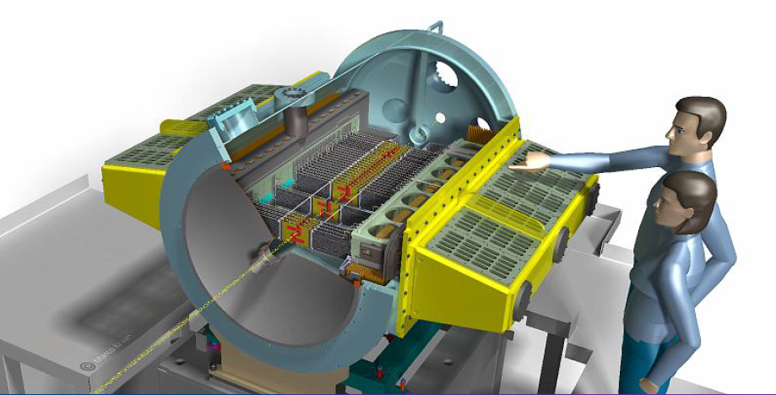
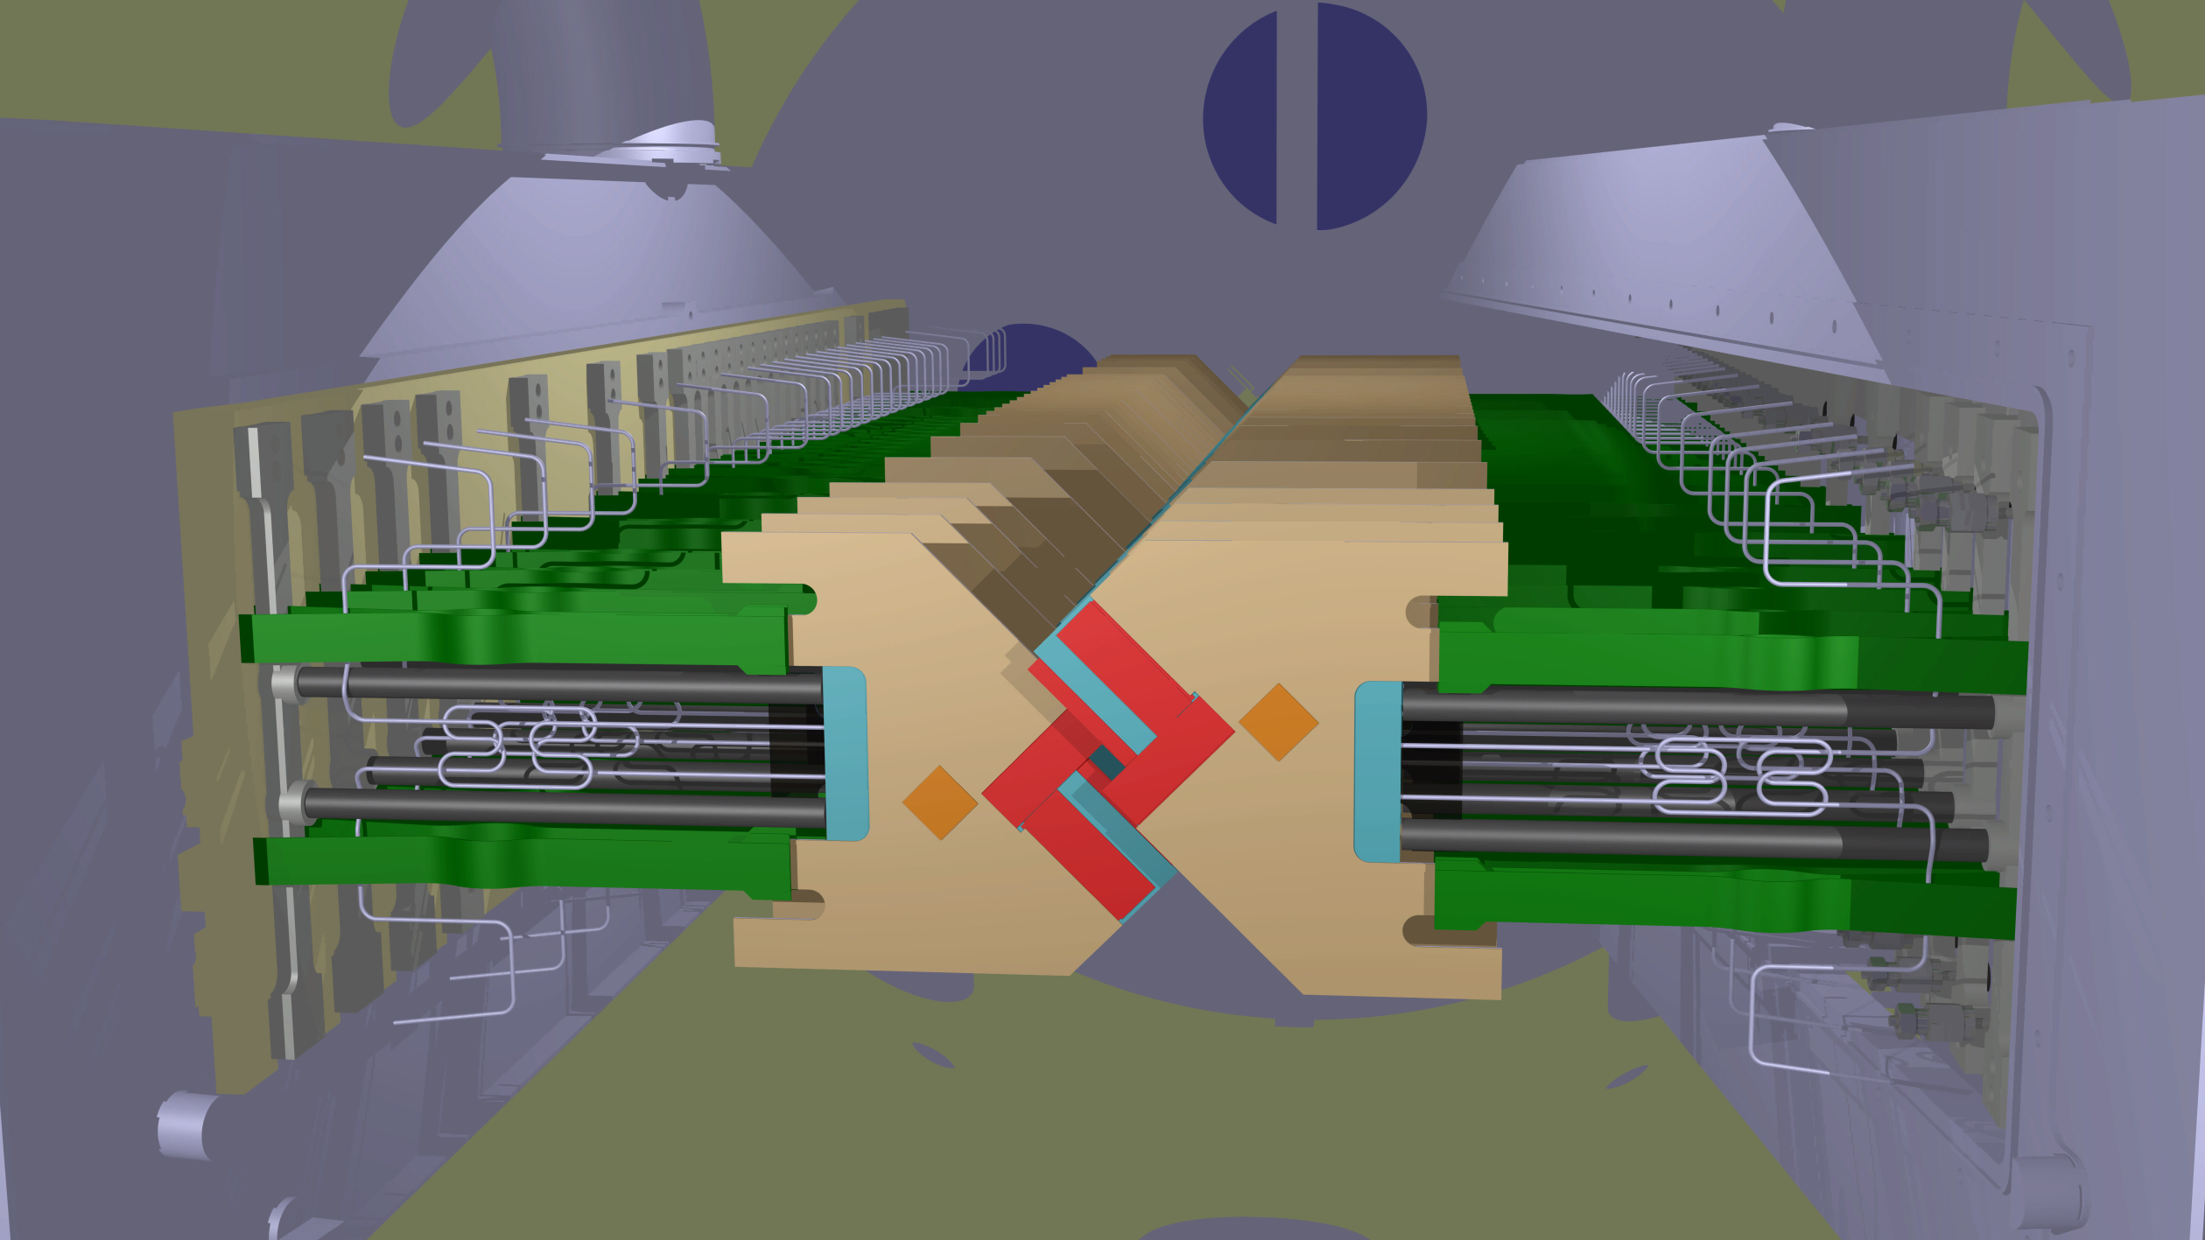
Vertex Locator Upgrade
bla
LHCb will be upgraded in 2019→2020
→ very tight planning
Vertex detector surrounding collision region
  In vacuum
  Close to the beam: 5.1 mm
From silicon strips to pixels
New R/O chip VeloPix, derived from Timepix3
In total 624 ASICs, ~41 Mpixels
Trigger-less readout (~2.9 Tbits/s)

Slide 6
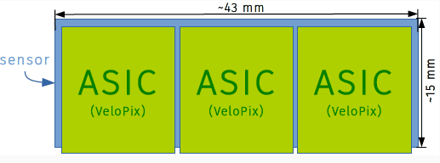
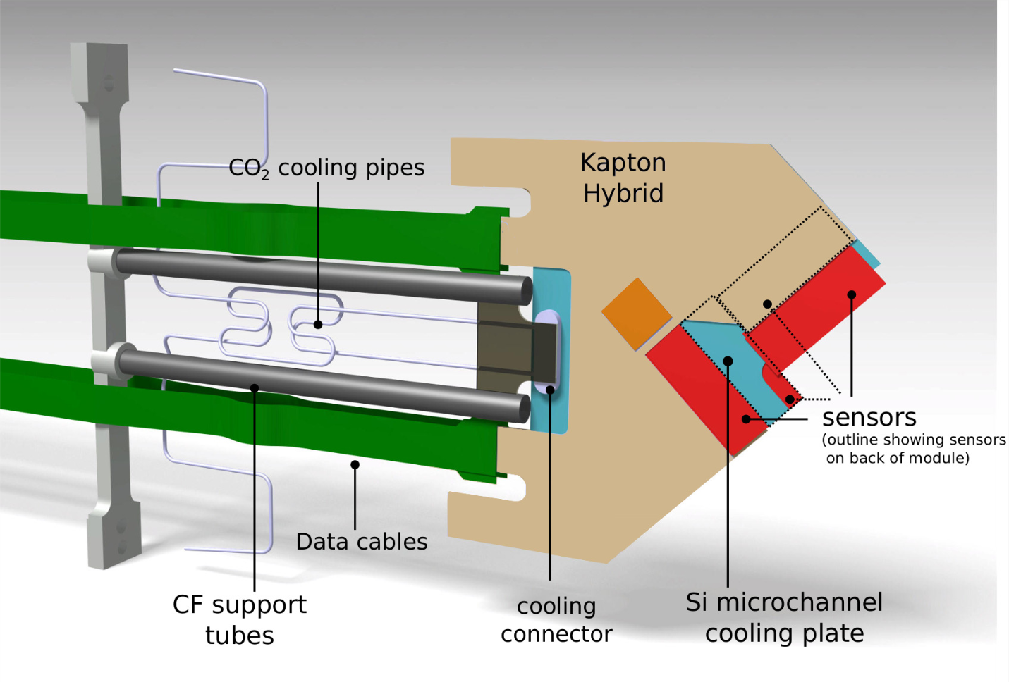
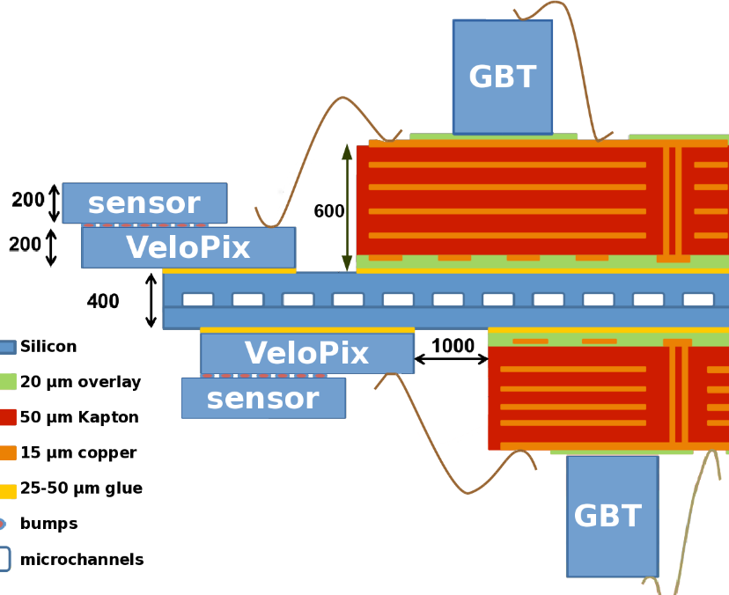
VELO module
One module = 4 sensors with 3 VeloPix ASICs each
256x256 pixels/ASIC, 55 x 55 µm² pixels
ASICs thinned to 200 µm
All silicon module, minimal CTE mismatch
Si substrate with m-channel evaporative CO₂ cooling
  sensors < -25 °C
Sensor signal at end-of-life ~7000 e-

Slide 7
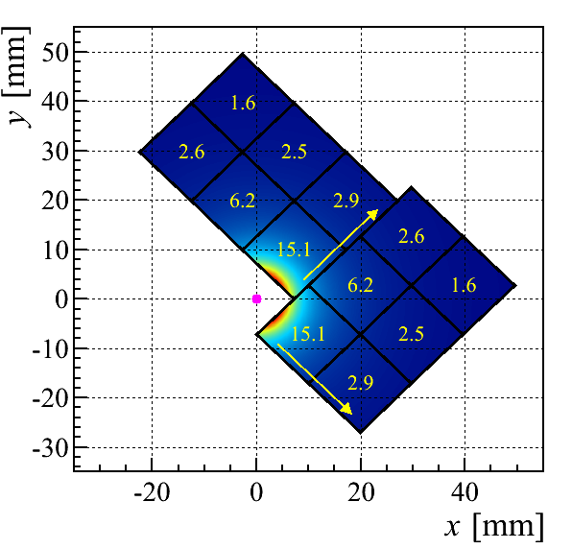
ASIC challenges: data rate & radiation hardness
Sensor and ASIC exposed to high, non-homogeneous, radiation fluence
  Only part of the pixel matrix gets the full dose of ~ 370 Mrad
  TID at periphery of chip is factor 10 lower
For data rates calc. we assume collisions in every LHCb bunch crossing
  in reality only 2/3 of bunches collide
  would require a lot of memory to level out
  → assume peak rates for ASIC design
Data flow simulations using physics
Monte Carlo data
No trigger, all data sent off chip
Hottest ASIC gives ~15 Gbps
ASIC design starting point: Timepix3
Data rates per ASIC (Gbps)

Slide 8
From Timepix3 → Velopix
 | Timepix3 (2013) | VeloPix (2016)
Pixel arrangement | 256 x 256
Pixel size | 55 x 55 µm²
Peak hit rate | 80 Mhits/s/ASIC | 800 Mhits/s/ASIC 50 khits/s/pixel
Readout type | Continuous, trigger-less, TOT | Continuous, trigger-less, binary
Timing resolution/range | 1.5625 ns, 18 bits | 25 ns, 9 bits
Total Power consumption | <1.5 W | < 3 W
Radiation hardness |  | 400 Mrad, SEU tolerant
Sensor type | Various, e- and h+ collection | Planar silicon, e- collection
Max. data rate | 5.12 Gbps | 20.48 Gbps
Technology | IBM 130 nm CMOS | TSMC 130 nm CMOS

Slide 9
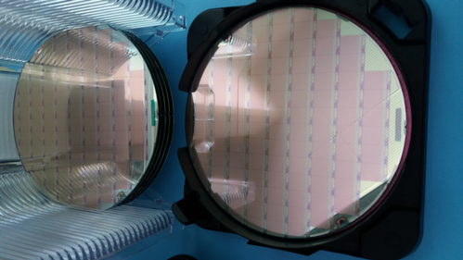
VeloPix Project Overview
Design started in June 2013 (after Timepix3 submission)
Change of technology (IBM 130nm → TSMC 130nm)
The chip was submitted as an engineering run on May 2016
First wafers received on 31st August
Fabricated (and diced) chips back at CERN on 7th September
First beam tests done on 6th November
Production testing later this year (624 chips)
Irradiation campaign in the future with sensors bonded
VeloPix wafers

Slide 10
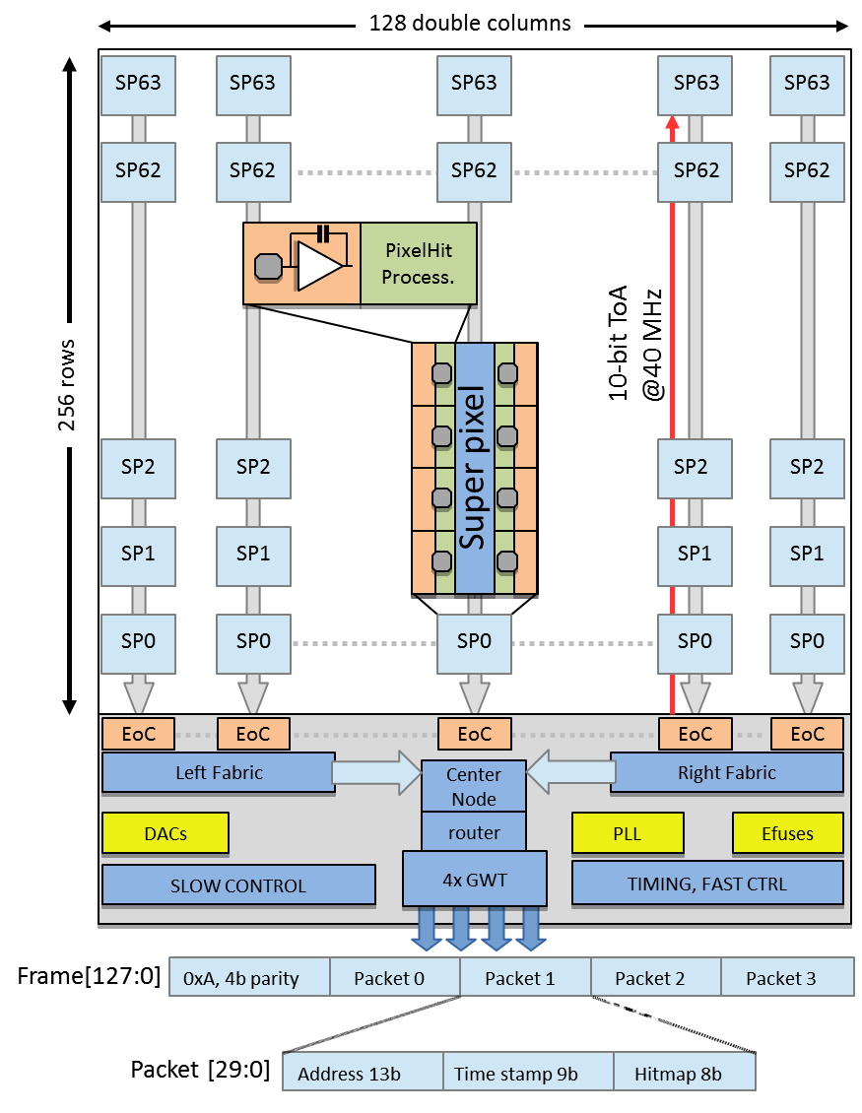
VeloPix Chip Architecture
Pixel matrix:
  256 x 256 pixels
  128 x 64 super pixels (2x4 pixels each)
  @40MHz
Packet-based architecture:
  8 pixels/packet + 9 bit time stamp → 30% reduction in data rate
Data-driven readout:
  20 Mpackets/s/double column
40, 80, 160 and 320 MHz TMR clock domains in the periphery
1 to 4 configurable serializers (GWT)
Similar to the GBT frame

Slide 11
VeloPix pixel schematic
1 pixel
Common for 8 pixels
From previous
SuperPixel
Front-end (Analog)
Front-end (Digital)
Super pixel (Digital)
24-bits
Leakage
Current
compensation
6-bits
6-bit TMR
Pixel memory
8
FIFO (2x18)
Synchronous handshake
4fF
Valid
Event
Addr (6-bit)
TOA (10-bit)
Hitmap (8-bit)
Input
pad
4-bit Local
Threshold
24-bits
6-bits
10-bits
6-bits
Preamp
Synchronizer
&
Clock gating
6-bit LFSR:
Counter
Shift Register
Clock
Manager
Data Node
TestBit
MaskBit
5fF
24-bits
Rafa
Xavi
Tuomas
Synchronous handshake
TpA
TpB
Global threshold
(LSB= ~15e⁻)
Clock
(40/80 MHz)
BXID
To the next
SuperPixel
Shutter
DataIO
TPulse

Slide 12
R.Ballabriga

Slide 13
Specifications
Parameter | Value
Technology | TSMC 130nm CMOS
Number of pixels | 256 x 256 @ 55 μm pitch
Analog front-end size | 55 x 14.5 μm
Analog supply voltage | 1.2 V
Detector capacitance | 50 fF
Detector polarity | Optimized for electron collection
Maximum of charge distribution | 16ke⁻ (200μm Si @ 80e⁻h⁺ pairs per μm)
Leakage current | Up to 12nA/pixel (non-uniform)
Minimum threshold | ~500e⁻
Pile-up | Discharge of 16ke⁻ charge in 300ns
Time of arrival resolution | 25ns
Operating temperature (in experiment) | -30ºC<T<0ºC
Analog power consumption | ~6.1μW/pixel 200mW/cm² (250mW/cm²) (constant)

Slide 14
FAB 6 (NMOS)
FAB 14 (NMOS)
Limited NMOS leakage current (in good Fab)
The annealing at -30ºC is much faster in HVT transistors wrt regular transistors
L>min
2 Fabs showed different results in terms of leakage for the NMOS transistors
We decided to design for the worst case i.e.:
NMOS transistors either ELT or HVT
minL, W>1 (or LVT)
minL
ELTs do not move!
Ion degradation<5%
Radiation measurements: S. Michelis, F. Faccio

Slide 15
The front-end circuit
FB
C_{fb}
4-bit offset calibration
-A
V_{out_disc}
V_{th}
-HV

Slide 16
vdda
vdda
vdda
vdda
V_{Bias_Ikhalf}
C_{leak}=700fF
x2
Segmented in 4 in the direction of the length
C_{fb}=5fF
Bias block shared between 2 adjacent pixels
vdda
I_{leak}
V_{IN}
V_{OUT}
-A
Vfbk
vssa
Vfbk
ELT
ELT
ELT
-HV
V_{x}
Vbias_Ikrum
ELT
ELT
The inner terminals of the ELTs are connected to Vx (to minimize Cdb (current source) and Csb (input pair)
Dummy (matching and decoupling)
ELT
vssa_ik
vssa_ik
vssa_ik

Slide 17
vdda
vdda
vdda
V_{Bias_Ikhalf}
1.2V
vdda
vdda
C_{leak}=700fF
830nA
2x830nA
Vbias_preamp
x1 x2
C_{fb}=5fF
Vbias_preamp_casc
x1 x2
vdda
I_{leak}
V_{OUT}
V_{IN}
-A
V_{OUT}
Vin_casc
REG_ELT
Vfbk
(500mV)
vssa
HVT_ELT
HVT_ELT
V_{IN}
V_{x}
HVT_ELT
2.5μA
Vbias_Ikrum
vssa
25nA
ELT
ELT
vssa_ik
vssa_ik

Slide 18
The choice on the capacitance for C_{LEAK}
Vx
(Vx)
C_{LEAK} implemented as a PMOS LVT
For Power Supply Rejection Ratio
For minimization of its gate leakage current!
Vx

Slide 19
The comparator
Designed for minimizing time-walk of the system (target below 25ns)
Designed based on cascading low gain stages was selected
Constant current consumption in analog part

Slide 20
Gain ~4, BW ~40MHz
Gain ~3.2, BW ~40MHz
1.2V
1.2V
V_{OUT_s1-}
V_{OUT_s1+}
V_{OUT_s2-}
V_{OUT_s2+}
V_{CAS}
V_{CAS}
ELT, reg
I_{EQ}
I_{EQ}_BAR
V_{THR}
V_{IN}
V_{OUT_s1-}
V_{OUT_s1+}
ELT, reg
ELT, reg
1.2μA
1.2μA
hvt
hvt

Slide 21
Analog Digital
Gain ~40
Analog_Disc_Out
Digital_Disc_Out
hvt
V_{OUT_s2-}
V_{OUT_s2+}
ELT, hvt
Inverter_B_XL

Slide 22
Simulation ToA, ToT
Threshold at 750e-, reference pixel (bottom column).
Corners: typ,ff,ss, radiation corners (at 100Mrad and 400Mrad)

Slide 23
Implementation of the DAC
55nA
55nA
x2
VbiasDAC_local
x1 x1
VbiasDACcasc_local
…
x2
Bn<0>
Bn<1>
B<1>
VbiasDACcasc
VbiasDAC
110nA
I_DACOutL
ELT
I_DACOutR
VbiasDAC and VbiasDACcasc are provided from the periphery. / Less loading to the DAC in the periphery.

Slide 24
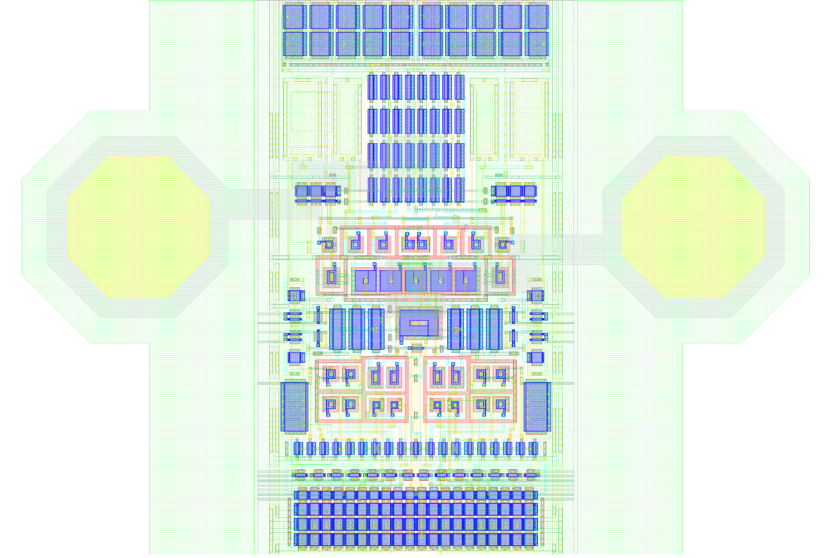
2.5um
14um
18um

Slide 25
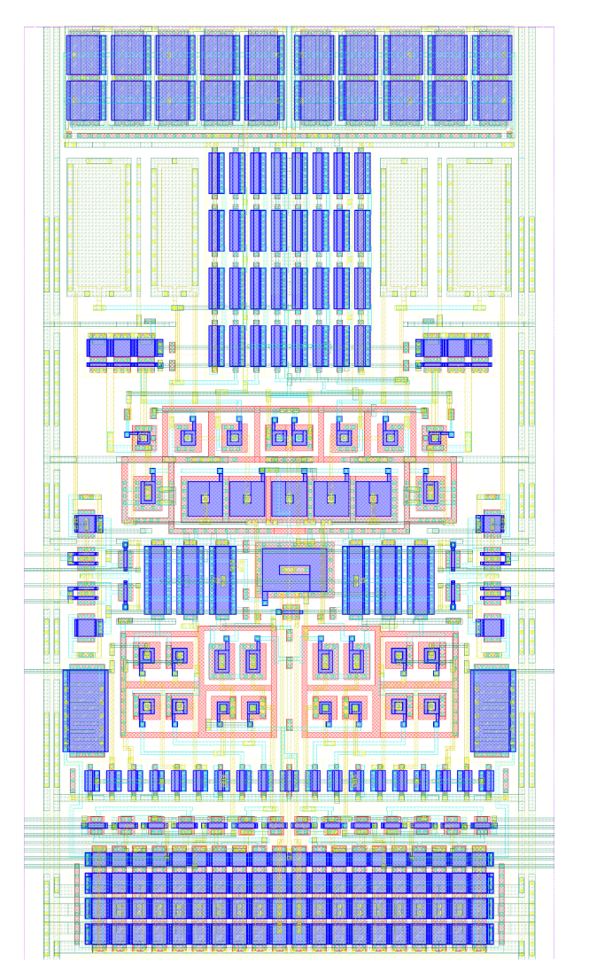
Preamplifier
Leakage current compensation capacitor
Test capacitor
Feedback capacitor
Input transistors
IKRUM current sources
Target transistor DAC
Blocks “double pixel”
NMOS transistors on DNW
Ikrum current sources
Shielding
Most contacts are double
Left/right most columns different schematic and layout
Dimensions 29um x 55um
Test pulse switches
Comparators
DACs

Slide 26
X. llopart

Slide 27
eCDRPLL (simplified) Block Diagram
P. Leitao
feedbackClocks
Divider
(8 / 6 / 4 / 2)
smCtrl[x:x]
Wien-bridge
smCtrl[x:x]
Phase Shifter
clock240_320MHz
vcoClock
BIST
Phase / Frequency Detector
Loop filter
clock120_160MHz
refClk40MHz
vControl
VCO
clock60_80MHz
vcoClockPhases[15:0]
2.56 Gb/s
clock40MHz
resampledData
smCtrl[x:x]
smCtrl[x:x]
smCtrl[x:x]
recoveredData
State Machine
smCtrl[x:x]
extControl[x:0]
smCtrl[x:0]
analog
data
control
clock
http://cern.ch/proj-gbt/eCDR-PLL

Slide 28
ePLLCDR Description
P. Leitao
Radiation-hard and phase deterministic PLL & CDR
  TSMC 130nm, 960 x 420 µm
Two Frequency Multiplier modes
  VCO@240MHz - 40, 60, 120 and 240 MHz simultaneous output clocks
    260-ps phase shift resolution
    Targets GBT-FPGA/backend applications
  VCO@320 MHz – 40, 80, 160 and 320 MHz simultaneous output clocks
    195-ps phase shift resolution
    Targets typical TTC/e-link applications
  BIST for jitter characterization (to be run at production time)
Clock and Data Recovery
  VCO@320 MHz only
    40, 80, 160 and 320 MHz simultaneous output clocks
    40, 80, 160 and 320 Mbps selectable output recovered data
    Uses reference-less wien-bridge VCO calibration (no external clock required)
    195-ps phase shift resolution (data pushed-out on clock’s falling edge)
http://cern.ch/proj-gbt/eCDR-PLL

Slide 29
ePLLCDR preliminary experimental data
P. Leitao
Jitter measured using the phase noise (Agilent E5052B)
  Input Clock:
    40 MHz (Agilent 81133A)
  Output Clock:
    320 MHz
    PLL w/ Default parameters
Phase Shifter
  INL and DNL < 0.5 LSB
PLL full characterization on going
CDR and BIST are still being characterized
http://cern.ch/proj-gbt/eCDR-PLL

Slide 30
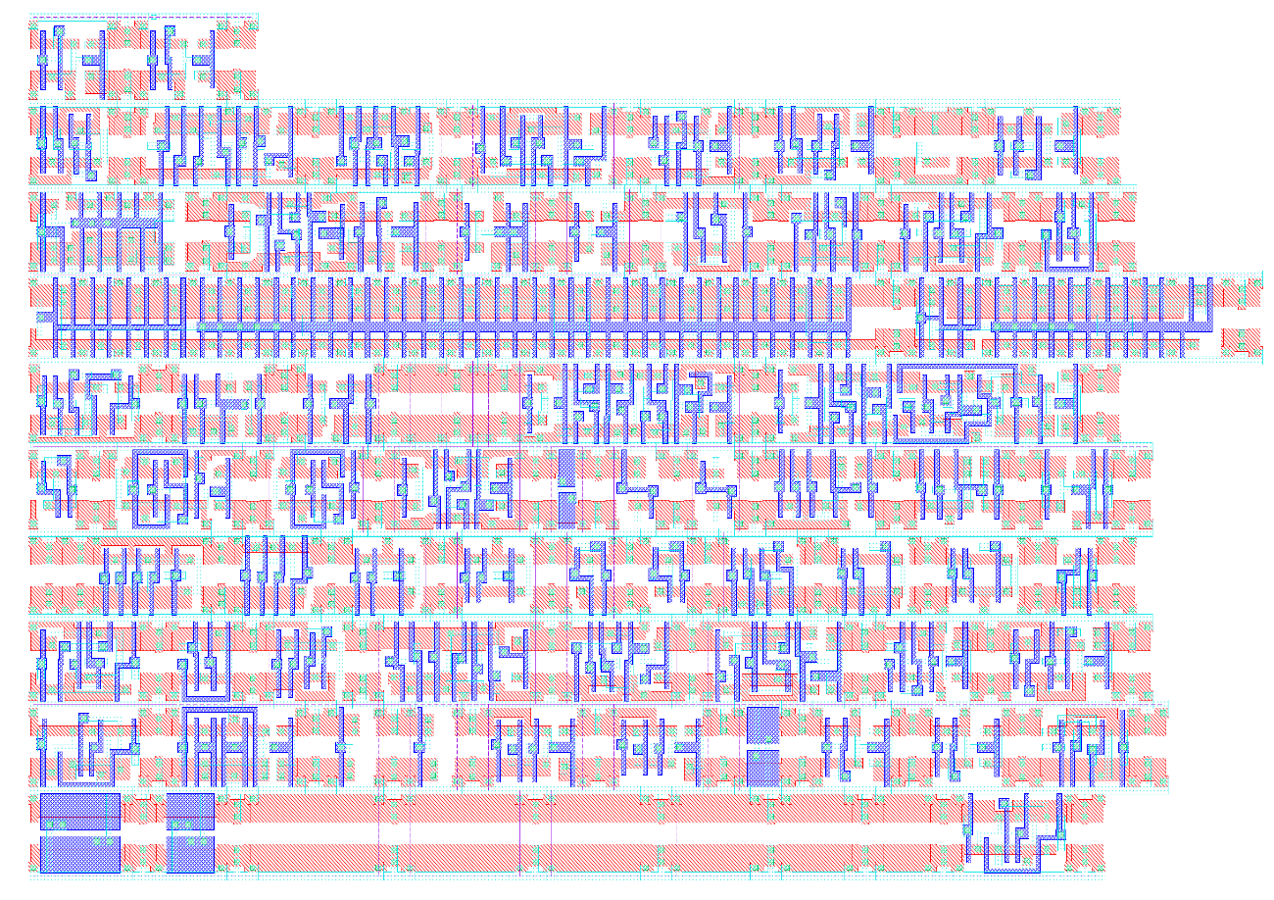
CERN TSMC 130nm HD Library
Library type | Tap-less CMOS standard cell library
Transistors | Pmos+NmosHVT
Antenna cell | 1
WellSubTap cell | 1
Filler cells | 8
DeCap cells | 5 (thin gate) 4 (thin gate + diode) 4 (thick gate)
Sequential cells | 2
ClockGate cells | 1
ClockBuffer cells | 3
Combinatorial cells | 54
Total cells | 83
Technology | TSMC 130nm 1p7m4x1z1u
Metals used | M1 to M2
Corners [prerad, 100M and 400MRad] | 1.2 25C TT 1.1 80C SS 1.3 -20C FF

Slide 31
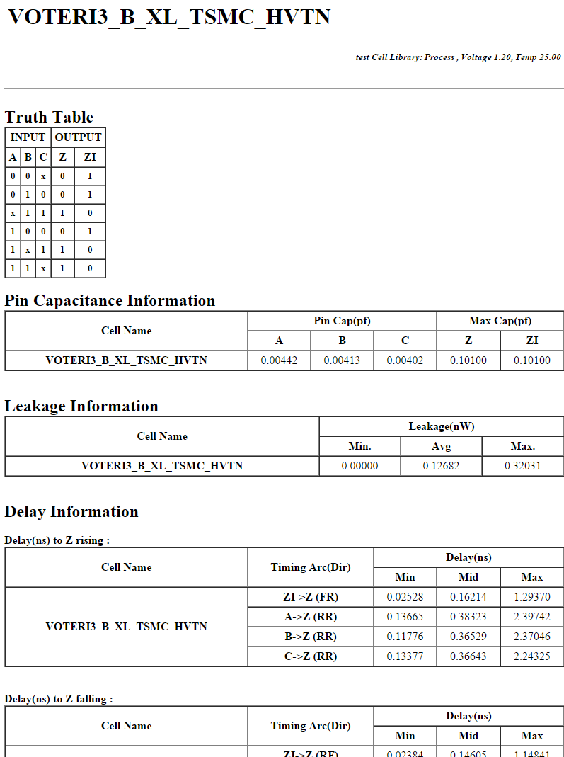
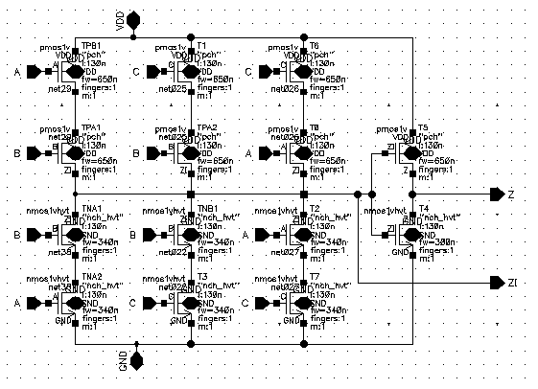
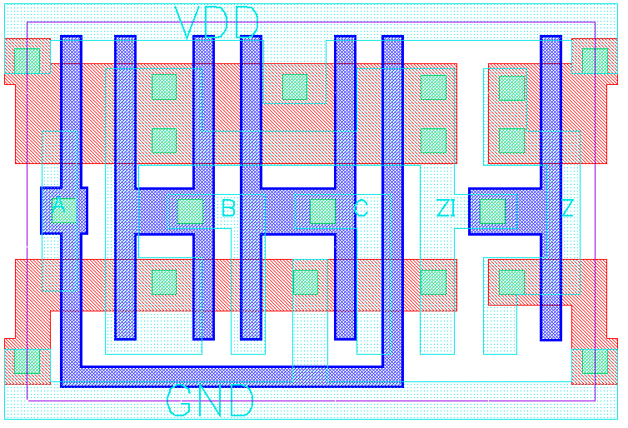
VOTERI_B_XL_TSMC_HVTN
2.46 µm
3.68 µm

Slide 32
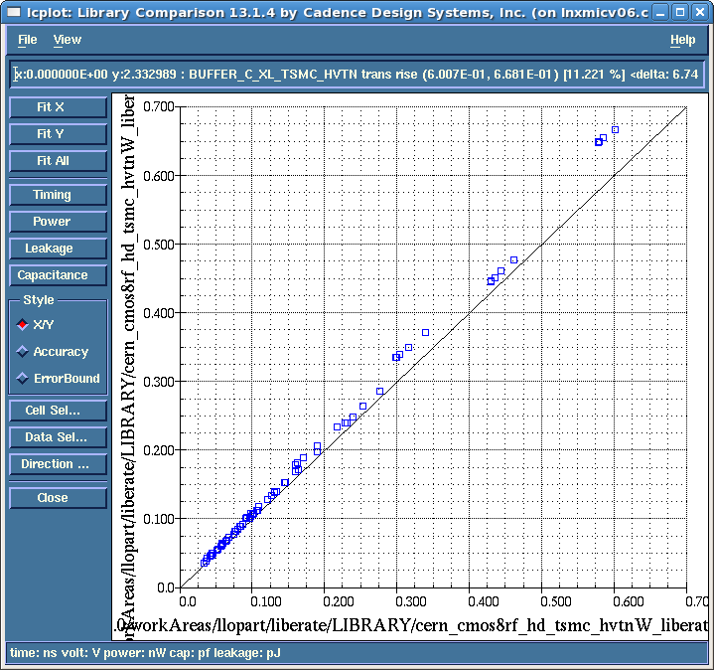
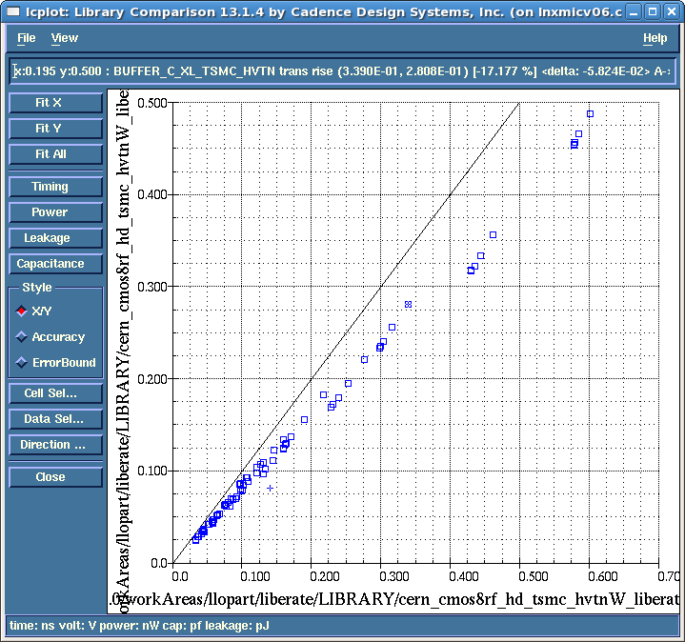
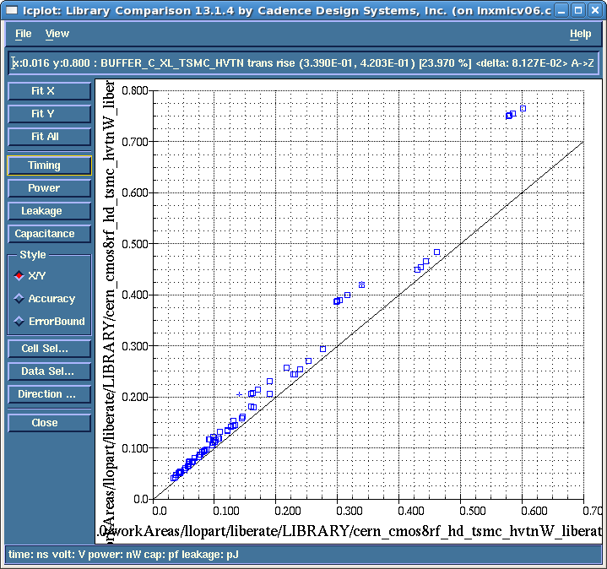
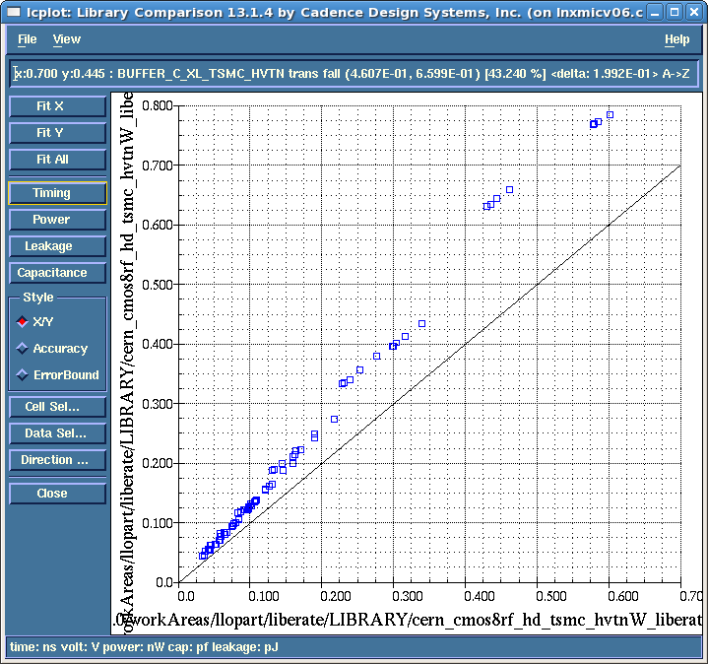
HD Library Characterization
Use Liberate
9 different corners:
  TT 25C 1.2
    preRad
    100MRad
    400MRad
  SS 80C 1.1
    preRad
    100MRad
    400MRad
  FF -20C 1.3
    preRad
    100MRad
    400MRad
Observation:
  400MRad_TT → preRad_SS
Corners used:
  SLOW: SS 80C 1.1 400MRad
  TYP: TT 25C 1.2 PreRad
  FAST: FF -20C 1.3 PreRad
100MRad_tt
preRad_ff
preRad_tt
preRad_tt
400MRad_tt
preRad_ss
preRad_tt
preRad_tt

Slide 33
Velopix Pixel
@Shutter | SelectOverflow_FullRange_TOToverflow | TOToverflow [1:0] | Select_1hitTOT_iTOT | Select_PC_TOT | @SelectDirection_Write_Read | read_seu | @Parallel Load
0 | X | XX | X | X | 0 | 0 | 0 | Read | Reads the 6-bit Shift Register
 |  |  |  |  |  |  | 1 |  | Reads back the 6-bit PCR
 |  |  |  |  |  | 1 | 1 |  | Reads the 6-bit SEU status from the PCR
 |  |  |  |  | 1 | X | X | Write | Writes the 6-bit PCR
1 | 0 | 00 | 0 | 0 | X | X | X | Data acquisition | Valid event generated if TOT_{measured} ≥ 0
 |  | 01 |  |  |  |  |  |  | Valid event generated if TOT_{measured} ≥ 1
 |  | 10 |  |  |  |  |  |  | Valid event generated if TOT_{measured} ≥ 2
 |  | 11 |  |  |  |  |  |  | Valid event generated if TOT_{measured} ≥ 3
 | 1 | XX | 0 | 0 |  |  |  | Data debug acquisition | Integrating TOT up to 63 counts
 |  |  |  | 1 |  |  |  |  | Integrating PC up to 63 counts
 |  |  | 1 | 0 |  |  |  |  | 1-hit integrating TOT up to 63 counts
 |  |  |  | 1 |  |  |  |  | 1-hit integrating PC up to 63 counts

Slide 34
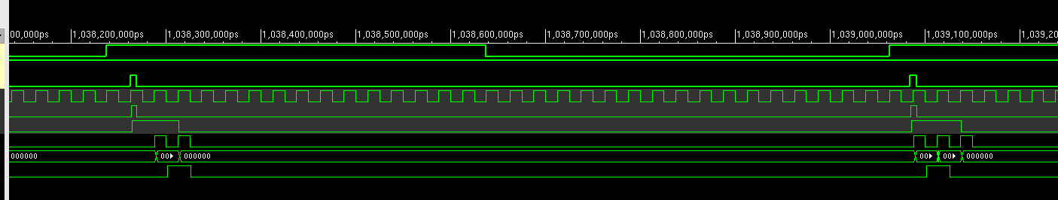
TOT Processor
Tpeak > 25ns
Event-by-event processor
Very useful to correctly set a hit in BxID
Events below TOT threshold are ignored
Most noise events can also be filtered
Tw#1< 25ns
Tw#2> 25ns
TOT threshold | TOT clocks | Fix delay to valid event
00 | 0 | 50ns
01 | 1 | 75ns
10 | 2 | 100ns
11 | 3 | 125ns
Off_time
On_time
Qin=700e-

Slide 35
Simulation of TOT processor
Peak Time | 25ns
Return to zero | 12.5ns/Ke⁻
ENC | 60e⁻_{rms}
Threshold mismatch | 30e⁻_{rms}
Gain | 35e⁻/mV
Analog Threshold | ~570e⁻
Pixels tested | 64
TestPulses per Qin/pixel | 100
Best setting: TOT=01 → 100% Qindetected ≥ 1.0 Ke⁻

Slide 36
T. Poikela

Slide 37
Double column datapath
Timestamping @ 40 MHz
Previous
Node
Sensor
8 analog
Front-ends
8 digital
Front-ends
FIFO
Node
FIFO
Data
FIFO
Node
0 1
Arbiter
64 FIFOs
FIFO
Node
Register
FIFO
Node
Next
Node
Size = 2
packets
Up to 20
Mpackets/s
Super pixel packet:
Analog pixel
column
Digital pixel
column
Super pixel
column
Addr 6b
ToA 10b
hitmap 8b

Slide 38
Periphery datapath
64x up to 20 Mpackets/s
64x up to 20 Mpackets/s
Pixel Matrix
64 EoCs
64 EoCs
Center
Node
Left
Data Fabric
Right
Data Fabric
4.8 Gbps per bus
Data Node
19.20
Gbps
FIFO
Router/
Scramblers/
Framing
4 x 5.12 Gbps
GWT link
Data
out
160 Mpackets/s/node

Slide 39
EoC Data Fabric
64 EoC Blocks (Periphery left side)
Periphery
Right side
0,0
0,1
0,15
L0
R0
L1
R1
1,0
1,1
1,15
Center
Node
2,0
2,1
2,15
L2
R2
data[29:0]
3,0
3,1
3,15
L3
R3
handshake
20.48
Gbps
0
1
2
3
Channel:
30b @ 160 MHz
Packet
Router

Slide 40
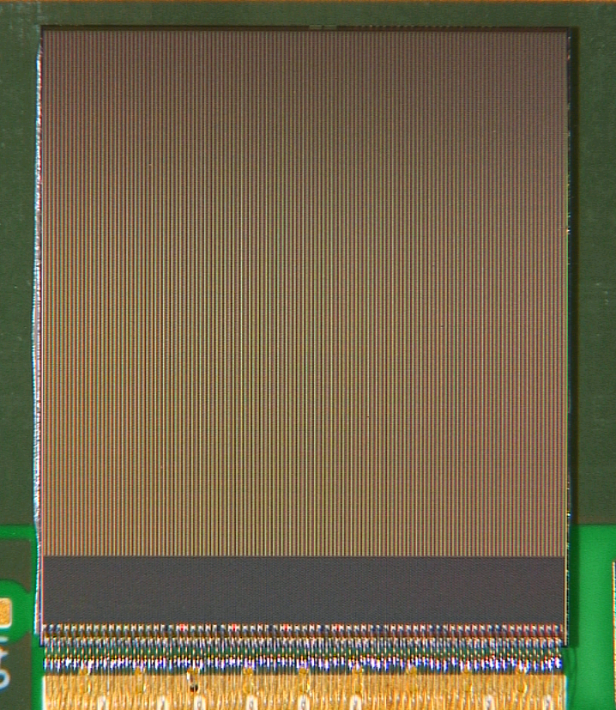
Packet processors (Center node)
Filtered
packets
Latency: T1 - T0
data
Packet
Proc L0
T0
empty/
read
SP
Filtered
packets
data
Packet
Proc L1
empty/
read
10
data
Filtered
packets
Packet
Proc L2
empty/
read
EoC
BX ID
T1
Counter
Packet
Proc L3
Filtered
packets
data
empty/
read
32-b counter
Max latency
Max hits
Time stamp
@ 40 MHz

Slide 41
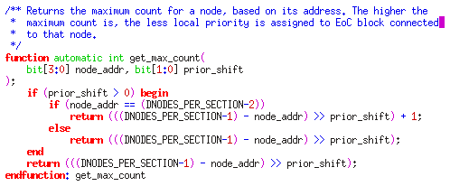
EoC Data Fabric Node
Double column
data
empty/read
EoC Block
empty/read
empty/
read
FSM
write/
full
Arbiter
4-bit counter
get_max
count()
Previous Node
Next Node
30
1
empty/read
FIFO
2x 30 bits
0
30
30

Slide 42
Packet Router
Input ID
Output ID
0
VOQ 0,0
30b
1
VOQ 0,1
30b
30b
Input 0
Round robin
arbiter
Round robin
arbiter
0
Output0
2
VOQ 0,2
3
VOQ 0,3
0
VOQ 1,0
Input 1
Round robin
arbiter
1
VOQ 1,1
Round robin
arbiter
Output
1
1
2
VOQ 1,2
3
VOQ 1,3
0
VOQ 2,0
Input 2
Round robin
arbiter
1
VOQ 2,1
Round robin
arbiter
Output
2
2
2
VOQ 2,2
3
VOQ 2,3
0
VOQ 3,0
Input 3
Round robin
arbiter
1
VOQ 3,1
Round robin
arbiter
Output
3
3
2
VOQ 3,2
3
VOQ 3,3

Slide 43
Router and output block
Fixed latency
Channel
Mask [3:0]
4x 30b
4x 30b
4x 128b
f2r[0]
Scrambler
Framing
Serializer
f2r[1]
Packet
Router
(4x4
crossbar)
EoC Data Fabric
Scrambler
Framing
Serializer
f2r[2]
Scrambler
Framing
Serializer
f2r[3]
Scrambler
Framing
Serializer
160
MHz
160
MHz
160
MHz
40
MHz
320 MHz
DDR
128b registers:
parity + header
16-to-1b
ser.
Output
drivers

Slide 44
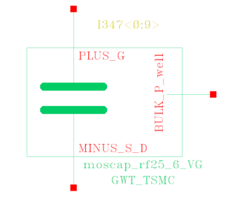
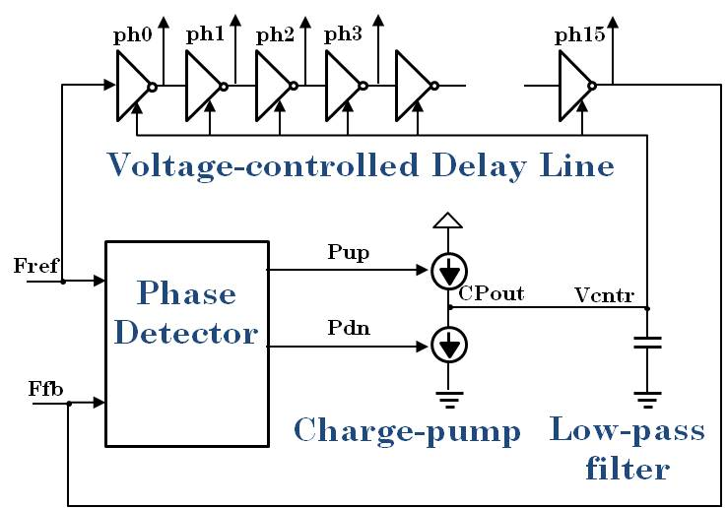
GWT (NIKHEF)
Low power 5.12 Gbps byte-interleaved serializer and wireline transmitter
VDD_CORE
3Ω
data
8bit @ 320MHz
VDD_HS
Reg <8:15>
MUX
16 phases
dc: 7mA ,
ripples: <2mV p-p
serialized data @ 5.12 Gbps
5Ω
posedge
Driver
dc: 13mA ,
ripples: <2mV p-p
data
8bit @ 320MHz
Reg
<0:7>
CMOS
negedge
534pF
534pF
Multi-phase DLL
Edge-
combiner
5Ω
ph_0
ph_1
GND_HS
ph_2
ph_3
<30mW/channel
ph_14
320MHz
ph_15
3Ω
GND_CORE

Slide 45
Clock distribution
clk_en
Control & config domain
Data in/out
80 MHz
(slow control)
ECS Master
Registers
bypass
PLL
Data domain
Master 40
40 MHz
(system)
PLL
Data in
(sensor)
40
160
320
40
160
320
TMR:
40, 160, 320
Datapath
Data out
(GWT)
320 MHz
(TFC)
ClkGen
clk_en

Slide 46
Velopix: TMR/RadHard design
Pixel Matrix (<400Mrad):
  Only NMOS ELT transistors used in analog front-end
  Full TMR in FSM & configuration FFs:
    Pixel configuration → Asynchronous self correcting TMR latch
  Pixel data flip-flops (FF) unprotected
  Custom made HD Standard cell library (74 cells) with HVT NMOS HVT and regular PMOS:
    Standard cell library characterized at 400 Mrad, High-Vt NMOS + Std PMOS
Periphery (<50Mrad):
  Full TMR in FSM & configuration FFs
  Data path unprotected

Slide 47

VeloPix
Analog front-end
16 x 55 um²
Double column:
  512 pixels
  64 super pixels
Full matrix:
  128 Double columns
  ~190 Mtransistors
  14.8nF digital decoupling (thick gate)
Pixel & Superpixel Logic (HD Library)
16.6 mm
Active Periphery:
  40, 80, 160 and 320 TMR clocks
  HVT TSMC (tcb013ghphvt library)
  4nF digital decoupling (thin gate)
2.4 mm
14.14 mm

Slide 48
J. Buytaert

Slide 49
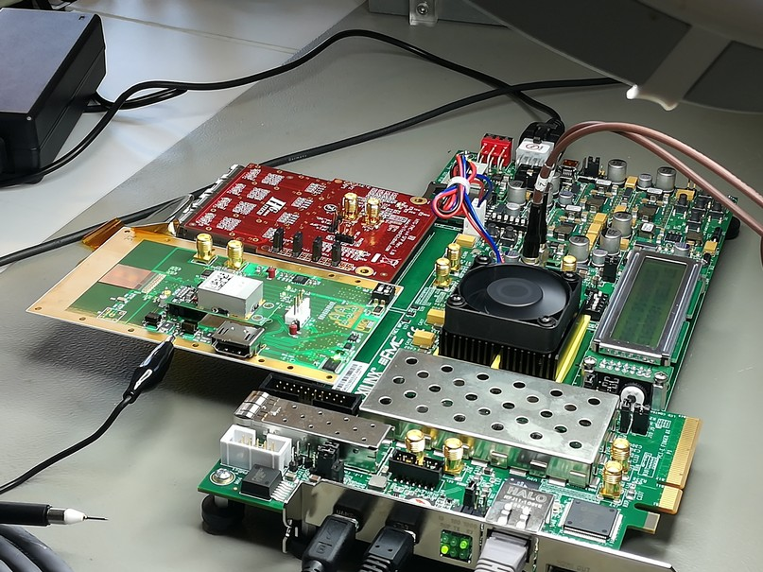
VeloPix test readout system
SPIDR-readout system developed at NIKHEF (NL)
  Based on a Virtex VC707
Similar as Timepix3. -> Large reuse of soft & firmware.
Chipboard developed at Univ. Santiago De Compostella.
Not final LHCb readout.
VeloPix

Slide 50
VeloPix: General Measurements
Measured power consumption (@nominal settings):
  Analog suuply < 480 mW
  Digital:
    Periphery < 380mW
    Pixel Matrix <350mW (idle, i.e. clock distribution only)
    @High rate ~+300mW (simulated)
  Total= ~1.5W @High rate
Slow and Fast control fully functional.
Pixel matrix Configuration and readout
On-chip biasing DACs (next slide)
Internally measured packet latency (@low rate)
eCDRPLL (CERN) total jitter @320MHz <6ps_{rms}

Slide 51
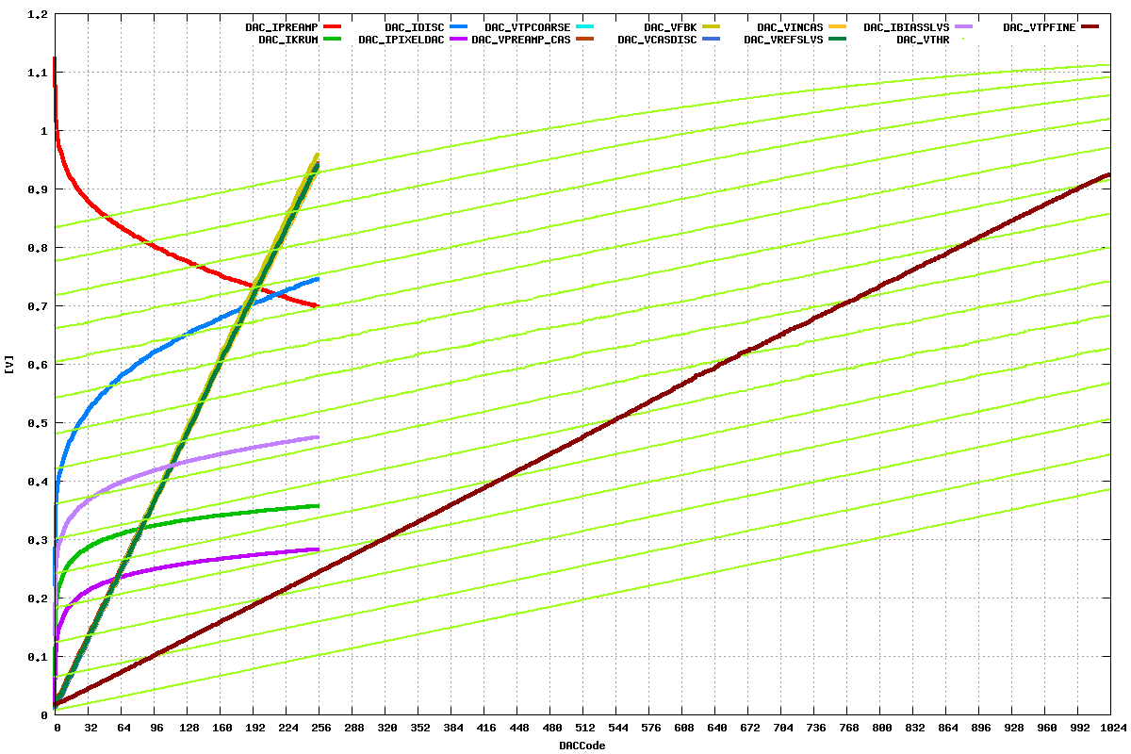
VeloPix on-chip biasing DACs
8 bit DAC’s
TestPulse (~31.25e⁻ LSB)
Range : > ~25 ke⁻
10 bit DAC
14 bit DAC implemented as
16 x 10bit DAC with offsets)
VTHR (~15e⁻ LSB)
Range: 15.3 ke⁻

Slide 52
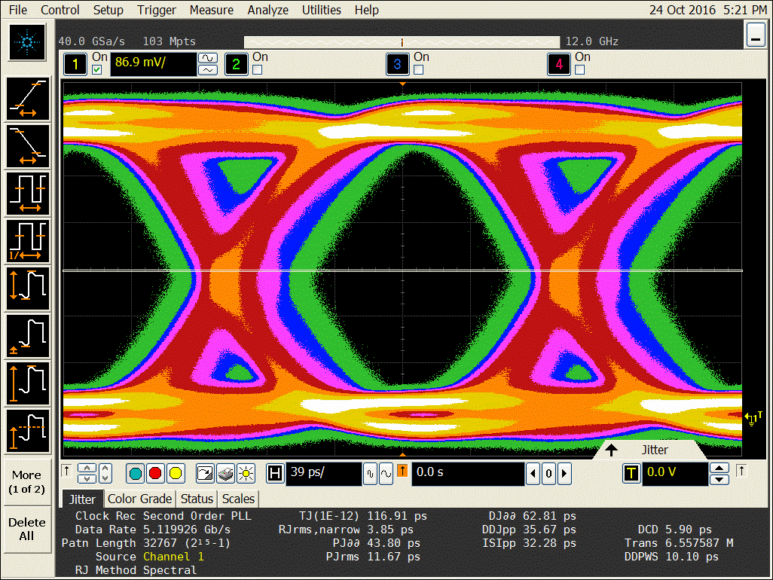
VeloPix Serializers (GWT)
A low power (~20mW) 5.12 Gbps byte-interleaved serializer and wireline transmitter (NIKHEF).
Voltage driver, large swing (1.6 V diff)
Measure internally generated PRBS15 signal with scope → Measured BER<10⁻¹²
Eye of VeloPix PRBS15 stream

Slide 53
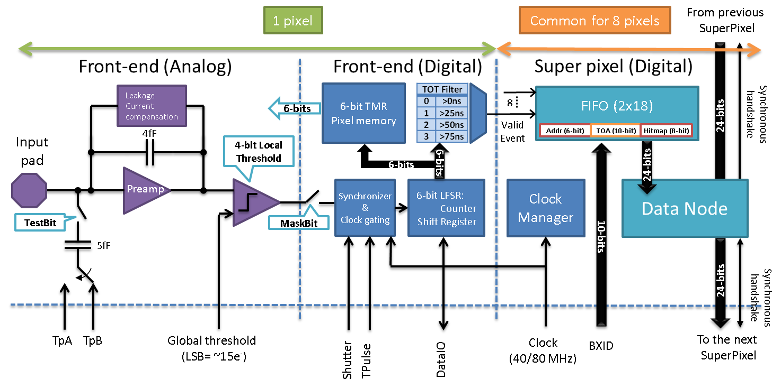
FE Measurements
Front end characterization measurements done through the slow control readout.

Slide 54
Front-end gain:
(test pulses in one pixel)
0.0154 e⁻/DAC_{LSB}*→ 1 DAC_{LSB} = 0.38mV → 24.6 mV/ke⁻
Test pulse amplitude in e-(*)
Global threshold level
*Assuming Ctest=5fF

Slide 55
Front-end gain uniformity
(test pulses in 32 pixels)
64.72 DAC_{LSB}/ke- → 1 DAC_{LSB} = 0.38mV →
24.6 mV/ke⁻ (0.81 mV/ke- rms) → ~3.3% gain variation
~3.3% front-end gain variation

Slide 56
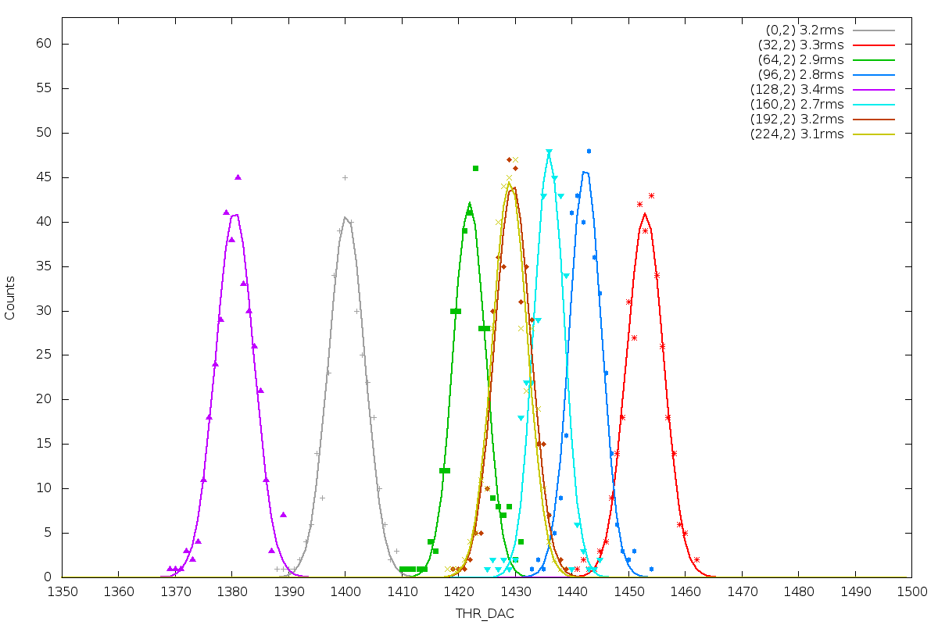
Pixel ENC.
[Threshold scan over noise floor in PC mode]
8 pixels
Typically ~60 enc

Slide 57
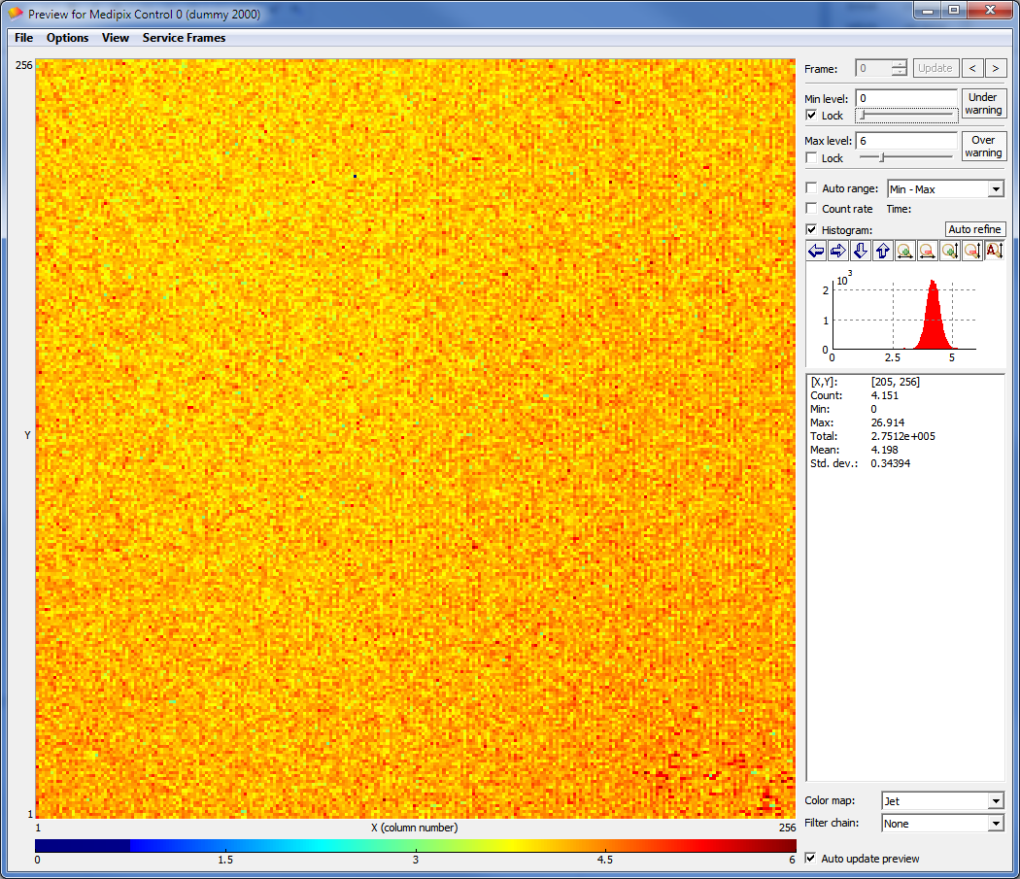
ENC of full matrix.
Measured ENC of all pixels
Threshold scan over noise floor
All pixels at code 0xF
No trend visible
µ_{eq}= 4.14 (62.9 e⁻)*
σ_{eq}= 0.27 (4.1 e⁻_{rms})*
*@gain of 25mV/ke⁻

Slide 58
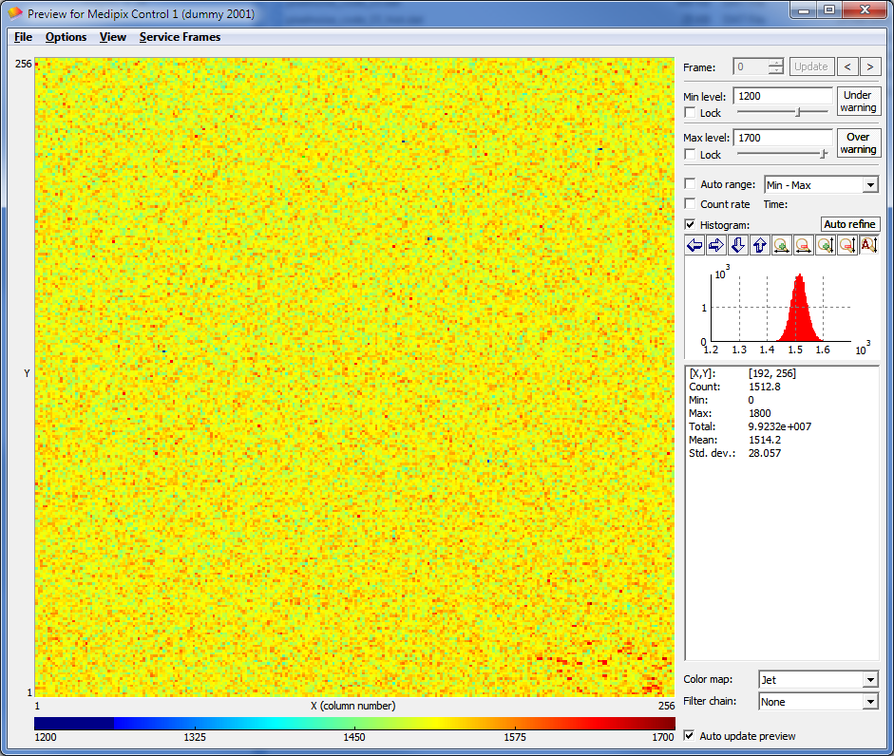
Threshold Equalization.
µ_{eq}= 1446
σ_{eq}= 2.65 (40.3 e⁻_{rms})*
Unequalised Threshold distribution:
All pixels at code 0x0
No trend visible.
µ_{0x0}= 1378
σ_{0x0}= 27.06
µ_{0xF}= 1513
σ_{0xF}= 26.19
*@gain of 25mV/ke⁻

Slide 59
Summary of pixel measurements
Pixel gain | ~24.6 mV/Ke⁻
Pixel to pixel gain variation | ~3.3%
Pixel ENC | 62.9 e⁻
Pixel to pixel threshold mismatch | 410 e⁻rms
Pixel to pixel threshold mismatch calibrated (Threq) | 40.3 e⁻rms
Expected minimum threshold | > 450 e-
Threshold equalization only calculated not measured on chip
All measurements assuming Ctest=5fF

Slide 60
Bumps on a Velopix chip
SEM images done by S. Vähänen (Advacam)

Slide 61
Velopix Modules
Bumping to the 200 µm n-p Hamamatsu Si sensor
8 3x1 modules and 6 single sensors available
Not thinned → Experiment requires thinning to ~200 µm

Slide 62
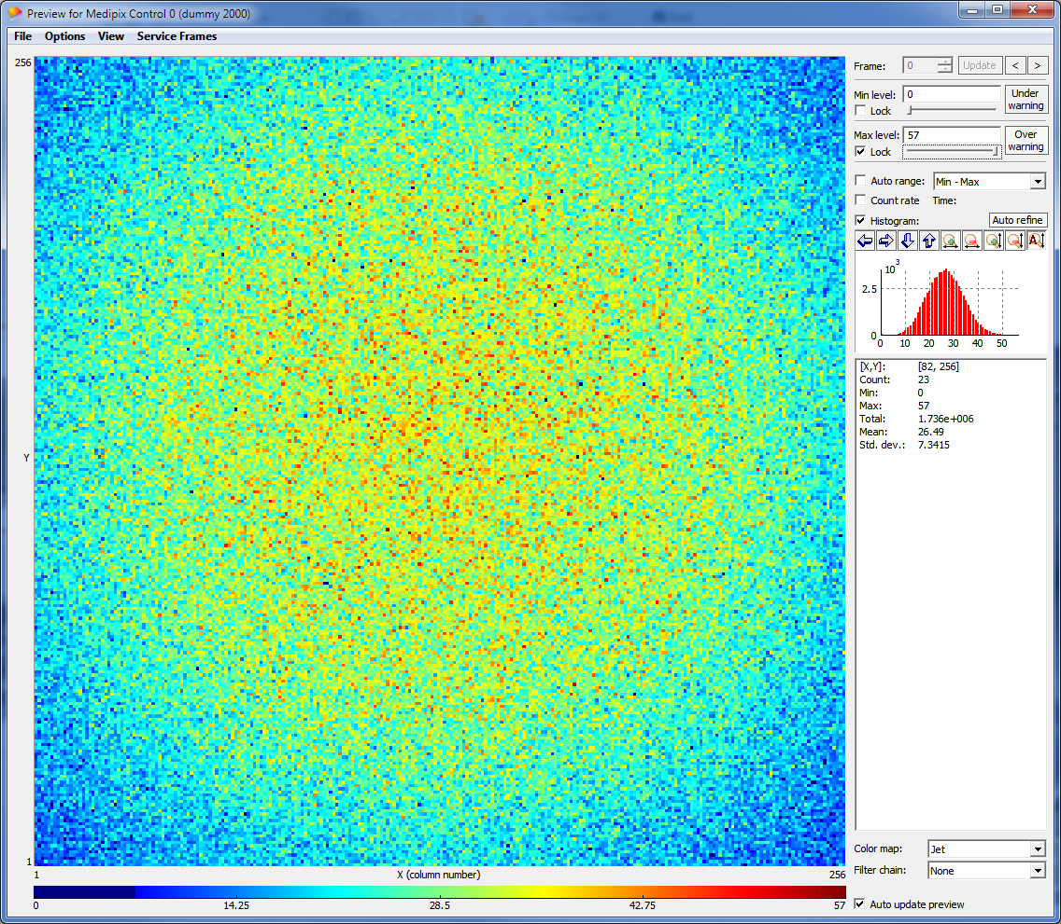
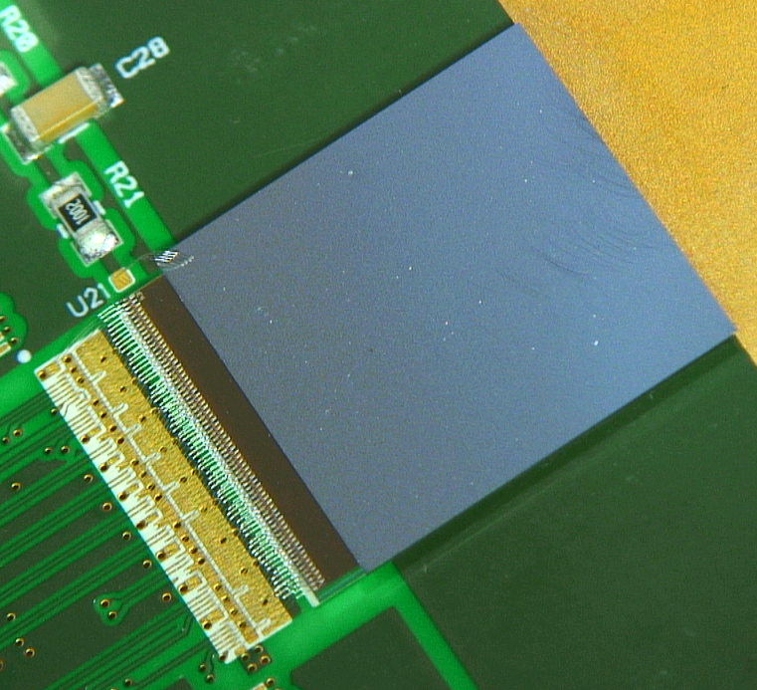
First source measurements
[S40 single sensor]
Image taken through the ECS (Slow Control) in photon counting mode
Fe55 600s Thr ~900 e⁻

Slide 63
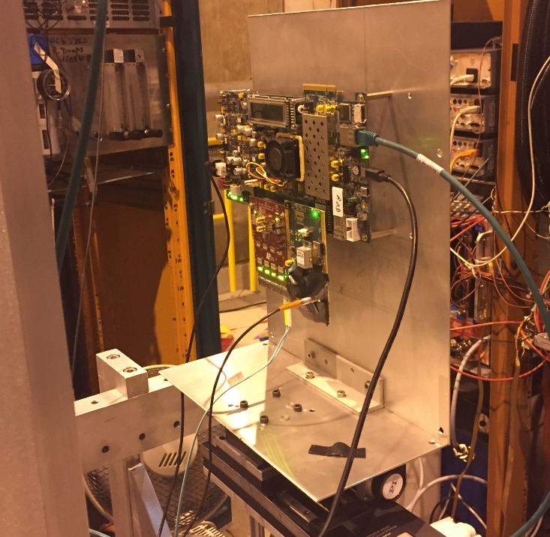
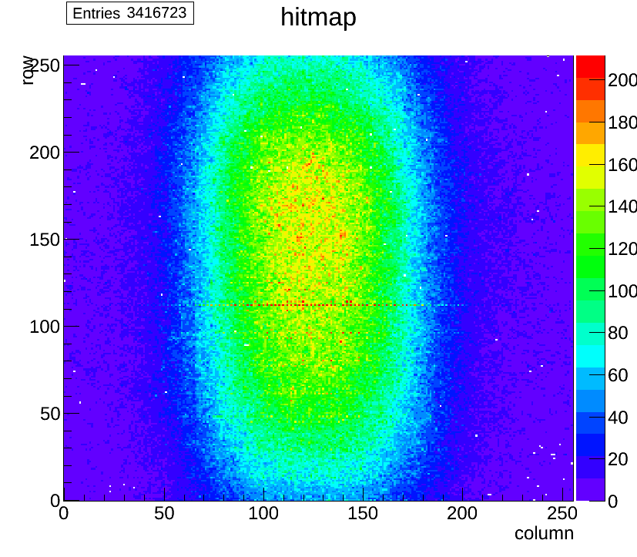
Beamtest
First VeloPix in testbeam last Sunday
Image taken through 1 GWT link
Hitmap from 1 SPS spill (~5 sec)
Received 2.6 Million Superpixel packets with 3.42 Million pixel hits:
  Numbers consistent with #tracks recorded by the Timepix3 telescope (upstream of VeloPix)
  Linking of VeloPix hits to telescope tracks to be done
Note that this is only 0.1% of the rate capability of VeloPix !

Slide 64
Still to do…
Obtain calibration with X-ray sources:
  Extract correct FE characterization (ENC, gain…)
Read the chip at full bandwidth with all GWT (20 Gbps):
  where to find such beam?
Whole setup test using: GBT as clock reference, optical drivers, 200m of fibers and miniDaq
TID and SEU irradiation campaigns
Production testing later this year at CERN

Slide 65
Conclusions
VeloPix ASIC designed in 130nm CMOS for the LS2 VELO upgrade
First results show the chip is alive and eyes open:
  Power < 2 W/ASIC, DACs working, pixels functional
  Pixel: Gain ~25 mV/Ke- and ENC 63 e- (no sensor)
  GWT serializer working
All measurements, so far, indicate that the Velopix chip is fully functional as designed:
  First source images taken in photon counting mode : Slow Control
  First beam test through the binary readout chain @ low rate
  Scheduled TID and SEU campaigns to validate design robustness

Slide 66
VeloPix Contributors
ASIC designers:
  R.Ballabriga, V.Gromov, X.Llopart, S.Miryala, T.Poikela, J.D.Schipper and W.Wong
IP Blocks:
  eCDRPLL: R. de Oliveira and P. Leitao
  Band-Gap: S. Michelis
Support, readout and Testing:
  J. Alozy, M.van Beuzekom, H.Boterenbrood, B. van der Heijden, J. Buytaert, M.Daldoss and E.Lemos

