Slide 1
Technical report

Slide 2
software
Bogdan and Sergej will look at the geometry of VFS in DD4HEP
Strahinja will join the beamcal simulation efforts

Slide 3
Test beam
Before 2019, need for a test beam with :
  Between 12 and 20 layers
  Readout as close as possible to the final electronics
  No need to equip all the layers
What need to be done
  Finalize, check and produce FEB and DAQ
  Check new sensors
  Ensure connectivity between the actual sensors and the FEB

Slide 4
thanks

Slide 5
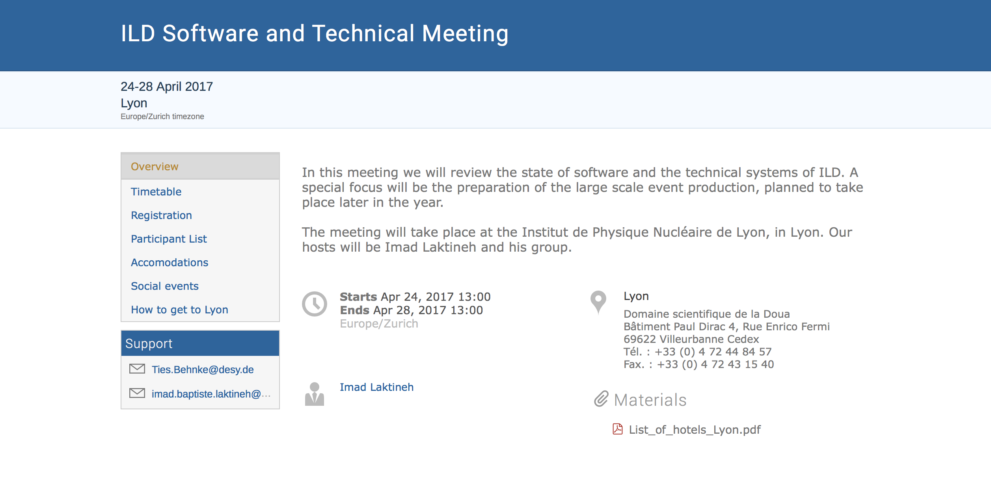
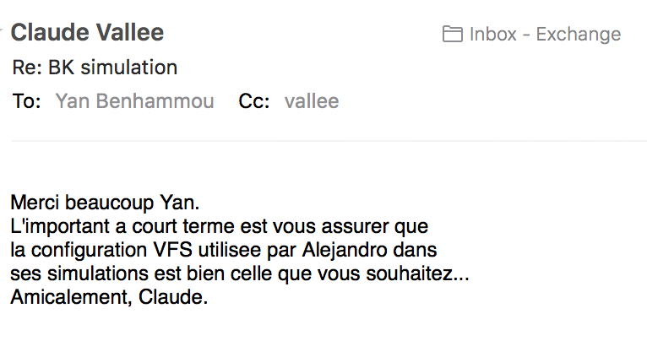
Status
No test beam this year : what with the beamcal ?
Some hardware developments:
  Electronics from AGH : need to start to think of the integration with sensors.test beam in 2018 ?
  Irradiation tests
Slow down R&D on the edgeless sensors : is that a must for AIDA2020?
Need some clarification on the simulation

