Slide 1
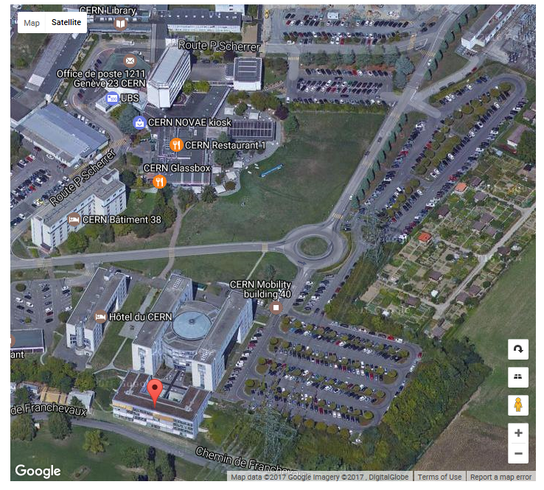
Tuesday morning session: room 42/3-032

