Slide 1

Proposal for changes in the portal and reports. Background for the discussion.
Julia Andreeva CERN
06.10.2016

Slide 2
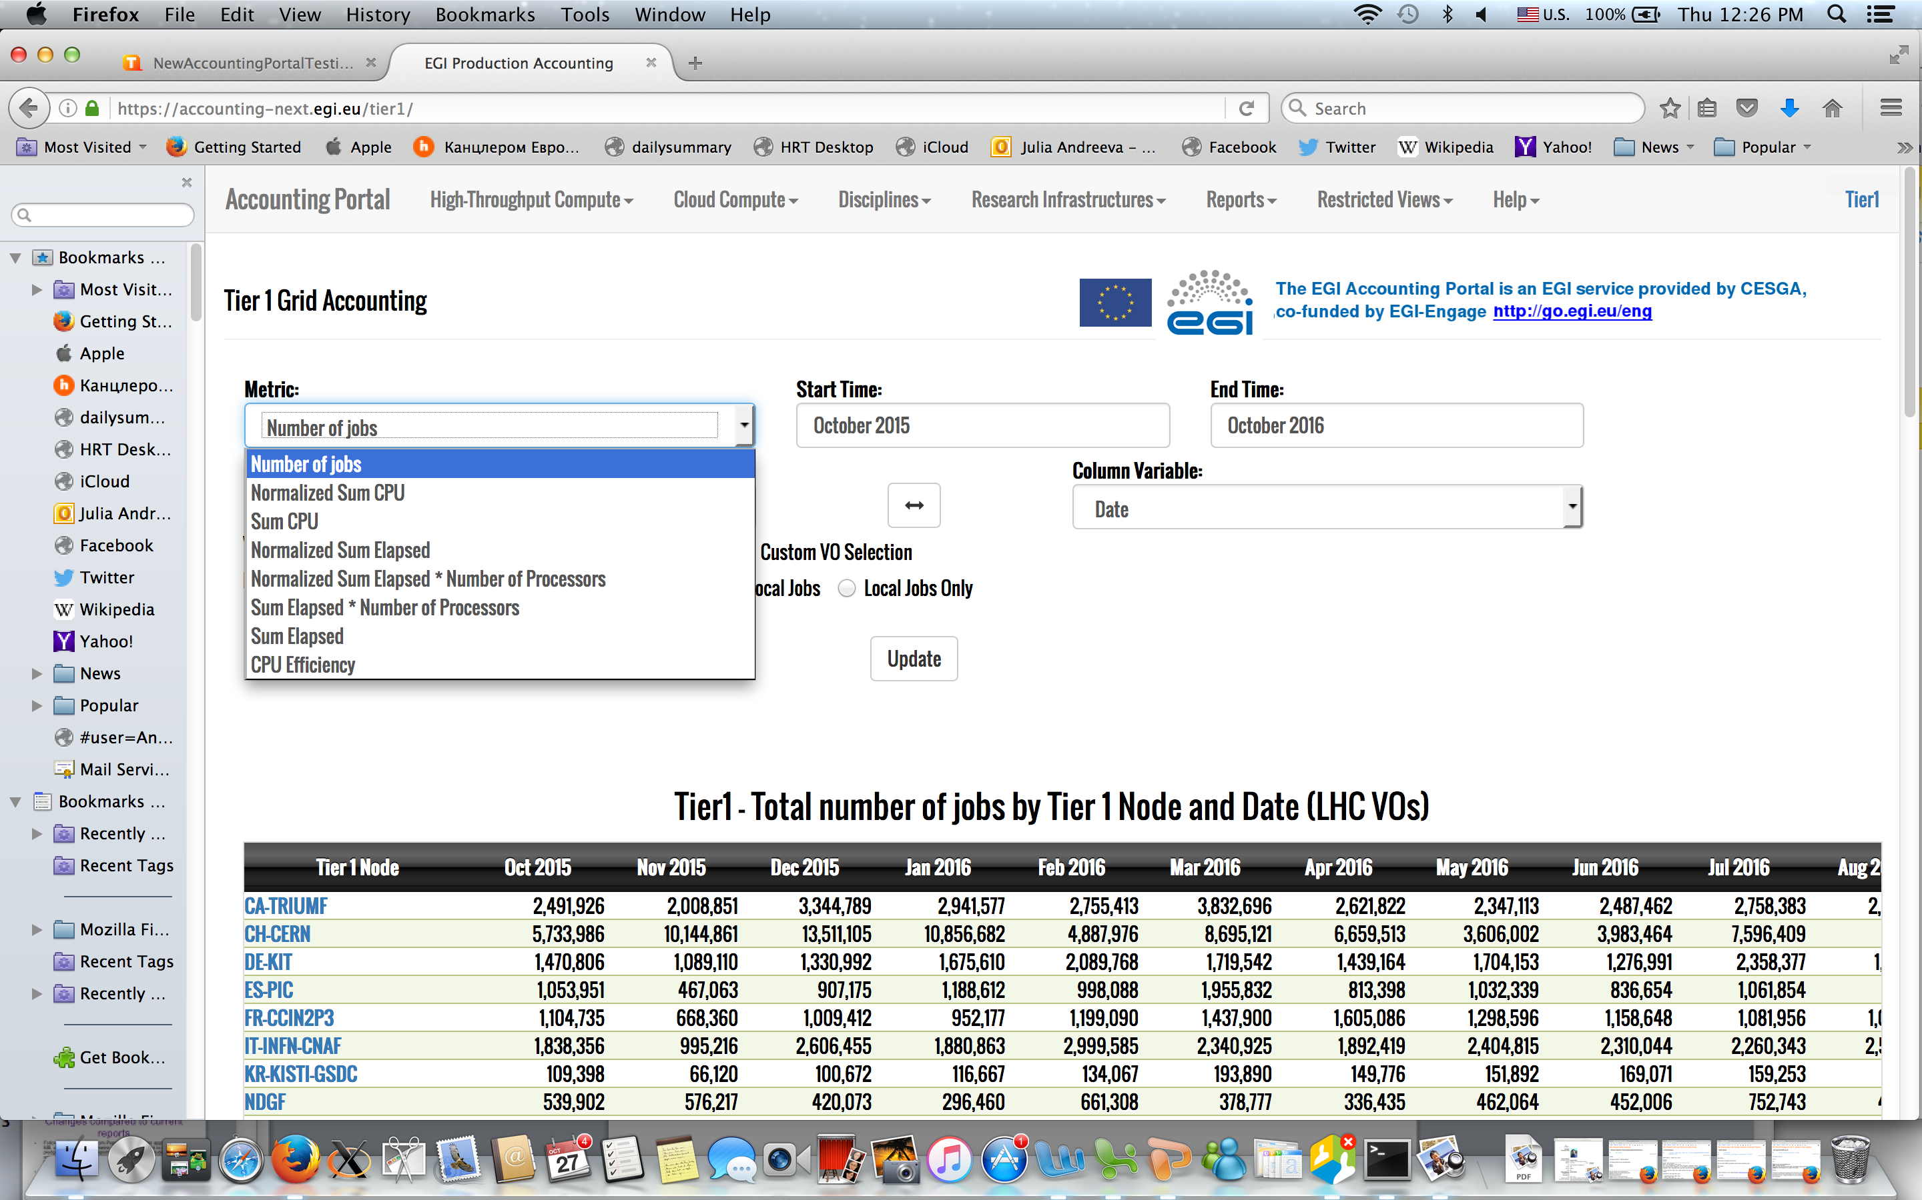
Review metric list and names (1)
Reviewing this page:
https://accounting-next.egi.eu/tier1/
Do we keep the term “Infrastructure “ for jobs of distributed nature?
Do we replace it by some other term?
Do we keep Grid vs Cloud vs HPC?

Slide 3
Review metric list and names (2)
Current name | Proposed name | Definition | Unit | Action
Number of Jobs | Number of jobs | clear | jobs | No change
Sum CPU | SUM CPU time | CPU time as reported to apel by batch system | Hours/days | Pepe argued that since this metric is not normalizsed to the CPU power we can not compare any shares for this metric. Either we leave it removing all plots and table columns where comparison is performed, or remove it completely. To be agreed
Normalized SUM CPU | SUM CPU work | CPU time normalized by benchmarked HEPSPEC06 strength of a given CPU resource | HS06 hours/days | Change metric name
SUM elapsed | SUM wall clock time If we keep this metric at all | Raw wallclock, (End_time_stamp_of_the_job - Start_time_stamp_of_the_job) Does not take into account number of processing cores, misleading. Unfortunately some sites are sending scaled wall clock | hours/days | There are two problems with this metric: 1).It is misleading since it does not take into account number of processing cores. The proposal would be to drop this metric form the WLCG pages 2). Some sites send scaled wall clock instead of raw wall clock. For the time being there is no way to make difference between the two in usage record. Might need to change it.

Slide 4
Review metric list and names (3)
Sum elapsed * Number of Processors | SUM wall clock time | Same as above but multiplied by number of processing cores. This metric is the most important one since it allows to check correctness of the accounting data | Hours/Days | Change the name
Normalized sum elapsed | Most probably do not want to keep this metric | Raw wall clock (ideally should be raw) time normalized by benchmarked HEPSPEC06 strength of a given CPU resource | HS06 Hours/days | It is misleading since does not take into account number of processing cores. Suggest to drop it
Normalized sum elapsed * Number of Processors | SUM wall clock work | Raw wall clock (ideally should be raw) time normalized by benchmarked HEPSPEC06 strength of a given CPU resource multiplied by number of cores | HS06 Hours/days | To change the metric name
CPU efficiency | CPU efficiency | 100* SUM CPU time / SUM (wallclock * number of processing cores) | % | No change

Slide 5
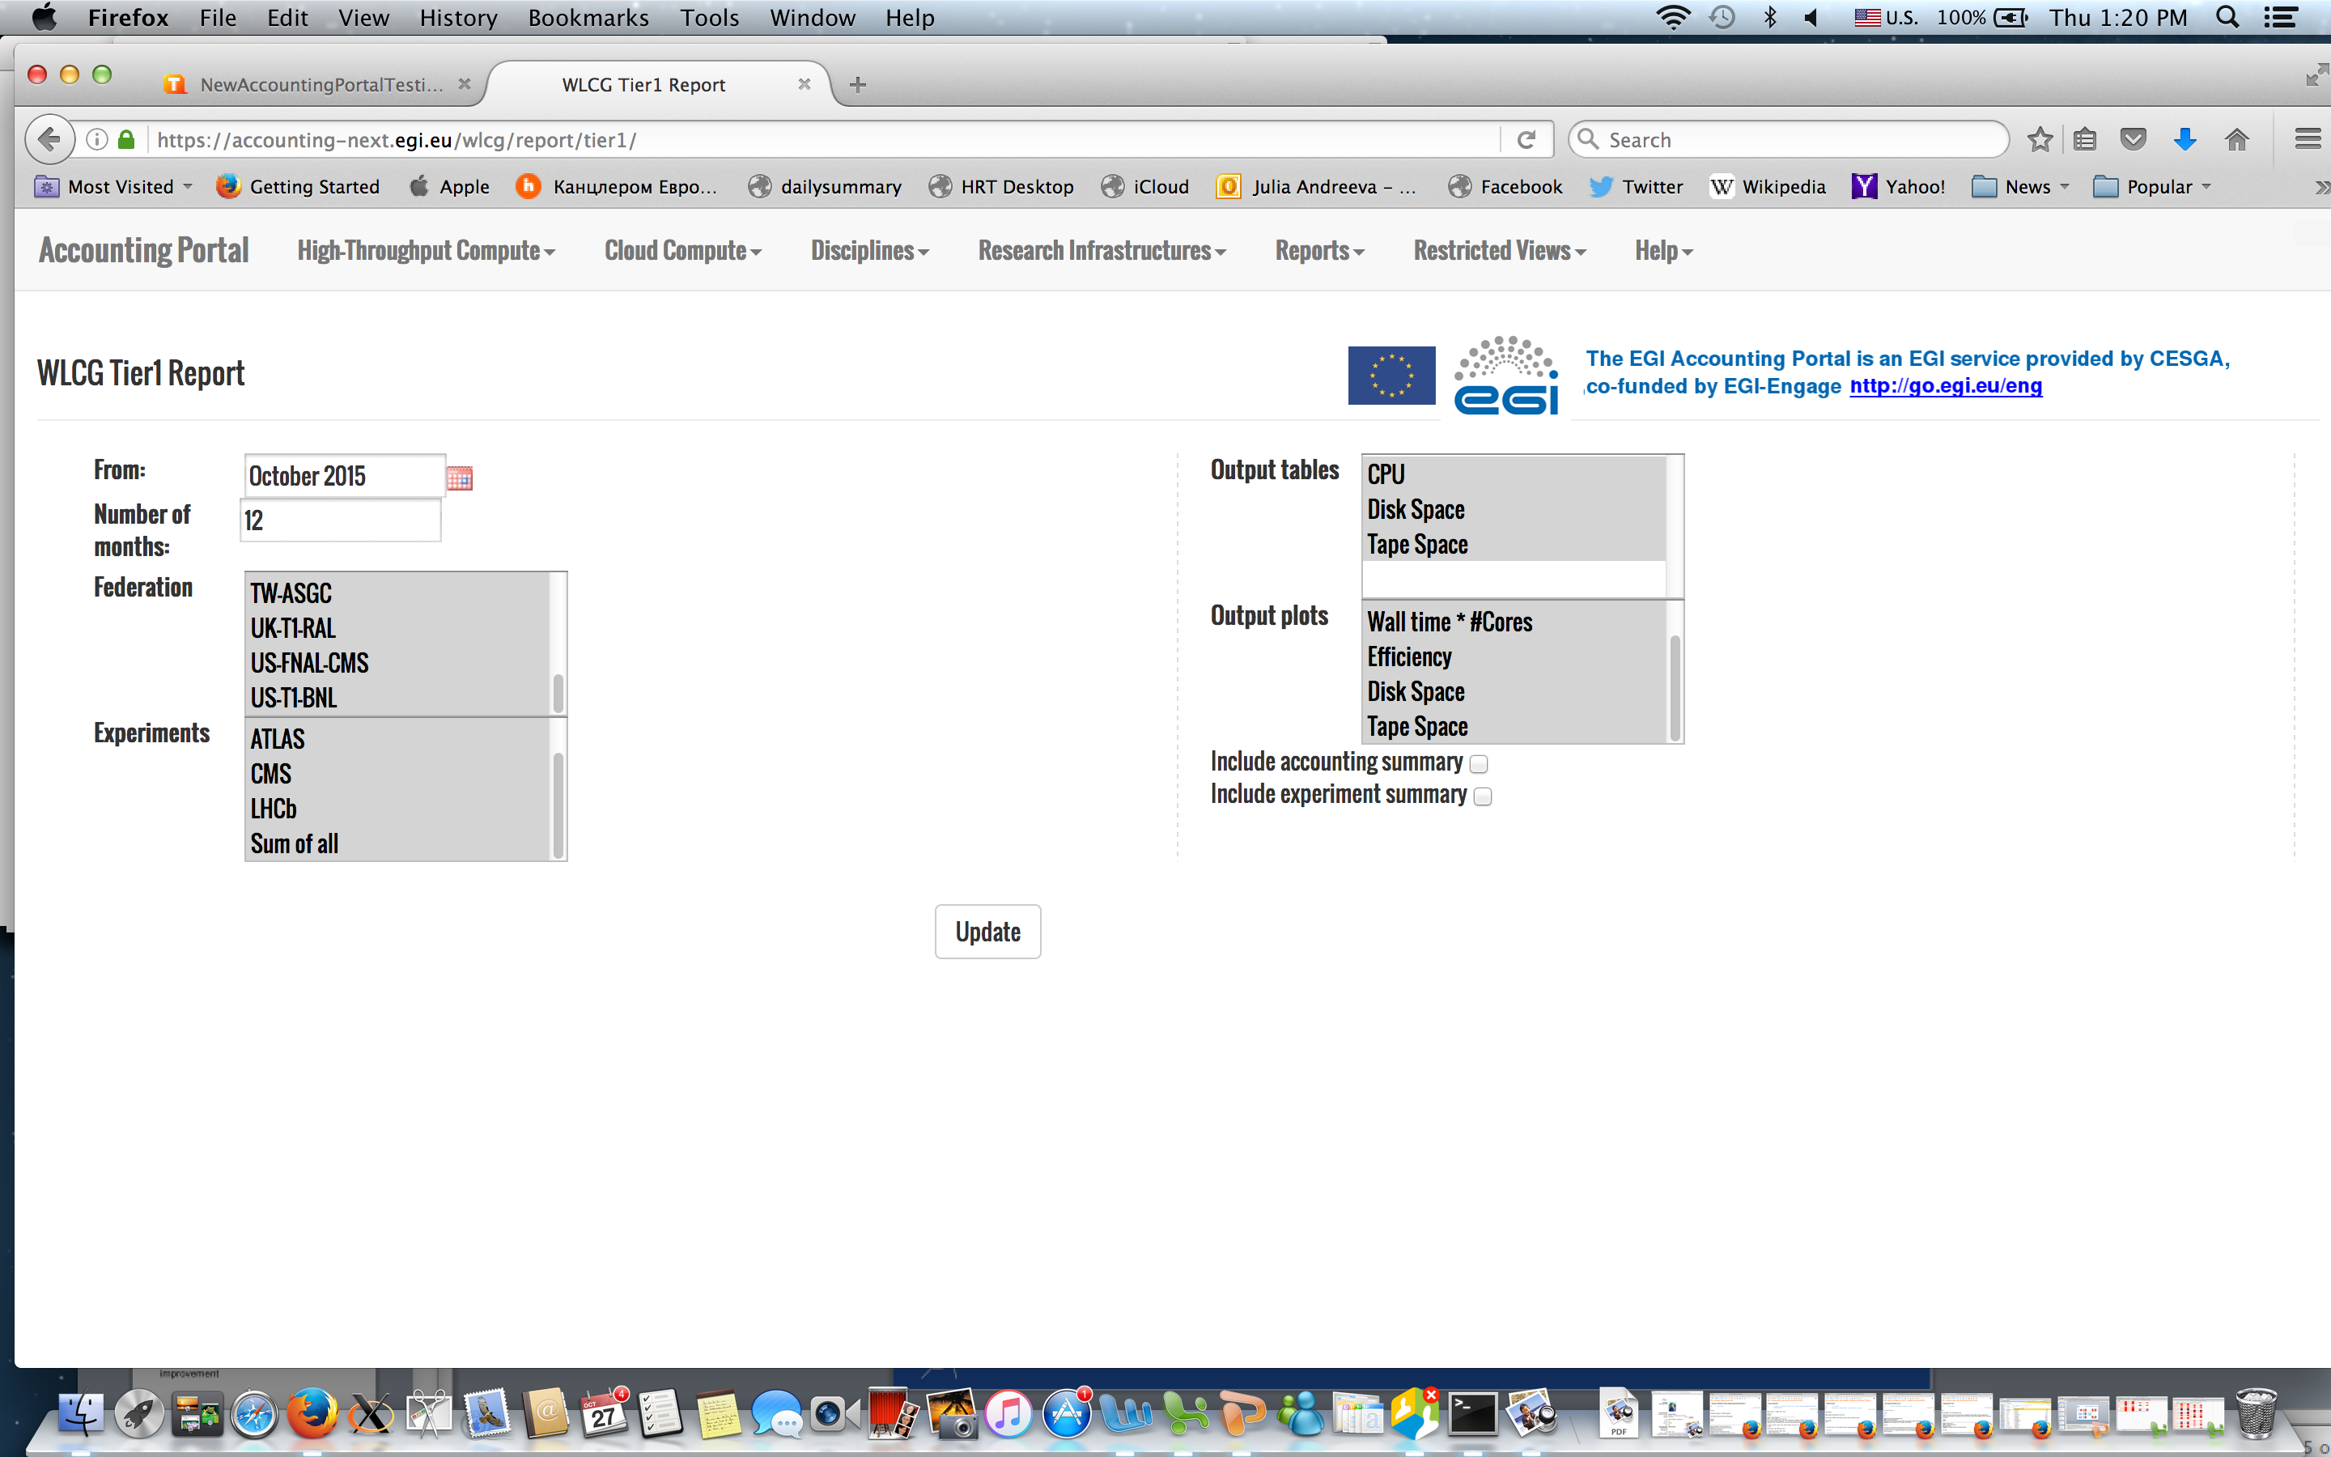
Review reports T1 (1)
Reviewing this page: https://accounting-next.egi.eu/wlcg/report/tier1/
Replace CPU by ‘CPU consumption’
Replace Wall time * Ncores by
Wall clock work
This is applied to all pages of this view
One of the main questions for T1 and T2 reports is whether we show both CPU work and wallclock work, or we show only wallclock work which is compared to pledges

Slide 6
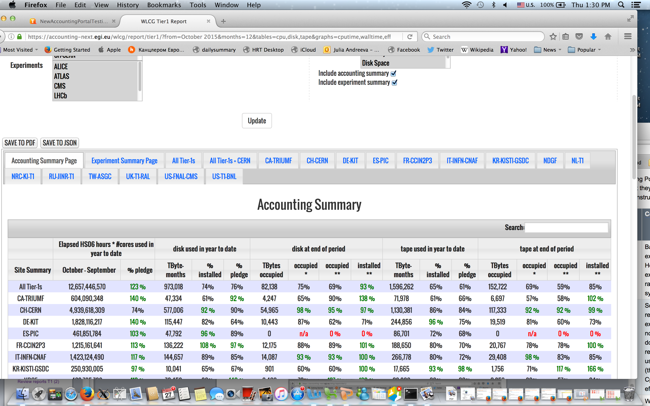
Review reports T1 (2)
Reviewing page” Accounting summary”: https://accounting-next.egi.eu/wlcg/report/tier1/?from=October%202015&months=12&tables=cpu,disk,tape&graphs=cputime,walltime,efficiency,disk,tape&federations=All_Tier-1s_and_CERN,All_Tier-1s__,CA-TRIUMF,CH-CERN,DE-KIT,ES-PIC,FR-CCIN2P3,IT-INFN-CNAF,KR-KISTI-GSDC,NDGF,NL-T1,NRC-KI-T1,RU-JINR-T1,TW-ASGC,UK-T1-RAL,US-FNAL-CMS,US-T1-BNL&experiments=ALICE,ATLAS,CMS,LHCb,total&accsum=1&expsum=1
Replace all headers where we have Elapsed HS06 hours * number of cores by Wall clock work in HS06 hours/days
Pepe’s suggestion is
CPU work wrt wallclock
Add a possibility to change units to days
Same is applied to the “Experiment summary view”

Slide 7
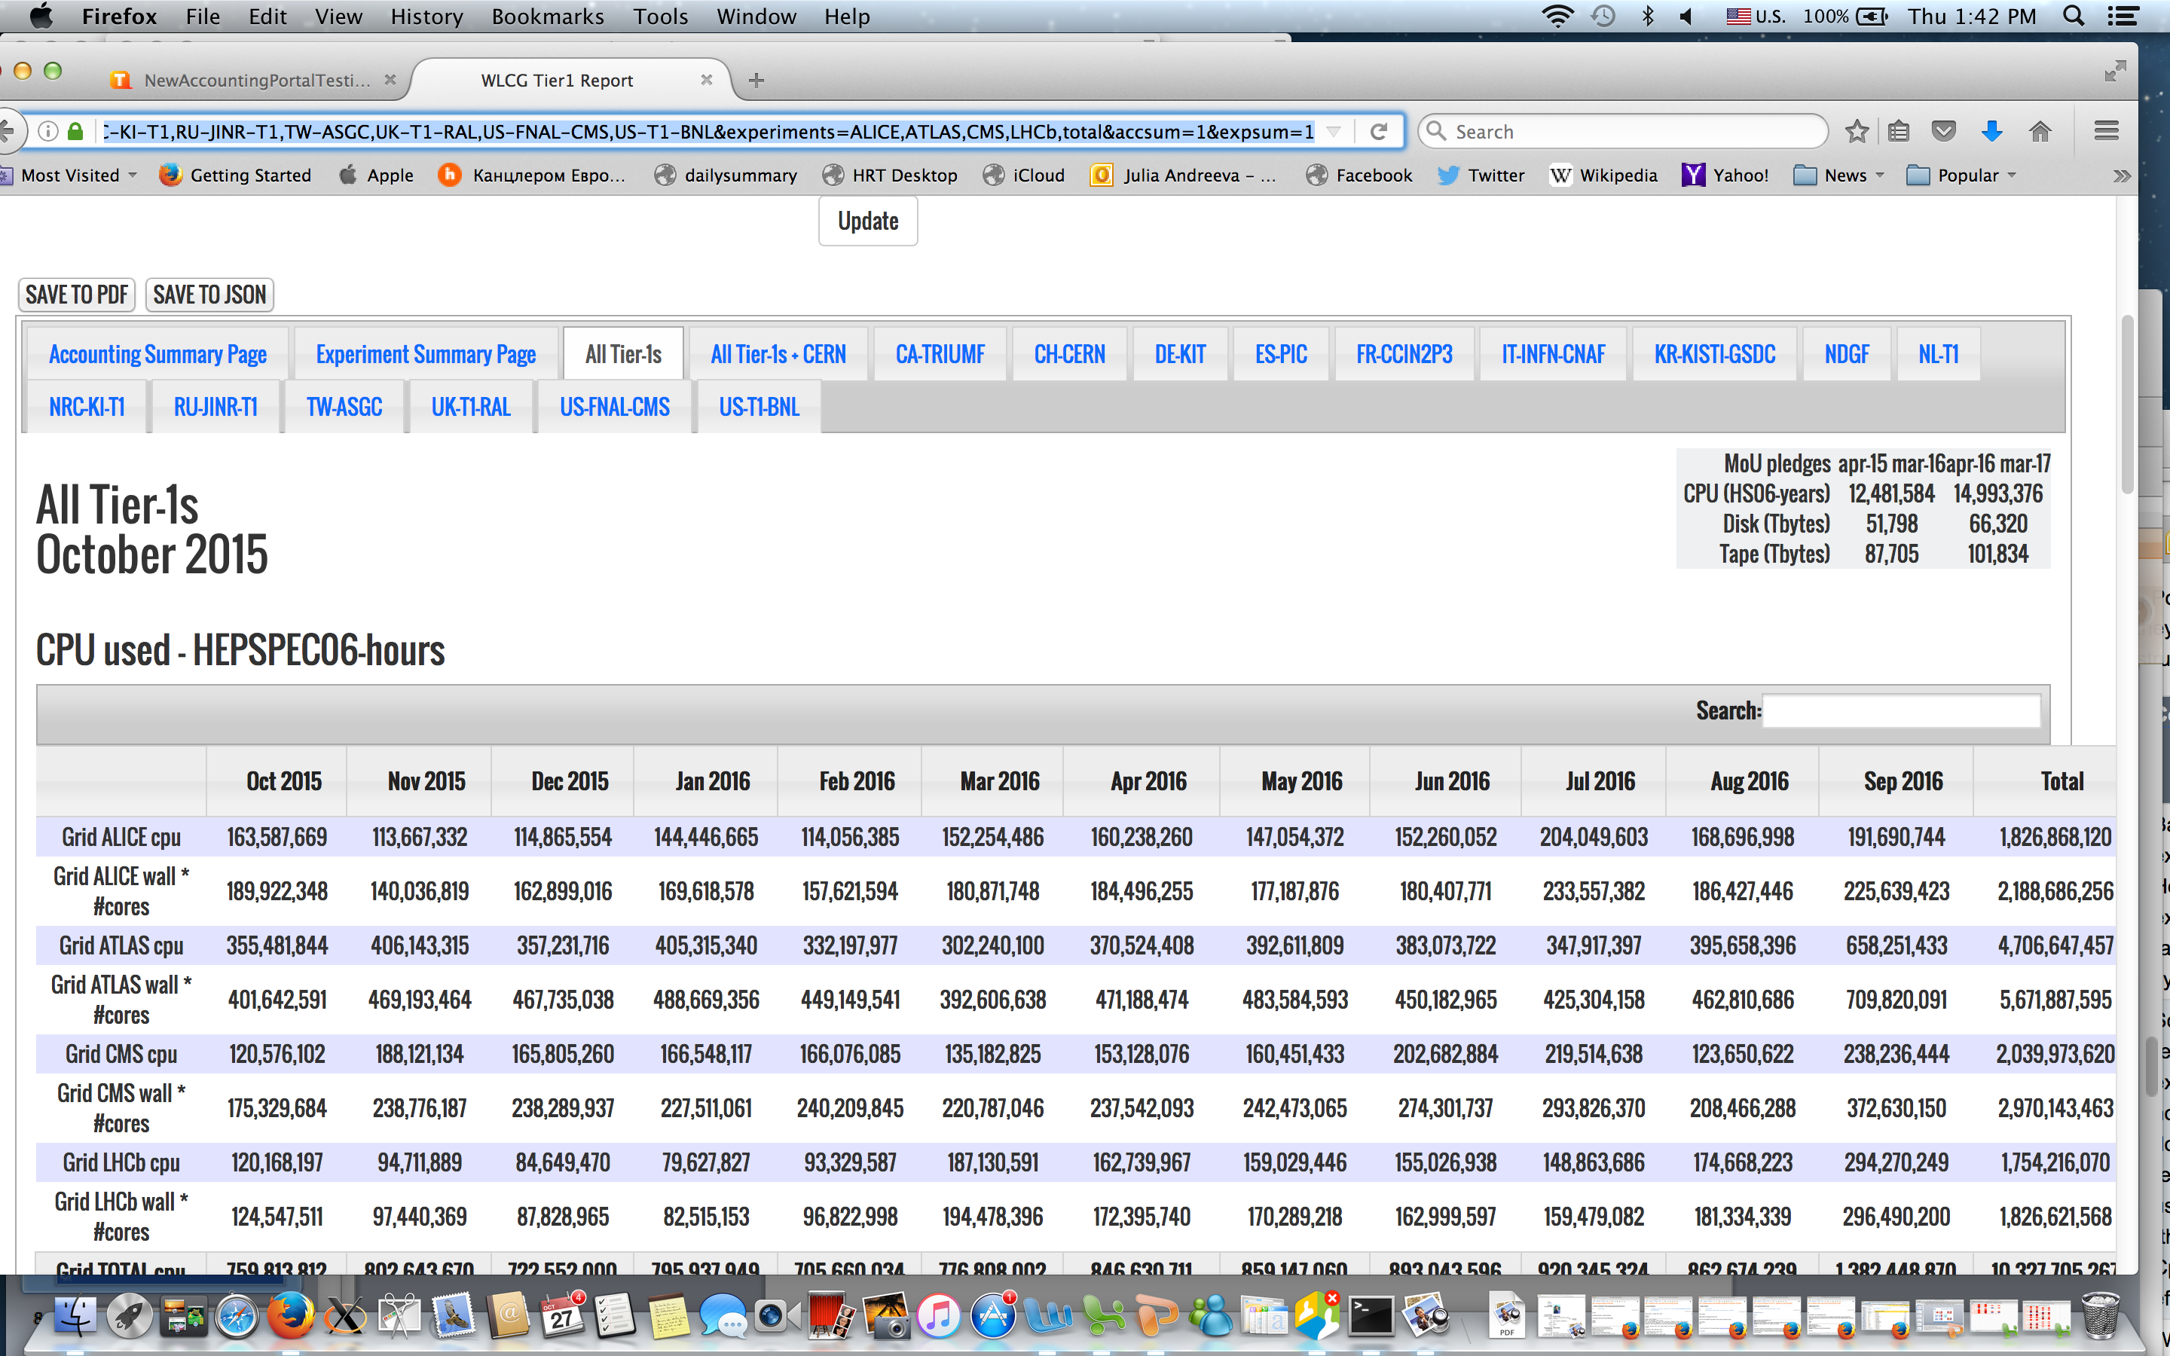
Review reports T1 (3)
Reviewing page “All Tier1” https://accounting-next.egi.eu/wlcg/report/tier1/?from=October%202015&months=12&tables=cpu,disk,tape&graphs=cputime,walltime,efficiency,disk,tape&federations=All_Tier-1s_and_CERN,All_Tier-1s__,CA-TRIUMF,CH-CERN,DE-KIT,ES-PIC,FR-CCIN2P3,IT-INFN-CNAF,KR-KISTI-GSDC,NDGF,NL-T1,NRC-KI-T1,RU-JINR-T1,TW-ASGC,UK-T1-RAL,US-FNAL-CMS,US-T1-BNL&experiments=ALICE,ATLAS,CMS,LHCb,total&accsum=1&expsum=1
Replace CPU used –HEPSPEC06 hours
By CPU consumption HS06 hours (could be days)
Replace GRID ALICE cpu by
GRID ALICE CPU work
Replace GRID ALICE wall * Ncores
By GRID ALICE wall clock work
Same everywhere

Slide 8
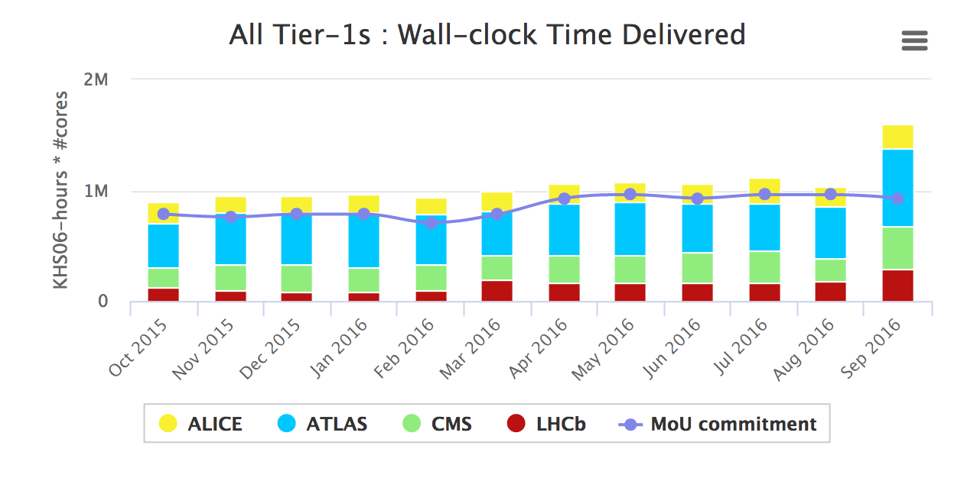
Review reports T1 (4)
Reviewing page “All Tier1” https://accounting-next.egi.eu/wlcg/report/tier1/?from=October%202015&months=12&tables=cpu,disk,tape&graphs=cputime,walltime,efficiency,disk,tape&federations=All_Tier-1s_and_CERN,All_Tier-1s__,CA-TRIUMF,CH-CERN,DE-KIT,ES-PIC,FR-CCIN2P3,IT-INFN-CNAF,KR-KISTI-GSDC,NDGF,NL-T1,NRC-KI-T1,RU-JINR-T1,TW-ASGC,UK-T1-RAL,US-FNAL-CMS,US-T1-BNL&experiments=ALICE,ATLAS,CMS,LHCb,total&accsum=1&expsum=1
Change the header of the plot to
Wall clock work

Slide 9
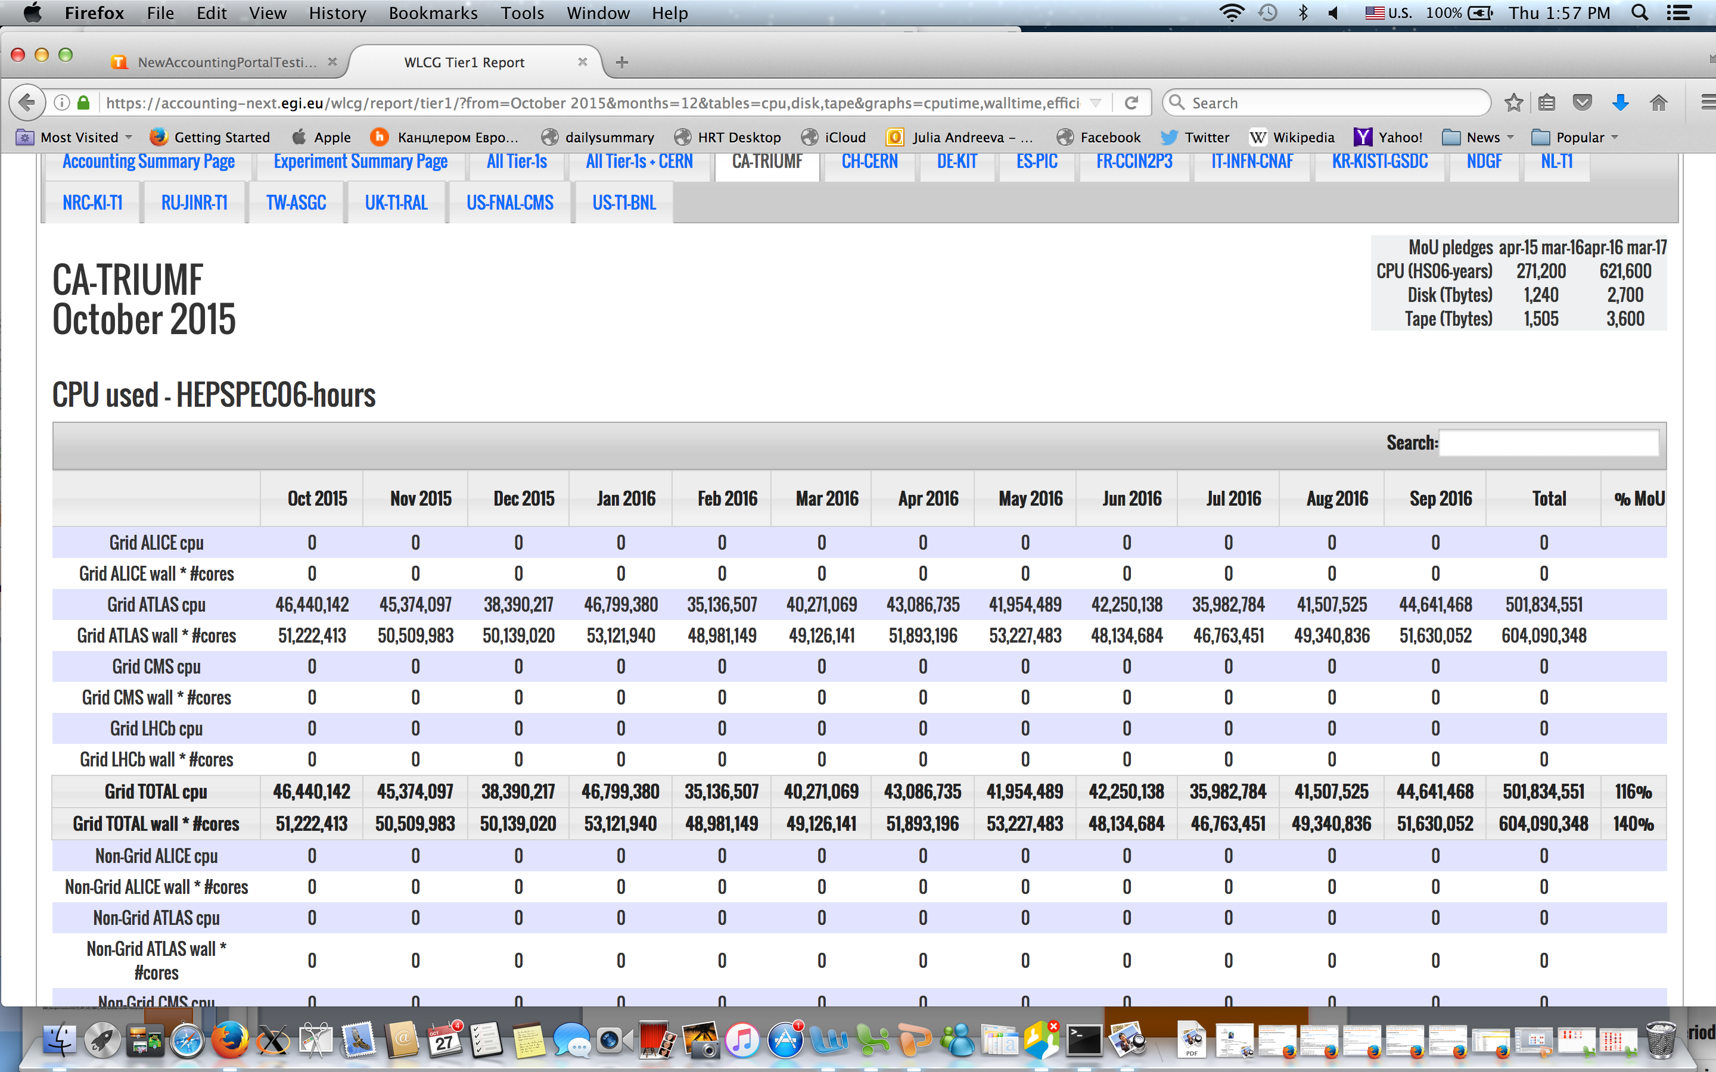
Review reports T1 (5)
Reviewing page with per site summary https://accounting-next.egi.eu/wlcg/report/tier1/?from=October%202015&months=12&tables=cpu,disk,tape&graphs=cputime,walltime,efficiency,disk,tape&federations=All_Tier-1s_and_CERN,All_Tier-1s__,CA-TRIUMF,CH-CERN,DE-KIT,ES-PIC,FR-CCIN2P3,IT-INFN-CNAF,KR-KISTI-GSDC,NDGF,NL-T1,NRC-KI-T1,RU-JINR-T1,TW-ASGC,UK-T1-RAL,US-FNAL-CMS,US-T1-BNL&experiments=ALICE,ATLAS,CMS,LHCb,total&accsum=1&expsum=1
Replace CPU used –HEPSPEC06 hours
By CPU consumption HS06 hours (could be days)
Replace GRID ALICE cpu by
GRID ALICE CPU work
Replace GRID ALICE wall * Ncores
By GRID ALICE wall clock work
Same everywhere
Add line with wallclock work for every site, not just on the federation level
In the Total line, remove comparison with pledges for CPU work, leave it only for wallclock work

Slide 10
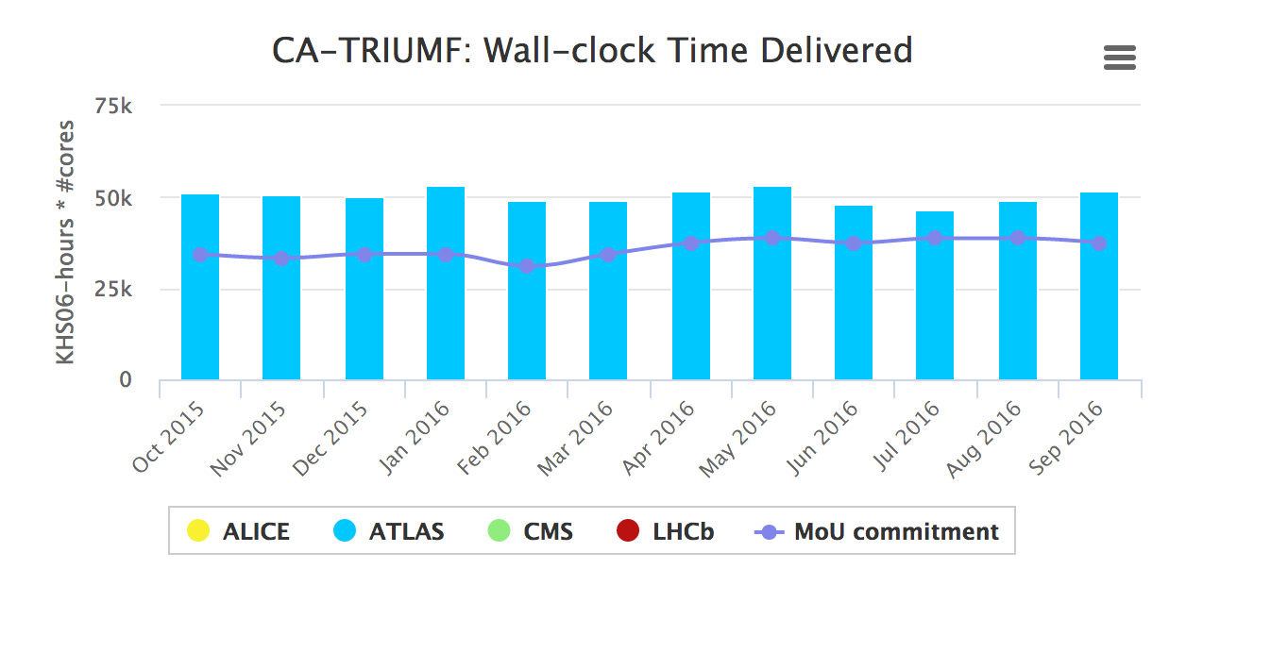
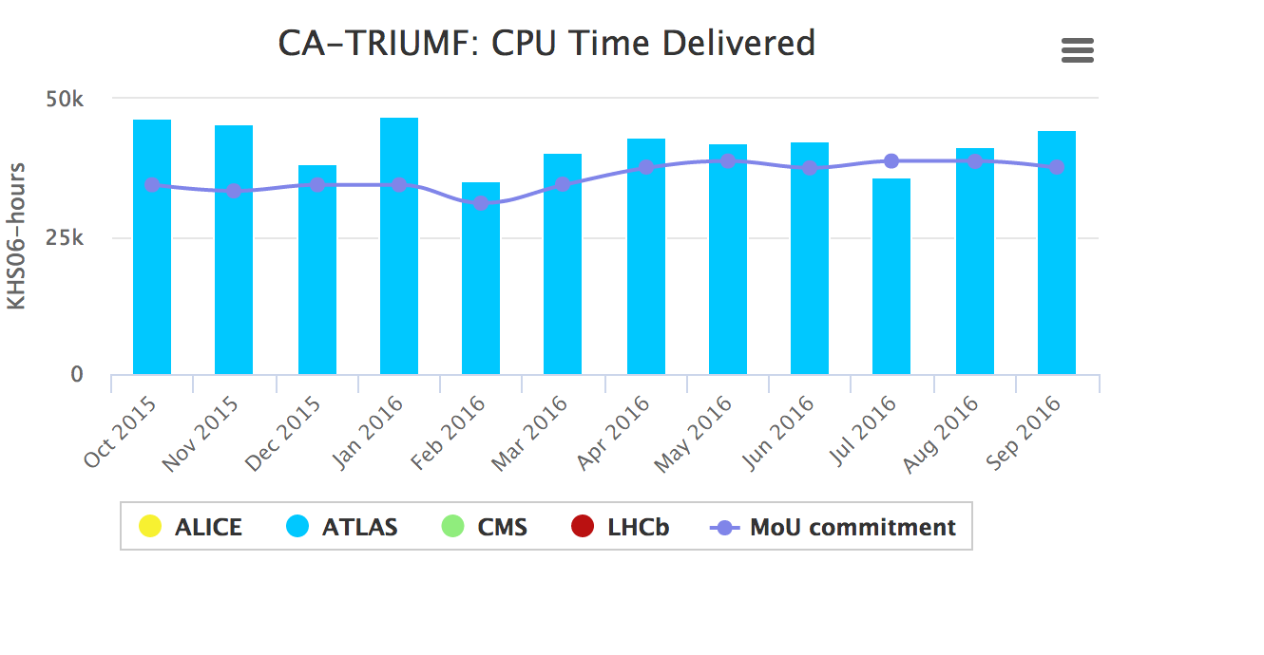
Review reports T1 (6)
Reviewing page detailed per site https://accounting-next.egi.eu/wlcg/report/tier1/?from=October%202015&months=12&tables=cpu,disk,tape&graphs=cputime,walltime,efficiency,disk,tape&federations=All_Tier-1s_and_CERN,All_Tier-1s__,CA-TRIUMF,CH-CERN,DE-KIT,ES-PIC,FR-CCIN2P3,IT-INFN-CNAF,KR-KISTI-GSDC,NDGF,NL-T1,NRC-KI-T1,RU-JINR-T1,TW-ASGC,UK-T1-RAL,US-FNAL-CMS,US-T1-BNL&experiments=ALICE,ATLAS,CMS,LHCb,total&accsum=1&expsum=1
Change headers of the plots to
Wall clock work
CPU work
correspondingly

Slide 11
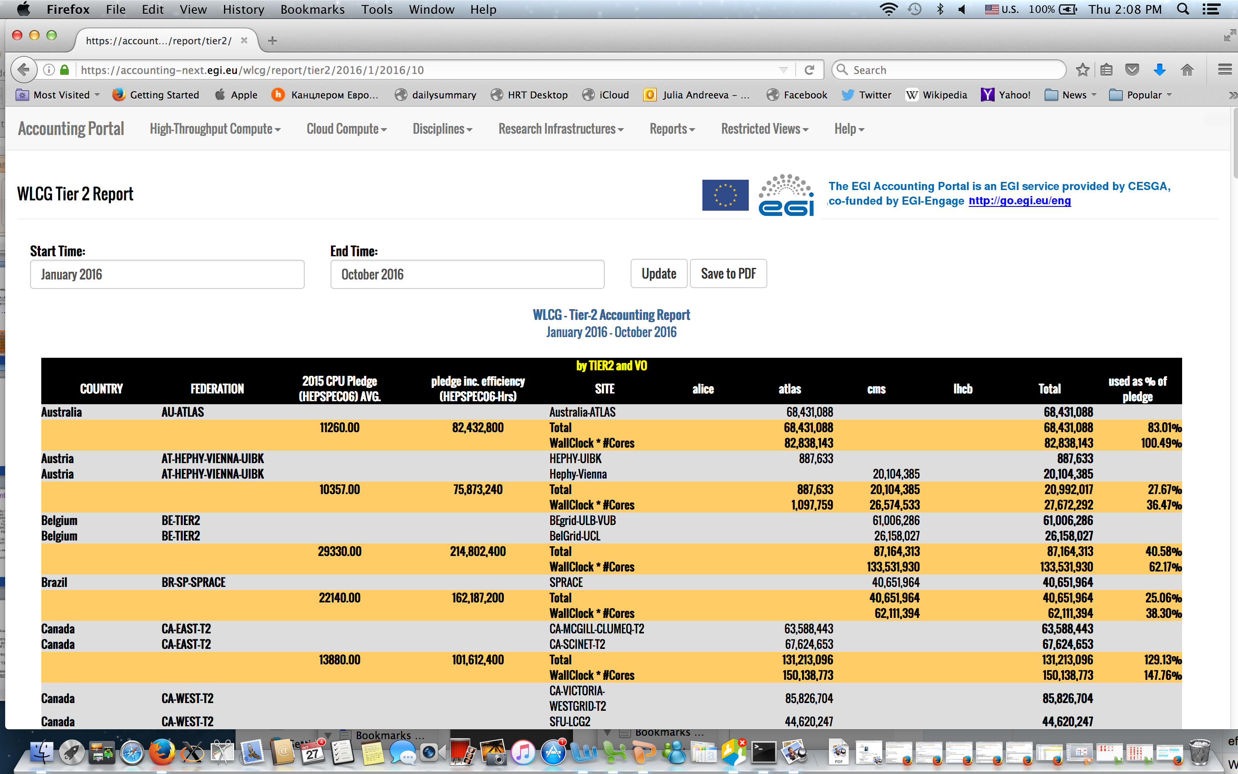
Review reports T2 (1)
Reviewing this page: https://accounting-next.egi.eu/wlcg/report/tier2/
Add wall clock work for every site, not just for federation
Remove comparison with pledge for the CPU work metric
Replace 2016 CPU Pledge (HEPSPEC06) AVG. by “Average hourly pledge for the referenced period HS06 hours (could be days)”
Replace “pledge inc. efficiency” by CPU pledge HS06 hours

Slide 13
Changes compared to current reports
Following of suggestion from Pepe which has been approved by the MB, use clock time work metric instead of CPU work to compare to pledges. Currently in T2 reports both metrics are included for pledge comparison. This change caused consumption vs pledge ratio look much better compared to what we have in the current reports. For T1s 101% (new) vs 78% (current), T2s 141% (new) vs 104% (current)
Move generation of T1 reports from REBUS to the EGI portal. REBUS code was re-used.
Use HS06 hours instead of days for both T1 and T2 reports. Following the feedback of Miguel, Ivan will implement a possibility to select the report unit (hours or days) through the UI
Dropped installed capacity for CPU metrics from T1 reports as was agreed during the WLCG accounting review at April GDB
Pledge value is calculated as a weighted average over the selected period instead of latest value as in the current reports

Slide 14
Questions and issues
Does not 40% consumption over pledge look a bit too optimistic?
Weighted average for pledge instead of the latest value looks correct, doesn’t it?
Should we change the headings of the columns in agreement with terminology we agreed at the task force (clock time work , CPU work instead of ‘Elapsed HS06 hours * #cores used’) or we leave it as it is?
Should we drop CPU work metric compared to pledge which is currently included in T2 reports?
T0 data in the new report is not correct, since up to now T0 usage is being manually corrected in REBUS.
There is an exception which shows up in T1 reports in case one selects time range including future months, to be corrected by Ivan

Slide 15
Feedback
So far feedback we got is positive. In particular form the Cath Noble , who generates reports every month and sends them around. She considers it a big improvement

Slide 16
How do we migrate (proposal)
Start to send two sets of reports in parallel starting from October. New ones will not be considered official yet. This would give people an opportunity to validate new reports and send their feedback.
We can not switch completely to the new ones unless T0 manual updates are required
Validation of T0 data is ongoing. According to Miguel, new T0 accounting reporting can be integrated with APEL production instance very soon.
So realistically we perform a final switch in January 2017

