Slide 1
Comparison of structure schedules between presented at ACE of 2-20-2008 and now, a Δt of 7 months.
W. Wuensch
CLIC ACE
26-5-2009

Slide 2
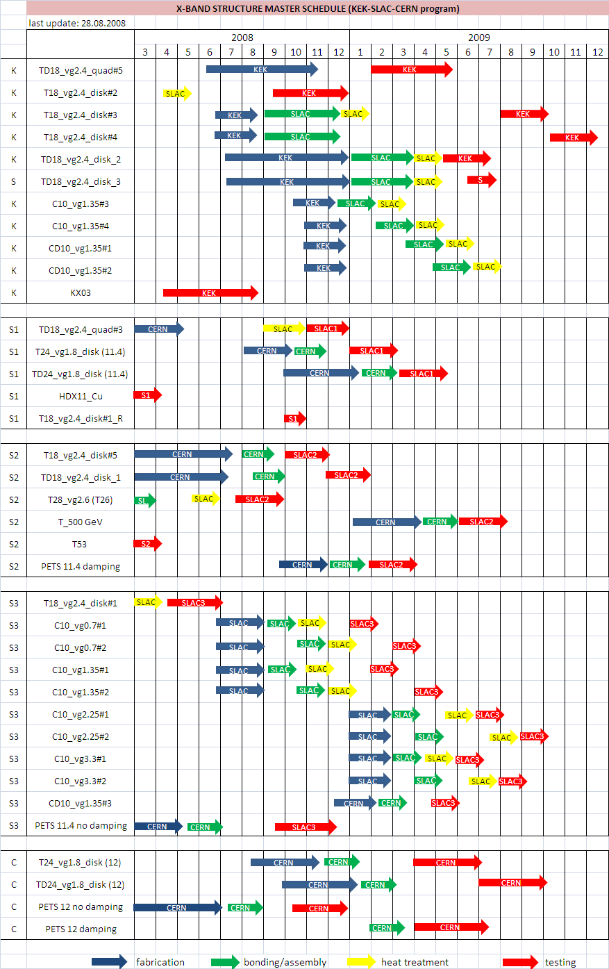
ACE 10-2008
X-band structure master schedule (1/2)
G. Riddone

Slide 3
ACE 10-2008
X-band structure master schedule (2/2)
G. Riddone

Slide 4
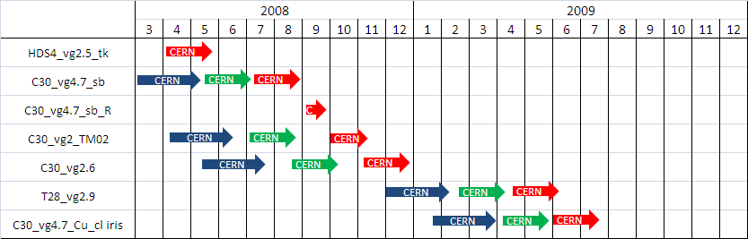
ACE 10-2008
30 GHz structure master schedule
G. Riddone

Slide 5
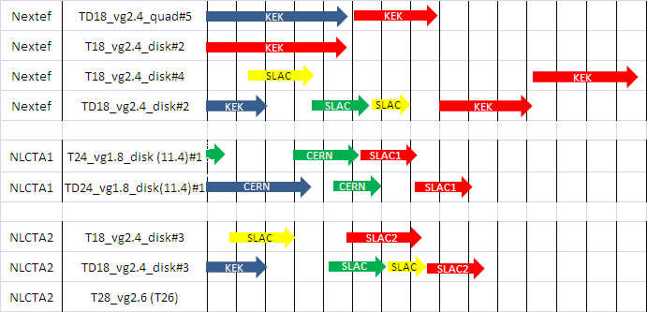
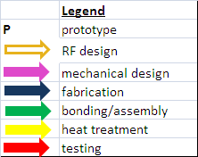
Structures under test
ACE 5-2009

Slide 6
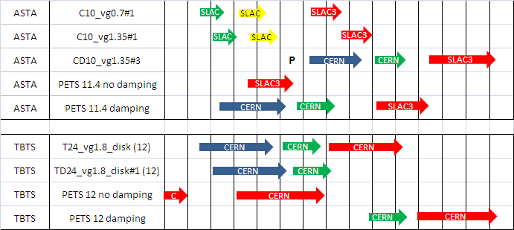
Structures under test
ACE 5-2009

Slide 7
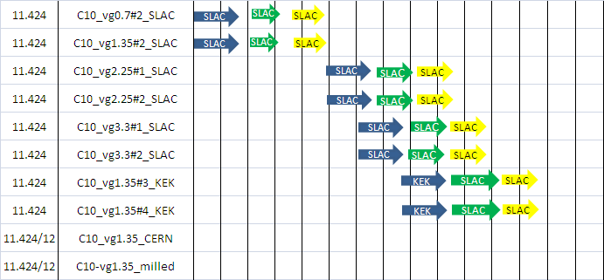
C10 structures
ACE 5-2009

Slide 8
combined
X-band structure master schedule (1/2)
Currently active or scheduled testing time
To SLAC
Fabrication
underway
Done
Done
G. Riddone

Slide 9
combined
X-band structure master schedule (2/2)
Done
On hold
Done
Detailed design
not yet launched
Done
Waiting for collaboration
agreement
Test not scheduled
G. Riddone

