Slide 1
TECHNICAL CHALLENGES OF ACCELERATOR COMPONENTS
Antti Kolehmainen
Tommi Mikkola
on behalf of CERN EN/MME

Slide 2
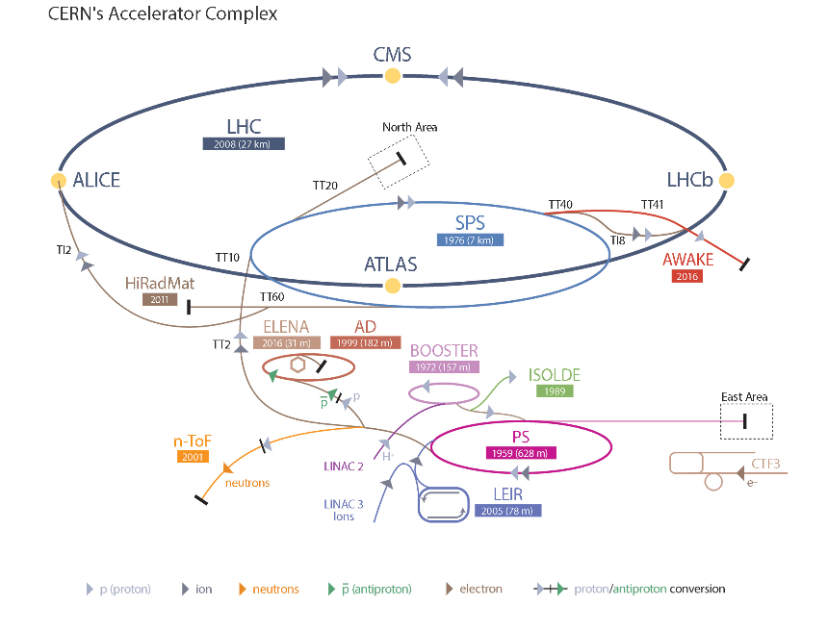
CERN EN-MME GROUP
“The mandate of the MME group is to provide to the CERN community specific engineering solutions combining mechanical design, fabrication and material sciences.”

Slide 3
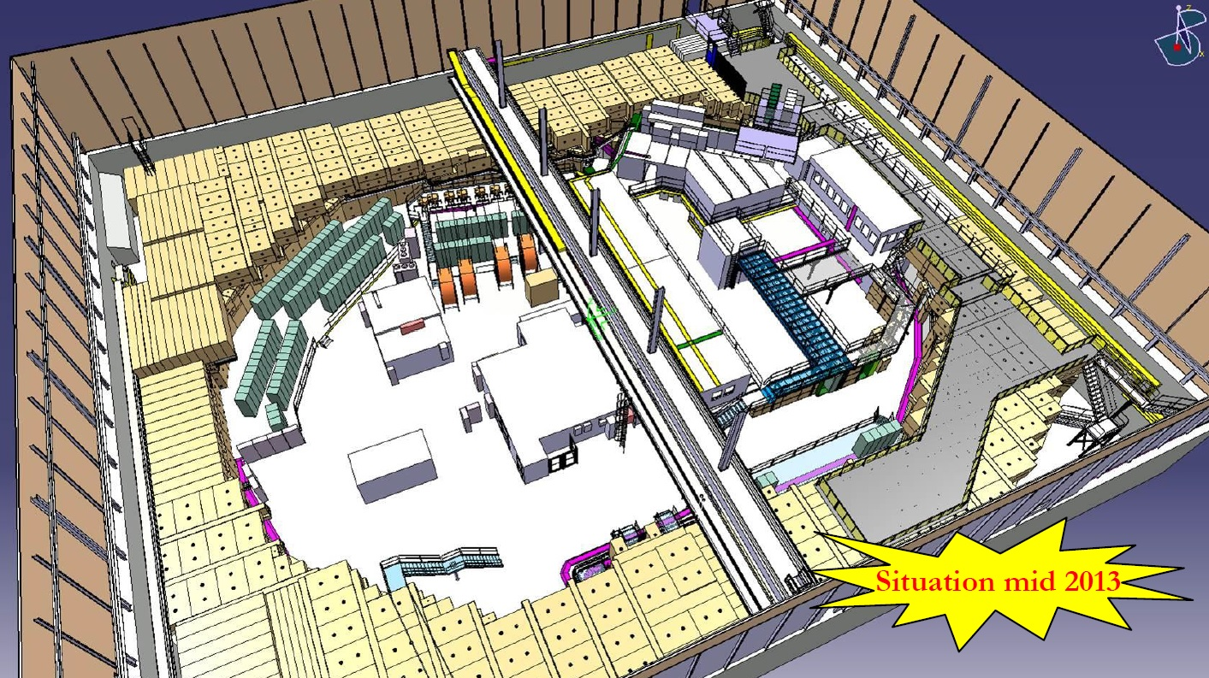
NEW ACCELERATOR
ELENA:
PROPOSAL 1980’s
PROJECT LAUNCH 2011
1ST BEAM 2016

Slide 4
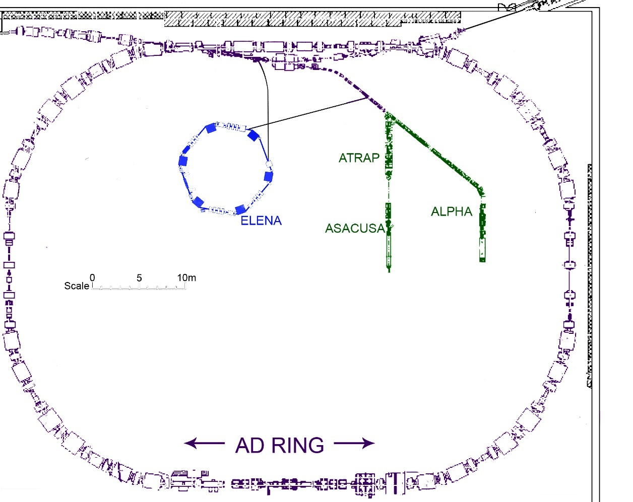
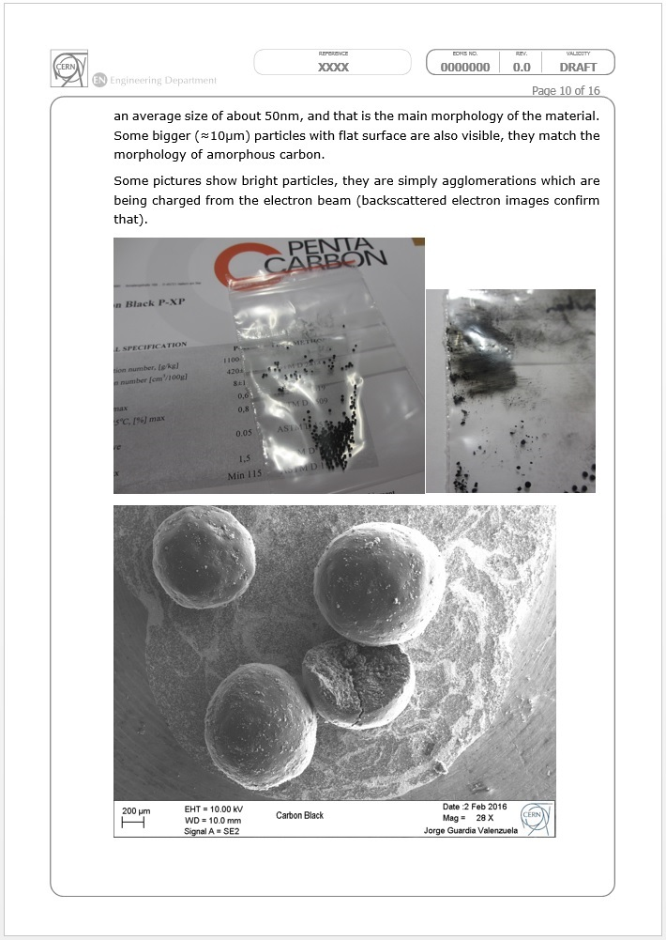
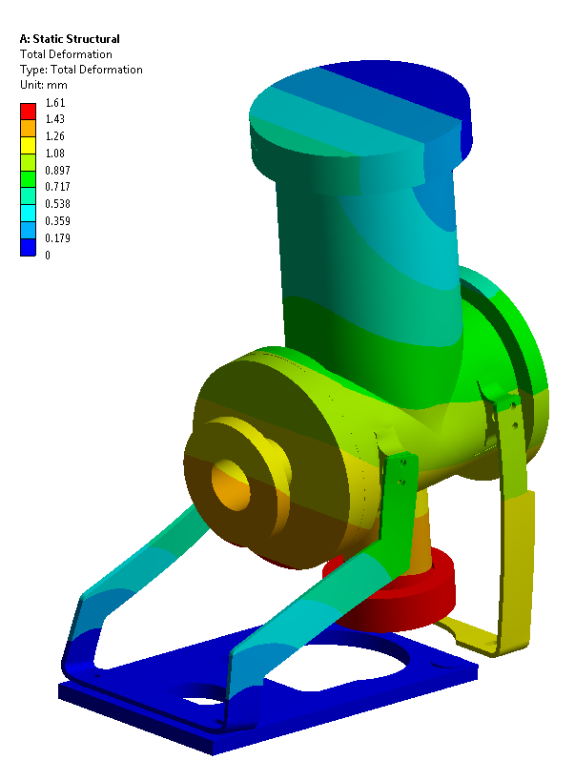
FIRST VERSION
MME CONTRIBUTION:
MATERIAL DEVELOPMENT
SIMULATIONS

Slide 5
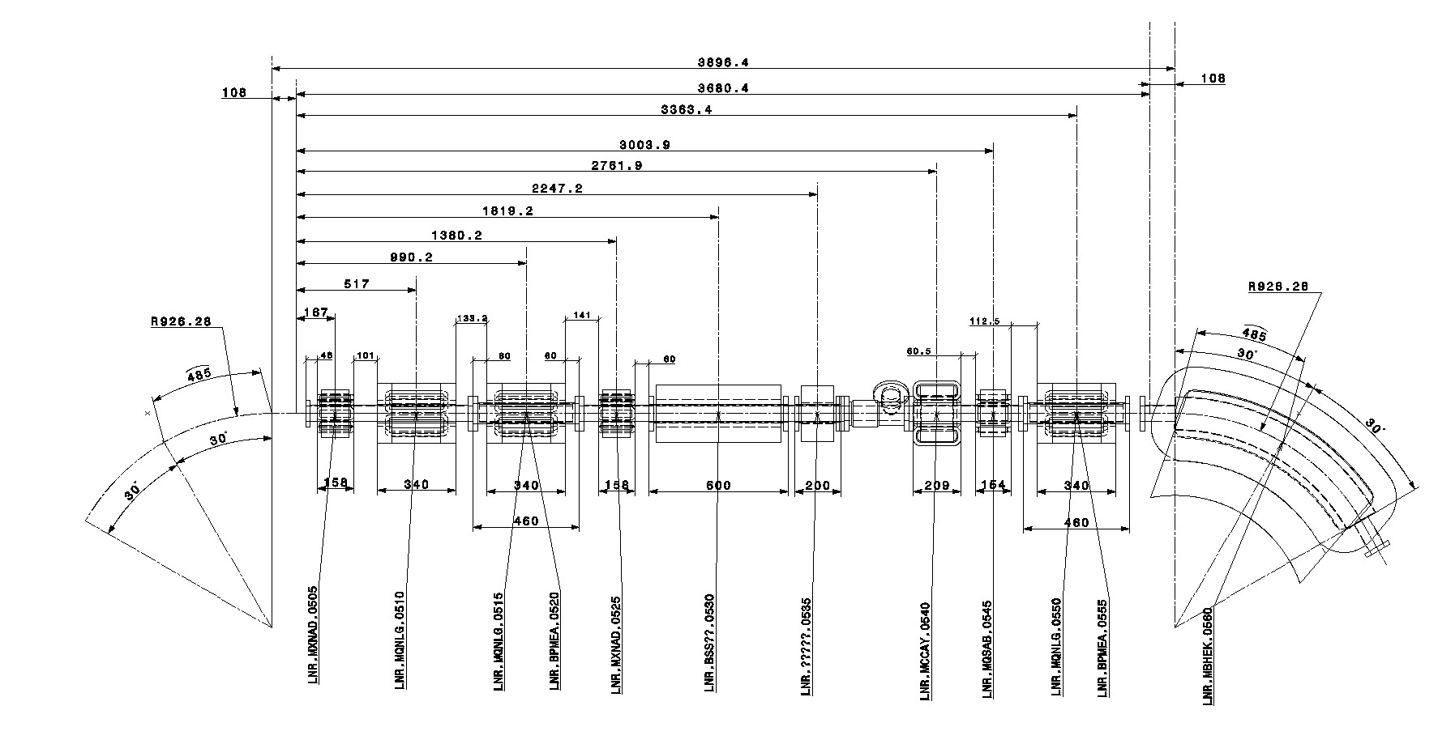
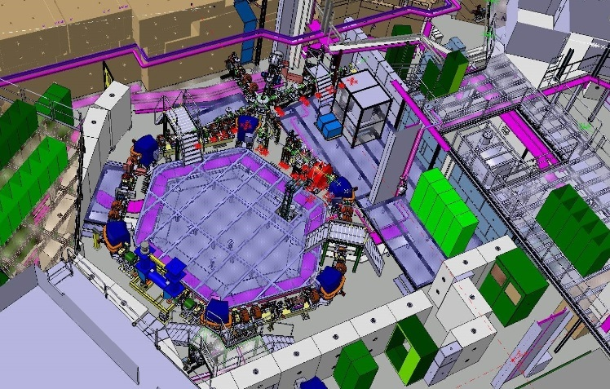
DESIGN PHASE
EN-MME CONTRIBUTION:
DETAILED DESIGN OF THE EQUIPMENT
SOURCE SUPPLIERS FOR COMPONENTS
CONSULT THE EQUIPMENT OWNERS ON MANUFACTURING, PLAN MANUFACTURING OF THE REQUESTED EQUIPMENT

Slide 6
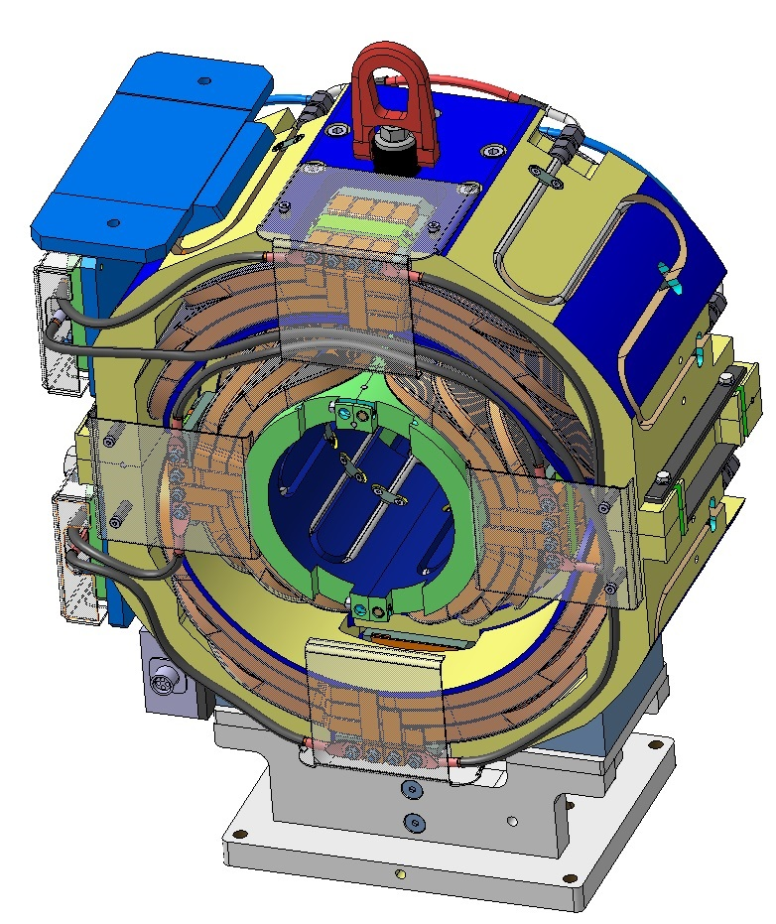
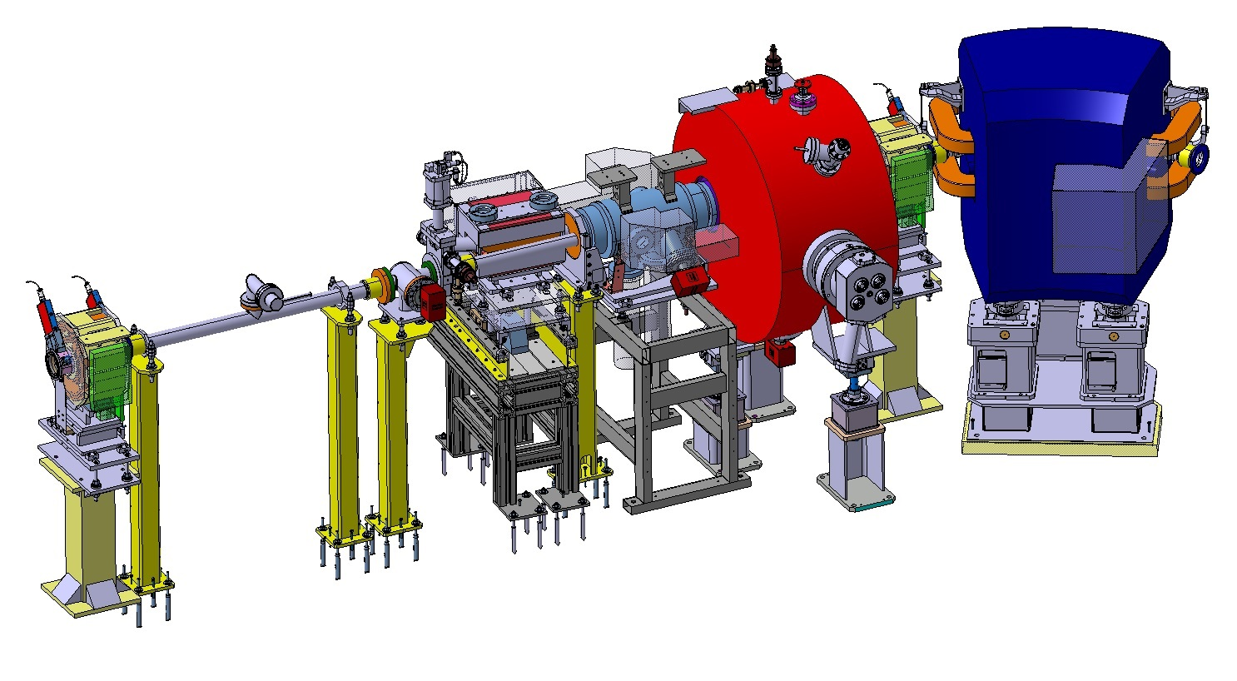
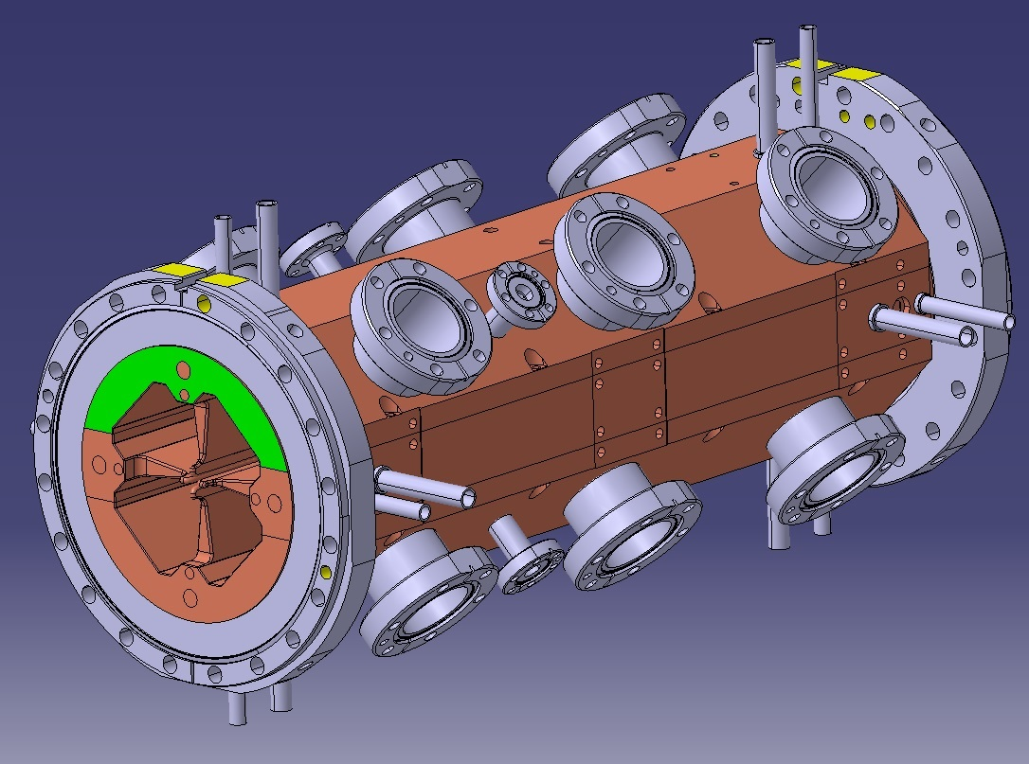
GEOMETRIES
CHALLENGES:
COMPLEX GEOMETRY TO MODEL, DRAW AND MANUFACTURE
TIGHT TOLERANCES, PERFECTION DESIRED
DIFFERENT MATERIALS

Slide 7
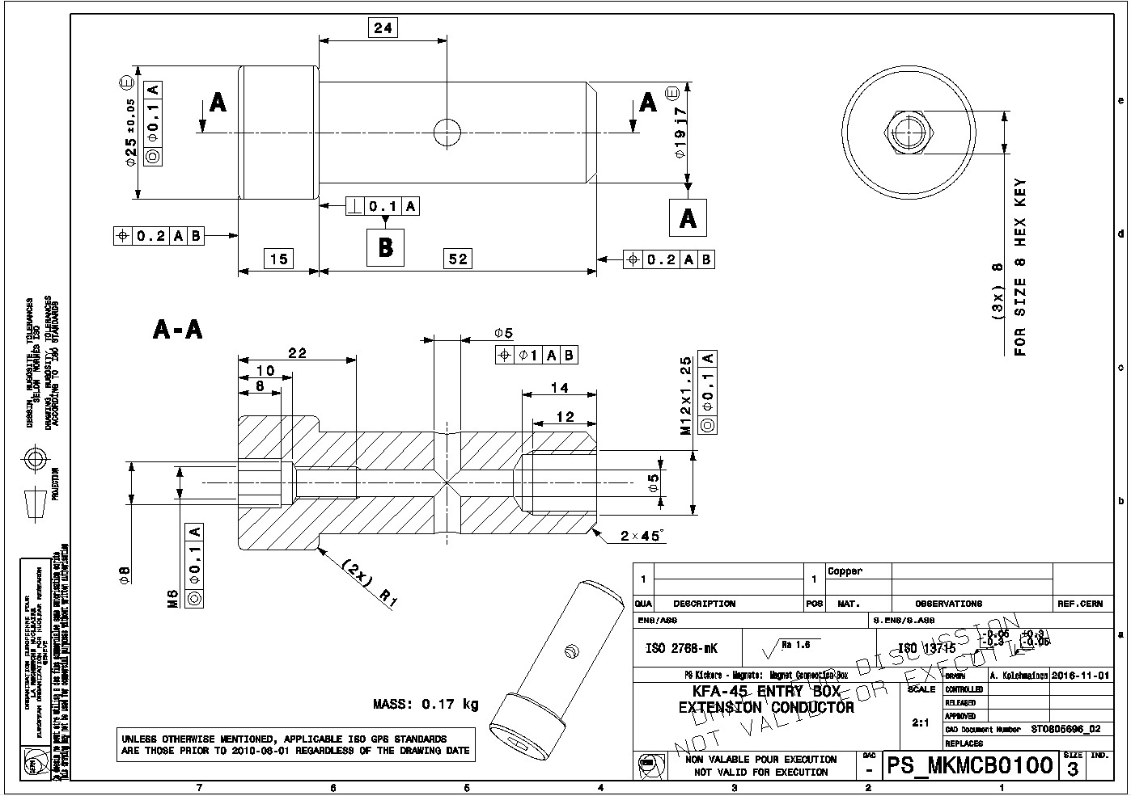
GEOMETRIES
STANDARDIZED PRESENTATION
“LEGAL DOCUMENT”

Slide 8
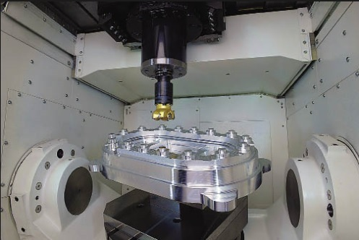
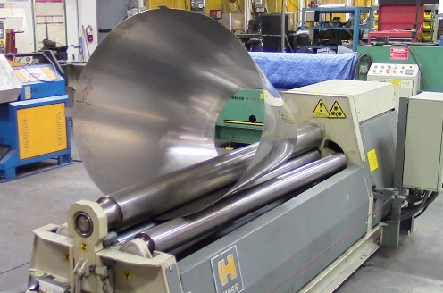
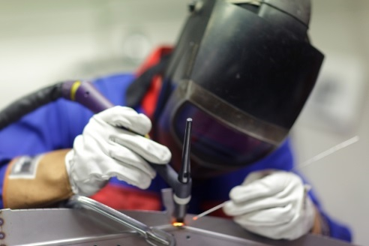
MANUFACTURING
FORM MATERIAL
BEND / ROLL / DRAW
REMOVE MATERIAL BY CUTTING
ADDING DEGREES OF FREEDOM ALLOWS MORE COMPLEXE GEOMETRIES
MELT PARTS TO BE JOINED LOCALLY

Slide 9
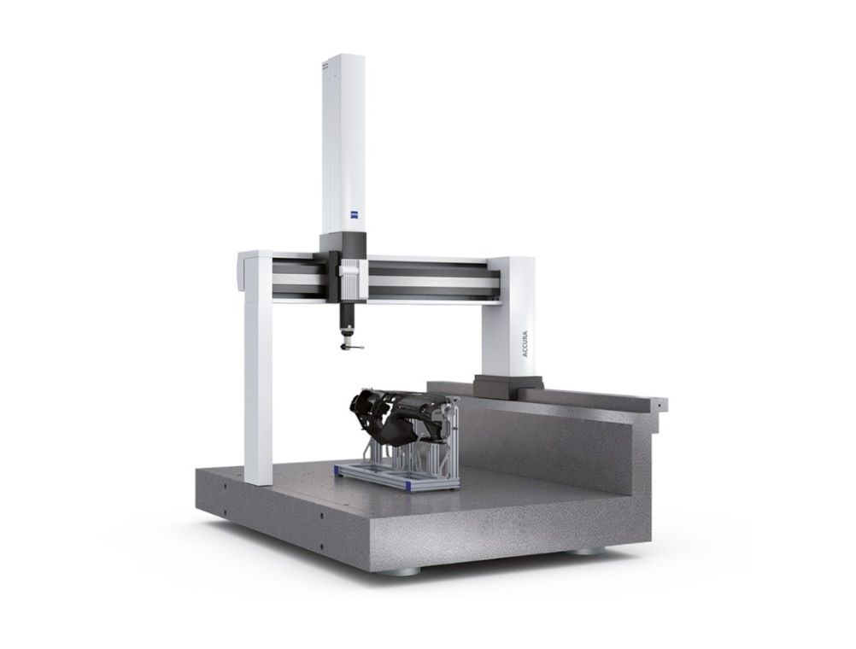

MEASURING
WHAT IS THE REQUIRED RESOLUTION?
WE CAN GO TO 0.X μm(1/1000 mm)

Slide 10
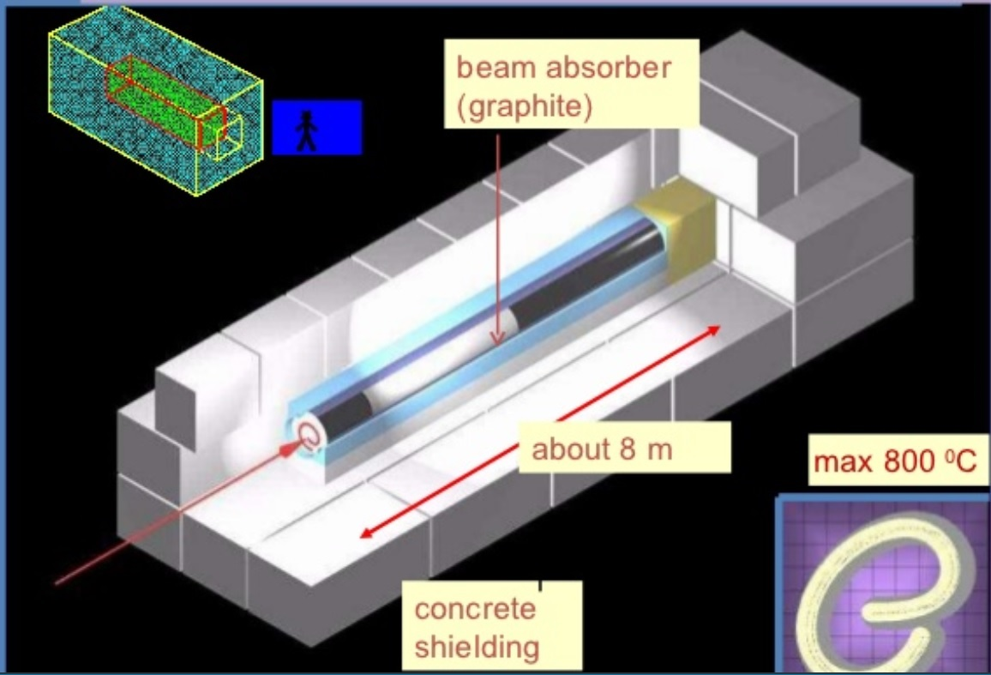
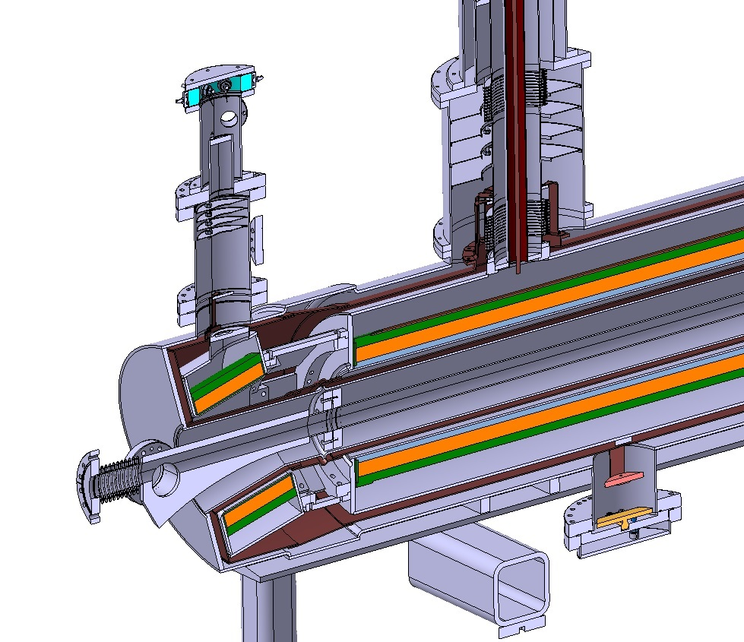
BEAM AND MAGNET ENERGY
ONE LHC BEAM ENERGY ~ TGV TRAIN
DILUTE THE BEAM -> SPREAD INTO A GRAPHITE CYLINDER(EN-MME MATERIAL DEVELOPMENT)
RADIATION IN CERTAIN AREAS
SUPERCONDUCTING MAGNETS INVOLVE CRYOGENICS, SUPERCONDUCTIVITY AND VACUUM IN ONE DEVICE
CHALLENGES:
STOP THE HEAT LOAD – 1 W REMOVED FROM HELIUM NEEDS 1000 W IN ROOM TEMPERATURE
RETAIN COILS WITH HIGH FORCES STATIC
  154 LHC DIPOLES STORED ENERGY~ AIR-CRAFT CARRIER @ 20 km/h
MANAGE THE THERMAL CONTRACTION/EXPANSION

Slide 11
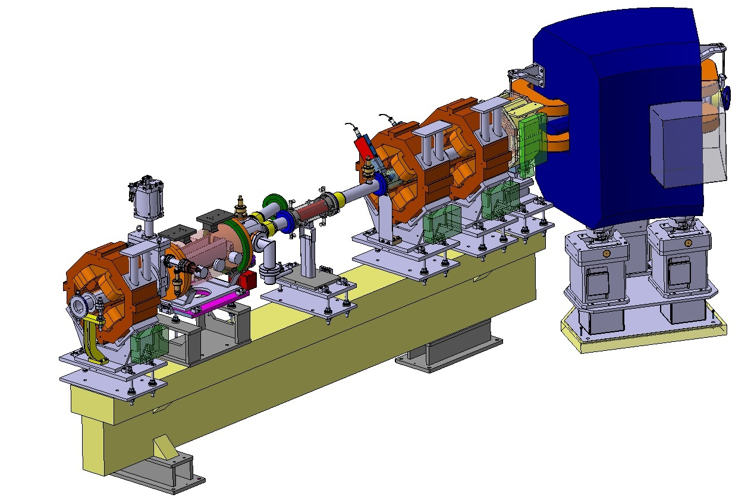
VACUUM
THE LOWER THE PRESSURE THE LESS UNWANTED COLLISIONS
MATERIAL REQUIREMENTS LEAD OFTEN TO STAINLESS STEEL OR COPPER
MATERIAL QUALITY CLOSELY FOLLOWED
TREATMENTS TO IMPROVE VACUUM
VACUUM FIRING
NEG COATING
CRYO-PUMPING
FOR DESIGNER:
THE LESS CONNECTIONS THE LESS POSSIBLE LEAKAGES
AVOID TRAPPED VOLUMES
ULTRA HIGH VACUUM(UHV) = 10⁻¹³ bar ~ DEEP SPACE PRESSURE OR ~ 1/10 OF THE PRESSURE IN THE MOON

Slide 12
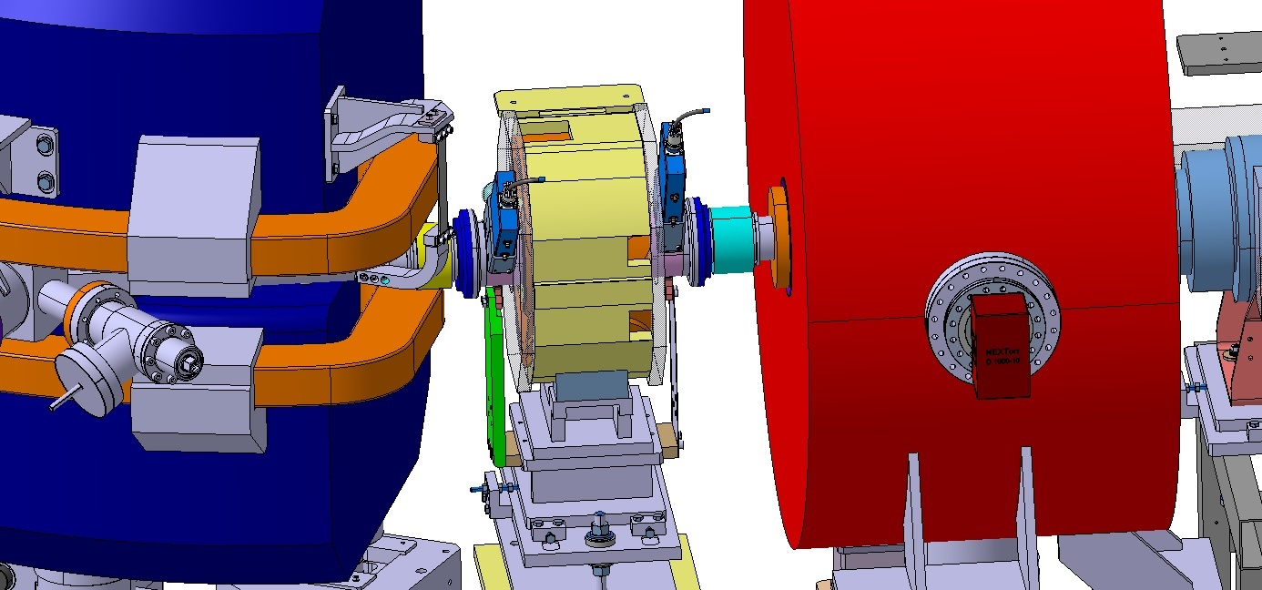
INTEGRATION & PROJECTS
CHALLENGES:
LIMITED SPACE
MANAGE ALL THE COMPONENTS
  FOLLOW-UP OF THE DESIGN
  WORK TOGETHER WITH EVERYONE INVOLVED

Slide 13
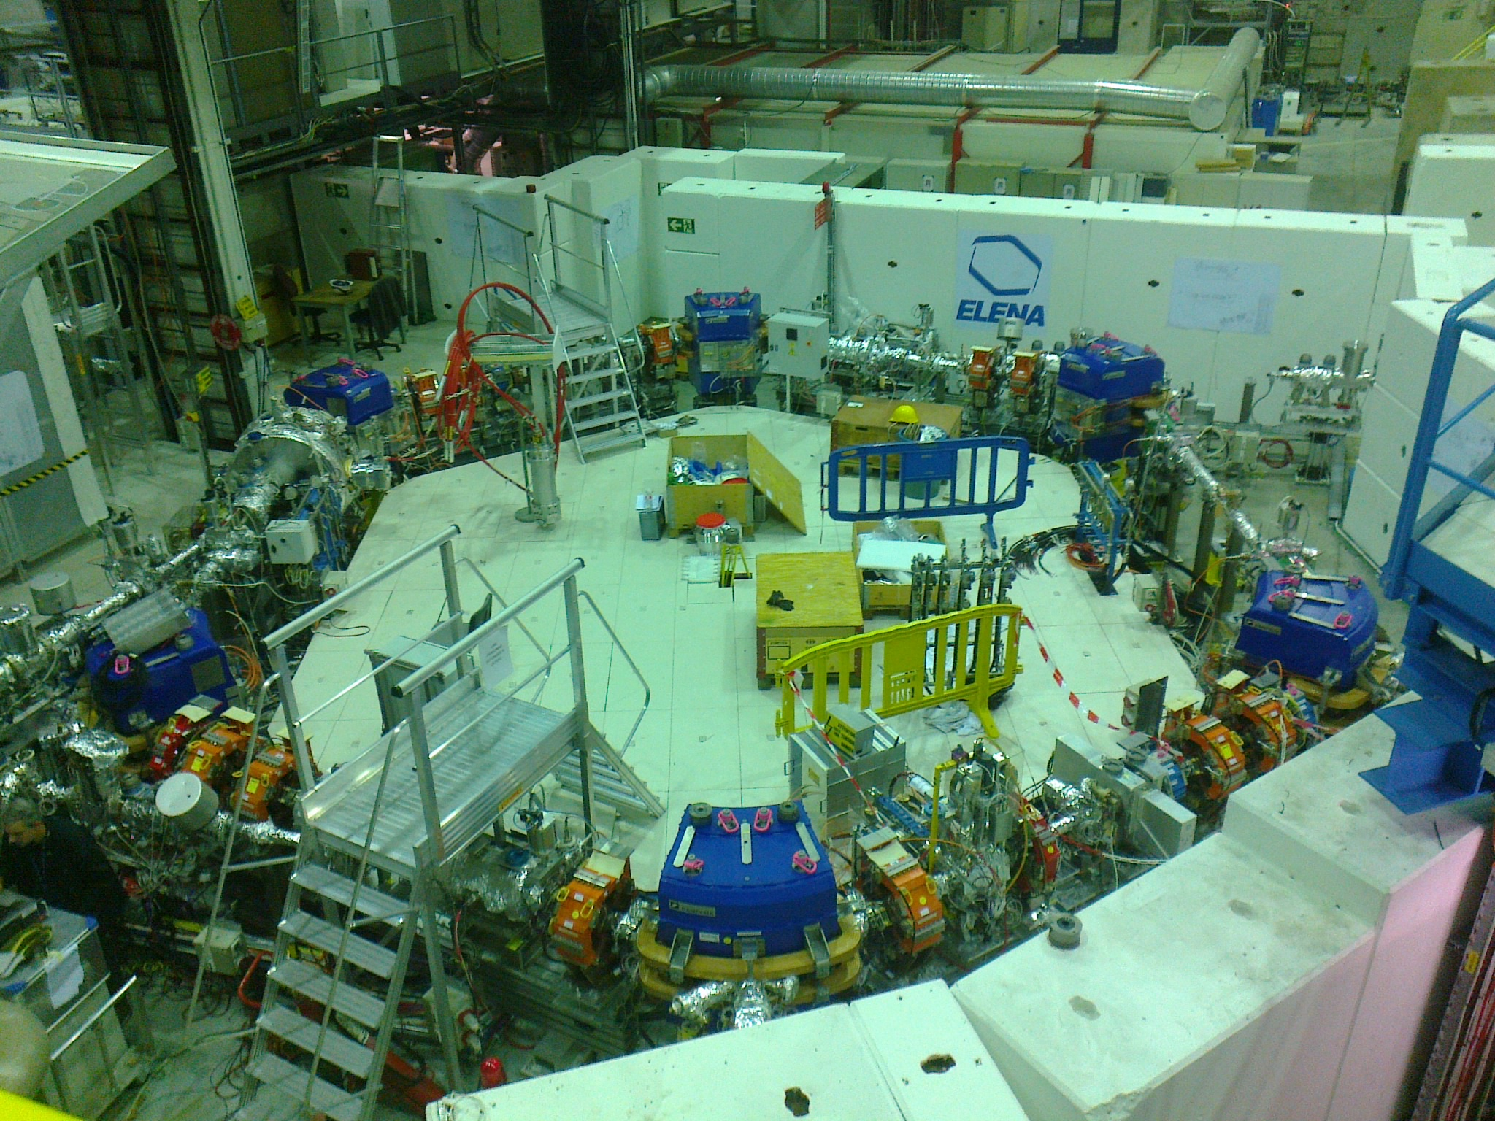
INSTALLED ACCELERATOR
EN-MME CONTRIBUTION:
DELIVERY OF THE MANUFACTURED AND PURCHASED COMPONENTS
INSTALLATION FOLLOW-UP AND SUPPORT
COMPLETE THE DOCUMENTATION

Slide 14
? / !
QUESTIONS / THANK YOU FOR YOUR ATTENTION

