Slide 1



Run II Radiation Damage Effects and Operation of the LHCb Vertex Locator
Agnieszka Obłąkowska-Mucha
AGH UST Kraków
on behalf of LHCb VELO Group
29th RD50 Workshop
21-23 November 2016
CERN

Slide 2
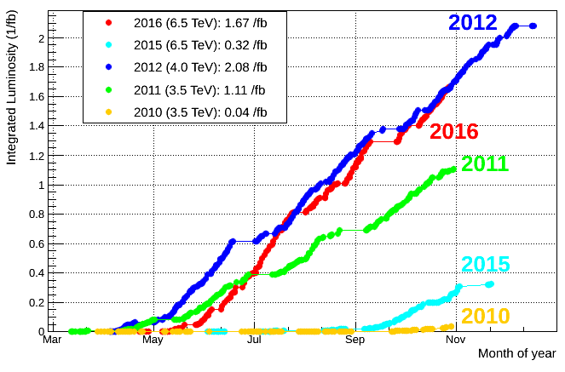
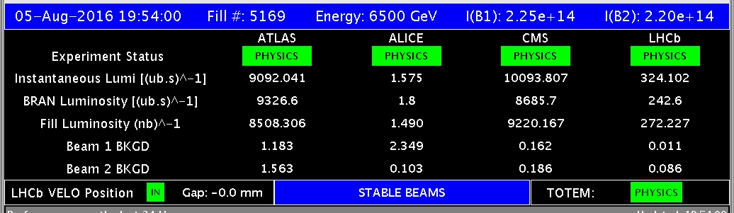

Outline
LHCb spectrometer and physics program.
Vertex Locator.
Radiation Damage:
  Leakage current.
  Effective depletion voltage.
  Charge collection efficiency.
  Cluster finding efficiency.
Summary.
>$𝓞(10)$ lower Lumi then ATLAS

Slide 3
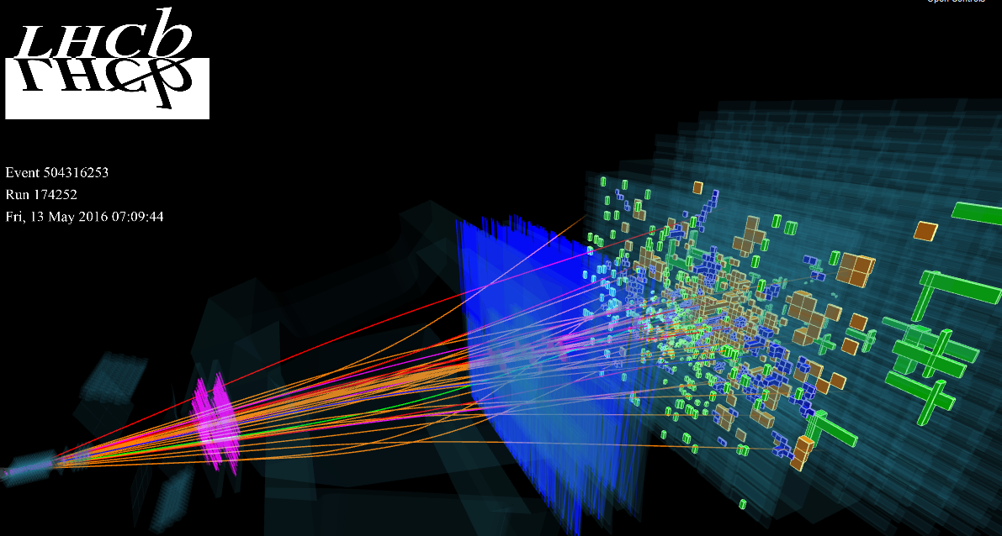
The LHCb Spectrometer
ECal
Outer Tracker
Muon Hits
RICH2
HCal
Inner Tracker
Trigger Tracker
Magnet
RICH1
VELO
pions
protons
kaons
muons
electrons

Slide 4
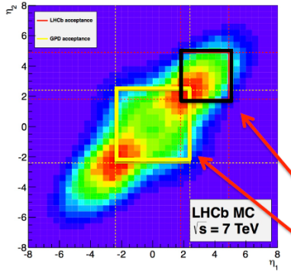
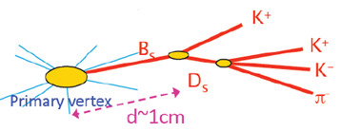
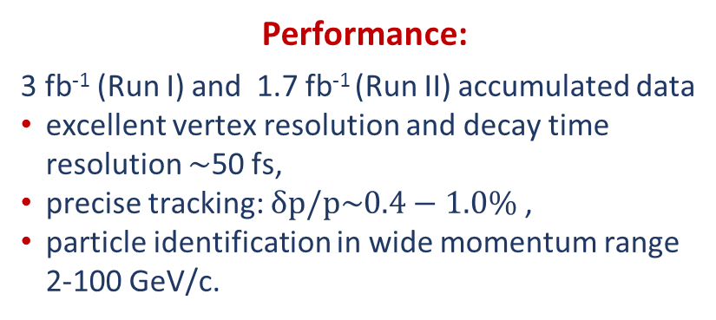


The LHCb Physics Program
The detector dedicated for studying flavour physics at LHC.
Especially CP violation and rare decays of beauty and charm mesons.
ECal
Complementary kinematical coverage to CMS and ATLAS
Muon Hits
Performance:
  3 fb⁻¹ (Run I) and 1.7 fb⁻¹ (Run II) accumulated data
  excellent vertex resolution and decay time resolution $\sim$50 fs,
  precise tracking: $δp/p\sim 0.4−1.0\%$ ,
  particle identification in wide momentum range 2-100 GeV/c.
Outer Tracker
HCal
Inner Tracker
LHCb
$$2<η<5$$
Trigger Tracker
Magnet
ATLAS,CMS: $\left|η\right|<2.5$
VELO
The crucial requirements for a Vertex Detector:
very good vertex separation power, IP resolution,
fast tracking for the High Level Trigger,
withstand severe radiation environment,
pions
protons
kaons
muons
electrons

Slide 5
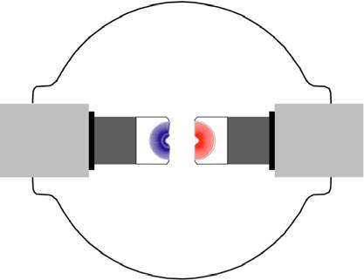
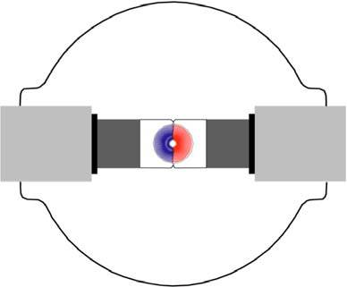
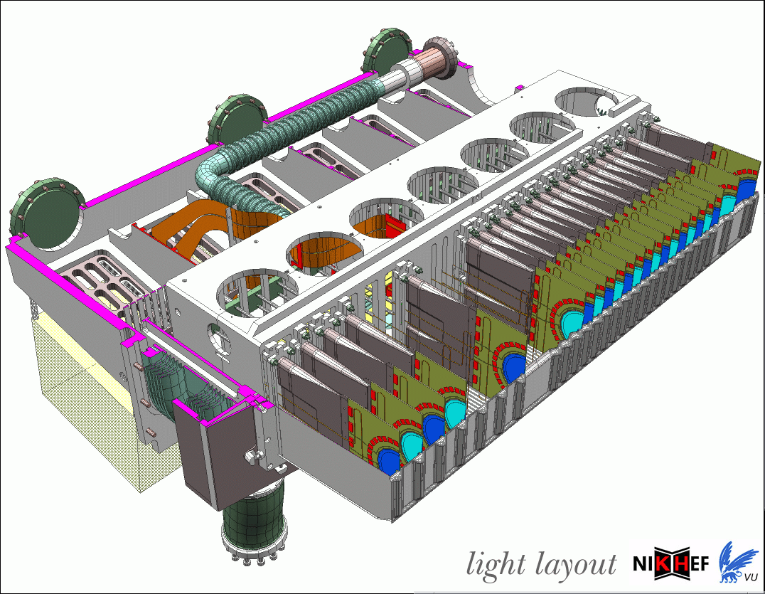
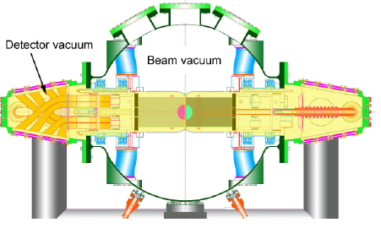
The LHCb VELO
VErtex LOcator
Close proximity of the beam-pipe.
stable beams
injection
VELO halves are movable- the movement is steered by a precise system (accuracy of 10 μm),
When stable beams, the silicon edge is only 8 mm from the proton beam – sensors are in harsh and non-uniform particle fluence .
Operated in a secondary vacuum, separated from the LHC vacuum by 300 μm thick aluminium foil.
6 cm
Performance of the LHCb Vertex Locator,
J. Instrum. 9 (2014) P09007

Slide 6
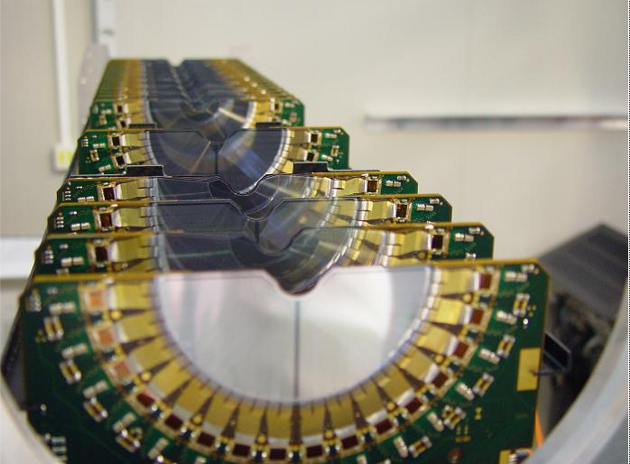
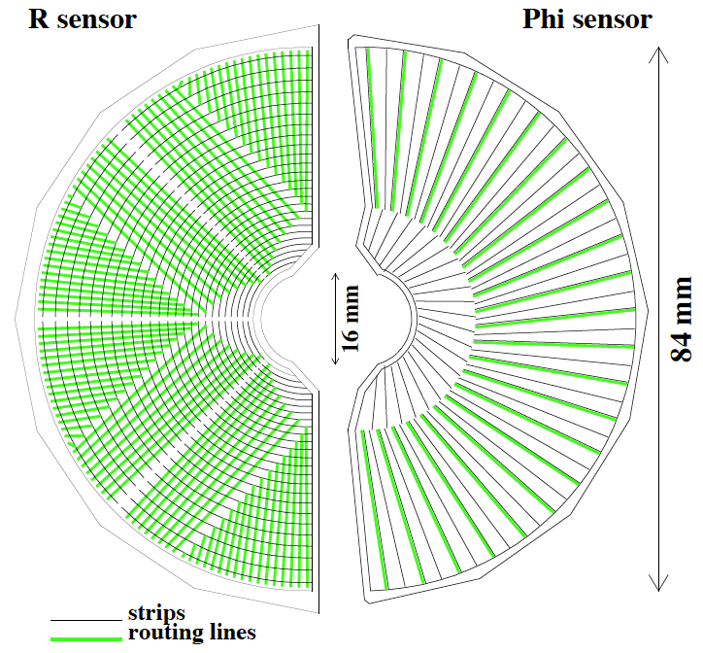
VELO modules
Sensors
VELO consist of 42 modules (two halves).
Modules have two (R and Phi) microstrip silicon oxygenated n⁺-on-n sensors (two sensons are n⁺-on-p).
Sensors are 300 μm thick, strip pitches: 40-100 μm.
Evaporative CO₂ cooling system keeps sensors at -7ºC.

Slide 7
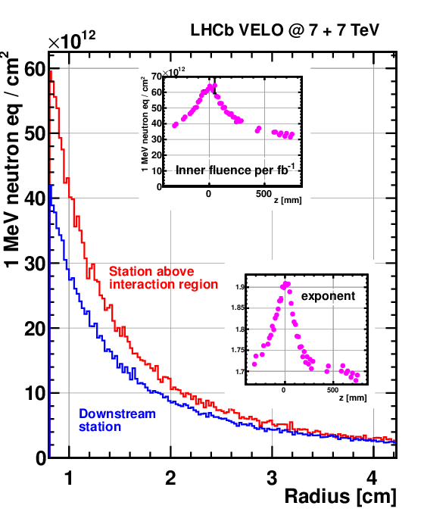
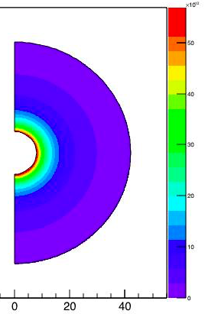
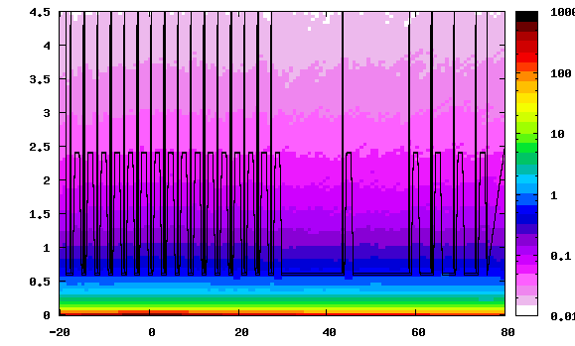





Particle Fluence
Radiation environment
VELO is currently the most exposed detector in the LHC- fluence up to 2.0∙10¹⁴MeV n_{eq}/cm²,
  LHCb has collected almost 5 fb⁻¹ until now,
  VELO is designed to cope with 10-11 fb⁻¹ .
The radiation field is highly non uniform – the fluence accumulated in inner and outer part of the sensor differs by a factor of ten.
1 fb⁻¹
$$7 TeV+7 TeV$$
$$Fluka LHCb VELO Simulation$$
Preliminary
r$[cm]$
Fluence $[a.u.]$
$$z [cm]$$

Slide 8
Radiation Damage - effects
Radiation induced changes in properties and structures of the silicon tracking detectors are observed as macroscopic effects caused by microscopic defects:
Increase of leakage current, caused by creation of generation and recombination centres.
Change of the effective doping concentration with significant influence on operating voltage needed for total depletion.
Loss of charge collection efficiency due to charge carrier trapping.
Constant monitoring of radiation influence on VELO sensors:
Current - Voltage scans (IV),
Current - Temperature scans (IT),
Charge Collection Efficiency scan (CCE).
The microscopic defects accumulate over time and have a damaging impact on the sensor performance.

Slide 9
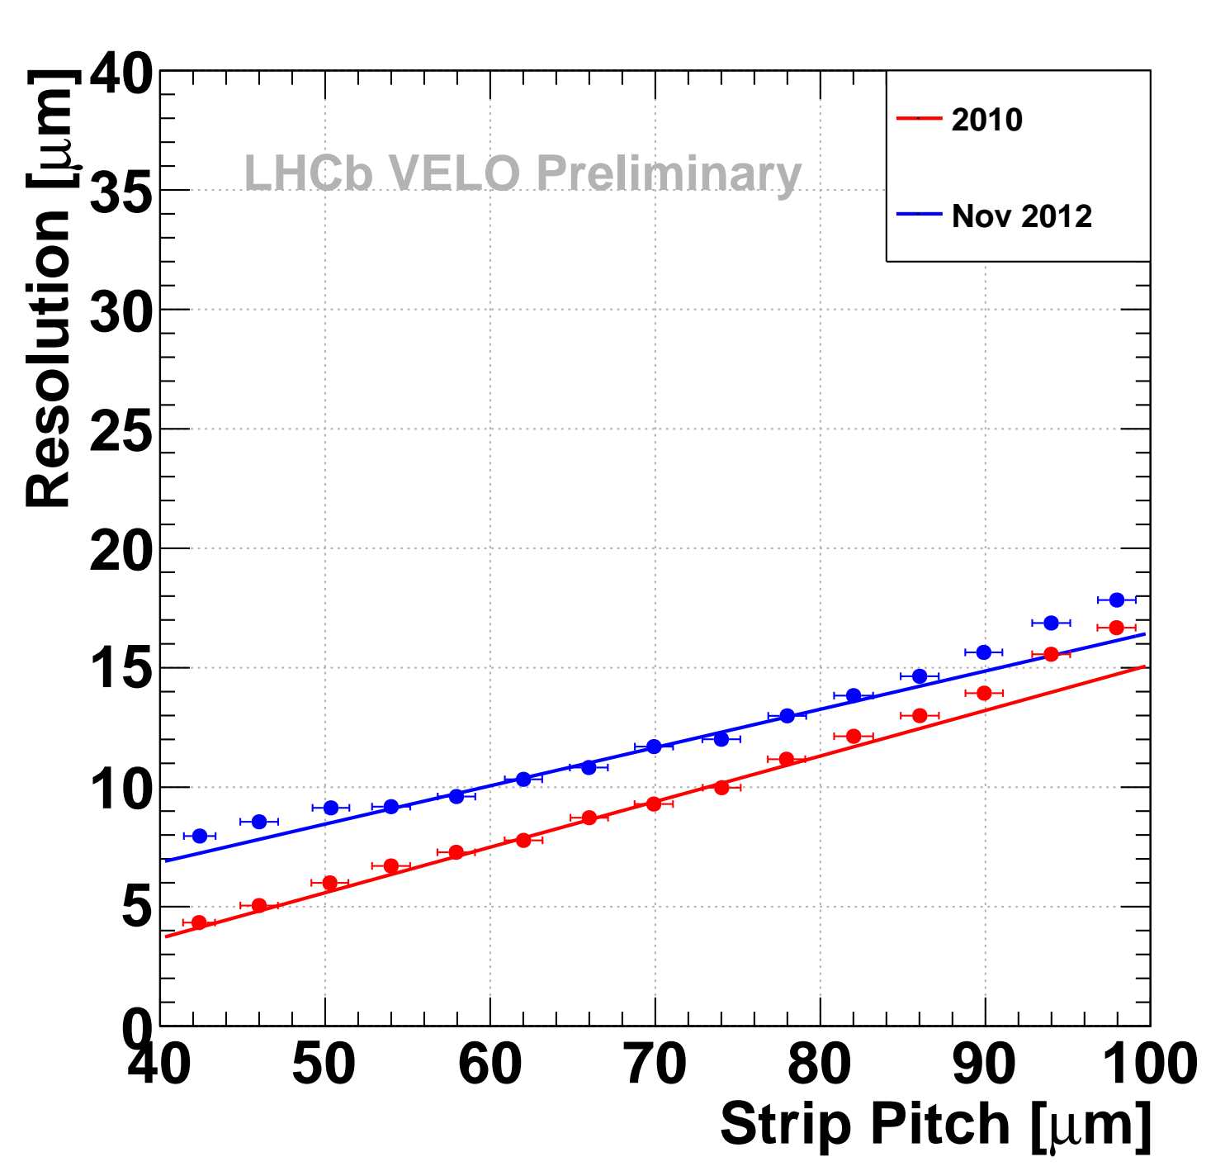
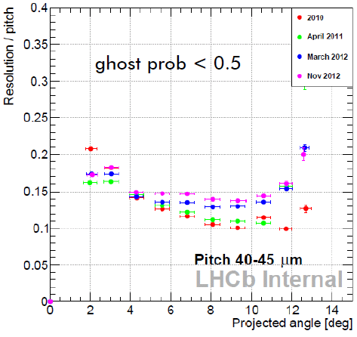
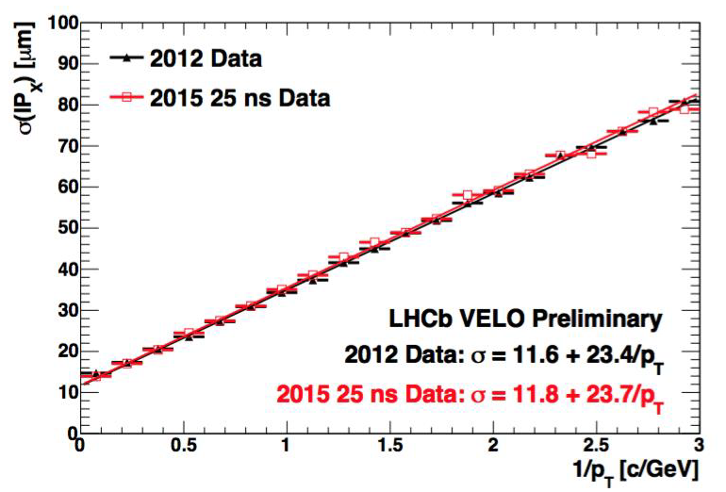
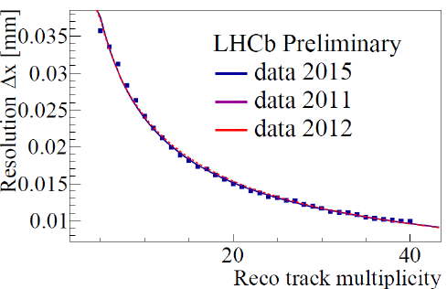
VELO performance after 3.4 fb⁻¹
1. Hit resolution:
2. IP resolution:
9 degrees
a) as a function of strip pitch b) as a function of track angle
3. PV resolution:
  Although some degradation is observed, VELO performance did not change much after Run I.

Slide 10
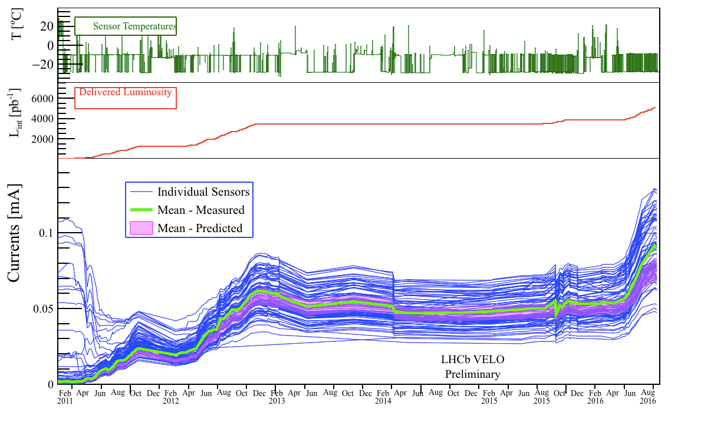
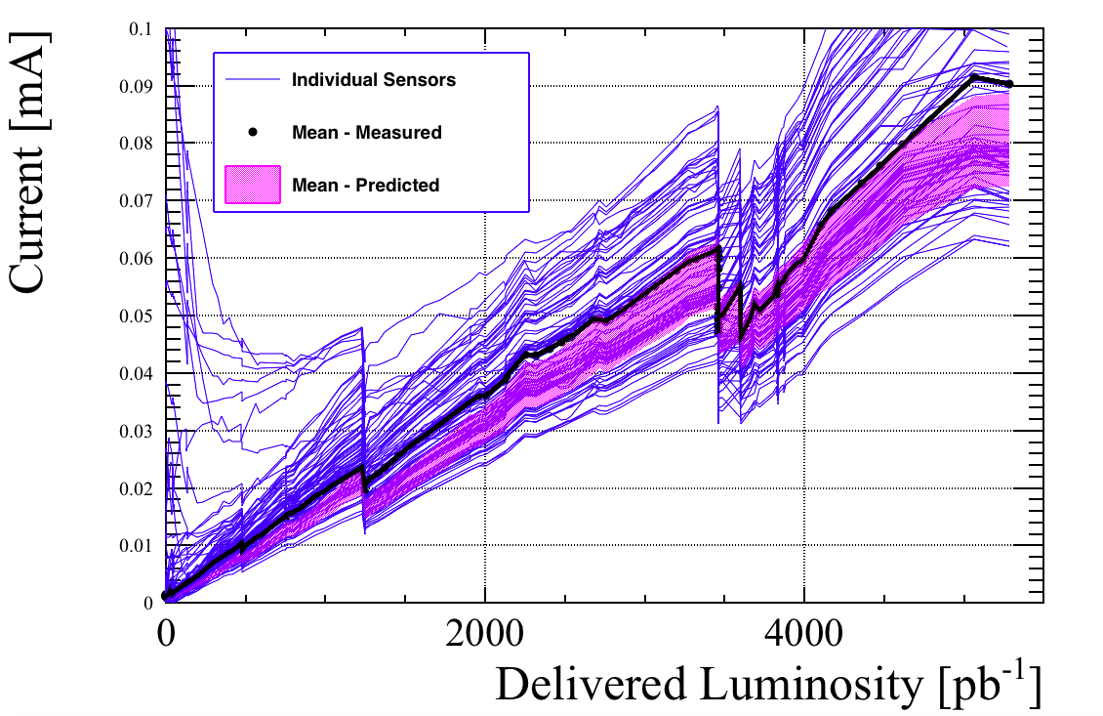
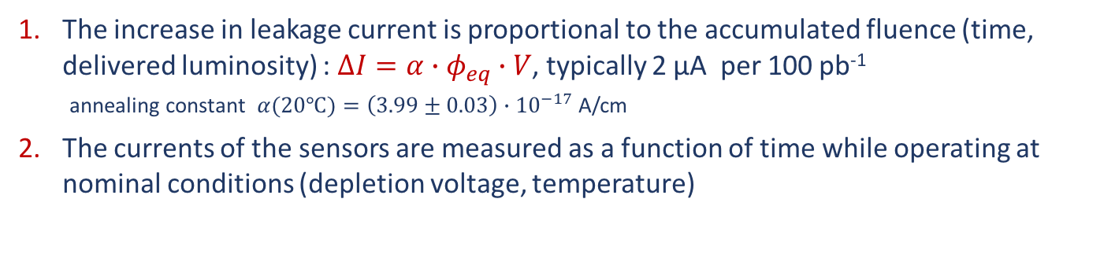
Leakage Current
“Radiation Damage in the LHCb VELO”
JINST 8 (2013) P08002
The increase in leakage current is proportional to the accumulated fluence (time, delivered luminosity) : $∆I=α∙φ_{eq}∙V$, typically 2 μA per 100 pb⁻¹
annealing constant $α(20℃)=\left(3.99±0.03\right)∙{10}^{−17}$ A/cm
The currents of the sensors are measured as a function of time while operating at nominal conditions (depletion voltage, temperature)
2016
Run II
LS1
Run I
Bulk currents increases with fluence es expected, with occasional drops due to annealing.

Slide 11
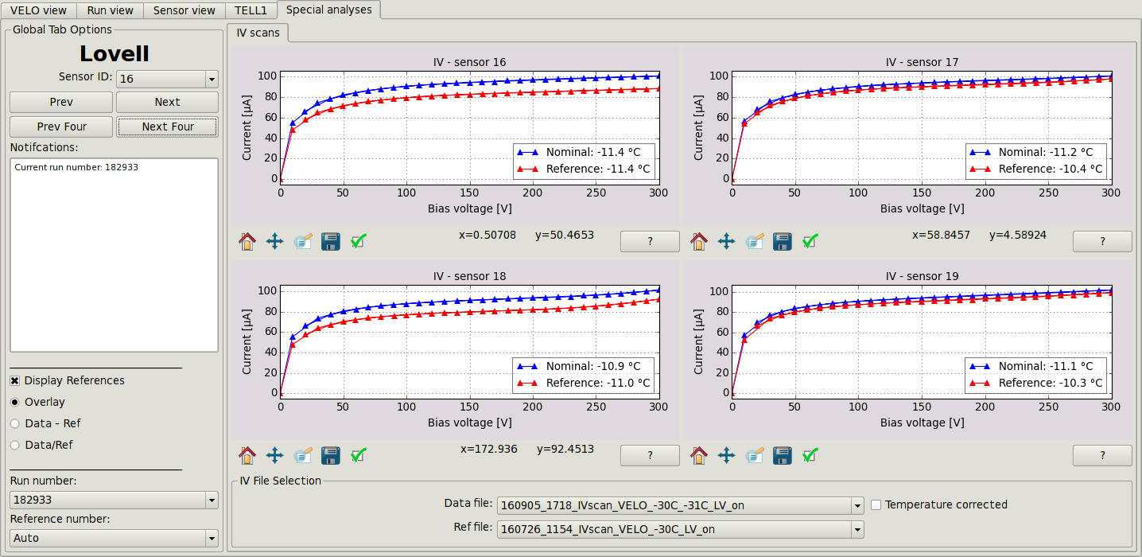
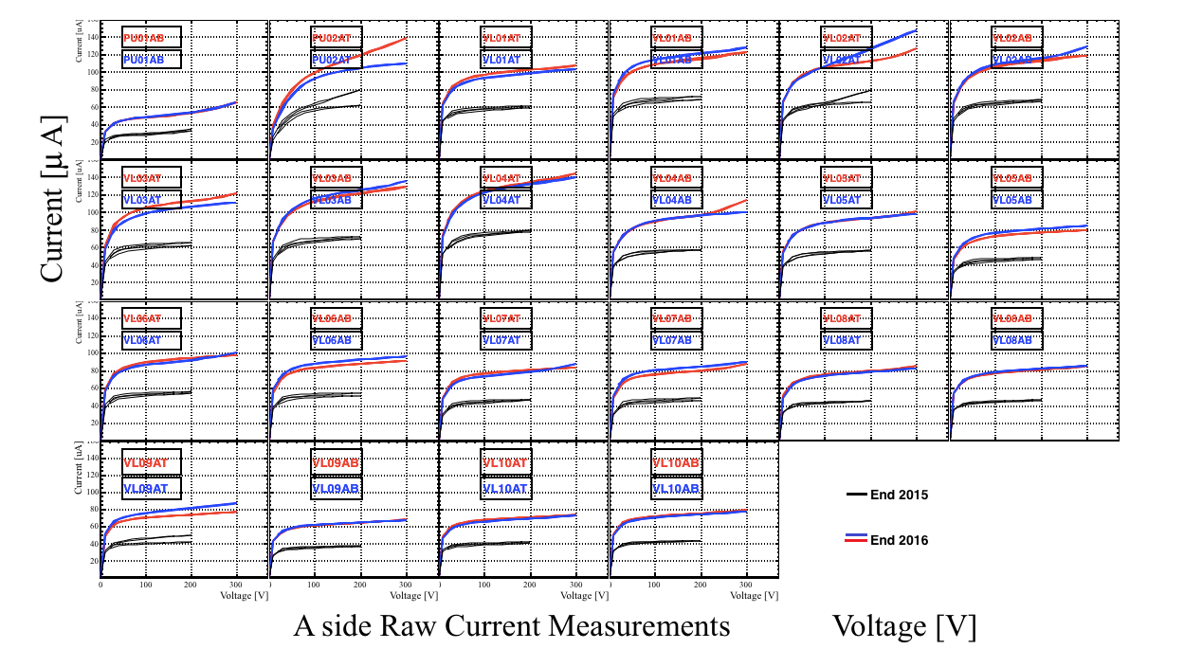
IV scans
IV scans are performed semi-automatically at the end of fills (in data taking periods).
On-line new monitoring – Lovell.

Slide 12
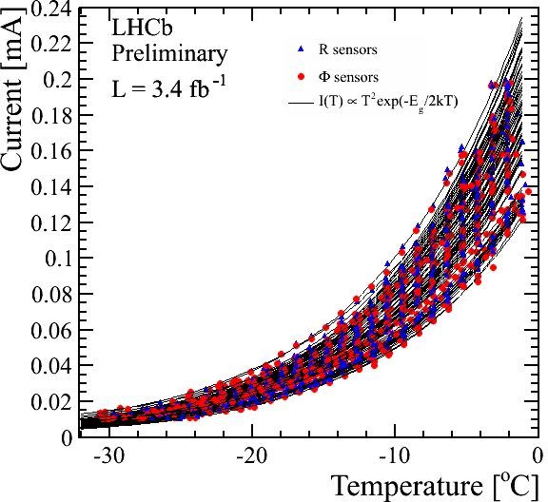

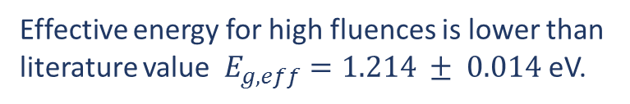

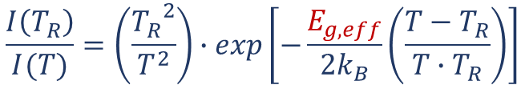
Leakage Current – IT scans
Bulk current in silicon has an exponential dependence on temperature.
The study of current-temperature dependence (IT scans) are performed a few times during each period of data taking.
The silicon effective band gap can be also determined.
current scaling:
$$\frac{I\left(T_{R}\right)}{I(T)}=\left(\frac{{T_{R}}^{2}}{T^{2}}\right)∙exp\left[−\frac{E_{g,eff}}{2k_{B}}\left(\frac{T−T_{R}}{T∙T_{R}}\right)\right]$$
$$T_{R}=0℃$$
$E_{g,eff}=1.16 ± 0.06$ eV
Effective energy for high fluences is lower than literature value $E_{g,eff}=1.214 ± 0.014$eV.
A. Chilingarov; 2013 JINST 8 P10003
see also: Nucl.Instrum.Meth. A796 (2015) 126-130

Slide 13
Collected charge

Slide 14
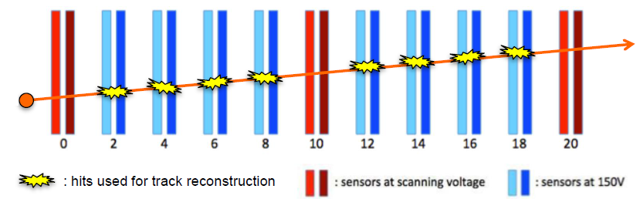
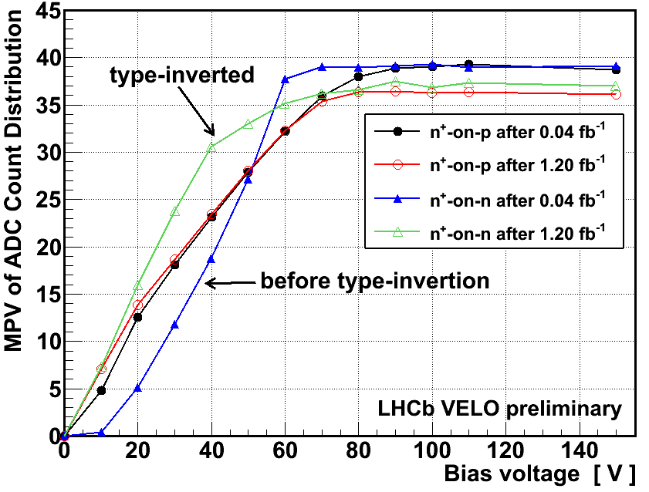
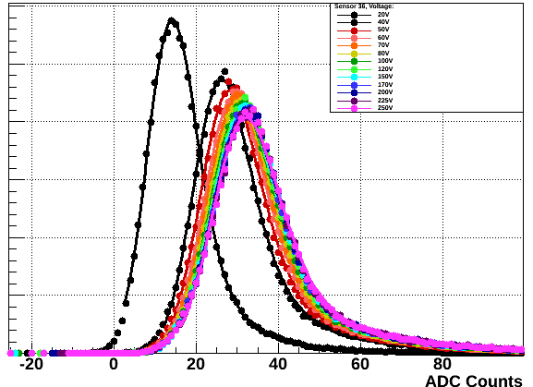
Charge Collection Efficiency - V_{ED}
Charge Collection Efficency (CCE)
The effective depletion voltage (V_{ED}) is the voltage where MPV is 80% of maximum.
Type inversion occurred at (10-15)×10¹² 1MeV n_{eq}/cm², inversion started at inner radius.
During data taking a tested sensor is excluded from the track fit.
A voltage bias scan is performed on it and the charge deposited in sensor around the track intercept is measured.
Relative nnumber of tracks
LHCb VELO preliminary
CCE scan is used to measure:
Effective Depletion Voltage (V_{ED})
Cluster Finding Efficiency (CFE)

Slide 15
CCE – Effective Depleted Voltage V_{ED}
L = 40 pb⁻¹

Slide 16
CCE – Effective Depleted Voltage V_{ED}
L = 1.1 fb⁻¹

Slide 17
CCE – Effective Depleted Voltage V_{ED}
L = 3.4 fb⁻¹

Slide 18
CCE – Effective Depleted Voltage V_{ED}
L = 3.7 fb⁻¹

Slide 19
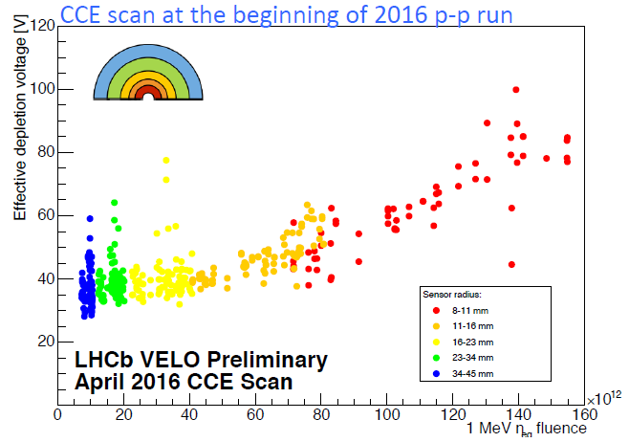
CCE – Effective Depleted Voltage V_{ED}

Slide 20
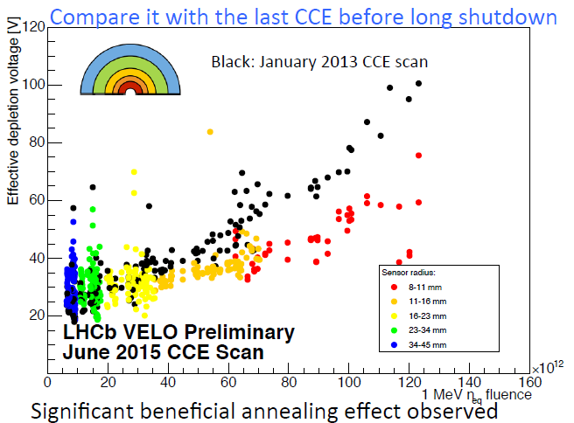
CCE – Effective Depleted Voltage V_{ED}

Slide 21
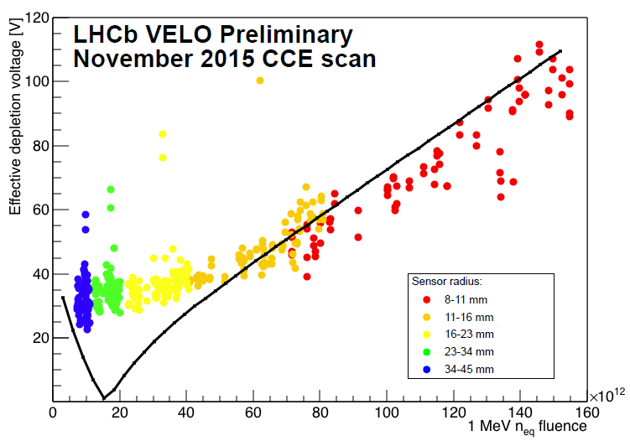
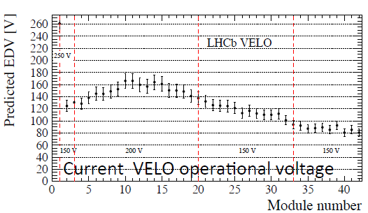

CCE – Effective Depleted Voltage V_{ED}
At the production, initial depletion voltage was 25-70 V.
Sensors in 2011-12 were biased at 100-150 V, currently 150-200 V (250 V for n-on-p).
$ℒ$ = 3.7 fb⁻¹
n-on-p sensors
Good agreement with Hamburg model – we can predict voltages for the next periods of operation.
n-on-p
Notes:
n-on-p – maybe VL 01L?

Slide 22
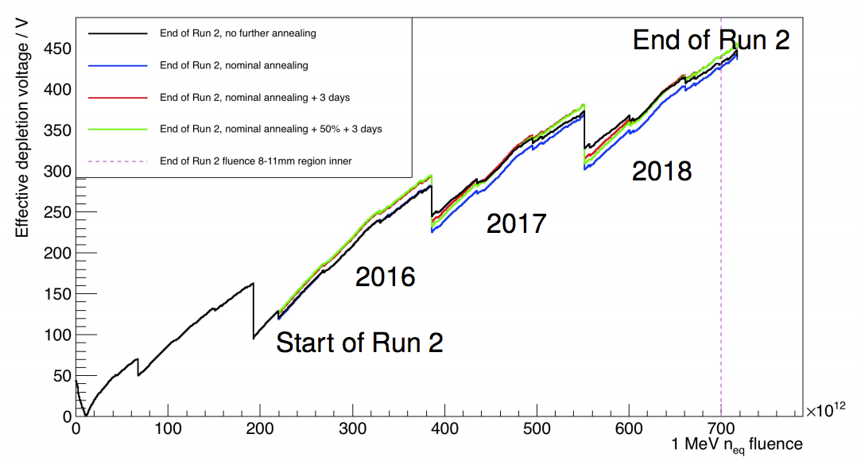
V_{ED} – expectations for Run II
LHCb is supposed to collect 8 fb⁻¹ by the end of Run II, what means that the VELO sensors will accumulate maximum of 7∙10¹⁴ 1MeV n_{eq}/cm² (most irradiated tips of the sensor).
Hamburg model
VELO sensors can be operated up to 500V.
During LS2 (2018-19) VELO microstrip sensors will be replaced by pixels.

Slide 23
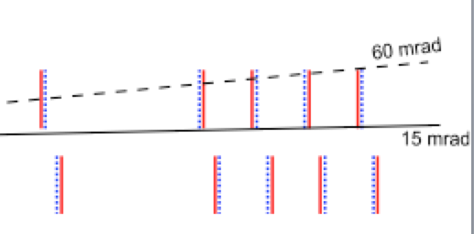
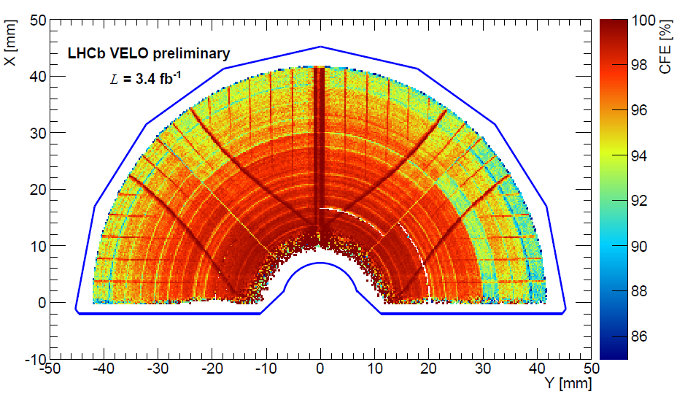
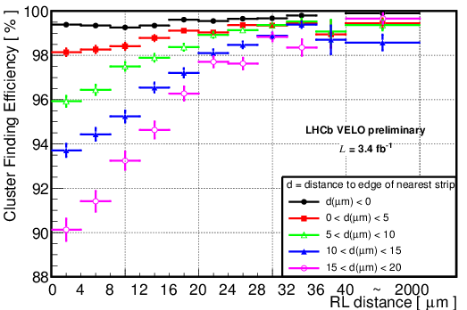
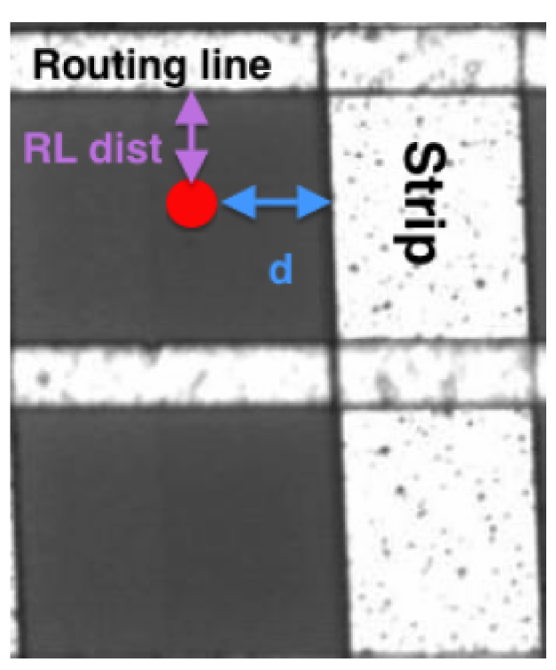
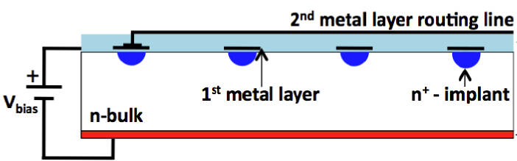
Cluster Finding Efficiency
Higher than expected loss in cluster finding efficiency in the outer parts of the less irradiated sensors.
Especially R sensors in the most forward positions.
Before irradiation CFE was > 99%.
SiO₂
In R sensors the routing lines are perpendicular to the strips.
CFE is reduced for tracks far from a strip and close to a routing line.
It is caused by the charge induction on the routing lines.
p⁺
Second metal layer effect does not impact the tracking performance!

Slide 24
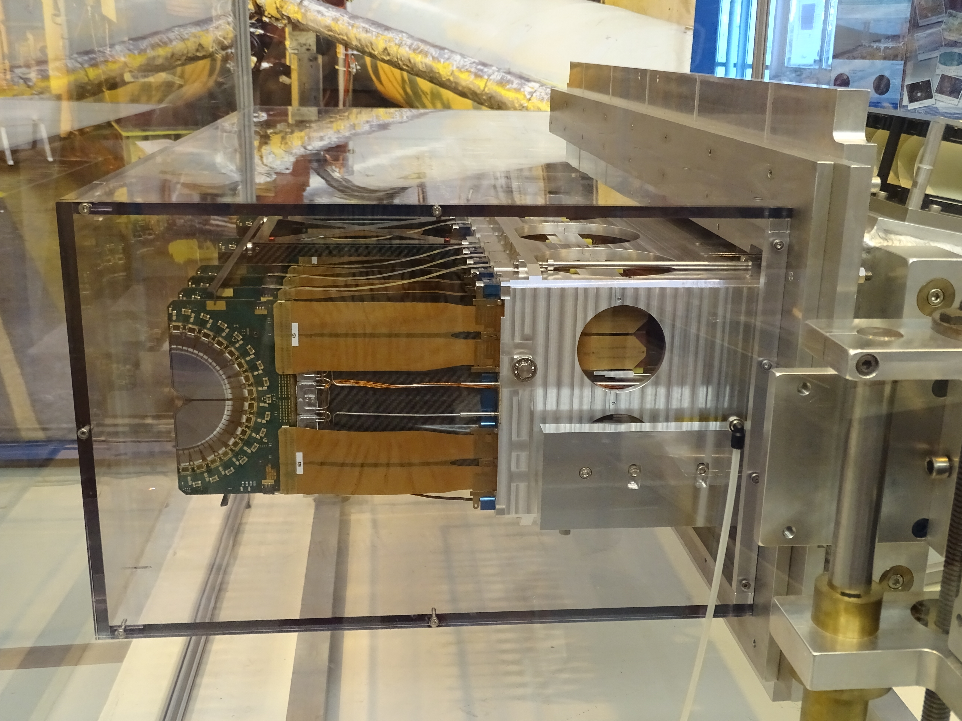
Summary
Vertex Locator is performing successfully in Run II obtaining the resolutions similar to Run I.
The degradation of detector due to the radiation is observed and carefully monitored (new software VELO monitor – Lovell).
The measurements in Run I indicate that the detector is sufficiently radiation hard.
Bias High Voltages have been raised and we expect that the increase until the end of Run II will be below the maximum limit.
The fully operational copy of VELO is still on display at LHCb Pit.

