Slide 1
3D solvers for impedance simulations
Benoit and Kyrre

Slide 2
Agenda
Description of the physics and the modeling of the code
  What effects are included and what are not?
  What is the impact of the simulation tool for CERN studies?
Code implementation
  Programming language(s)
  Programming style (object oriented, procedural, …)
  Prerequisites to run the code (OS, compilers, libraries, other codes)
  Parallelisation technology (if any)
Example of typical application (use case)
  How many simulations for one study
  Where the code is run (lxplus, lxbatch, other clusters)
  Computing time
Performance
  Is the performance in general adequate to the present needs?
Available documentation
Licensing policy
  Open source?
Future plans and needs
  Maintenance, extension and further development
    Include more physics to better model cases of interest for CERN?
    Performance improvement?
  Resource estimation for maintenance/development over next years
  What type of hardware resources would be best suited for the physics case?

Slide 3
codes
CST (~10 users in ABP)
ABCI (1 or 2 users)
ACE3P (1 superuser and 3 beginners)
GdfidL (0 user so far)
[ANSYS HFSS]
[COMSOL]

Slide 4
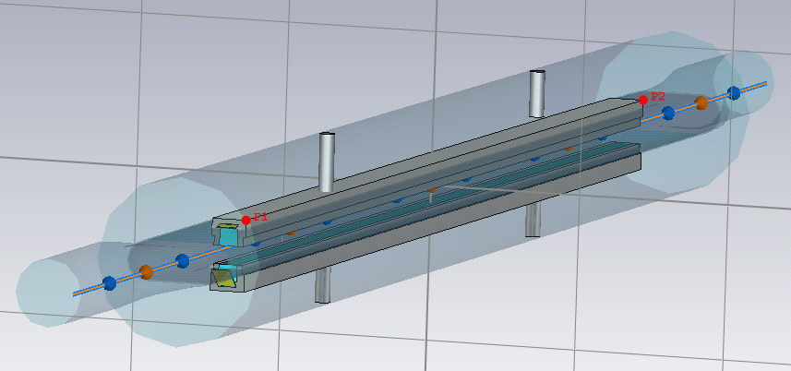
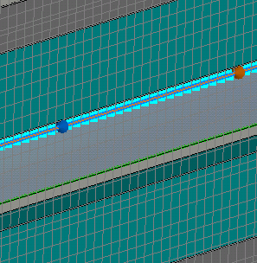
Description of the physics and the modeling of the code
Goal: simulate impedance and wakefields of accelerator devices
  For direct observation (comparison with existing models and known limits)
  For use in beam dynamics tools (Sacherer formula, MOSES, DELPHI, HEADTAIL, ELEGANT, etc.)
  → critical for CERN studies since many years to determine intensity limitations for current machines (PSB, PS, SPS, LHC), projects (LIU, HL- LHC, CLIC) and studies (e.g. FCC-ee and FCC-hh)
Method: 3D codes cut the simulation domain into mesh cells, in which Maxwell’s equations can be solved.

Slide 5
Code implementation
Programming language(s)
  Source code is not accessible easily
  Some VB for the postprocessing
Programming style (object oriented, procedural, …)
  Not applicable
Prerequisites to run the code (OS, compilers, libraries, other codes)
  Runs well on Windows 7, exists also for Linux OS (but apparently less optimized)
Parallelisation technology (if any)
  Yes, but requires additional license

Slide 6
Example of typical application (use case)
→ A device is being considered for installation
→ requires validation of its impact on performance (now done by impedance WG)
→ the model is designed in CATIA/SMARTEAM by e.g EN-MME
→ ST number is sent to us
→ we access the ST database, save locally the CATIA file, suppress the many unnecessary items
→ we import the model into CST, simplify it further, define frequency range, materials, and typically run:
  the wakefield solver, to get the longitudinal and transverse impedances and/or wakes (dip and quad) as a function of frequency
  the eigenmode solver to assess which modes can resonate in the structure
  run some parameter scans to check convergence and consistency (outgoing beam pipe length, mesh size, wake length)
  computing time can range from minutes to days depending on the mesh size to geometry aspect ratio
In case there is a need to mitigate issues, a campaign of simulations is launched to check the sensitivity to geometry and material parameters. This can be very long.

Slide 7
Where is the code run (lxplus, lxbatch, other clusters)
There are currently the following possibilities for our team:
  Run on local PC or server
  Run on servers managed by IT and fully or partly paid by ABP
  Run on HPC remote servers
  Run on CST servers (need to pay)

Slide 8
PerformaIs the performance in general adequate to the present needs?
Yes and no
Yes:
for “simple” reasonably small structures in the LHC complex, since the average beam pipe cut-off for resonant modes is usually well above the frequency range excited by the beam.
No:
it is really (1) a pain and (2) very unreliable for studies that require short bunch length (e.g. FCC-ee, CLIC damping rings and light sources)
Some shapes are difficult to mesh for the wakefield solver (wires, shallow tapers)
Some materials (loss, coating, non linear) hit the limits of the code
→ The problem is not just the computing power, but also the noise levels

Slide 9
Available documentation
Very useful embedded help and documentation
Very responsive helpdesk if triggered adequately

Slide 10
Licensing policy
The opposite of open source
A certain number of expensive licenses are available inside CERN through IT. Like BMW, every option costs more.
ABP and RF chipped in at some point to get more licenses.
There used to be problems with licenses, but actions were taken by IT to mitigate this
It is forbidden to remotely use CERN CST licenses from other labs

Slide 11
Future plans and needs
No cost for maintenance (obviously)
T. Weiland has left, now part of Dassault-systemes.
→ Difficult to predict what will happen in the near future (maintenance? Improvements?).
→ Clearly accelerators are a very small business compared to other customers.
There has been slow but steady improvement in the performance of the code since 2006 (bugs correction, lossy materials in eigenmode, etc.).
Next steps include the possibility to use the TET mesh in the wakefield solver.
There are alternatives (GdfidL, ACE3P, ABCI for wakefields) and in particular HFSS for eigenmode, but they are not as convenient as CST for bulk of the cases.

Slide 12
What type of hardware resources would be best suited for the physics case?
A combination of HPC and local servers are very efficient for now.
GPU acceleration is not available for the wakefield solver yet.

Slide 13
codes
CST
ABCI
ACE3P
GdfidL
[ANSYS HFSS]
[COMSOL]

Slide 14
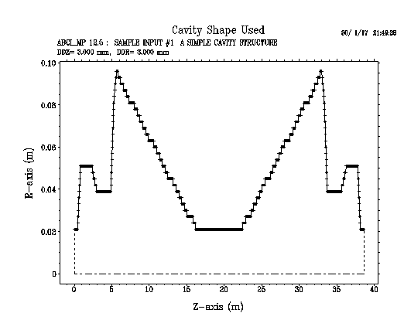
Description of the physics and the modeling of the code
Goal: simulate impedance and wakefields of accelerator devices
  For direct observation (comparison with existing models and known limits)
  For use in beam dynamics tools (Sacherer formula, MOSES, DELPHI, HEADTAIL, ELEGANT, etc.)
  → critical for CERN studies since many years to determine intensity limitations for current machines (PSB, PS, SPS, LHC), projects (LIU, HL- LHC, CLIC) and studies (e.g. FCC-ee and FCC-hh)
  → can only be used for axisymmetric structures
Method: 2D codes cut the simulation domain into mesh cells, in which Maxwell’s equations can be solved in time domain.

Slide 15
Code implementation
Code developed by Y.H. Chin (KEK/JPARC, Japan). CERN-SL helped for the computing optimization (H. Grote).
Programming language(s)
  Fortran
Programming style (object oriented, procedural, …)
  Not applicable as not open source
Prerequisites to run the code (OS, compilers, libraries, other codes)
  Runs well on Windows 7, exists also for Linux OS
Parallelisation technology (if any)
  Yes, in openMP for shared memory computer
  “ The MPI version of ABCI is also under consideration.” (sic)

Slide 16
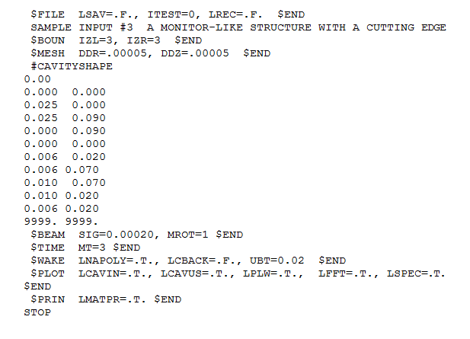
Example of typical application (use case)
→ A rotationally symmetric device is being considered for installation
We get the coordinates of the vacuum chamber and type them into the input file
computing time is typically minutes for our case.

Slide 17
Where is the code run (lxplus, lxbatch, other clusters)
→ I run it on my local PC. It crashes on local servers so far.
→ It is not clear that it is needed though.

Slide 18
Is the performance in general adequate to the present needs?
Yes
It is a good complement to CST and other 3D codes, as it is very fast even for small mesh size thanks to the 2D symmetry.
However, only perfect conductors are used.

Slide 19
Available documentation
http://abci.kek.jp/abci.htm
The manual is embedded in the installation package

Slide 20
Licensing policy
“the ABCI programs [is] free to use, but it is not Open Source.
If you find someone who want to use it, just tell him the above URL to download the package.”

Slide 21
Future plans and needs
No cost for maintenance (obviously)
No update since 2009 apparently, but some papers suggest that also other types of materials can be used, which is not obvious from the manual. TO be followed up.

Slide 22
codes
CST
ABCI
ACE3P (done by Kyrre)
GdfidL
[ANSYS HFSS]
[COMSOL]

Slide 23
Description of the physics and the modeling of the code
What effects are included and what are not?
  Eigenmode and S-parameter; including damping (ports, lossy materials [volume or surface]), periodic solutions
  Time domain; driven by beam or port, post processing for longitudinal- and transverse wakefield, moving mesh window for long structures, extraction of signals on ports. Damping through ports.
  Tracking/PIC: Calculate the field using the eigenmode- or S-parameter solver, then solve particle motion in the field. For multipacting and dark current simulation. Can also include the fields from the tracked particles and self-consistently solve the particle motion (for gun or klystron design).
  Multiphysics: Lorentz detuning, detuning from heat, mechanical eigenmodes
What is the impact of the simulation tool for CERN studies?
  Ability to solve large and complex systems, such as the RF fingers.
  Still requires benchmark
  Meshing always done using Trellis / Cubit, this produces a tetrahedral mesh

Slide 24
Code implementation
Code developed and maintained by SLAC.
Programming language(s)
  C++ (uses libraries written in various languages)
Programming style (object oriented, procedural, …)
  Object oriented
Prerequisites to run the code (OS, compilers, libraries, other codes)
  Linux, MPI, various open source libraries
Parallelisation technology (if any)
  MPI

Slide 25
Example of typical application (use case)
How many simulations:
  Depends on the study - for geometry optimisation it can be ~100s-1000s (Depends on # parameters),
  for wakefield a few simulations * geometry variations
  Computing time: (few minutes - 1 day) * (1 - 10) nodes
  Where: nersc.gov (2 large servers available), but no control over priority.

Slide 26
Where is the code run (lxplus, lxbatch, other clusters)
→ I run it on my local PC. It crashes on local servers so far.
→ It is not clear that it is needed though.

Slide 27
Is the performance in general adequate to the present needs?
Inconvenient setup of simulations (several different tools needed successively), long learning curve
Generally fast enough; access to large cluster -> possible to run many jobs in parallel.
Throughput can sometimes be lowered due to reduced capacity (Cori upgrade this autumn)
Benchmark ongoing for transverse impedance

Slide 28
Available documentation
https://confluence.slac.stanford.edu/display/AdvComp/Materials+for+CW16

Slide 29
Licensing policy
- Need for license for the mesher (Trelis) → 1 license bought by ABP
- Need for collaboration agreement with SLAC → 25 kCHF per year (partly paid by ABP). This includes support and access to NERSC servers. This contribution should be reviewed depending on the outcome of the benchmarks and the future needs.

Slide 30
Future plans and needs
Need to get confident with this code as seems the only available tool that can treat complicated structures and very short bunch length (e.g. FCC, RF fingers).
Can not be used for collimators (only devices that allow for the “indirect testbeam integration method”)
Cannot be used for dispersive materials.

Slide 31
codes
CST
ABCI
ACE3P (done by Kyrre)
GdfidL
[ANSYS HFSS]
[COMSOL]

Slide 32
Description of the physics and the modeling of the code
What effects are included and what are not?
    dispersive materials not included, lossy metal benchmarked by Oscar, no TET mesh, but moving hexahedral mesh
What is the impact of the simulation tool for CERN studies?
  Not much used in ABP (only Eleonora is trying), mostly in RF and other labs

Slide 33
Code implementation
Code developed and maintained by SLAC.
Programming language(s)
  ?
Programming style (object oriented, procedural, …)
  Green-orange
Prerequisites to run the code (OS, compilers, libraries, other codes)
  At CERN, only on lxplus and only on lxclic
Parallelisation technology (if any)
  Yes, is efficiently parallelized

Slide 34
Example of typical application (use case)
How many simulations:
  Same as CST

Slide 35
Is the performance in general adequate to the present needs?
  Was useful for light sources (Simon White), as can use brute force for large number of mesh cells but still many issues pending, and need for benchmark

Slide 36
Available documentation
http://www.gdfidl.de/

Slide 37
Licensing policy
- Need to pay for a license, but CERN has a site license (not paid by ABP) ~10 kCHF per year

Slide 38
Future plans and needs
Need to get the code working and see if can be used for FCC-ee

