Slide 1
Electromagnetic “CERN-made” solvers: ImpedanceWake2D, MMM, TLwall, etc..
D.Amorim, N.Biancacci, E.Métral, S.Persichelli, T.Rijoff, B.Salvant, C.Zannini
ABP-CWG, 2 February 2017

Slide 2
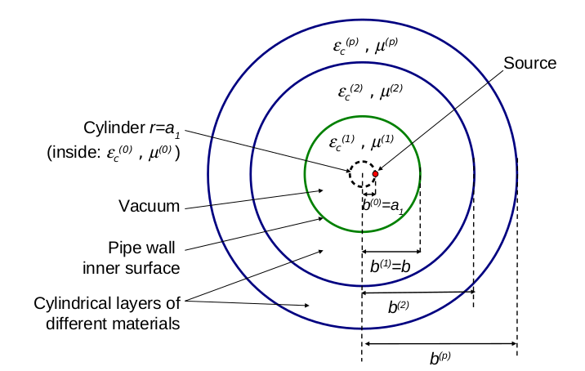
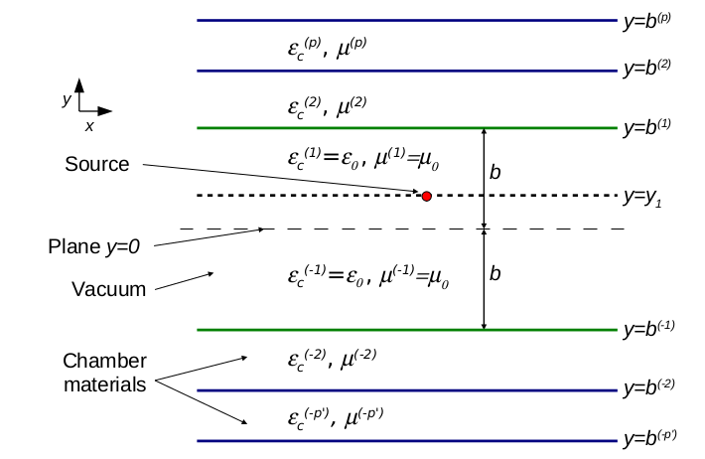
ImpedanceWake2D
Written by N.Mounet (originated from ReWall).
Sometimes referred to as IW2D, or ImpedWake2D.
Electromagnetic (EM) code aimed to calculate beam coupling impedance for azimuthally symmetric or flat multilayered infinitely long structures.
The code is based on the Field Matching techniques: EM continuity relations are applied at the layers boundaries.

Slide 3
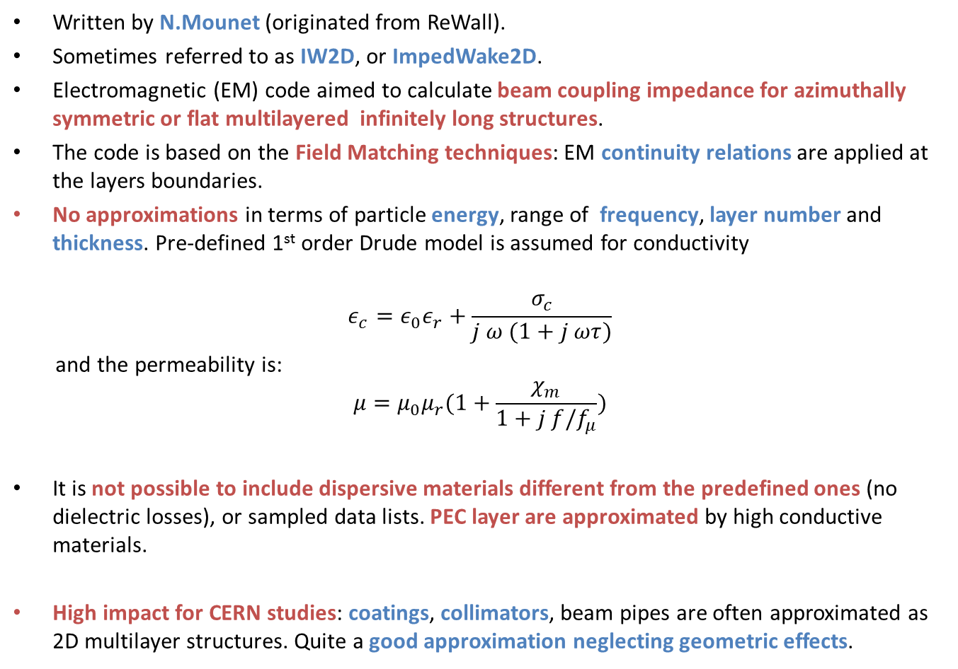
ImpedanceWake2D
Written by N.Mounet (originated from ReWall).
Sometimes referred to as IW2D, or ImpedWake2D.
Electromagnetic (EM) code aimed to calculate beam coupling impedance for azimuthally symmetric or flat multilayered infinitely long structures.
The code is based on the Field Matching techniques: EM continuity relations are applied at the layers boundaries.
No approximations in terms of particle energy, range of frequency, layer number and thickness. Pre-defined 1st order Drude model is assumed for conductivity
$$ε_{c}=ε_{0}ε_{r}+\frac{σ_{c}}{j ω (1+j ωτ)}$$
and the permeability is:
$$μ=μ_{0}μ_{r}(1+\frac{χ_{m}}{1+j f/f_{μ}})$$
It is not possible to include dispersive materials different from the predefined ones (no dielectric losses), or sampled data lists. PEC layer are approximated by high conductive materials.
High impact for CERN studies: coatings, collimators, beam pipes are often approximated as 2D multilayer structures. Quite a good approximation neglecting geometric effects.

Slide 4
ImpedanceWake2D
Code implemented in C++ (and some parts in C). Handy Python wrapper object oriented (Impedance and layers as class objects)
The Code run on Linux platforms. Prerequisites for the C/C++ core (some already present if on lxplus):
  GMP (http://gmplib.org/),
  MPFR (http://www.mpfr.org/),
  GSL (http://www.gnu.org/software/gsl/),
  ALGLIB (http://www.alglib.net/).
No parallelization implemented.
Typical use for LEIR/PS/LHC/HLLHC/FCC impedance models
LHC example: computed impedance of upto 80 elements between collimators and beam screens with different gaps/radii -> ~80 simulations for 1 machine configuration.
Usually run in parallel on lxbatch -> 30’ time needed (smallest gap / highly lossy materials simulations can take >10’ each, few minutes/seconds otherwise).
Large community of users also out of CERN: GSI, INF-LNF, KEK, etc…

Slide 5
ImpedanceWake2D
Performance is generally adequate to CERN needs right now, and performance ensured with present hardware infrastructure.
For the nearby future, the implementation of general dispersive permittivity/permeability may become important (LESS, amorphous carbon surfaces impedance, etc..)
The code is open source and it is maintained on the CERN IRIS repository hosted on
CERN-GitLab (https://gitlab.cern.ch/IRIS/IW2D): only available for CERN users. Mirrored to GitLab private repo for External users.
No further development is currently taking place on the core C/C++ codes.
Few features have been added on the Python Impedance related libraries.
Documentation is available in the same repository.

Slide 6
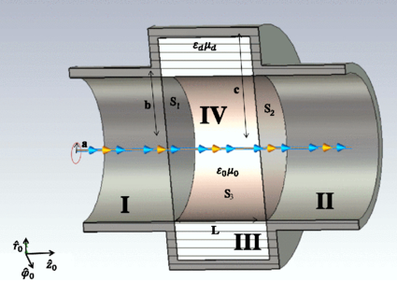
Mode Matching Method
Also reported as MMM.
Code written in Matlab (could be transported easily to Python) for calculation of impedance of a cylindrical cavity loaded with any dispersive material.
It performs a mode matching between the inner cavity volume and the access beam pipes (NB: very different from Field Matching) -> based on the non uniform convergence of the fields at the boundaries (paper)

Slide 7
Mode Matching Method
Also reported as MMM.
Code written in Matlab (could be transported easily to Python) for calculation of impedance of a cylindrical cavity loaded with any dispersive material.
It performs a mode matching between the inner cavity volume and the access beam pipes (NB: very different from Field Matching) -> based on the non uniform convergence of the fields at the boundaries (paper)
Simple structure -> Mainly a benchmark tool (e.g. Ferrite implementation in GdfidL). Still used for quick computations on thin inserts impedance / characterization of very dispersive materials.
The code needs Matlab to be run (not open source) but could be transported easily to Python.
Available on the impedance website: http://impedance.web.cern.ch/impedance/
Prospective of development (still early stage): coupling CST Eigenmode solver to obtain eigenmodes of more general structures -> could obtain accurate impedance function from frequency domain simulations (avoid Wakefield and Fourier transform)

Slide 8
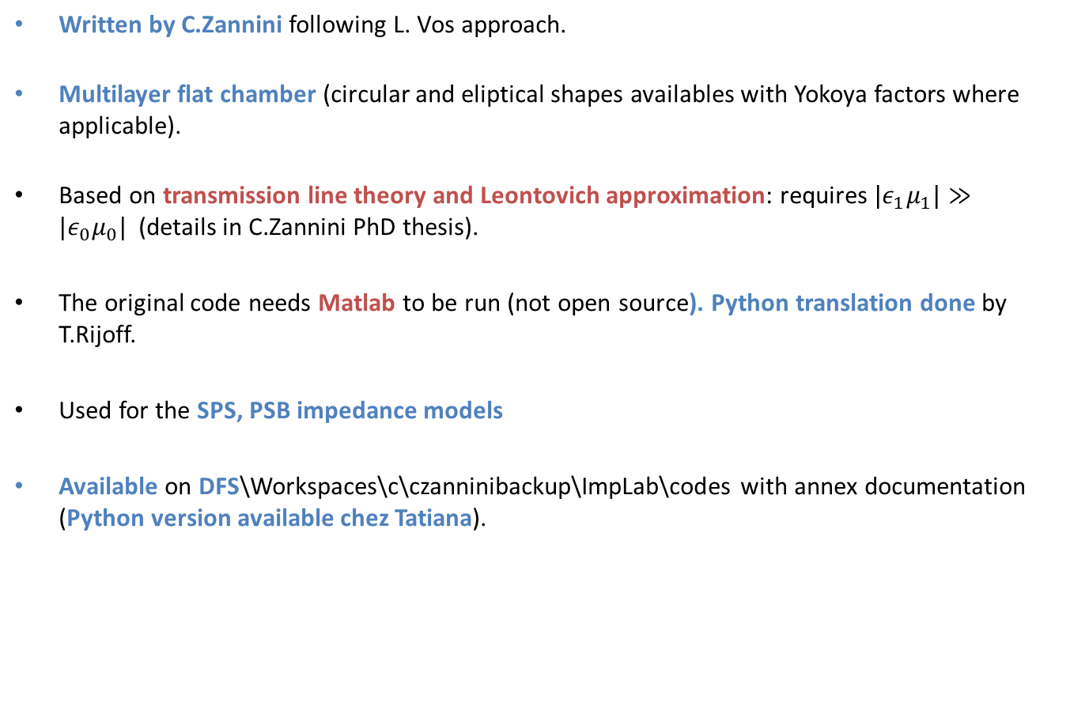
TLwall
Written by C.Zannini following L. Vos approach.
Multilayer flat chamber (circular and eliptical shapes availables with Yokoya factors where applicable).
Based on transmission line theory and Leontovich approximation: requires ${|ε}_{1}μ_{1}|≫{|ε}_{0}μ_{0}|$(details in C.Zannini PhD thesis).
The original code needs Matlab to be run (not open source). Python translation done by T.Rijoff.
Used for the SPS, PSB impedance models
Available on DFS\Workspaces\c\czanninibackup\ImpLab\codes with annex documentation (Python version available chez Tatiana).

Slide 9
Other codes
CIRCAMB (available on DFS\Workspaces\c\czanninibackup\ImpLab\codes with annex documentation)
CMKcab3D (available on DFS\Workspaces\c\czanninibackup\ImpLab\codes with annex documentation)
Interrupted pipe and stripline kicker (available on request to C.Zannini/T.Rijoff)
Kicker as microstrip (available on DFS\Workspaces\c\czanninibackup\ImpLab\codes with annex documentation)
Circular step-out (available on DFS\Workspaces\c\czanninibackup\ImpLab\codes with annex documentation)
Elliptical step (developed by S.Persichelli, being finalized)

