Slide 1
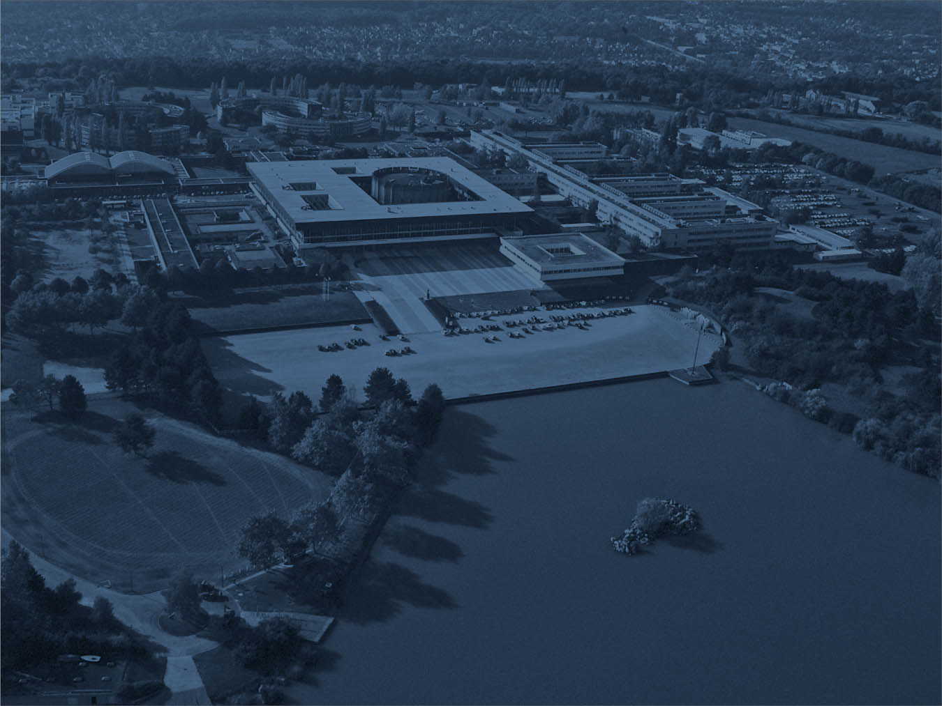


Introducing the grid
Pascale Hennion december 2016
Part 1

Slide 2
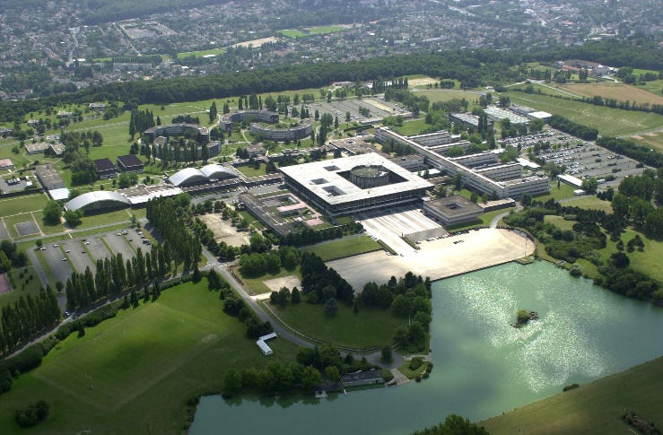

Outline of part 1
  Introducing the grid
    What is it;
    Difference between cluster, cloud and grid
    Hourglass model;
    Examples;
  Introducing WLCG
    LHC computing
    Activity
  WLCG Architecture
    Tiers
    Information system
    Authentication
    Data management
    Jobs workflow
    VO’s applications

Slide 3
Outline of part 1
  Introducing the grid
    What is it;
    Difference between cluster, cloud and grid
    Hourglass model;
    Examples;
  Introducing WLCG
  WLCG Architecture

Slide 4
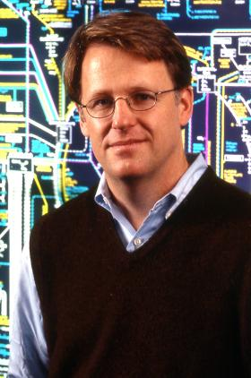
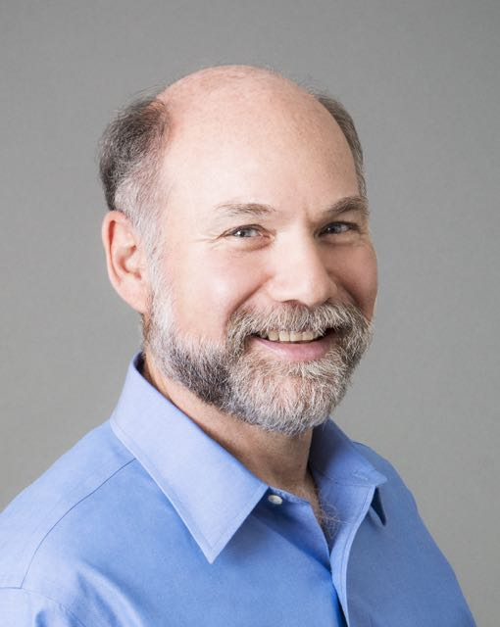
Introducing the GRID
‘‘ The term «The Grid» was coined in the mid-1990s to denote a (then) proposed distributed computing infrastructure for advanced science and engineering. ’’
The Anatomy of the Grid. Ian Foster, Carl Kesselman, Steven Tuecke.
Born during «Building a Computational Grid» workshop at ANL (8-10 Sep 1997)
  http://www.crpc.rice.edu/newsletters/fal97/news_grid.html;
some fundamental texts:
  The Grid: Blueprint for a New Computing Infrastructure. I.F, C.K.
  Grid Services for Distributed System Integration. I.F., C.K., J. Nick, S. Tuecke. Computer, 35(6), 2002.
  The Anatomy of the Grid: Enabling Scalable Virtual Organizations. I.F., C. K.C., S. Tuecke. International J. Supercomputer Applications
Ian Foster
Carl Kesselman

Slide 5
What is it ?
Coordinated resource sharing in dynamic, multi-institutional virtual organizations (VO’s)
sharing is not only file exchange but rather direct access to computers, software, data, and other resources;
it is, necessarily, highly controlled, with resource providers and consumers defining clearly and carefully just what is shared, who is allowed to share, and the conditions under which sharing occurs.
All of which may vary dynamically;
Virtual Organizations (VO’s)
a group of mutually distrustful participants with varying degrees of prior relationship (perhaps none at all) that want to share resources in order to perform some tasks.

Slide 6
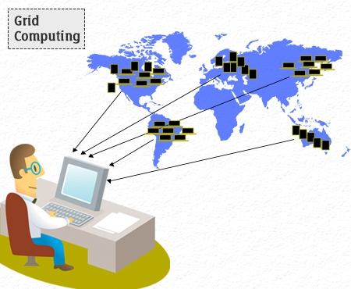
A vision of the grid

Slide 7
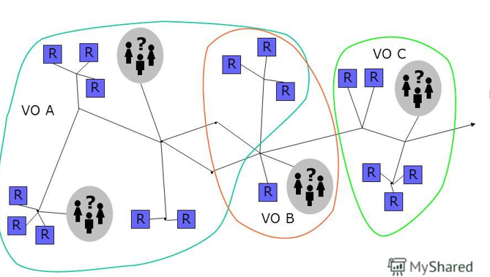
The VO’s
A group of participants that want to share resources
The users of a VO can belong to any site
One user can belong to more than one VO
Each site choose which VO it wants to support

Slide 8
A grid is :
Many sites
  Filled with any kind of servers, for calculation as well as data storage
All the sites connected by a fast network
A few servers/softwares that make the grid work
Tons of users and different applications

Slide 9
To achieve that, we need:
Network
  link together geographily distributed resources and allow then to be used collectively
Software
Standards
  Grid standards for developpers and users
  Mandatory
Coordination and partnerships
  among the different actors of the Grid

Slide 10
Outline of part 1
  Introducing the grid
    What is it;
    Difference between cluster, cloud and grid
    Hourglass model;
    Examples;
  Introducing WLCG
  WLCG Architecture

Slide 11
Clusters and Super Calculator
A cluster is :
  A bunch of computers in a single location
  All identical
  Connected by a low latency network (Infiniband)
  For parallel jobs
  MPI (message passing interface) to pass informations between process
  Expensive ( IB => 30% extra cost)
Supercalculator = huge cluster
In HEP :
  No need for supercalculator’ fast network
    Process each event individually
    No need for communication between jobs
  But can easily use a suprcalculator (Embarrassingly parallel)

Slide 12
Cloud
Recent technology
Both for data and computers
Computer = > virtualisation
2 possibilities for HEP
  Cloud federation
    The user choose the exploitation system, the amount of memory, the number of CPU …
    Possibility to get a VM from any cloud of the federation
  Any computer of the grid can be a virtual machine
    A small amount of CPU is lost because of virtualisation
Tests ongoing to use commercial cloud for HEP computing

Slide 13
Grid not dead
Grid users like it:
    HEP tuned
    Cheaper than cloud or clusters
    Practice it for ~10 years
    Strong authentication
But it has limitations:
    Very few different exploitation system
    2Gb memory/core
    Strong authentication
Future: more data to arrive (higher luminosity) . HEP will have to make use of any available computer time

Slide 14
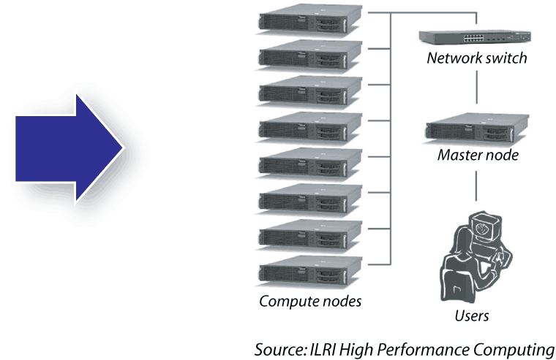

Future ?
HPC cluster

Slide 15
Outline of part 1
  Introducing the grid
    What is it;
    Difference between cluster, cloud and grid
    Hourglass model;
    Examples;
  Introducing WLCG
  WLCG Architecture

Slide 16
Hourglass Model
Wide top: various users applications
Application layer
Thin center: few standards
Middleware layer
Wide bottom: many types of hardwares
Resource layer

Slide 17
Layers
  Application layer : applications in science, engineering, business, finance and more, as well as portals and development toolkits to support the applications.
    This is the layer that grid users "see" and interact with.
  Middleware layer provides the tools that enable the various elements (servers, storage, networks, etc.) to participate in a grid. The middleware layer is sometimes the "brains" behind a computing grid!
  Resource layer: actual grid resources, such as computers, storage systems, electronic data catalogues, that are connected to the network.

Slide 18
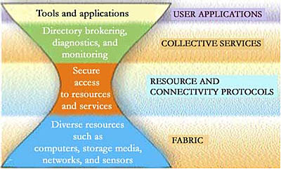
Hourglass Model

Slide 19
Outline of part 1
  Introducing the grid
    What is it;
    Difference between cluster, cloud and grid
    Hourglass model;
    Examples;
  Introducing WLCG
  WLCG Architecture

Slide 20

Example 1
World Community Grid enables anyone with a computer, smartphone or tablet to donate their unused computing power to advance cutting-edge scientific research on topics related to health, poverty and sustainability. Through the contributions of over 650,000 individuals and 460 organizations, World Community Grid has supported 25 research projects to date, including searches for more effective treatments for cancer, HIV/AIDS and neglected tropical diseases. Other projects are looking for low-cost water filtration systems and new materials for capturing solar energy efficiently.
…
Started in 2004, World Community Grid is a philanthropic initiative of IBM Corporate Citizenship, the corporate social responsibility and philanthropy division of IBM. Through Corporate Citizenship, IBM donates its technology and talent to address some of the world's most pressing social and environmental issues.
http://www.worldcommunitygrid.org

Slide 21


Example 2
The Open Science Grid Consortium is an organization that administers a worldwide grid of technological resources called the Open Science Grid, which facilitates distributed computing for scientific research. Founded in 2004, the consortium is composed of service and resource providers, researchers from universities and national laboratories, as well as computing centers across the United States. Members independently own and manage the resources which make up the distributed facility, and consortium agreements provide the framework for technological and organizational integration.
…
The OSG facilitates access to distributed high throughput computing for research in the US. The resources accessible through the OSG are contributed by the community, organized by the OSG, and governed by the OSG consortium. In the last 12 months, we have provided more than 800 million CPU hours to researchers across a wide variety of projects.
…
http://www.opensciencegrid.org

Slide 22

Example 3
European Grid Initiative (EGI)
EGI is a federation of computing and storage resource providers united by a mission to support research and development. The federation is governed by the participants represented in the EGI Council and coordinated by the EGI Foundation.
The EGI federated e-infrastructure is publicly funded and provides computing and storage resources to support research and innovation.
https://www.egi.eu/

Slide 23
Egypt T3
EG-ZC-T3 – AfricaArabia is one of EGI Tier3 data center ( Zewail city)
    UI.
    CE
    TORQUE server (pbs)
    2 Physical WN + 2 virtual WNs.
    DPM_MYSQL and DPM_DISK on one machine.
    SQUID-server
    8 TB separate storage server (nfs)
BU : Tier3 working, not EMI register yet
Other T3 and T2 under construction

Slide 24

    European Middleware Initiative
The European Middleware Initiative (EMI) is a computer software platform for high performance distributed computing. It is developed and distributed directly by the EMI project. It is the base for other grid middleware distributions used by scientific research communities and distributed computing infrastructures all over the world especially in Europe, South America and Asia. EMI supports broad scientific experiments and initiatives, such as the Worldwide LHC Computing Grid (for the Large Hadron Collider).
The EMI middleware is a cooperation among three general purpose grid platforms, the Advanced Resource Connector, gLite and UNICORE and the dCache storage software.
…
EMI improves the existing middleware services and harmonizes them, realizing a common framework with the result of rendering the middleware to be simpler and easier to use, reducing at the same time the interoperability problems faced by the distributed computing infrastructure providers. Thanks to EMI, it was possible to get the results in a previously unthinkable time and to contribute to the discovery of one of the most ‘wanted’ particles: a Higgs boson.
http://www.eu-emi.eu

Slide 25
Outline of part 1
  Introducing the grid
  Introducing WLCG
    LHC computing
    Activity
  WLCG Architecture

Slide 26

Introducing WLCG.
The Worldwide LHC Computing Grid (WLCG) is a global computing infrastructure whose mission is to provide computing resources to store, distribute and analyze the data generated by the Large Hadron Collider (LHC), making the data equally available to all partners, regardless of their physical location.
WLCG is the world's largest computing grid. It is supported by many associated national and international grids across the world, such as European Grid Initiative (Europe-based) and Open Science Grid (US-based), as well as many other regional grids.
WLCG is co-ordinated by CERN. It is managed and operated by a worldwide collaboration between the experiments (ALICE, ATLAS, CMS and LHCb) and the participating computer centers. It is reviewed by a board of delegates from partner country funding agencies, and scientifically reviewed by the LHC Experiments Committee.
http://wlcg.web.cern.ch/

Slide 27
LHC (CMS) computing.
Data pours out of the LHC detectors at a blistering rate. Even after filtering out 99% of it, there is still around 30 petabytes of data per year to deal with. That's 30 million gigabytes, the equivalent to nearly 9 million high-definition (HD) movies.
The scale and complexity of data from the LHC is unprecedented. This data needs to be stored, easily retrieved and analyzed by physicists all over the world. This requires massive storage facilities, global networking, immense computing power, and, of course, funding.
CERN does not have the computing or financial resources to crunch all of the data on site, so in 2002 it turned to grid computing to share the burden with computer centres around the world.
The result, the Worldwide LHC Computing Grid (WLCG), is a distributed computing infrastructure arranged in tiers – giving a community of over 10,000 physicists near real-time access to LHC data. The WLCG builds on the ideas of grid technology initially proposed in 1999 by Ian Foster and Carl Kesselman (link is external).
http://wlcg-public.web.cern.ch/about

Slide 28
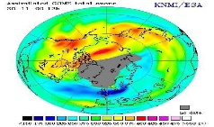
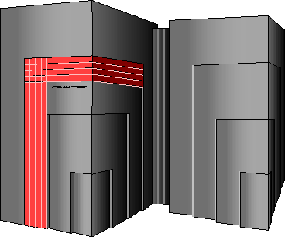
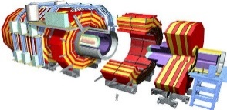

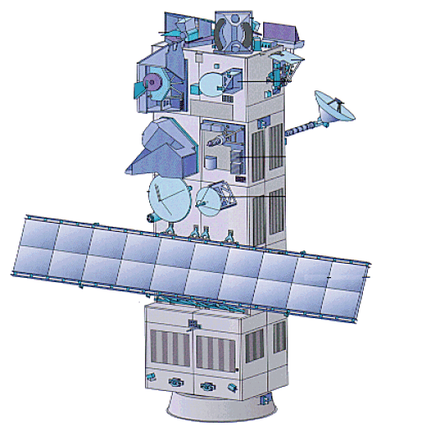
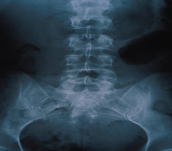
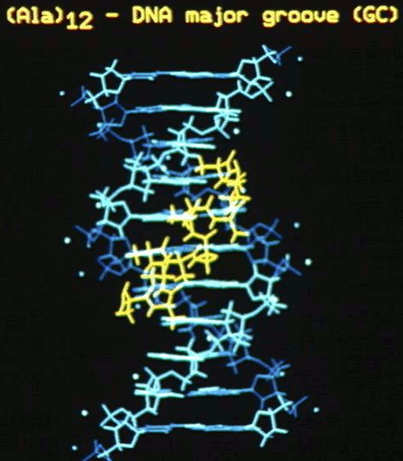
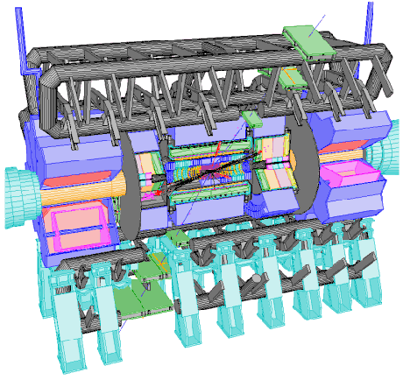
The characteristics of WLCG
Hardware
  Off the shelf
  Inexpensive
  Many hardware varieties and suppliers
Available ressources vary in time
Grid is open to other communities

Slide 29
A few numbers
the world's largest computing grid
553 611 cores
2 000 000 jobs/day
300 Petabytes of online disk storage and 230PB of nearline (magnetic tape) storage.
~50 Petabytes of data expected in 2016
funding is ~$100M/year

Slide 30
Outline of part 1
  Introducing the grid
  Introducing WLCG
    LHC computing
    Activity
  WLCG Architecture

Slide 31
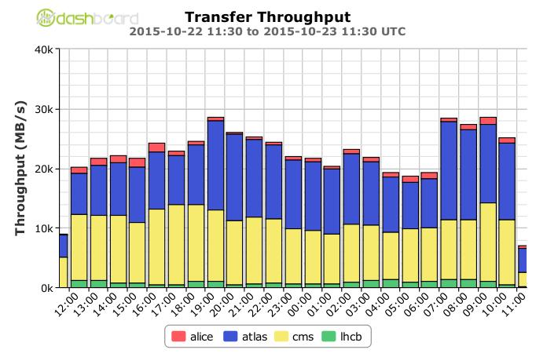
WLCG activity 2015
40000 MB/S
One day period in october 2015

Slide 32
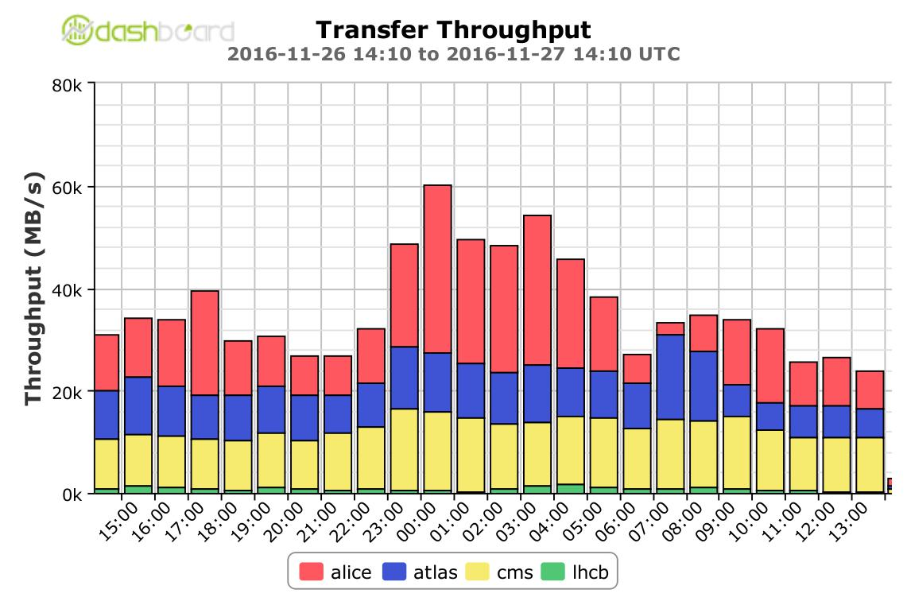

WLCG activity 2016.
80000 MB/S
One day period in november 2016

Slide 33
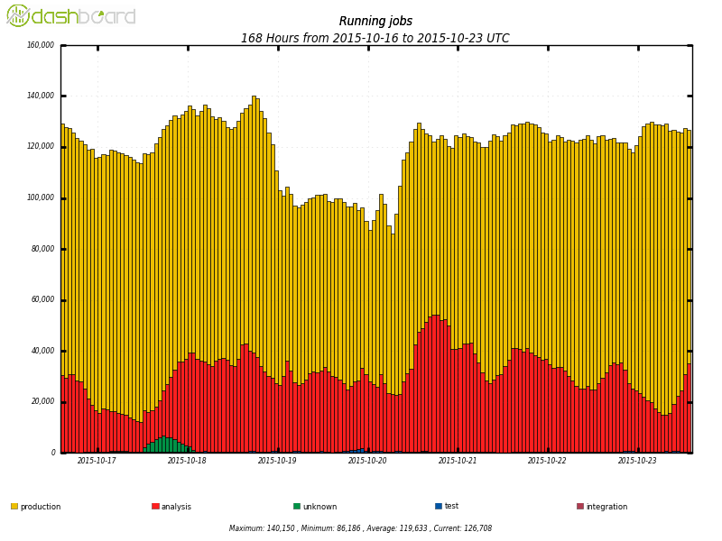
CMS activity in oct 2015
160 000 running jobs
One week period in october 2015
production
analysis
unknown

Slide 34
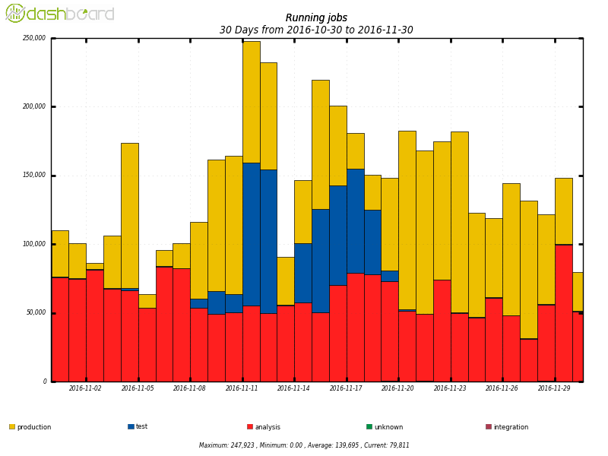
CMS activity in nov 2016
250 000 running jobs
One week period in november 2016
production
analysis
test

Slide 35
Outline of part 1
  Introducing the grid
  Introducing WLCG
  WLCG Architecture
    Tiers
    Information system
    Authentication
    Data management
    Jobs workflow
    VO’s applications

Slide 36
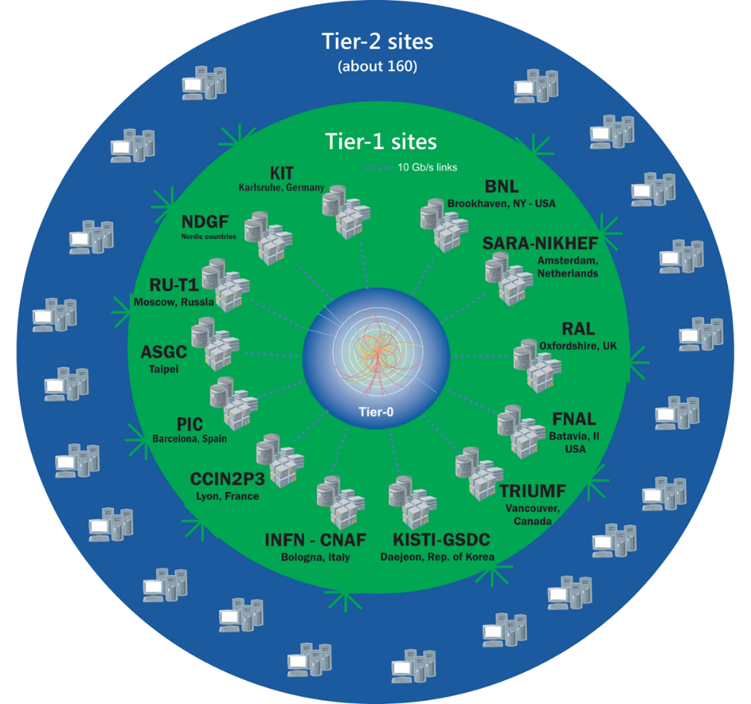
WLCG sites - Tier-0
Tier-0
This is the CERN Data Centre, which is located in Geneva, Switzerland and also at the Wigner Research Centre for Physics in Budapest, Hungary over 1200km away. The two sites are connected by two dedicated 100 Gbit/s data links. All data from the LHC passes through the central CERN hub, but CERN provides less than 20% of the total compute capacity.
Tier 0 is responsible for the safe-keeping of the raw data (first copy), first pass reconstruction, distribution of raw data and reconstruction output to the Tier 1s, and reprocessing of data during LHC down-times.
http://wlcg-public.web.cern.ch/tier-centres

Slide 37
WLCG sites - Tier-1’s
Tier-1’s
These are thirteen large computer centres with sufficient storage capacity and with round-the-clock support for the Grid. They are responsible for the safe-keeping of a proportional share of raw and reconstructed data, large-scale reprocessing and safe-keeping of corresponding output, distribution of data to Tier 2s and safe-keeping of a share of simulated data produced at these Tier 2s.
http://wlcg-public.web.cern.ch/tier-centres

Slide 38
WLCG sites - Tier-2’s
Tier-2’s
The Tier 2s are typically universities and other scientific institutes, which can store sufficient data and provide adequate computing power for specific analysis tasks. They handle analysis requirements and proportional share of simulated event production and reconstruction.
There are currently around 160 Tier 2 sites covering most of the globe.
http://wlcg-public.web.cern.ch/tier-centres

Slide 39
WLCG sites – Tier-3’s
Tier-3’s
Individual scientists will access these facilities through local (also sometimes referred to as Tier 3) computing resources, which can consist of local clusters in a University Department or even just an individual PC. There is no formal engagement between WLCG and Tier 3 resources.
http://wlcg-public.web.cern.ch/tier-centres

Slide 40
Outline of part 1
  Introducing the grid
  Introducing WLCG
  WLCG Architecture
    Tiers
    Information system
    Authentication
    Data management
    Jobs workflow
    VO’s applications

Slide 41
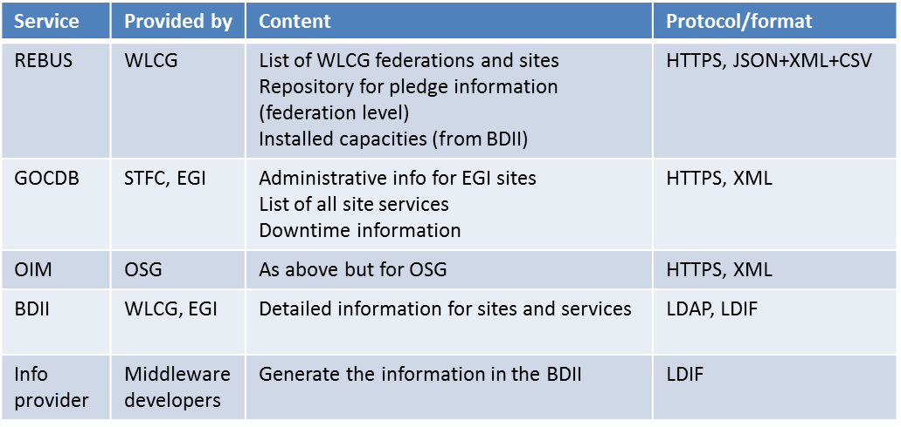
Information system.
Collective
Resource

Slide 42
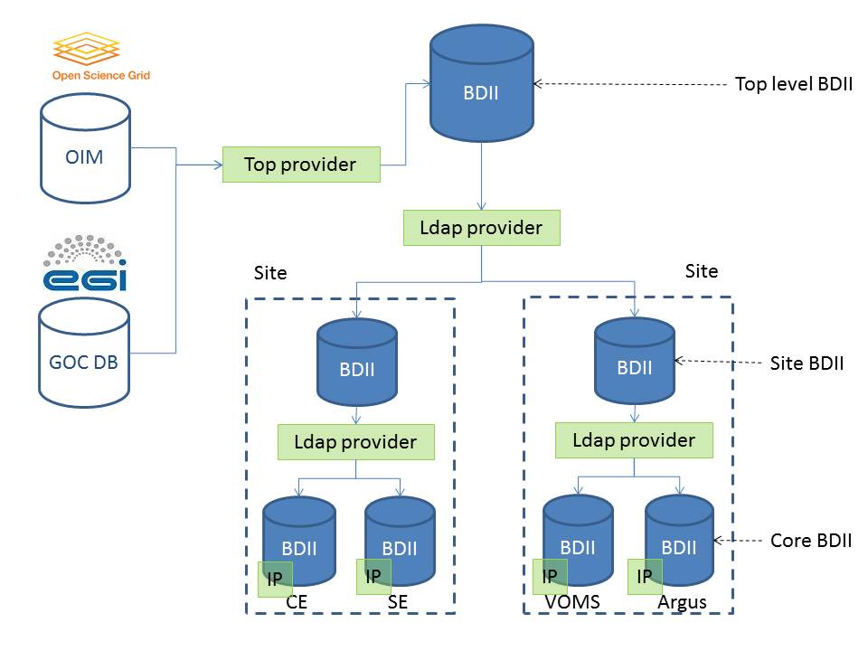
Information system.

Slide 43
Outline of part 1
  Introducing the grid
  Introducing WLCG
  WLCG Architecture
    Tiers
    Information system
    Authentication
    Data management
    Jobs workflow
    VO’s applications

Slide 44
Certificates
A user certificate is a text file with encrypted data that you install on your PC so that you can secure/encrypt sensitive communications between your site and the grid.
grid credentials:
  digital certificate and private key
  Based on Public Key Infrastructure (PKI). X.509 standard
  Certification Authority (CA) signs certificates. Trust relationship

Slide 45
Proxy
Each grid service requires a valid certificate.
The user certificate, whose private key is protected by a password, cannot be used to access these services;
-> user has to create a Proxy
Proxy :
  temporary certificate without password.
Proxy = proof of identity -> short lifetime (typically 12 hours) to reduce security risks should it be stolen

Slide 46
VO
(Just in case you have forgotten ;=)
Virtual Organizations (VO’s)
a group of mutually distrustful participants with varying degrees of prior relationship (perhaps none at all) that want to share resources in order to perform some tasks.
For instance there is a VO called CMS, but a VO can have any name

Slide 47
Virtual Organization Membership Service (VOMS)
EGEE/gLite enhancement for VO management
Provides information on user's relationship with Virtual Organization
  Membership
  Group membership
  Roles of user
Multiple VO
  User can register to multiple VOs and create an aggregate proxy
  Access ressources in every registered VO
Backward compatibility
  Extra VO related information in users proxy certificate
  Users proxy can still be used with non VOMS-aware services

Slide 48



Authentication.
personal cert
Certification Authority
voms server
VO users DB
identity
VO, roles...
temporary proxy cert.
The service receives the proxy, verifies CA and voms signaures and give access to the user (or user’s job/request).
VOMS pkey
CA pkey
Grid service

Slide 49
Outline of part 1
  Introducing the grid
  Introducing WLCG
  WLCG Architecture
    Tiers
    Information system
    Authentication
    Data management
    Jobs workflow
    VO’s applications

Slide 50
Data
User and programs produce and require data
  data can be send from/to jobs, but
    Input/Output Sandboxes are limited to 10 MB
    Data has to be copied from/to local filesystems to the Grid
Solution
  Storing data in Grid datasets
    Located in Storage Elements (SE)
    Several replicas of one file in different sites
    Accessible by Grid users and applications from “everywhere”
    data requirements in the job description (jdl)

Slide 51
Data ressource
Each VO manages its own files
via a file catalog
The File Catalog (or Replica Catalog) maps between the Logical File Name and the Storage URL (or URLs) for files managed by the Grid
lcg-util for operations on the files

Slide 52
Files names:
the GridUniqueIDentiﬁer(GUID) identiﬁes a ﬁle uniquely
the LogicalFileName(LFN) is a human-readable name for a ﬁle
the Storage URL (SURL), also known as Physical File Name (PFN), identiﬁes a replica in a SE (storage element)
the Transport URL (TURL), is a valid URI with the necessary information to access a ﬁle in a SE

Slide 53
Files catalog (LFC):
Maintains mappings between LFN(s), GUID and SURL(s)
a Grid ﬁle must be both physically present in a SE and registered in a ﬁle catalogue
LFC attaches to a ﬁle or directory an access control list (ACL), a list of permissions which specify who is allowed to access or modify it
            LFN : LogicalFileName
            GUID : GridUniqueIDentiﬁer
            SURL: Storage URL = PFN : Physical File

Slide 54


Storage Resource Manager (SRM)
user
VO
SRM based storage:
  SRM the middleware over the different storage technologies;
  serves metadata and redirects data request to other services: gFTP, (gsi)http, xrootd;
  (gsi)http, xrootd and gridFTP are middleware services over data serving;
SRM
xroot
gFTP
Site
info/requests
(Resource Layer)
data
GFAL

Slide 55

Data management.
To ease notation, from now on…
SRM
xroot
gFTP
SRM
xrootd
xroot

Slide 56



File transfert workflow.
VO2
VO1
File Transfer Service:
  manages site to site transfers at file level;
  the user submits a file request to the FTS queue and FTS deals with the SRMs to perform it;
File Transfer Service
SRM
SRM
info/requests
SiteA
SiteB
data
transf. req.

Slide 57


File transfert workflow.
VO2
VO1
Xrootd federations
  global (read) access to files via a hierarchy of redirectors;
  integrated in root and in the exp’s software;
  soon http and gsiftp federations as well.
Xrootd redirs
xrootd
xrootd
SiteA
SiteB
data
request

Slide 58
Outline of part 1
  Introducing the grid
  Introducing WLCG
  WLCG Architecture
    Tiers
    Information system
    Authentication
    Data management
    Jobs workflow
    VO’s applications

Slide 59

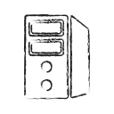
Computing Element (CE)
user
VO
Computing Element (CE):
  middleware layer on top of a local batch system;
  standard protocol for different batch technologies;
  deals with authentication and authorization, map the grid user to local group;
  local batch system implements shares and priorities.
job
CE
Local batch system
Site

Slide 60
To ease notation:
To ease notation, from now on…
CE
CE
Local batch system

Slide 61
Grid jobs workflow (Push mode)
VO2
VO1
(Run-1)
Push mode:
  WMS does match-making;
  local sites scheduling does fine grained (intra-VO) policies: not optimal for manage complex policies;
  users jobs run directly on the nodes: non optimal slots usage time.
Workload Management System/Resource Broker
CE
CE
SiteA
SiteB

Slide 62
Workload management System (WMS)
If the jobs do not specifie where it must be run, it is sent to a WMS (Workload Management System )
The WMS selects the site where the job will be run.
  The site has to match the job requirements
  jobs must be executed as fast as possible
  jobs must be evenly and efficiently distributed across the entire Grid.
The WMS interacts with the Data Management service and the Information System
  They supply all the information required for jobs dispatching

Slide 63

Grid jobs workflow (Pull mode)
VO2
(Run-2)
VO1
Pilots Factories
(Run-1)
Pull mode:
  pilot factory does match-making and fine-grained (intra-VO) scheduling;
  submits pilot agents to the site. Local scheduling for coarse grained policies;
  pilots pull users jobs from the pilot factory: usage time optimized.
pilot
pilots
CE
CE
SiteA
SiteB

Slide 64
Outline of part 1
  Introducing the grid
  Introducing WLCG
  WLCG Architecture
    Tiers
    Information system
    Authentication
    Data management
    Jobs workflow
    VO’s applications

Slide 65



VO (CMS) applications.
SiteDB: CMS specific informations about sites, people and resources.
DBS, TMDB and DAS: informations about data: location of replicas, organisation in datasets/fileblocks, physics related info (Run, lumi, etc.).
PhEDEx: site to site data transfers at dataset/fileblock level, tracking of sites occupation.
CRAB: user tool for performing analysis on grid. Connects grid submission to CMS specific data management (DBS/TMDB) and site’s info (SiteDB).

Slide 66

Questions?

Slide 67
Files names:
the GridUniqueIDentiﬁer(GUID) identiﬁes a ﬁle uniquely, is of the form:
  guid:38ed3f60-c402-11d7-a6b0-f53ee5a37e1d
the LogicalFileName(LFN) is a human-readable name for a ﬁle, has this format: lfn:/grid/<vo>/<directory>/<file>
the Storage URL (SURL), also known as Physical File Name (PFN), which identiﬁes a replica in a SE, is of the general form:
  srm://srm.cern.ch:8443/srm/managerv2?SFN=castor/cern.ch/dteam/file
• the Transport URL (TURL), which is a valid URI with the necessary information to access a ﬁle in a SE, has the following form:
  <protocol>://<some_string>
  gsiftp://tbed0101.cern.ch/data/dteam/doe/file1
  root://$STAGE_HOST//castor/cern.ch/compass/data/2006/oracle_

