Slide 1
Gravitation and Cosmology I
Introduction to Cosmology
Adel Awad
Centre for Theoretical Physics
British University

Slide 2
Content
  Observed Universe
  General Relativity and Cosmology
  Cosmological Eras
  Dark matter
  Dark energy
  Particle Physics and Cosmology

Slide 3
Observed Universe

Slide 4
I- Observed Universe
Features of the observed Universe:
Homogeneous and isotropic on large scales ( >100 Mpc)
Expanding (Hubble’s Law)
Hotter in the past (CMB)
Matter-antimatter asymmetry
Accelerating (we live in an accelerating era)
Possibly it has a vanishing or small spatial curvature (k ~ 0)
Energy-matter budget now is:
  Nonrelativistic matter ~ 26% = 23% (dark matter) + 4% (baryonic matter)
  Dark energy ~ 73%
Cosmological Data are consistent with ΛCDM model

Slide 5
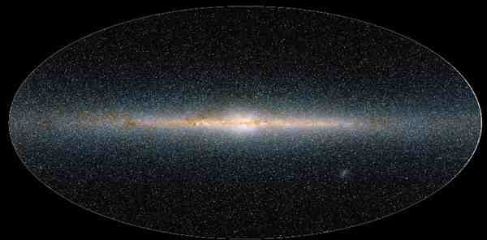
Isotropic universe at large scales 100 Mpc
I- Observed Universe
Our isotropic and homogenous Universe
Rem : 1 parsec ~ 3.262 light years ~ 3.1×10¹³ km

Slide 6
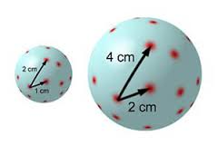
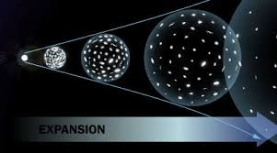
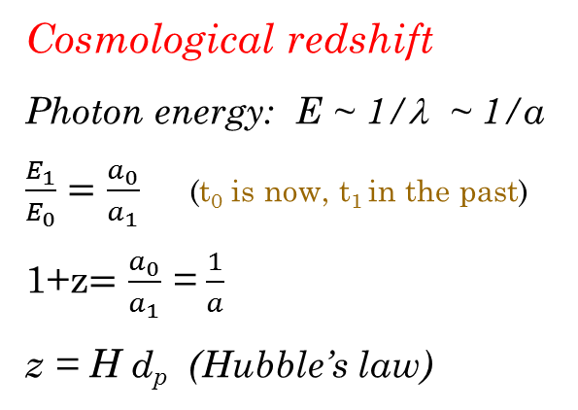
I- Observed Universe
Hubble’s law
small
Cosmological redshift
Photon energy: E ~ 1/λ ~ 1/a
$\frac{E_{1}}{E_{0}}=\frac{a_{0}}{a_{1}}$ (t₀ is now, t₁ in the past)
1+z$=\frac{a_{0}}{a_{1}}$ = $\frac{1}{a}$
z = H d_{p} (Hubble’s law)
d_{p} = a(t) x
d (d_{p} )/dt = da/dt x + a dx/dt
V ≈ H d_{p}

Slide 7
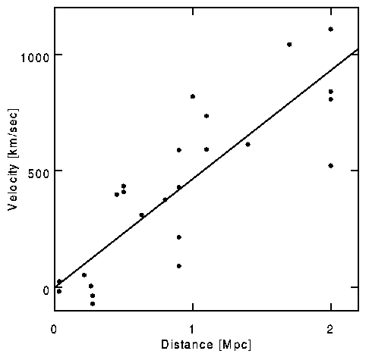
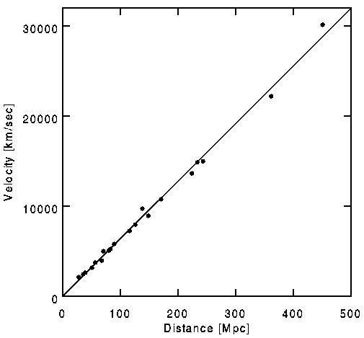
Hubble’s law
I- Observed Universe
Hubble’s law
V = H₀ D
H₀ = 71 ± 4 km/s/Mpc
(Hubble, 1929)
Rem : 1 parsec ~ 3.262 light years ~ 3.1×10¹³ km

Slide 8
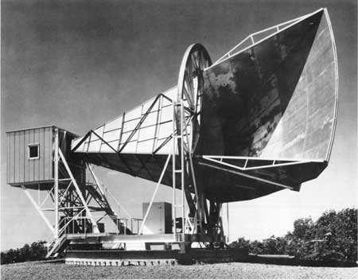
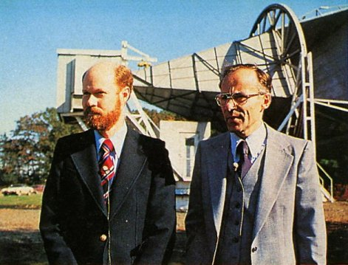
I- Observed Universe
Cosmic Microwave Background (CMB)
First
detection
1965
at 7.35 cm
Penzias & Wilson
Nobel Prize 1978

Slide 9
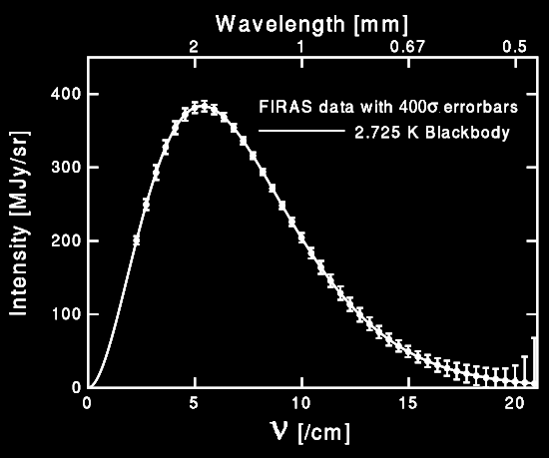
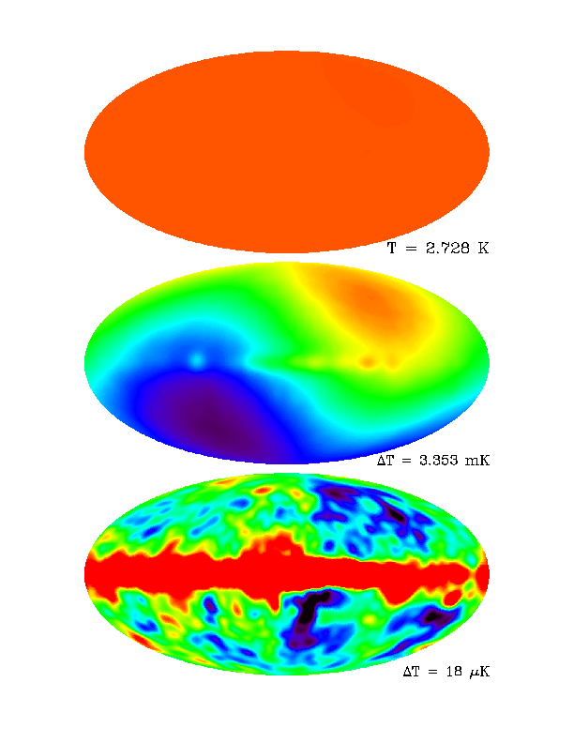
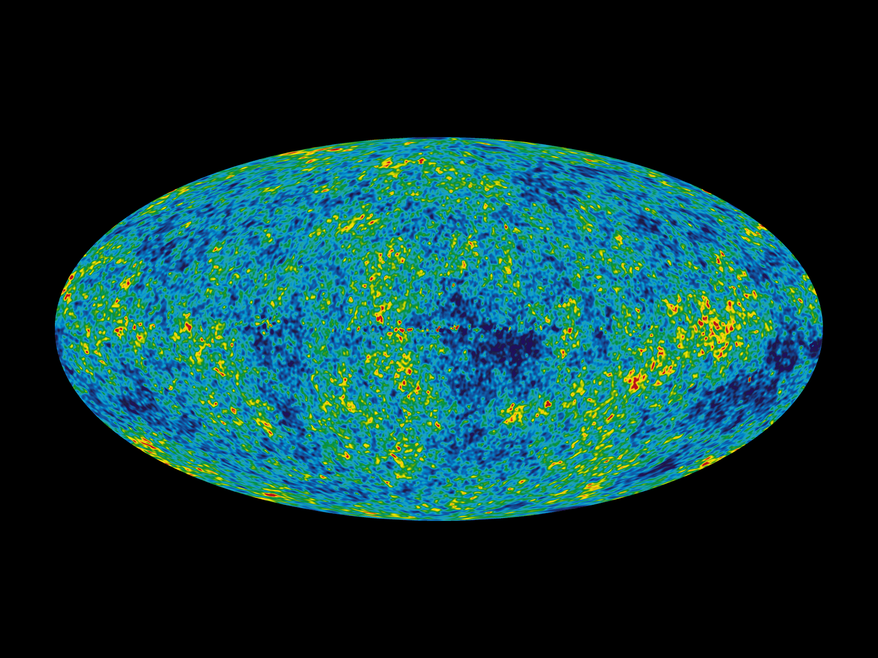
I- Observed Universe
Cosmic Microwave Background (CMB)

Slide 10
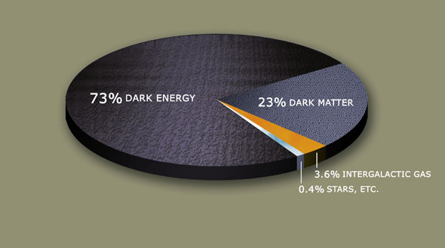
I- Observed Universe
Cosmic Pie
Mass-energy density
Age : 13.7 billion years
Dark energy: energy with unknown physical origin.
Dark matter: matter that interact only gravitationally and weakly;
(not in the Standard Model of Particle Physics)

Slide 11

Three eras:
Radiation Era: P =1/3 ρ $E^{2}$= $p^{2}$+$m^{2}$
Nonrelativistic matter Era: P =0
Vacuum energy Era (cosmological const.) : P = - ρ_{c}

Slide 12
II- General Relativity and Cosmology

Slide 13
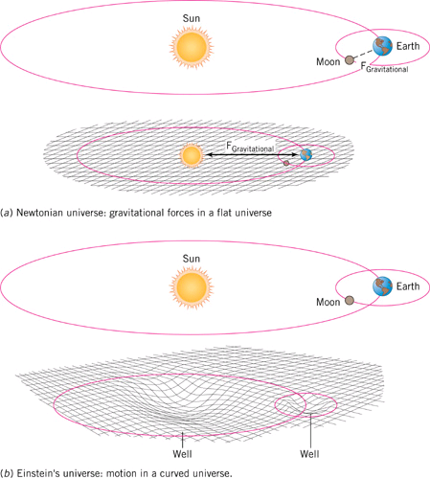
II- General Relativity and Cosmology
i- Gravity and Curved Space
Gravitational mass:
Inertial mass:
Acceleration:
Compare to Coulomb’s accel.
Mass affect the space around it.
- Example: The sun’s mass distorts space in its vicinity, producing curvature
- Planets follow curved paths because of curvature of space.

Slide 14
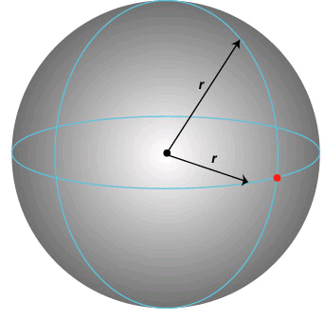
ii- Curvature and Einstein’s Equation
II- General Relativity and Cosmology
The curvature of a sphere of radius r is 1/r².
  curvature is small for large spheres
Einstein proposed that curvature of space-time is proportional to the density of matter.
  Einstein’s equation (roughly):
Einstein Field Equations:
(geometry) R_{μν}- 1/2 g_{μν} R+ Λ g_{μν} = 8πG T_{μν} (matter)
Similar to
∇² φ = 4π ε ρ
The fundamental quantity here is the metric g_{μν}
ds² = g_{μν} dx ^{μ} dx ^{ν}.

Slide 15
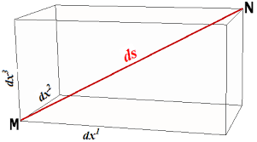
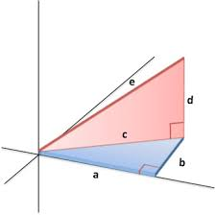

ii- Curvature and Einstein’s Equation
II- General Relativity and Cosmology
The metric g is the fundamental quantity is GR,
it plays the role of the potential in this theory.
In Euclidian space:
ds² = (dx¹)² +(dx²)² +(dx³)²
What if the space was curved like the surface of a sphere,
in this case
ds² ₌ g₁₁ (dx¹)² + g₂₂ (dx²)² + 2 g₂₁ (dx¹dx²)
These g_{ij} are function of the coordinates x¹ and x² in general, for example for the sphere;
ds²= R² dθ² + R² sin (θ)² dφ²
The metric component, g_{μν,} describe the relativistic gravitational field, g₀₀ correspond to the Newtonian potential φ when gravity is weak.
g₀₀ = 1+ c φ

Slide 16
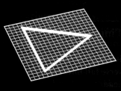
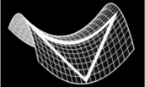
iii- The cosmological principle
II- General Relativity and Cosmology
Universe highly isotropic
Universe highly homogenous
These symmetries are very constraining to the metric, g_{μν} and T_{μν} , it reduces the number of arbitrary functions from 10 to 1.
Isotropy and Homogeneity ⇒ maximally symmetric space
Closed three-sphere S³ (k=1)
Open three-hyperbola H³ (k=-1)
Flat Euclidean space R³ (k=0)
k=1
k= -1
k= 0

Slide 17
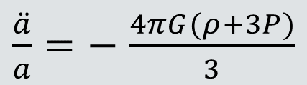
iv- Friedmann Equations
II- General Relativity and Cosmology
Equation that governs expansion of the Universe: or
  a(t), scale factor, X(t) =a(t) x
  ρ, energy density
Cosmic acceleration:
Equation of state (k=0):
  Matter-dominated Universe
  Radiation-dominated Universe
  Vacuum-dominated Universe
  (cosmological const. or dark energy)
$\frac{\ddot{a}}{a}=−$ $\frac{4πG(ρ+3P)}{3}$

Slide 18

iv- Friedmann Equations: Newtonian dynamics
II- General Relativity and Cosmology
It is very pedagogical to try to derive GR Friedmann Equations
using Newtonian gravity.
Consider a homogeneous and isotropic expanding fluid, a mass
element, m, has a time-dependent position, r(t) = a(t) r_{0.}
According to Newtonian gravity the element with mass, m, is affected only by the mass of the sphere with radius r(t), all forces from outside the sphere cancels. If we consider only gravitational force, then the total energy is conserved and we have ,M =4/3π(a r₀)³ρ
E = ½ m ${\dot{r}}^{2}−G \frac{m M}{{r\left(t\right)}^{}}⇒{\dot{a}}^{2}−\frac{8πGa^{2}ρ}{3}$ = $\frac{2E }{m{r_{0}}^{2}}⇒ \frac{{\dot{a}}^{2}}{a^{2}}−\frac{8πGρ}{3}$ = $\frac{k}{a^{2}}$
The gravitational force on a mass m, at a distant r(t) is
m $\ddot{r}$(t)$=−G \frac{m M}{{r\left(t\right)}^{2}} \frac{\overline{r}\left(t\right)}{r\left(t\right)}⇒ \frac{\ddot{a}}{a}=−$ $\frac{4πGρ}{3},$
$ρ →ρ+3P, \frac{\ddot{a}}{a}=−$ $\frac{4πG(ρ+3P)}{3}$

Slide 19
III- Cosmological Eras

Slide 20


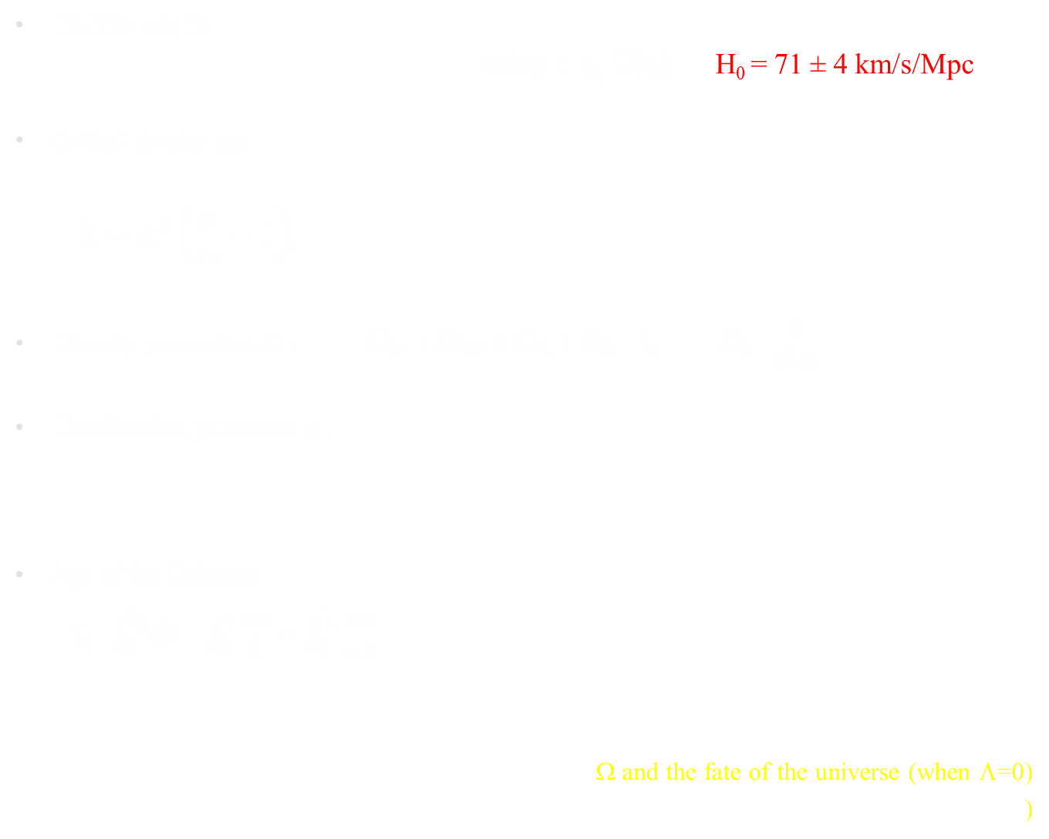
III- Cosmological Eras
Cosmological parameters
Hubble rate H:
                today t=t_{0,} H(t₀) = H₀ = 71 ± 4 km/s/Mpc
Critical density ρ_{c}:
$k={\dot{a}}^{2}\left(\frac{ρ}{ρ_{c}}−1\right)$,
Density parameters Ω : Ω_{m} + Ω_{DE} + Ω_{R} + Ω_{k} =1, Ω_{k} =$\frac{k}{a^{2}ρ_{c}}$
Deceleration parameter q :
Age of the Universe
$\text{t}\text{0}\text{=}\int_{0}^{\text{t}\text{0}}{dt}$=$\int_{0}^{1}{\frac{da}{\dot{a}}}$ $=\int_{0}^{\text{1}}{\frac{da}{a H}}$
Ω and the fate of the universe (when Λ=0)
q = - $\frac{\ddot{a}}{a H^{2}}=−\left(\frac{4π G}{3}\right)\left(\frac{\text{ρ}+3P}{H^{2}}\right)$
H² = $\frac{8π G}{3}$ $\left(ρ_{R}+ρ_{m}+ρ_{DE}\right)$

Slide 21

Friedmann Equations:
III- Cosmological Eras
EoS: p = w ρ, for flat Universe (k=0):
Matter-dominated Universe
Radiation-dominated Universe
Vacuum-dominated Universe
Radiation:
Matter:
Vacuum (Cosm. Const. ):
Age of the Universe
$\text{t}\text{0} \text{=}\int_{0}^{\text{t}\text{0}}{dt}$=$\int_{0}^{1}{\frac{da}{\dot{a}}}$ $=\int_{0}^{\text{1}}{\frac{da}{a H}}$
= $\int_{0}^{\text{1}}{da H_{0}^{−1}a^{\frac{3}{2}\left(w+1\right)−1}}$
= $\frac{2}{3\left(w+1\right)}H_{0}^{−1}$

Slide 22
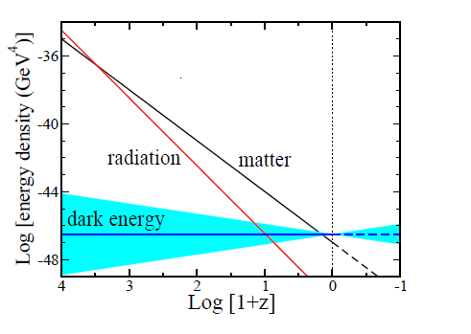
III- Cosmological Eras

Slide 23
IV- Dark Matter

Slide 24
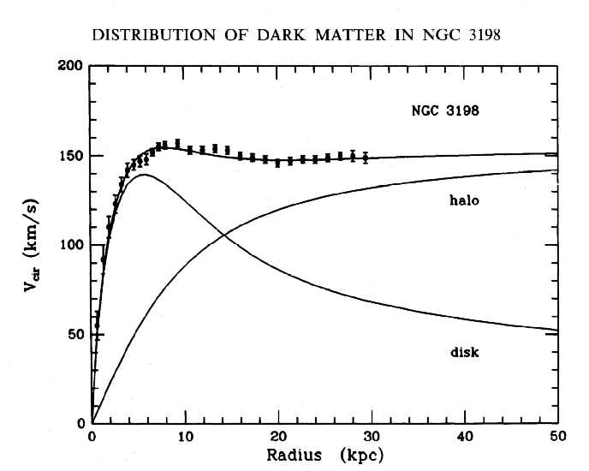
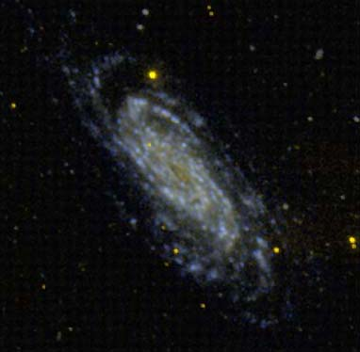

IV- Dark Matter
Galactic Dark Matter
Observe galaxy rotation curve using Doppler shifts
$$v=\sqrt{\frac{GM}{r}}$$

Slide 25
Indirect arguments for Dark Matter
IV- Dark Matter
Spiral galaxies made of bulge + disk: unstable as a self-gravitating system ⇒ need a (near) spherical halo
With only baryons as matter, structure starts forming too late: we won’t exist
Matter-radiation equality too late

Slide 26
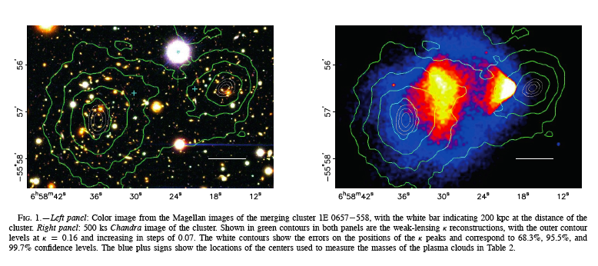
IV- Dark Matter
Bullet Cluster
Optical image of merging clusters (here: 1E 0657-558)
Reconstruct the shear and the convergence (grav. lensing)
Projected density maps
(green contours)
200 kpc
Clowe et al. ApJL 2006
Notes:
26

Slide 27
IV- Dark Matter
Bullet Cluster
X-ray image of the same cluster, 1E 0657-558, by Chandra
Green contours : convergence  (prop. to the projected density)
White contours : peaks of κ at 68.3%, 95.5% and 99.7% C.L.
200 kpc
Clowe et al. ApJL 2006
➔ Presence of non-luminous gravitating mass !
Notes:
27

Slide 28
V- Dark Energy

Slide 29
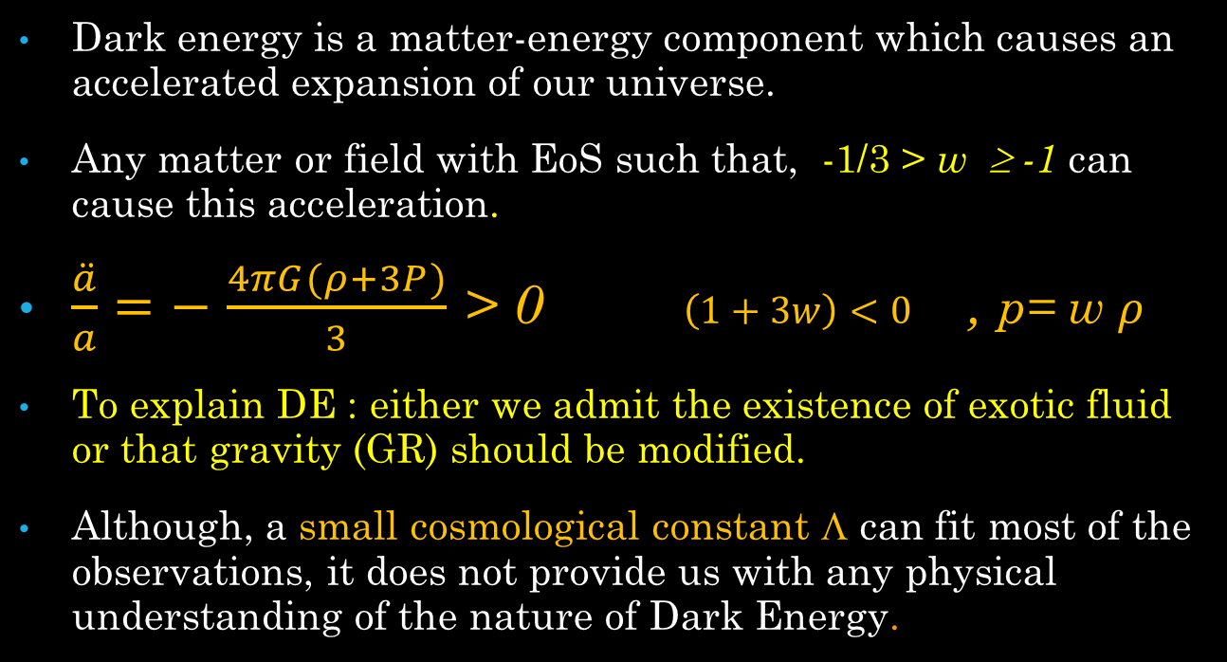
V- Dark Energy
What is dark energy?
Dark energy is a matter-energy component which causes an accelerated expansion of our universe.
Any matter or field with EoS such that, -1/3 > w ≥ -1 can cause this acceleration.
$\frac{\ddot{a}}{a}=−$ $\frac{4πG(ρ+3P)}{3}$ > 0 $\left(1+3w\right)<0$ , p= w $ρ$
To explain DE : either we admit the existence of exotic fluid or that gravity (GR) should be modified.
Although, a small cosmological constant Λ can fit most of the observations, it does not provide us with any physical understanding of the nature of Dark Energy.

Slide 30
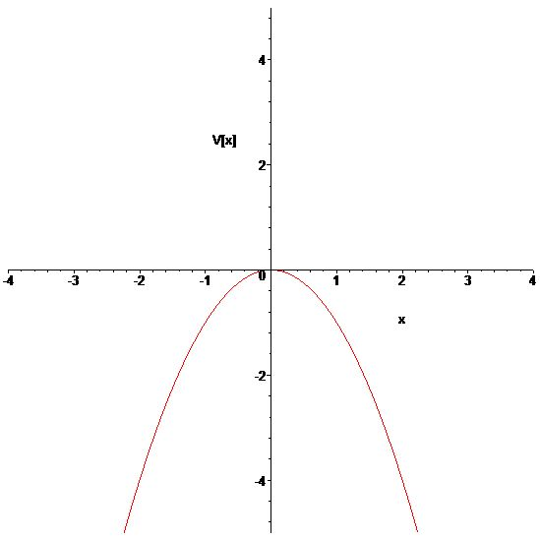

V- Dark Energy
Vacuum Energy:
Since p = - ρ_{c} → dE = ρ_{c} dV (Energy is increasing!!)
Acceleration equation:
$\frac{\ddot{a}}{a}=−$ $\frac{4πG(ρ+3P)}{3}$ = $+$ $\frac{8πG}{3}$ρ_{c}
$\ddot{a}=$ $\frac{8πG}{3}$ρ_{c} a (an inverted oscillator)
This acceleration is derivable from
a potential$\text{V}\text{(}\text{a}\text{) =}−\frac{8πG}{6}\text{ρ}\text{c}{ a}^{2}$
a(t) = a₀ exp ($\sqrt{\frac{8πG}{3} \text{ρ}\text{c}}$ t).

Slide 31
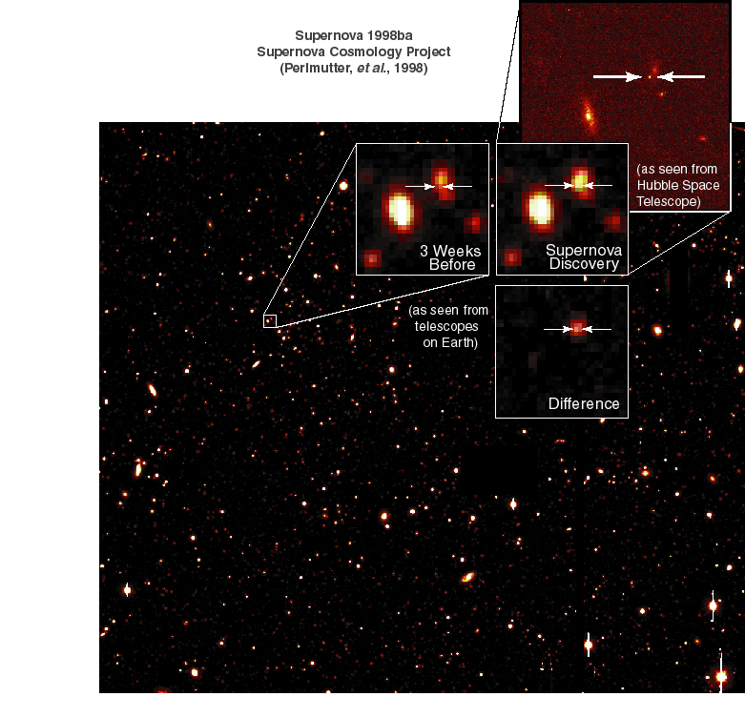
Type-IA Supernovae
V- Dark Energy
Evidence for Dark Energy
As bright as the host galaxy

Slide 32
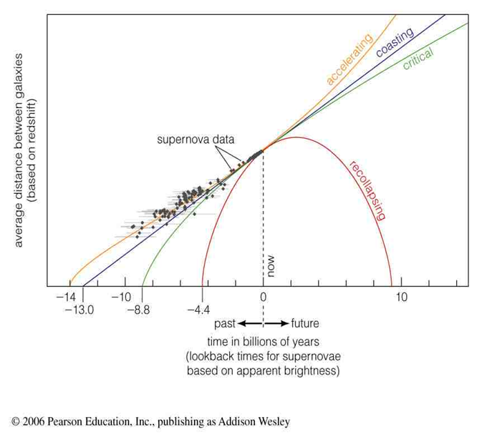
V- Dark Energy
Type-IA Supernovae

Slide 33

Cosmological Acceleration
V- Dark Energy
=$(\frac{Δλ}{λ})$

Slide 34
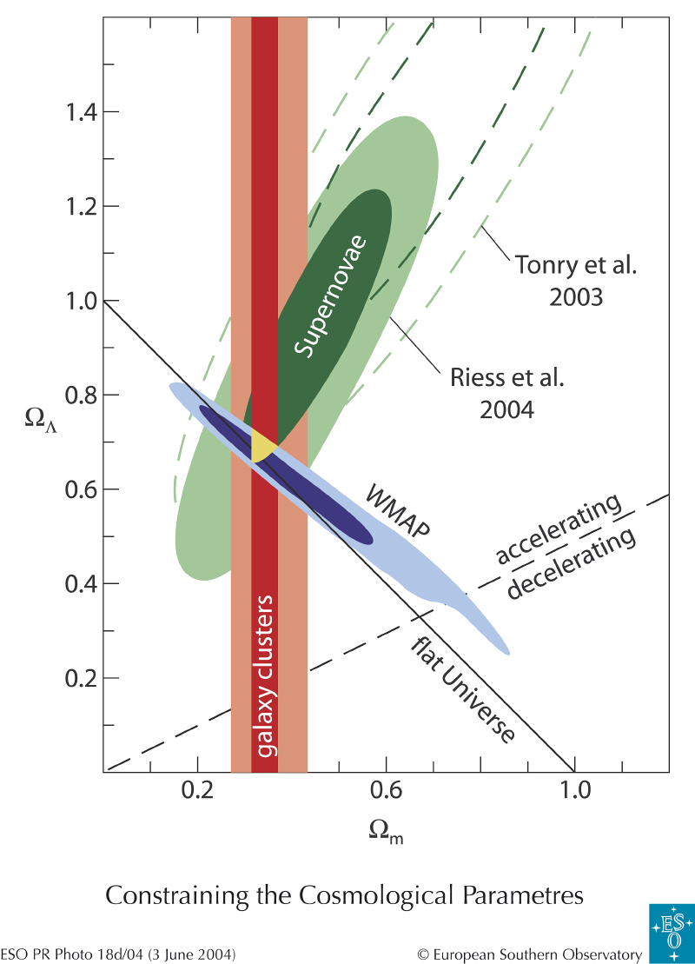
Cosmic Concordance
V- Dark Energy
WMAP: flat Universe
Ω~1
Cluster data etc:
Ω_{matter}~0.3
SNIA:
(Ω_{Λ}–2Ω_{matter})~0.1
Good concordance among three

Slide 35
VI- Particle Physics and
Cosmology

Slide 36
Dark Matter Particle
VI- Particle Physics and Cosmology
Suppose: a particle is the source of Dark Matter
Electroweak scale the correct energy scale!
Stable, TeV scale particle, produced in early Universe, electrically neutral, only weakly interacting
No such candidate in the Standard Model
Supersymmetry: (LSP) Lightest Supersymmetric Particle is a superpartner of a gauge boson in most models: “bino” a perfect candidate for WIMP
But there are many other possibilities (techni-baryons, gravitino, axino, invisible axion, etc)
Can we produce it in LHC?

Slide 37
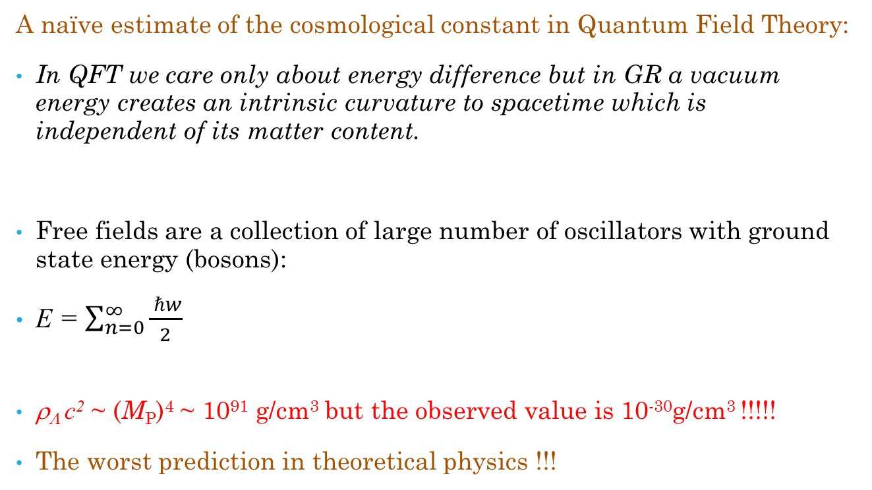
Embarrassment with Dark Energy
VI- Particle Physics and Cosmology
A naïve estimate of the cosmological constant in Quantum Field Theory:
In QFT we care only about energy difference but in GR a vacuum energy creates an intrinsic curvature to spacetime which is independent of its matter content.
Free fields are a collection of large number of oscillators with ground state energy (bosons):
E = $\sum_{n=0}^{∞}{\frac{ ℏw}{2}}$
ρ_{Λ} c² ~ (M_{P})⁴ ~ 10⁹¹ g/cm³ but the observed value is 10⁻³⁰g/cm³ !!!!!
The worst prediction in theoretical physics !!!

Slide 38
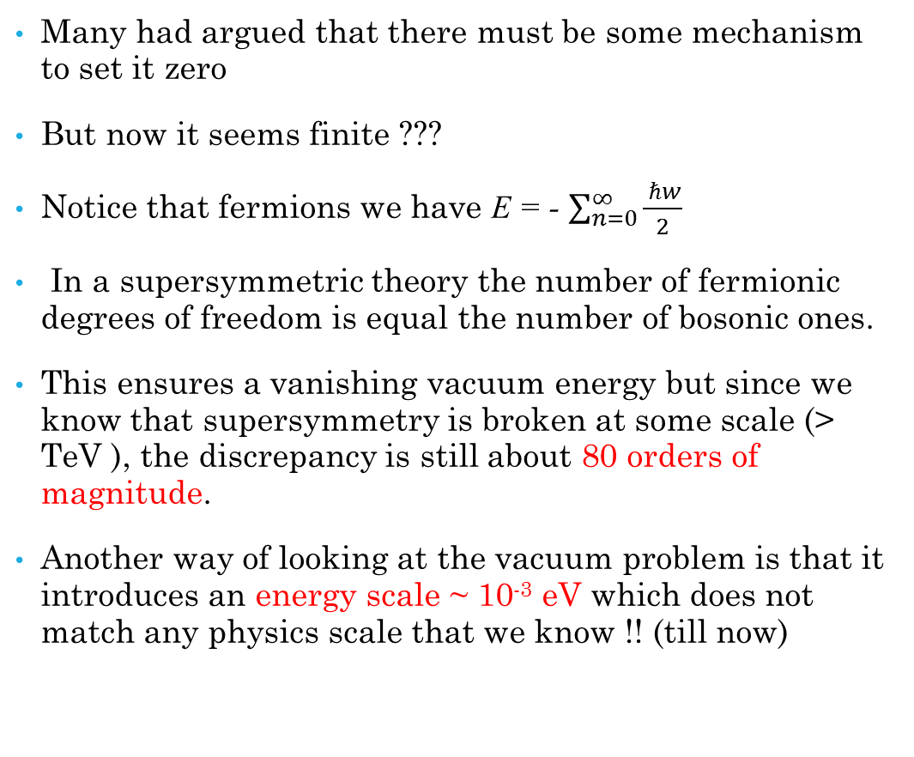
VI- Particle Physics and Cosmology
Many had argued that there must be some mechanism to set it zero
But now it seems finite ???
Notice that fermions we have E = - $\sum_{n=0}^{∞}{\frac{ ℏw}{2}}$
In a supersymmetric theory the number of fermionic degrees of freedom is equal the number of bosonic ones.
This ensures a vanishing vacuum energy but since we know that supersymmetry is broken at some scale (> TeV ), the discrepancy is still about 80 orders of magnitude.
Another way of looking at the vacuum problem is that it introduces an energy scale ~ 10⁻³ eV which does not match any physics scale that we know !! (till now)

Slide 39
Conclusions
Mounting evidence that non-baryonic Dark Matter and Dark Energy exist.
Dark Matter likely to be in a scale > TeV scale.
Our search is on for many Dark Matter particle candidates.
The discovery of Dark Matter and Dark Energy could be an important step towards new frameworks in particle physics and gravity.

Slide 40
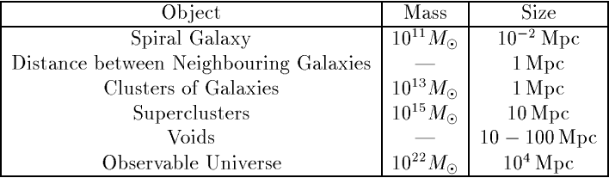
Different scales in our Universe
ly = 9.5 x 10¹⁵ m
1 pc = 3.26 ly

