Slide 1
Physical Cosmology II
Structure Formation and Evolution
Amr El-Zant (CTP@BUE)
Useful refs.
Peacock: Large Scale Surveys and Cosmic Structure (overview of structure form. from Newtonian perspective)
Wayne Hu’s CMB pages: http://background.uchicago.edu/~whu/: Multilevel overview of CMB (nice graphics… used here)
Peacock: Cosmological Physics (comprehensive account; intermediate level)
Doddleson: Modern Cosmology (Relatively advanced treatment of structure formation and associated kinetics in GR)
Daniel Baumann Tripos Lectures http://www.damtp.cam.ac.uk/user/db275/Cosmology.pdf Chap 4 & 5

Slide 2
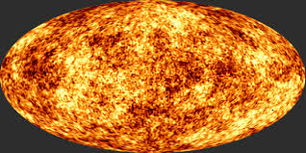
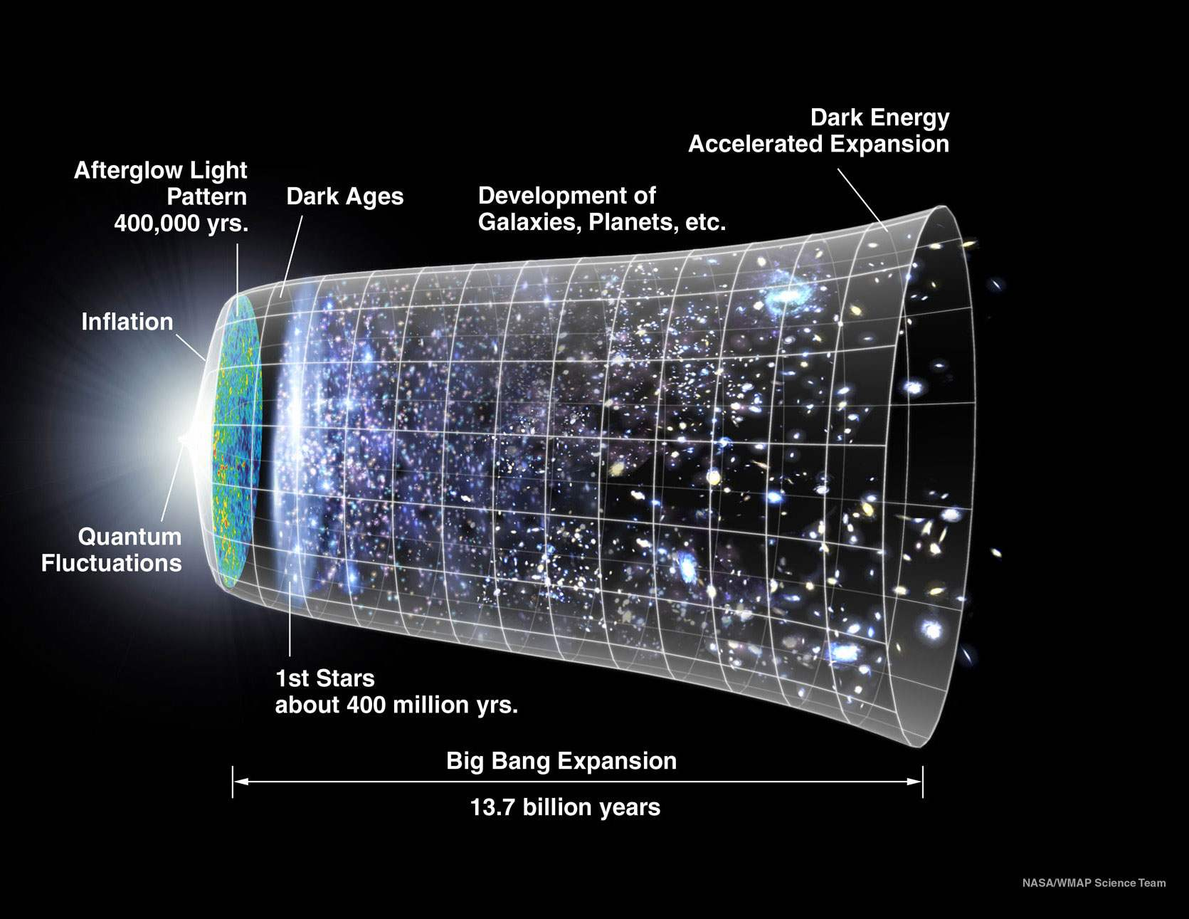
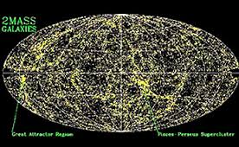
Forming Structure from Fluctuations
** The CMB 300 000 yrs
**Galaxy Distribution (14 Gyr)

Slide 3
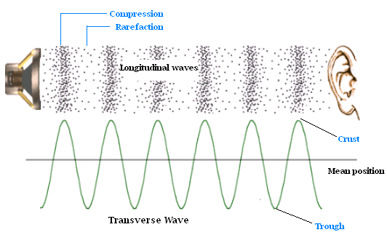
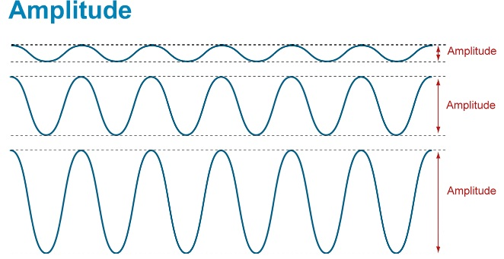
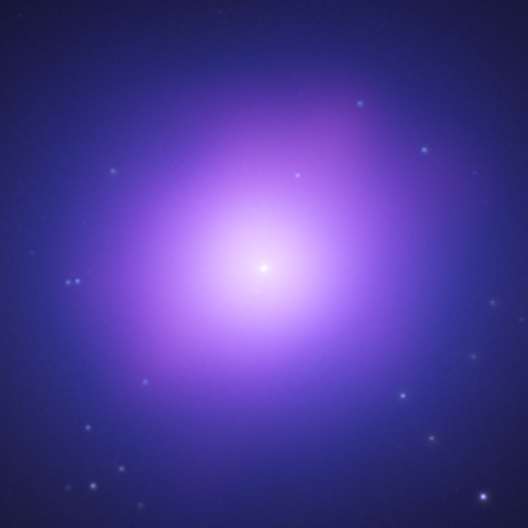
Fundamental Aspect of Gravity : Clustering Instability
Gravity: i) always attractive ii) Long range
I) ‘Normal’ sound wave
Gravity against Pressure
ii) Gravity beats pressure
→ Collapse!

Slide 4
Fluids with Gravity
Mass Conservation (continuity eq.):
Momentum Conservation (Euler eq.):
Poisson Eq. (Gauss law in differential form):

Slide 5
Small Perturbation Propagation → Linearise
Meaning: Expand variables in power series and only take first order terms (as in Taylor expansion)…
(much of the physics you learned is a consequence of this ‘trick’)
First Ignore gravity
++ Introduce adiabatic sound speed
Wave equation:
→ Solutions in terms of Fourier modes and

Slide 6
Add Gravity and Start to Cluster
Gravitational source term
“Loading”
→ Jeans (clustering or collapse) scale ~ Dynamical time / sound horizon
If Gravity can start collapse before pressure can act → collapse

Slide 7
Fundamental Aspect of Gravity : Clustering Instability
I) Small scales
Wavelength <<
Larger Scales
** Slower Propagation
** Larger Amplitude
→ Then collapse
Wavelength >

Slide 8

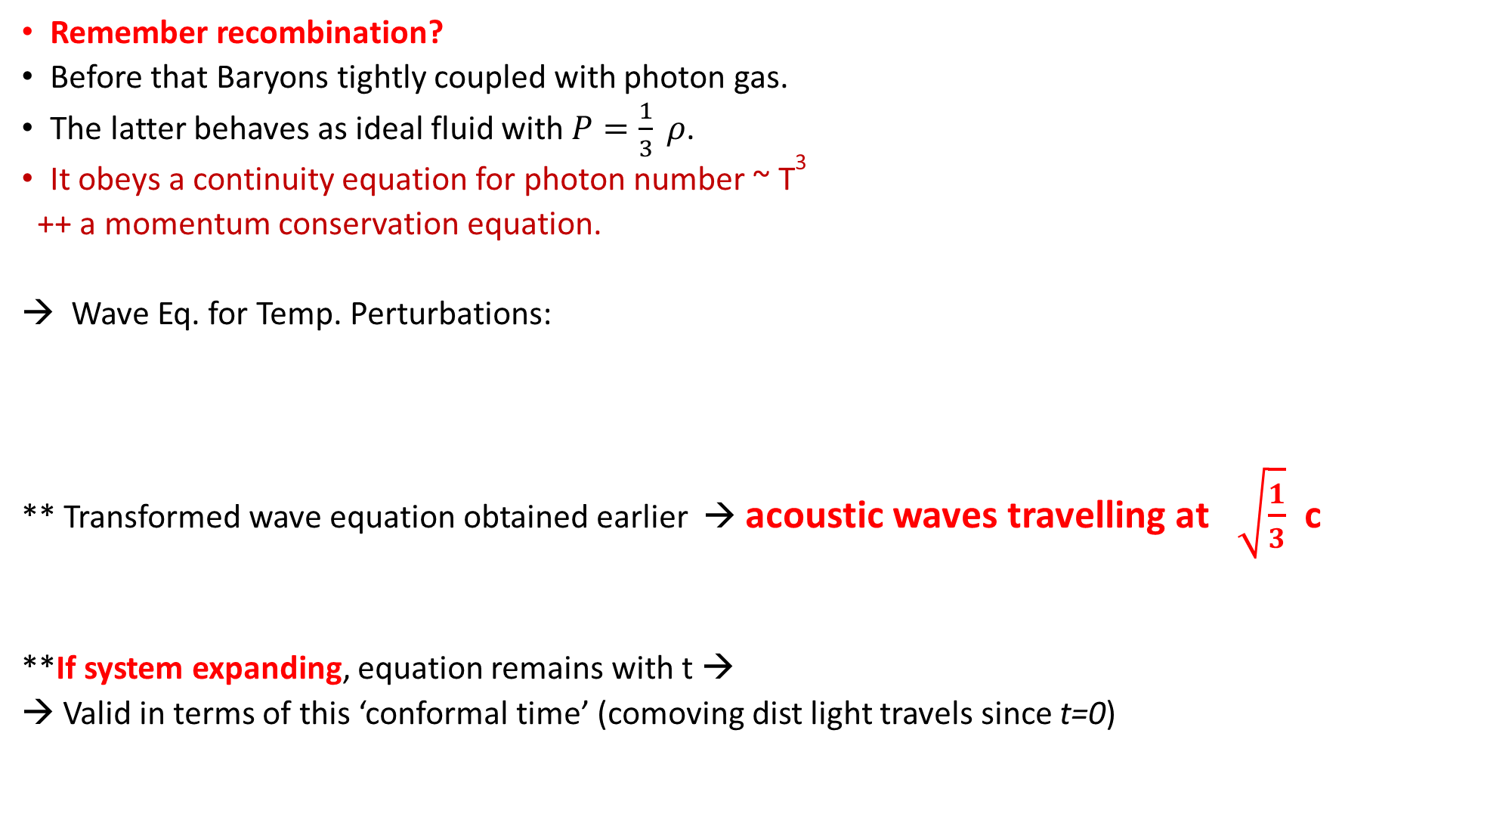
Sound Waves in a Photon Fluid
Remember recombination?
Before that Baryons tightly coupled with photon gas.
The latter behaves as ideal fluid with $P=\frac{1}{3} ρ$.
It obeys a continuity equation for photon number ~ T³
++ a momentum conservation equation.
Wave Eq. for Temp. Perturbations:
** Transformed wave equation obtained earlier → acoustic waves travelling at $\sqrt{\frac{1}{3}}$ c
**If system expanding, equation remains with t →
→ Valid in terms of this ‘conformal time’ (comoving dist light travels since t=0)

Slide 9
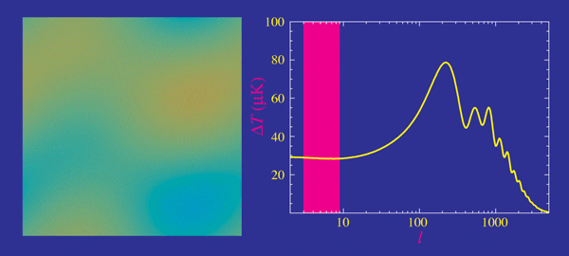
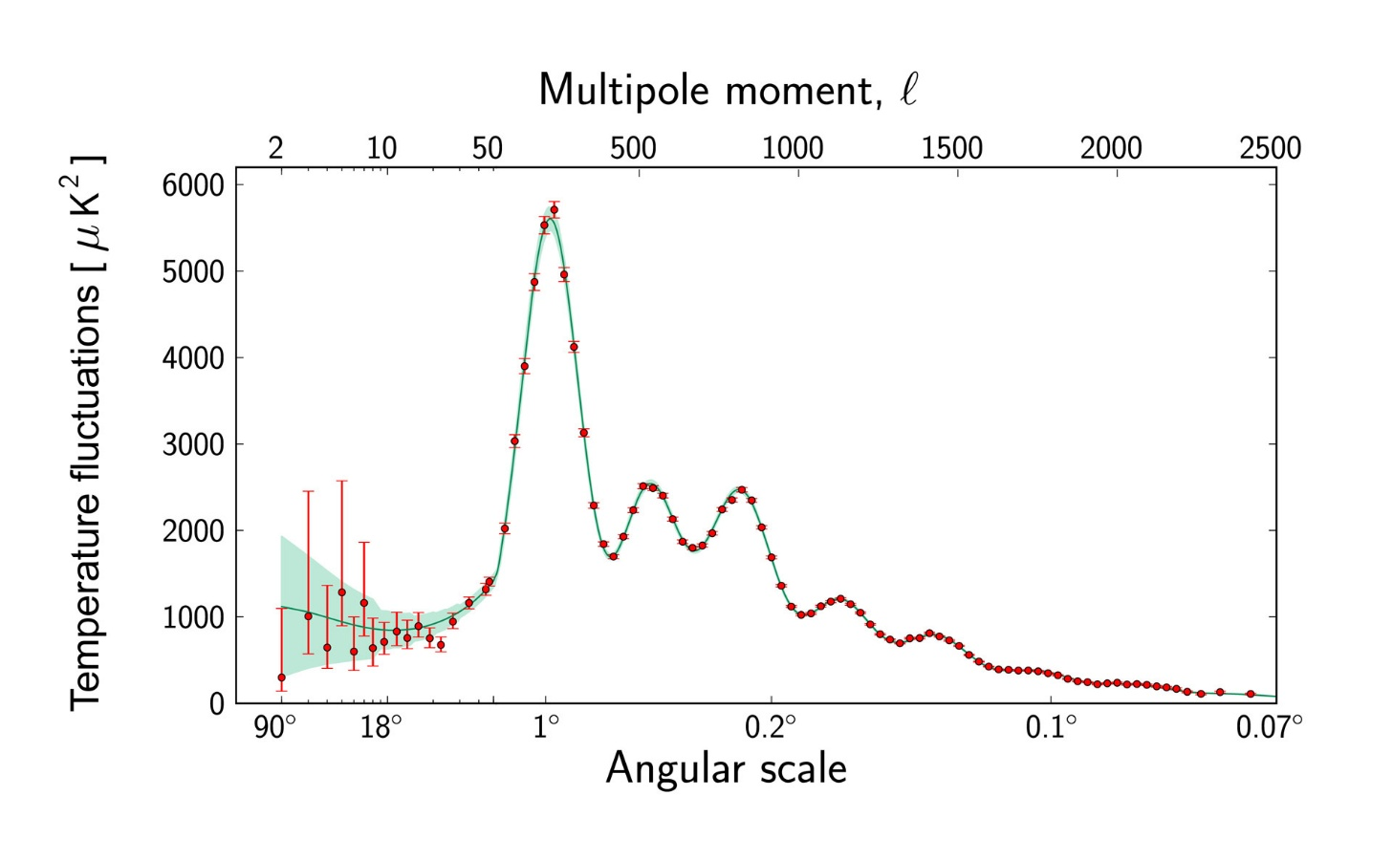

Acoustic Peaks
Photon fluid is permeated by sound waves
Frozen at recombination
→ Temperature fluctuations:
where and $s_{∗}$ and indicates recomb. era.
** Peaks indicate $k=nπ/s_{∗}$
First peak → 1st Compression
Second → 1st Rarefication
Third → 2nd Compression
more oscillations→ damping

Slide 10
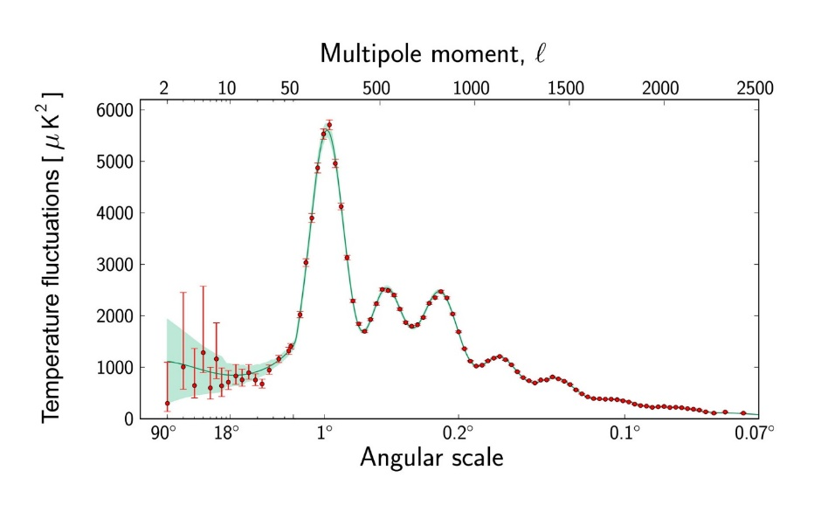
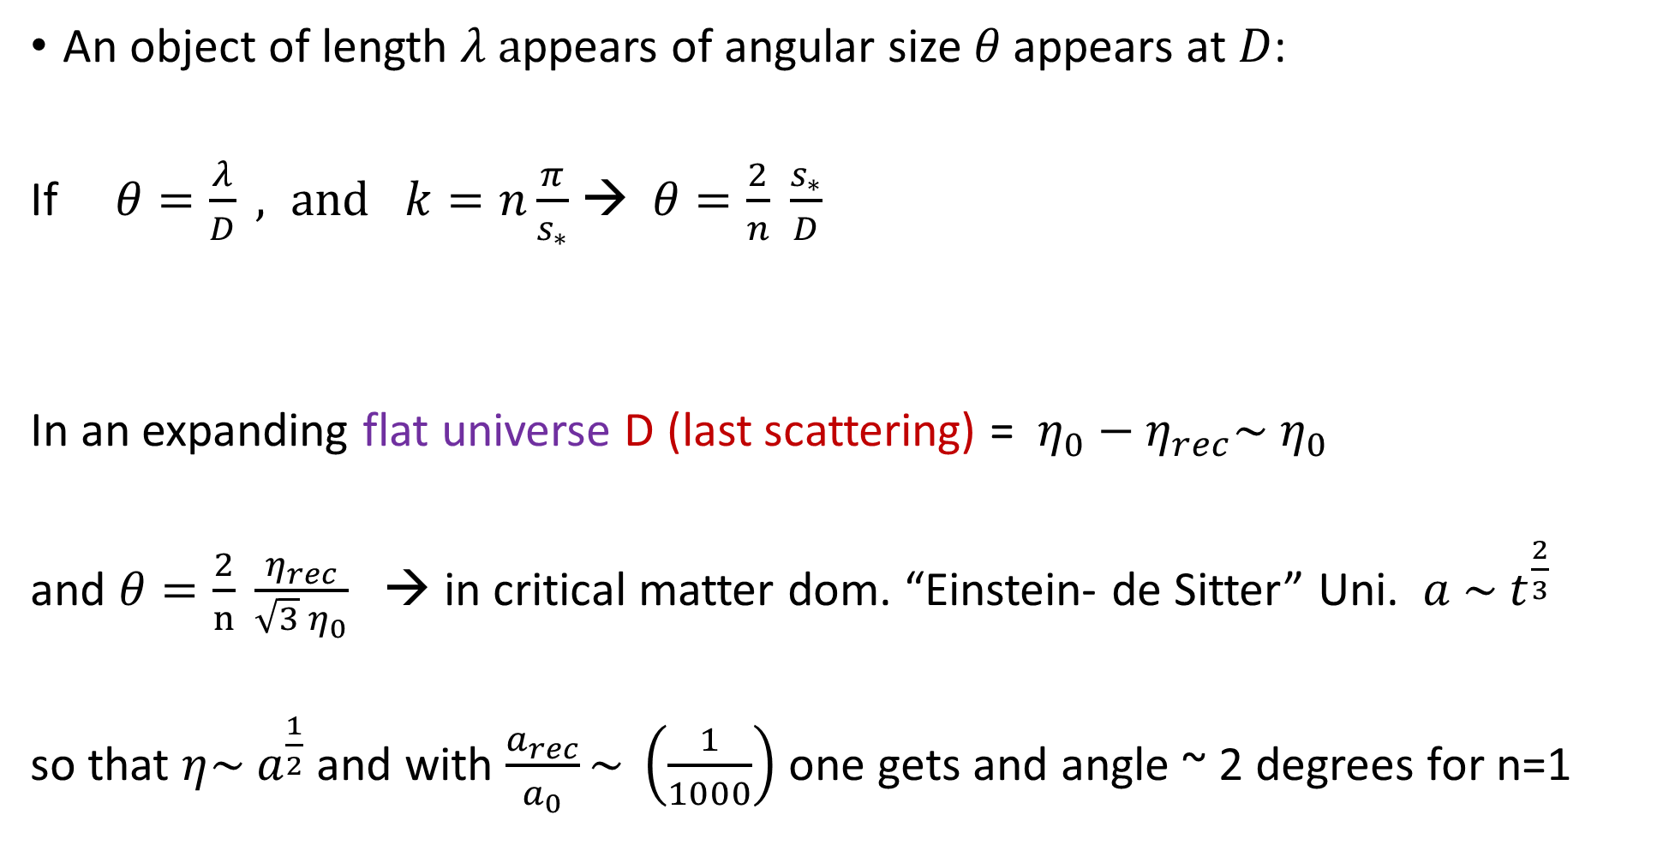
Location of the Peaks
An object of length $λ a$ppears of angular size $θ \text{appears} \text{at} D$:
If $θ=\frac{λ}{D} , and$ $k=n\frac{π}{s_{∗}}$ → $θ=\frac{2}{n} \frac{s_{∗}}{D}$
In an expanding flat universe D (last scattering) = $η_{0}−η_{rec}\sim η_{0}$
and $θ=\frac{2}{n} \frac{η_{rec}}{\sqrt{3} η_{0}}$ → in critical matter dom. “Einstein- de Sitter” Uni. $a \sim t^{\frac{2}{3}}$
so that $η\sim a^{\frac{1}{2}}$and with $\frac{a_{rec}}{a_{0}}\sim \left(\frac{1}{1000}\right)$one gets and angle ~ 2 degrees for n=1

Slide 11
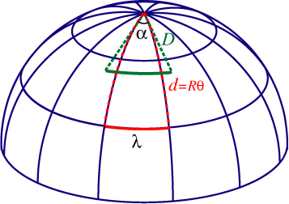
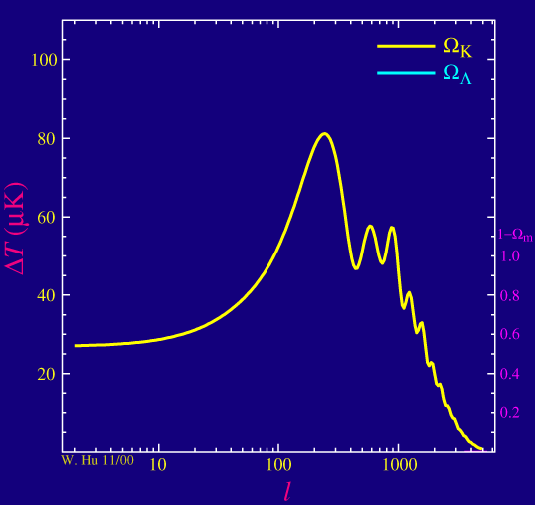

Curvature and Cosmological Constant
In a closed universe objects appear
closer → peaks shifted to
larger angles as
where R is the radius of curvature
In an open universe things will appear further away
(the sin → sinh)
Also in a universe with $Λ$ since

Slide 12
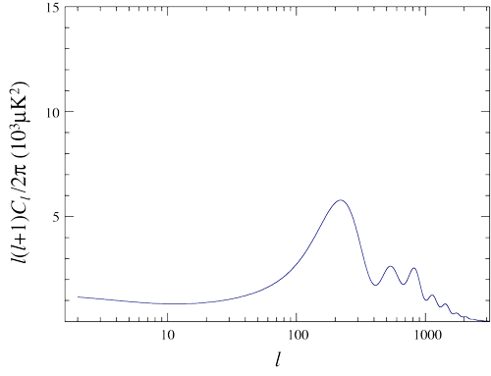
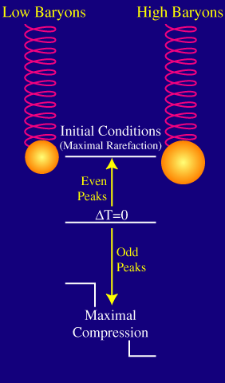
Baryon Loading
Perturbations exist even if there’s no initial temperature fluctuation (due to potential fluctuations from Inflation)
Adding baryons → additional source (gravitational potential) term in wave Eq.
→ compression larger than rarefaction (but no collapse as Jeans scale is of order of horizon for coupled baryons)

Slide 13
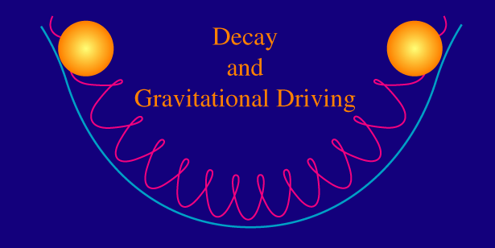
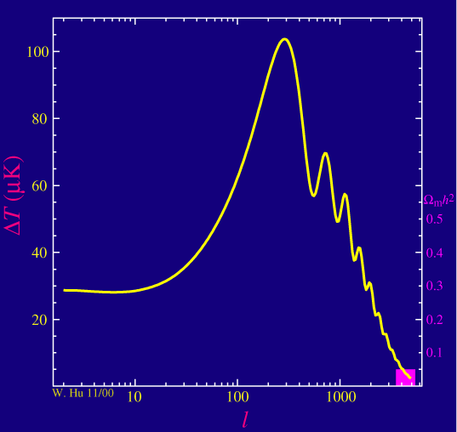
Radiation Driving and DM fraction

Slide 14
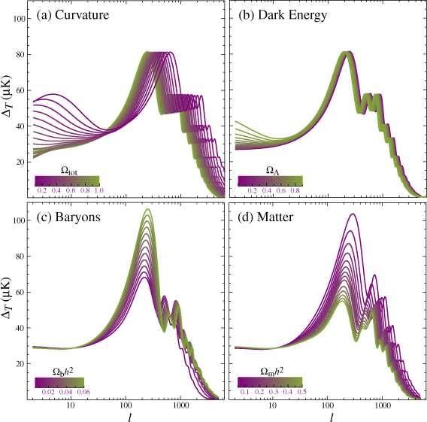
Summary of CMB Parameter Sensitivity

Slide 15
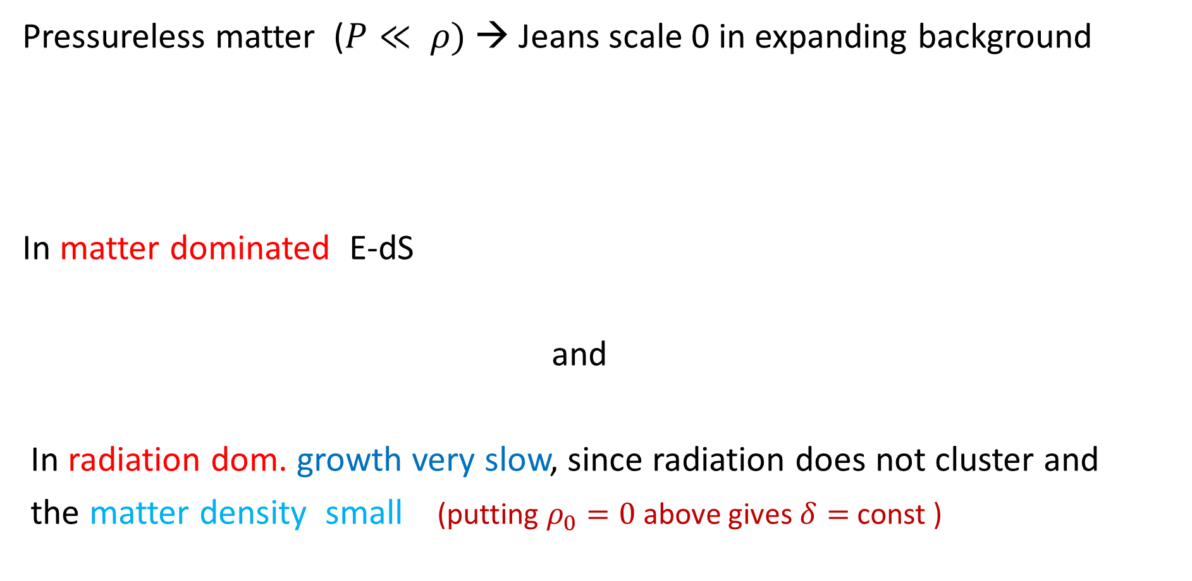
Now remember the WIMPS? Not coupled to photon bath and are heavy and slow moving!
Pressureless matter ($P≪ ρ)$→ Jeans scale 0 in expanding background
In matter dominated E-dS
and
In radiation dom. growth very slow, since radiation does not cluster and
the matter density small (putting $ρ_{0}=0$above gives $δ=$const )

Slide 16
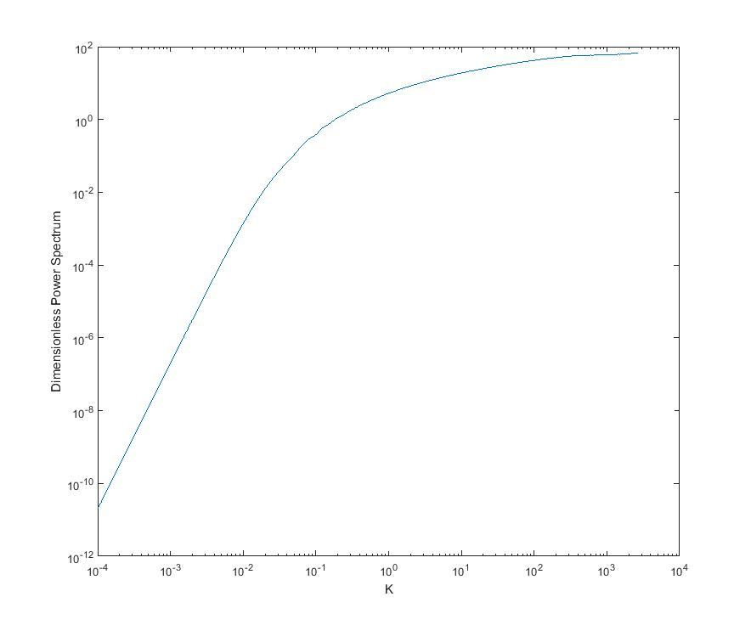

Shape of Matter Spectrum of Fluctuations
Use Poisson equation (formally in GR will be valid for fluctuations in the commoving gauge)
$\sim { k}^{3} φ_{k}^{2}$ ~ constant
(as predicted by inflation)
→ $Δ^{2}\sim k^{3}δ_{k} {\sim k}^{4}$
But (in frame comoving with perturbations)
Perturbations grow outside horizon
during radiation era… but not inside!

Slide 17
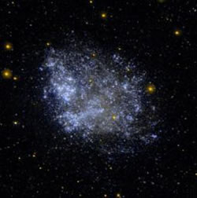
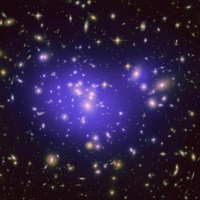
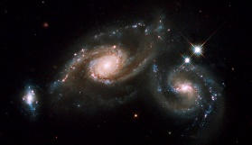
CDM Seeding of Hierarchical Formation
Linear regime scales grow independently
Small scales are favoured →
When overdensity reaches ~1
Collapse into structures
Largest scales still linear
They probe primordial spectrum
Time

Slide 18
Modelling Cosmic Structure Formation
** Cosmic Microwave Background 400 000 yrs
**Present Galaxy Distribution (~14 Gyr)

Slide 19
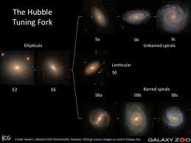
As in hydrodynamics
→ Baryons are tracers of DM on large scales
→ Success in predicting the large scale galaxy distribution
Gas cools and condenses in centers of haloes,.. Forms stars (efficiently) when self gravitating ~ dominant in central region
most galaxies form hierarchically

Slide 20
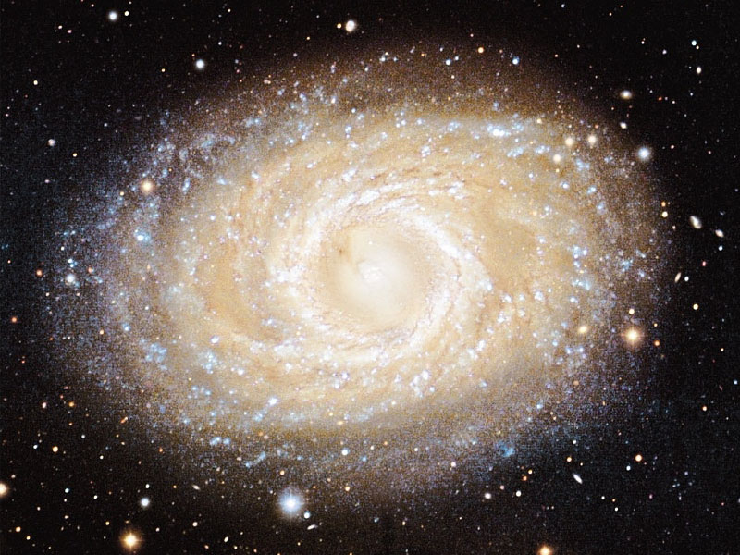
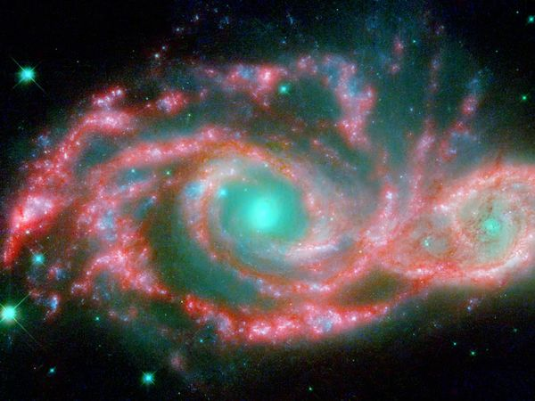
The Galaxy Population
Determined by mass, rotation, history of star formation
→ largely determined by the hierarchical DM halo buildup
In turn
→ ~ Determined by the statistics of initial fluctuations
Some predictions appear borne out: → e.g, fraction of large disk
galaxies increases with time
→

Slide 21
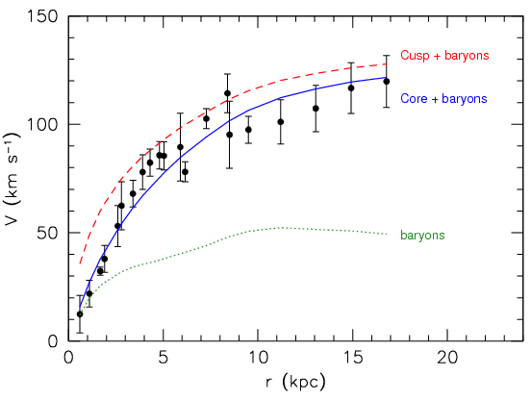
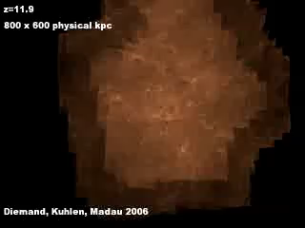
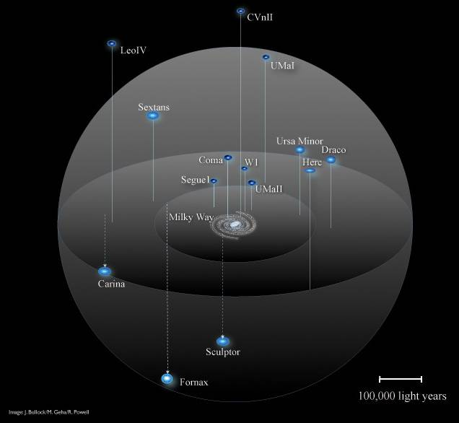
Small Scale Failures of CDM
The central parts of CDM structures are too dense.
Too many small structures (also of wrong mass profile!)

Slide 22
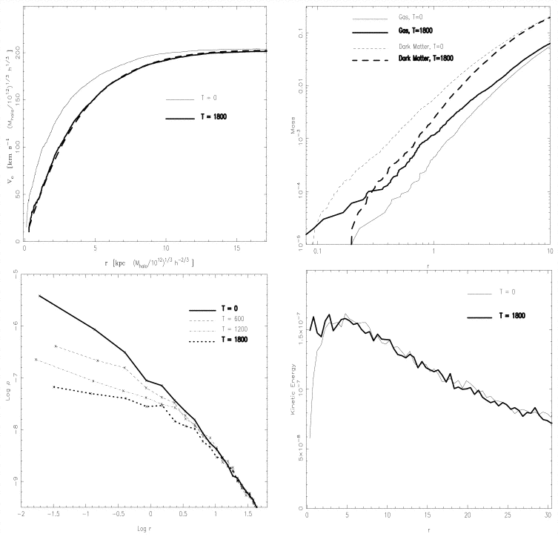
Proposed solutions
Pump energy → decrease DM density:
** Warm DM (smaller mass) → preheat!
(e.g., Lowell et. al. 2013; El-Zant, Sil & Khalil 2015)
** Self interacting DM → Conduction
(Spergel & Steinhardt 2000; Elbert et. al. 2015)
** Quantum effects (on kpc scale!)
** Baryonic solutions: gas gives off energy to DM as it settles into halo (El-Zant et. al 2001;2004;2016)
Rotation Curve
Density prof.

Slide 23
Toward a Consistent Picture of
Cosmic Evolution and Fundamental Physics
Our model of the universe →
Precise: explains spatial distribution and many galaxy properties
from primordial (quantum) fluctuations
BUT most of it is missing: we know the parameters but not content
Non-gravitational physics of galaxy formation and internal not well understood (intense research ongoing on small scale problem and other conundrums…)
→ stringent tests as we obtain complete time maps
All salvageable; or completely new physics?
(e.g., serious modifications to gravity theory)

Slide 24
The Power Spectrum
Fourier analyse as we did with temp of CMB
Dimensionless Power spectrum (measures fluctuations per log. Interval in k)

Slide 25

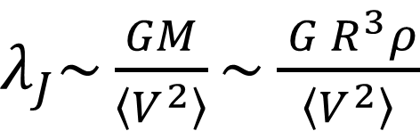

Dynamical Equilibrium for Self Gravity
$λ_{J}\sim \frac{GM}{\left\langle V^{2}\right\rangle }\sim \frac{{ G R}^{3}ρ}{\left\langle V^{2}\right\rangle }$
→ $R \sim$
If speeds are too large for given density system unravels.
→ Size determined by completion density .vs. ‘pressure’
$$R\sim λ_{J}\sim \sqrt{\frac{\left\langle V^{2}\right\rangle }{Gρ}}$$

