Slide 1




Gas Detectors (RPC)
The 6th Egyptian school for high energy physics
December 3-8, 2016
The British university in Egypt
by
Yasser Assran

Slide 2
Creation of signal
Charged particles leave a trail of ions and electrons along their path: Electron-Ion pairs in gases and liquids, electron hole pairs in solids.
Photons from de-excitation are usually converted to electrons for detection.
The produced charges can be registered → Position measurement → Time measurement → Tracking Detectors ....
Cloud Chamber: Charges create drops.
Bubble Chamber: Charges create bubbles.
Emulsion: Charges ‘blacked’ the film.
Spark Chamber: Charges produce a conductive channel that create a discharge
Gas and Solid State Detectors: Moving Charges (electric fields) induce electronic signals on metallic electrons that can be read by dedicated electronics.
In solid state detectors the charge created by the incoming particle is sufficient
In gas detectors (e.g. wire chamber) the charges are internally multiplied in order to provide a measurable signal.

Slide 3
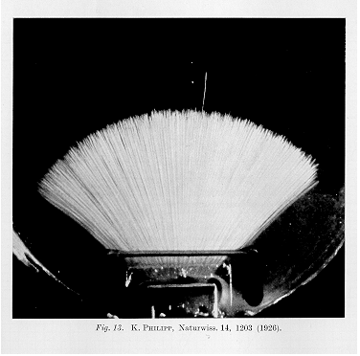
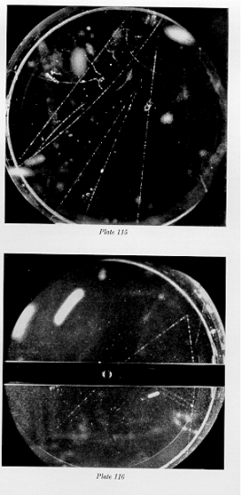
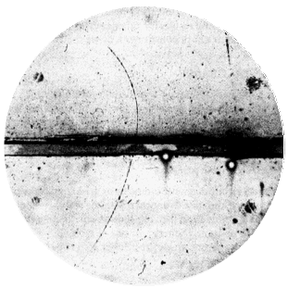
Cloud Chamber, C.T.R. Wilson 1910
Charges act as condensation nuclei in supersaturated water vapor
Alphas, Philipp 1926
Positron discovery, Carl Andersen 1933
V- particles, Rochester and Wilson, 1940ies

Slide 4
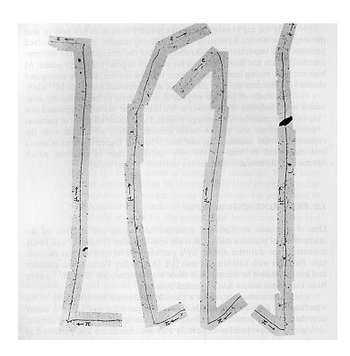
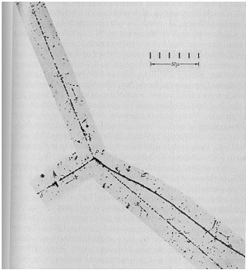
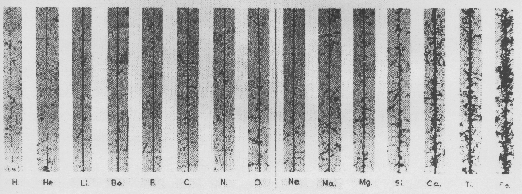
Nuclear Emulsion, M. Blau 1930ies
Charges initiate a chemical reaction that blackens the emulsion (film)
C. Powell, Discovery of muon and pion, 1947
Kaon Decay into 3 pions, 1949
Cosmic Ray Composition

Slide 5
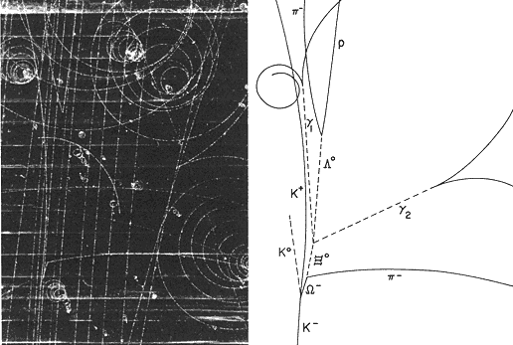
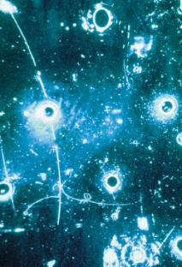
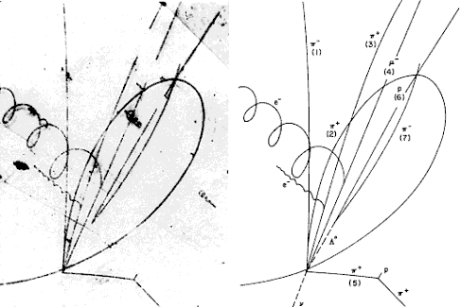
Bubble Chamber, D. Glaser 1952
Charges create bubbles in superheated liquid, e.g. propane or Hydrogen (Alvarez)
Discovery of the ⁻ in 1964
Neutral Currents 1973
Charmed Baryon, 1975

Slide 6
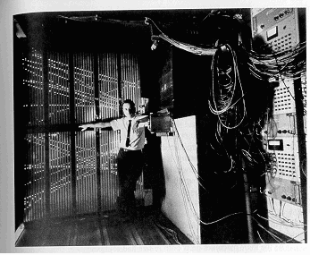
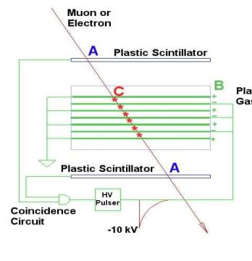
Spark Chamber, 1960ies
Charges create ‘conductive channel’ which initiates a spark in case HV is applied.
Discovery of the Muon Neutrino 1960ies

Slide 7
Induced Charges
A point charge q at a distance z₀ above a grounded metal plate ‘induces’ a surface charge.
+
q
z₀
-
-
-
-
-
-
-
-
-

Slide 8

Induced Charges
The solution for the field of a point charge in front of a metal plate is equal to the solution of the charge together with a (negative) mirror charge at z=-z₀.
q
q
+
+
E
z₀
E
=
z₀
-
-
-
-
-
-
-
-
-
z₀
The field on the electrode surface (z=0) is therefore
-

Slide 9
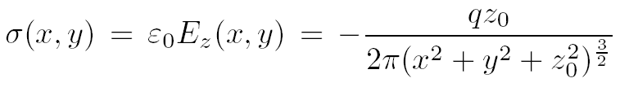

Induced Charges
We therefore find a surface charge density of
And therefore a total induced charge of
+
q
z₀
-
-
-
-
-
-
-
-
-

Slide 10
Induced Charges
The total charge induced by a point charge q on an infinitely large grounded metal plate is equal to –q, independent of the distance of the charge from the plate.
The surface charge distribution is however depending on the distance z₀ of the charge q.
+
q
z₀
-q
-
-
-
-
-
-
-
-
-

Slide 11
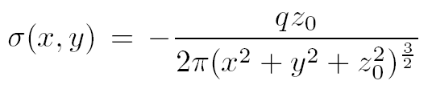
Induced Charges
Moving the point charge closer to the metal plate, the surface charge distribution becomes more peaked, the total induced charge is however always equal to –q.
q
q
-q
-q
I=0

Slide 12
Signal Induction by Moving Charges
If we segment the grounded metal plate and if we ground the individual strips, the surface charge density doesn’t change with respect to the continuous metal plate.
q
The charge induced on the individual strips is now depending on the position z₀ of the charge.
If the charge is moving there are currents flowing between the strips and ground.
→ The movement of the charge induces a current.
V
-q
-q
I₁(t) I₂(t) I₃(t) I₄(t)

Slide 13
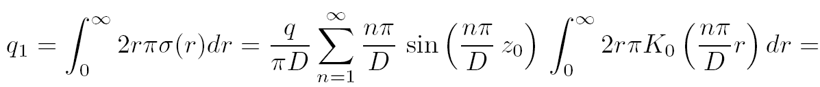
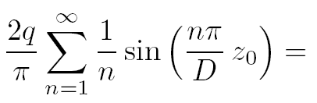
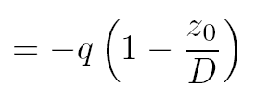
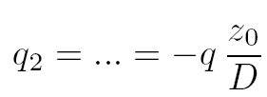
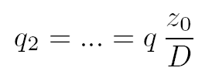

Parallel Plate Chamber
Plate 2
q₂
q
D
z₀
q₁
Plate 1

Slide 14
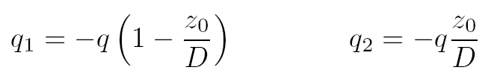

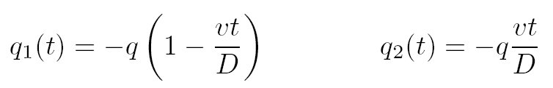

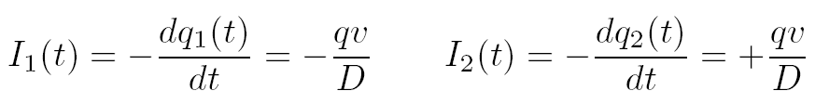

Parallel Plate Chamber
I₂(t)
Plate 2
q₂
q
D
z₀(t)
q₁
Plate 1
I₁(t)

Slide 15
Parallel Plate Chamber
I₂(t)
Plate 2
q₂
q
D
q₁
z₀
Plate 1
I₁(t)
The sum of all induced charges is equal to the moving charge at any time.
The sum of the induced currents is zero at any time.

Slide 16
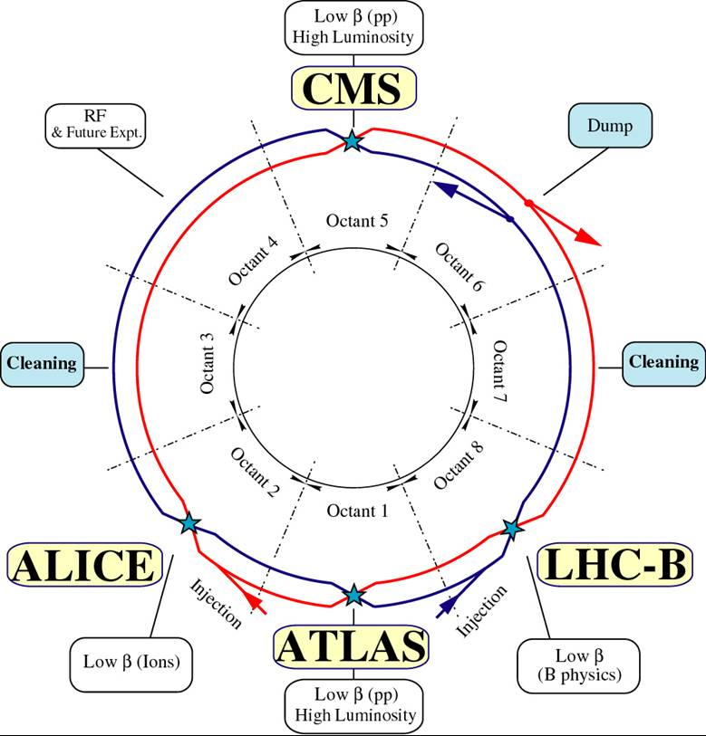
Large Hadron Collider
18

Slide 17
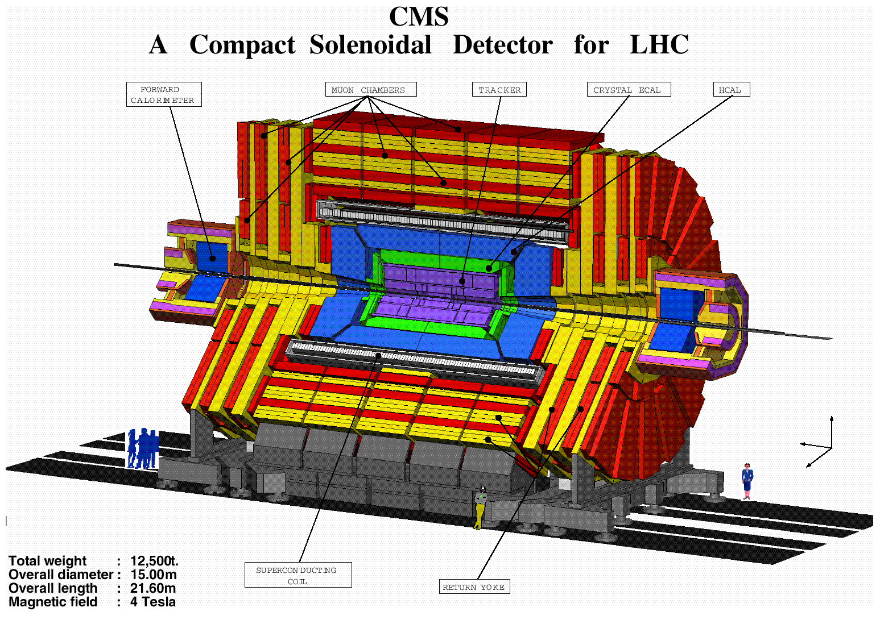
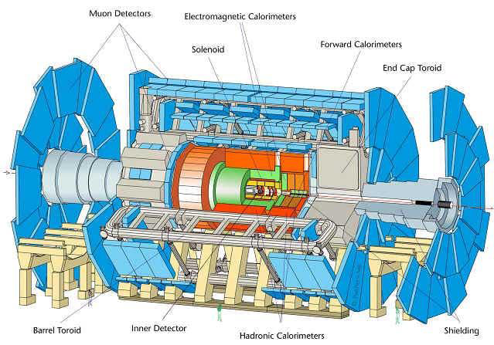
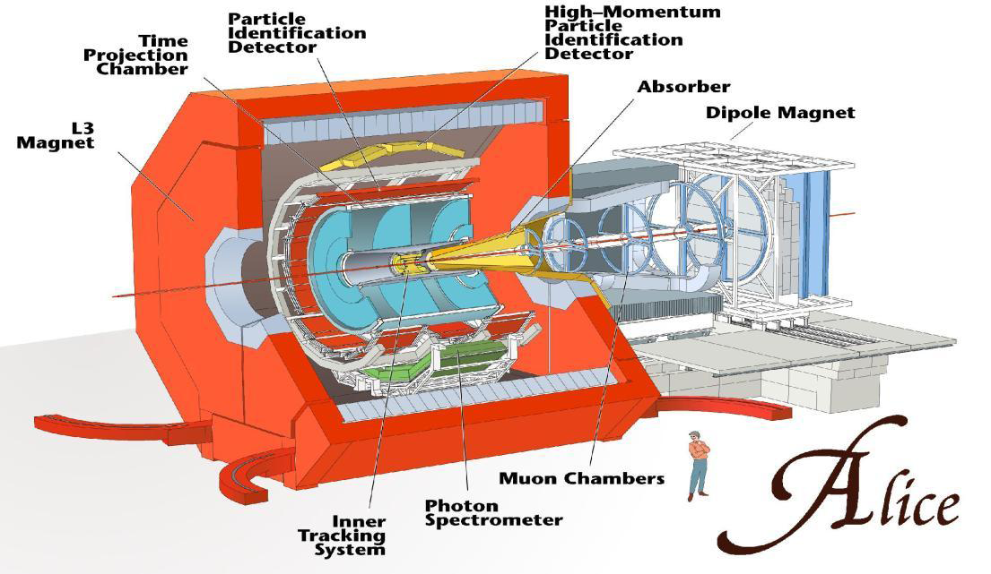
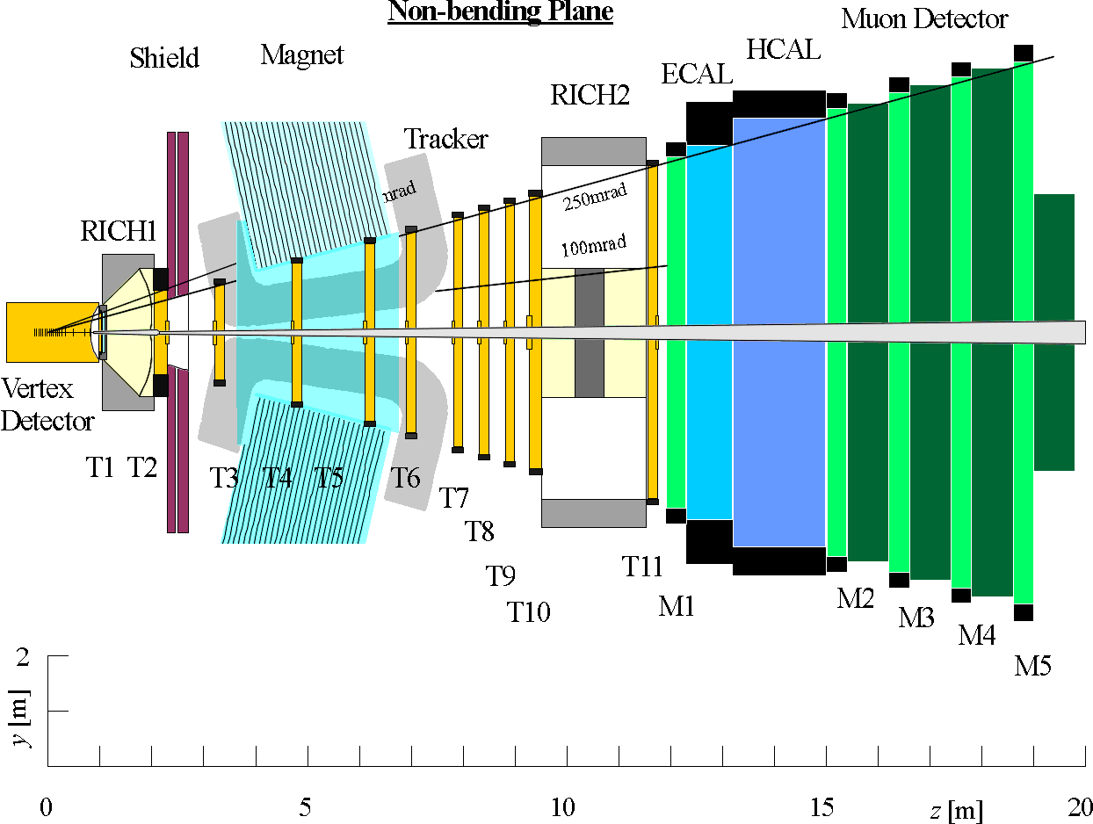

Slide 18
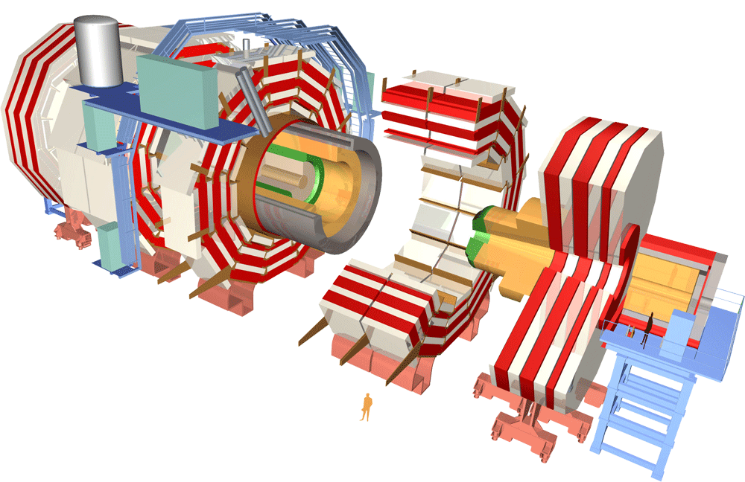
RPC in CMS

Slide 19
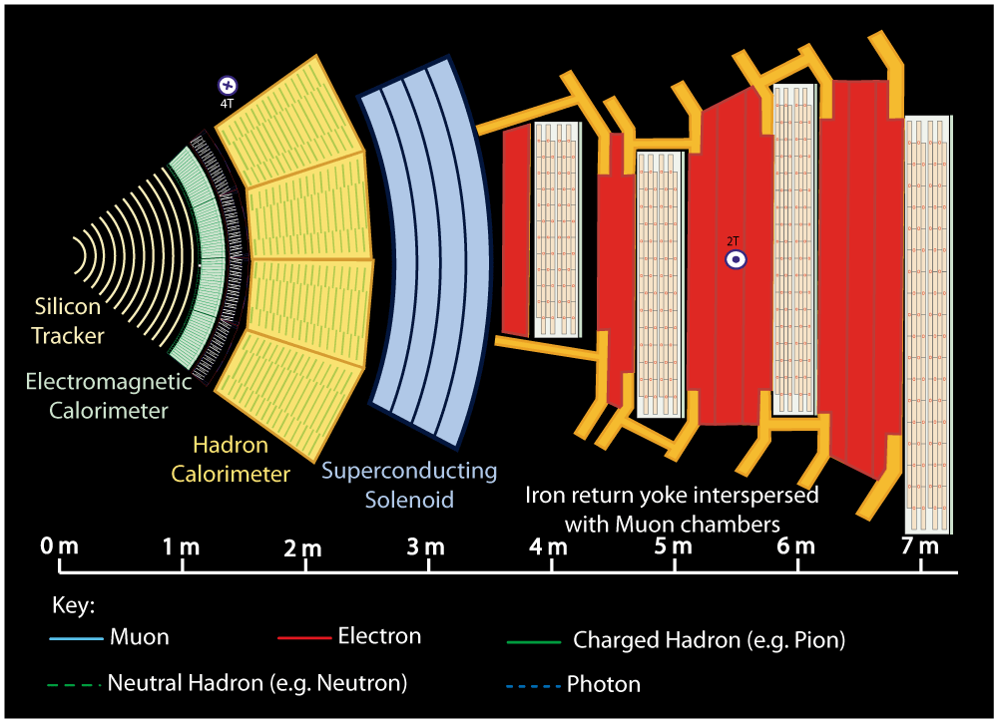
Notes:
Buttons. Click on any particle type to display the relevant slide with animations. Clicking again will return to this slide.
Recommend putting this slide in the middle of your presentation and putting the other 5 slides at the end.
If you have any difficulties, contact David.Barney@cern.ch

Slide 20
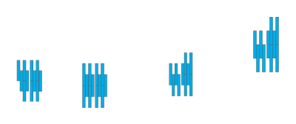


Notes:
Muon: passing through CMS, bending in the field (both ways, depending on when it is inside or outside of the solenoid) leaving hits in the Tracker layers and the muon chambers before escaping completely

Slide 21
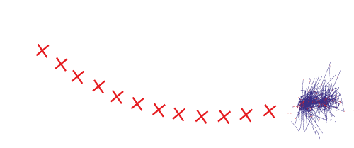
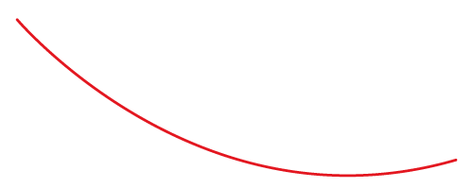

Notes:
Electron: Bending in the magnetic field, leaving hits in the tracker layers and being “stopped” by the electromagnetic calorimeter

Slide 22
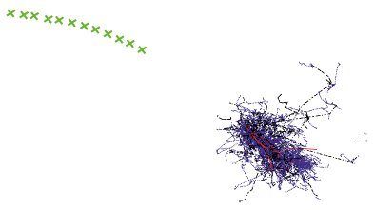
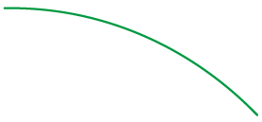

Notes:
Charged hadron: Bends in the magnetic field and leaves signals in the tracker layers; passes through the electromagnetic calorimeter leaving essentially no signal, and is “stopped” by the hadron calorimeter

Slide 23
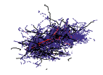

Notes:
Neutral hadron: Does not bend in the magnetic field and does not leave any signal in the tracker layers; passes through the electromagnetic calorimeter leaving essentially no signal, and is “stopped” by the hadron calorimeter

Slide 24

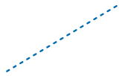

Notes:
Photon: passes through the tracker without bending in the magnetic field or leaving hits, is “stopped” by the electromagnetic calorimeter

Slide 25
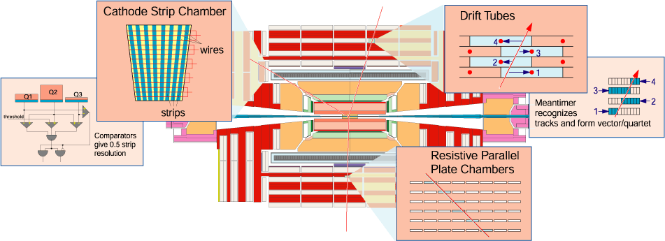
The Muon System for the CMS exp.

Slide 26
Principle Aims of the CMS Muon Detector
Muon Identification.
Muon Momentum Measurement.
Triggering on Muons

Slide 27
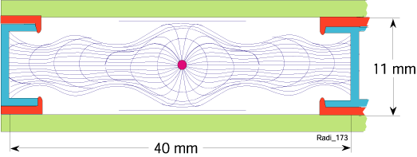
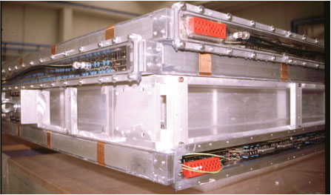
The drift tube (DT).
Each tube contains a wire with large pitch (4 cm), and the tubes are arranged in layers. Only the signals from the wires are recorded - resulting in a moderate number of electronic channels needed to read out the detectors
When an ionizing particle passes through the tube, it liberates electrons which move along the field lines to the wire, which is at positive potential. The coordinate on the plane perpendicular to the wire is obtained with high precision from the time taken by the ionization electrons to migrate to the wire

Slide 28
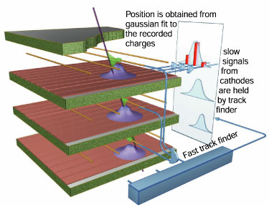
Cathode strip chamber (CSC)
CSCs are multiwire proportional chambers in which one cathode plane is segmented intro strips running across wires. An avalanche developed on a wire induces a charge on several strips of the cathode plane. In a CSC plane two coordinates per plane are made available by the simultaneous and independent detection of the signal induced by the same track on the wires and on the strips. The wires give the radial coordinate whereas the strips measure phi.

Slide 29
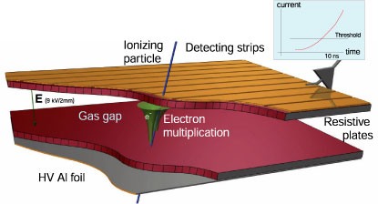
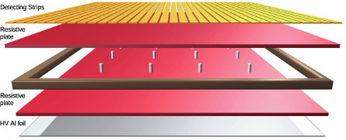
RESISTIVE PLATE CHAMBER (RPC).
The RPC is a parallel plate counter with the two electrodes made of very high resistivity plastic material. The high resistivity electrodes are transparent to the electric signals generated by the current of the avalanche: the signals are picked up by external metallic strips.

Slide 30
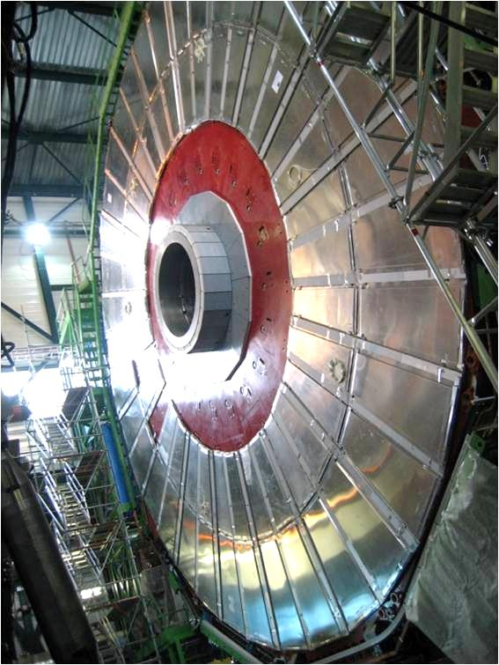

Slide 31
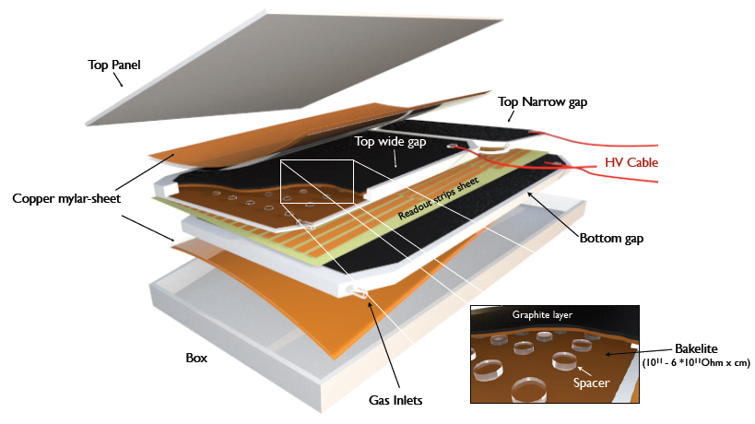
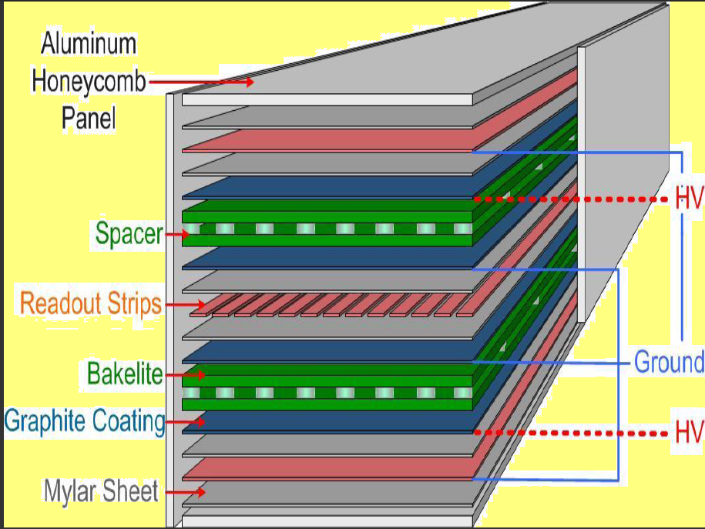
The RPC contains two layers of gas gaps with a sheet of Copper readout strips sandwiched between them.
RPC are used in both Barrel (RB) and Endcap (RE) region.
RPC are used for trigger purpose.

Slide 32
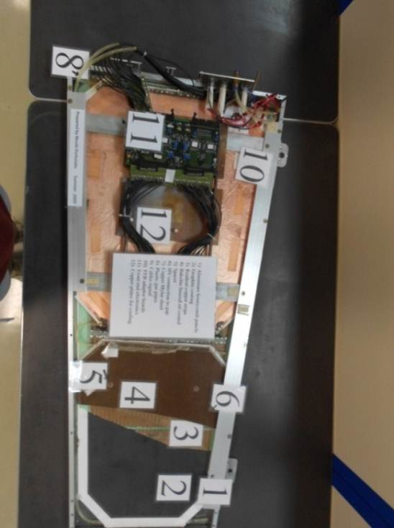
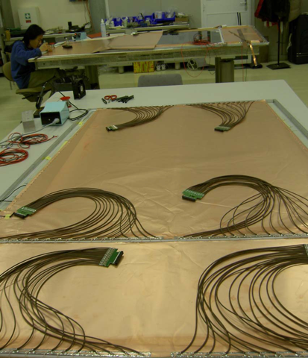
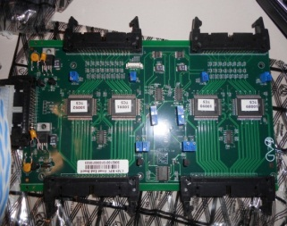
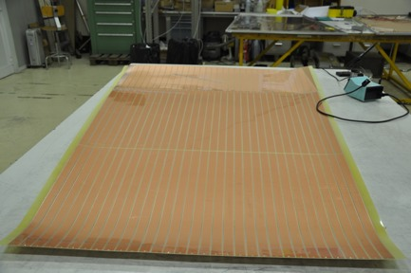
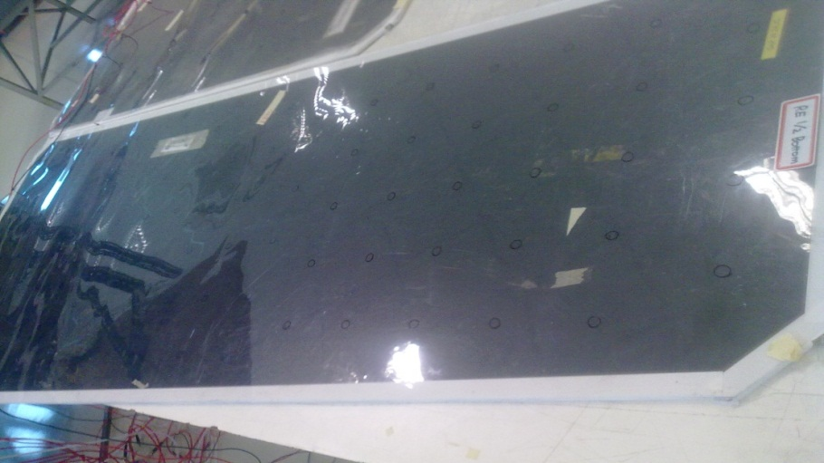

Slide 33
RPC double gap design

Slide 34
Quality control of the RPC detector.
The quality control of the RPC detector is divided into two parts :
Gap quality control.
Chamber quality control.

Slide 35
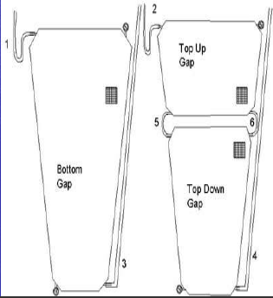
Gap quality control
1-leak test:
The Gap leak tests were performed by filling up the gaps with gas and applying an overpressure of 20 mbar. Watching the pressure difference after 20 minutes, the leak rate was calculated. if the pressure change is less than 1% the gap is ok.

Slide 36


Slide 37

2- spacer test

Slide 38



Slide 39

HV Test
Method: Gaps were flushed with RPC gas and then subjected to HV after about 50 volume exchanges. With the working gas mixture and HV (9.4 KV), if the current is less than 5 µA, the gap is ok.

Slide 40

Quality control of chamber

Slide 41
Quality control of chamber
Efficiency
Efficiency is defined as the ratio between the number of chamber signals in a fixed time window and the number of triggers.
Cluster Size
Cluster size is defined as the number of contiguous strips of the same chambers.
Strip profile
It is a plot shows the response of individual strip.

Slide 42




Strip profile
The chamber in the 2nd station
has dead strips and flat signal
cables connected incorrectly
Diagnostic plots:
Strip response profiles

Slide 43
RPC Upgrade Project.
CMS has decided to split the upgrade project into two distinct phases:
    Phase 1: Competition of the law eta part ( eta < 1.6).
    Phase 2: Competition of the high eta part ( 1.6 < eta < 2.1).

Slide 44

Low eta upgrade.
The Forward Muon upgrade is driven by lack of redundancy in the low and high eta region and by unacceptable high muon LV1 trigger threshold at peak instantaneous luminosity.
Up to η = 1.8 lack of redundancy in
RPC/CSC :
restoration of the fourth layer of RPCs (RE4) and enables efficient 3 out of 4 logic at the level- 1 trigger, restoring loss of trigger efficiency in this region.

Slide 45


Low eta upgrade.
1) Restoration 4th stations
RPC trigger requires 3/3 algorithm
-with 2/3: rate is just too high due to
noise and wrong pt assignment. shutdown 2013

Slide 46
High eta upgrade
Improvement of detector functions for CMS RPCs
➢ Higher rate capability ~ 5 kHz cm-2
➢ Better longevity by reducing avalanche charges
Improved RPC could be :
Backlite RPC
Glass RPC

Slide 47

High eta upgrade

Slide 48
High eta upgrade (Backlite RPC)
Detector structures
Use thinner electrode
Use thinner gap thickness
Electronics
Use more sensitive front-end electronics
RPC models in baseline design in the 2015 R&D
➢ 1.6 mm double-gap RPCs
➢ 0.8 mm 4-gap(multi-gap) RPCs
RPC models in baseline design in the 2016 R&D
➢ 1.2 mm double-gap RPCs
➢ 0.5 mm 4-gap(multi-gap) RPCs

Slide 49
High eta upgrade (Backlite RPC)
Prototype RPCs
Three 1.2-mm double-gap RPC (two are tested at GIF++)
Two 1.4 mm double-gap RPCs (being constructed)
One 0.5-mm 4-gap RPC (tested at GIF++)
Dimensions of prototype RPCs
Active area = 35.6 cm x 75.6 cm
Resistivity ~ 5 x 10¹⁰ Ωcm
Strip pitch = 11.1 mm
2 partitions of 32 strips
Maximum rate at GIF++
~ 6 kHz cm⁻² at GIF++
Gas = 95.2 TFE+ 4.5 iC4H10 + 0.3 SF6 + water vapor

Slide 50
High eta upgrade (Glass RPC)
Current CMS RPC have limited detection capabilities due to the resistive nature of their electrodes 𝞀, the thickness of these d and the charge created by the avalanche q in the gas gap.
To increase rate capability you need to reduce 𝞀 → Low-resistivity glass.
To reduce the electrodes thickness d → Easier for glass than Bakelite.
To reduce the charge q → Reduce the gas gap and if possible go multi-gap.

Slide 51

High eta upgrade (Glass RPC)
Glass Specifications:
Bulk resistivity: ≈10¹⁰Ω.cm
Standard thickness: 0.5mm--2mm
Thickness uniformity: ±0.02mm
Dielectric constant: ≈7.5-9.5
Surface roughness: < 10 nm
DC measurement: Ohmic behavior,
stable up to 1 C/cm²

Slide 52


Single-gap and multi-gap GRPC
Mylar layer (50μ)
Readout pads
(1cm x 1cm)
PCB interconnect
PCB (1.2mm)+ASICs(1.7 mm)
Readout ASIC
(Hardroc2, 1.6mm)
PCB support (polycarbonate)
Gas gap(1.2mm)
Mylar (175μ)
Cathode glass (1.1mm)
+ resistive coating
Ceramic ball spacer
Glass fiber frame (≈1.2mm)
Anode glass (0.7mm)
+ resistive coating

Slide 53
Thank you!

